Slide 1
Chapter 9: Ethnography

Slide 2
Challenge: Research in unfamiliar places
How do you design a tool for use in situations that are completely new to you?
Build an information systems for intensive care units …
But you’re not a health-care professional
… in a foreign country
That you’ve never been to

Slide 3
Lack of familiarity..
You don’t know the work
How do people communicate?
What information do they need?
Who’s in charge?
You don’t know the culture
Broader societal/social context
You don’t know the language
Idioms and subtexts

Slide 4
Shortcomings of other approaches
Surveys, interviews require some idea of
what you’re trying to learn
which questions to ask
How to ask them
Results may be hard to interpret
Another disadvantage of not knowing the culture

Slide 5
In-depth, in-context observation
Go to site
Work closely with someone who can show you around
Ask questions for basic understanding
Observe workers in action, talk with some in detail
“Shadow” – follow them around as they work
Build understanding

Slide 6
In-depth, in-context observation
Build models of work
Refine in discussion with users
Build requirements and elements of design
Refine with users
Travel to another hospital to determine whether or not findings generalize

Slide 7
Ethnography
Combination of multiple forms of data collection
Observations
Interviews
Participation is key
Deep immersion to develop deep understanding
Richer and more detailed than other methods, but ..
Expensive and challenging

Slide 8
Observation vs. usability testing
Usability testing (chap. 10) uses observation to identify interface flaws
Short term, few individuals
No focus on groups, context, or human dynamics
Ethnography: understanding people, context, organizations, and problems

Slide 9
Ethnography: Background
“The art and science of describing a human group – its institutions, interpersonal behaviors, material productions, and beliefs” (Angrosino, 2007)
Roots in anthropological studies of non-Western cultures
Limited interactions and interviews insufficient
Step out of role of scientific observer, engage directly with people in daily lives
Years living in traditional villages

Slide 10
Conceptual basis
True understanding of complex human practices requires in-depth, engaged study
“to gain an understanding of a world that you know little about, you must encounter it firsthand” (Blomberg and Burrell, 2007, p. 967).
Participation is key

Slide 11
Ethnography vs. hypothesis-driven research
Ethnography is inductive
Data -> Patterns -> Theories
Not hypothesis driven
No controls – every study is unique
Similar to case studies (Chapter 7)
Multiple sources of data, triangulation

Slide 12
Ethnography vs. Case Studies
Similarities
Multiple sources of data
Triangulation
Time-intensive
Personal
In-context
Difference
Ethnography is generally not theory-driven
(but this is a topic of debate)

Slide 13
Ethnography as fluid research
Deep engagement with subjects
More so than with case studies
Data collection “in the movement”
Ordinary conversations and events can become data collection opportunities

Slide 14
How does this relate to HCI
HCI researchers rarely, if ever, spend long periods of time living in traditional villages
But, we do build technologies for communication and collaboration in complex environments with deep cultures
Workplaces, hospitals, schools, homes
Need to develop deep understanding of how participants work and communicate

Slide 15
Ethnography in HCI
Lucy Suchman – early HCI ethnography pioneer
Situated action—all action is a product of the context from which it is taken
Human, social and organizational aspects of information systems development are critical to project success
Ethnography focuses on understanding context
Informs building of systems

Slide 16
Generalization? No
Many research methods focus on reducing research to understand portions of it, with the hope of being able to generalize
Ethnography is the opposite—understanding a context of individuals in groups, their processes and norms, at a specific point in time, without hoping to generalize

Slide 17
Example: Communication and Multitasking (Su and Mark, 2008)
“Shadow” 19 workers at a large US corporation
Note all activities at desk
Follow them around
550 hours of data, 13,000 events
Analyze and code to understand who workers talk to, how they switch tasks
Find: coordinating with multiple people is stressful and difficult
Systems might be designed to reduce overhead

Slide 18
Participatory Design
Participation of users at all stages of design: requirements, prototyping, and eventual system design, used when:
User tasks are not well-understood
Users themselves are not well-understood (often people with impairments)
High-risk life-critical information systems
Similar to, but distinct from ethnography

Slide 19
Conducting ethnographic research
Working “in the wild”
Homes, workplaces, schools, etc.
Extended time periods
Juggle goals
Understanding how to navigate unfamiliar world
Collecting data
Be sensitive to background and bias

Slide 20
Selecting a site or group
Often no choice – if working for a specific customer
“representative” vs. extreme situations?
…all ethnographies are different
Convenience
Preliminary interactions evaluate suitability and build trust
Consider impact on subjects
Benefits should outweigh the costs

Slide 21
Barriers
Are there privacy laws that limit access?
Hospitals and patient data
Schools and pupil performance data
Financial information
Military information
Possible
background and security checks, fingerprinting, or sexual harassment training
confidentiality or other legal agreements

Slide 22
Roles in ethnography
What does “participate” mean?
Complete participant – hides role as researcher
Very challenging
Rare in HCI work
Participant-Observer
Observer-Participant
Complete Observer

Slide 23
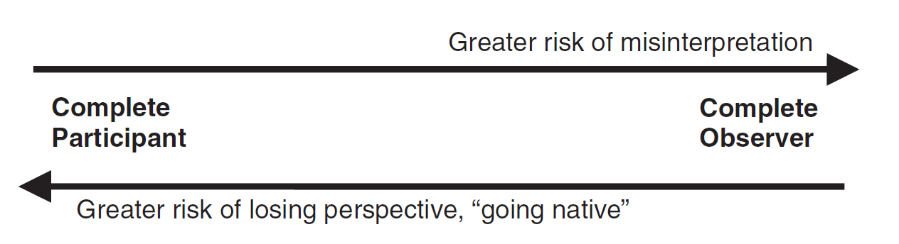
Roles - tradeoffs
Fidelity of data vs. risk of losing perspective
“going native”

Slide 24
Working with a familiar group
Ethnography when a member of the group?
Pros:
access, relationships, trust, and knowledge
Cons:
pre-informed opinions, biases, and existing relationships
Limit your ability to be neutral and truly understand
Membership in a group may lead to interesting research opportunities

Slide 25
Building relationships
Need trust of the group
Group members may vary in interest and enthusiasm
Workplace studies – users may fear for their jobs
Work to show that you can be trusted
Be helpful
Explain research
Respect needs and goals of group members

Slide 26
Making contact
Start with a few well-chosen group members
They will introduce you to others
Stranger-handlers and deviants may mislead
Good initial contacts are well liked, respected, observant
Don’t be too closely-tied to any individual
May bias observations and
complicate communications with others
It’s like you have already “taken sides”

Slide 27
Interacting with group members
Informants are likely to give you the story as they see it—it’s “their truth”
Or as they want you to see it
Use discussions to derive questions, build theories, plan further investigations
Confirm or refute comments
Work to maintain relationships
Present yourself as non-threatening

Slide 28
Goals of ethnography
Create interpretation of data points gathered through interacting with group members
potentially biased
incomplete
and contradictory
Interpretation should help understanding group functions
Triangulation improves accuracy

Slide 29
Ethnographic interviews
Part of longer, ongoing relationships
Start with establishing trust and understanding broad parameters
May not feel like interviews at all
Ask questions as they show you around
Other informal settings
Get people talking
Opportunistically ask for more detail
Follow your curiosity
More formal interviews are also possible

Slide 30
Observation
Not just “stand back and watch”
Goal – see situations with “new” eyes
Record only what you see, don’t interpret
Less biased
Try to broaden scope of observations
“Is there anything I’m missing?”
Skill that takes time and practice

Slide 31
Note-taking
Record details
Time, place, participants (anonymized), context, behaviors, interactions
Might not be able to take notes in real time
While observing ongoing events
Write notes as soon as possible afterwards
Recordings might be possible, but
Obtrusive
Hard to transcribe/analyze

Slide 32
More on notes
Start by recording lots of detail
As you build understanding and develop patterns
Record observations in terms of patterns
Note of unfamiliar events for further consideration

Slide 33
Other data sources
Documents, artifacts, and archives
Pictures, letters, e-mails, documents, reports, tools
Take your time, re-read..
but understand that they only tell a portion of the story!

Slide 34
Analysis
Qualitative (Chapter 11) and quantitative analysis techniques
Informs development of models & description
Group data into categories and frameworks
Identify questions to be pursued in subsequent observations or interviews
No “cherry-picking”- account for all of your data!

Slide 35
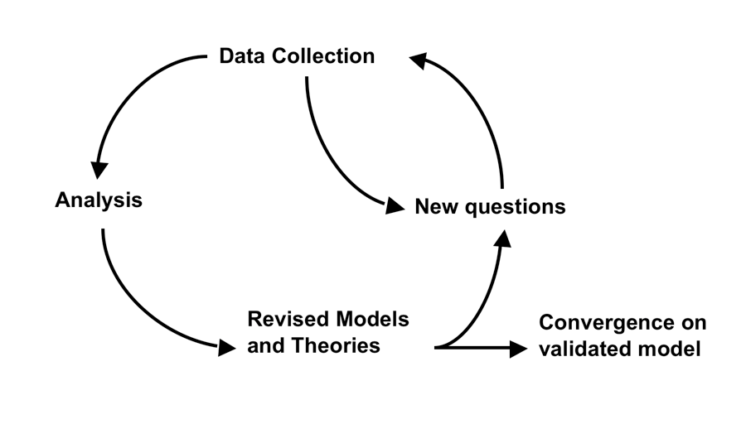
Iterative process
Continue until you are
Not learning anymore or
Out of time/money

Slide 36
Increasing validity
Ethnography is inherently interpretive
Why is your model better than any other?
Compare to alternatives
Include more viewpoints
Multiple informants
Multiple observers

Slide 37
Reporting results
Describe goals and methods
Justify choice of groups
Describe analyses
Matrices, charts and figures to display data
Consider rival explanations
Show participants your report – get their feedback

Slide 38
Ethnography in HCI
Homes
Workplaces
Educational settings
Virtual settings
Mobile devices

Slide 39
Homes
County, culture, and religion have a great impact on how technology is used in homes around the world
Sometimes, researchers discover a relationship between gender issues and technology usage in the home
Often, ethnography can help identify technologies that are needed in home settings

Slide 40
Workplaces
Insurance claims handling, department of highways, healthcare settings, etc..
Workplaces which need to be understood can also be outside (e.g. vineyards)
Understand
context of work
constraints of technology
where technology needs to be introduced
who the potential users are

Slide 41
Education
Schools are complex
Many simultaneous activities
Policy and administrative constraints
Major differences in technology use
Ages, educational approaches, different countries…
School buildings may pose constraints to technology use

Slide 42
Mobile and ubiquitous systems
On-the-go ethnography for technology used outside of a static setting..
Automobile drivers using GPS
Smartphone users
Technology used by firefighters or other emergency responders
See Chapter 14

Slide 43
Virtual ethnography
Online groups and communities of interest
Ethnographers are inherently participants if the join the group
Different identities
Easier to change and control online
Researchers can define themselves as participants however they want
Objectivity can be easier to maintain

Slide 44
Virtual ethnography
Conduct online studies without revealing youridentity or the fact that you are a researcher
When should you identify yourself as a researcher?
Create multiple identities online, to see how people react to an argument between these identities
What happens when there is a face-to-face component of the group? How do researchers handle that? Do they let people know their goal?
Ethnical dilemmas?
Behave to build trust.

