Slide 1
Introduction to 3110
Prof. Clarkson
Fall 2019
Today’s music: Prelude from Final Fantasy VII by Nobuo Uematsu (remastered by Sean Schafianski)
Notes:
I picked music because (1) prelude to perhaps greatest video game ever and I think 3110 is the greatest CS course ever (and I hope you do too), and (2) [there’s a second reason---but we’ll get to it---let me keep you in suspense]
(it’s because state is a fantasy)
Music: start at 10:00:30 am

Slide 2
Programming is not hard

Slide 3
Programming well is very hard

Slide 4
10x
Folklore:
variation in professional programmer productivity
[Grant and Sackman, 1967]: 28x [Prechelt 1999]: 2-4x
Notes:
The 28:1 Grant/Sackman legend is misleading, or: How large is interpersonal variation really?.
By Lutz Prechelt, TR 1999-18, Universitaet Karlsruhe, Dec 20, 1999.

Slide 5
The Goal of 3110
Become a better programmer though study of programming languages

Slide 6
Programming Languages
Java is to Programming Languages
as
Japanese is to Linguistics
Programming Languages: Language design, implementation, semantics, compilers, interpreters, runtime systems, programming methodology, testing, verification, security, reliability…
Adjacent to Software Engineering in the CS family tree.

Slide 7
Questions we'll pursue
How do you write code for and with other people?
How do you know your code is correct?
How do you describe and implement a programming language?

Slide 8

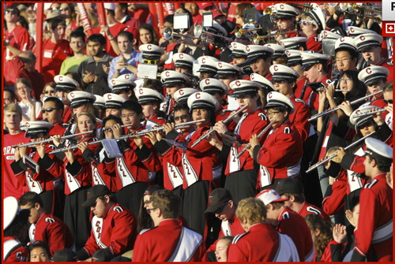
Tasks we'll pursue
Practice of programming: read and write lots of code
7 programming assignments:
first 4 individual, latter 3 partners recommended

Slide 9

Tasks we'll pursue
Practice of programming: coding as a team
team project, agile development, 4 milestones
3 team members of your choice from your discussion section

Slide 10
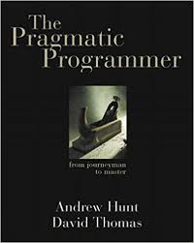
Tasks we'll pursue
Philososphy of programming: written reflections
Six written responses to The Pragmatic Programmer reflecting on your experience
with coding and how you are growing as a programmer

Slide 11

Tasks we'll pursue
Learning a functional language
Why? What does that even mean?

Slide 12
What is a functional language?
A functional language:
defines computations as mathematical functions
avoids mutable state
State: the information maintained by a computation
Mutable: can be changed (antonym: immutable)

Slide 13
Mutability
The fantasy of mutability:
It's easy to reason about: the machine does this, then this...
The reality of mutability:
Machines are good at complicated manipulation of state
Humans are not good at understanding it!
Mutability breaks referential transparency: ability to replace expression with its value without affecting result of computation
Notes:
[This is the second reason for today’s music]
In math, if f(x)=y, then you can substitute y anywhere you see f(x)
In imperative languages, you cannot: f might have side effects, so computing f(x) at time t might result in different value than at time t'

Slide 14
Imperative programming
Commands specify how to compute by destructively changing state:
x = x+1;
a[i] = 42;
p.next = p.next.next;
Functions/methods have side effects:
int x = 0;
int incr_x() {
x++;
return x;
}

Slide 15
Functional programming
Expressions specify what to compute
Variables never change value
Functions never have side effects
The reality of immutability:
No need to think about state
Powerful ways to build correct programs

Slide 16
Why study functional programming?
Functional languages teach you that programming transcends programming in a language (assuming you you have only programmed in imperative languages)
Functional languages predict the future
(Functional languages are sometimes used in industry)
Functional languages are elegant

Slide 17
Why study functional programming?
Functional languages teach you that programming transcends programming in a language (assuming you you have only programmed in imperative languages)
Functional languages predict the future
(Functional languages are sometimes used in industry)
Functional languages are elegant

Slide 18

Analogy: studying a foreign language
Learn about another culture; incorporate aspects into your own life
Shed preconceptions and prejudices about others
Understand your native language better

Slide 19
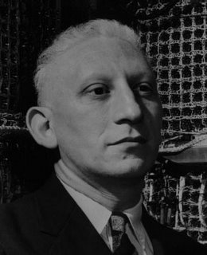
Alan J. Perlis
“A language that doesn't affect the
way you think about programming
is not worth knowing.”
First recipient of the Turing Award
for his “influence in the area of advanced programming techniques and compiler construction”
1922-1990

Slide 20
Why study functional programming?
Functional languages teach you that programming transcends programming in a language (assuming you you have only programmed in imperative languages)
Functional languages predict the future
(Functional languages are sometimes used in industry)
Functional languages are elegant

Slide 21
Functional languages predict the future
Garbage collection Java [1995], LISP [1958]
Generics Java 5 [2004], ML [1990]
Higher-order functions C#3.0 [2007], Java 8 [2014], LISP [1958]
Type inference C++11 [2011], Java 7 [2011] and 8, ML [1990]
What's next?
Notes:
(Don’t spend much time on this slide.)
The type inference in C++ and Java is to figure out how to instantiate type arguments

Slide 22
Why study functional programming?
Functional languages teach you that programming transcends programming in a language (assuming you you have only programmed in imperative languages)
Functional languages predict the future
(Functional languages are sometimes used in industry)
Functional languages are elegant

Slide 23



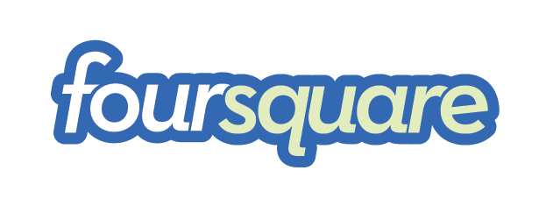









Functional languages in the real world
Java 8
F#, C# 3.0, LINQ
Scala
Haskell
Erlang
OCaml https://ocaml.org/learn/companies.html
...but Cornell CS (et al.) require functional programming for your education, not to get you a job
Notes:
(Don’t spend much time on this!)

Slide 24
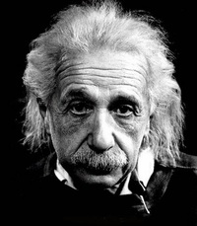
Albert Einstein
"Education is what remains after one has forgotten everything one learned in school."
1879-1955
Notes:
Einstein quotes are like Lincoln quotes. *Maybe* he said this.

Slide 25
Why study functional programming?
Functional languages teach you that programming transcends programming in a language (assuming you you have only programmed in imperative languages)
Functional languages predict the future
(Functional languages are sometimes used in industry)
Functional languages are elegant

Slide 26
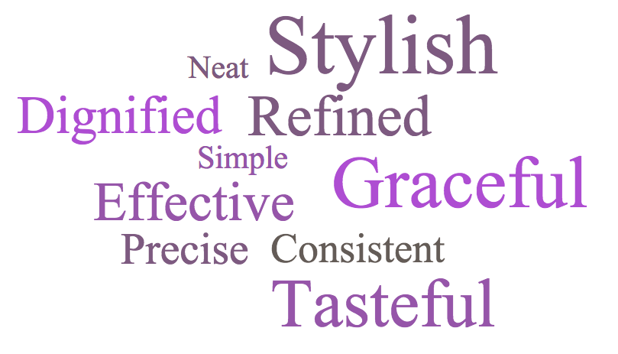
Elegant

Slide 27
Elegant
Beautiful

Slide 28
Do aesthetics matter?
YES!
Who reads code?
Machines
Humans
Elegant code is easier to read and maintain
Elegant code might (not) be easier to write

Slide 29

OCaml
A pretty good language for writing beautiful programs
O = Objective, Caml=not important
ML is a family of languages; originally the “meta-language” for a tool

Slide 30
OCaml is awesome
Immutable programming
Variable’s values cannot destructively be changed; makes reasoning about program easier!
Algebraic datatypes and pattern matching
Makes definition and manipulation of complex data structures easy to express
First-class functions
Functions can be passed around like ordinary values
Static type-checking
Reduce number of run-time errors
Automatic type inference
No burden to write down types of every single variable
Parametric polymorphism
Enables construction of abstractions that work across many data types
Garbage collection
Automated memory management eliminates many run-time errors
Modules
Advanced system for structuring large systems
But no language is perfect…

Slide 31
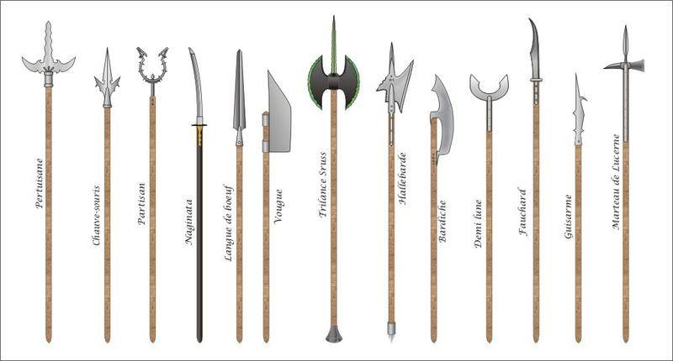
Languages are tools
Notes:
Medieval pole arms: no perfect weapon

Slide 32
Languages are tools
There's no universally perfect tool
There's no universally perfect language
OCaml is good for this course because:
good mix of functional & imperative features
relatively easy to reason about meaning of programs
But OCaml isn't perfect
there will be features you miss from language X
there will be annoyances based on your expectations
keep an open mind, try to have fun

Slide 33
Why study functional programming?
Functional languages teach you that programming transcends programming in a language (assuming you you have only programmed in imperative languages)
Functional languages predict the future
(Functional languages are sometimes used in industry)
Functional languages are elegant
Notes:
Those were four reasons to study FP. But let me turn the question around…

Slide 34
you
Why are
here?
Notes:
What brings you to 3110?
I ask because you’re going to need a WHY.
When the going gets tough, when you’re hunting down a bug at 2 am, in mid-November when the skies get gray, you’re going to need a why.
For…
You? Your family?
Because you love to program?
Because a career in CS sounds great?
Whatever it is, you’re gonna need that WHY. So I want you to think about that over the weekend. We’ll talk about it again next week.
But, here’s why you need that WHY…

Slide 35
CS 2110 | vs. | CS 3110
3 credits |  | 4 credits
Engineers |  | CS majors & minors
Intro |  | Core
Lines of code…
Notes:
Important to convey this because it’s the first time some of you will have had me in 2110 then immediately in 3110.
I want your expectations to be informed by reality.

Slide 36
Notes:
Have you been taught how to read graphs? First read the title, then y axis, then x axis labels.

Slide 37
Notes:
Actually that was for solving all the 3110 assignments, including the last portion that was worth about 20% called “excellent scope”. I’m reducing that to only 5% this semester, so that if you want to opt out of writing as much code, you can do that; and if you want to really dig in and gets lots of coding experience, you can do that too. If you completely skip the excellent scope all semester that ends up being worth less than 2% of your final grade; at the very most that could drop you by a 1/3 letter grade, but more likely it doesn’t make a difference. So I’m expecting the 3110 numbers to drop dramatically. (And maybe the next time I teach 2110 its numbers are going to rise.)

Slide 38
Logistics

Slide 39
Course website
cs3110.org
or
https://www.cs.cornell.edu/courses/cs3110/2019fa/
Notes:
Show the lecture materials, homework, solutions – no information asymmetry on course materials.

Slide 40
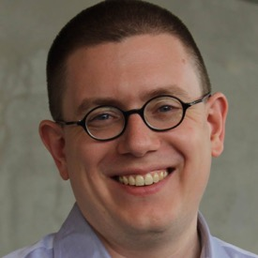

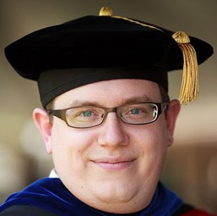
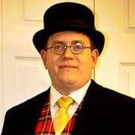

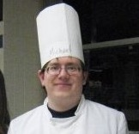
Prof. Michael Clarkson
PhD 2010 Cornell University
BS (CS) & BM (piano) 1999 Miami University
Regularly teach: CS 3110, CS 2110 (Java), CS 4160 (Coq)
Expect: memes, sci-fi and fantasy, video games, music
I like hats…
Notes:
This is my 7th time teaching 3110 as the prof; I was a TA back in 2008

Slide 41
Course staff
TAs and consultants: 66 at last count
…approx. 6-to-1 student-to-instructor ratio
Over 130 person-hours of consulting/office hours scheduled each week

Slide 42

Campuswire
Please prefer Campuswire to email
Notes:
Not trying to monetize your data
Experience more like modern social media
You can easily form your own chatrooms with other members of course
Reputation system: feeds into participation component of final grade

Slide 43
Upcoming events
[now] Pick up one-page course summary on your way out
[today] No discussion sections
[today] Consulting hours start
[Monday] Holiday
[Tuesday lecture] Bring iClicker
[Tuesday/Wednesday] Discussion sections start
[Thursday] A0 released
…why are you still here? Get to work! ☺
THIS IS 3110
Notes:
(Don’t pass out 1-page handout until very very end otherwise room will get rowdy.)
Are you excited? I AM!!! b/c…

