Slide 1
Proofs about Programs, part 2
Prof. Clarkson
Fall 2019
Today’s music: Pictures of Pandas Painting by They Might Be Giants
Notes:
Music: 4 copies, start at 10:01:28
I chose this music because of the recursion in it: pictures of pandas painting pictures of pandas painting…penguins.

Slide 2

Notes:
https://www.youtube.com/watch?v=PO7hCREWsA0&feature=youtu.be&t=100

Slide 3
Clicker Question 1

Slide 4
Review
Previously in 3110:
Equational reasoning
Induction on natural numbers
Today:
Induction on lists and trees

Slide 5
CS 4160: Formal Verification
Sponsored Advertisement

Slide 6


Coq
Tool based on calculus of (inductive) constructions
Thierry Coquand
1961 –

Slide 7

Coq for program verification
Coq program
Verified OCaml program
guidance with tactics
Coq theorem
Proof of theorem
Demo

Slide 8

Notes:
But, also button mashing.

Slide 9
Induction on Lists

Slide 10

Induction principle on naturals
forall properties P,
if P(0)
and (forall k, P(k) implies P(k+1))
then (forall n, P(n))

Slide 11
Induction principle on lists
forall properties P,
if P([])
and (forall h t, P t implies P (h :: t))
then (forall lst, P lst)

Slide 12
Induction on lists
Theorem: forall lst, P(lst).
Proof: by induction on lst
Base case: lst = []
Show: P([])
Inductive case: lst = h :: t
IH: P(t)
Show: P(h :: t)
QED

Slide 13
Example: length
Theorem: forall xs ys,
length (xs @ ys) = length xs + length ys
let rec length = function
| [] -> 0
| _ :: t -> 1 + length t
let rec append lst1 lst2 = match lst1 with
| [] -> lst2
| h :: t -> h :: append t lst2
let (@) = append
Demo
Notes:
Proof. by induction on xs.
P(xs) = forall ys, length (xs @ ys) = length xs + length ys
Base case: xs = []
Show: forall ys, length ([] @ ys) = length [] + length ys
length ([] @ ys)
= { evaluation }
length ys
length [] + length ys
= { evaluation }
0 + length ys
= {algebra}
length ys
Inductive case: xs = h :: t
(* pause here for iclicker: what is the IH? *)
IH: forall ys, length (t @ ys) = length t + length ys
Show: forall ys, length ((h :: t) @ ys) = length (h :: t) + length ys
length ((h :: t) @ ys)
= { evaluation of @ }
length (h :: (t @ ys))
= { evaluation of length }
1 + length (t @ ys)
= { IH }
1 + length t + length ys
length (h :: t) + length ys
= { evaluation }
1 + length t + length ys
QED

Slide 14
Clicker Question 2

Slide 15
Example: map
Theorem: forall f g,
(map f) << (map g) = map (f << g)
let rec map f = function
| [] -> []
| h :: t -> f h :: map f t
let compose f g x = f (g x)
let (<<) = compose
Notes:
Proof.
By extensionality, we need to show:
forall lst, ((map f) << (map g)) lst = map (f << g) lst
((map f) << (map g)) lst
= { eval << }
(map f) ((map g) lst)
= { remove parens }
map f (map g lst)
So we need to show:
forall lst, map f (map g lst) = map (f << g) lst
We do so by induction on lst.
P(lst) = map f (map g lst) = map (f << g) lst
Base case: lst = []
Show: map f (map g []) = map (f << g) []
map f (map g [])
= { eval }
map f []
= { eval }
[]
map (f << g) []
= { eval }
[]
Inductive case: lst = h :: t
IH: map f (map g t) = map (f << g) t
Show: Show: map f (map g (h :: t)) = map (f << g) (h :: t)
map f (map g (h :: t))
= { eval inner map }
map f (g h :: map g t)
= { eval outer map }
f (g h) :: map f (map g t)
= { IH }
f (g h) :: map (f << g) t
map (f << g) (h :: t)
= { eval map }
(f << g) h :: map (f << g) t
= { eval first << }
f (g h) :: map (f << g) t
QED

Slide 16
Induction on Trees

Slide 17
Binary trees
type 'a tree =
| Leaf
| Node of 'a tree * 'a * 'a tree

Slide 18
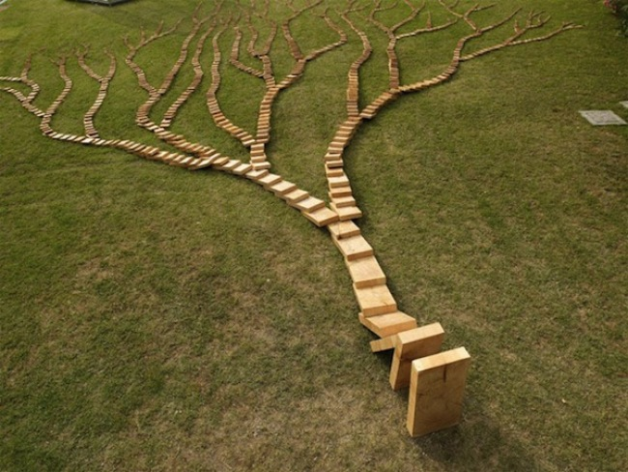
Induction principle on trees
forall properties P,
if P(Leaf)
and (forall v l r,
(P(l) and P(r)) implies P(Node (l, v, r)))
then forall t, P(t)

Slide 19
Induction on trees
Theorem: forall t, P(t).
Proof: by induction on t
Case: n = Leaf
Show: P(Leaf)
Case: n = Node (l, v, r)
IH1: P(l)
IH2: P(r)
Show: P(Node (l, v, r))
QED

Slide 20
Example: leaves and nodes
let rec nodes = function
| Leaf -> 0
| Node (l, _, r) ->
1 + nodes l + nodes r
let rec leaves = function
| Leaf -> 1
| Node (l, _, r) ->
leaves l + leaves r
Theorem: forall t, leaves t = 1 + nodes t
Notes:
Proof: by induction on t
P(t) = leaves t = 1 + nodes t
Base case: t = Leaf
Show: leaves Leaf = 1 + nodes Leaf
leaves Leaf
= { eval }
1
1 + nodes Leaf
= { eval }
1 + 0
= { algebra }
1
Inductive case: t = Node (l, v, r)
IH1: leaves l = 1 + nodes l
IH2: leaves r = 1 + nodes r
Show: leaves (Node (l, v, r)) = 1 + nodes (Node (l, v, r))
leaves (Node (l, v, r))
= { eval }
leaves l + leaves r
= { IH1 }
1 + nodes l + leaves r
= { IH 2}
1 + nodes l + 1 + nodes r
= { algebra }
2 + nodes l + nodes r
1 + nodes (Node (l, v, r))
= { eval }
1 + 1 + nodes l + nodes r
= { algebra }
2 + nodes l + nodes r
QED

Slide 21
Induction vs. Recursion
What induction principles tell us about

Slide 22
Induction vs. recursion
Inductive proofs are like recursive programs
 | Proofs | Programs
Per constructor… | One proof case | One pattern-matching branch
On smaller value… | Use IH | Make recursive call

Slide 23
Upcoming events
[tonight] A6 due
[Sun 11:00:00 pm] A6 late deadline. Reminder: submit at least an hour before deadline.
This is principled.
THIS IS 3110

