Slide 1
Variants
Prof. Clarkson
Fall 2019
Today’s music: Union by The Black Eyed Peas (feat. Sting)
Notes:
Music: 2 copies, start at 9:59:58
Variants are "tagged unions"

Slide 2
Clicker Question 1

Slide 3
WICC
Women in Computing at Cornell

Slide 4
Review
Previously in 3110:
Lists, records, tuples
Pattern matching
Today:
Variants

Slide 5
Variants
Demo
Notes:
(* simplest variant: constant constructors *)
type primary_color = Red | Blue | Green
(* more complicated variant with non-constant constructors *)
type point = float * float
type shape =
| Circle of {center : point; radius : float}
| Rectangle of {lower_left : point; upper_right : point}
(* | Point of point *) (* we'll add this later: when we do note warning *)
let mid a b =
(b -. a) /. 2.
let center = function
| Circle {center} -> center
| Rectangle {lower_left=(x_ll, y_ll); upper_right=(x_ur, y_ur)} ->
(mid x_ll x_ur, mid y_ll y_ur)
(* | Point p -> p *) (* we'll add this later *)
(* the code for [center] above is equivalent to this more verbose version
that doesn't take advantage of various pieces of syntactic sugar
and pattern syntax *)
let center_verbose s =
match s with
| Circle {center=c} -> c
| Rectangle {lower_left=ll; upper_right=ur} ->
let x_ll, y_ll = ll in
let x_ur, y_ur = ur in
(mid x_ll x_ur, mid y_ll y_ur)

Slide 6
Variant types
Type definition syntax:
type t =
| C1 of t1
| ...
| Cn of tn
Optional data carried by constructor
Constructors aka tags

Slide 7
Clicker Question 2

Slide 8
Variant: union
type string_or_int =
| String of string
| Int of int
strings
ints
∪

Slide 9
Variant: tagged union
type blue_or_pink_int =
| Blue of int
| Pink of int
ints
ints
⨄

Slide 10
Recursive variants
Demo
Notes:
type intlist =
| Nil
| Cons of int * intlist
let rec length = function
| Nil -> 0
| Cons (_,t) -> 1 + length t

Slide 11
Parameterized variants
Demo
Notes:
type stringlist =
| Nil
| Cons of string * stringlist
let rec length = function
| Nil -> 0
| Cons (_,t) -> 1 + length t
(* poor engineering to copy code! *)
(* parameterized variants *)
type 'a mylist =
| Nil
| Cons of 'a * 'a mylist
let rec length = function
| Nil -> 0
| Cons (_,t) -> 1 + length t

Slide 12
List implementation
OCaml just codes up lists as variants:
type 'a list = [] | (::) of 'a * 'a list
list is a type constructor parameterized on type variable 'a
[] and :: are constructors
Notes:
(* lists are just parameterized recursive variants *)
type 'a mylist =
| []
| (::) of 'a * 'a mylist
let rec length = function
| [] -> 0
| _ :: t -> 1 + length t

Slide 13
Clicker Question 3

Slide 14
Options
Notes:
Options solve a very real problem that you know from Java: null pointer exceptions
(But options are more general than that.)

Slide 15

Option: A built-in variant
type 'a option = None | Some of 'a
Demo
Notes:
"Maybe" something in the box, maybe not
Options are parameterized but not recursive variants.
Stdlib.max;;
let rec list_max = function
| [] -> None
| h :: t ->
match list_max t with
| None -> Some h
| Some m -> Some (max h m)

Slide 16
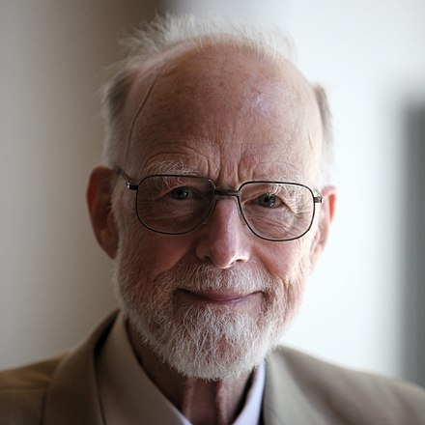
Tony Hoare
Turing Award 1980
For his “fundamental contributions to the definition and design of programming languages.”
Inventor of quicksort
b. 1934
“I call [null] my billion-dollar mistake…I was designing the…type system for…an object-oriented language. I couldn’t resist the temptation to put in a null reference…This has led to innumerable errors, vulnerabilities, and system crashes, which have probably caused a billion dollars of pain and damage in the last forty years."
Notes:
Part of the problem is that programmers forget to check whether something is null or not.

Slide 17
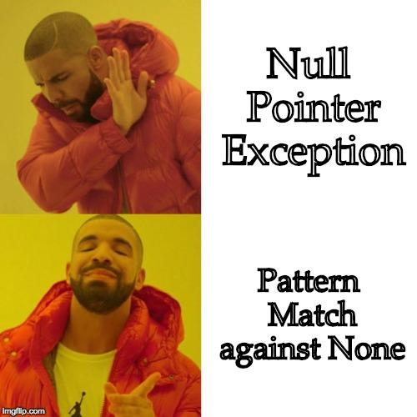

Slide 18
Exceptions

Slide 19
Exceptions are extensible variants
type exn
exception MyNewException of string
Type exn is an extensible variant that may have new constructors added after its original definition
Raise exceptions with raise e, where e is a value of type exn
Handle exceptions with pattern matching, just like you would process any variant

Slide 20
Upcoming events
[Mon] R2 due
[Mon] Level Up: git
This is powerful.
THIS IS 3110

Slide 21
Move to recitation

Slide 22
+
One Of: Sum Type

Slide 23
×
Each Of: Product Type

Slide 24
Algebraic Data Types
Notes:
Look back at shapes: both + and x
But you could also have a record with a field whose type is variant

