Slide 1
The Environment Model
Prof. Clarkson
Fall 2019
Today’s music: Selections from Doctor Who soundtracks by Murray Gold
Notes:
Music: Remember Me, The Majestic Tale, Onwards, Doctor Who XI
Start at 10:00:51
I chose this music because today we're going to talk about how to implement time travel.

Slide 2
Clicker Question 1

Slide 3
Review
Previously in 3110:
Interpreters
Substitution model
Today:
Small-step vs. big-step evaluation
Environment model
Dynamic vs. static scope

Slide 4
Small-step evaluation
Small (single) step relation: e → e'
(10 + 1) + (5 + 6) → 11 + (5 + 6)
11 + (5 + 6) → 11 + 11
11 + 11 → 22
22 ↛
Multistep relation: e →* e'
(10 + 1) + (5 + 6) → * (10 + 1) + (5 + 6)
(10 + 1) + (5 + 6) → * 11 + (5 + 6)
(10 + 1) + (5 + 6) → * 11 + 11
(10 + 1) + (5 + 6) → * 22
The final value is what OCaml actually gives us…

Slide 5
e ⟹ v
big-step relation
the eval function we implemented
Notes:
read as e big-steps to v
another notation: e ⇓ v
read as e evaluates down to v

Slide 6
Small vs. big step evaluation
forget about intermediate steps
e → e1 → e2 → e3 → ... → v
e ⟹ v
Big and small should be consistent: for all expressions e and values v, e ⟹ v if and only if e →* v

Slide 7
Big-Step Semantics

Slide 8
SimPL
e ::= x | i | b
| e1 bop e2
| let x = e1 in e2
| if e1 then e2 else e3
bop ::= + | * | <=
Notes:
This is the language we reached at the end of last lecture.

Slide 9
Semantics
v ⟹ v
e1 + e2 ⟹ v
if e1 ⟹ v1
and e2 ⟹ v2
and v is the result of primitive operation v1 + v2
x ⇏
Notes:
42 ⟹ 42
true ⟹ true
"big" ^ "red" ⟹ "bigred"
1 + 2 ⟹ 3
1 + (2+3) ⟹ 6

Slide 10
Semantics
let x = e1 in e2 ⟹ v2
if e1 ⟹ v1
and e2{v1/x} ⟹ v2
if e1 then e2 else e3 ⟹ v2
if e1 ⟹ true
and e2 ⟹ v2
if e1 then e2 else e3 ⟹ v3
if e1 ⟹ false
and e3 ⟹ v3
Demo

Slide 11
Environment Model

Slide 12
Substitution could be slow
let x = 0 in 42
let b = ... in
let x = ... in
if b then x + 1 else x - 1
Imagine a large block of code instead of just [42]
Imagine large blocks of code instead of just [x+1] and [x-1]
Notes:
Never need x in first example
Never need one of the branches (but don't know which) in the second example

Slide 13
Dictionaries are fast
Dynamic environment
let x = 42 in
let y = 3110 in
x + y
x | 42
x | 42
y | 3110

Slide 14
Dynamic environment
Maps variable names to values in current scope
Implements a kind of lazy substitution
let x = 0 in 42
let b = ... in
let x = ... in
if b then x + 1 else x - 1
x | 0
Doesn't matter how large a block of code
b | ?
x | ?

Slide 15
machine configuration
⟨env, e⟩ ⟹ v
environment-model big-step relation
Notes:
Machine configuration: like a pair
Contains memory and program of the "machine"
Using weird angle brackets to be clear it's a piece of mathematical notation, not OCaml pairs/syntax.
(It would be possible to give a small-step environment model, too, but we aren't going to.)

Slide 16
Values
⟨env, v⟩ ⟹ v

Slide 17
Binary operators
⟨env, e1 + e2⟩ ⟹ v
if ⟨env, e1⟩ ⟹ v1
and ⟨env, e2⟩ ⟹ v2
and v is v1 + v2

Slide 18
If expressions
⟨env, if e1 then e2 else e3⟩ ⟹ v2
if ⟨env, e1⟩ ⟹ true
and ⟨env, e2⟩ ⟹ v2
⟨env, if e1 then e2 else e3⟩ ⟹ v3
if ⟨env, e1⟩ ⟹ false
and ⟨env, e3⟩ ⟹ v3

Slide 19
Let expressions
⟨env, let x = e1 in e2⟩ ⟹ v2
if ⟨env, e1⟩ ⟹ v1
and ⟨env[x ↦ v1], e2⟩ ⟹ v2
env[x ↦ v]: env with x bound to v
think of this as recording the substitution in case it is ever needed
Notes:
Example: ⟨{},let x = 42 in x⟩ ⟹ 42
Because...
⟨{}, 42⟩ ⟹ 42
and ⟨{}[x ↦ 42], x⟩ ⟹ 42
Because {x:42}(x)=42

Slide 20
Variables
⟨env, x⟩ ⟹ env(x)
env(x): the value to which env binds x
Demo
Notes:
If variable not in dictionary, then we can't evaluate using this rule. Implement with an error in interpreter.
Type checking guarantees that variable is bound, so we can’t ever fail to find a binding in dynamic environment
Notation: let's use abstract dictionary notation we used earlier (same as Python)
let {} be the empty environment
let {x : 42} be the dictionary that maps x to 42 etc.
<{x:42}, x> ==> 42
<{}, x> =/=>

Slide 21
Functions

Slide 22
SimPL + functions
e ::= x | i | b
| e1 bop e2
| let x = e1 in e2
| if e1 then e2 else e3
| fun x -> e
| e1 e2
bop ::= + | * | <=
Notes:
This is the language we reached at the end of last lecture.

Slide 23
Function values v1.0
Since functions are values:
⟨env, fun x -> e⟩ ⟹ fun x -> e

Slide 24
Function application rule v1.0
⟨env,e1 e2⟩ ⟹ v
if ⟨env,e1⟩ ⟹ fun x -> e
and ⟨env,e2⟩ ⟹ v2
and ⟨env[x ↦ v2],e⟩ ⟹ v
Notes:
Example:
⟨{},(fun x -> x) 1⟩ ⟹ 1
b/c ⟨{},fun x -> x⟩ ⟹ fun x -> x
and ⟨{},1⟩ ⟹ 1
and ⟨{}[x ↦ 1], x⟩ ⟹ 1

Slide 25
Clicker Question 2

Slide 26
Scope: OCaml
What does OCaml say this evaluates to?
let x = 1 in
let f = fun y -> x in
let x = 2 in
f 0
- : int = 1

Slide 27
Scope: our semantics
What does our semantics say?
let x = 1 in
{x:1} let f = fun y -> x in
{x:1,f:(fun y -> x)} let x = 2 in
{x:2,f:(fun y -> x)} f 0
⟨{x:2,f:(fun y -> x)}, f 0⟩ ⟹ ???
Evaluate f to a value: fun y -> x
Evaluate 0 to a value: 0
Extend environment to map parameter: {x:2, f:(fun y -> x), y:0}
Evaluate body x in that environment
Return 2
2 <> 1

Slide 28
Why different answers?
Two different rules for variable scope:
Rule of dynamic scope (our semantics so far)
Rule of lexical scope (OCaml)

Slide 29
Dynamic scope
Rule of dynamic scope: The body of a function is evaluated in the current dynamic environment at the time the function is called, not the old dynamic environment that existed at the time the function was defined.
Causes our semantics to use latest binding of x
Thus return 2

Slide 30
Lexical scope
Rule of lexical scope: The body of a function is evaluated in the old dynamic environment that existed at the time the function was defined, not the current environment when the function is called.
Causes OCaml to use earlier binding of x
Thus return 1

Slide 31

Lexical scope
Rule of lexical scope: The body of a function is evaluated in the old dynamic environment that existed at the time the function was defined, not the current environment when the function is called.
Causes OCaml to use earlier binding of x
Thus return 1

Slide 32
Implementing time travel
Q: How can functions be evaluated in old environments?
A: The language implementation keeps old environments around as necessary

Slide 33
Implementing time travel
A function value is really a data structure called a function closure that has two parts:
The code, an expression e
The environment env that was current when the function was defined
We'll notate that data structure as (|e , env|)
(|e , env|) is like a pair
But indivisible: you cannot write OCaml syntax to access the pieces
And inexpressible: you cannot directly write it in OCaml syntax

Slide 34
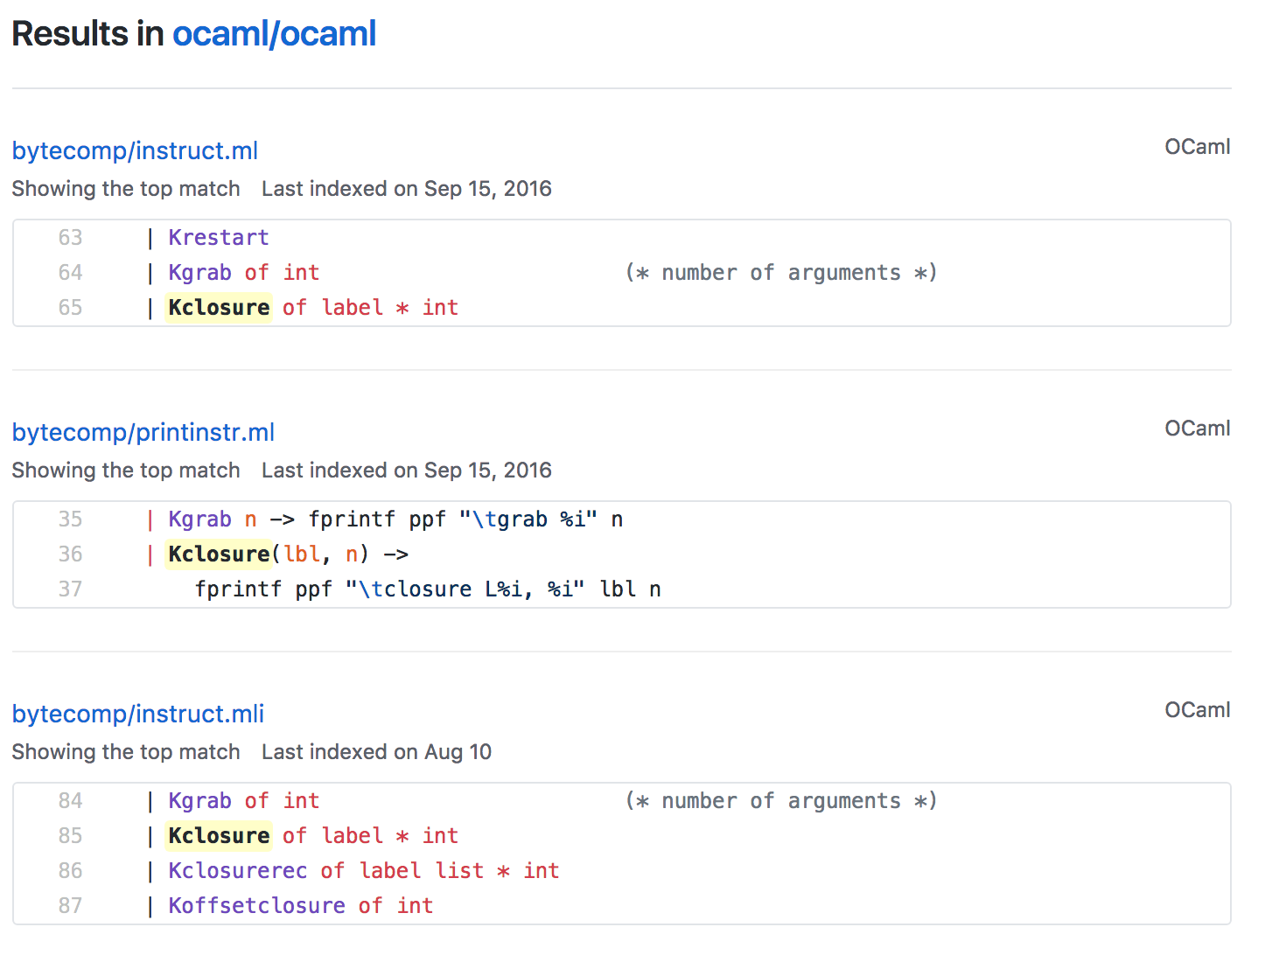
Closures in OCaml bytecode compiler
https://github.com/ocaml/ocaml/search?q=kclosure

Slide 35
Function values v2.0
Anonymous functions fun x -> e are closures:
⟨env, fun x -> e⟩
⟹ (|fun x -> e , env|)

Slide 36
Function application rule v2.0
⟨env, e1 e2⟩ ⟹ v
if ⟨env, e1⟩ ⟹ (|fun x -> e , defenv|)
and ⟨env, e2⟩ ⟹ v2
and ⟨defenv[x ↦ v2], e⟩ ⟹ v

Slide 37
Lexical vs. dynamic scope
Consensus after decades of programming language design is that:
Lexical scope is usually the right choice
Dynamic scope is useful in some situations
Exception handling resembles dynamic scope:
raise e transfers control to the “most recent” exception handler
like how dynamic scope uses “most recent” binding of variable
Notes:
Why is lexical scope right?
it supports the Principle of Name Irrelevance: name of variable shouldn't matter to meaning of program
programmers free to change names of local variables
type checker can prevent more run-time errors
Dynamic scope:
Some languages use it as the norm (e.g., Emacs LISP, LaTeX)
Some languages have special ways to do it (e.g., Perl, Racket)
But most languages just don’t have it

Slide 38
Upcoming events
[last night]: R8 due (last reflection!)
[Tue/Wed]: MS1 demos in section
[Thur]: MS1 due in CMS
This is closure.
THIS IS 3110

