Slide 1
Higher-order Programming
Prof. Clarkson
Fall 2019
Today’s music: Selections from the soundtrack to 2001: A Space Odyssey:
On the Beautiful Blue Danube, Also sprach Zarathustra (Strauss)
Notes:
Music: start at 10:02:18
2001: opening scene, the dawn of mankind. huge monolith. the discovery of tools. walking upright.
I chose this music because today you will take an evolutionary step. You will learn a huge, monumentally useful tool. So useful your TAs have trouble remembering NOT to use it.

Slide 2
Clicker Question 1

Slide 3
Review
Previously in 3110:
Lots of language features
Today:
No new language features
New idioms and library functions:
Map, fold, and other higher-order functions

Slide 4
Review: Functions are values
Can use them anywhere we use values
Functions can take functions as arguments
Functions can return functions as results
…so functions are higher-order

Slide 5
Higher-order Functions
Demo
Notes:
(* Higher-order functions *)
let double x = 2 * x
let square x = x * x
let quad x = 4 * x
let quad' x = double (double x)
let quad'' x = x |> double |> double
let fourth x = x * x * x * x
let fourth' x = square (square x)
let fourth'' x = x |> square |> square
(* Note repeated code: applying a function twice.
Let's write a function for that. *)
let twice f x = f (f x)
(* : ('a -> 'a) -> 'a -> 'a
takes a function as input *)
let twice' f x = x |> f |> f
let quad''' x = twice double x
let fourth''' x = twice square x
(* The argument is unnecessary thanks to partial application: produce
a function as output. *)
let quad'''' = twice double
let fourth'''' = twice square

Slide 6

Two Monumental higher-order functions

Slide 7
map
fold
Sibling: reduce

Slide 8
MapReduce
“[Google’s MapReduce] abstraction is inspired by the map and reduce primitives present in Lisp and many other functional languages."
[Dean and Ghemawat, 2008]
Notes:
Google organized large-scale data-parallel computations with MapReduce.
Open source implementation by Apache called Hadoop.
The technology they use has changed, but the primitives are still important.

Slide 9
transform list elements
map
fold

Slide 10



Map
map (fun x -> shirt_color(x)) [ ]

Slide 11



Map
map (fun x -> shirt_color(x)) [ ]
= [gold; blue; red]

Slide 12

Notes:
Spock talking to Sarek on transporter pad.

Slide 13
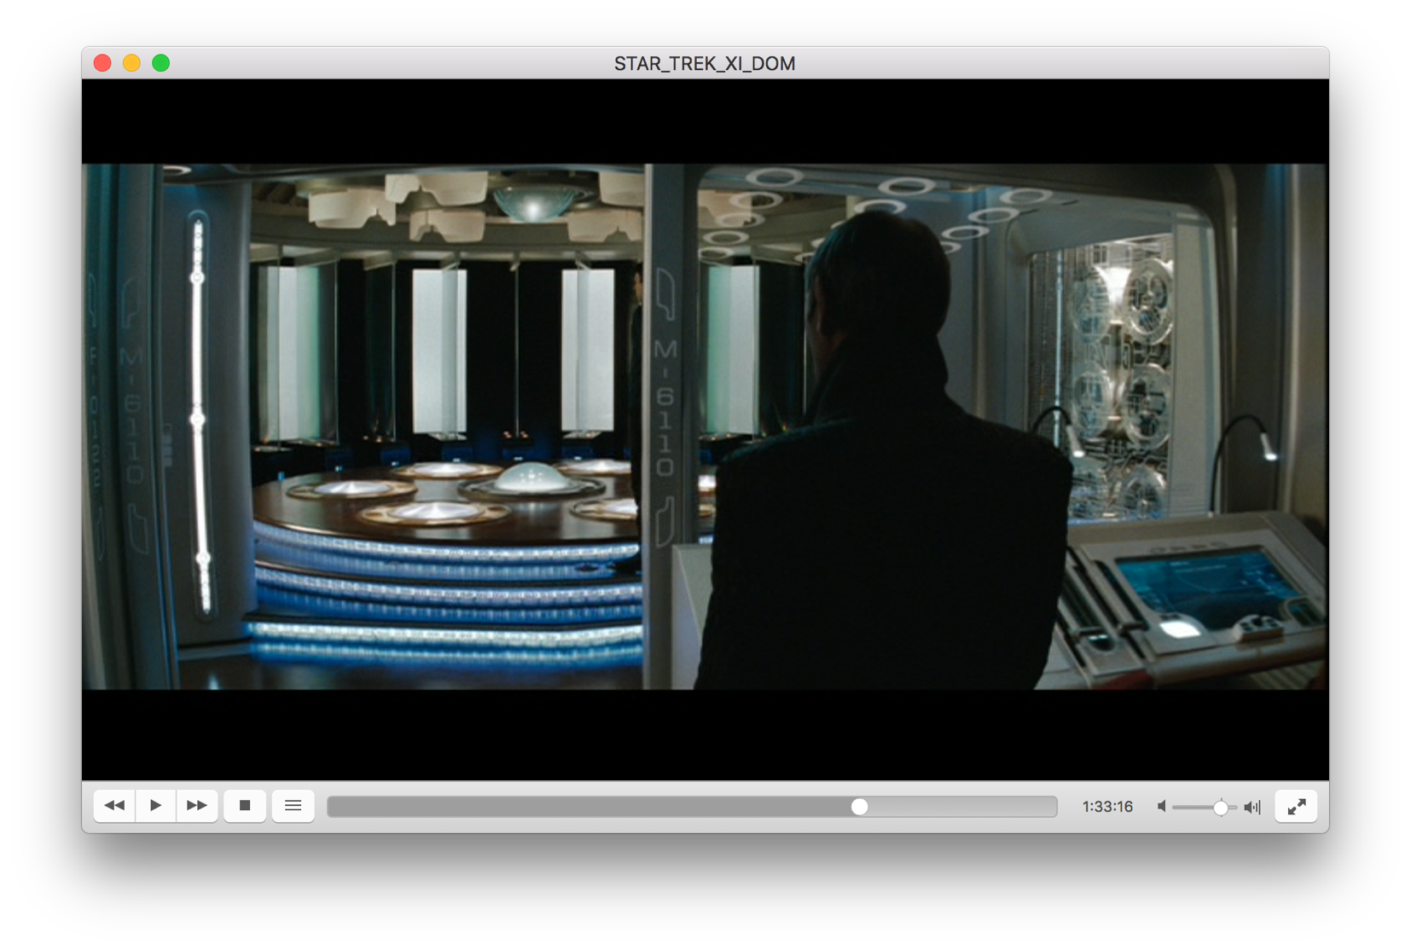
Notes:
Studying PL will transport you.

Slide 14
Map
bad style!
map (fun x -> shirt_color(x)) [ ]
= [gold; blue; red]

Slide 15
Map
map shirt_color [ ]
= [gold; blue; red]

Slide 16
Transforming Elements
Demo
Notes:
let rec add1 = function
| [] -> []
| h :: t -> (h + 1) :: add1 t
let rec concat3110 = function
| [] -> []
| h :: t -> (h ^ "3110") :: concat3110 t
let rec map f = function
| [] -> []
| h :: t -> f h :: map f t
let add1' = map (fun x -> x + 1)
let add1'' = map ((+) 1)
let concat3110' = map (fun x -> x ^ "3110")
let concat3110'' = map ((^) "3110") (* wrong: does not append; prepends *)

Slide 17
Map
let rec map f = function
| [] -> []
| h :: t -> f h :: map f t
map : ('a -> 'b) -> 'a list -> 'b list

Slide 18
Abstraction Principle
Factor out recurring code patterns.
Don't duplicate them.

Slide 19
Clicker Question 2

Slide 20
map
fold
combine list elements

Slide 21
Combining Elements
Demo
Notes:
let rec sum = function
| [] -> 0
| h :: t -> h + sum t
let rec concat = function
| [] -> ""
| h :: t -> h ^ concat t
(* Factor out repeated code... *)
let rec combine init op = function
| [] -> init
| h :: t -> op h (combine init op t)
let sum' = combine 0 (+)
let concat' = combine "" (^)

Slide 22
Combining elements
let rec combine init op = function
| [] -> init
| h :: t ->
op h (combine init op t)
combining elements, using init and op, is the essential idea behind library functions known as fold

Slide 23
List.fold_right
List.fold_right f [a;b;c] init
computes
f a (f b (f c init))
Accumulates an answer by
repeatedly applying f to an element of list and “answer so far”
folding in list elements “from the right”
Demo
Notes:
let rec fold_right f lst acc =
match lst with
| [] -> acc
| h :: t ->
f h (fold_right f t acc)

Slide 24
List.fold_left
List.fold_left f init [a;b;c]
computes
f (f (f init a) b) c
Accumulates an answer by
repeatedly applying f to "answer so far" and an element of list
folding in list elements “from the left”
Demo
Notes:
let rec fold_left f acc lst =
match lst with
| [] -> acc
| h :: t ->
fold_left f (f acc h) t

Slide 25
Left vs. right
folding [1;2;3] with 0 and (+)
left to right: ((0+1)+2)+3 = 6
right to left: 1+(2+(3+0)) = 6
folding [1;2;3] with 0 and (-)
left to right: ((0-1)-2)-3 = -6
right to left: 1-(2-(3-0)) = 2
Notes:
(+) just happens to be associative and commutative, so it works out fine.
(/), (**), etc. are not.

Slide 26
Behold the power of fold
let rev xs =
fold_left (fun xs x -> x :: xs) [] xs
let length xs =
fold_left (fun a _ -> a + 1) 0 xs
let map f xs =
fold_right (fun x a -> f x :: a) xs []
Notes:
These aren’t obvious; well worth your time to study and understand why they work.

Slide 27
Upcoming events
[last night] R2 was due
[Wed] A1 due
This is monumental.
THIS IS 3110

