Slide 1
Proofs about Programs
Prof. Clarkson
Fall 2019
Today’s music: Suite from Downton Abbey by John Lunn
Notes:
Music: start at 10:02:58.
I chose this music because I love how formal Downton Abbey is, and we’re about to do some formal reasoning about programs.

Slide 2
Clicker Question 1

Slide 3
Review
Previously in 3110:
Functional programming
Modular programming
Efficiency
Interpreters
Next unit of course: proofs about programs
Today:
Equational reasoning
Proving correctness of recursive functions
Notes:
This unit is experimental: we had tried something the last couple years [more about that at the end], now we’re trying something different.

Slide 4

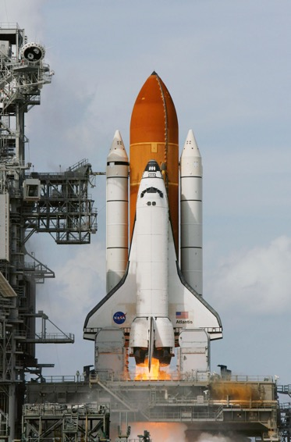
Notes:
Flight controller, autonomous vehicle, space shuttle, DNA sequencer, power grid controller

Slide 5
Approaches to validation [lec 10]
Social
Code reviews
Extreme/Pair programming
Methodological
Design patterns
Test-driven development
Version control
Bug tracking
Technological
Static analysis (“lint” tools, FindBugs, …)
Fuzzers
Mathematical
Sound type systems
“Formal” verification
Less formal: Techniques may
miss problems in programs
All of these methods should be used!
Even the most formal can still have holes:
did you prove the right thing?
do your assumptions match reality?
More formal: eliminate with certainty as many problems as possible.
Slide credit: Benjamin C. Pierce (UPenn)

Slide 6
Verification
In the 1970s, scaled to about tens of LOC
Now, research projects scale to real software:
CompCert: verified C compiler
seL4: verified microkernel OS
Ynot: verified DBMS, web services
Four color theorem
Project Everest: verified HTTPS stack [in progress]
Etc.
In another 40 years?
Notes:
Back in the 70’s, our own Gries was one of the people leading the charge.

Slide 7
Our goals
Write small, pure functional programs
no side effects, mutability, I/O; always terminating
integers, lists, options, trees
Prove correctness theorems
CS 2800 mathematics: induction, logic
Be rigorous but not completely formal

Slide 8
Correctness

Slide 9
Specifications
(** [fact n] is [n] factorial,
i.e., [n!].
Requires: [n >= 0]. *)
let rec fact n = ...
Postcondition gives an equality between function output and an English/mathematical description involving input

Slide 10
Correctness proofs
Based on equality between expressions
When does e = e’?
Not asking about OCaml Boolean equality
Asking whether two pieces of code are equal…
Notes:
Harder to reason about equality between code and English
Easier to reason about equality between two pieces of code

Slide 11
Equality of expressions
41 + 1 ≟ 42
Semantically: yes
Syntactically: no
41 + 1 →* 42 42 →* 42
+
42
41
1

Slide 12
Equality of expressions
fun x -> x ≟ fun y -> y
Extensionality
Semantically: yes
Syntactically: no
for all v,
(fun x -> x) v →* v
(fun y -> y) v →* v
fun
fun
x
x
y
y
Notes:
This definition of function equality known as extensionality: functions produce the same output for all inputs
Maybe they compute it a different way (one is slow, the other fast, etc.): that doesn’t matter
Bubble sort and Quicksort and Merge sort could all be seen as extensionally equal.

Slide 13
Equality of expressions
e = e’
if e and e’ evaluate to the same value
must be well typed, pure, total
Notes:
Doesn’t matter whether we use big or small step model. They are consistent and get the same answers after all.
Same for substitution vs. environment. Under lexical scope they get the same answers.
But for examples if it’s ever relevant we’ll use the small-step substitution model. Substitution is easier to think about than closures; and if e -->* e’ we know they must reach the same value, so small-step can sometimes make the reasoning easier
The fine print is technically important but not going to be our focus. We’re not allowed references, I/O, exceptions, or infinite loops basically.

Slide 14
Equational Reasoning
Notes:
TBH this is just giving a fancy name to a really simple concept

Slide 15
Example 1
let twice f x = f (f x)
let compose f g x = f (g x)
twice h x = h (h x) (by evaluation)
compose h h x = h (h x) (by evaluation)
so
twice h x = compose h h x (by transitivity)

Slide 16
Example 1
let twice f x = f (f x)
let compose f g x = f (g x)
twice h x
= {evaluation}
h (h x)
= {evaluation}
compose h h x
Please use this proof format
Notes:
Note proof format:
chain of equalities
each step has a hint as to justification
equalities are outdented
the transitivity piece is obvious
Proof format credited to Wim Feijen

Slide 17
Example 2
let (<<) = compose
Theorem: composition is associative.
(f << g) << h = f << (g << h)
Proof: by extensionality, we need to show:
forall x, ((f << g) << h) x = (f << (g << h)) x

Slide 18
Example 2
let compose f1 f2 x = f1 (f2 x)
((f << g) << h) x = (f << (g << h)) x
((f << g) << h) x
= { evaluation }
(f << g) (h x)
= { evaluation }
f (g (h x))
(f << (g << h)) x
= { evaluation }
f ((g << h) x)
= { evaluation }
f (g (h x))
QED
Notes:
Note two-column approach.
Or could do one-column, one after the other.
The idea is to work from each end toward the middle.
Strategy: simplify each as much as possible, hopefully reaching same expression. If you get stuck, think about why you’re stuck and adjust.

Slide 19
Proofs with Recursion
Notes:
Prove the correctness of recursive functions. Using: induction!

Slide 20
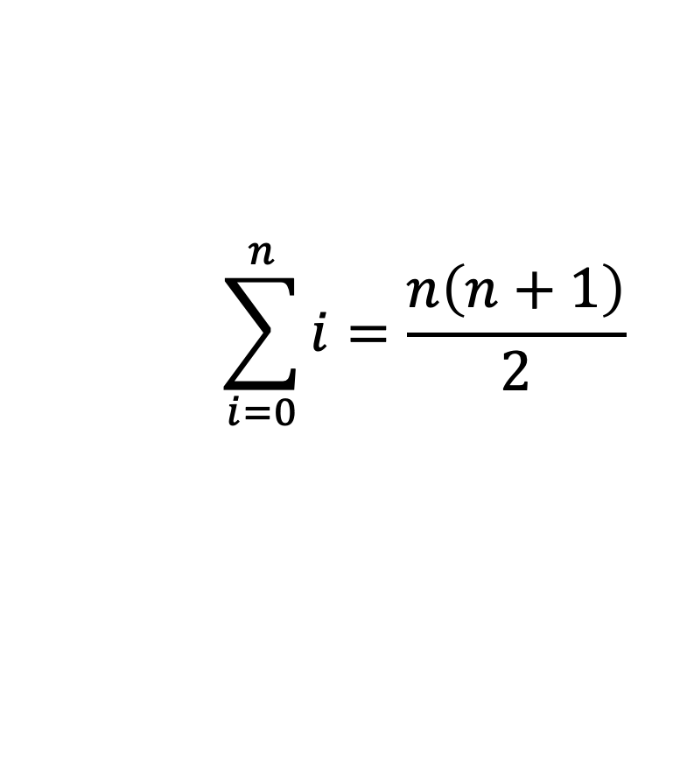
Example 1: Summation
$$\sum_{i=0}^{n}{i}=\frac{n\left(n+1\right)}{2}$$
let rec sumto n =
if n = 0 then 0
else n + sumto (n - 1)
sumto n ≟ n * (n + 1) / 2
Notes:
You might recall needing induction to prove that math equation in CS 2800
We’ll also need induction to prove the code correct

Slide 21
Induction on natural numbers
Theorem: forall natural numbers n, P(n).
Proof: by induction on n
Base case: n = 0
Show: P(0)
Inductive case: n = k+1
IH: P(k)
Show: P(k+1)
QED
Please use this proof format
Notes:
Aka “weak induction” in CS 2800
Always state the P, state what each case is, state what you need to show in each case, explicitly state IH.
Why? Because it will keep you from making mistakes, and guide your work.
Why does induction work as a proof technique…? See next slide.

Slide 22

Induction principle
forall properties P of natural numbers,
if P 0
and (forall n, P n implies P (n+1))
then (forall n, P n)

Slide 23
Summation: proof structure
Claim: forall n, sumto n = n * (n + 1) / 2
Proof: by induction on n.
P(n) = sumto n = n * (n + 1) / 2
Base case: n = 0
Show: sumto 0 = 0 * (0 + 1) / 2
Inductive case: n = k + 1
IH: ???

Slide 24
Clicker Question 2

Slide 25
Summation: proof structure
Claim: forall n, sumto n = n * (n + 1) / 2
Proof: by induction on n.
P(n) = sumto n = n * (n + 1) / 2
Base case: n = 0
Show: sumto 0 = 0 * (0 + 1) / 2
Inductive case: n = k + 1
IH: sumto k = k * (k + 1) / 2
Show: sumto (k + 1) = (k + 1) * ((k + 1) + 1) / 2

Slide 26
Summation: base case
Base case: n = 0
Show: sumto 0 = 0 * (0 + 1) / 2
sumto 0
= { evaluation }
0
= { algebra (or evaluation) }
0 * (0 + 1) / 2
let rec sumto n =
if n = 0 then 0
else n + sumto (n - 1)
Notes:
OCaml integers don’t work exactly like mathematical naturals, but we’re going to not be fussy about that in this class.

Slide 27
Summation: inductive case
Inductive case: n = k + 1
IH: sumto k = k * (k + 1) / 2
Show: sumto (k + 1) = (k + 1) * ((k + 1) + 1) / 2
sumto (k + 1)
= { evaluation }
k + 1 + sumto k
= { IH }
k + 1 + k * (k + 1) / 2
= { algebra }
(k + 1) * ((k + 1) + 1) / 2
let rec sumto n =
if n = 0 then 0
else n + sumto (n - 1)
QED

Slide 28
Example 2: Factorial
let rec fact n =
if n = 0 then 1
else n * fact (n - 1)
let rec facti acc n =
if n = 0 then acc
else facti (acc * n) (n - 1)
let fact_tr n = facti 1 n
“i” suggests iterative
Notes:
iterative: closely resembles a while loop solution in say Java. See notes.

Slide 29
Factorial: correctness
Claim: forall n, fact n = facti 1 n
Proof: by induction on n.
P(n) = fact n = facti 1 n
Base case: n = 0
Show: fact 0 = facti 1 0
Inductive case: n = k + 1
IH: fact k = facti 1 k
Show: fact (k + 1) = facti 1 (k + 1)
Notes:
let’s skip straight to the inductive case, since the base case is quite easy

Slide 30
Factorial: inductive case
Inductive case: n = k + 1
IH: fact k = facti 1 k
Show: fact (k + 1) = facti 1 (k + 1)
fact (k + 1)
= { evaluation }
(k + 1) * fact k
= { IH }
(k + 1) * facti 1 k
facti 1 (k + 1)
= { evaluation }
facti (k + 1) k
STUCK
let rec fact n =
if n = 0 then 1
else n * fact (n - 1)
let rec facti acc n =
if n = 0 then acc
else facti (acc * n) (n - 1)
want to move (k + 1) into accumulator: facti (k + 1) k
but how?
Notes:
When you get stuck after applying IH, ask yourself: am I proving too weak a statement? Do I need a strengthened IH?

Slide 31
Strengthened IH
What we have from IH:
(k + 1) * fact k = (k + 1) * facti 1 k
What we want:
(k + 1) * fact k = facti (k + 1) k
So, strengthen P(n) to give us what we want:
forall p, p * fact n = facti p n
want to multiply (k + 1) into acc
can multiply anything into acc

Slide 32
Factorial: correctness, take 2
Lemma: forall n, forall p, p * fact n = facti p n
Proof: by induction on n.
P(n) = forall p, p * fact n = facti p n
Base case: n = 0
Show: forall p, p * fact 0 = facti p 0
Inductive case: n = k + 1
IH: forall p, p * fact k = facti p k
Show: forall p, p * fact (k + 1) = facti p (k + 1)
Notes:
again, let’s skip straight to the inductive case, since the base case is quite easy

Slide 33
Factorial: strengthened ind. case
Inductive case: n = k + 1
IH: forall p, p * fact k = facti p k
Show: forall p, p * fact (k + 1) = facti p (k + 1)
p * fact (k + 1)
= { evaluation }
(p * (k + 1)) * fact k
= { IH with p := p * (k + 1) }
facti (p * (k + 1)) k
facti p (k + 1)
= { evaluation }
facti (p * (k + 1)) k
let rec fact n =
if n = 0 then 1
else n * fact (n - 1)
let rec facti acc n =
if n = 0 then acc
else facti (acc * n) (n - 1)
QED

Slide 34
Factorial: correctness
Claim: forall n, fact n = fact_tr n
Proof:
fact_tr n
= { evaluation }
facti 1 n
= { previous lemma with p := 1 }
fact n
QED

Slide 35
CS 4160: Formal Verification
Sponsored Advertisement

Slide 36
Proof assistant
theorem
assistant
proof
human guidance
Notes:
You give assistant a theorem
You and assistant cooperatively find proof
Human guides the construction
Machine does the low-level details
goal is proof; timeouts or counterexamples might also happen

Slide 37

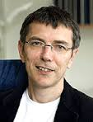
Coq
1984: Coquand and Huet implement Coq based on calculus of inductive constructions
1992: Coq ported to Caml
Now implemented in OCaml
Thierry Coquand
1961 –

Slide 38

Coq for program verification
Coq program
Verified OCaml program
guidance with tactics
Coq theorem
Proof of theorem
Demo

Slide 39

Notes:
But, also button mashing.

Slide 40
Upcoming events
[Wed] A6 due
This is formal.
THIS IS 3110

