Slide 1
Victory Lap
Prof. Clarkson
Fall 2019
Today’s music: We are the Champions by Queen
Notes:
Music: 3 copies, start at 10:00:54
I chose this music because we've achieved victory! (see next slide) REMINDER: don't turn off sound; will need it for final slide

Slide 2
A. I've paid my dues
Time after time.
I've done my sentence
But committed no crime.
B. And bad mistakes‒
I've made a few.
I've had my share of sand kicked in my face
But I've come through.
C. It's been no bed of roses,
No pleasure cruise.
I consider it a challenge before the whole human race,
And I ain't gonna lose.
D. We are the champions, my friends.
And we'll keep on fighting 'til the end.
We are the champions.
No time for losers
'Cause we are the champions of the world.
3110

Slide 3
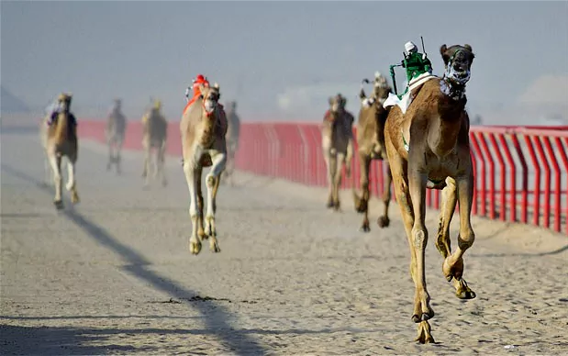
Victory Lap
Extra trip around the track by the exhausted victors – WE are the champions

Slide 4
Bonus Clicker Question 1

Slide 5
Thank you!
Huge thank you to TAs and consultants!
Mark Anastos, Henry Bender, Nicolas Buitrago, Nickolas Cavagnaro, Alexander Chang, Stephen Chin, Claire Yuqing Cui, Samantha Deng, Kerri Diamond, Nathaniel Diamond, Rhea Dutta, Mike Fang, Emily Grigg, Tjaden Hess, Elina Hvirtsman, Elaine Hwang, Imaan Seraphine Islam Rahim, Kartikay Jain, Elijah Koreman, Zhizhimontova Ksenia, Chris Lam, Sydney Lawrence, Brian Leffew, Olivia Li, Helen Liang, Quinn Liu, Bhargava Manja, Edgar Marroquin, Chris Mulvaney, Natalie Neamtu, Shan Parikh, Samwise Parkinson, Rudy Peterson, Allison Portis, Navin Ramsaroop, Omar Rasheed, Aniroodh Ravikumar, Max Ren, Laasya Renganathan, Ryan Richardson, Ahad Rizvi, Christopher Roman, Katerina Sadov, Jake Sanders, Cassandra Scarpa, William Smith, Alaia Solko-Breslin, Nathan Stack, Kevin Sun, Samuel Thomas, Noah Thompson, Dylan Tsai, Katherine Voor, Zheng Wang, Adam Wojciechowski, Guanqun Wu, Youya Xia, Amanda Xu, Anthony Yang, Danny Yang, Joseph Yang, Ray Zeng, Henry Zheng, Iris Zheng, Josh Zheng

Slide 6
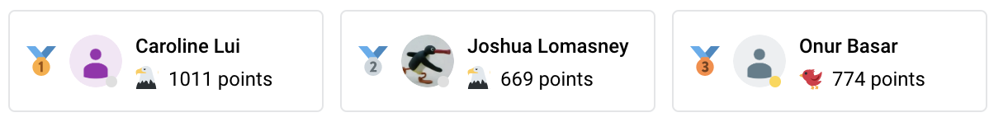
Thank you!
Thank you to Campuswire heroes!

Slide 7
Thank you!
And a huge thank you to all of you!
You surmounted a daunting challenge
You occasionally laughed at my dumb jokes ☺
I ❤️ this course. You make it all worthwhile.

Slide 8
What did we learn?
You feel exhausted...
You're tired of coding...
...step back and think about what happened

Slide 9
Programming is not hard

Slide 10
Programming well is very hard

Slide 11
The Goal of 3110
Become a better programmer though study of programming languages

Slide 12
Questions we pursued
How do you write code for and with other people?
Modular programming
Team-based final project
How do you know your code is correct?
Testing
Verification
How do you describe and implement a programming language?
Syntax and semantics
Interpreters

Slide 13

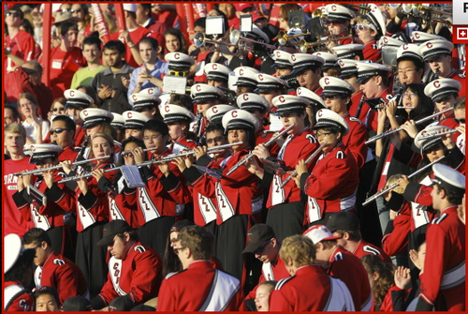
Tasks we pursued
Practice of programming: read and write lots of code

Slide 14

Tasks we pursued
Practice of programming: coding as a team

Slide 15
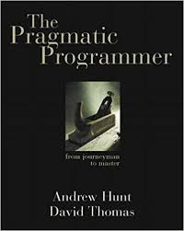
Tasks we pursued
Philosophy of programming

Slide 16

Tasks we pursued
Learning a functional language

Slide 17
[Lec 1] OCaml is awesome because of…
Immutable programming
Variable’s values cannot destructively be changed; makes reasoning about program easier!
Algebraic datatypes and pattern matching
Makes definition and manipulation of complex data structures easy to express
First-class functions
Functions can be passed around like ordinary values
Static type-checking
Reduce number of run-time errors
Automatic type inference
No burden to write down types of every single variable
Parametric polymorphism
Enables construction of abstractions that work across many data types
Garbage collection
Automated memory management eliminates many run-time errors
Modules
Advanced system for structuring large systems

Slide 18
Bonus Clicker Question 2

Slide 19
Big Ideas

Slide 20
1. Languages can be learned systematically
Every language feature can be defined in isolation from other features, with rules for:
syntax
static semantics (typing rules)
dynamic semantics (evaluation rules)
Divide-and-conquer!
Entire language can be defined mathematically and precisely
SML is. Read The Definition of Standard ML (Revised), by Tofte, Harper, and MacQueen, 1997.
Learning to think about software in this “PL” way has made you a better programmer even when you go back to old ways
And given you the mental tools and experience you need for a lifetime of confidently picking up new languages and ideas

Slide 21
2. Immutability is an advantage
No need to think about pointers or draw memory diagrams
Think at a higher level of abstraction
Programmer can alias or copy without worry
But mutability is appropriate when
you need to model inherently state-based phenomena
or implement some efficient data structures

Slide 22
3. Programming languages aren’t magic
Interpretation of a (smallish) language is something you can implement yourself
Domain specific languages (DSL): something you probably will implement for some project(s) in your career

Slide 23
4. Elegant abstractions are magic
From a small number of simple ideas...
...an explosion of code!
language features: product types, union types
higher order functions: map, fold, ...
data structures: lists, trees, dictionaries, monads
module systems: abstraction, functors

Slide 24
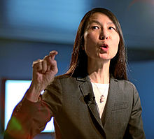
Computational Thinking
Computational thinking is using abstraction and decomposition when... designing a large, complex system.
Thinking like a computer scientist means more than being able to program a computer. It requires thinking at multiple levels of abstraction.
https://www.cs.cmu.edu/~15110-s13/Wing06-ct.pdf
https://www.microsoft.com/en-us/research/video/computational-thinking/
Jeanette Wing
Notes:
Prof. Wing is director of the Data Science Institute at Columbia. Previously was the head of Microsoft Research. Before that she ran the CS directorate at NSF, and was the head of the CMU CS department.

Slide 25
5. Building software is more than hacking
Design: think before you type
Empathy: write code to communicate
Assurance: testing and verification
Teamwork: accomplish more with others

Slide 26
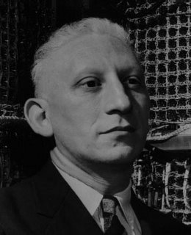
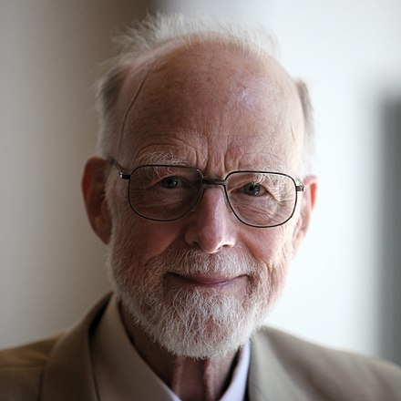
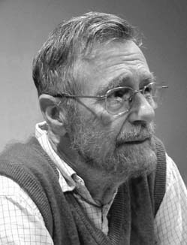
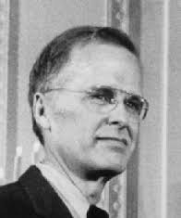
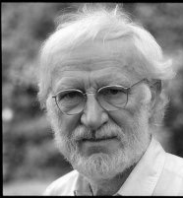
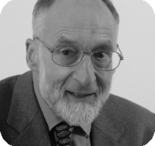
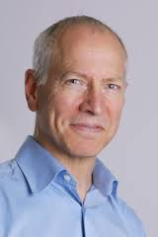
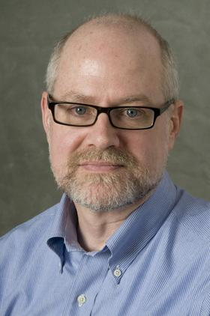
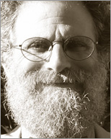
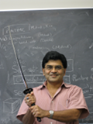
6. CS has an intellectual history and you can contribute
Notes:
Perlis, Hoare, Liskov, Dijkstra,
Backus, Naur, Milner, Tarjan,
Pingali, Reppy, Wadler, Wing

Slide 27
Big ideas
Languages can be learned systematically
Immutability is an advantage
Programming languages aren't magic
Elegant abstractions are magic
Building software is more than hacking
CS has an intellectual history and you can contribute

Slide 28
Bonus Clicker Question 3

Slide 29
Q&A

Slide 30
FAQs
Why OCaml?
When will I use FP again?
Notes:
Why OCaml? Because the ML family is worth knowing.

Slide 31
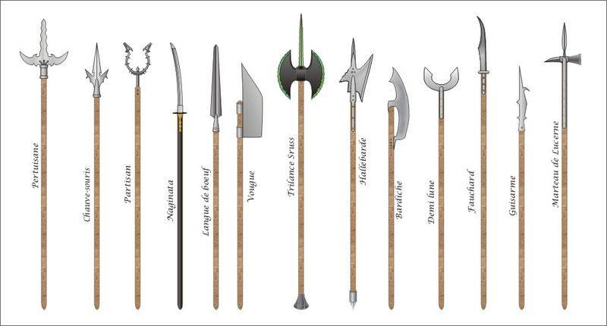
Languages are tools

Slide 32
Languages are tools
There's no universally perfect tool
There's no universally perfect language
OCaml was good for this course because:
good mix of functional & imperative features
relatively easy to reason about meaning of programs
From the Turing Award page for Robin Milner: ML was way ahead of its time. It is built on clean and well-articulated mathematical ideas, teased apart so that they can be studied independently and relatively easily remixed and reused. ML has influenced many practical languages, including Java, Scala, and Microsoft’s F#. Indeed, no serious language designer should ignore this example of good design.
But OCaml isn't perfect (see above)

Slide 33
FAQs
Why OCaml?
When will I use FP again?

Slide 34
FAQs
Why OCaml?
When will I use FP again? Why did I study FP?

Slide 35
Why study functional programming?
Functional languages teach you that programming transcends programming in a language (assuming you you have only programmed in imperative languages)
Functional languages predict the future
(Functional languages are sometimes used in industry)
Functional languages are elegant

Slide 36
Why study functional programming?
Functional languages teach you that programming transcends programming in a language (assuming you you have only programmed in imperative languages)
Functional languages predict the future
(Functional languages are sometimes used in industry)
Functional languages are elegant

Slide 37

Analogy: studying a foreign language
Learn about another culture; incorporate aspects into your own life
Shed preconceptions and prejudices about others
Understand your native language better

Slide 38
Alan J. Perlis
“A language that doesn't affect the
way you think about programming
is not worth knowing.”
First recipient of the Turing Award
for his “influence in the area of advanced programming techniques and compiler construction”
1922-1990

Slide 39
Why study functional programming?
Functional languages teach you that programming transcends programming in a language (assuming you you have only programmed in imperative languages)
Functional languages predict the future
(Functional languages are sometimes used in industry)
Functional languages are elegant

Slide 40
Functional languages predict the future
Garbage collection Java [1995], LISP [1958]
Generics Java 5 [2004], ML [1990]
Higher-order functions C#3.0 [2007], Java 8 [2014], LISP [1958]
Type inference C++11 [2011], Java 7 [2011] and 8, ML [1990]
What's next?

Slide 41
Why study functional programming?
Functional languages teach you that programming transcends programming in a language (assuming you you have only programmed in imperative languages)
Functional languages predict the future
(Functional languages are sometimes used in industry)
Functional languages are elegant

Slide 42



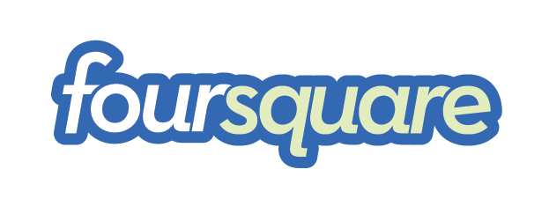









Functional languages in the real world
Java 8
F#, C# 3.0, LINQ
Scala
Haskell
Erlang
OCaml https://ocaml.org/learn/companies.html

Slide 43
Why study functional programming?
Functional languages teach you that programming transcends programming in a language (assuming you you have only programmed in imperative languages)
Functional languages predict the future
(Functional languages are sometimes used in industry)
Functional languages are elegant

Slide 44
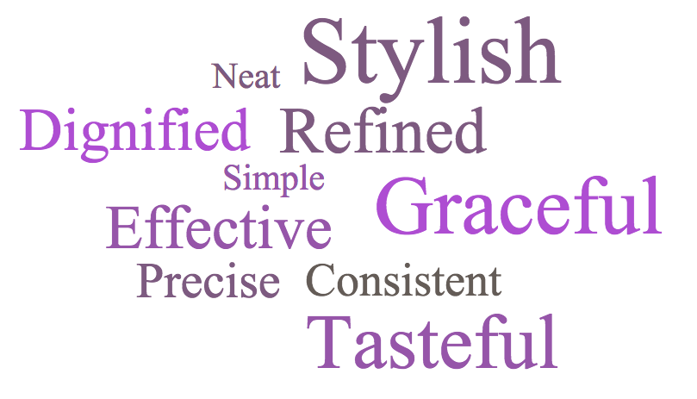
Elegant

Slide 45
Elegant
Beautiful

Slide 46
Final matters

Slide 47
Please: keep repos private
11 Academic Integrity cases this fall
3 students failed the course as a result
other lesser penalties
In nearly every case, plagiarism enabled because a student from a previous semester made their code public in a repo
Notes:
There were weeks I spent 10-20 hours on AI cases. The whole course suffers as a result.
Final project repos are the exception. Share those all you want.

Slide 48
What next?
Follow-on courses:
CS 4110 Programming Languages and Logics (how to define and reason about programming languages)
CS 4120 Compilers (how to implement programming languages)
CS 4160 Formal Verification (how to prove correctness)
CS 5150/5152 Software Engineering (build for real clients)
Learn another functional language?
Racket or Haskell
Join the course staff?
CS department collects applications
Apply in May 2020 to be on my staff for Fall 2020: I seek a diverse course staff of people who want to give back to the community and can speak from their successes as well as struggles

Slide 49
What next?
Stay in touch
Tell me when 3110 helps you out with future courses (or jobs!)
Ask me cool PL questions
Drop by to tell me about the rest of your time in CS (and beyond!)… I really do like to know
Crossing the finish line is just the beginning of the next race… DO AMAZING THINGS WITH YOUR LIFE

Slide 50
Upcoming events
[Fri?] Course evaluations
[Sat, 12/14, 9 am] Final exam
[Sat, 12/14, 11:59 pm] Peer evaluations
This is ...

Slide 51
This is victory.

Slide 52
THIS HAS BEEN 3110

