Slide 1
Proofs are Programs
Prof. Clarkson
Fall 2019
Today’s music: Proof by Paul Simon
Notes:
Music: 2 copies, start at 10:00:20
I chose this music because it's about proof. "Proof is the bottom line.”

Slide 2
Clicker Question 1

Slide 3
Review
Previously in 3110:
Proofs about programs
Today: Proofs are programs

Slide 4
Act I
Types = Propositions

Slide 5
Three innocent functions
let apply f x = f x
let const x = fun _ -> x
let subst x y z = x z (y z)
Notes:
subst x y z is like (x y){z} = x{z} y{z}

Slide 6
Three innocent functions
let apply f x = f x
: ('a -> 'b) -> 'a -> 'b
let const x = fun _ -> x
: 'a -> 'b -> 'a
let subst x y z = x z (y z)
: ('a -> 'b -> 'c)
-> ('a -> 'b) -> 'a -> 'c

Slide 7
Three innocent functions
let apply f x = f x
: ('a -> 'b) -> 'a -> 'b
let const x = fun _ -> x
: 'a -> 'b -> 'a
let subst x y z = x z (y z)
: ('a -> 'b -> 'c)
-> ('a -> 'b) -> 'a -> 'c

Slide 8
Three innocent functions propositions
let apply f x = f x
: ('a ⇒ 'b) ⇒ 'a ⇒ 'b
let const x = fun _ -> x
: 'a ⇒ 'b ⇒ 'a
let subst x y z = x z (y z)
: ('a ⇒ 'b ⇒ 'c)
⇒ ('a ⇒ 'b) ⇒ 'a ⇒ 'c

Slide 9
Three innocent functions propositions
let apply f x = f x
: ( A ⇒ B) ⇒ A ⇒ B
let const x = fun _ -> x
: A ⇒ B ⇒ A
let subst x y z = x z (y z)
: ( A ⇒ B ⇒ C)
⇒ ( A ⇒ B) ⇒ A ⇒ C

Slide 10
Three innocent functions propositions
let apply f x = f x
: ( A ⇒ B) ⇒ A ⇒ B
let const x = fun _ -> x
: A ⇒ (B ⇒ A)
let subst x y z = x z (y z)
: ( A ⇒ (B ⇒ C))
⇒(( A ⇒ B) ⇒ (A ⇒ C))
Do you recognize these propositions?

Slide 11
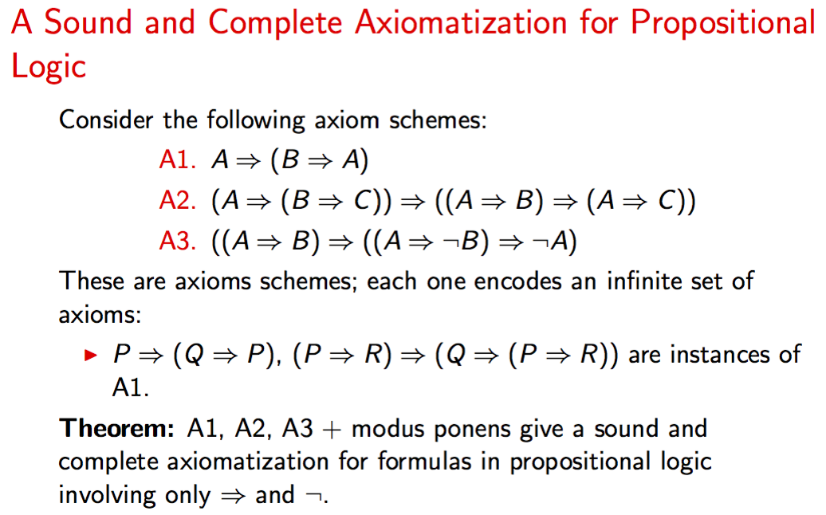
source: http://www.cs.cornell.edu/courses/cs2800/2016fa/lectures/2800logic.pdf

Slide 12
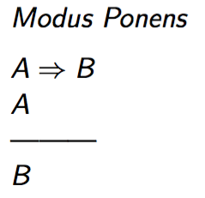
source: http://www.cs.cornell.edu/courses/cs2800/2016fa/lectures/2800logic.pdf

Slide 13
Three innocent functions/propositions
MP as axiom
let apply f x = f x
: ( A ⇒ B) ⇒ A ⇒ B
let const x = fun _ -> x
: A ⇒ (B ⇒ A)
let subst x y z = x z (y z)
: ( A ⇒ (B ⇒ C))
⇒(( A ⇒ B) ⇒ (A ⇒ C))
A1
A2

Slide 14
Types and propositions
Logical propositions can be read as program types, and vice versa
Type | Proposition
Type variable 'a | Atomic proposition A
Function type -> | Implication ⇒

Slide 15
Conjunction and truth
let fst (a,b) = a
: 'a * 'b -> 'a
let snd (a,b) = b
: 'a * 'b -> 'b
let pair a b = (a,b)
: 'a -> 'b -> 'a * 'b
let tt = ()
: unit

Slide 16
Conjunction and truth
let fst (a,b) = a
: (A ∧ B) ⇒ A
let snd (a,b) = b
: (A ∧ B) ⇒ B
let pair a b = (a,b)
: A ⇒ (B ⇒ (A ∧ B))
let tt = ()
: true

Slide 17
Types and propositions
Logical propositions can be read as program types, and vice versa
Type | Proposition
Type variable 'a | Atomic proposition A
Function type -> | Implication ⇒
Product type * | Conjunction ∧
unit | True
Disjunction, false, and negation also possible; see notes

Slide 18
Program types
and
logical propositions
are fundamentally the same idea

Slide 19
Act II
Programs = Proofs

Slide 20
Innocent typing rule
Recall [lec19]
Static environment is a map from identifiers to types
Typing relation env ⊢ e : t says that e has type t in environment env
Typing rule for function application:
if env ⊢ e1 : t -> u
and env ⊢ e2 : t
then env ⊢ e1 e2 : u

Slide 21
Innocent typing rule
if env ⊢ e1 : t -> u
and env ⊢ e2 : t
then env ⊢ e1 e2 : u

Slide 22
Innocent typing rule
if env ⊢ e1 : t -> u
and env ⊢ e2 : t
then env ⊢ e1 e2 : u

Slide 23
Innocent typing rule
if env ⊢ e1 : t -> u
and env ⊢ e2 : t
then env ⊢ e1 e2 : u

Slide 24
Innocent typing rule
if env ⊢ e1 : t ⇒ u
and env ⊢ e2 : t
then env ⊢ e1 e2 : u
Do you recognize this rule?

Slide 25
intermission

Slide 26
Logical proof systems
Ways of formalizing what is provable
Which may differ from what is true or decidable
Two styles:
Hilbert:
lots of axioms
few inference rules (maybe just modus ponens)
Gentzen:
lots of inference rules (a couple for each operator)
few axioms

Slide 27
Inference rules
P₁
P₂
...P_{n}
Q
From premises P₁, P₂, ..., P_{n}
Infer conclusion Q
Express allowed means of inference or deductive reasoning
Axiom is an inference rule with zero premises

Slide 28
Judgments
A₁, A₂, ..., A_{n} ⊢ B
From assumptions A₁, A₂, ..., A_{n}
traditional to write Γ for set of assumptions
Judge that B is derivable or provable
Express allowed means of hypothetical reasoning
Γ,A ⊢ A is an axiom

Slide 29
Inference rules for ⇒ and ∧
Γ, A ⊢ B
Γ ⊢ A ⇒ B
Γ ⊢ A
⇒ intro
⇒ elim
Γ ⊢ A ⇒ B
Γ ⊢ B
Γ ⊢ A ∧ B
∧ elim 1
Γ ⊢ A
Γ ⊢ B
Γ ⊢ A
∧ intro
Γ ⊢ A ∧ B
Γ ⊢ A ∧ B
∧ elim 2
Γ ⊢ B

Slide 30
Introduction and elimination
Introduction rules say how to define an operator
Elimination rules say how to use an operator
Gentzen's insight: every operator should come with intro and elim rules

Slide 31
Back to the Show

Slide 32
Innocent typing rule
if env ⊢ e1 : t -> u
and env ⊢ e2 : t
then env ⊢ e1 e2 : u
env ⊢ e1 : t -> u
env ⊢ e2 : t
env ⊢ e1 e2 : u

Slide 33
Innocent typing rule
if env ⊢ e1 : t -> u
and env ⊢ e2 : t
then env ⊢ e1 e2 : u
env ⊢ e1 : t -> u
env ⊢ e2 : t
env ⊢ e1 e2 : u

Slide 34
Innocent typing rule
if env ⊢ e1 : t -> u
and env ⊢ e2 : t
then env ⊢ e1 e2 : u
env ⊢ e1 : t ⇒ u
env ⊢ e2 : t
⇒ elim
env ⊢ e1 e2 : u
Modus ponens is function application

Slide 35
Computing with evidence
Modus ponens (aka ⇒ elim) is a way of computing with evidence
Given evidence e2 that t holds
And given a way e1 of transforming evidence for t into evidence for u
MP produces evidence for u by applying e1 to e2
So e1 e2 is a program... and a proof!
env ⊢ e1 : t -> u
env ⊢ e2 : t
env ⊢ e1 e2 : u

Slide 36
Typing rules for pairs
env ⊢ e : t1*t2
env ⊢ fst e : t1
env ⊢ e : t1*t2
env ⊢ snd e : t2

Slide 37
Proof rules for ∧
env ⊢ e : t1∧t2
∧ elim 1
env ⊢ fst e : t1
env ⊢ e : t1∧t2
∧ elim 2
env ⊢ snd e : t2
computing with evidence:
given evidence e for both ti, project out the evidence for one of them

Slide 38
Programs and proofs
A well-typed program demonstrates that there is at least one value for that type
i.e. the that type is inhabited
a program is a proof that the type is inhabited
A proof demonstrates that there is at least one way of deriving a formula
i.e. that the formula is provable by manipulating assumptions and doing inference
a proof is a program that manipulates evidence
Proofs are programs, and programs are proofs

Slide 39
Programs
and
Proofs
are fundamentally the same idea

Slide 40
Act III
Evaluation = Simplification

Slide 41
Many proofs/programs
A given proposition/type could have many proofs/programs.
Proposition/type:
A ⇒ (B ⇒ (A ∧ B))
'a -> ('b -> ('a * 'b))
Proofs/programs:
fun x -> fun y -> (fun z -> (snd z, fst z)) (y,x)
fun x -> fun y -> (snd (y,x), fst (y,x))
fun x -> fun y -> (x,y)

Slide 42
Many proofs/programs
Body of each proof/program:
(fun z -> (snd z, fst z)) (y,x)
(snd (y,x), fst (y,x))
(x,y)
Each is the result of small-stepping the previous
...and in each case, the proof/program gets simpler
Taking an evaluation step corresponds to simplifying the proof

Slide 43
Program evaluation
and
proof simplification
are fundamentally the same idea

Slide 44
Conclusion

Slide 45
These are all the same ideas
Programming | Logic
Types | Propositions
Programs | Proofs
Evaluation | Simplification
Computation is reasoning
Functional programming is fundamental

Slide 46
Upcoming events
MS2 deliverables due tonight, no late submissions
MS3 due in last week of classes
This is fundamental.
THIS IS 3110

