Slide 1
Efficiency
Prof. Clarkson
Fall 2019
Today’s music: Patience by Tame Impala
Notes:
Music: two copies, start at 10:00:16.
I chose this music because we aren’t patient: we want efficient, fast programs.

Slide 2
Clicker Question 1

Slide 3
Review
Previously in 3110:
Functional programming
Modular programming and software engineering
New unit of course: Efficiency
Today:
What it means to be efficient
Big-Oh notation

Slide 4
What is Efficiency?
Credit: Kleinberg and Tardos, Algorithm Design, chapter 2, 2006.

Slide 5
What is efficiency?
Attempt #1: An algorithm is efficient if, when implemented, it runs in a small amount of time on particular input instances
Exercise: write down three problems with that definition.
Notes:
Incomplete list of problems:
Inefficient algorithms can run quickly on small test cases
Fast processors and optimizing compilers can make inefficient algorithms run quickly
Efficient algorithms can run slowly when coded sloppily
Some input instances are harder than others
Efficiency on small inputs doesn't imply efficiency on large inputs
Some clients can afford to be more patient than others; quick for me might be slow for you

Slide 6
Lessons learned from attempt #1
Lesson 1: Time as measured by a clock is not the right metric
Idea: Use number of “steps” taken during evaluation
What counts as a step?
Notes:
Want a metric that is reasonably independent of hardware, compiler, other software running, etc.

Slide 7
Steps
Any kind of primitive unit of computation inside a function
Should be machine independent
Examples:
Pseudocode: one line
Imperative language: assignment, array index, pointer dereference, arithmetic operation, etc.
OCaml: apply an arithmetic operator or constructor, substitute a let-binding, choose a branch of if/match, etc.
Notes:
Steps are independent of implementation details
Could each step take a different amount of time? Sure, but in practice, it doesn’t really matter

Slide 8
Lessons learned from attempt #1
Lesson 2: Running time on particular input instances is not the right metric
Idea: Use “size” of the input instance
How to measure size?
Notes:
Want a metric that can predict running time on any input instance
But: particular inputs of the same size might really take a different amount of time?
multiplying arbitrary matrices vs. multiplying by all zeros
in practice, size matters more

Slide 9
Size
Some representation of how big input is compared to other inputs
Examples:
Number of elements in list or array
Number of bits in number
Number of nodes and edges in a graph
Etc.

Slide 10
Lessons learned from attempt #1
Lesson 3: "Small" is too relative
Okay idea: beats brute-force search
Notes:
Want a metric that is reasonably objective; independent of subjective notions of what is fast
brute force: enumerate all the answers one by one, check and see whether the answer is right
e.g., enumerate every possible permutation of a list, then check to see whether it’s a sorted version of input list, until you find one that is; you don’t really have to implement a sort that way!
Brute force is the simple, dumb solution to nearly any algorithmic problem. But requires enumeration of a huge space.
related idea: guess an answer, check whether correct; e.g., bogosort
but by how much is enough to beat brute-force search?

Slide 11
Lessons learned from attempt #1
Lesson 3: "Small" is too relative
Better idea: Polynomial time
Number of steps is a polynomial function of the input size:
f(x) = a_{n}x^{n} + a_{n-1}x^{n-1} + … + a₂x² + a₁x + a₀

Slide 12
Objections to polynomial time
Some polynomials might be too big? e.g. N¹⁰⁰
Some non-polynomials might be fine? e.g. N^{1+.02(log N)}
But in practice, it just works
Notes:
Problems for which there are high-degree polynomial solutions eventually turn out to have low-degree solutions, in practice.
Problems for which there are only non-polynomial (but small) solutions turn out to be hard to solve anyway, in practice.

Slide 13
What is efficiency?
Attempt #2: An algorithm is efficient if its maximum number of steps of execution is polynomial in the size of its input.
let's give that a try...
Notes:
Why “maximum”? Because now that we’re talking about input size instead of actual inputs, we have to talk about a range of number of steps.
Could consider minimum or average, too. But right now we want to know how patient we have to be, so let’s restrict to maximum.

Slide 14
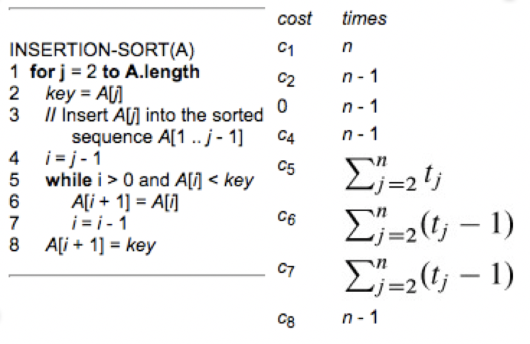

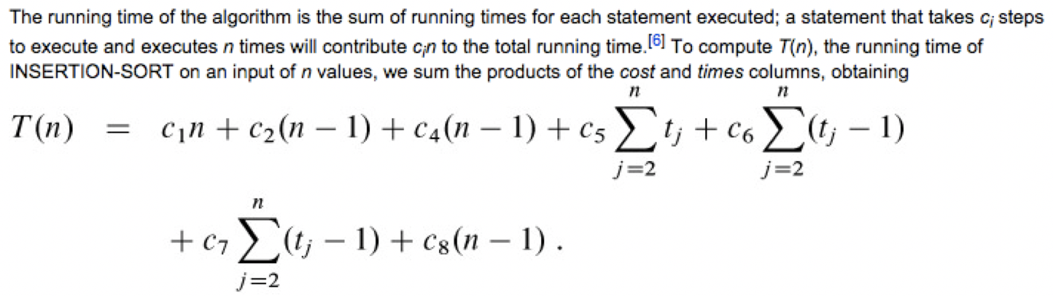
Analysis of running time
[Cormen et al. Introduction to Algorithms, 3rd ed, 2009]

Slide 15
Precision of running time
Precise bounds are exhausting to find
Precise bounds are to some extent meaningless
Caveat: if you're building code that flies an airplane or controls a nuclear reactor, you do care about precise, real-time guarantees
Notes:
Are those constants c1..c8 really useful?
If it takes 25 steps in Java, but compiled down to RISC-V would take 10x more steps, is the precision useful?

Slide 16
Simplifying running times
Goal: identify broad classes of algorithms with similar performance
Don’t say: 1.62N² + 3.5N + 8
Do say: N²
Ignore the low-order terms
Ignore the constant factor of high-order term

Slide 17
Why ignore low-order terms?
max # steps as function of N
 | N | N² | N³ | 2^{N}
N=10 | < 1 sec | < 1 sec | < 1 sec | < 1 sec
N=100 | < 1 sec | < 1 sec | 1 sec | 10¹⁷ years
N=1,000 | < 1 sec | 1 sec | 18 min | very long
N=10,000 | < 1 sec | 2 min | 12 days | very long
N=100,000 | < 1 sec | 3 hours | 32 years | very long
N=1,000,000 | 1 sec | 12 days | 10⁴ years | very long
size of input
assuming 1 microsecond/step
very long = more years than the estimated number of atoms in universe
Think Big

Slide 18
Why ignore constant factor?
For classifying algorithms, constants are irrelevant in practice
1.62N² steps in pseudocode might be 1620 steps in assembly
My current laptop might be 2x as fast as last year’s
…but those aren’t interesting properties of the algorithm
Caveat: Performance tuning real-world code actually can be about getting the constants to be small!

Slide 19
Imprecise abstraction
Exact: 1.62N² + 3.5N + 8
Imprecise abstraction: N²

Slide 20
Other abstractions
OCaml's int type abstracts (subset of) Z
±1 is an abstraction of {1,-1}
Big Oh…
Notes:
don't know which int when reasoning about the type of an expression
don't know whether positive or negative when manipulating it in a formula
But before we do Big Oh, let’s do something simpler: Big Ell

Slide 21
Big Ell
Credit: Graham, Knuth, and Patashnik, Concrete Mathematics, chapter 9, 1989.

Slide 22
Big Ell
L(n) = {m | 0 ≤ m ≤ n}, where m,n ∊ ℕ
L(n) represents a natural number less than or equal to n
e.g., L(5) = {0, 1, 2, 3, 4, 5}

Slide 23
Big Ell
Exercise: what is 1 + L(5)?
Try to express answer in the form L(x), for some x.
Hint: there are some ambiguities in this question.
Notes:
Trick question!
Replace L(5) with set: 1 + {0..5}
But + is defined on ints, not sets of ints
We could distribute the + over the set: {1+0, ..., 1+5} = {1..6}
That is, a set of values, one for each possible instantiation of L(5)
Note that {1..6} ⊆ {0..6} = L(6)
So we could say that 1 + L(5) ⊆ L(6)
We could even say 1 + L(5) ⊆ L(7), which is accurate but not tight
So might say that 1 + L(5) = L(6), but I deplore that notation

Slide 24
Clicker Question 2

Slide 25
A little trickier...
What is 2^{L(3)}?
...we can use this idea of Big Ell to invent an imprecise abstraction for running times
Notes:
L(3) = {0..3}
So 2^{L(3)} could be any of {2⁰, ... , 2³} = {1, 2, 4, 8}
And {1,2,4,8} ⊆ L(8) = L(2³)
Therefore 2^{L(3)} ⊆ L(2³)

Slide 26
Big Oh

Slide 27
Big Oh, version 1
L(n) represents any natural number that is less than or equal to a natural number n
A natural function is a function of type ℕ →ℕ
O(g) represents any natural function that is less than or equal to a natural function g, for every input n
Big Oh is a higher-order version of Big Ell: generalize from naturals to functions on naturals
Notes:
Why the naturals? We're assuming function inputs and outputs are non-negative:
These are functions on input size and running time
Those won't be negative

Slide 28
Big Oh, version 1
Definition: O(g) = { f | ∀n . f(n) ≤ g(n)}
e.g.
O(fun n → 2n) = {f | ∀n . f(n) ≤ 2n}
(fun n → n) ∈ O(fun n → 2n)
Note: these are mathematical functions written in OCaml notation, not OCaml functions

Slide 29
Big Oh, version 2
Recall: we want to ignore constant factors
(fun n → n), (fun n → 2n), (fun n → 3n)
...all should be in O(fun n → n)
Revised intuition: O(g) represents any natural function that is less than or equal to natural function g times some positive constant c, for every input n

Slide 30
Big Oh, version 2
Definition: O(g) = { f | ∃c>0 . ∀n . f(n) ≤ c g(n)}
e.g.
O(fun n → n³) = { f | ∃c>0 . ∀n . f(n) ≤ cn³}
(fun n → 3n³) ∈ O(fun n → n³) because 3n³ ≤ cn³, where c = 3 (or c=4, ...)

Slide 31
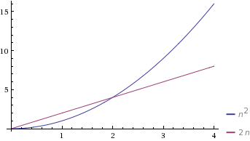
Big Oh, version 3
Recall: Think Big
fun n → n²
fun n → 2n
could just build a lookup table for inputs in the range 0..2

Slide 32
Big Oh, version 3
Revised intuition: O(g) represents any function that is less than or equal to function g times some positive constant c, for every input n greater than or equal to some positive constant n₀

Slide 33
Big Oh, version 3
Definition:
O(g) = { f | ∃c>0, n₀>0 .∀n ≥ n₀ . f(n) ≤ c g(n)}
this is the important, final definition you should know!
e.g.:
O(fun n → n²) = { f | ∃c>0, n₀>0 .∀n ≥ n0 . f(n) ≤ cn²}
(fun n → 2n) ∈ O(fun n → n²) because 2n ≤ cn², where c = 2, for all n ≥ 1

Slide 34
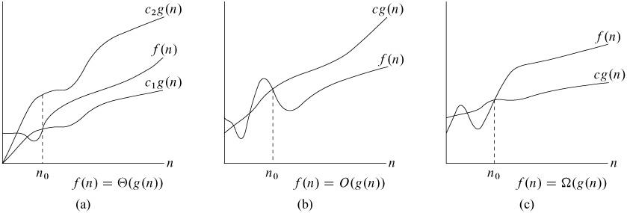
Asymptotic bound
Big Oh is an asymptotic upper bound
If f ∈ O(g) then f is at least as efficient as g, and might be more efficient
Graph: [Cormen et al. Introduction to Algorithms, 3rd ed, 2009]

Slide 35
Big Oh Notation: Warning 1
Instead of
O(g) = {f | ...
most authors write
O(g(n)) = {f(n) | ...
They don't really mean g applied to n; they mean a function g parameterized on input n but not yet applied
Maybe they never studied functional programming 😆🐪

Slide 36
Big Oh Notation: Warning 2
Instead of
(fun n → 2n) ∈ O(fun n → n²)
Nearly all authors write
2n = O(n²)
The standard defense is that = should be read here as "is" not as "equals"
Be careful: one-directional "equality"!
Notes:
I have always found this abusage distressing...

Slide 37
Efficiency

Slide 38
What is efficiency?
Final answer:
An algorithm is efficient if its worst-case running time on input size N is O(N^{d}) for some constant d.

Slide 39
Upcoming events
[last night] A3 due
[later today] A4 CMS assignment (and handout) released
[Friday 5pm] deadline to schedule A3 demos with your section’s grading team
[Friday 11:59pm] deadline to form A4 partners in A4 CMS assignment
This is efficient.
THIS IS 3110

