Slide 1
Testing
Prof. Clarkson
Fall 2019
Today’s music: Wrecking Ball by Miley Cyrus
Notes:
PROP: bring rubber duck
Music: two copies, start at 10:02:38
Test suites are like a wrecking ball, tearing down your illusions about the correctness of your code.

Slide 2
Clicker Question 1

Slide 3
Review
Previously in 3110:
Modules
Specification (functions, modules)
Today:
Validation
Testing
Black box
Glass box

Slide 4
Validation
Validation: does program behave as intended?
Testing: a process for validation
Debugging: determining cause of unintended behavior
Defensive programming: implementation techniques for making validation and debugging easier

Slide 5
Approaches to validation
Social
Code reviews
Extreme/Pair programming
Methodological
Test-driven development
Version control
Bug tracking
Technological
Static analysis (“lint” tools, FindBugs, …)
Fuzzers
Mathematical
Type systems
Formal verification
Less formal: Techniques may
miss problems in programs
All of these methods should be used!
Even the most formal can still have holes:
did you prove the right thing?
do your assumptions match reality?
More formal: eliminate with certainty as many problems as possible.
Slide credit: Benjamin C. Pierce (UPenn)
Notes:
“Social”: rubber duck debugging
Slide credit: Benjamin C. Pierce (UPenn)

Slide 6
Testing vs. Verification
Testing:
Cost effective
Guarantee that program is correct on tested inputs and in tested environments
Verification:
Expensive
Guarantee that program is correct on all inputs and in all environments

Slide 7
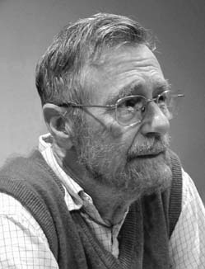
Edsger W. Dijkstra
Turing Award Winner (1972)
For eloquent insistence and practical demonstration that programs should be composed correctly, not just debugged into correctness
"Program testing can at best show the presence of errors but never their absence."
(1930-2002)

Slide 8
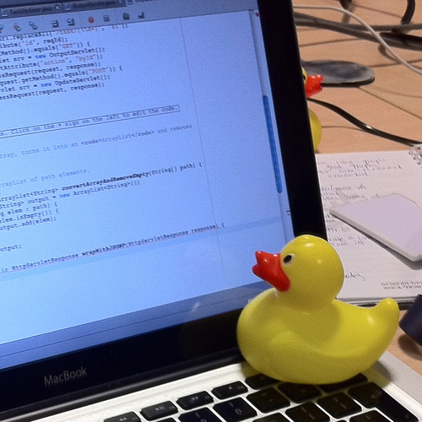
Debugging advice
(more in recitation)
Notes:
Rubber duck debugging: explaining your thinking to another human, or lacking that, a rubber duck, is surprisingly effective

Slide 9
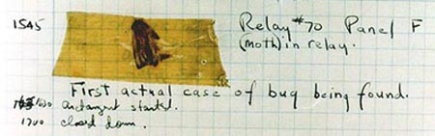
Bugs
"bug": suggests something just wandered in
[IEEE 729]
Fault: result of human error in software system
E.g., implementation doesn't match design, or design doesn't match requirements
Might never appear to end user
Failure: violation of requirement
Something goes wrong for end user
Human error
Fault
Failure
Notes:
First bug found by Grace Hopper

Slide 10
Testing
Goal is to expose existence of faults, so that they can be fixed
Unit testing: isolated components
Integration testing: combined components
System testing: functionality, performance, acceptance, installation

Slide 11
Regression testing
Regression: a previously fixed fault is reintroduced into the code
Regression testing: running tests against new version of software to ensure no regressions
If you ever find and fix a fault…
Put a test case into your suite for it
Run suite frequently to detect regressions

Slide 12
Clicker Question 2

Slide 13
Testing
When do you stop testing?
Bad answer: when time is up
Bad answer: what all tests pass

Slide 14
Testing
When do you stop testing?
Good answer: when testing methodology is complete
Future answer: statistical estimation says Pr[undetected faults] is low enough (active research)

Slide 15
Testing

Slide 16
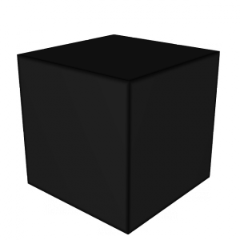
Black box testing
Input
Output
tester knows nothing about internals of functionality being tested

Slide 17
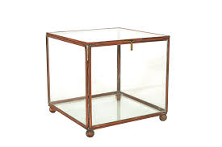
Glass box testing
Input
Output
tester knows internals of functionality being tested

Slide 18
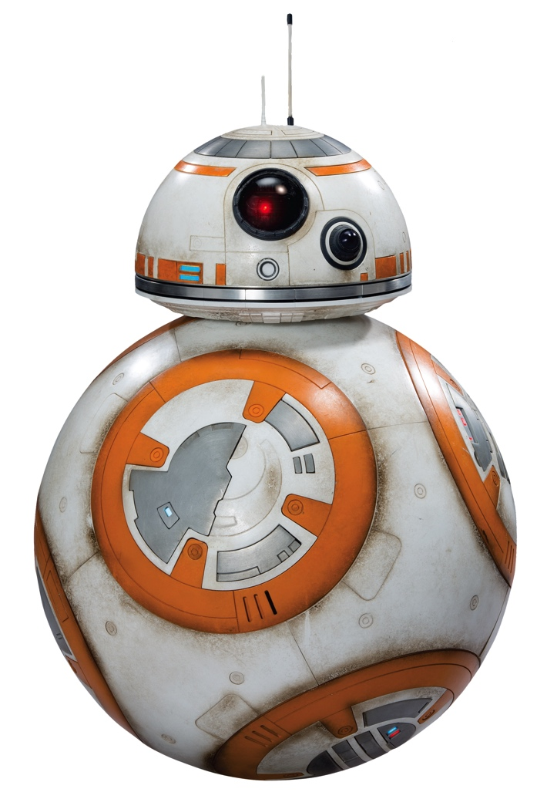
Black box testing
Input
Output
tester knows nothing about internals of functionality being tested

Slide 19
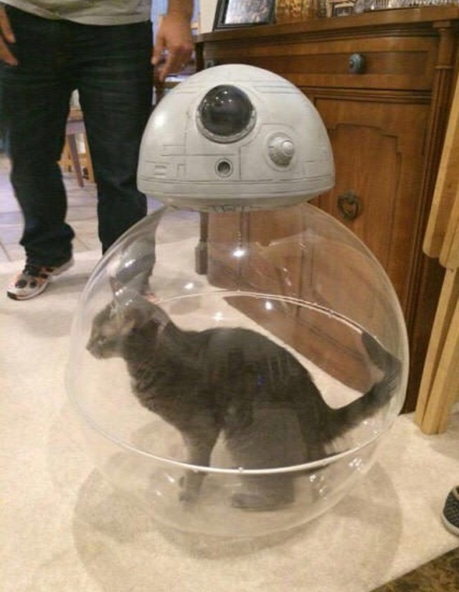
Glass box testing
Input
Output
tester knows internals of functionality being tested

Slide 20
Black box Testing

Slide 21
Black box testing
Tests are based on the specification
Advantages:
Tester is not biased by assumptions made in implementation
Tests are robust w.r.t. changes in implementation
Tests can be read and evaluated by reviewers who are not implementers
Main kinds of black box tests:
Example inputs provided by spec
Typical inputs
Boundary cases
Paths through spec

Slide 22
Typical inputs
Common, simple values of a type
int: small integers like 1 or 10
char: alphabetic letters, digits
string: whose length is a small integer and whose characters are typical
'a list: a small integer number of elements, each of which is a typical value of type 'a
records/tuples: each field/component with a typical value
variants: typical constructors, if there is such a thing

Slide 23
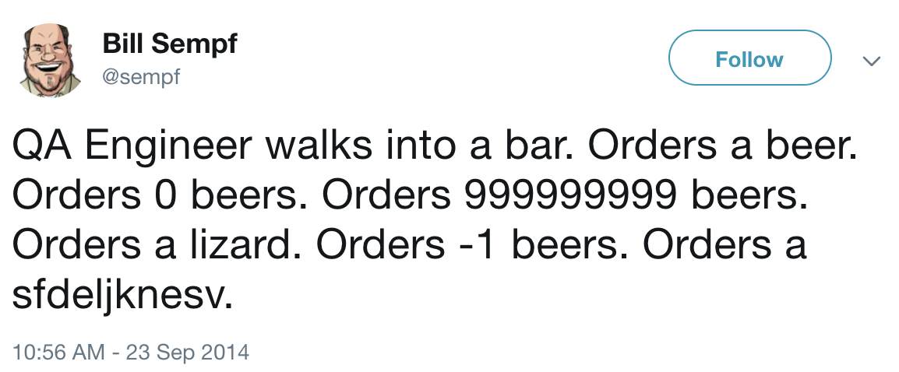
Boundary cases

Slide 24
Boundary cases
aka corner cases or edge cases
Atypical or extremal values of a type, and values nearby
int: 0, 1, -1, min_int, max_int
char: '\000', '\255', '\032'(space), '\127'(delete)
string: empty string, string with a single character, unreasonably long string
'a list: empty list, list with a single element, list with enough elements to trigger stack overflow on non-tail-recursive functions
records/tuples: combinations of atypical values
variants: all constructors

Slide 25
Paths through spec
Representative inputs for classes of outputs
(* [is_prime n] is true iff [n] is prime *)
val is_prime: int -> bool
two classes of output:
true: representative input: n=13
false: representative input: n=42
other examples:
compare functions have three classes of output
functions that return variants have several classes of output

Slide 26
Paths through spec
Representative inputs for each way of satisfying the precondition
(* [sqrt x n] is the square root of [x]
* computed to an accuracy of [n]
* significant digits
* requires: x >= 0 and n >= 1 *)
val sqrt : float -> int -> float
(i) x=0.0, n=1, (ii) x=1.0, n=1, (iii) x=0.0, n=2, (iv) x=1.0, n=2

Slide 27
Paths through spec
Representative inputs for each way of raising and not raising exception
(* [pos x lst] is the 0-based position of
* the first element of [lst] that equals [x].
* raises: Not_found if [x] is not in [lst]. *)
val pos: 'a -> 'a list -> int
(i) x=1, lst=[1], (ii) x=0, lst[1]

Slide 28
Glass box Testing

Slide 29
Glass box testing
aka white box testing
Advantages:
can determine whether a new test case really yields additional information about correctness of implementation
can address likely errors that are not apparent from specification
Supplements black-box testing; does not replace examination of specification

Slide 30
Glass box testing
Goal is to cover entire program with test cases: ensure entire program exercised by tests
Branches (if, match, Boolean ops, exceptions, loops, etc.) make it challenging
Exact definition of coverage is flexible; could attempt to:
Evaluate every expression
Evaluate every Boolean/pattern match to each possible value
Cause every possible execution path through program to occur
Classically those are called statement, condition, and path coverage

Slide 31
Coverage
let max3 x y z =
if x>y then
if x>z then x else z
else
if y>z then y else z
Testing according to black-box specification might lead to all kinds of inputs
But there are really only four paths through implementation!
Representatives: (i) 3 2 1, (ii) 3, 2, 4, (iii) 1, 2, 1, (iv) 1, 2, 3

Slide 32
Achieving good coverage
Include test cases for:
each branch of each (nested) if expression
each branch of each (nested) pattern match
Particularly watch out for:
base cases of recursive function
recursive calls in recursive function
every place where an exception might be raised

Slide 33
Bisect
OCaml tool for glass-box testing (statement and condition coverage)
Tutorial in textbook
You will use it on A4

Slide 34
Randomized (“Fuzz”) Testing

Slide 35
Randomized testing
"It was a dark and stormy night..."
Generate random inputs and feed them to programs:
Crash? hang? terminate normally?
Of ~90 utilities in '89, crashed about 25-33% in various Unixes
Crash => buffer overflow potential
Since then, "fuzzing" has become a standard practice for security testing
Results have been repeated for X-windows system, Windows NT, Mac OS X
Results keep getting worse in GUIs but better on command line
Notes:
Literally was a dark and stormy night: noise on telephone line was inserting random character into shell session, causing Unix utilities to crash

Slide 36
Upcoming events
[last night] R4 due
[tomorrow] A3 due, followed by demos
This is saving your code from being rekt.
THIS IS 3110

