Slide 2
System Objectives
Allow HR clerk to see an overview of the current employee status
Allow HR clerk to manage the employee data (including any other relevant information)
Search / add / modify / delete employee details
Search / add / modify / delete leave statuses
Etc, etc..

Slide 4
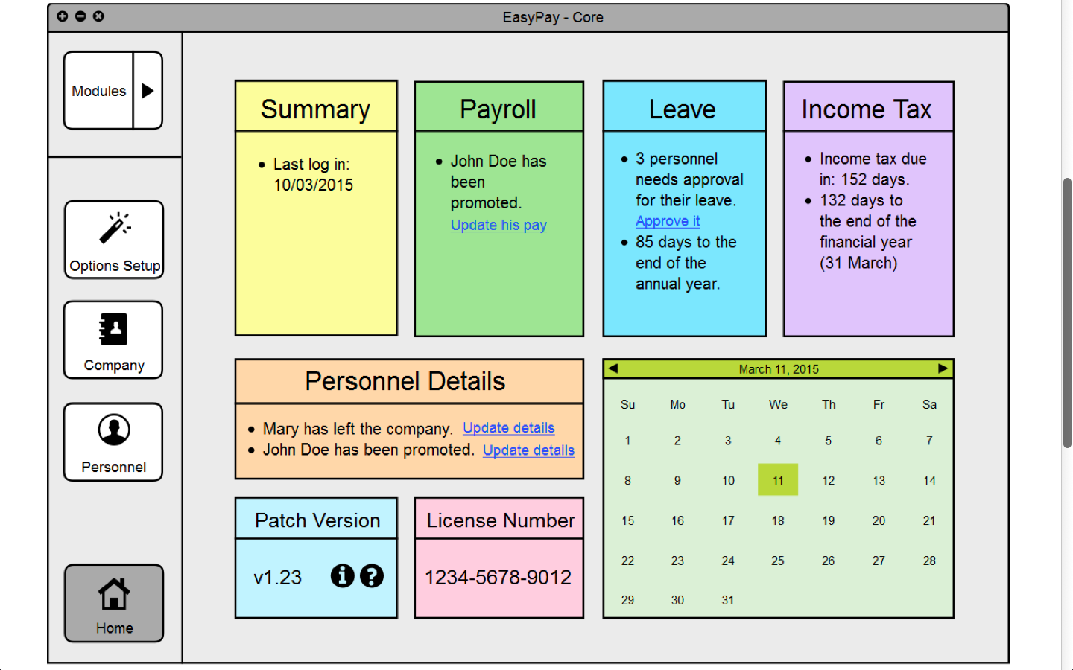
Analysis of Design
Notes:
Strengths:
- simplistic interface elements and organization
- overall consistency with design (the left column with buttons, and the right main window widget)
- straightforward way of navigating.
- use of colours and icons to distinguish elements
Weakness:
- redundancy of certain elements (summary, patch version, license number)
- messy module button that covers the main screen when clicked upon.
- ambiguity of home button

Slide 5
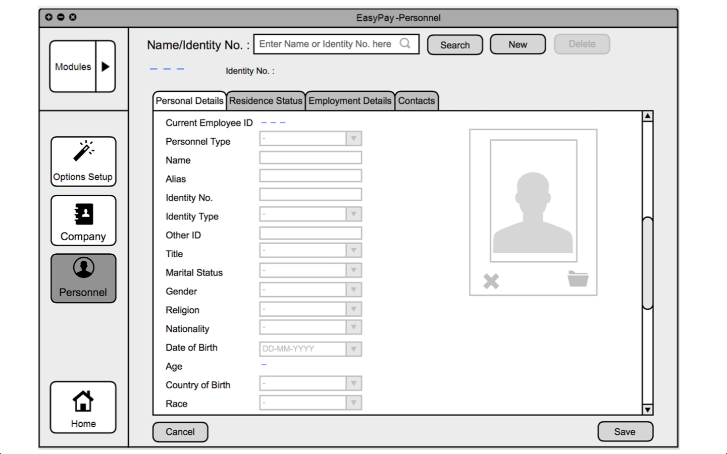
Analysis of Design

Slide 6
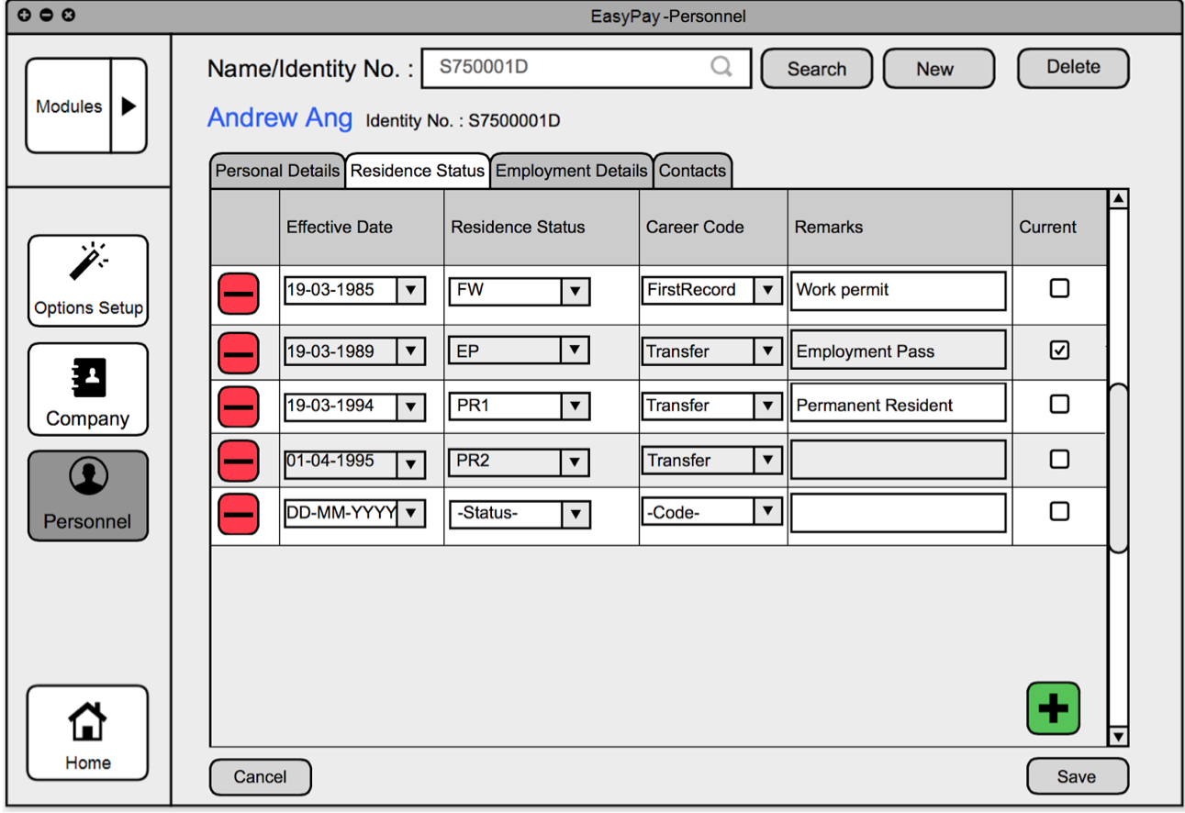
Analysis of Design

Slide 7
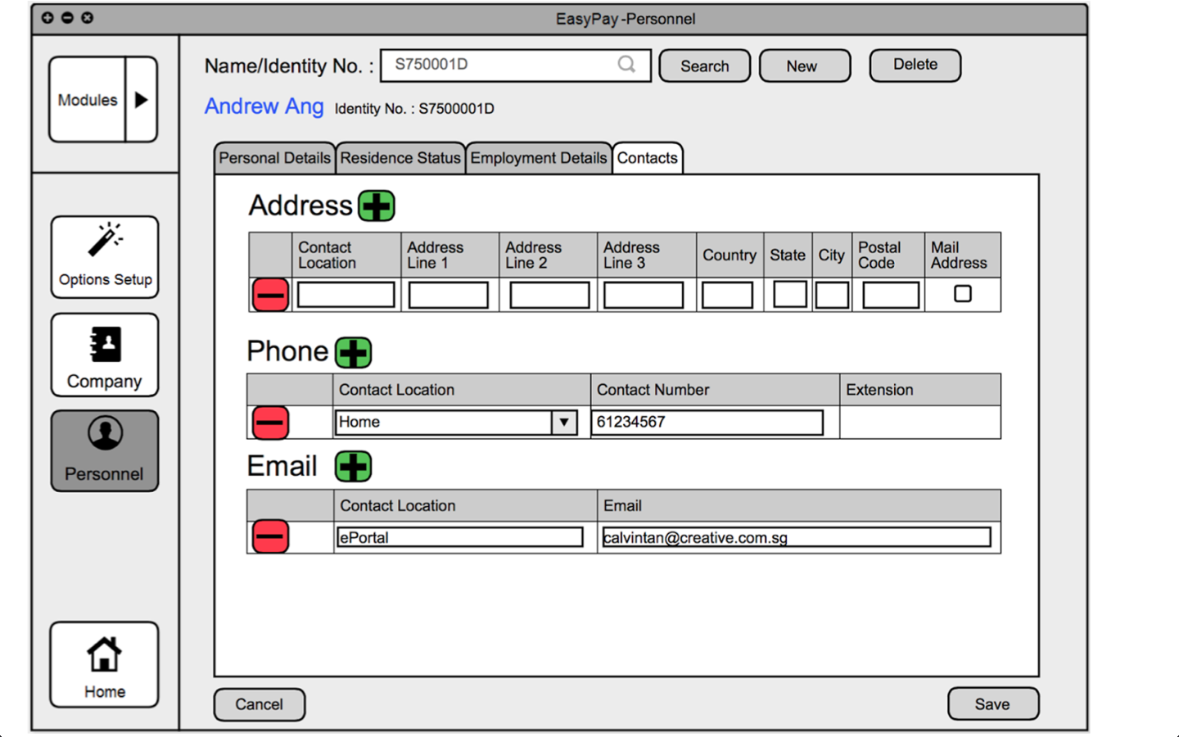
Analysis of Design

Slide 8
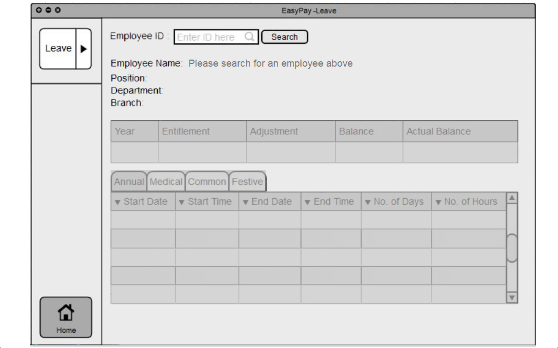
Analysis of Design

Slide 10
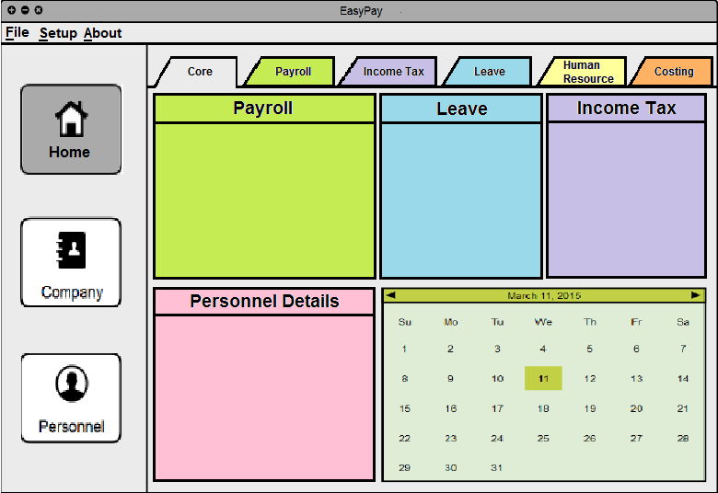
Alternative design
Notes:
Improvements:
- Consolidated the Core module under “Home”
- Used tabs instead of slide out for Modules
.. Does not block the main widget / cross over the column – neater.
.. Requires only one click instead of two
- Moved the setup options to the file menu
.. Options is rarely used; does not need to always be in the window taking up space.
- Removed redundant info on the dashboard

Slide 11
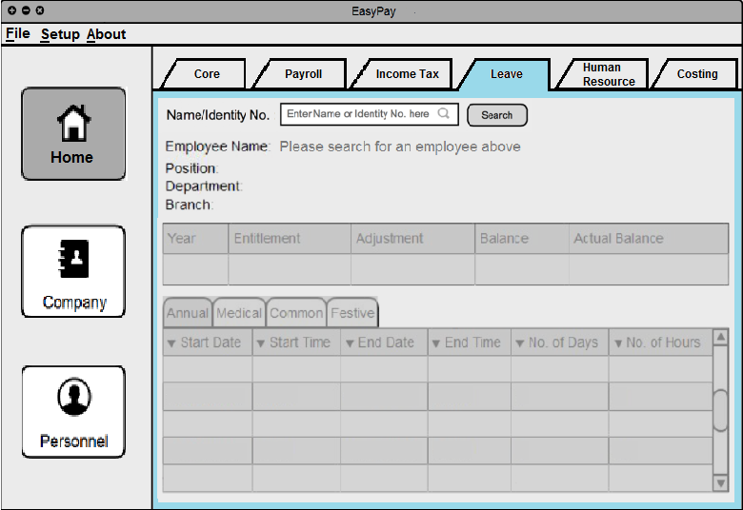
Alternative design

Slide 12
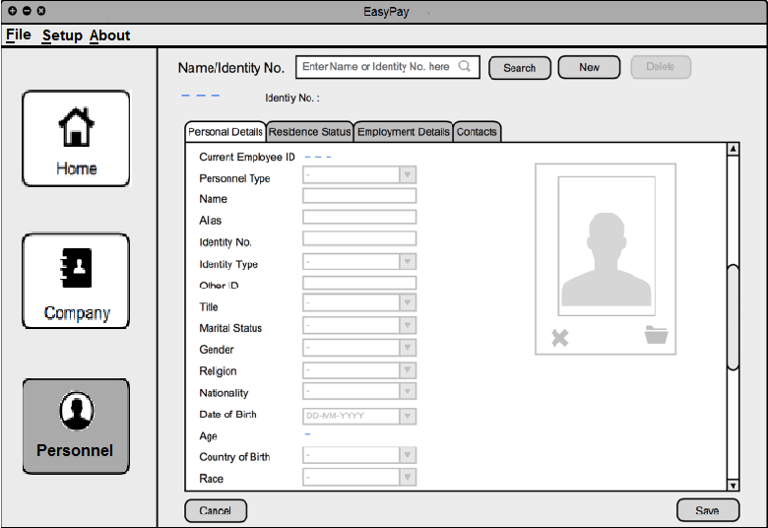
Alternative design

Slide 14
Points to note
Dashboard
.. Info in dashboard not found in individual modules
.. Details should already been updated; "update details" for personnel details
.. Missing approval button in Leave module
Personnel
.. Current functions only allow searching for individual employees;
.. Allow searching for employees by categories?
.. Same for the leave module.
Leave
.. Modifying options given but unable to add or delete
.. Modifying options – editing start and end times should decide the #days and #hours.
Arrows for sorting (not sure which is currently selected).
Edit button in options setup given
.. Different from Leave and Personnel modules where editing is done directly.
Organization
.. Inconsistent positioning of buttons (+/-, save/cancel)

