Slide 2
System Objectives
Allow HR clerk to see an overview of the current employee status
Allow HR clerk to manage the employee data (including any other relevant information)
Search / add / modify / delete employee details
Search / add / modify / delete leave statuses
Etc, etc..

Slide 3
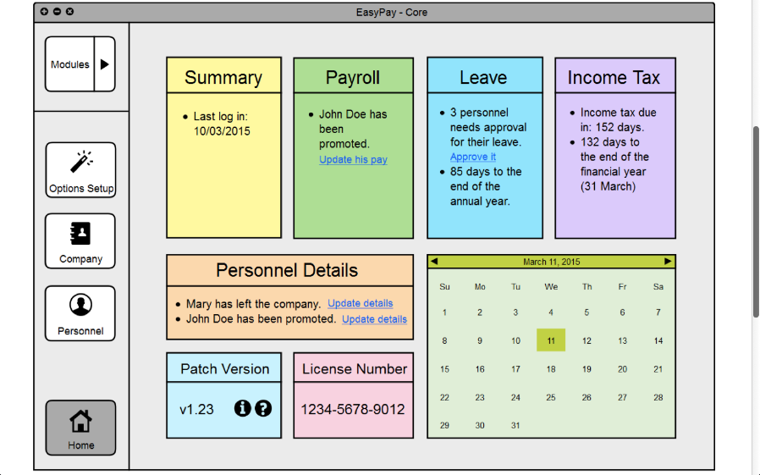
Analysis of Design
Notes:
Strengths:
- simplistic interface elements and organization
- overall consistency with design (the left column with buttons, and the right main window widget)
- straightforward way of navigating.
- use of colours and icons to distinguish elements
Weakness:
- redundancy of certain elements (summary, patch version, license number)
- messy module button that covers the main screen when clicked upon.
- ambiguity of home button

Slide 4
Strengths
Colors and icons to distinguish elements
Consistent navigation element (left bar)
Straightforward navigation and organization
Left bar button remains depressed to indicate page

Slide 5
Weaknesses
Redundant elements (License, version number)
Module button covers many elements on home screen
Seldom-used options menu easily accessible

Slide 6
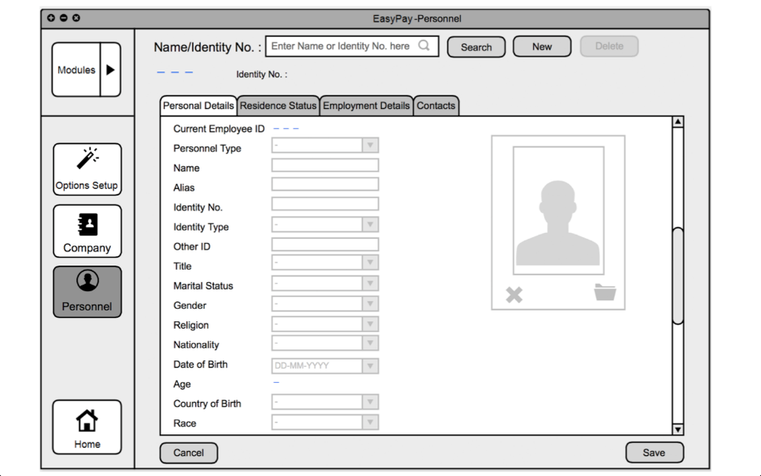
Analysis of Design

Slide 7
Strengths
Most straightforward method for viewing/entering data
Cancel/Save layout consistent, minimizes user error
Tabs categorized well

Slide 8
Weaknesses
Can only search for name/identity no (Architecture limitation?)
Delete unclear in edge cases (If viewing another user, and having just entered a new user without clicking search, will I delete the currently-viewed user or the new user?)

Slide 9
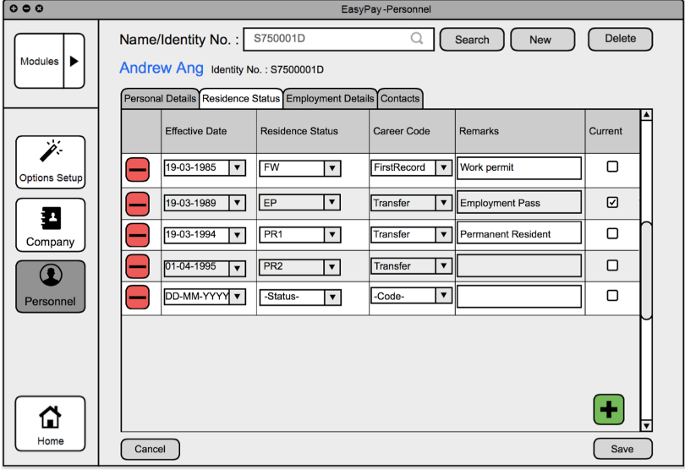
Analysis of Design

Slide 10
Strengths
Easy to add/remove records

Slide 11
Weaknesses
Add button within scrollbox (vanishes if scrolled up?)

Slide 12
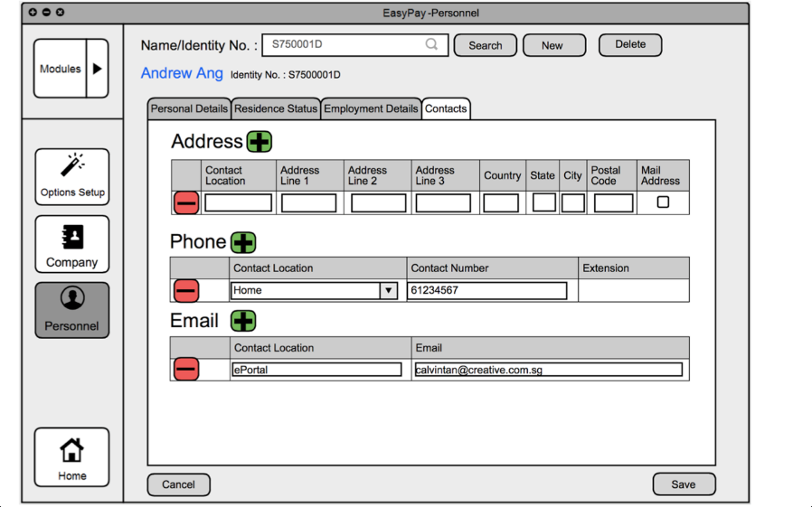
Analysis of Design

Slide 13
Strengths
Easy to add/remove records

Slide 14
Weaknesses
Button usage/placement inconsistent

Slide 15
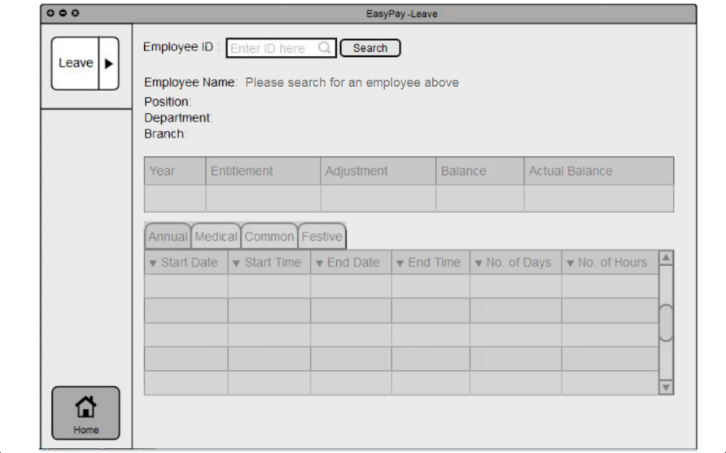
Analysis of Design

Slide 16
Strengths
Table/tabs optimal for displaying data

Slide 17
Weaknesses
Can only search by ID (Opposed to Employee Name/Identity No.)
Unable to add/delete leave (Architecture limitation?)

Slide 18
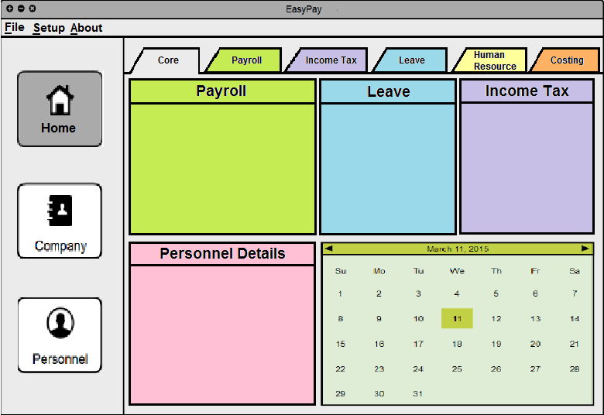
Alternative design
Notes:
Improvements:
- Consolidated the Core module under “Home”
- Used tabs instead of slide out for Modules
.. Does not block the main widget / cross over the column – neater.
.. Requires only one click instead of two
- Moved the setup options to the file menu
.. Options is rarely used; does not need to always be in the window taking up space.
Removed redundant info on the dashboard
Each section has its own colours, so that each section can be easily associated by colour, as well as to make the GUI less dull

Slide 19
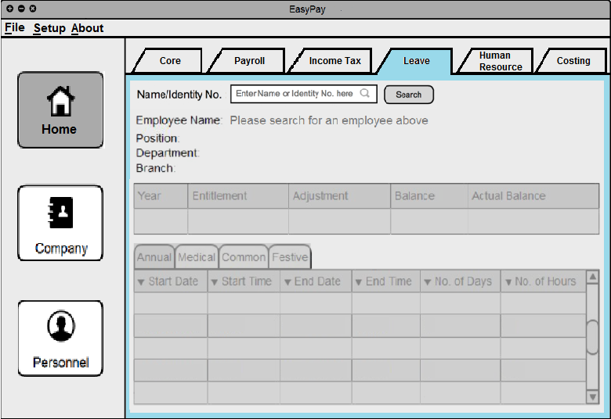
Alternative design
Notes:
Added a border of colour to be associated with each tab.

Slide 20
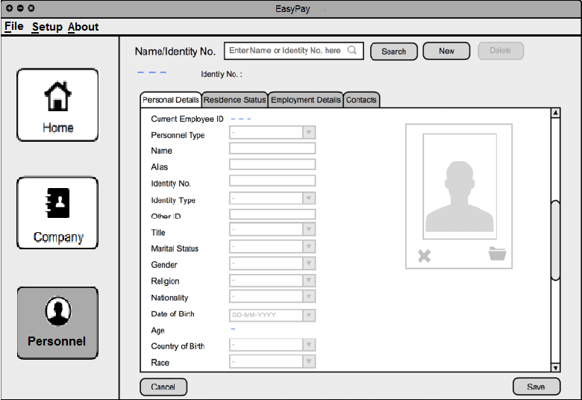
Alternative design
Notes:
Search by name too, instead of just identity no.

Slide 22
Points to note
Dashboard
.. Info in dashboard not found in individual modules
.. Details should already been updated; "update details" for personnel details
.. Missing approval button in Leave module
Personnel
.. Current functions only allow searching for individual employees;
.. Allow searching for employees by categories?
.. Same for the leave module.
Leave
.. Modifying options given but unable to add or delete
.. Modifying options – editing start and end times should decide the #days and #hours.
Arrows for sorting (not sure which is currently selected).
Edit button in options setup given
.. Different from Leave and Personnel modules where editing is done directly.
Organization
.. Inconsistent positioning of buttons (+/-, save/cancel)

