Slide 1
Compilation and System Calls
Sandeep Neema
Will Hedgecock
Bryan Ward

Slide 2
Overview
C Language Overview
Compilation Basics: From Source to Executable
Concepts and Definitions
Introduction to System Calls
Programming Assignment #1

Slide 3
C Language Overview
Notes:
What are the fundamental functions of an operating system? What features are required? Is the “start menu” or desktop environment part of the operating system? Why or why not?

Slide 4
C vs C++: A Comparison
 | C | C++
Paradigm | Procedural | Object-Oriented
Keywords | 32 | 63
Inheritance | Not Supported | Fully Supported
Overloading | Not Supported | Functional Polymorphism
Allocation | malloc/free | new/delete
Encapsulation | struct | class + struct
Access Control | None | Access Modifiers

Slide 5
C vs C++: Compatibility
C++ is fully backward compatible with C
C++ can directly call C code
C code can call C++ code that has been declared with extern “C”
Shared structure, grammar, and syntax
C++ is a superset of C
Commonly referred to as “C with class”
C is historically used in OS kernels and device drivers

Slide 6
C Language Overview
struct
Groups variables into a single object
Stored as a contiguous block of memory
Identical to a C++ class with a public access modifier
May contain variables of any data type
Multiple ways of instantiating objects
Must include the “struct” keyword when declaring variables of corresponding type
struct example {
int var1, var2;
char var3;
};
struct example ex1 = {
1, 2, ‘c’ };
struct example ex2 = {
.var1 = 1,
.var2 = 2,
.var3 = ‘c’
};

Slide 7
C Language Overview
Pointer
Stores the memory address of a variable
Also known as a reference to a variable
Declare pointer using “*” symbol
Obtain variable address using “&”
Dereference pointer using “->” or “*”
Ex:
ex2->var1 == 1;
What does ex2->var2 contain?
struct test {
int var1, *var2;
char var3;
};
struct test ex1 = {
1, 2, ‘c’ };
struct test *ex2 = &ex1;

Slide 8
C Language Overview
Function Pointer
Exact same as a variable pointer
Contains the address of a function
Can be stored in a variable and passed to other functions
See example on right for syntax
All pointers are typically stored in a memory block of the same size as the underlying hardware architecture
E.g., A 64-bit OS uses 64-bit pointers
int func(int a, char b)
{
return a + b;
};
// Function pointer decl
int (*fp)(int, char);
// Function assignment
fp = &func;

Slide 9
C Language Overview
Header Files
Have the extension “.h”
Used to declare (not define) types, variables, and definitions
Compilation Unit
Originates from a single source file with the extension “.c”
Includes contents of all “#include”ed header files
All Compilation Units linked together during final stage of compilation
extern keyword
Declares variables that are defined in a different Compilation Unit

Slide 10
Compilation: From Source Code to Runnable Program

Slide 11
From Source to Running Program in C
We begin with a source file saved as text (e.g., prog.c)
This is a sequence of bits organized into 8-bit chunks called bytes
Each byte represents a character
ASCII/UTF-8: Unique byte-sized integer value for each character
Source file stored as sequence of bytes
Files consisting exclusively of ASCII or UTF-8 characters are text files; binary files otherwise
All files are just bits
Distinguishing difference is the context in which we view them

Slide 12
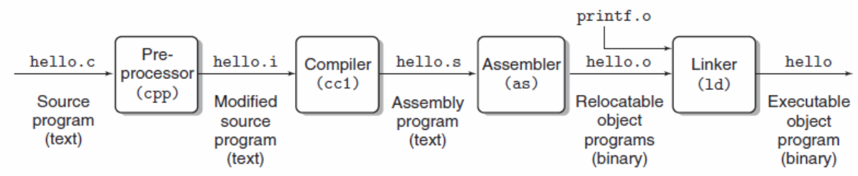
From Source to Running Program
Before it can run, source code must be translated into a sequence of machine-language instructions
Packaged into a form called an “executable object program” and stored as a binary file on disk
Translation is done by a compiler
Individual steps of compilation can be seen with:
gcc -E hello.c -o hello.i // produces a modified source program
gcc -S hello.i // produces an assembly language program
gcc -c hello.s // produces a binary object file
gcc hello.o // produces a linked executable

Slide 13
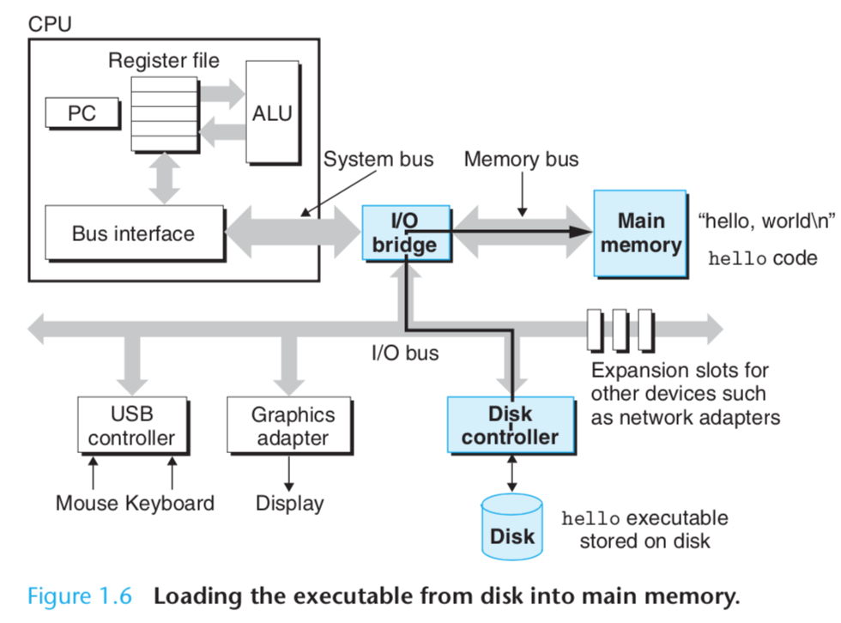
From Source to Running Program
Running “hello world”
The shell then loads the executable “hello” file by executing instructions that copy the code and data in the “hello” object file into main memory. DMA allows the data to go from disk to main memory directly.
Once the code and data are in memory, the OS switches to the “hello” process and begins executing its instructions

Slide 14
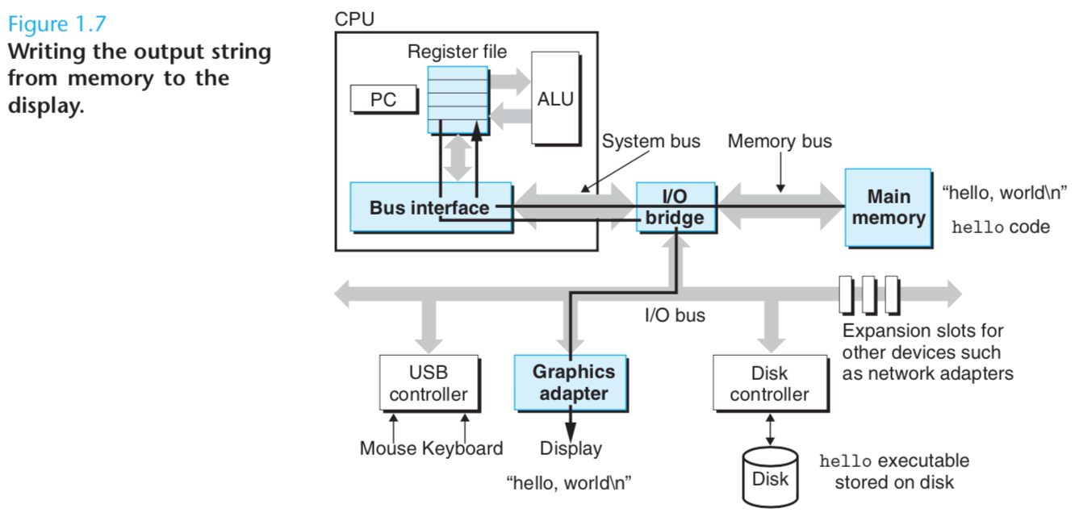
From Source to Running Program
Running “hello world”
These instructions copy the data bytes “hello, world\n” from main memory to a register
From there they go to the display device where they are displayed on the screen

Slide 15
What is an Operating System?
Notes:
What are the fundamental functions of an operating system? What features are required? Is the “start menu” or desktop environment part of the operating system? Why or why not?

Slide 16
Operating System: Definition
Many definitions
A program that shares a computer among multiple programs and provides a more useful set of services than the hardware alone
A program that makes the hardware do “something useful”
Accomplishes this by “virtualizing” the hardware
The OS makes it appear as though every process has the hardware all to itself
Provides services through a system call interface
The core part of the OS is called the OS kernel, or just kernel
Key point: the operating system is itself a program!
But unlike other programs, it should have full access to all resources! How can we accomplish this?
Notes:
OS consists of kernel and accompanying packages such as shell and editors
Library functions provide an interface that is more friendly compared to system calls

Slide 17
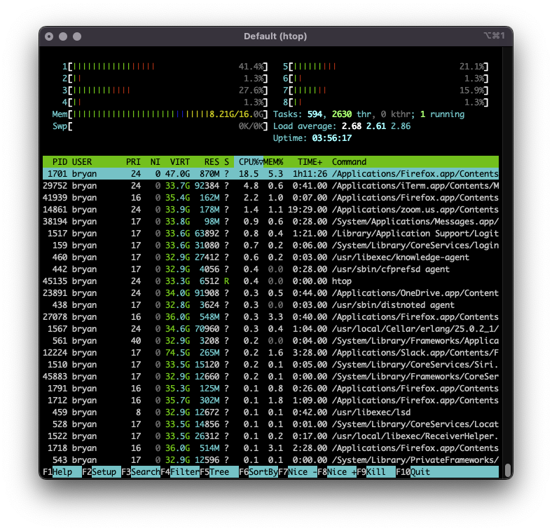
Processes
A process is a running instance of a program
It’s the primary unit of isolation/abstraction provided by the OS
The process is the abstraction that gives the illusion to a program that it has the machine to itself
Each process thinks it has the whole CPU
Each process thinks it has all memory to itself
Serves several purposes:
Prevents a process X from corrupting or spying on a process Y
Prevents a process from corrupting the operating system itself
“ps” “top” or “htop” show all active processes

Slide 18
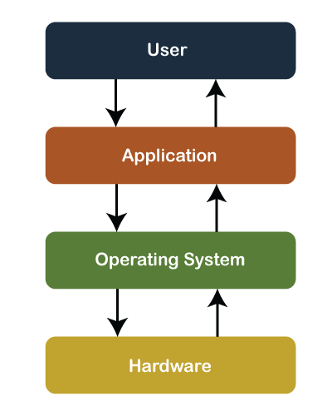
System Calls
The system-call API is the interface that makes OS services available to user-level programs
What are examples of these services?
Create a process
Request memory
Read/write from/to a file
Send data over the network
A process requests theses service from the OS by making a system call
Why does the OS provide these services?
User-level processes cannot be trusted to be non-malicious
Example: one malicious process could erase your entire hard drive!
System-call
Boundary

Slide 19
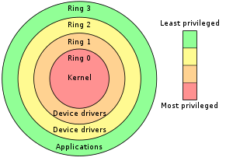
Rings: Kernel Mode vs. User Mode
The kernel needs full access to all hardware and CPU instructions
User-level processes (like Chrome or Firefox) should not be allowed full access to all hardware nor should they be able to execute all CPU instructions
How should we enforce this? With hardware support!
A flag in a CPU register determines whether privileged instructions are allowed
On x86 it’s called the CPL (current privilege level)
CPL = 0 (0b00) means kernel mode: privileged
CPL = 3 (0b11) means user mode: no privilege
The CPL enforces isolation in several ways:
Guards access to the privilege register
Checks every memory read/write
Checks every I/O port access
Controls register access (like the EFLAGS register)
In summary:
The privilege level determines whether instructions can access privileged hardware
Only the kernel should be allowed to operate in a privileged mode
Notes:
Hardware instructions are executed by kernel
Mention 3 access levels in xv6

Slide 20
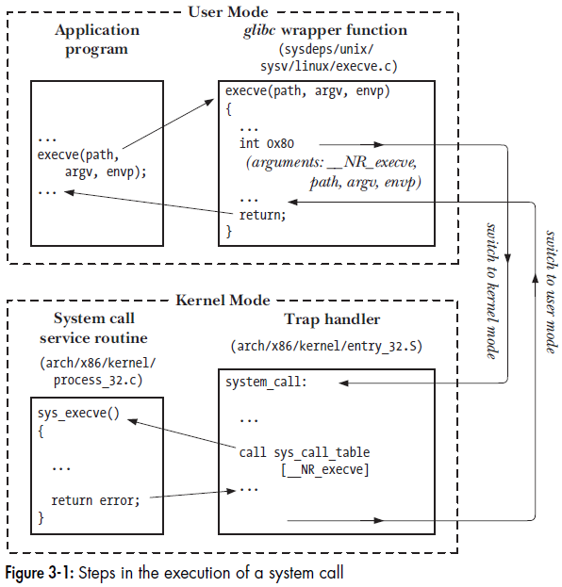
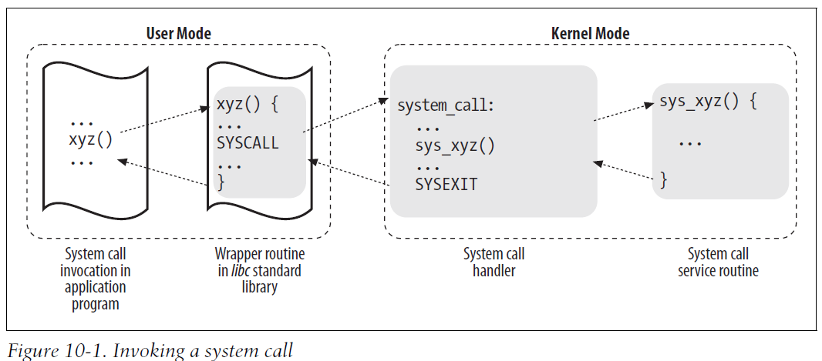
Invoking a System Call
How and when should the privilege level change?
When a system call is invoked:
Instruction used to invoke the system call sets CPL=0
Execution jumps to a specific entry point in the kernel, which can then do further validation
The system call return sets CPL=3 before returning to user code

Slide 21
Details of System-Call Implementation
The program invokes a wrapper function in the C library. The reason for this is that the wrapper function sets up the system-call arguments as expected by the OS
The wrapper function puts any arguments to the system call on the stack
All system calls enter the kernel the same way, so the kernel must be able to identify them. In x86, the wrapper function in the C library copies the system call number into the %eax register of the CPU
The wrapper function executes a trap machine instruction. This is int 0x80. This causes the processor to switch from user mode to kernel mode (that is, it sets CPL=0) and executes the code pointed to by location 0x80 of the system's trap vector
The kernel invokes its system_call routine to handle the trap to location 0x80. This is where the meat of the system-call logic happens: the kernel does some bookkeeping, checks the validity of the arguments, invokes the service routine, and finally the service routine returns a result status to the system_call routine
The wrapper function checks if the service returned an error, and if so, sets a global variable named errno with this error value. The wrapper function returns to the caller and provides an integer return value to indicate success or failure
Notes:
trap vector contains the address of routines that handle exceptions.

Slide 22
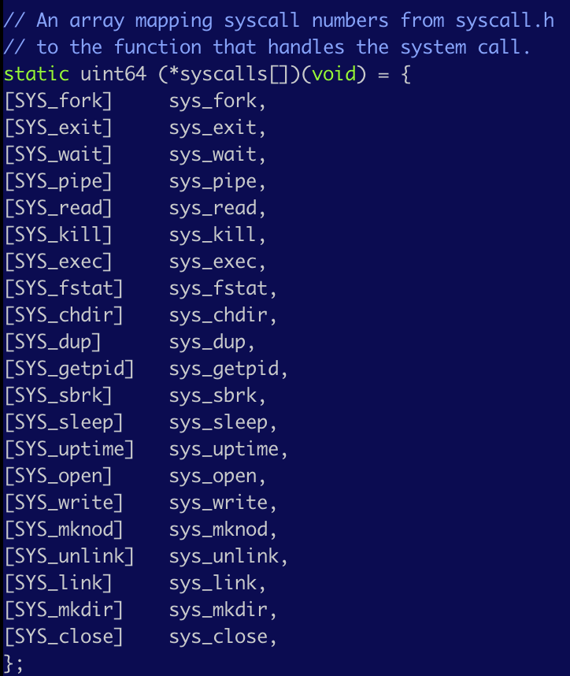
System Call Numbers
The syscall interface relies on an integer
To associate each system call number with its corresponding service routine, the kernel uses a system-call dispatch table
The n-th entry contains the service-routine address of the system call having number n.
xv6 syscall table
Notes:
The sys_call_table is indexed by system call numbers.

Slide 23
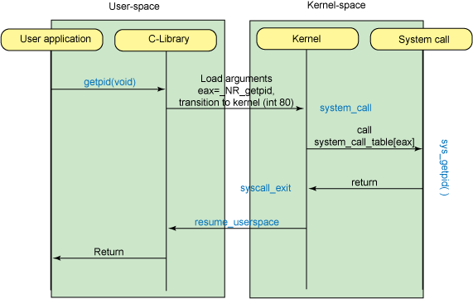
Another system-call control flow example

Slide 24
Another system call control flow example
This is an interrupt
The instruction used to invoke the system call sets CPL=0.
Execution jumps to a specific entry point
in the kernel of the OS, which can then do further validation.
The system call return sets CPL=3 before returning to user code.

Slide 25
Let’s see this in xv6!

Slide 26
Assignment #1 Overview

Slide 27
Tracing system calls
The strace command lets you see the system calls that are made by a process
Example: type “strace ls” at a terminal to see all the system calls that the ls (which lists files in the current directory) makes. You might see calls like:
execve -- this loads a new program and starts running it
open -- open a file
read -- read from a file
close -- close a file
fstat -- get information about a file

Slide 28
Tracing systems calls
strace ls
Execv call loads in a new program into a process
- We will learn more about it in the next lecture
vagrant@cs281spring2017devbox:~$ strace ls
execve("/bin/ls", ["ls"], [/* 58 vars */]) = 0
brk(NULL) = 0x1164000
access("/etc/ld.so.nohwcap", F_OK) = -1 ENOENT (No such file or directory)
…..
open("/etc/ld.so.cache", O_RDONLY|O_CLOEXEC) = 3
fstat(3, {st_mode=S_IFREG|0644, st_size=70675, ...}) = 0
mmap(NULL, 70675, PROT_READ, MAP_PRIVATE, 3, 0) = 0x7f21e9c83000
close(3)
….
exit_group(0) = ?
+++ exited with 0 +++ = 0
The exit_group call terminates a process

