Slide 1
Operating Systems
CS3281 / CS5281
Fall 2023

Slide 2
Team
Instructors
Dr. Will Hedgecock
Dr. Sandeep Neema
Dr. Bryan Ward
Graders
Binh Mai Trevor Jones Wesley Minton
Eileen Tsu Ilayda Koca Anda Liang
Anda Liang

Slide 3
Office Hours
Day | Time | Person
Monday | 9am – 10am | Ilayda Koca
 | 11am – 12:30pm | Eileen Hsu
 | 4pm – 6pm | Binh Mai
Tuesday | 2pm – 3pm | Will Hedgecock
 | 3pm – 4pm | Sandeep Neema
Wednesday | 9am – 10am | Ilayda Koca
 | 10am – 1pm | Anda Liang
 | 1pm – 2pm | Wesley Minton
 | 3:30pm – 5pm | Eileen Hsu
Thursday | 1pm – 2pm | Wesley Minton
 | 2pm – 3pm | Bryan Ward
 | 3pm – 4pm | Will Hedgecock
 | 4:30pm – 6:30pm | Trevor Jones
Friday | 3:30pm – 5:30pm | Jiashu Huang

Slide 4
Important Links
Textbook | http://pages.cs.wisc.edu/~remzi/OSTEP/
Discussion Forum & Announcements | https://piazza.com/vanderbilt/fall2023/cs32815281
Lectures | https://github.com/cs3281/lectures
Programming Assignments | https://classroom.github.com/classrooms/30844110-fall2023
Announcements & Administration | https://vanderbilt.edu/brightspace/

Slide 5
Programming Assignments
Administered through GitHub Classroom
Requires admission to the cs3281 repository using your GitHub ID

Slide 6
Programming Assignments
Administered through GitHub Classroom
Requires admission to the cs3281 repository using your GitHub ID
[TOPHAT GITHUB ID COLLECTION]

Slide 7
Programming Assignments
Administered through GitHub Classroom
Requires admission to the cs3281 repository using your GitHub ID
Graded using the VUIT-provided AWS Virtual Machines
Download the AWS WorkSpaces client from: https://clients.amazonworkspaces.com/
Enter the following registration code:
SLiad+DGTNYL
Log in with your VUNetID and password

Slide 8
Programming Assignments
Administered through GitHub Classroom
Requires admission to the cs3281 repository using your GitHub ID
Graded using the VUIT-provided AWS Virtual Machines
Download the AWS WorkSpaces client from: https://clients.amazonworkspaces.com/
Enter the following registration code:
SLiad+DGTNYL
Log in with your VUNetID and password
[TOPHAT WITH REGCODE, YES/NO FOR SUCCESS]

Slide 9
Programming Assignments
Full instructions at: https://github.com/cs3281/lectures/wiki
Automate GitHub credentials:
Go to https://github.com/settings/tokens
Click "Generate new token (classic)"
Note: Development
Expiration: No expiration
Select scopes: repo, user, codespace
Click "Generate token"
Copy Personal Access Token and write it down or save it somewhere
In a terminal, run "git config --global credential.helper store"
In a terminal, run "git clone https://github.com/cs3281/lectures.git"
When prompted, enter you GitHub username and enter the above-generated Personal Access Token as your password
You should never be prompted to do enter these credentials again
In a terminal, run:
mkdir -p $HOME/.config/gdb && echo "set auto-load safe-path /" > $HOME/.config/gdb/gdbinit

Slide 10

Textbook
We will draw material from a variety of sources
Primary textbook: Operating Systems: Three Easy Pieces
Available for free at http://pages.cs.wisc.edu/~remzi/OSTEP/
Other possible texts:
The Linux Programming Interface
Computer Systems: A Programmer’s Perspective
Linux Kernel Development

Slide 11
Course Assessment
Programming assignments: 50%
Learn by doing
In-Class assignments: 10%
Mid-term exam: 15%
Final exam: 25%
Participation, Professionalism, Attendance: ±2%

Slide 12
Late days
You have a total of 4 late days that you can use across programming assignments as you wish
A maximum of two late days can be used on a given programing assignment
Example: assignment is due by 11:59pm Monday; you can use two late days to submit that assignment by 11:59pm Wednesday with no penalty
To use late days: push a file named late_days.md to the top-level directory of your assignment repo with a line stating whether you're using one or two late days
Assignments submitted more than two days late will not be accepted
No collaborations unless explicitly permitted

Slide 13

Regrade Requests
Grading errors can and do happen
Not malicious!
You can “challenge” if you believe an error was made
If you are wrong, you may lose a late day

Slide 14

ChatGPT and AI assistants
We have entered a new era with AI assistants
Our goal is to use them to enhance the learning experience
We are adopting a new experimental policy
You can use ChatGPT and other AI tools however you want!
However, you must document your use
No points will be deducted for use of AI, so please document your use authentically
We want you to reflect on how these technologies are helpful and how they aren’t. We want to know both how it failed, as well as how it succeeded!
This policy is experimental, and is subject to change at the instructor’s discretion

Slide 15
Linux
The Linux operating system is open source but very complex
Over 25 million source lines of code!
Many performance optimizations, which can obscure fundamental concepts
You should learn to use Linux as it is widely used in industrial settings, and many applications, especially in research, use it exclusively
It is unreasonable to implement many course concepts in Linux itself

Slide 16
xv6
Instead, we will use the teaching-oriented operating system xv6
xv6 developed and used in OS class at MIT
Only ~5,000 source lines of code
Also used at many other universities
We will use some existing xv6 assignments and some of our own
Posting or sharing solutions is a serious violation of the honor code and will be treated as such
Copying solutions from the web is also an honor-code violation and will be directed to the honor council

Slide 17
Course expectations
You are expected to read the material for a lecture beforehand and participate in class discussions
We may occasionally assign videos to watch; please watch them ahead of time so you can participate in class discussions
All assignments can be found on Brightspace
Check back frequently
Brightspace may be updated up to a week before any given lecture based on class progress and timeline

Slide 18
Course expectations: Office Hours
We will use an office-hour policy similar to the one listed here: https://www2.seas.gwu.edu/~gparmer/resources/2021-09-20-Office-Hours-HOWTO.html
Please read this policy carefully and adhere to its guidelines
It will help you and us

Slide 19
Development Environment
Most of this course will use C
This is an OS course, not a course on C
While some C material will be discussed, it is up to you to learn and build your proficiency in C if you aren’t proficient already
Remember, you can ask ChatGPT for help!
We will assume Ubuntu as the development environment
VMs provided through VUIT
You’re free to choose your development environment, but your work will be tested and evaluated on the Ubuntu VM environment
We do not support alternative environments
We will use GitHub and git for content and assignment management

Slide 20
Development Environment
We will use the MIT-sponsored “xv6” teaching OS for most assignments
Based on the original UNIX kernel
Allows us to actually hack on a real kernel
Runs on a RISC-V architecture which will be emulated on your VM through the QEMU application
Good idea to read relevant sections of the “xv6 book” while doing homework assignments: https://pdos.csail.mit.edu/6.S081/2023/xv6/book-riscv-rev3.pdf
Exit xv6/QEMU by pressing “Ctrl+a” followed by “x”

Slide 21
Development Environment
[SHOW REALTIME EXAMPLE OF STARTING UP xv6 AND EXITING IT]
Clone from git clone git://g.csail.mit.edu/xv6-labs-2023
cd xv6-labs-2023
make qemu, try “ls”, then exit
[WERE YOU ABLE TO GET THIS RUNNING?]
make qemu-gdb for debugging

Slide 22
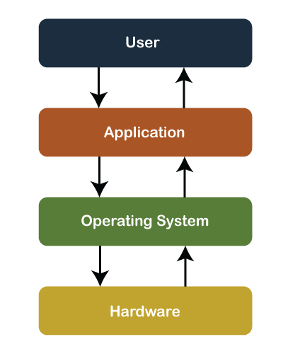
Course Goals
Understand operating systems by learning their architecture and services
Experience with low-level systems development

Slide 23
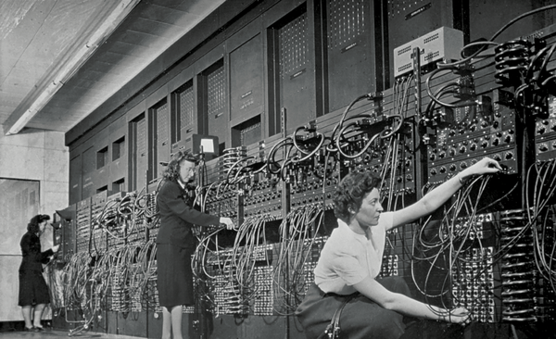
Historical Perspective
Early computers did not have an operating system. People manually performed functions that are now controlled in software systems that operate the machine
Notes:
https://www.nytimes.com/2019/02/13/magazine/women-coding-computer-programming.html

Slide 24
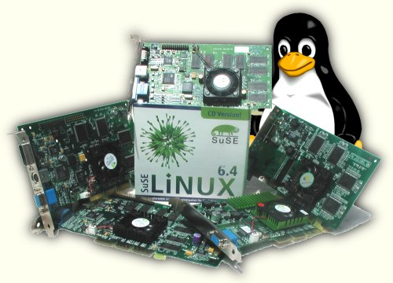
Why is this important?
Operating system is responsible for
Abstracting the hardware details for convenience and portability

Slide 25
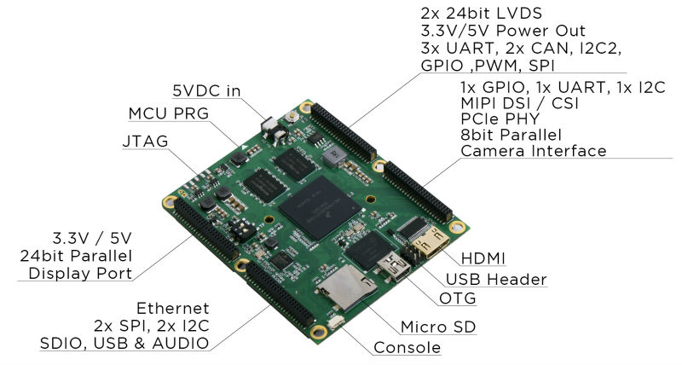

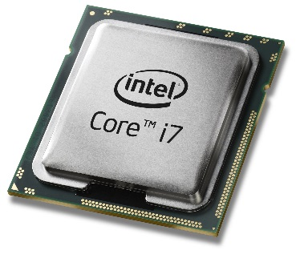
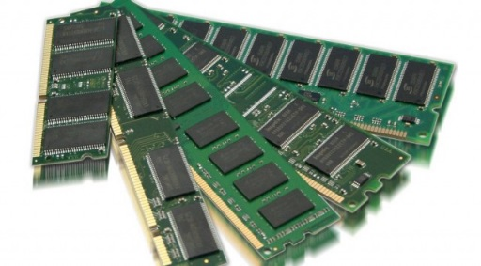
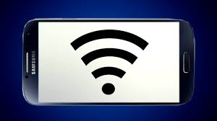
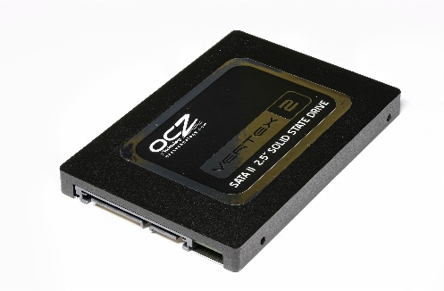
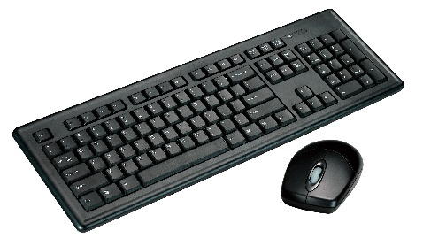
Why is this important?
Operating system is responsible for
Abstracting the hardware details for convenience and portability
Multiplexing the hardware among multiple applications

Slide 26

Why is this important?
Operating system is responsible for
Abstracting the hardware details for convenience and portability
Multiplexing the hardware among multiple applications
Isolating applications to contain bugs

Slide 27
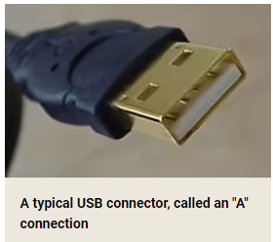
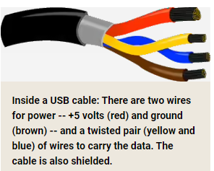
Example: USB device insertion
Consider what happens when you plug-in a USB device to your laptop
USB controller informs its driver
The driver is part of the kernel
The driver asks the device to identify itself
Device sends back an ID
Driver uses ID to match a driver to the new device
Notes:
https://superuser.com/questions/42022/how-does-usb-device-recognition-work
https://stackoverflow.com/questions/3013142/what-happens-when-you-plug-in-a-new-usb-device

Slide 28
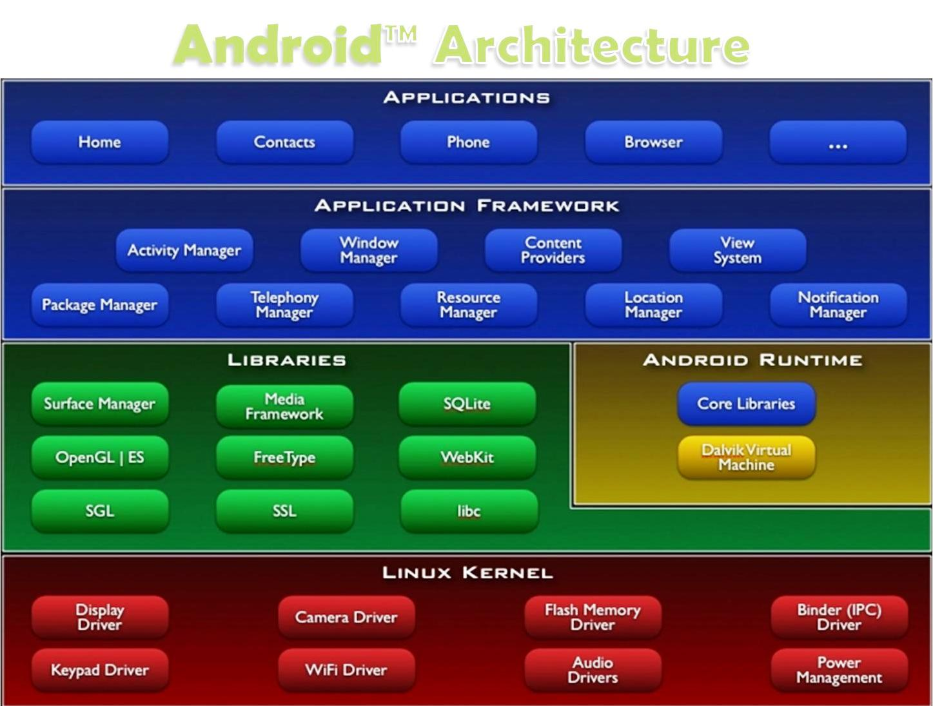
Layers of a modern computing system
Application – the user program
Application framework
Helpful libraries for providing modularity and reuse
System Libraries – the core services of the OS are encapsulated by these libraries, e.g. libc
The operating system kernel

Slide 29
Layers of a modern computing system
Application – the user program.
Application framework
Helpful libraries for providing modularity and reuse
System Libraries – the core services of OS are encapsulated by these libraries, e.g. libc
The operating system kernel
In this course we will primarily focus on
The kernel and the system libraries.
Notes:
Instruction set architecture defines the format of instructions and processor state

Slide 30
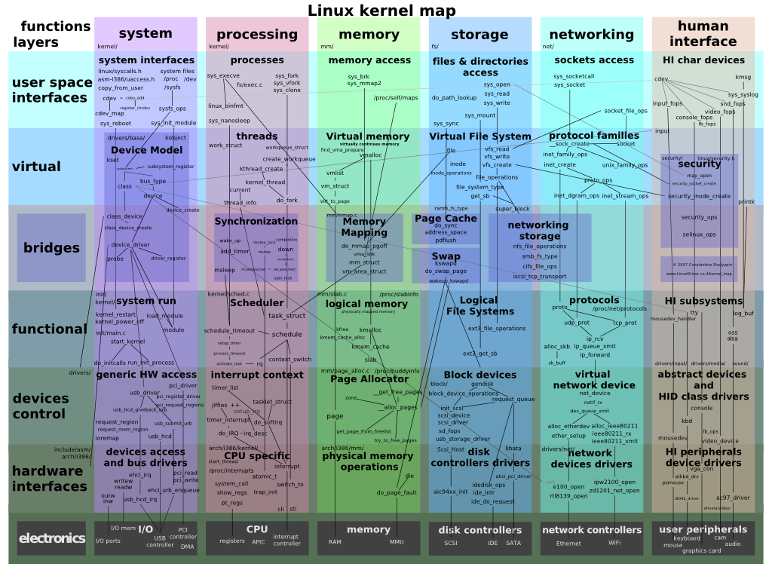

The OS Kernel

Slide 31
The OS Kernel
Process management
Memory management
File-system management
Security
Communication and networking
Time Synchronization
Many others: users, IPC, network, time, terminals
Notes:
Filesystem allows a process to perform I/O operations on files.
Security – OS protects applications against malicious applications.

Slide 32
How do we interact with the kernel?
Applications only see them via system calls (system calls are the API of the kernel)
Examples, from UNIX / Linux:
pid_t pid = getpid();
printf("mypid is %d\n", pid);

Slide 33
How do we interact with the kernel?
Applications only see them via system calls (system calls are the API of the kernel)
Examples, from UNIX / Linux:
pid_t pid = getpid();
printf("mypid is %d\n", pid);
brk(0x18c9000) = 0x18c9000
clone(child_stack=0, flags=CLONE_CHILD_CLEARTID|CLONE_CHILD_SETTID|SIGCHLD, child_tidptr=0x7fbf4bda1a10) = 3710
getpid() = 3709
fstat(1, {st_mode=S_IFCHR|0620, st_rdev=makedev(136, 6), ...}) = 0
write(1, "mypid is 3709\n", 14mypid is 3709
) = 14
exit_group(0)
Strace output (system calls in bold)

Slide 34
Why OS design is challenging
The environment is unforgiving: weird h/w, hard to debug
It must be efficient (thus low-level?)
but abstract/portable (thus high-level?)
Powerful (thus many features?)
but simple (thus a few composable building blocks?)
Features interact: `fd = open(); ...; fork()`
Behaviors interact: CPU priority vs memory allocator
Open problems: security, multi-core

Slide 35
Before Next Class
Ensure that you have full access to your VUIT Amazon AWS Virtual Machine
Ensure that you can access the CS 3281 GitHub repo, including
https://github.com/cs3281/lectures
https://github.com/cs3281/lectures/wiki
Verify access to Brightspace and Piazza

