Slide 1
Operating Systems
CS3281 / CS5281
Spring 2024

Slide 2
Team
Instructors
Dr. Andy Gokhale, Dr. Abhishek Dubey, Dr. Shervin Hajiamini
Graduate TAs
Sanjana Das, Saman Kittani
Graders
Salomon Dushimirimana, Mohammed Khan, Rana Muhammad Shahroz Khan, Ilayda Koca, Chuci Liu, Xiaohan Liu, Binh Mai, Akash Munagala, Yurui Xu

Slide 3
Top Hat
You will receive an email for your section. Please join.
Then you will receive a question about github id. Do join.

Slide 4
Office Hours
See on github.

Slide 5
Important Links
Textbook | http://pages.cs.wisc.edu/~remzi/OSTEP/
Discussion Forum & Announcements | https://piazza.com/vanderbilt/spring2024/cs32815281
Lectures | https://github.com/cs3281/lectures
Programming Assignments | https://classroom.github.com/classrooms/30844110-cs3281-classroom-spring2024
Announcements & Administration | https://vanderbilt.edu/brightspace/

Slide 6
Programming Assignments
Administered through GitHub Classroom
Requires admission to the cs3281 repository using your GitHub ID

Slide 7
Programming Assignments
Administered through GitHub Classroom
Requires admission to the cs3281 repository using your GitHub ID
[TOPHAT GITHUB ID COLLECTION]

Slide 8
Programming Assignments
Administered through GitHub Classroom
Requires admission to the cs3281 repository using your GitHub ID
Graded using the VUIT-provided AWS Virtual Machines
Access your WorkSpace on a virtual machine in a browser at
https://webclient.amazonworkspaces.com
or download the AWS WorkSpaces client from: https://clients.amazonworkspaces.com/
Enter the following registration code:
SLiad+DGTNYL
Log in with your VUNetID and password

Slide 9
Programming Assignments
Full instructions for using xv6 are at: https://github.com/cs3281/lectures/wiki
Automate GitHub credentials:
Go to https://github.com/settings/tokens
Click "Generate new token (classic)"
Note: Development
Expiration: No expiration
Select scopes: repo, user, codespace
Click "Generate token"
Copy Personal Access Token and write it down or save it somewhere
In a terminal, run "git clone https://github.com/cs3281/lectures.git"
When prompted, enter you GitHub username and enter the above-generated Personal Access Token as your password
You should never be prompted to do enter these credentials again
In a terminal, run "git config --global credential.helper store"
Git should save your token in ~/.git-credentials file
GDB reads gdbinit file from the current directory in your virtual machine
In a terminal, run:
mkdir -p $HOME/.config/gdb && echo "set auto-load safe-path /" > $HOME/.config/gdb/gdbinit
Notes:
gdbinit - User initialization file contains commands that are executed upon starting up GDB
Set auto-load safe-path

Slide 10

Textbook
We will draw material from a variety of sources
Primary textbook: Operating Systems: Three Easy Pieces
Available for free at http://pages.cs.wisc.edu/~remzi/OSTEP/
Other possible texts:
The Linux Programming Interface
Computer Systems: A Programmer’s Perspective
Linux Kernel Development

Slide 11
Course Assessment
Programming assignments: 50%
Learn by doing
In-Class assignments/quizzes: 10%
Mid-term exam: 15%
Final exam: 25%
Participation, Professionalism, Attendance: ±2%

Slide 12
Late days
You have a total of 4 late days that you can use across programming assignments as you wish
A maximum of two late days can be used on a given programing assignment
Example: assignment is due by 11:59pm Monday; you can use two late days to submit that assignment by 11:59pm Wednesday with no penalty
To use late days: push a file named late_days.md to the top-level directory of your assignment repo with a line stating whether you're using one or two late days
Assignments submitted more than two days late will not be accepted
No collaborations unless explicitly permitted

Slide 13

Regrade Requests
Grading errors can and do happen
Not malicious!
You can “challenge” if you believe an error was made
If you are wrong, you may lose a late day

Slide 14

ChatGPT and AI assistants
We have entered a new era with AI assistants
Our goal is to use them to enhance the learning experience
We are adopting a new experimental policy
You can use ChatGPT and other AI tools however you want!
However, you must document your use
No points will be deducted for use of AI, so please document your use authentically
We want you to reflect on how these technologies are helpful and how they aren’t. We want to know both how it failed, as well as how it succeeded!
This policy is experimental, and is subject to change at the instructor’s discretion

Slide 15
Linux
The Linux operating system is open source but very complex
Over 25 million source lines of code!
Many performance optimizations, which can obscure fundamental concepts
You should learn to use Linux as it is widely used in industrial settings, and many applications, especially in research, use it exclusively
It is unreasonable to implement many course concepts in Linux itself
Watch this video: https://www.youtube.com/watch?v=actgZVvs_Jk

Slide 16
xv6
Instead, we will use the teaching-oriented operating system xv6
xv6 developed and used in OS class at MIT
Only ~5,000 source lines of code
Also used at many other universities
We will use some existing xv6 assignments and some of our own
Posting or sharing solutions is a serious violation of the honor code and will be treated as such
Copying solutions from the web is also an honor-code violation and will be directed to the honor council

Slide 17
Course expectations
You are expected to read the material for a lecture beforehand and participate in class discussions
We may occasionally assign videos to watch; please watch them ahead of time so you can participate in class discussions
All assignments can be found on Brightspace
Check back frequently
Brightspace may be updated up to a week before any given lecture based on class progress and timeline

Slide 18
Course expectations: Office Hours
We will use an office-hour policy similar to the one listed here: https://www2.seas.gwu.edu/~gparmer/resources/2021-09-20-Office-Hours-HOWTO.html
Please read this policy carefully and adhere to its guidelines
It will help you and us
Notes:
Show tests, explain expected and actual behavior, come to office hours for asking specific questions on code
Your code should compile
Use a good style for programming – Put comments, Use descriptive variable names

Slide 19
Development Environment
Most of this course will use C
This is an OS course, not a course on C
While some C material will be discussed, it is up to you to learn and build your proficiency in C if you aren’t proficient already
Remember, you can ask ChatGPT for help!
We will assume Ubuntu as the development environment
VMs provided through VUIT
You’re free to choose your development environment, but your work will be tested and evaluated on the Ubuntu VM environment
We do not support alternative environments
We will use GitHub and git for content and assignment management

Slide 20
Development Environment
We will use the MIT-sponsored “xv6” teaching OS for most assignments
Based on the original UNIX kernel
Allows us to actually hack on a real kernel
Runs on a RISC-V architecture which will be emulated on your VM through the QEMU application
Good idea to read relevant sections of the “xv6 book” while doing homework assignments: https://pdos.csail.mit.edu/6.S081/2023/xv6/book-riscv-rev3.pdf
Exit xv6/QEMU by pressing “Ctrl+a” followed by “x”
Notes:
xv6 runs on multi-core RISC-V

Slide 21
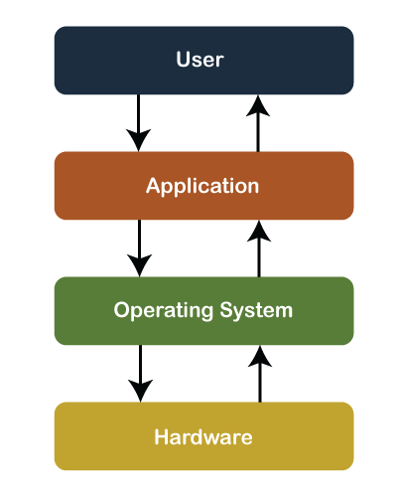
Course Goals
Understand operating systems by learning their architecture and services
Experience with low-level systems development

Slide 22

Historical Perspective
Early computers did not have an operating system. People manually performed functions that are now controlled in software systems that operate the machine
Notes:
https://www.nytimes.com/2019/02/13/magazine/women-coding-computer-programming.html

Slide 23
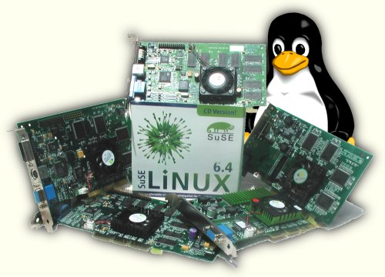
Why is this important?
Operating system is responsible for
Abstracting the hardware details for convenience and portability

Slide 24
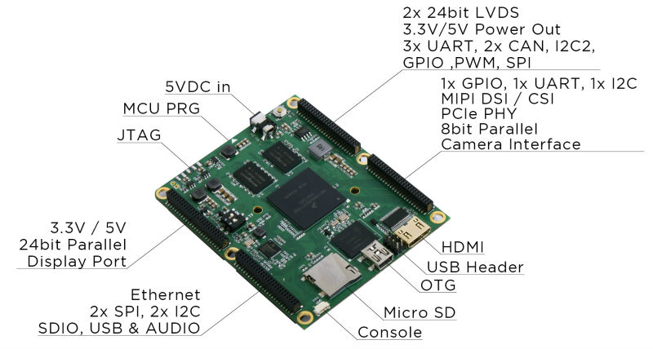

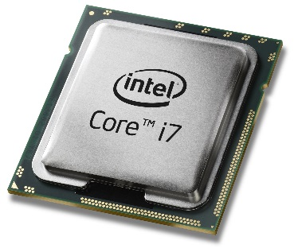
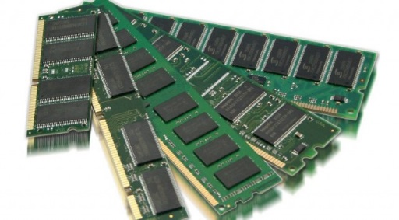
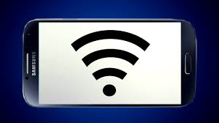
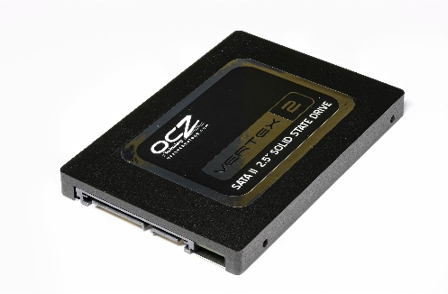
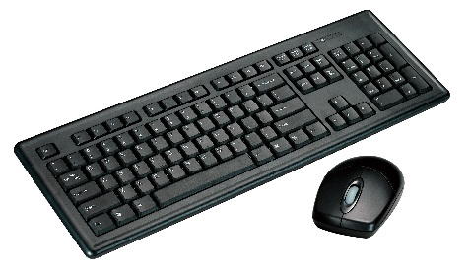
Why is this important?
Operating system is responsible for
Abstracting the hardware details for convenience and portability
Multiplexing the hardware among multiple applications

Slide 25

Why is this important?
Operating system is responsible for
Abstracting the hardware details for convenience and portability
Multiplexing the hardware among multiple applications
Isolating applications to contain bugs

Slide 26
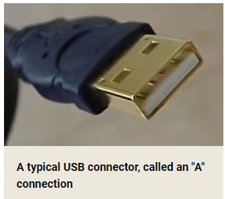
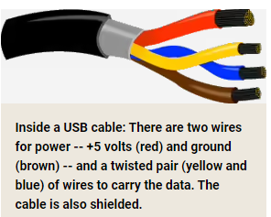
Example: USB device insertion
Consider what happens when you plug-in a USB device to your laptop
USB controller informs its driver
The driver is part of the kernel
The driver asks the device to identify itself
Device sends back an ID
Controller uses ID to match a driver to the new device
Notes:
https://superuser.com/questions/42022/how-does-usb-device-recognition-work
https://stackoverflow.com/questions/3013142/what-happens-when-you-plug-in-a-new-usb-device

Slide 27
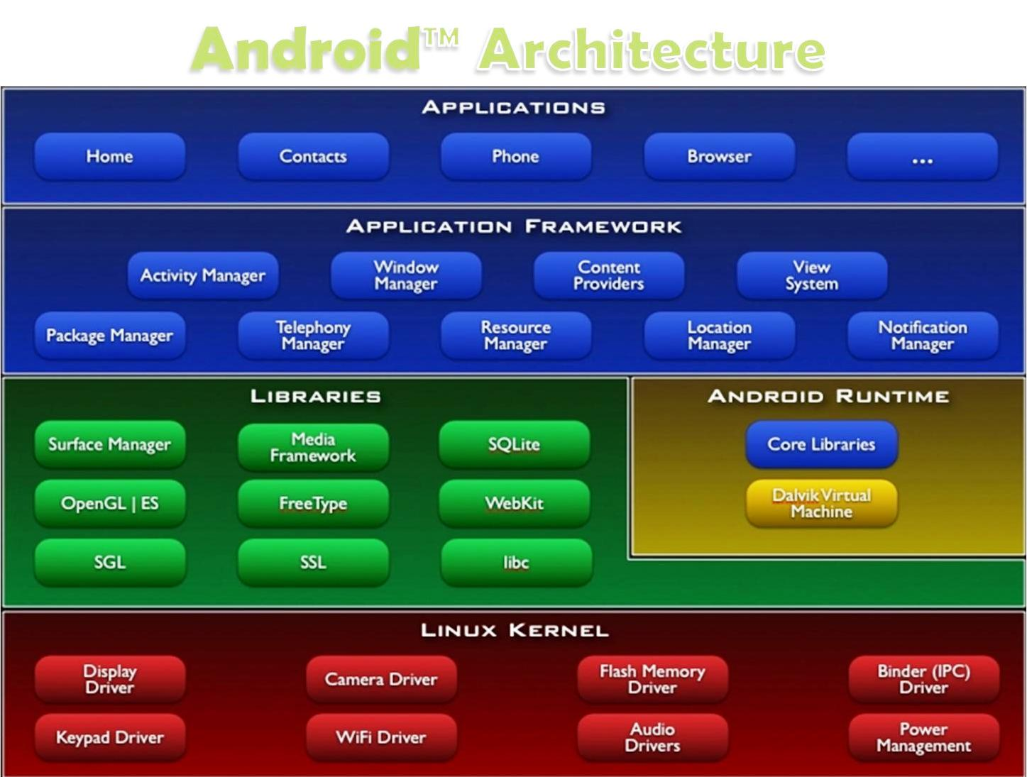
Layers of a modern computing system
Application – the user program
Application framework
Helpful libraries for providing modularity and reuse
System Libraries – the core services of the OS are encapsulated by these libraries, e.g. libc
The operating system kernel
Notes:
Application framework – reusable code e.g., classes and objects
System libraries – fundamental code such as file I/O and memory management

Slide 28
Layers of a modern computing system
Application – the user program.
Application framework
Helpful libraries for providing modularity and reuse
System Libraries – the core services of OS are encapsulated by these libraries, e.g. libc
The operating system kernel
In this course we will primarily focus on
The kernel and the system libraries.
Notes:
Instruction set architecture defines the format of instructions and processor state

Slide 29
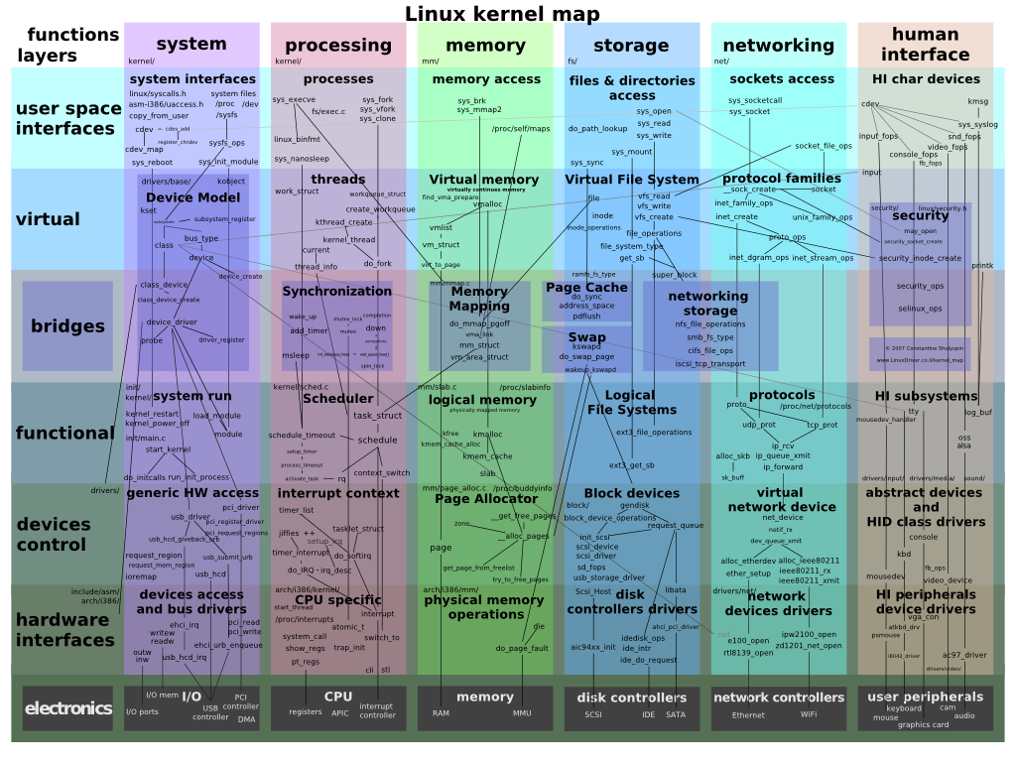
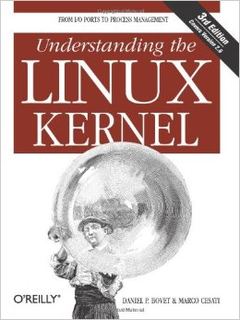
The OS Kernel

Slide 30
The OS Kernel
Process management
Memory management
File-system management
Security
Communication and networking
Time Synchronization
Many others: users, IPC, network, time, terminals
Notes:
Filesystem allows a process to perform I/O operations on files. It creates, deletes, and upda
Security – OS protects applications against malicious applications.

Slide 31
How do we interact with the kernel?
Applications only see them via system calls (system calls are the API of the kernel)
Examples, from UNIX / Linux:
pid_t pid = getpid();
printf("mypid is %d\n", pid);

Slide 32
How do we interact with the kernel?
Applications only see them via system calls (system calls are the API of the kernel)
Examples, from UNIX / Linux:
pid_t pid = getpid();
printf("mypid is %d\n", pid);
brk(0x18c9000) = 0x18c9000
clone(child_stack=0, flags=CLONE_CHILD_CLEARTID|CLONE_CHILD_SETTID|SIGCHLD, child_tidptr=0x7fbf4bda1a10) = 3710
getpid() = 3709
fstat(1, {st_mode=S_IFCHR|0620, st_rdev=makedev(136, 6), ...}) = 0
write(1, "mypid is 3709\n", 14mypid is 3709
) = 14
exit_group(0)
Strace output (system calls in bold)

Slide 33
Why OS design is challenging
The environment is unforgiving: weird h/w, hard to debug
It must be efficient (thus low-level?)
but abstract/portable (thus high-level?)
Powerful (thus many features?)
but simple (thus a few composable building blocks?)
Features interact: `fd = open(); ...; fork()`
Behaviors interact: CPU priority vs memory allocator
Open problems: security, multi-core

Slide 34
Before Next Class
Ensure that you have full access to your VUIT Amazon AWS Virtual Machine
Ensure that you can access the CS 3281 GitHub repo, including
https://github.com/cs3281/lectures
https://github.com/cs3281/lectures/wiki
Verify access to Brightspace and Piazza

Slide 35
Additional Reference Material
https://github.com/cs3281/coding-interview-university
https://missing.csail.mit.edu/ - The Missing Semester of Your CS Education
Videos and material which will be very useful for you.

