Slide 1

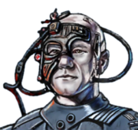
What Went Well?
TEAM – Little to no conflict. Everyone was helpful to each other when answering questions. All able to sync repositories and modify shared project.
Walter – Idea input creation and providing resources to team.
Carter – No conflict while working on project. Everyone worked well as a team and all discussions went smoothly, work was evenly distributed.
Daniel – Repository organization.
Elvin –
Luke – Cooperation, agreement, etc.

Slide 2
What Might Be Impeding Us from Performing Better?
Time management, underestimating how much time it takes to complete a task
Learning new tools/languages/frameworks so that everyone has an equal understanding of the project.
Learning how to create “real time” updates for the multiplayer aspect with multiple users. Will require more research.

Slide 3
What Can We do to Improve?
TEAM – Updating Task Board and Communication. Having more realistic tasks that can be completed within the time frame.
Walter – Communication relay. Better response time on tasks.
Carter – Time management, starting tasks a lot earlier so we don’t do things last second.
Daniel – Informing team of current task and task progress. Manage personal schedule to have more time for group meetups.
Elvin –
Luke – Communication, ask for help when necessary

