Slide 1
Color Sort!
Landon Boone
Logan Lett
Coleman Oates
Shanna Wallace
University of Tennessee, Knoxville
COSC 340
Spring 2024

Slide 2
Project Motivation
Gain experience with mobile app development
Create fully functional Color Sort mobile game that is:
Fun to play
Easy to use
Free of annoying and invasive ads
Offers additional challenges and customization options

Slide 3
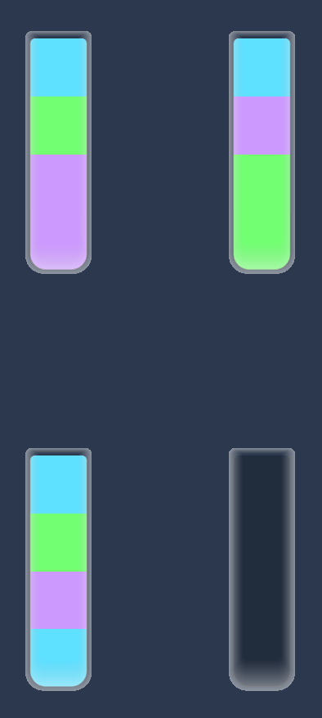
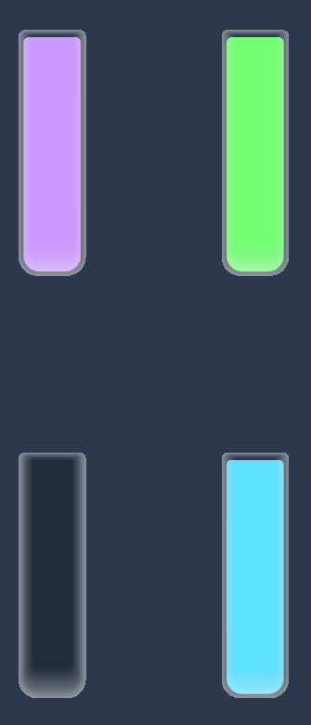
Color Sort!
What is Color Sort? Popular 2D puzzle game
Objective: Given bottles with shuffled up colors, sort the colors so that all blocks of the same color are in the same bottle

Slide 4
Color Sort Gameplay:
You can move blocks of color from one bottle to another if:
The destination bottle is empty
The top colors in the two bottles match and the destination bottle has room available
You may only move as many blocks of color as will fit in the empty bottle
Once all blocks of the same color are in the same bottle, the level is complete!

Slide 5
Features Planned:
Reset levels
Undo moves
Save game progress
Difficulty level customization
Additional challenges:
Hide some colors from the user
Limit the number of moves that can made to complete the level
Give user limited amount of time to complete levels

Slide 6

Features Actually Implemented:
Reset levels
Undo moves
Save game progress
Difficulty level customization
Additional challenges:
Hide some colors from the user
Limit the number of moves that can made to complete the level
Give user limited amount of time to complete levels

Slide 7
Technology and System Structure
App built on Godot V 4.2 Game Engine
Written with Godot’s scripting language, GDScript
Levels created by separate C++ level generation program

Slide 8
C++
.txt file with game level specification
Level Generator
.txt file containing level data
Godot / GDScript
Process user input until game is complete or user exits
Read input file, load levels, initialize game board
Save user’s game state
Make move
Undo move
Reset level
View instructions
Adjust volume

Slide 9
Technology and System Structure
Changes from initial plan:
Originally considered using C++ plug-in to use the existing C++ code
Ended up being easier to rewrite the game in GDScript

Slide 10
Testing
Predominantly manual testing, running the game on desktop using Godot’s mobile app simulator
Ran game through Godot’s Android app to test sizing and usability of elements on a phone display
Incremental testing - made sure basic functionality worked before adding any additional features
Code review to plan and revise program structure

Slide 11
Team Member Contributions
Tasks were divided on a weekly or bi-weekly basis
Roles were dynamic
Every member got some experience with each aspect of the development process
Weekly collaborative group work meetings

Slide 12
Challenges
Learning curve to get started:
No prior experience with mobile app development
Only one member had any prior Godot experience
GDScript:
Though similar to Python, it was still a new language for everyone in the group
First time building a larger project with a scripting language
Had to convert existing C++ code to GDScript

Slide 13
Challenges
Figuring out best way to organize and structure the code:
Which functions should go in which script?
How will different elements of the game communicate with each other?
Version Control issues:
Updates getting written over when merging
When merging tasks completed individually, sometimes one member’s updates would be incompatible with another’s
Missing files

Slide 14

Challenges
Level generator program creates some unsolvable levels
Did not finish solver program:
Unable to automate testing levels for solvability
Unable to implement planned minimum move count challenge
Did not upload game to a real app store:
Not enough time to fully prepare app for public release
Cost prohibitive:
Apple Developer Program: $99
Google Play Store: $25

Slide 15

Achievements
Built a functional mobile game
Gained valuable experience with mobile app and video game development
Stayed on schedule and did a good job keeping project goals realistic for the time we had available
Have an impressive project to add to our resumes and GitHub portfolios

