Slide 1
Color & Graphics
The complete display system is:
Model
Frame Buffer
Screen
Eye
Brain

Slide 2
Color & Vision
We'll talk about:
Light
Visions
Psychophysics, Colorimetry
Color
Perceptually based models
Hardware models

Slide 3
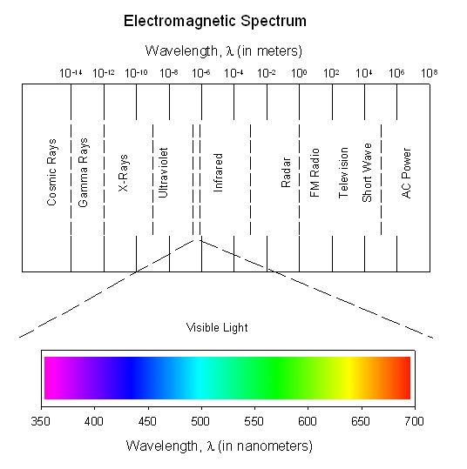
Light
More next class
Vision = perception of electromagnetic energy
Very small portion of EM spectrum is visible

Slide 4
Vision: The Eye
A dynamic, biological camera!
a lens
a focal length
an equivalent of film
The lens must focus directly on the retina for perfect vision
Retina
Lens

Slide 5
Vision: The Retina
The eye's "film"
Covered with cells sensitive to light
turn light into electrochemical impulses
Two types of cells
rods
cones

Slide 6
Vision: Rods
Sensitive to most wavelengths (brightness)
About 120 million in eye
Most outside of fovea (center of retina)
Used for low light vision
Absorption function:
400
700

Slide 7
Vision: Cones
Three kinds
R sensitive to long wavelengths (L in book)
G to middle (M in book)
B to short (S in book)
About 8 million in eye
Highly concentrated in fovea
B cones more evenly distributed than others
Used for high detail color vision

Slide 8
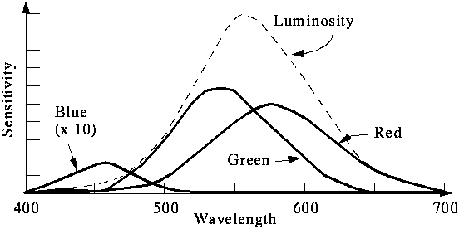
Vision: Cones
The absorption functions of the cones are:

Slide 9
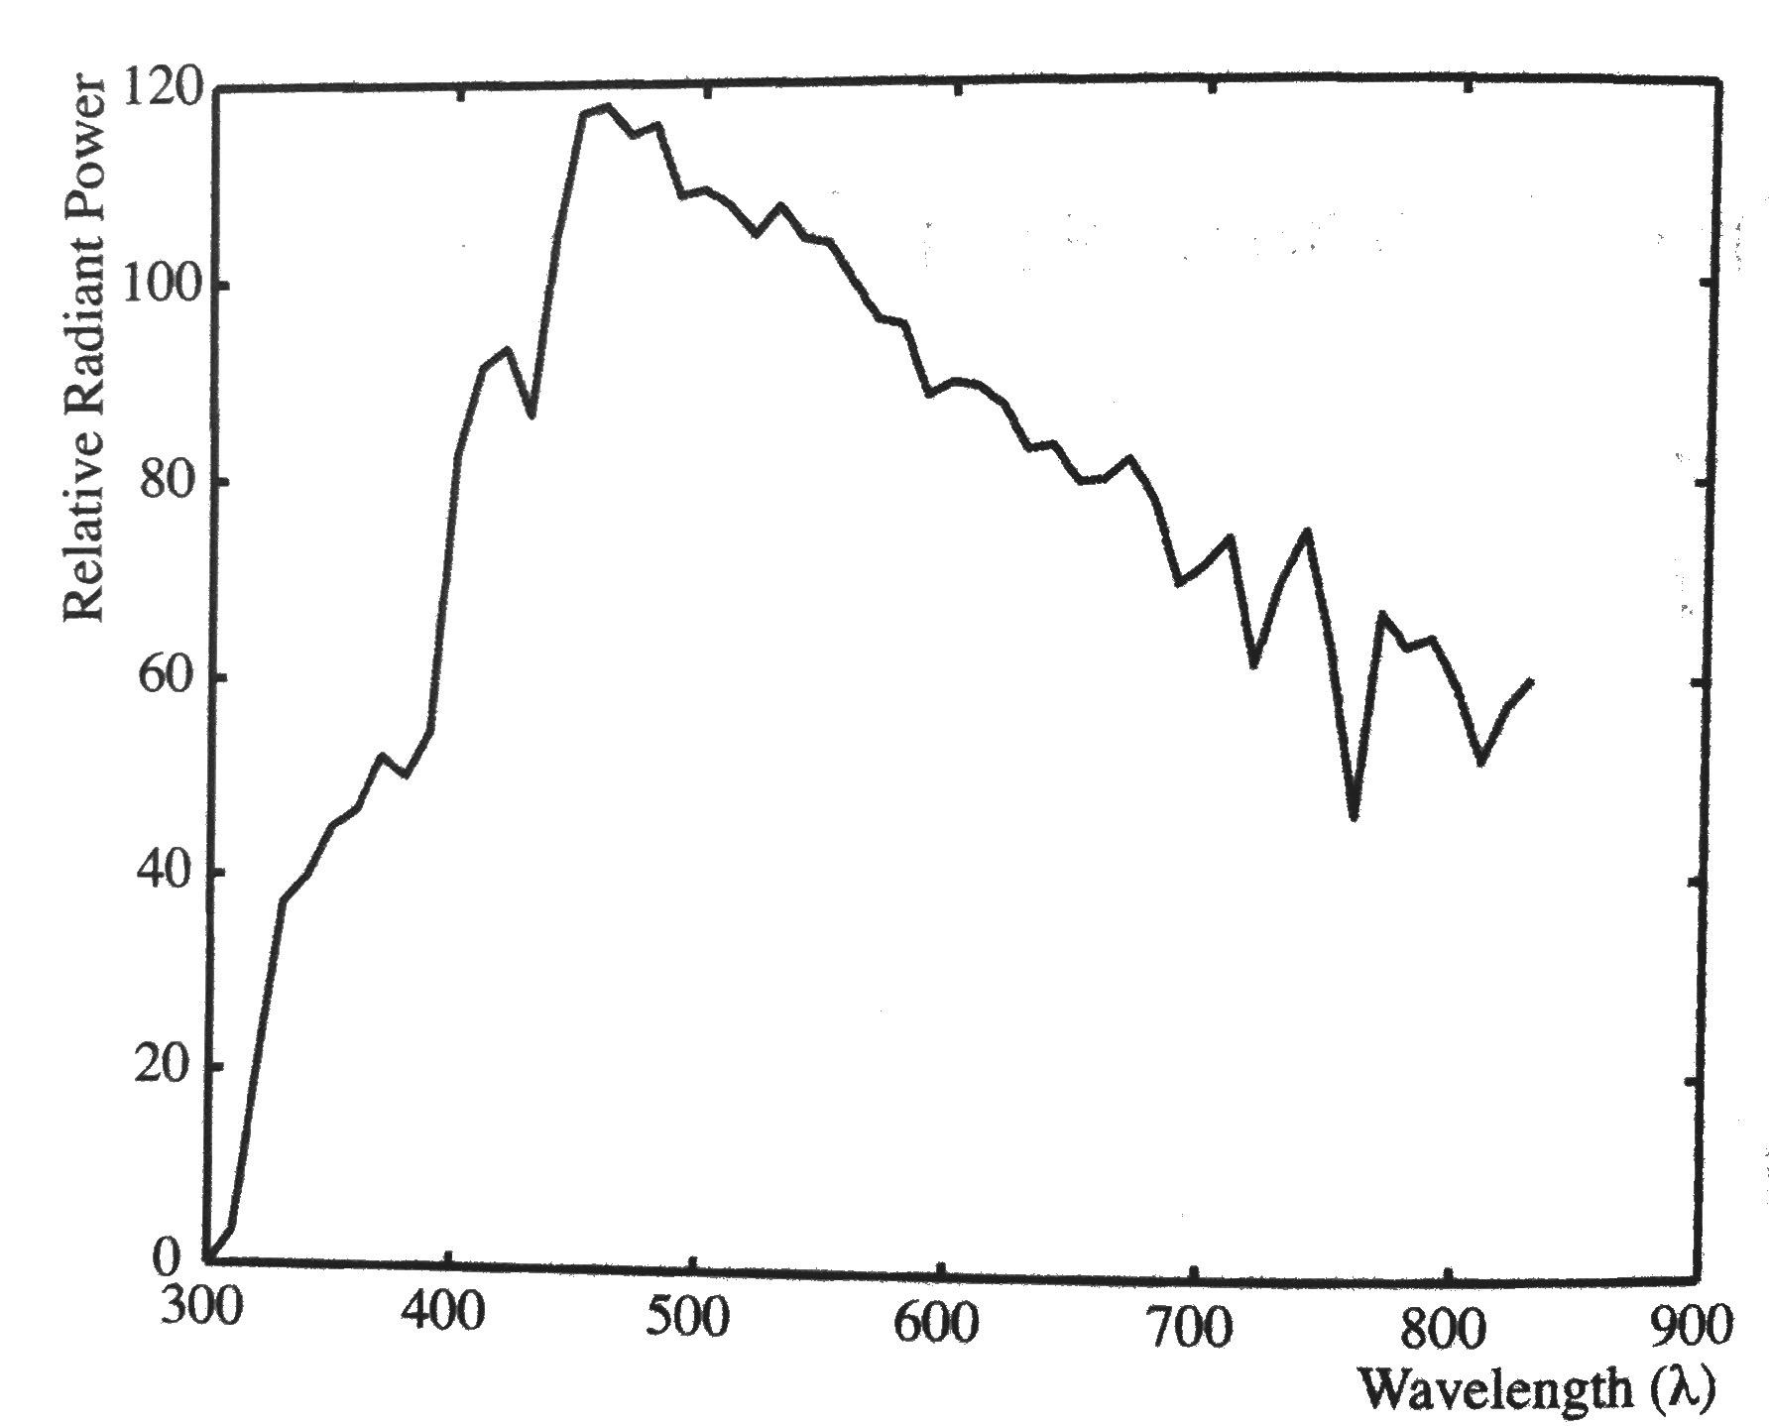
Psychophysics
Spectral Energy Distribution
measure intensity of light at unit wavelength intervals of electromagnetic spectrum from ~400 nm to ~700 nm

Slide 10
Psychophysics
Dominant Wavelength ≅ hue
Excitation Purity ≅ saturation
Luminance ≅ intensity
Lightness: luminance from a reflecting object
Brightness: luminance from a light source
To mix colors
mix power distributions!

Slide 11
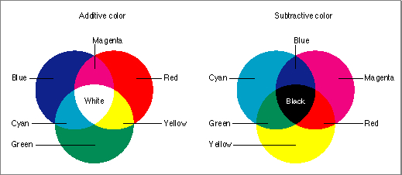
Color Mixing: Additive
Luminous objects emit s.e.d.
Linearly add s.e.d.’s
Primaries: red green blue
Complements: cyan magenta yellow
e.g. Monitors, lights

Slide 12
Color Mixing: Subtractive
Reflective objects absorb (or filter) light
Can’t subtract s.e.d.’s
Filters: transmission functions
Pigment: suspension, scattering of light
Primaries: cyan magenta yellow
Complements: red green blue
E.g., ink, film, paint, dye

Slide 13
Colorimetry
Based on matching colors using additive color mixing
Tristimulous Values
Metamers
Different s.e.d.’s that appear the same
Same tristimulous values

Slide 14
Colorimetric Color Models
Generated color match functions
match each wavelength, multiple people
some colors require negative red!
CIE produced two device independent models:
1931: Measured on 10 subjects (!) on samples subtending 2 (!) degrees of the field of view
1964: Measured on larger number of subjects subtending 10 degrees of field of view

Slide 15
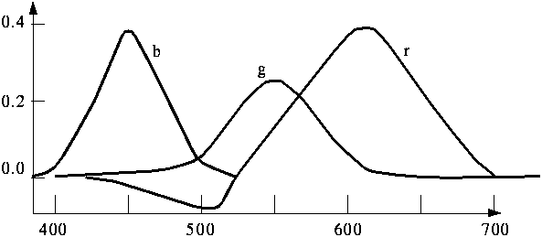
Color Match Functions

Slide 16
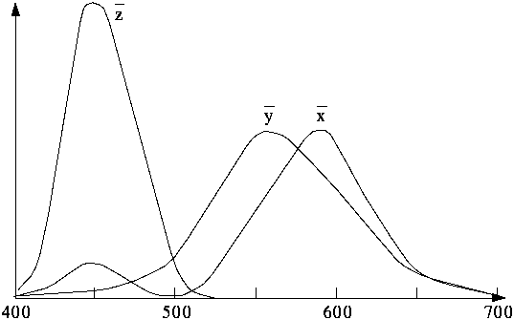
CIE 1931 Imaginary Primaries
Defines three new primary “colors”
X, Y and Z
Mixtures positive valued
Y’s fcn corresponds to luminance-efficiency function
To define a color
weights x,y,z for the X,Y,Z primaries (e.g. color = xX + yY + zZ)

Slide 17
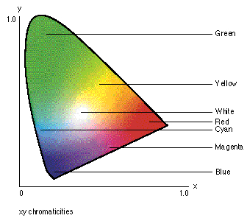
CIE 1931 Chromaticity
X, Y and Z form a three dimensional color volume
Y is luminance, others aren’t intuitive
Factor luminance by normalizing x+y+z = 1
Chromaticity values:
x’ = x/(x+y+z)
y’ = y/(x+y+z)
z’ = 1 - x’ - y’

Slide 18
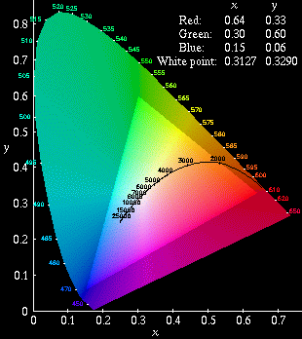
CIE 1931 Chromaticity Diagram
Chromaticity diagram
Plot of x’ vs. y’
Additive color mixing
linear interpolation
Color gamuts
range of possible colors for a device
convex hull of primary colors
C
C = standard illuminant,
approximates sunlight, near 4K white
HDTV (ITU-R BT.709) and sRGB

Slide 19
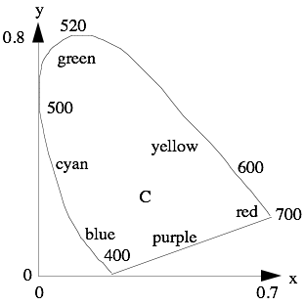
CIE 1931 Chromaticity Diagram
Dominant Wavelength/Hue:
inscribe line from C through color (A) to edge of diagram (H)
Saturation
distance C-A distance C-H
Complements
inscribe line through C to the edge of the diagram (H’)
What if edge is bottom?
H
A
H’

Slide 20
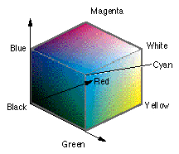
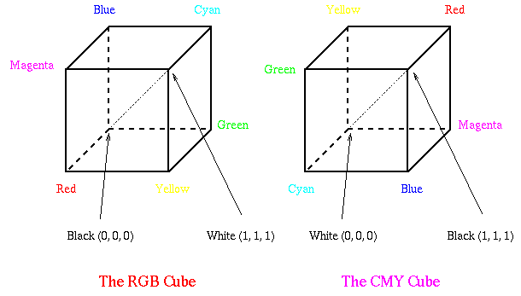
Hardware Models: RGB (Additive Color)
(red, green, blue)
Parameters vary between 0 and 1
Hard to achieve intuitive effects:
Hue is defined by the one or two largest parameters
Saturation controlled by varying the collective minumum value of R, G and B
Luminance controlled by varying magnitudes while keeping ratios constant

Slide 21
Hardware Models: CMY, CMYK (Subtractive Color)
(cyan, magenta, yellow, +blacK)
All parameters vary between 0 and 1
K = min (C,M,Y)
subtract K from each
M
black
Y
C

Slide 22
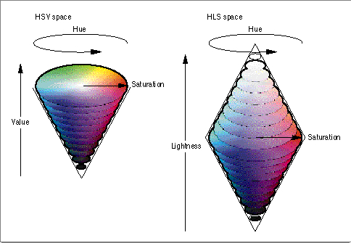
Intuitive Hardware Models: HSV
(hue, saturation, value)
value roughly luminance
hue: (0...360), saturation/value: (0...1)
Simple xform of RGB
What do hexagonal and triangle cross sections look like?

Slide 23
Intuitive Hardware Models: HLS
(hue, lightness, saturation)
lightness roughly luminance
hue: (0...360), saturation/value: (0...1)
saturated colors at l=0.5
tints above, shades below
What do hexagonal and triangle cross sections look like?

Slide 24
Problem: V/L != Luminance
Fully saturated colors (same v/l) have far different Y values in XYZ (Sun 17” monitor, 1991):
Colour RGB XYZ Chromaticity
White 1 1 1 0.951 1.000 1.088 0.313 0.329
Red 1 0 0 0.589 0.290 0.000 0.670 0.330
Green 0 1 0 0.179 0.605 0.068 0.210 0.710
Blue 0 0 1 0.183 0.105 1.020 0.140 0.080
Cyan 0 1 1 0.362 0.710 1.088 0.168 0.329
Magenta 1 0 1 0.772 0.395 1.020 0.363 0.181
Yellow 1 1 0 0.768 0.895 0.068 0.444 0.517

Slide 25
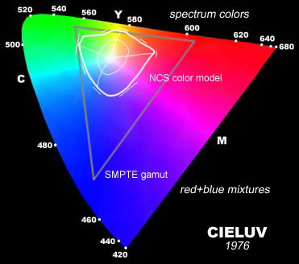
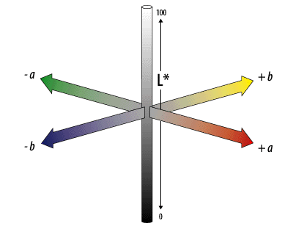
Problem: None of these models are perceptually uniform
Perceived distance between two colors not proportional to linear distance
Uniform Color Spaces
Non-linear deformations
OSA Uniform Color Space (limited range)
CIELUV
CIELAB

Slide 26
Issue: Device-independent color
Must use CIEXYZ
ie. Apple Colorsync
RGB = (0.3,0.2,0.55) tells you what computer generates, not what the monitor will display!
Depends on phosphors, room lighting, monitor adjustment
Moving between devices (and media)
Go through XYZ
Must know properties of devices

