Slide 1
11 - raytracing

Slide 2
3 approaches to graphics
On-line / “real-time”
Immediate mode
Retained mode
Off-line / batch / “slow”

Slide 3
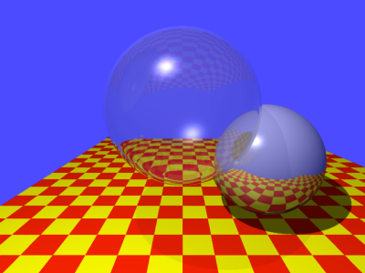
Ray Tracing

Slide 4
Basic Idea
Light Source
Shadow
Center of
Projection
Reflection
Ray
Projection Plane

Slide 5
Basic Algorithm

Slide 6
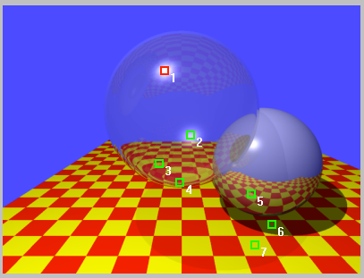
The Adventures of 7 Rays
from Alan Watt, 3D Computer Graphics, 3rd Edition, 1999

Slide 7
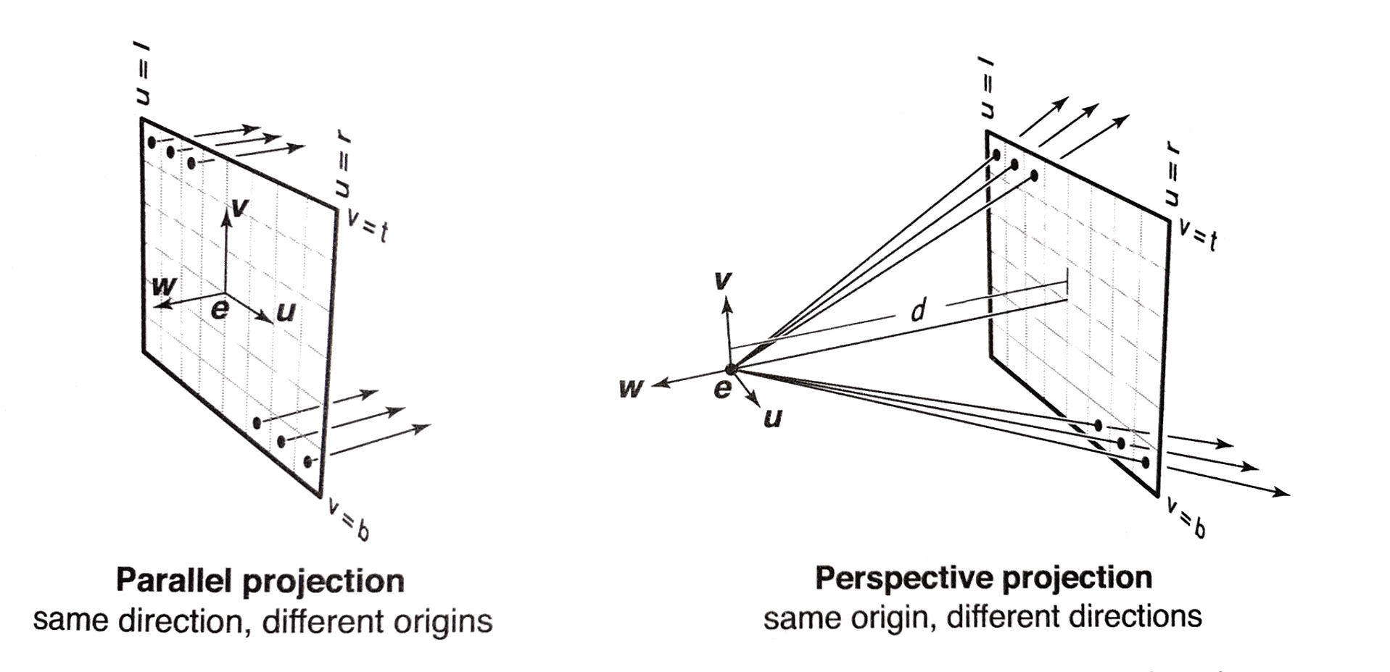
Projection (Orthographic, Perspective, Oblique)

Slide 8
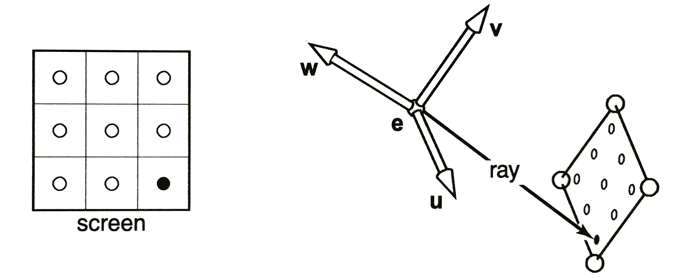
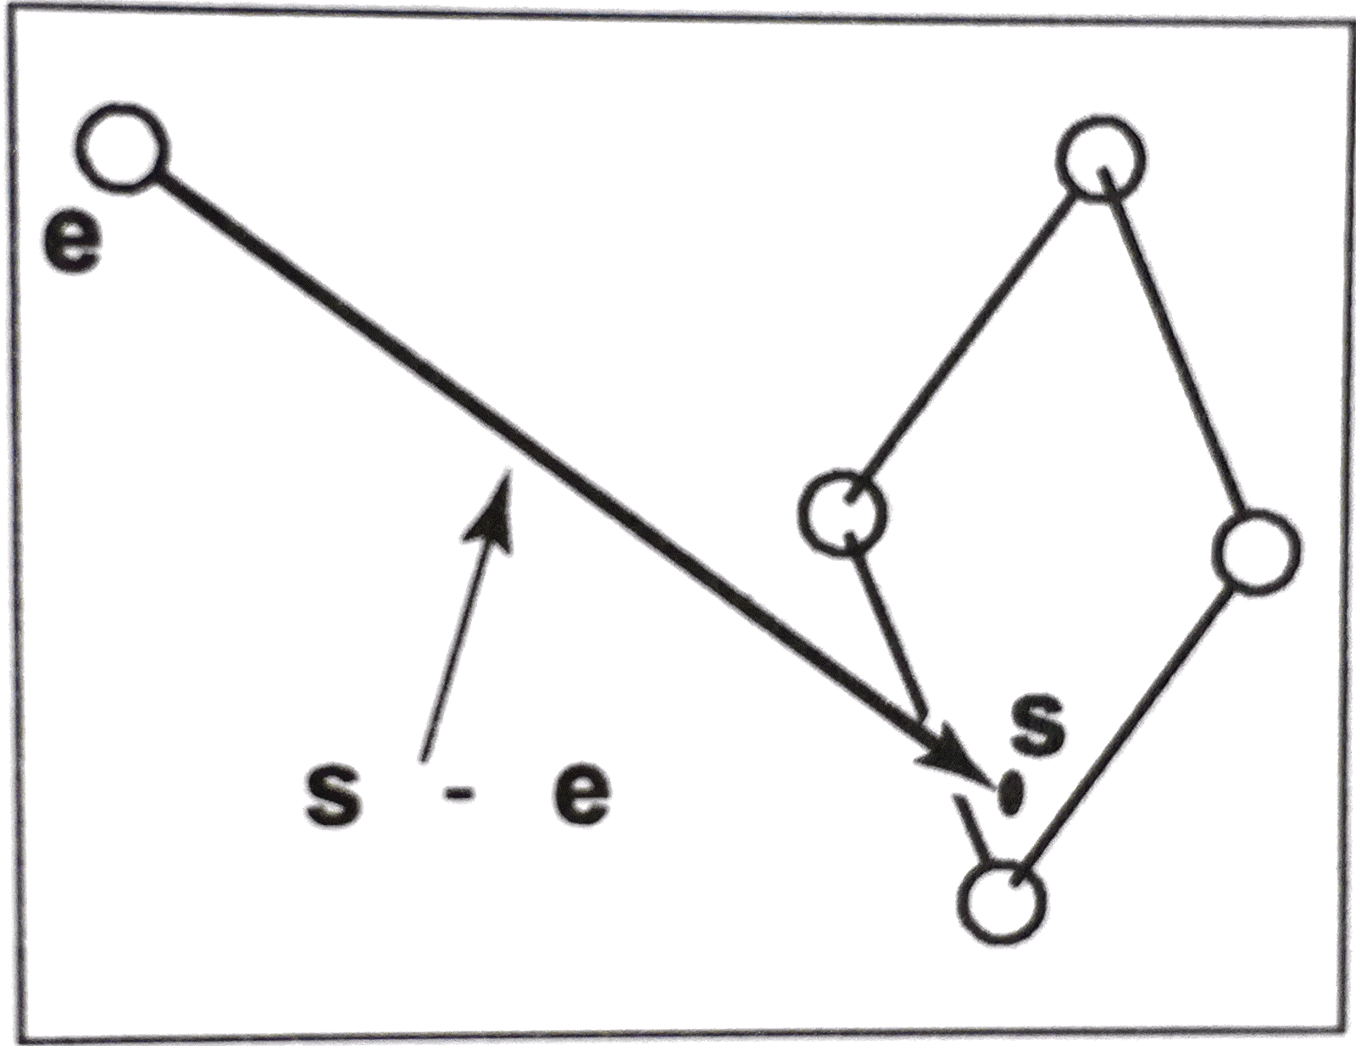

$$p\left(t\right)=e+t(s−e)$$

Slide 9
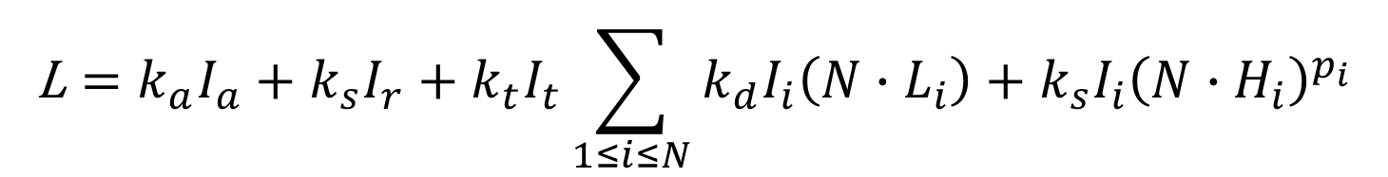
Illumination of a point
$$\text{L}=k_{a}I_{a}+k_{s}I_{r}+k_{t}I_{t}\sum_{1≤i≤N}{k_{d}I_{i}\left(N∙L_{i}\right)+k_{s}I_{i}{\left(N∙H_{i}\right)}^{p_{i}}}$$

Slide 10
Computing Intersections

Slide 11
Sphere/Ray Intersections

Slide 12
Ray/Plane Intersection

