Slide 1
3 - Matrices and Transformations
graphics is fun; graphics requires matrix math;
thus, matrix math must be fun

Slide 2
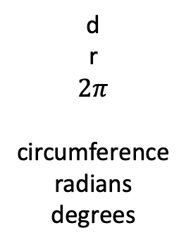
Simple Trig: Angles
d
r
$$2π$$
circumference
radians
degrees

Slide 3





Simple Trig: Angles
$$h$$
$$a^{2}+o^{2}=h^{2}$$
$$o$$
$$α$$
$$a$$
sin, cos, tan,
asin, acos, atan

Slide 4
Dot Product
Some images from https://en.wikipedia.org/wiki/Dot_product

Slide 5
Cross Product
Some images from https://en.wikipedia.org/wiki/Cross_product

Slide 6
Vectors
add/sub
length
scalar mult

Slide 7
3-D Vectors
Have length and direction
V = [x_{v}, y_{v}, z_{v}]
Length is given by the Euclidean Norm
||V|| = √( x_{v}² + y_{v}² + z_{v}² )
Dot Product V•U = [x_{v},y_{v},z_{v}]•[x_{u},y_{u},z_{u}]
= x_{v}x_{u}+y_{v}y_{u}+z_{v}z_{u}
= ||V|| ||U|| cos ß
Cross Product V x U = [v_{y}u_{z}-v_{z}u_{y}, -v_{x}u_{z}+v_{z}u_{x}, v_{x}u_{y}-v_{y}u_{x}]
V x U = - (U x V)

Slide 8
Cartesian Coordinates
Basis vectors (2D)
Linear independence
Coordinates
Orthogonal
Orthonormal
Cartesian
2D, 3D, 4D,…

Slide 10
3D Coordinate Systems
Y
Y
Z
X
X
Left-handed
coordinate system
Right-handed
coordinate system
Z

Slide 11
Matrices: Representation, Operations
Mult, not commutative
Identity
Inverses

Slide 14
Vector Operations with Matrices

Slide 15
Matrices as Transformations on Vectors

