Slide 1
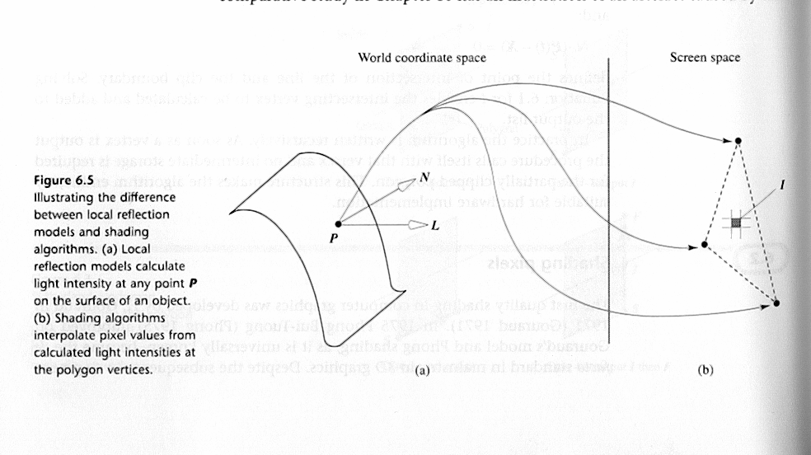
Illumination and Shading
Notes:
Illumination and Shading
9/19/02
CS4451: Fall 2002

Slide 2
Illumination and Shading
Illumination Models
  Ambient
  Diffuse
  Attenuation
  Specular Reflection
Interpolated Shading Models
  Flat, Gouraud, Phong
  Problems

Slide 3
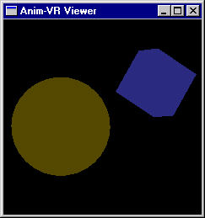
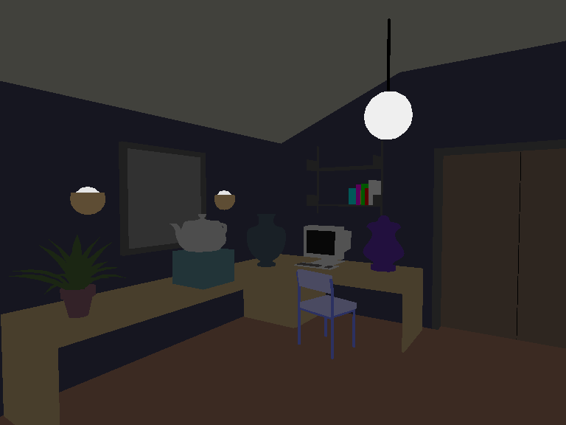
Illumination Models:
Ambient Light
Simple illumination model
  I = k_{i}
Use nondirectional lights
  I = I_{a}k_{a}
I_{a} = ambient light
intensity
k_{a} = ambient-reflection
coefficient
Uniform across surface

Slide 4
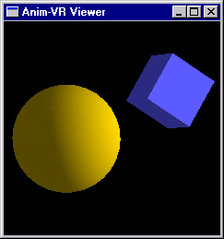
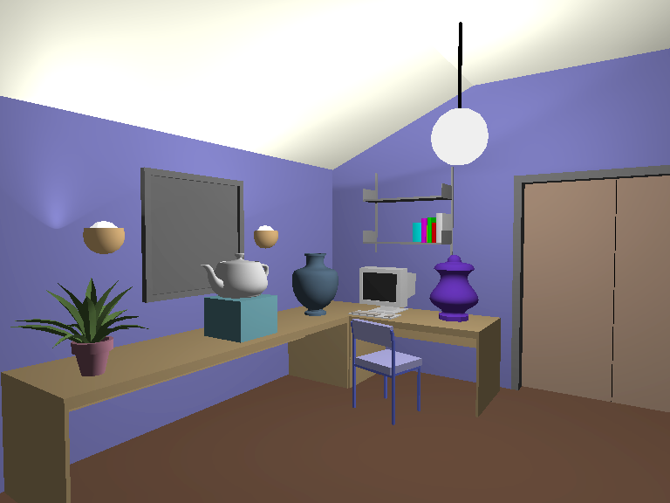
Diffuse Light
Account for light position
  Ignore viewer position
Proportional to cosΘ
between N and L
  I = I_{p}k_{d} cosΘ
  = I_{p}k_{d} (N ·L)
Model:
  I = I_{a}k_{a} + I_{p}k_{d} (N ·L)

Slide 5
Attenuation: Distance
f_{att} models distance from light
  I = I_{a}k_{a} + f_{att}I_{p}k_{d} (N ·L)
Realistic
  f_{att}= 1/(d_{L}²)
Hard to control, so OpenGL uses
  f_{att}= 1/(c₁ + c₂d_{L} + c₃d_{L}²)

Slide 6
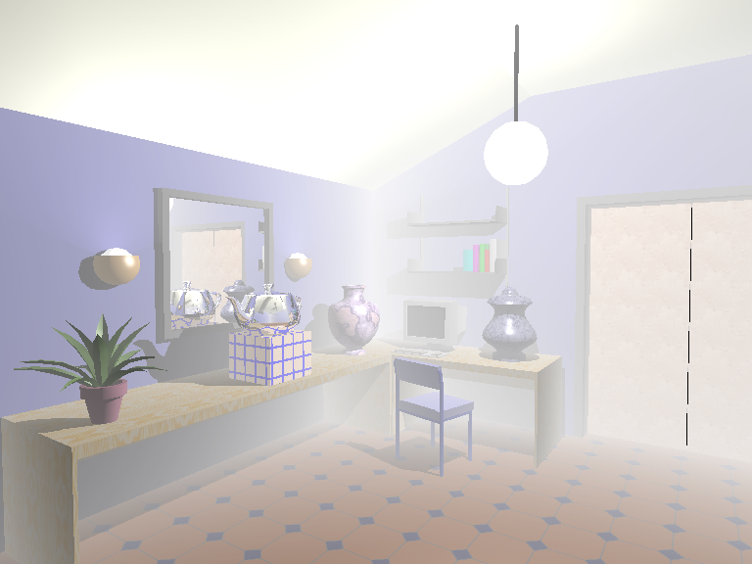
Attenuation:
Atmospheric (fog, haze)
z_{f} and z_{b}: near/far depth-cue plane
s_{f} and s_{b}: scale factors
I_{dc}: depth cue color
Given z_{f} > z₀ > z_{b}
interpolate s_{f} > s₀ > s_{b}
Adjust intensity
  I’ = s₀I + (1 - s₀)I_{dc}

Slide 7
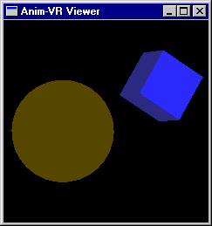
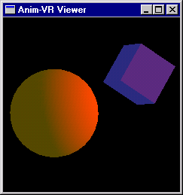
Colored Lights
(slightly different, but equivalent, to book)
O_{d}: diffuse color
  (O_{dR}, O_{dG}, O_{dB})
Compute for each component
i.e. red compenent is
  I_{R} = I_{aR}k_{a}O_{dR} + f_{att}I_{pR}k_{d}O_{dR} (N ·L)
Note: use O_{d} for
ambient and diffuse

Slide 8
Specular Reflection:
Phong Model
Account for viewer position
  Create highlights
Based on cos^{n}α = (R ·V)^{n}
  Larger n, smaller highlight
k_{s}: specular reflection coef.
  I = I_{a}k_{a}O_{d} + f_{att}I_{p} [ k_{d}O_{d} (N ·L) + k_{s} (R ·V)^{n}]
N
L
R
V
Θ
Θ
α

Slide 9
Multiple Light Sources
Obvious summation over m lights:
I = I_{a}k_{a}O_{d} + Σ f_{atti}I_{pi} [ k_{d}O_{d} (N ·L_{i}) + k_{s} (R_{i} ·V)^{n}]
1≤0≤m

Slide 10
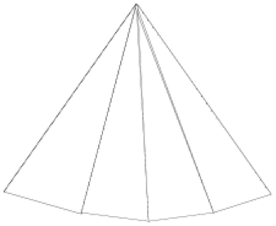

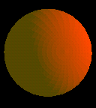
Shading Models:
Flat Shading
Compute one color for polygon
  Use polygon normal in lighting eqs.
Every pixel is assigned same color
Fast and simple
Shade of polygons independent

Slide 11
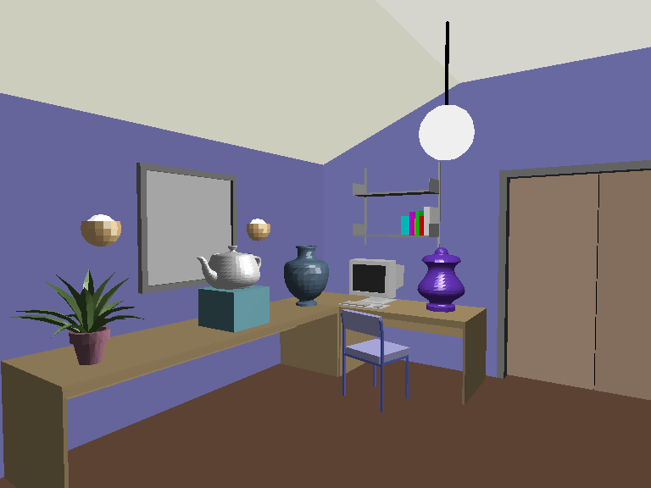

Slide 12
Gouraud Shading
N₃
N₄
N_{avg}
N₂
N₁
Compute vertex normals
  Average normals of abutting polygons
Use vertex normal in lighting eqs.
Linearly interpolate vertex
intensities
  Along edges
  Along scan lines
V₁
V₂
A
B
V_{is}
V₄
V₃

Slide 13
Gouraud Shading
Often appears dull, chalky
  Lacks accurate specular
  component
    If included, will be averaged
    over entire polygon
Mach banding
  Artifact at discontinuities in
  intensity or intensity slope

Slide 14
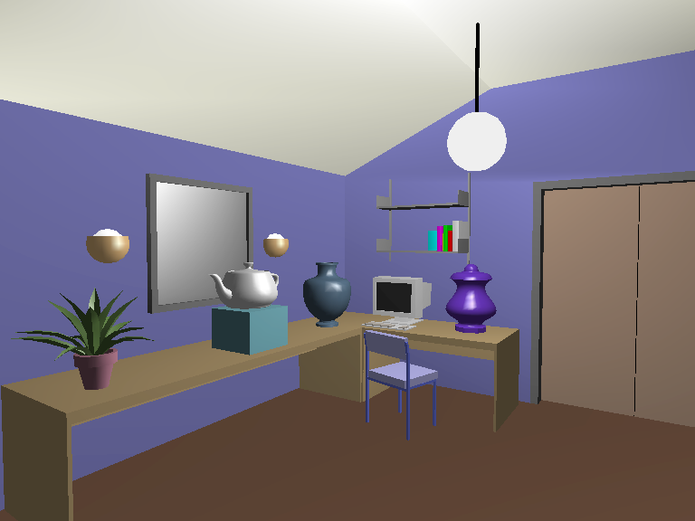

Slide 16
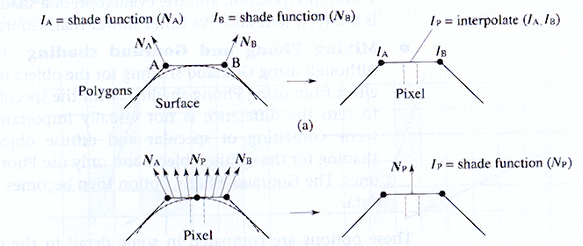
Phong Shading
Linearly interpolate vertex normals
  Compute lighting eqs. at each pixel
    Normals must be backmapped to WC
Can use specular component
Notes:
Illumination and Shading
9/19/02
CS4451: Fall 2002

Slide 17
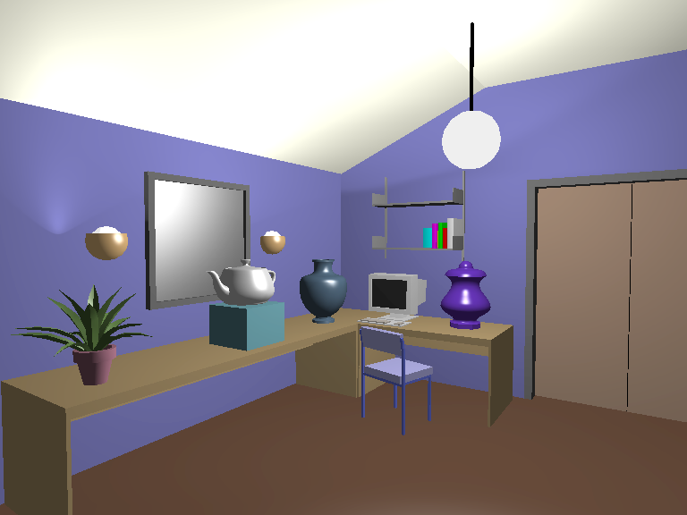

Slide 19
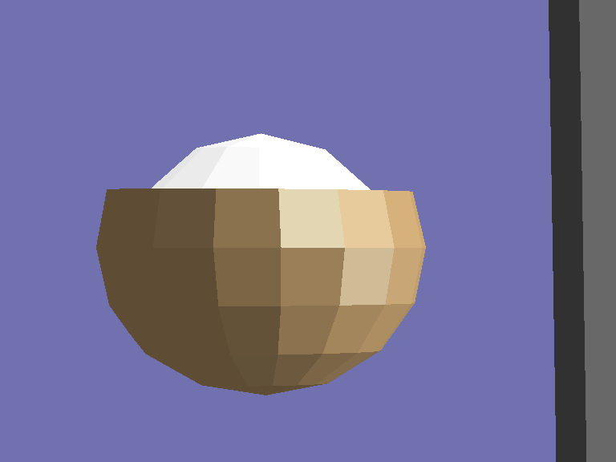
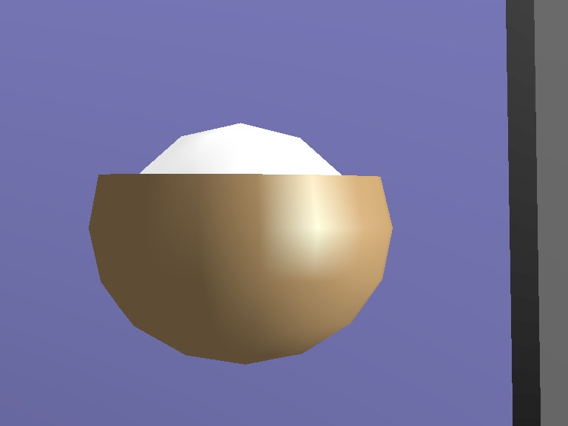
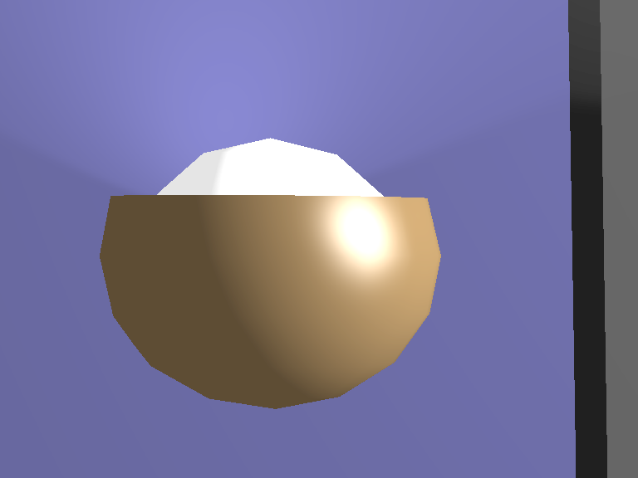
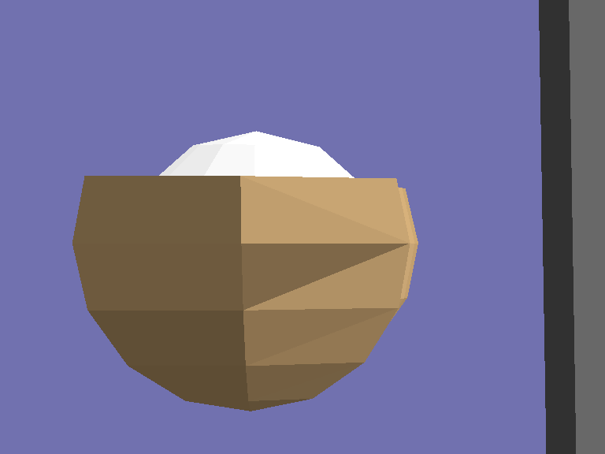
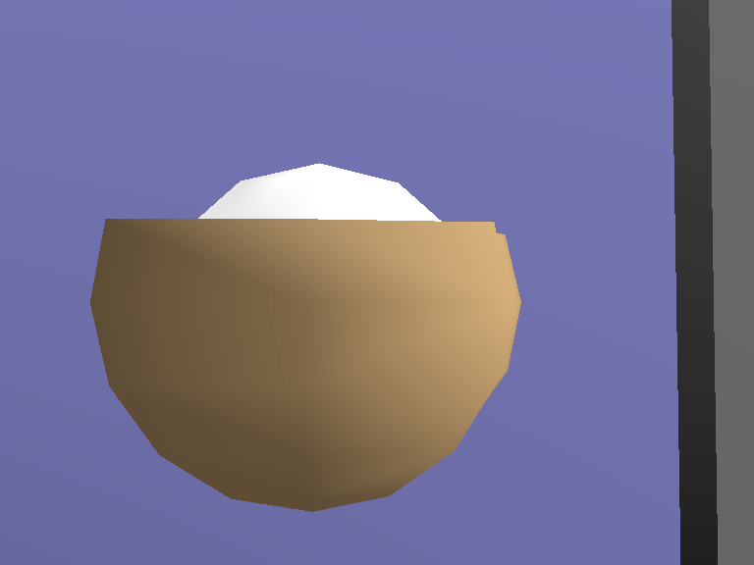
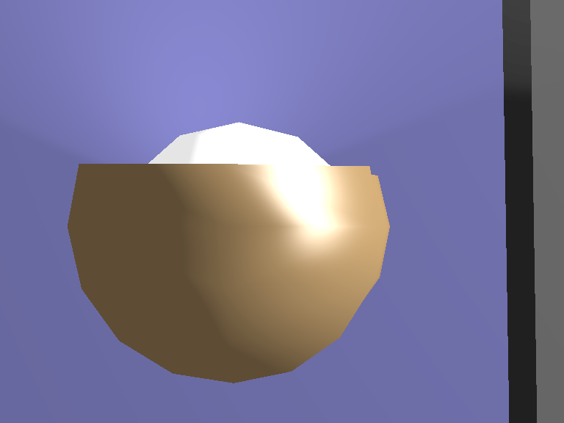
Closeup: Flat, Gouraud, Phong

Slide 20
Problems with Interpolated Shading
Polygonal
silhouette
Perspective distortion
V₁
V₂
A
B
V_{is}
V₄
V₃

Slide 21
Problems with Interpolated Shading
Scanline/orientation dependent
  Creates temporal aliasing when used to render animation frames:
= ?



Slide 22
Problems with Interpolated Shading
A
Shared vertices
Unrepresentative vertex normals
  Missed specular highlights
  Missed geometry
C
B

Slide 23
Lighting, in practice
Full lighting equation:
  I = I_{a}k_{a}O_{d} + Σ f_{atti}I_{pi} [ k_{d}O_{d} (N ·L_{i}) + k_{s} (R_{i} ·V)^{n}]
Ignore specular for now
Each surface: O_{d}, k_{a}, k_{d}, v_{i (i=0..n)}, N
Each light: I_{a or d}, f_{att} (c₁, c₂, c₃), P_{L} (position)
1≤0≤m

Slide 24
At a given point
Start with ambient: I_{a}k_{a}O_{d}
  R/G/B using I_{aR}, I_{aG}, I_{aB}, O_{dR}, O_{dG}, O_{dB}
For each Light, compute: f_{att}I_{p} k_{d}O_{d} (N ·L_{i})
  Position (P_{P}), normal (N_{P})
  L vector
  d_{L}
  f_{att}= 1/(c₁ + c₂d_{L} + c₃d_{L}²)
  R/G/B using I_{pR}, I_{pG}, I_{pB}, O_{dR}, O_{dG}, O_{dB}

Slide 25
Light Intensity Values
I_{a}, I_{d}
  Represent intensity
  Have R,G,B components
  Do not need to fall in the 0..1 range!
    Often need I_{d}>1
    Final computed I ≤ 1

Slide 26
Specular
A light might have a diffuse and specular specification, say I_{s}
  Allow slightly different colors, more control
    Remember, it’s a hack anyway!
I_{s} would have RGB parts, as with I_{a}, I_{d}
Illumination formula becomes
  I = I_{a}k_{a}O_{d} + Σ f_{atti} [I_{pdi}k_{d}O_{d} (N ·L_{i}) + I_{psi}k_{s} (R_{i} ·V)^{n}]
1≤0≤m

