Slide 1
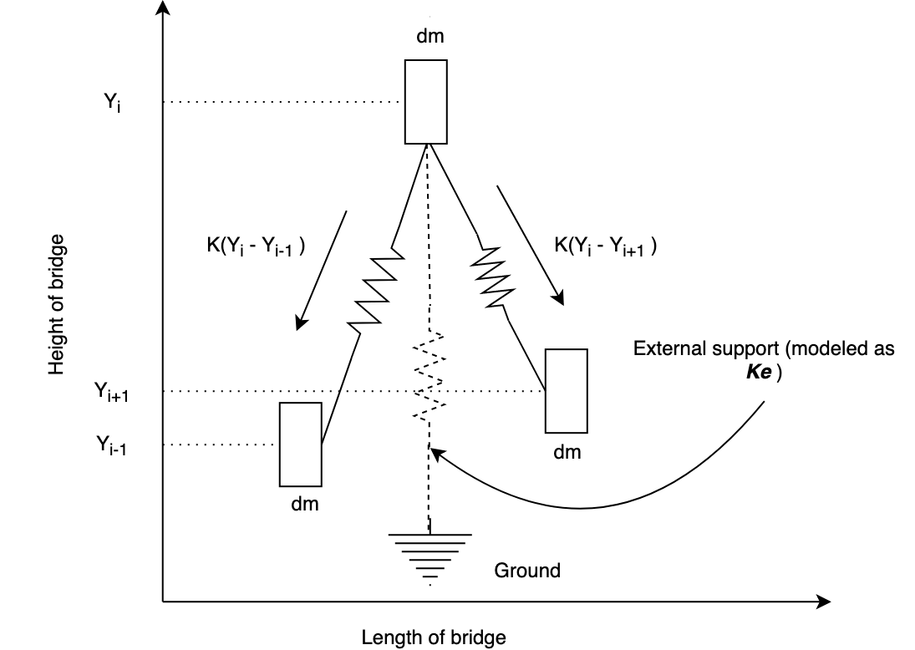

Slide 2





















Bridge height
$$y_{0}$$
$$y_{1}$$
$$y_{i−1}$$
$$y_{i}$$
$$y_{i+1}$$
…
…
$$m_{0}$$
$$m_{1}$$
$$m_{2}$$
$$m_{3}$$
$$m_{i−1}$$
$$m_{i}$$
$$m_{i+1}$$
$$m_{N−2}$$
$$m_{N−1}$$
Bridge length
$$y_{i+1}$$
Bridge height
$$m_{i+1}$$
$$y_{i}$$
$$y_{i−1}$$
$$m_{i}$$
$$m_{i−1}$$
Bridge length

Slide 3















Bridge height
$$y_{0}$$
$$y_{1}$$
$$y_{i−1}$$
$$y_{i}$$
$$y_{i+1}$$
$$m_{0}$$
$$m_{1}$$
$$m_{2}$$
$$m_{3}$$
$$m_{i−1}$$
$$m_{i}$$
$$m_{i+1}$$
$$m_{N−2}$$
$$m_{N−1}$$
…
…
$$p_{o}$$
$$p_{1}$$
$$p_{i}$$
$$p_{N−1}$$
Bridge length

