Slide 1
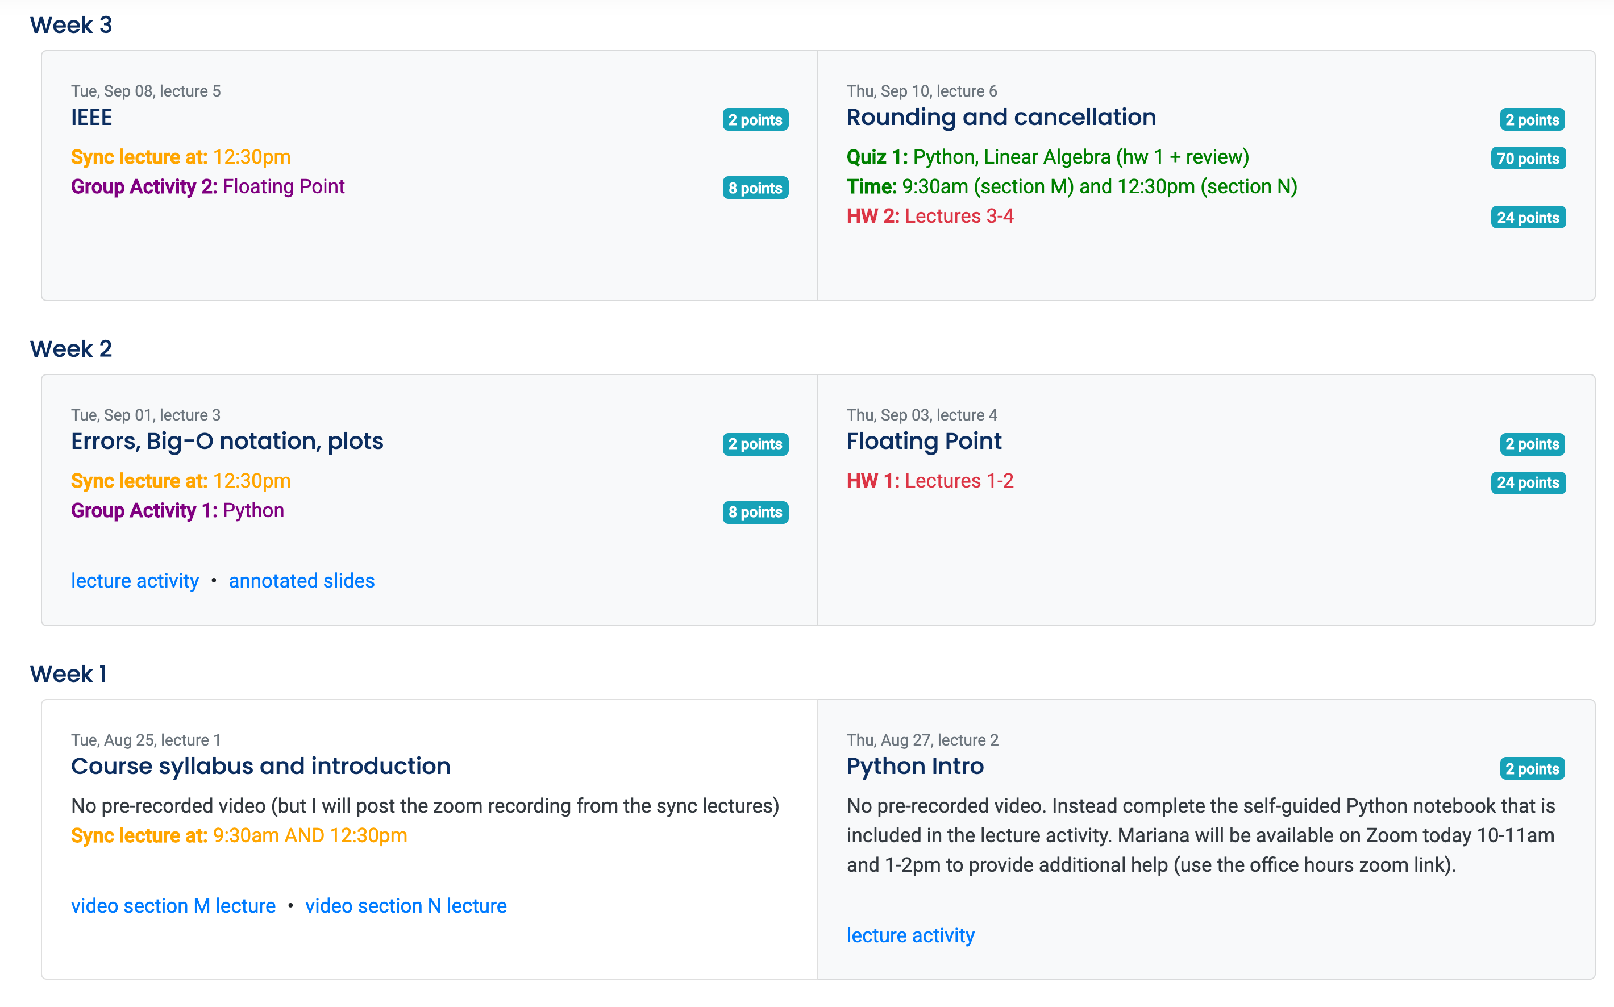
This group activity refers to material that you learned the previous week (and hence you should have completed L3 and L4 prior to starting GA2)
This is when you should be watching the the corresponding lecture activity (pre-recorded lectures embedded in PL). In this example, you should aim to complete L3 on September 1 (plus or minus one day).
Complete L4 on Sept 3 (+ or – 1 day)
This group activity refers to material that you learned the previous week. You should have completed L2 before starting GA1

