Slide 1
Graphs and Markov chains

Slide 2
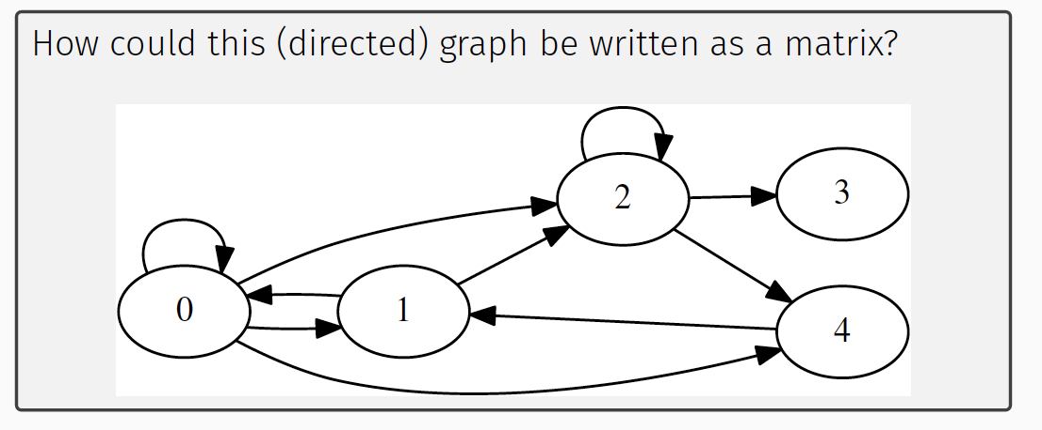
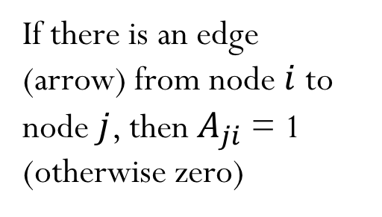
Graphs as matrices
 | 0 | 1 | 2 | 3 | 4
0 | 1 | 1 | 0 | 0 | 0
1 | 1 | 0 | 0 | 0 | 1
2 | 1 | 1 | 1 | 0 | 0
3 | 0 | 0 | 1 | 0 | 0
4 | 1 | 0 | 1 | 0 | 0
If there is an edge (arrow) from node $i$ to node $j$, then $A_{ji}$ = 1 (otherwise zero)
Adjacency Matrix
Notes:
Use the reference page, not wikipedia. Related to transition matrix.

Slide 3
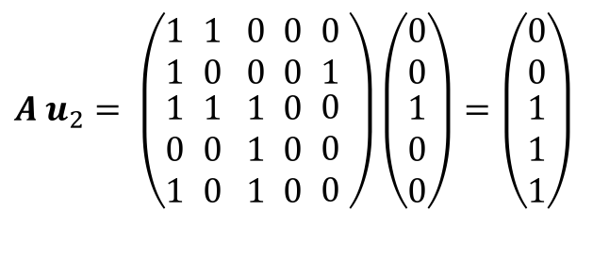
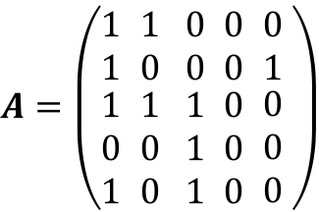
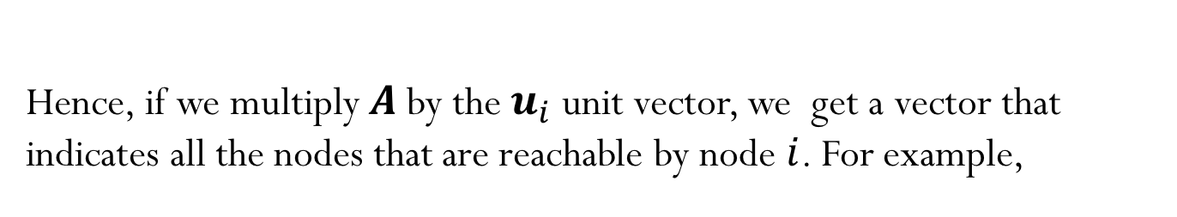
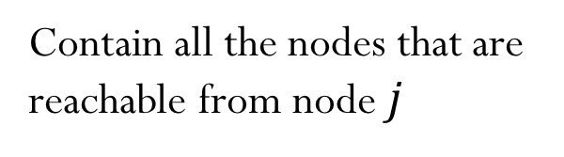
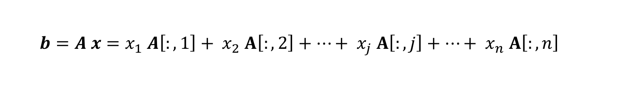
$$A=\left(\begin{matrix}1 \\ 1 \\ \begin{aligned}1 \\ 0 \\ 1\end{aligned}\end{matrix} \begin{matrix}1 \\ 0 \\ \begin{aligned}1 \\ 0 \\ 0\end{aligned}\end{matrix} \begin{matrix}0 \\ 0 \\ \begin{aligned}1 \\ 1 \\ 1\end{aligned}\end{matrix} \begin{matrix}0 \\ 0 \\ \begin{aligned}0 \\ 0 \\ 0\end{aligned}\end{matrix} \begin{matrix}0 \\ 1 \\ \begin{aligned}0 \\ 0 \\ 0\end{aligned}\end{matrix} \right)$$
Matrix-vector multiplication:
$${b=A x=x}_{1} A\left[:,1\right]+{ x}_{2} A\left[:,2\right]+…+{ x}_{j} A\left[:,j\right]+…+{ x}_{n} A\left[:,n\right]$$
Contain all the nodes that are reachable from node $j$
Hence, if we multiply $A$by the $u_{i}$ unit vector, we get a vector that indicates all the nodes that are reachable by node $i$. For example,
$A{ u}_{2}=$ $\left(\begin{matrix}1 \\ 1 \\ \begin{aligned}1 \\ 0 \\ 1\end{aligned}\end{matrix} \begin{matrix}1 \\ 0 \\ \begin{aligned}1 \\ 0 \\ 0\end{aligned}\end{matrix} \begin{matrix}0 \\ 0 \\ \begin{aligned}1 \\ 1 \\ 1\end{aligned}\end{matrix} \begin{matrix}0 \\ 0 \\ \begin{aligned}0 \\ 0 \\ 0\end{aligned}\end{matrix} \begin{matrix}0 \\ 1 \\ \begin{aligned}0 \\ 0 \\ 0\end{aligned}\end{matrix} \right)\left(\begin{matrix}0 \\ 0 \\ \begin{aligned}1 \\ 0 \\ 0\end{aligned}\end{matrix}\right)=\left(\begin{matrix}0 \\ 0 \\ \begin{aligned}1 \\ 1 \\ 1\end{aligned}\end{matrix}\right)$

Slide 4
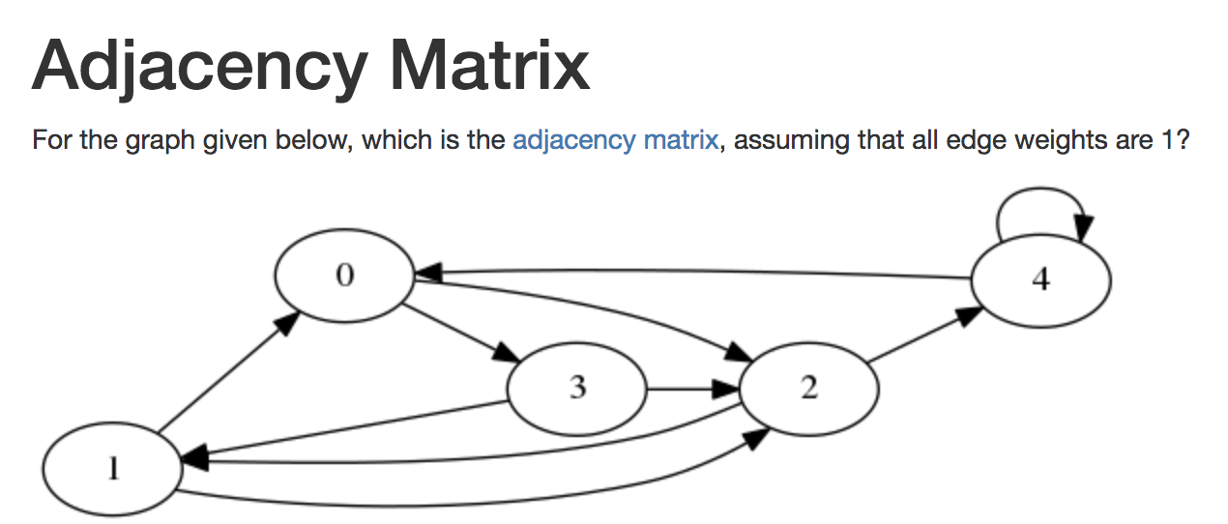
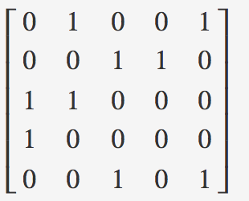
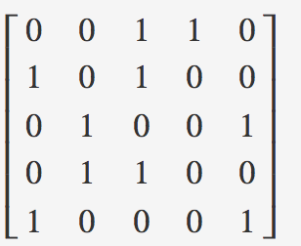
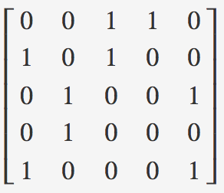
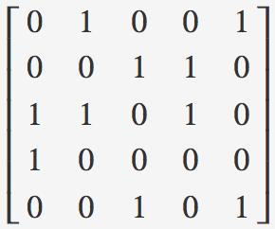
Iclicker question
A)
B)
C)
D)
Notes:
D)

Slide 5
Using graphs to represent the transition from one state to the next
After collecting data about the weather for many years, you observed that the chance of a rainy day occurring after a rainy day is 50% and that the chance of a rainy day after a sunny day is 10%.
SUNNY
RAINY
The graph can be represented as an adjacency matrix, where the edge weights are the probabilities of weather conditions (transition matrix)
 | Sunny | Rainy
Sunny
Rainy

Slide 6




Transition (or Markov) matrices
Note that only the most recent state matters to determine the probability of the next state (in this example, the weather predictions for tomorrow will only depend on the weather conditions of today) – memoryless process!
This is called the Markov property, and the model is called a Markov chain
$$10\%$$
 | Sunny | Rainy
Sunny | 0.9 | 0.5
Rainy | 0.1 | 0.5
$$90\%$$
SUNNY
RAINY
$$50\%$$
$$50\%$$

Slide 7



Transition (or Markov) matrices
The transition matrix describe the transitions of a Markov chain. Each entry is a non-negative real number representing a probability.
(I,J) entry of the transition matrix has the probability of transitioning from state J to state I.
Columns add up to one.
$$10\%$$
 | Sunny | Rainy
Sunny | 0.9 | 0.5
Rainy | 0.1 | 0.5
$$90\%$$
SUNNY
RAINY
$$50\%$$
$$50\%$$

Slide 8
Iclicker question
http://setosa.io/ev/markov-chains/
The weather today is sunny. What is the probability of a sunny day on Saturday?
81%
86%
90%
95%
Demo “Weather predictions”
Notes:
D)

Slide 9
What if I want to know the probability of days that are sunny in the long run?
Notes:
D)

Slide 10
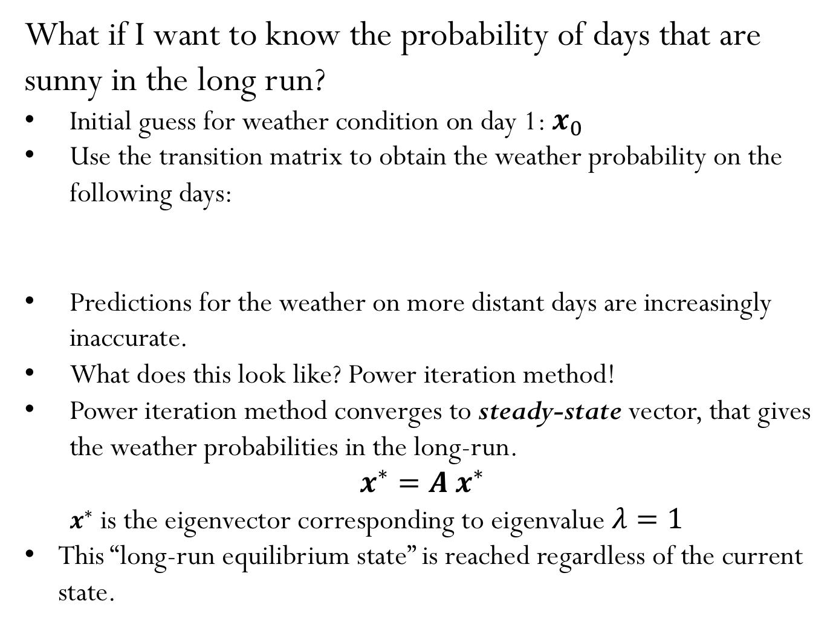




What if I want to know the probability of days that are sunny in the long run?
Initial guess for weather condition on day 1: $x_{0}$
Use the transition matrix to obtain the weather probability on the following days:
Predictions for the weather on more distant days are increasingly inaccurate.
What does this look like? Power iteration method!
Power iteration method converges to steady-state vector, that gives the weather probabilities in the long-run.
$$x^{∗}=A{ x}^{∗}$$
$x^{∗}$ is the eigenvector corresponding to eigenvalue $λ=1$
This “long-run equilibrium state” is reached regardless of the current state.
$${x_{1}=A x}_{0}$$
$${x_{2}=A x}_{1}$$
$$…$$
$${x_{5}=A x}_{4}$$
Notes:
D)

Slide 11
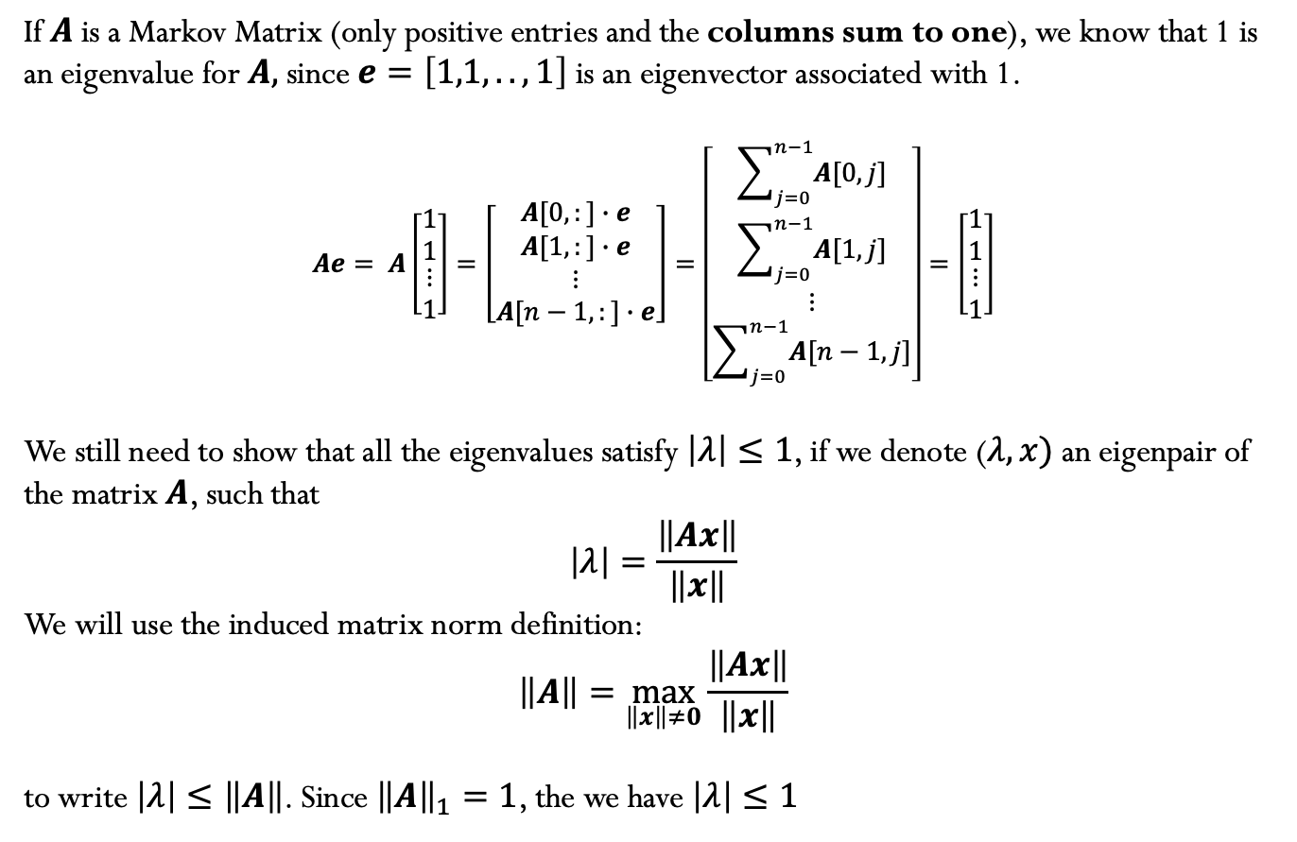
How can we show that the largest eigenvalue of the Markov Matrix is one?
If $A$ is a Markov Matrix (only positive entries and the columns sum to one), we know that 1 is an eigenvalue for $A,$ since $e=\left[1,1,..,1\right]$ is an eigenvector associated with 1.
$$Ae= A\left[\begin{matrix}1 \\ 1 \\ \begin{aligned}⋮ \\ 1\end{aligned}\end{matrix}\right]=\left[\begin{matrix}A[0,:]∙e \\ A[1,:]∙e \\ \begin{aligned}⋮ \\ A[n−1,:]∙e\end{aligned}\end{matrix}\right]=\left[\begin{matrix}\sum_{j=0}^{n−1}{A[0,j]} \\ \sum_{j=0}^{n−1}{A[1,j]} \\ \begin{aligned}⋮ \\ \sum_{j=0}^{n−1}{A[n−1,j]}\end{aligned}\end{matrix}\right]=\left[\begin{matrix}1 \\ 1 \\ \begin{aligned}⋮ \\ 1\end{aligned}\end{matrix}\right]$$
We still need to show that all the eigenvalues satisfy $\left|λ\right|≤1$, if we denote ($λ,x)$ an eigenpair of the matrix $A$, such that
$$\left|λ\right|=\frac{\left\|Ax\right\|}{\left\|x\right\|}$$
We will use the induced matrix norm definition:
$$\left\|A\right\|=\max_{\left\|x\right\|≠0}{\frac{\left\|Ax\right\|}{\left\|x\right\|}}$$
to write $\left|λ\right|≤\left\|A\right\|$. Since ${\left\|A\right\|}_{1}=1$, the we have $\left|λ\right|≤1$

Slide 12











Another example…
Consider the following graph of states. Suppose this is a model of the behavior of a student at each minute of a lecture. ☺
$$70\%$$
Working on a HW
$$10\%$$
$$20\%$$
$$15\%$$
$$60\%$$
$$10\%$$
Participating in lecture (working on demos, answering iclickers, listening and asking questions)
$$50\%$$
$$40\%$$
$$5\%$$
$$20\%$$
Exchanging text messages with friends
$$50\%$$
Surfing the web
$$30\%$$
$$20\%$$

Slide 13
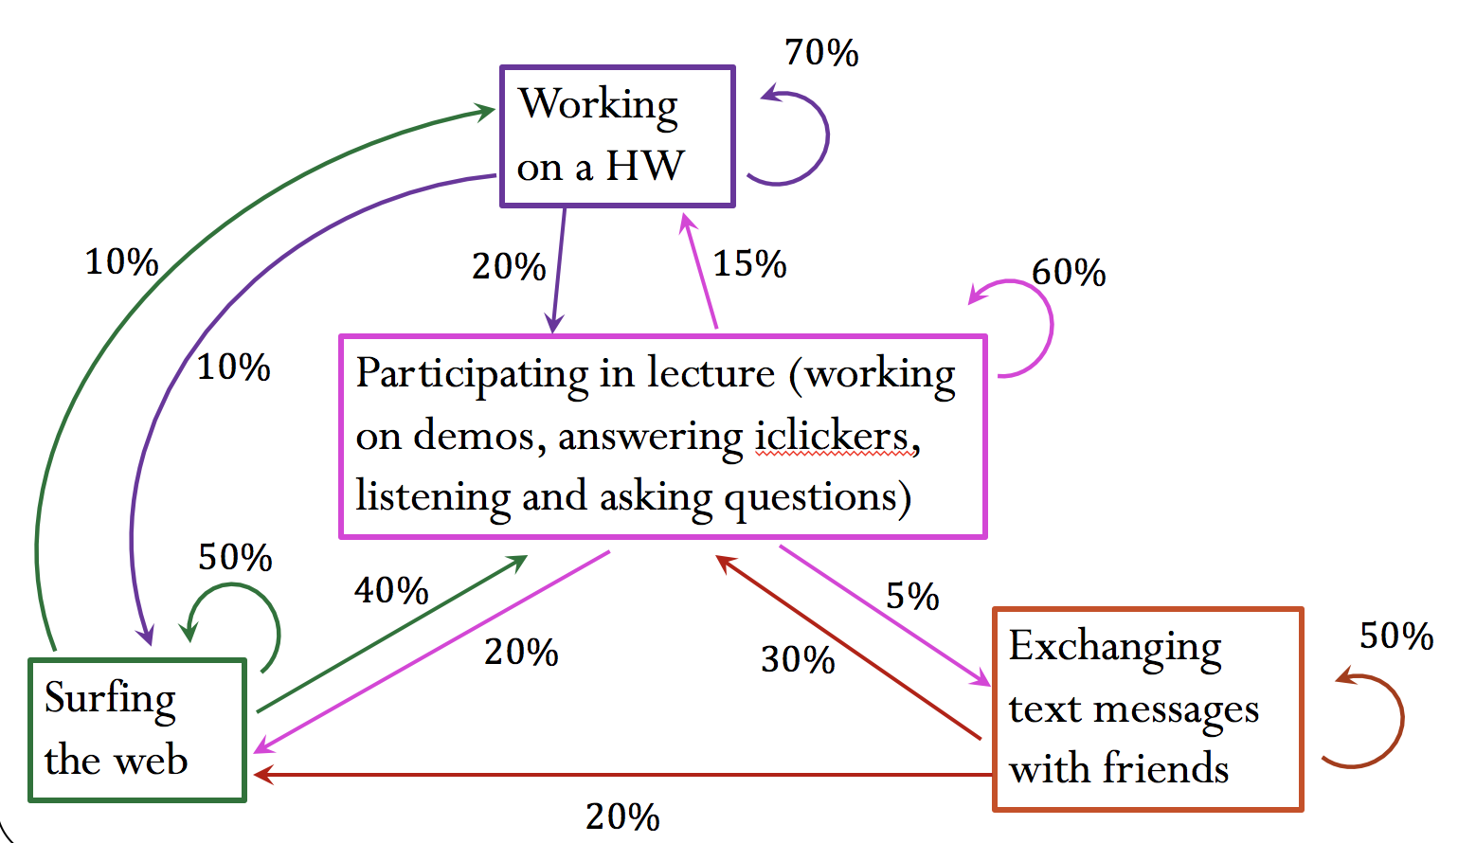
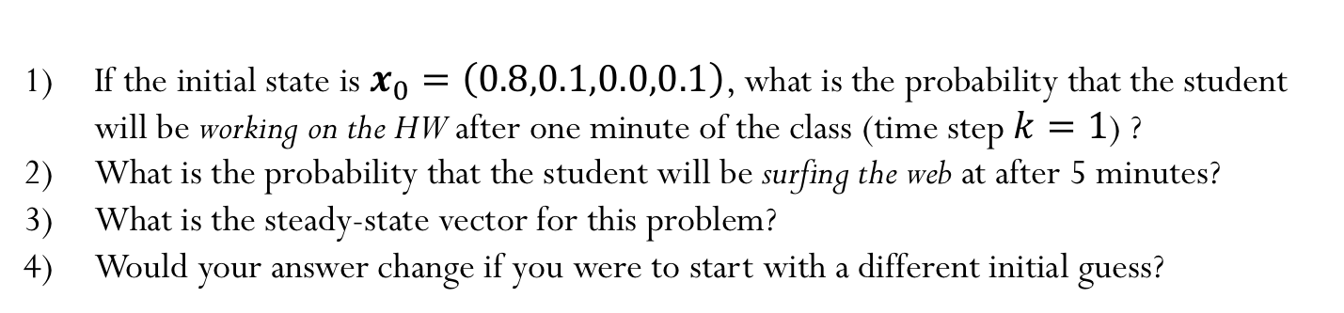

Student in-class activity
$x=\left(a,b,c,d\right)$contains the probabilities of a student performing each activity at each minute of the class:
$a$is the probability of participating in lecture,
$b$ is the probability of surfing the web,
$c$is the probability of working on the HW,
$d$is the probability of texting.
If the initial state is $x_{0}=\left(0.8,0.1,0.0,0.1\right)$, what is the probability that the student will be working on the HW after one minute of the class (time step $k=1$) ?
What is the probability that the student will be surfing the web at after 5 minutes?
What is the steady-state vector for this problem?
Would your answer change if you were to start with a different initial guess?

Slide 14
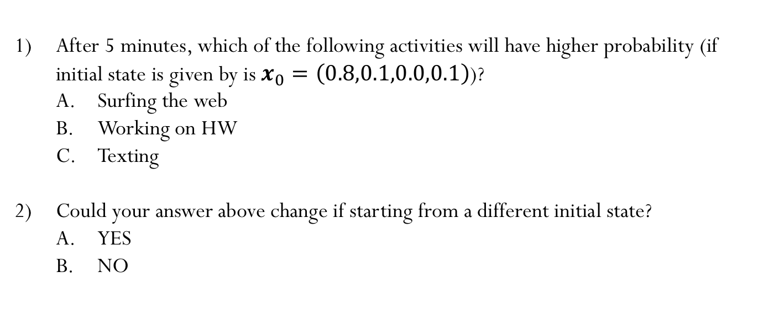
Student in-class activity
After 5 minutes, which of the following activities will have higher probability (if initial state is given by is $x_{0}=\left(0.8,0.1,0.0,0.1\right)$)?
Surfing the web
Working on HW
Texting
Could your answer above change if starting from a different initial state?
YES
NO
Demo “Student-Activities-During-Lecture”

Slide 15

 | Lect | Web | HW | Text
Lec | 0.6 | 0.4 | 0.2 | 0.3
Web | 0.2 | 0.5 | 0.1 | 0.2
HW | 0.15 | 0.1 | 0.7 | 0.0
Text | 0.05 | 0.0 | 0.0 | 0.5
$$A=$$
participating in lecture
working on the HW
surfing the web
texting
Notes:
C)

Slide 16
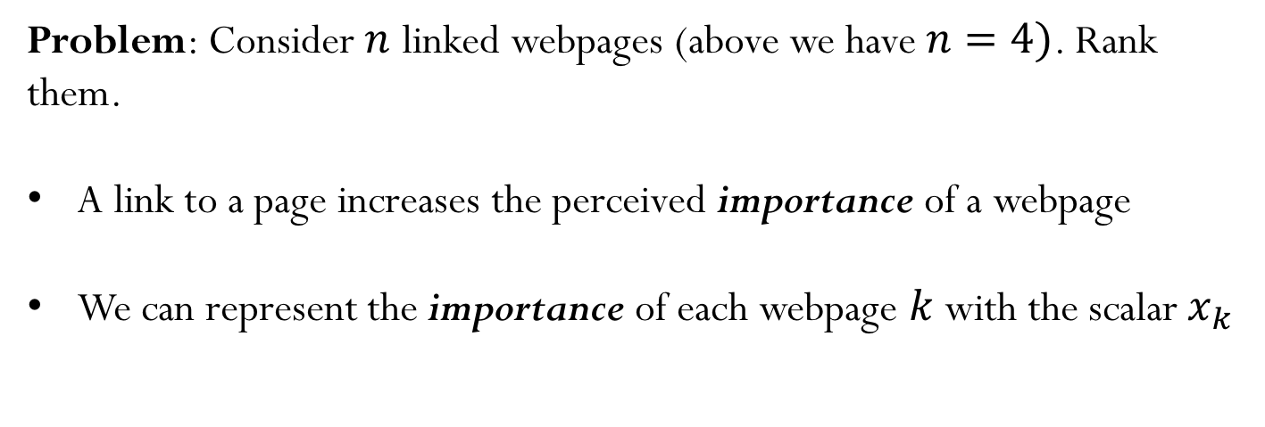
Page Rank
Webpage 1
Webpage 2
Webpage 3
Webpage 4
Problem: Consider $n$ linked webpages (above we have $n=4)$. Rank them.
A link to a page increases the perceived importance of a webpage
We can represent the importance of each webpage $k$ with the scalar$x_{k}$

Slide 17
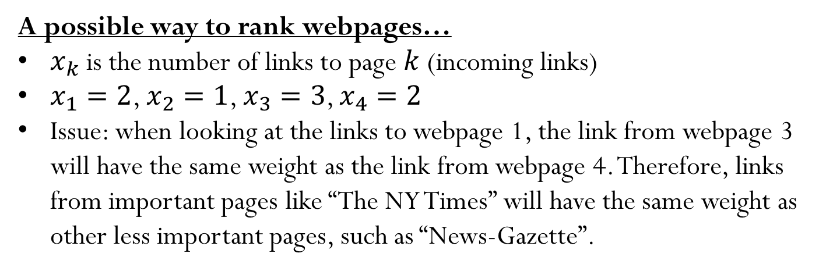
Page Rank
Webpage 1
Webpage 2
Webpage 3
Webpage 4
A possible way to rank webpages…
$x_{k}$ is the number of links to page $k$ (incoming links)
$x_{1}=2$, $x_{2}=1$, $x_{3}=3$, $x_{4}=2$
Issue: when looking at the links to webpage 1, the link from webpage 3 will have the same weight as the link from webpage 4. Therefore, links from important pages like “The NY Times” will have the same weight as other less important pages, such as “News-Gazette”.

Slide 18
Page Rank
Another way… Let’s think of Page Rank as an stochastic process.
http://infolab.stanford.edu/~backrub/google.html
“PageRank can be thought of as a model of user behavior. We assume there is a random surfer who is given a web page at random and keeps clicking on links, never hitting “back”…”
So the importance of a web page can be determined by the probability of a random user to end up on that page.

Slide 19
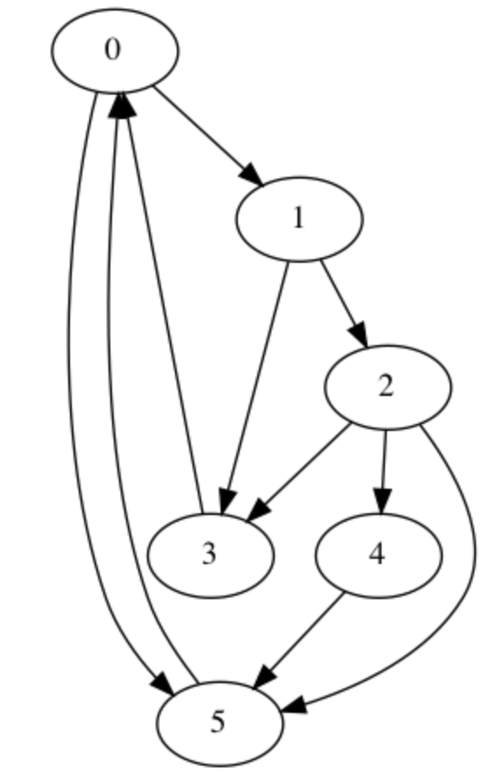
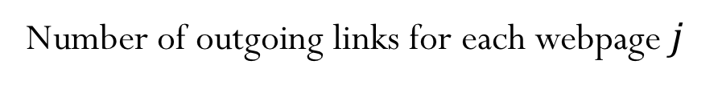
Page Rank
Let us write this graph problem (representing webpage links) as a matrix (adjacency matrix).
 | 0 | 1 | 2 | 3 | 4 | 5
0 | 0 |  |  | 1 |  | 1
1 | 1 | 0
2 |  | 1 | 0
3 |  | 1 | 1 | 0
4 |  |  | 1 |  | 0
5 | 1 |  | 1 |  | 1 | 0
2 | 2 | 3 | 1 | 1 | 1
Number of outgoing links for each webpage $j$

Slide 20
Page Rank
 | 0 | 1 | 2 | 3 | 4 | 5
0 | 0 |  |  | 1 |  | 1
1 | 1 | 0
2 |  | 1 | 0
3 |  | 1 | 1 | 0
4 |  |  | 1 |  | 0
5 | 1 |  | 1 |  | 1 | 0
The influence of each page is split evenly between the pages it links to (i.e., equal weights for each outgoing link)
Therefore, we should divide each row entry by the total column sum
 | 0 | 1 | 2 | 3 | 4 | 5
0 | 0 |  |  | 1.0 |  | 1.0
1 | 0.5 | 0
2 |  | 0.5 | 0
3 |  | 0.5 | 0.33 | 0
4 |  |  | 0.33 |  | 0
5 | 0.5 |  | 0.33 |  | 1.0 | 0

Slide 21

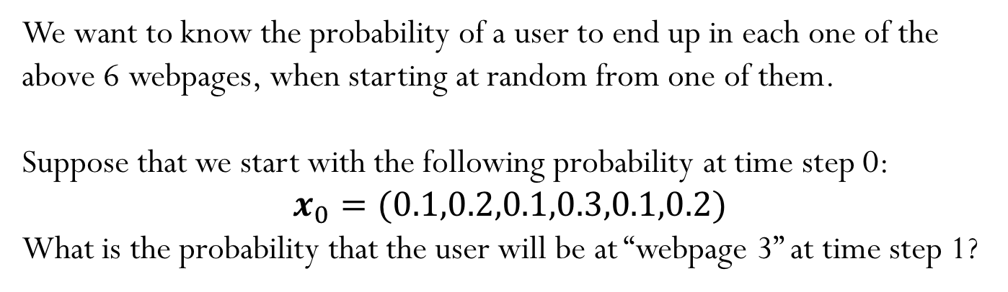
Page Rank
Note that the sum of each column is equal to 1. This is the Markov matrix!
0 |  |  | 1.0 |  | 1.0
0.5 | 0
 | 0.5 | 0
 | 0.5 | 0.33 | 0
 |  | 0.33 |  | 0
0.5 |  | 0.33 |  | 1.0 | 0
$$A=$$
We want to know the probability of a user to end up in each one of the above 6 webpages, when starting at random from one of them.
Suppose that we start with the following probability at time step 0:
$$x_{0}=(0.1,0.2,0.1,0.3,0.1,0.2)$$
What is the probability that the user will be at “webpage 3” at time step 1?

Slide 22
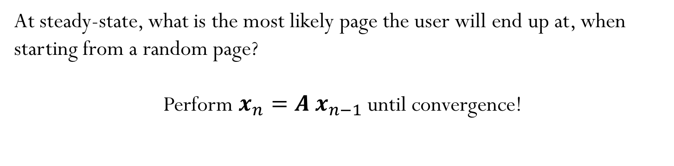
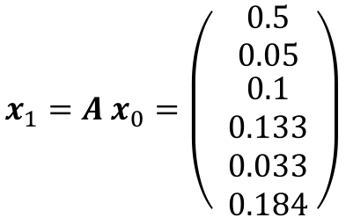
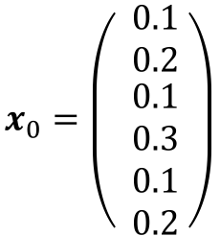
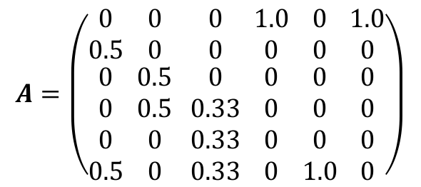
Page Rank
$$A=\left(\begin{matrix}0 \\ 0.5 \\ \begin{aligned}0 \\ 0 \\ 0 \\ 0.5\end{aligned}\end{matrix} \begin{matrix}0 \\ 0 \\ \begin{aligned}0.5 \\ 0.5 \\ 0 \\ 0\end{aligned}\end{matrix} \begin{matrix}0 \\ 0 \\ \begin{aligned}0 \\ 0.33 \\ 0.33 \\ 0.33\end{aligned}\end{matrix} \begin{matrix}1.0 \\ 0 \\ \begin{aligned}0 \\ 0 \\ 0 \\ 0\end{aligned}\end{matrix} \begin{matrix}0 \\ 0 \\ \begin{aligned}0 \\ 0 \\ 0 \\ 1.0\end{aligned}\end{matrix}\begin{matrix} 1.0 \\ 0 \\ \begin{aligned} 0 \\ 0 \\ 0 \\ 0\end{aligned}\end{matrix}\right)$$
$$x_{0}=\left(\begin{matrix} 0.1 \\ 0.2 \\ \begin{aligned} 0.1 \\ 0.3 \\ 0.1 \\ 0.2\end{aligned}\end{matrix} \right)$$
$$x_{1}=A x_{0}=\left(\begin{matrix} 0.5 \\ 0.05 \\ \begin{aligned} 0.1 \\ 0.133 \\ 0.033 \\ 0.184\end{aligned}\end{matrix} \right)$$
The user will have a probability of about 13% to be at “webpage 3” at time step 1.
At steady-state, what is the most likely page the user will end up at, when starting from a random page?
Perform $x_{n}=A x_{n−1}$until convergence!

Slide 23
Page Rank
The plot below shows the probabilities of a user ending up at each webpage for each time step.
0
5
1
3
2
4
The most “important” page is the one with the highest probability. Hence, the ranking for these 6 webpages would be (starting from the most important):
Webpages 0,5,1,3,2,4
Notes:
page_names = ['Google', 'Facebook', 'Amazon','Wikipedia','Twitter','YouTube']

Slide 24
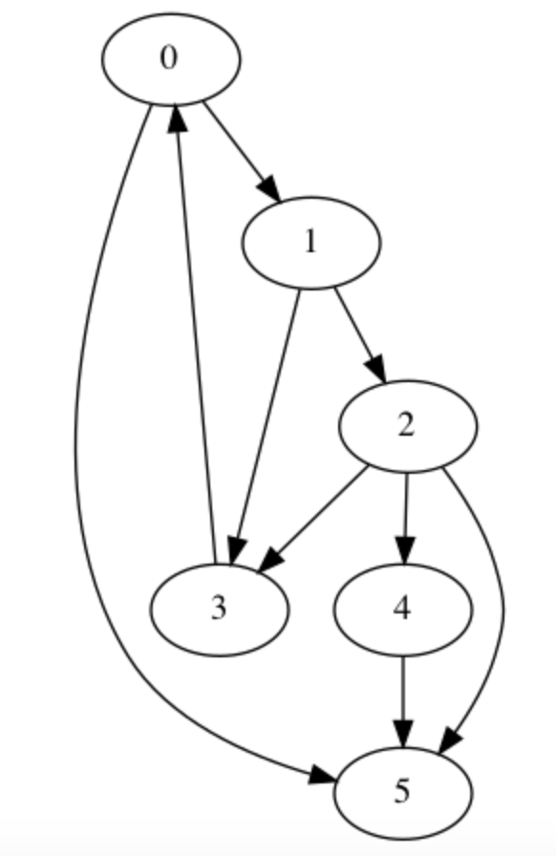
What if we now remove the link from webpage 5 to webpage 0?
 | 0 | 1 | 2 | 3 | 4 | 5
0 | 0 |  |  | 1
1 | 1 | 0
2 |  | 1 | 0
3 |  | 1 | 1 | 0
4 |  |  | 1 |  | 0
5 | 1 |  | 1 |  | 1 | 0
Note that we can no longer divide the entries of the last column by the total column sum, which in this case is zero (no outgoing links).

Slide 25
Approach: Since a random user will not stay on the same webpage forever, we can assume that all the other webpages have the same probability to be linked from “webpage 5”.
 | 0 | 1 | 2 | 3 | 4 | 5
0 | 0 |  |  | 1
1 | 1 | 0
2 |  | 1 | 0
3 |  | 1 | 1 | 0
4 |  |  | 1 |  | 0
5 | 1 |  | 1 |  | 1 | 0
 | 0 | 1 | 2 | 3 | 4 | 5
0 | 0 |  |  | 1.0 |  | 0.166
1 | 0.5 | 0 |  |  |  | 0.166
2 |  | 0.5 | 0 |  |  | 0.166
3 |  | 0.5 | 0.33 | 0 |  | 0.166
4 |  |  | 0.33 |  | 0 | 0.166
5 | 0.5 |  | 0.33 |  | 1.0 | 0.166

Slide 26
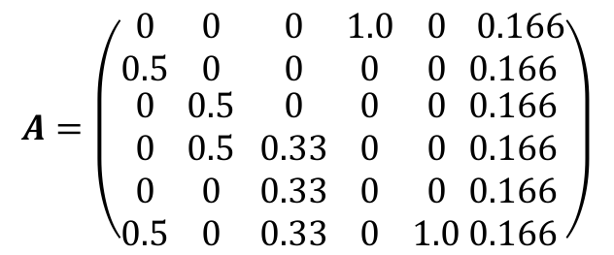
Page Rank
$$A=\left(\begin{matrix}0 \\ 0.5 \\ \begin{aligned}0 \\ 0 \\ 0 \\ 0.5\end{aligned}\end{matrix} \begin{matrix}0 \\ 0 \\ \begin{aligned}0.5 \\ 0.5 \\ 0 \\ 0\end{aligned}\end{matrix} \begin{matrix}0 \\ 0 \\ \begin{aligned}0 \\ 0.33 \\ 0.33 \\ 0.33\end{aligned}\end{matrix} \begin{matrix}1.0 \\ 0 \\ \begin{aligned}0 \\ 0 \\ 0 \\ 0\end{aligned}\end{matrix} \begin{matrix}0 \\ 0 \\ \begin{aligned}0 \\ 0 \\ 0 \\ 1.0\end{aligned}\end{matrix}\begin{matrix} 0.166 \\ 0.166 \\ \begin{aligned}0.166 \\ 0.166 \\ 0.166 \\ 0.166\end{aligned}\end{matrix}\right)$$
The plot below shows the probabilities of a user ending up at each webpage for each time step.
5
0
3
1
2
4
The most “important” page is the one with the highest probability. Hence, the ranking for these 6 webpages would be (starting from the most important):
Webpages 5,0,3,1,2,4

Slide 27
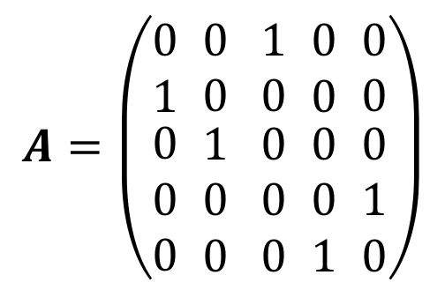

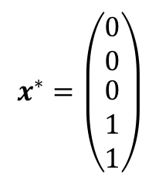
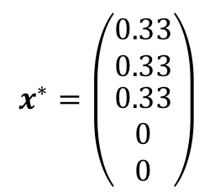
Page Rank
One remaining issue: the Markov matrix does not guarantee a unique solution
$$A=\left(\begin{matrix}0 \\ 1 \\ \begin{aligned}0 \\ 0 \\ 0\end{aligned}\end{matrix} \begin{matrix}0 \\ 0 \\ \begin{aligned}1 \\ 0 \\ 0\end{aligned}\end{matrix} \begin{matrix}1 \\ 0 \\ \begin{aligned}0 \\ 0 \\ 0\end{aligned}\end{matrix} \begin{matrix}0 \\ 0 \\ \begin{aligned}0 \\ 0 \\ 1\end{aligned}\end{matrix} \begin{matrix}0 \\ 0 \\ \begin{aligned}0 \\ 1 \\ 0\end{aligned}\end{matrix}\right)$$
1
2
4
3
5
Matrix A has two eigenvectors corresponding to the same eigenvalue 1
$$x^{∗}=\left(\begin{matrix}0.33 \\ 0.33 \\ \begin{aligned}0.33 \\ 0 \\ 0\end{aligned}\end{matrix}\right)$$
$$x^{∗}=\left(\begin{matrix}0 \\ 0 \\ \begin{aligned}0 \\ 1 \\ 1\end{aligned}\end{matrix}\right)$$
Perron-Frobenius theorem (CIRCA 1910):
If $A$ is a Markov matrix with all positive entries, then M has unique steady-state vector $x^{∗}$.

Slide 28
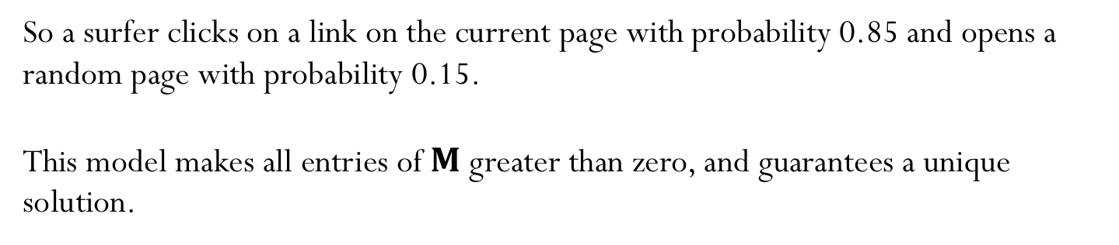
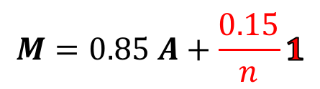
Page Rank
Brin-Page (1990s) proposed: “PageRank can be thought of as a model of user behavior. We assume there is a random surfer who is given a web page at random and keeps clicking on links, never hitting “back”, but eventually gets bored and starts on another random page.”
$$M=0.85 A+\frac{0.15}{n}1$$
So a surfer clicks on a link on the current page with probability 0.85 and opens a random page with probability 0.15.
This model makes all entries of $M$ greater than zero, and guarantees a unique solution.

Slide 29
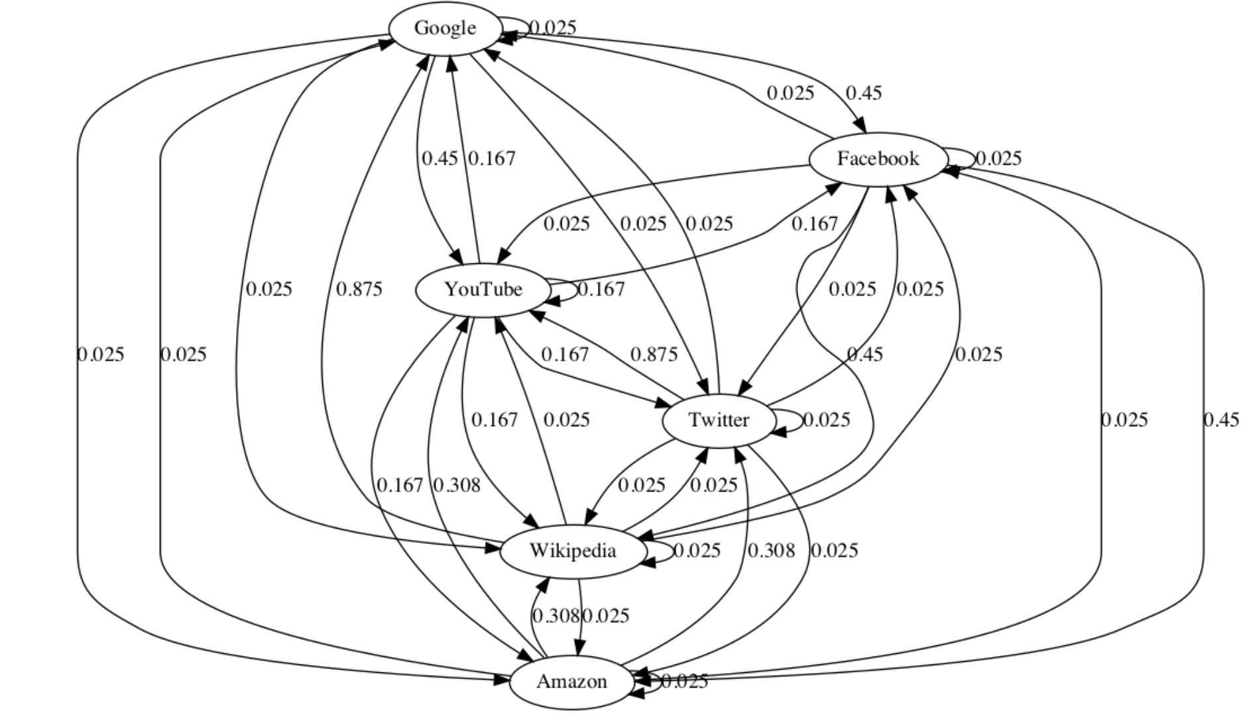
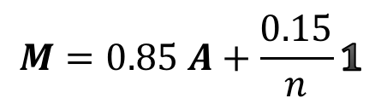
Page Rank
5
$$M=0.85 A+\frac{0.15}{n}1$$
0
3
1
2
4

Slide 30
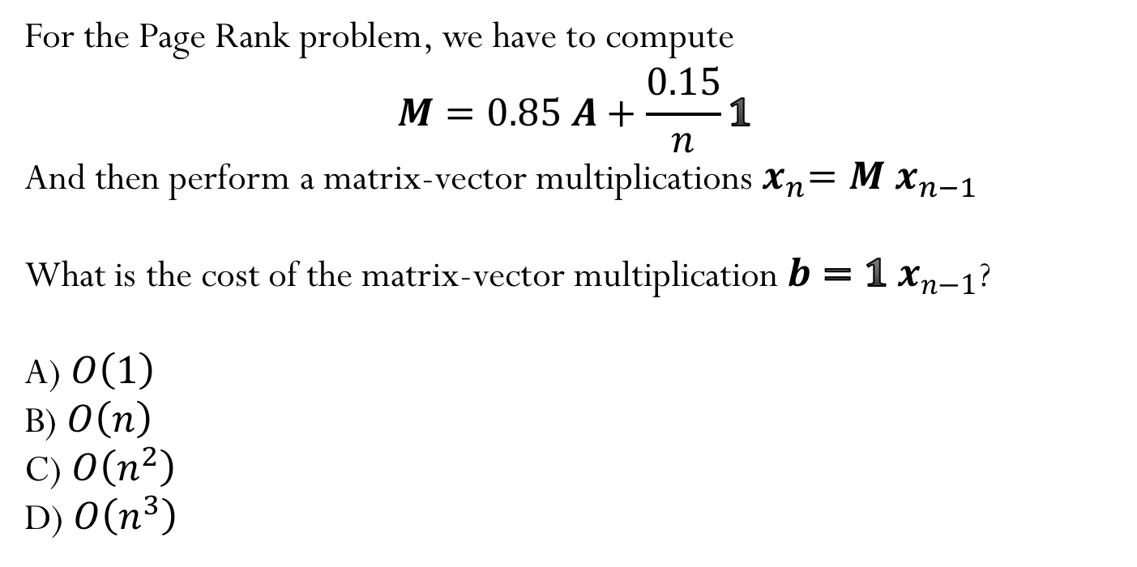
Iclicker question
For the Page Rank problem, we have to compute
$$M=0.85 A+\frac{0.15}{n}1$$
And then perform a matrix-vector multiplications${ x}_{n}=M x_{n−1}$
What is the cost of the matrix-vector multiplication $b=1$ $x_{n−1}$?
A) $O\left(1\right)$
B) $O\left(n\right)$
C) $O\left(n^{2}\right)$
D) $O\left(n^{3}\right)$

