Slide 1
Least Squares and Data Fitting
Notes:
Make updates! Look at this reference book!
https://web.stanford.edu/~boyd/vmls/vmls.pdf

Slide 2
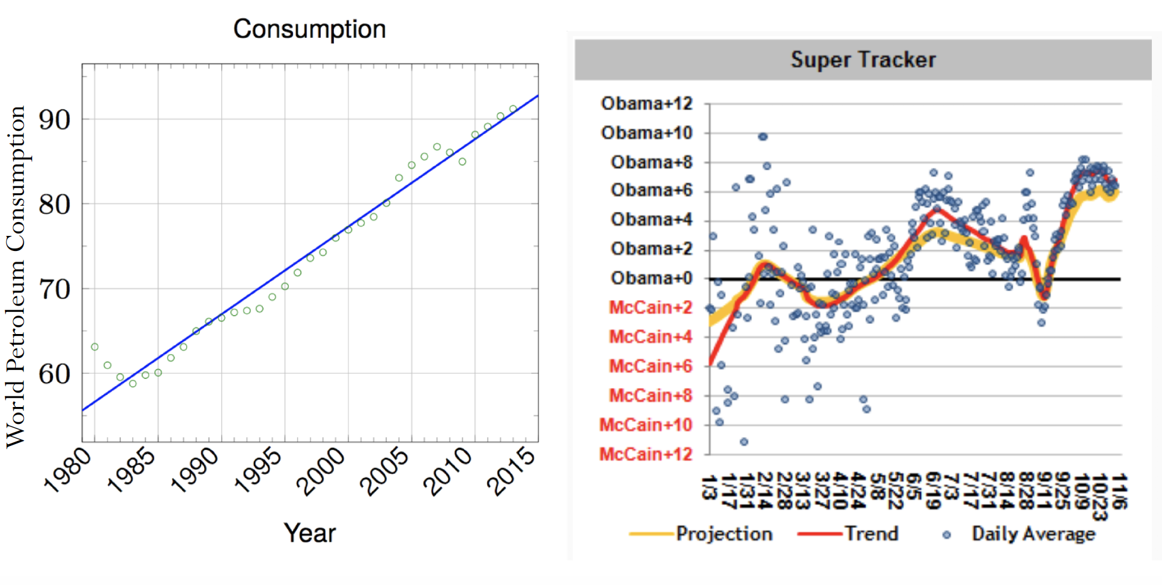
Data fitting
How do we best fit a set of data points?

Slide 3
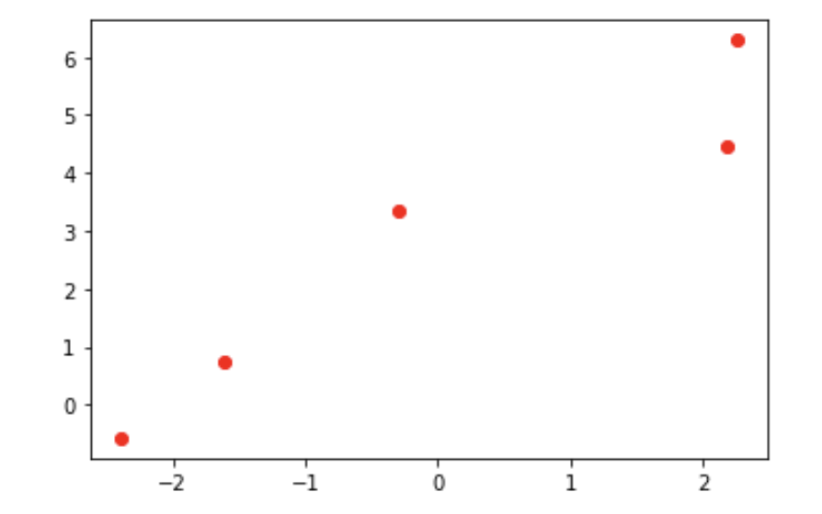
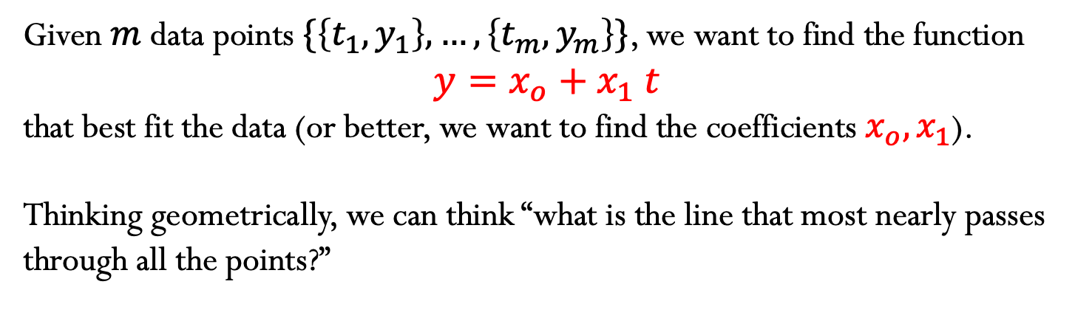
Linear Least Squares
1) Fitting with a line
Given$m$data points $\{\left\{t_{1},y_{1}\right\},…,\left\{t_{m},y_{m}\right\}\}$, we want to find the function
$$y=x_{o}+x_{1} t$$
that best fit the data (or better, we want to find the coefficients $x_{o},x_{1}$).
Thinking geometrically, we can think “what is the line that most nearly passes through all the points?”

Slide 4
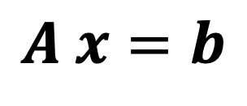
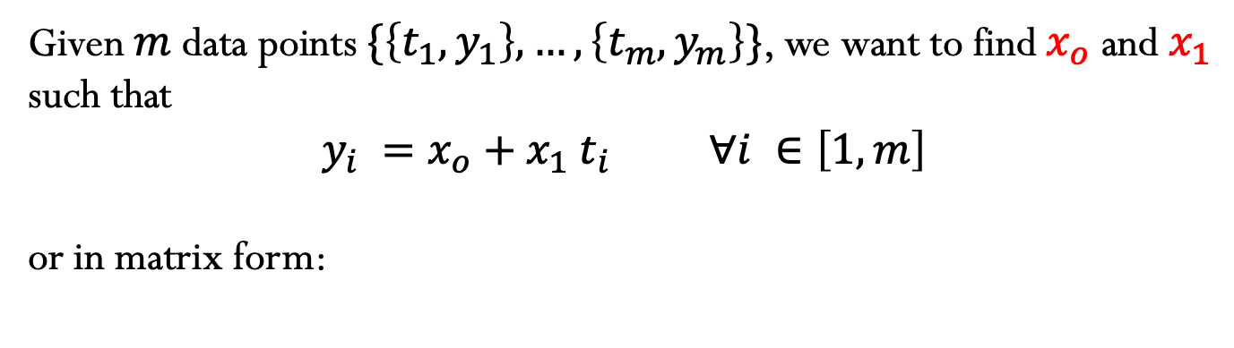
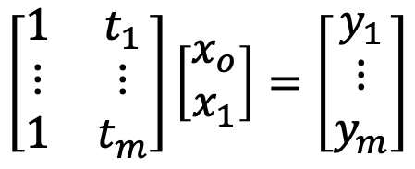



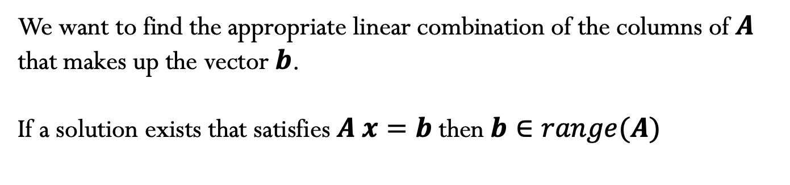
Given$m$data points $\{\left\{t_{1},y_{1}\right\},…,\left\{t_{m},y_{m}\right\}\}$, we want to find${ x}_{o}$ and $x_{1}$ such that
$$y_{i} =x_{o}+x_{1} t_{i} ∀i ∈\left[1,m\right]$$
or in matrix form:
Note that this system of linear equations has more equations than unknowns – OVERDETERMINED SYSTEMS
$$\left[\begin{matrix}1 & t_{1} \\ ⋮ & ⋮ \\ 1 & t_{m}\end{matrix}\right]\left[\begin{matrix}x_{o} \\ x_{1}\end{matrix}\right]=\left[\begin{matrix}y_{1} \\ ⋮ \\ y_{m}\end{matrix}\right]$$
$$A x=b$$
$$m×n$$
$$n×1$$
$$m×1$$
We want to find the appropriate linear combination of the columns of $A$ that makes up the vector $b$.
If a solution exists that satisfies $A x=b$ then $b∈range(A)$

Slide 5
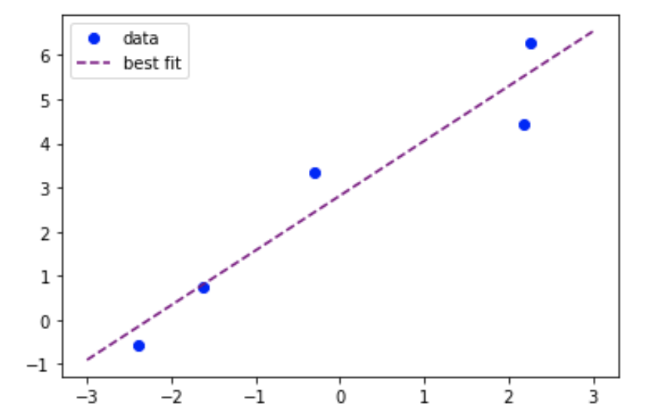

Linear Least Squares
In most cases, $b∉range(A)$ and $A x=b$ does not have an exact solution!
Therefore, an overdetermined system is better expressed as
$$A x≅b$$

Slide 6

Linear Least Squares
Least Squares: find the solution $x$ that minimizes the residual
$$r=b−A x$$
Let’s define the function $φ$ as the square of the 2-norm of the residual
$$φ\left(x\right)={\left\|b−A x\right\|}_{2}^{2}$$
Notes:
Why the 2-norm? Does not need to be. OTher p-norms could be used. However, just taking the summation of the absolute values will create problems when defining the optimization problem, since the derivative may not exist.

Slide 7
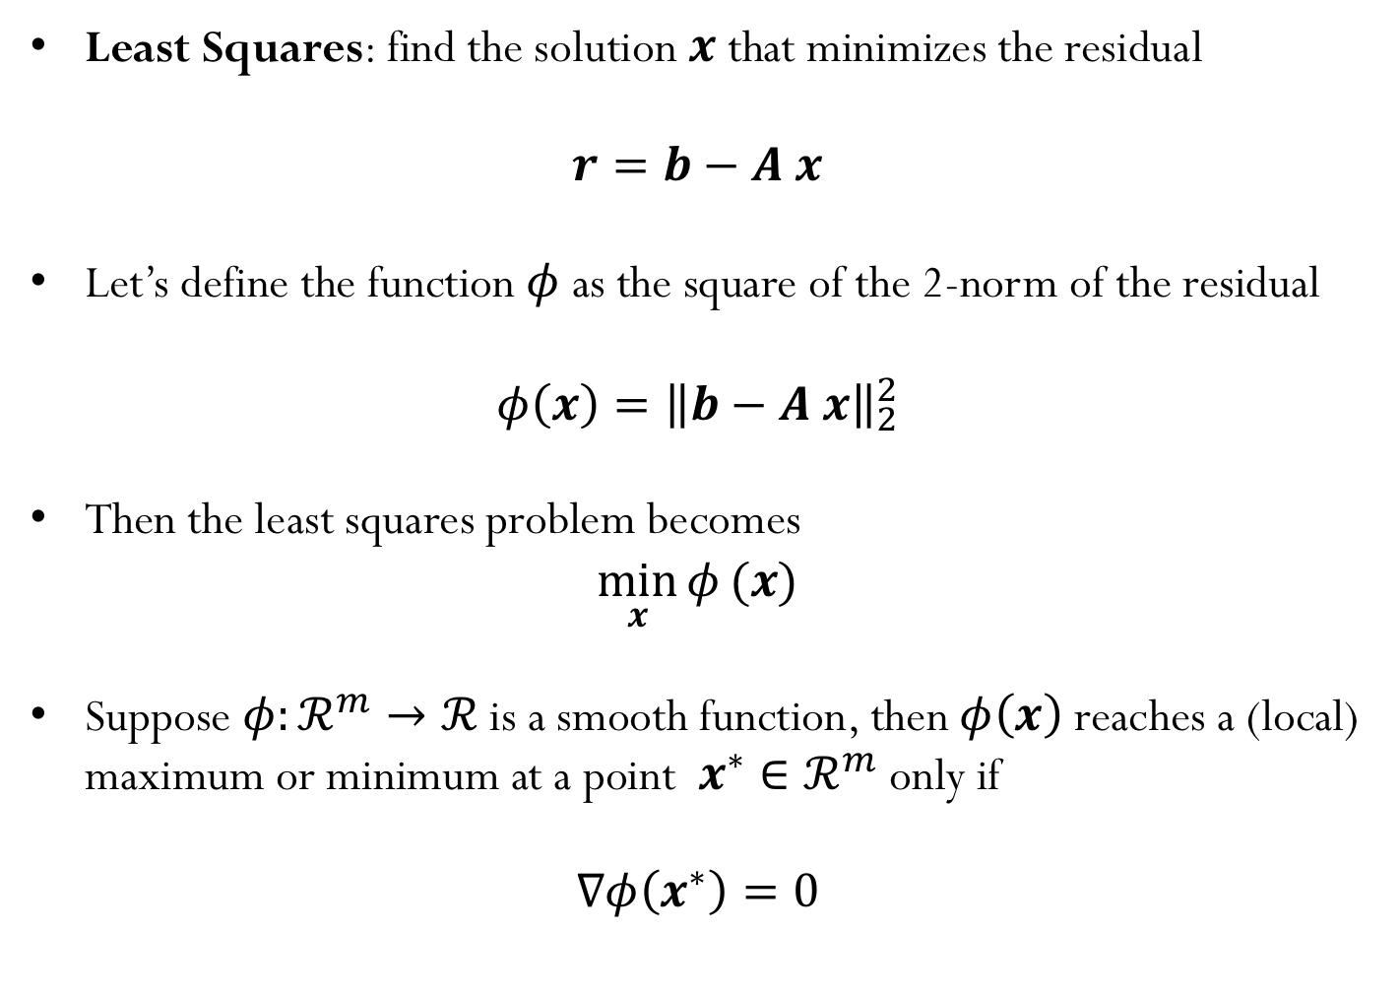
Linear Least Squares
Least Squares: find the solution $x$ that minimizes the residual
$$r=b−A x$$
Let’s define the function $φ$ as the square of the 2-norm of the residual
$$φ\left(x\right)={\left\|b−A x\right\|}_{2}^{2}$$
Then the least squares problem becomes
$$\min_{x}{φ}(x)$$
Suppose $φ:ℛ^{m}→ℛ$ is a smooth function, then$φ\left(x\right)$ reaches a (local) maximum or minimum at a point $x^{∗}∈ℛ^{m}$ only if
$$∇φ\left(x^{∗}\right)=0$$
Notes:
Why the 2-norm? Does not need to be. OTher p-norms could be used. However, just taking the summation of the absolute values will create problems when defining the optimization problem, since the derivative may not exist.

Slide 8
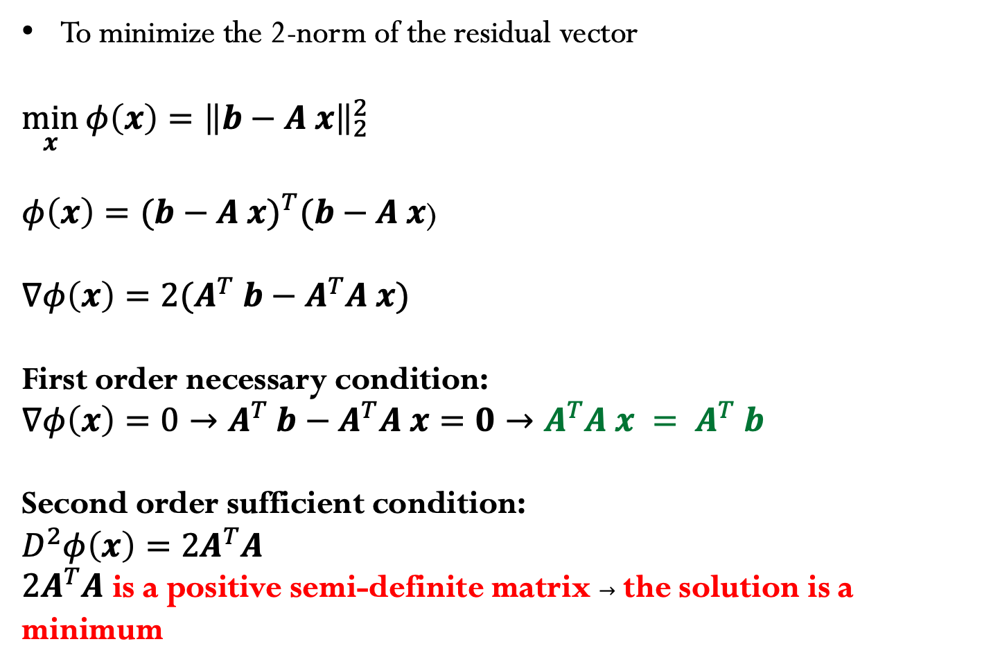
How to find the minimizer?
To minimize the 2-norm of the residual vector
$$\min_{x}{{φ\left(x\right)=\left\|b−A x\right\|}_{2}^{2}}$$
$φ\left(x\right)={(b−A x)}^{T}(b−A x$)
$∇φ\left(x\right)=2(A^{T}$ $b−A^{T}A x)$
First order necessary condition:
$∇φ\left(x\right)=0→A^{T}$ $b−A^{T}A x=0→{A^{T}A x = A}^{T}$ $b$
Second order sufficient condition:
$$D^{2}φ\left(x\right)=2A^{T}A$$
$2A^{T}A$ is a positive semi-definite matrix $→$ the solution is a minimum
Normal Equations – solve a linear system of equations
Notes:
Why the 2-norm? Does not need to be. Othate er p-norms could be used. However, just taking the summation of the absolute values will create problems when defining the optimization problem, since the derivative may not exist.

Slide 9
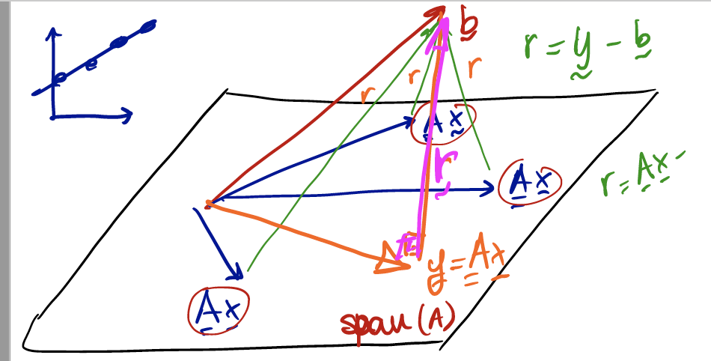
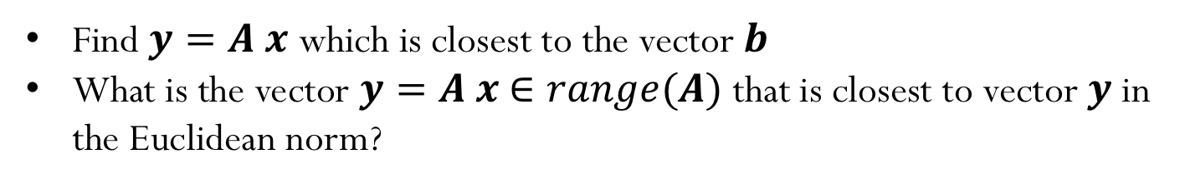


Linear Least Squares (another approach)
Find $y=A x$ which is closest to the vector $b$
What is the vector $y=A x$ $∈range(A)$ that is closest to vector $y$in the Euclidean norm?
When $r=b−y=b−A x$ is orthogonal to all columns of $A$, then $y$ is closest to $b$
${A^{T}r=A}^{T}(b−A x\text{)=}\text{0}$
${A^{T}A x = A}^{T}$ $b$

Slide 10
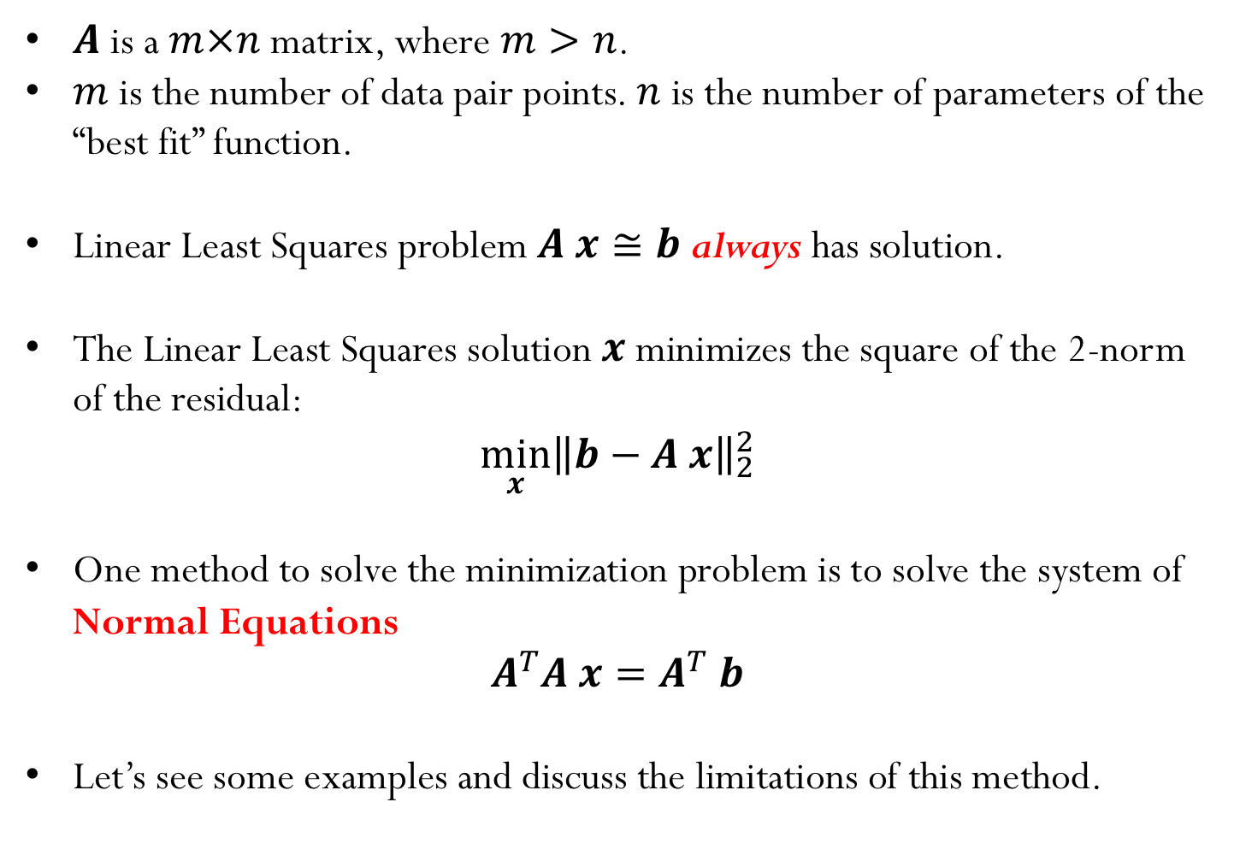
Summary:
$A$ is a $m×n$ matrix, where $m>n$.
$m$ is the number of data pair points. $n$ is the number of parameters of the “best fit” function.
Linear Least Squares problem $A x≅b$ always has solution.
The Linear Least Squares solution $x$ minimizes the square of the 2-norm of the residual:
$$\min_{x}{{\left\|b−A x\right\|}_{2}^{2}}$$
One method to solve the minimization problem is to solve the system of Normal Equations
$$A^{T}A x=A^{T} b$$
Let’s see some examples and discuss the limitations of this method.

Slide 11
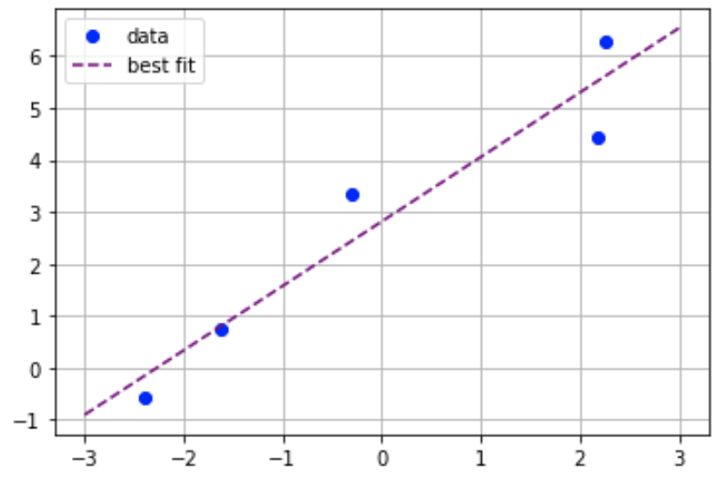
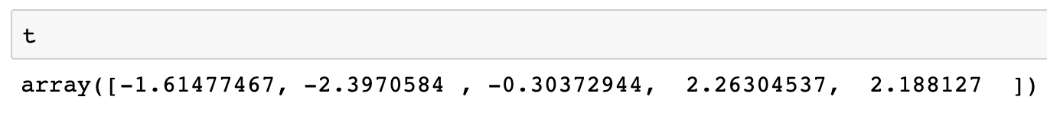
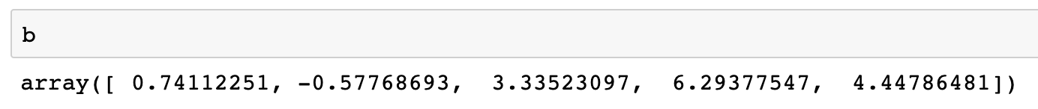
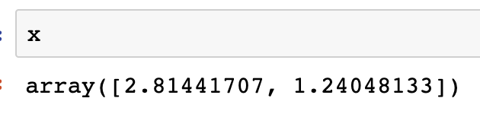
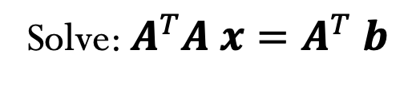
Example:
Solve: $A^{T}A x=A^{T} b$

Slide 12
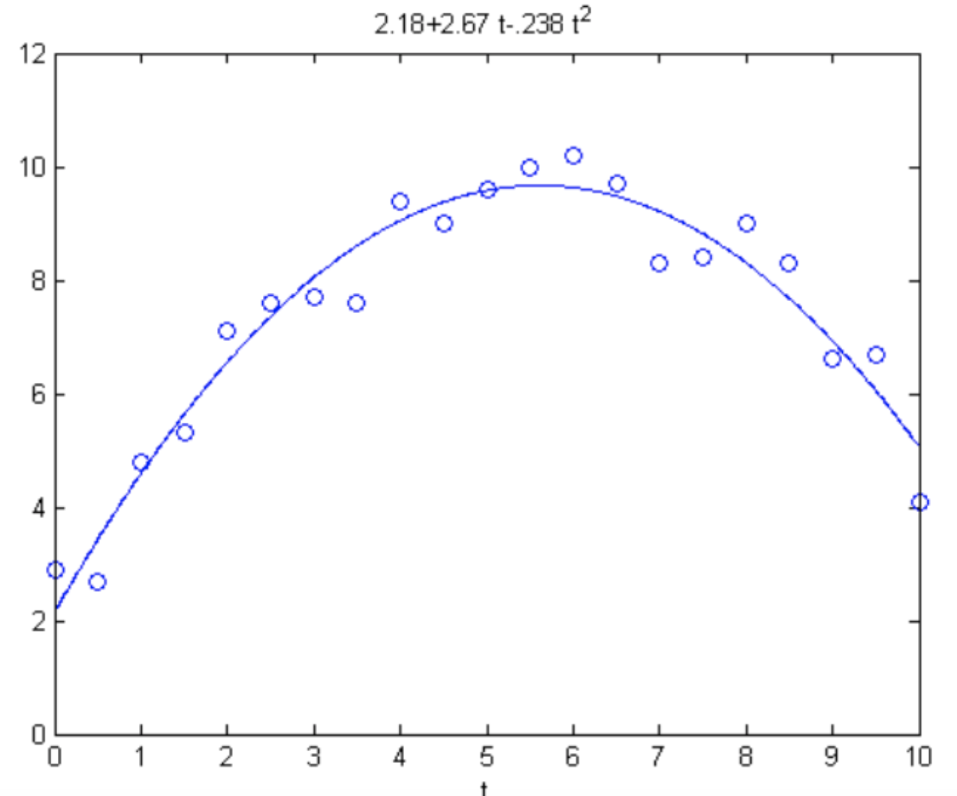
Data fitting - not always a line fit!
Does not need to be a line! For example, here we are fitting the data using a quadratic curve.
Linear Least Squares: The problem is linear in its coefficients!
Notes:
D

Slide 13
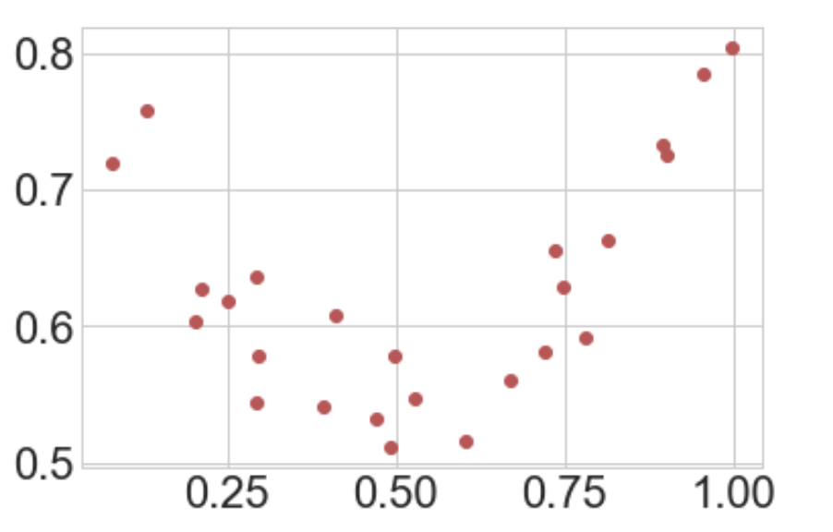
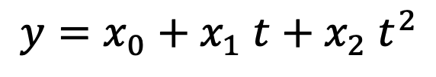
Another examples
We want to find the coefficients of the quadratic function that best fits the data points:
$$y=x_{0}+x_{1} t+x_{2} t^{2}$$
We would not want our “fit” curve to pass through the data points exactly as we are looking to model the general trend and not capture the noise.

Slide 14
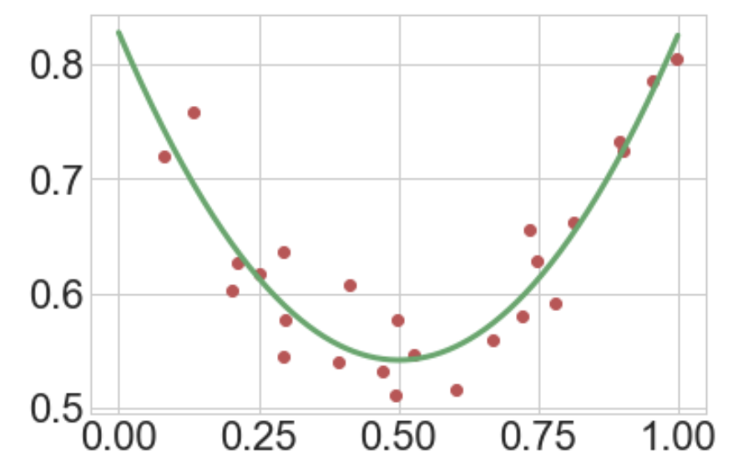
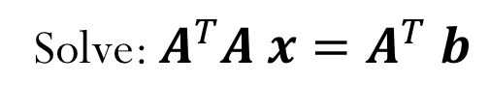
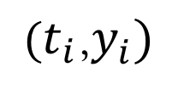
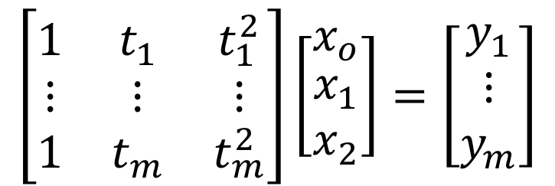
Data fitting
$$\left[\begin{matrix}1 & t_{1} & t_{1}^{2} \\ ⋮ & ⋮ & ⋮ \\ 1 & t_{m} & t_{m}^{2}\end{matrix}\right]\left[\begin{matrix}x_{o} \\ \begin{aligned}x_{1} \\ x_{2}\end{aligned}\end{matrix}\right]=\left[\begin{matrix}y_{1} \\ ⋮ \\ y_{m}\end{matrix}\right]$$
Solve: $A^{T}A x=A^{T} b$
$(t_{i}$,$y_{i})$

Slide 15
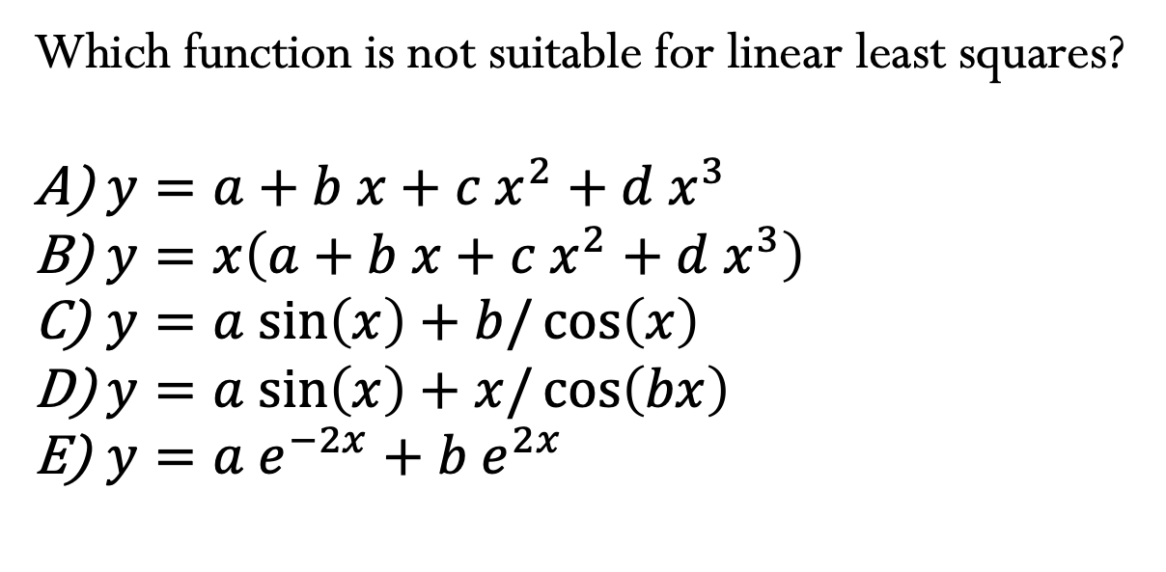
Which function is not suitable for linear least squares?
$y=a+b x+c{ x}^{2}+d{ x}^{3}$
$y=x\left(a+b x+c{ x}^{2}+d{ x}^{3}\right)$
$y=a sin\left(x\right)+b/\cos\left(x\right)$
$y=a sin\left(x\right)+x/\cos\left(bx\right)$
$y={a e}^{−2x}+{b e}^{2x}$
Notes:
D

Slide 16
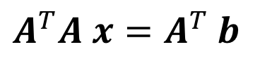
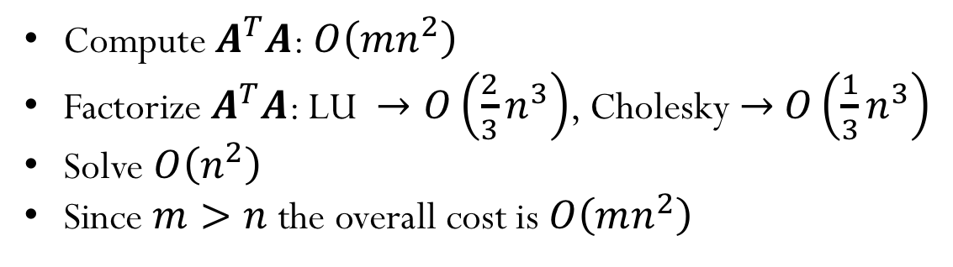
Computational Cost
$$A^{T}A x=A^{T} b$$
Compute $A^{T}A$: $O\left(mn^{2}\right)$
Factorize $A^{T}A$: LU $→O\left(\frac{2}{3}n^{3}\right)$, Cholesky $→$ $O\left(\frac{1}{3}n^{3}\right)$
Solve $O\left(n^{2}\right)$
Since $m>n$ the overall cost is $O\left(mn^{2}\right)$
Notes:
Solve linear systems, for example using LU factorization. Since it is symmetric, we can also use methods that take advantage of the symmetry, such as cholesky factorization
(Cholesky cost = n^3/3; LU cost = 2*n^3/3 (cholesky reduces cost by half)
One way of thinking about matrix multiplication is computing the dot product of each column of A with each row of AT in order to get a single column in the resulting matrix A^T*A. So the length of the columns of A are m and same for the rows of AT. So to compute one of these dot product requires m multiplications and additions. And we need to do this for each row in AT, of which there are n rows. So computing a single column resulting from this matrix-matrix multiplication costs O(mn) work. There are n columns in A and so the total cost of computing ATA is O(m*n^2).
Cost to compute A^T*A = O(m*n^2) + Cost to factorize and solve (n)
Total = O(m*n^2+n^3). Since m>n, then O(mn^2)

Slide 17
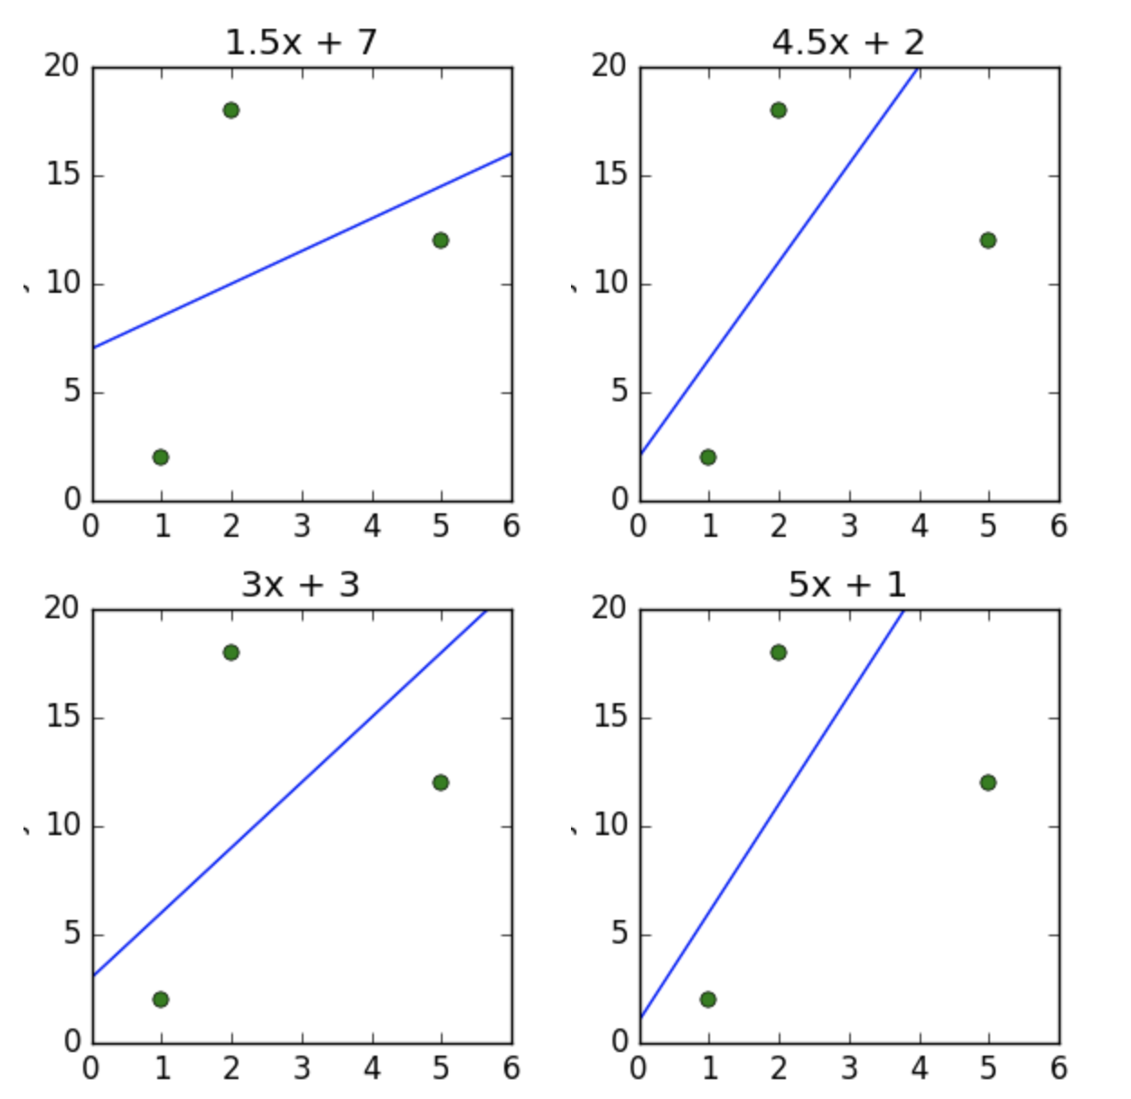
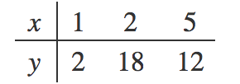
Short questions
Given the data in the table below, which of the plots shows the line of best fit in terms of least squares?
A)
B)
C)
D)
Notes:
A

Slide 18
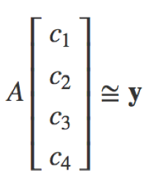
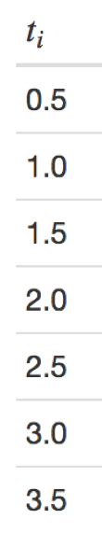
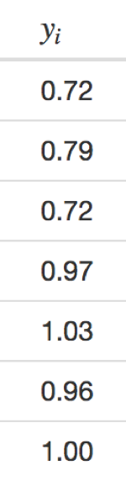


Short questions
Given the data in the table below, and the least squares model
$$y=c_{1}+c_{2}\sin\left(tπ\right)+c_{3}\sin\left(tπ/2\right)+c_{4}\sin\left(tπ/4\right)$$
written in matrix form as
determine the entry $A_{23}$ of the matrix $A$.
Note that indices start with 1.
A) $−1.0$
B) $1.0$
C) $− 0.7$
D) $0.7$
E) $0.0$
Notes:
Correct answer is 1 (B)

Slide 19
Solving Linear Least Squares with SVD
Notes:
Make updates! Look at this reference book!
https://web.stanford.edu/~boyd/vmls/vmls.pdf

Slide 20
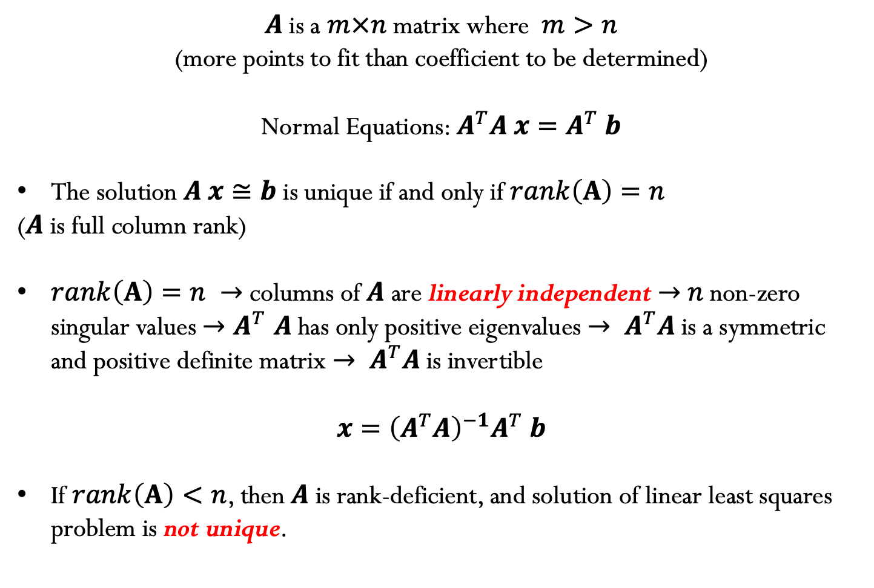
What we have learned so far…
$A$ is a $m×n$ matrix where $m>n$
(more points to fit than coefficient to be determined)
Normal Equations: $A^{T}A x=A^{T} b$
The solution $A x≅b$ is unique if and only if $rank\left(A\right)=n$
($A$ is full column rank)
$rank\left(A\right)=n →$ columns of $A$ are linearly independent $→$ $n$ non-zero singular values ${→A}^{T}A$has only positive eigenvalues $→ A^{T}A \text{is} \text{a} \text{symmetric} \text{and} \text{positive} \text{definite} \text{matrix}$ $→ A^{T}A$is invertible
$$x={\left(A^{T}A\right)}^{−1}A^{T} b$$
If $rank\left(A\right)<n$, then $A$ is rank-deficient, and solution of linear least squares problem is not unique.

Slide 21
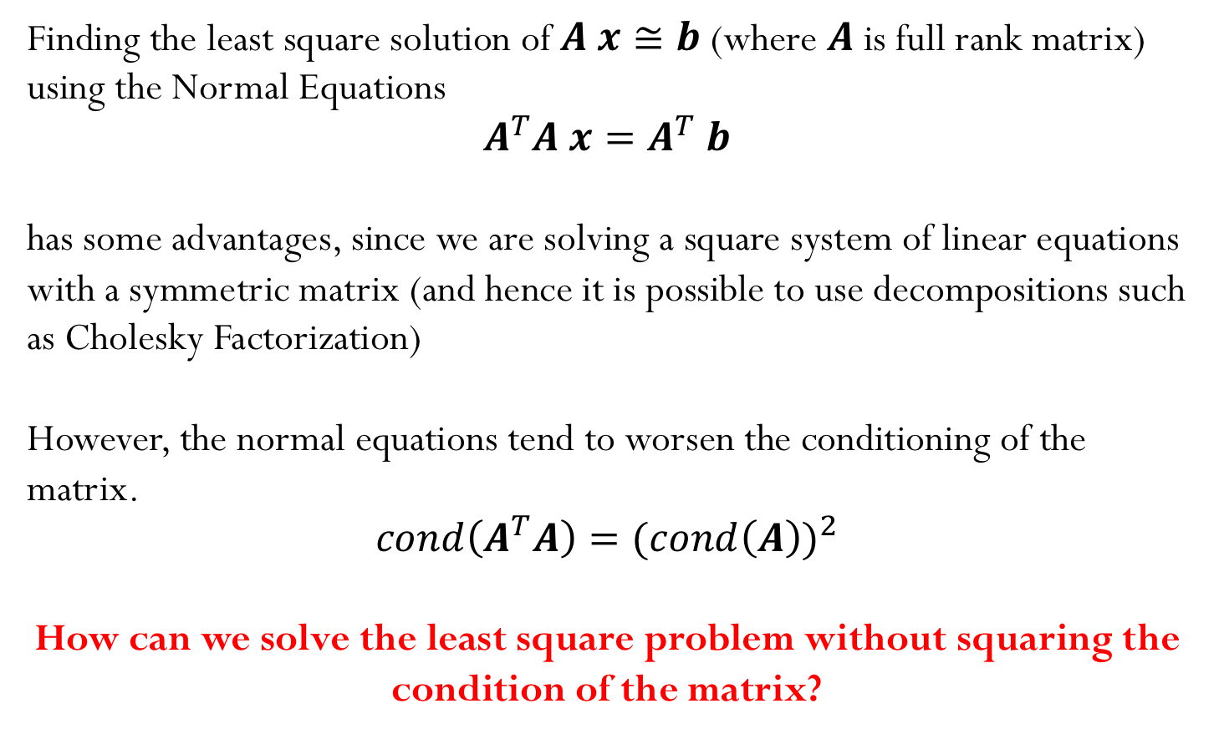
Condition number for Normal Equations
Finding the least square solution of $A x≅b$ (where $A$ is full rank matrix) using the Normal Equations
$$A^{T}A x=A^{T} b$$
has some advantages, since we are solving a square system of linear equations with a symmetric matrix (and hence it is possible to use decompositions such as Cholesky Factorization)
However, the normal equations tend to worsen the conditioning of the matrix.
$$cond\left(A^{T}A\right)={(cond\left(A\right))}^{2}$$
How can we solve the least square problem without squaring the condition of the matrix?
Notes:
Show example using python for a 10x10 random matrix. Show the condition number for Noise demo as well

Slide 22
SVD to solve linear least squares problems
$A \text{is} \text{a} m×n \text{rectangular} \text{matrix} \text{where} m>n,$and hence the SVD decomposition is given by:
$A=\left(\begin{matrix}⋮ & … & ⋮ \\ u_{1} & … & u_{m} \\ ⋮ & … & ⋮\end{matrix}\right)$ $\left(\begin{aligned}\begin{matrix}σ_{1} & & \\ & ⋱ & \\ & & σ_{n}\end{matrix} \\ \begin{matrix} & & 0 \\ & & ⋮ \\ & & 0\end{matrix}\end{aligned}\right)\left(\begin{matrix}… & v_{1}^{T} & … \\ ⋮ & ⋮ & ⋮ \\ … & v_{n}^{T} & …\end{matrix}\right)$
We want to find the least square solution of $A x≅b$, where$A=U Σ V^{T}$
or better expressed in reduced form: $A=U_{R} { Σ}_{R }V^{T}$

Slide 23
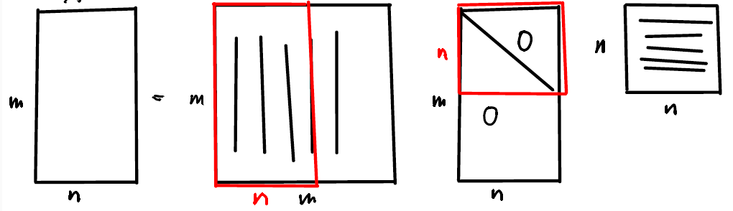
Recall Reduced SVD
$$m>n$$
$$A=U_{R} { Σ}_{R }V^{T}$$
$$m×n$$
$$m×n$$
$$n×n$$
$$n×n$$

Slide 24
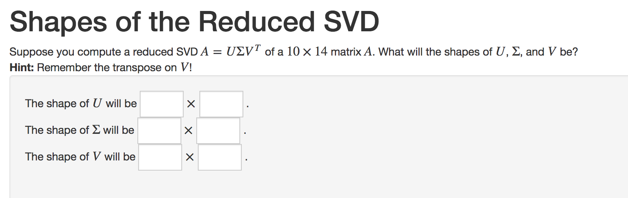

Slide 25
SVD to solve linear least squares problems
$$A=U_{R} { Σ}_{R }V^{T}$$
$A=\left(\begin{matrix}⋮ & … & ⋮ \\ u_{1} & … & u_{n} \\ ⋮ & … & ⋮\end{matrix}\right)$ $\left(\begin{aligned}\begin{matrix}σ_{1} & & \\ & ⋱ & \\ & & σ_{n}\end{matrix}\end{aligned}\right)\left(\begin{matrix}… & v_{1}^{T} & … \\ ⋮ & ⋮ & ⋮ \\ … & v_{n}^{T} & …\end{matrix}\right)$
We want to find the least square solution of $A x≅b$, where$A=U_{R} { Σ}_{R }V^{T}$
Normal equations:${ A}^{T}A x=A^{T} b ⟶{\left(U_{R} { Σ}_{R }V^{T}\right)}^{T}\left(U_{R} { Σ}_{R }V^{T}\right)x={\left(U_{R} { Σ}_{R }V^{T}\right)}^{T}b$
$$V{ Σ}_{R}{U_{R}}^{T}\left(U_{R} { Σ}_{R }V^{T}\right)x=V{ Σ}_{R}{U_{R}}^{T}b$$
$$V{ Σ}_{R}{ Σ}_{R }V^{T}x=V{ Σ}_{R}{U_{R}}^{T}b$$
$${\left({ Σ}_{R }\right)}^{2}{ V}^{T}x={ Σ}_{R}{U_{R}}^{T}b$$
When can we take the inverse of the singular matrix?

Slide 26












$${\left({ Σ}_{R }\right)}^{2}{ V}^{T}x={ Σ}_{R}{U_{R}}^{T}b$$
1) Full rank matrix ($σ_{i}≠0 ∀i$):
Unique solution:
$$rank\left(A\right)=n$$
$$x={V \left({ Σ}_{R }\right)}^{−1}{U_{R}}^{T} b$$
$${ V}^{T}x={\left({ Σ}_{R }\right)}^{−1}{U_{R}}^{T}b$$
$$n×1$$
$$m×1$$
$$n×n$$
$$n×n$$
$$n×m$$
2) Rank deficient matrix ($rank\left(A\right)=r<n$)
$${\left({ Σ}_{R }\right)}^{2}{ V}^{T}x={ Σ}_{R}{U_{R}}^{T}b$$
Solution is not unique!!
Find solution $x$such that
$$\min_{x}{{φ\left(x\right)=\left\|b−A x\right\|}_{2}^{2}}$$
and also
$$\min_{x}{{\left\|x\right\|}_{2}}$$

Slide 27
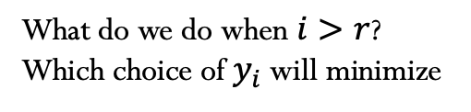

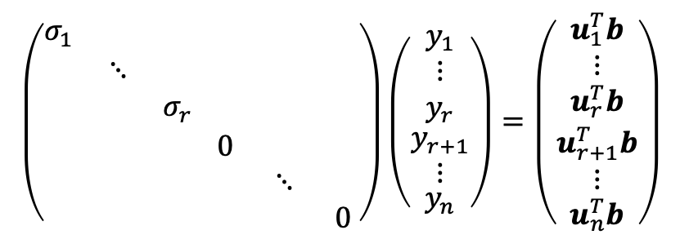

2) Rank deficient matrix (continue)
We want to find the solution $x$ that satisfies ${\left({ Σ}_{R }\right)}^{2}{ V}^{T}x={ Σ}_{R}{U_{R}}^{T}b$ and also satisfies $\min_{x}{{\left\|x\right\|}_{2}}$
Change of variables: Set ${ V}^{T}x=y$ and then solve${ Σ}_{R }y={U_{R}}^{T}b$ for the variable $y$
$$y_{i}=\frac{u_{i}^{T}b}{σ_{i}}$$
$$\left(\begin{aligned}\begin{aligned}\begin{matrix}σ_{1} & & \\ & ⋱ & \\ & & σ_{r}\end{matrix}\end{aligned} \begin{matrix} & & \\ & & \\ & & \end{matrix} \\ \begin{aligned}\begin{matrix} & & \\ & & \\ & & \end{matrix}\end{aligned} \begin{matrix}0 & & \\ & ⋱ & \\ & & 0\end{matrix}\end{aligned}\right)\left(\begin{aligned}\begin{aligned}\begin{aligned}\begin{matrix}y_{1} \\ ⋮ \\ y_{r}\end{matrix} \\ y_{r+1}\end{aligned} \\ ⋮\end{aligned} \\ y_{n}\end{aligned}\right)=\left(\begin{aligned}\begin{aligned}\begin{aligned}\begin{matrix}u_{1}^{T}b \\ ⋮ \\ u_{r}^{T}b\end{matrix} \\ u_{r+1}^{T}b\end{aligned} \\ ⋮\end{aligned} \\ u_{n}^{T}b\end{aligned}\right)$$
$$i=1,2,…,r$$
What do we do when $i>r$?
Which choice of $y_{i}$ will minimize
${\left\|x\right\|}_{2}={\left\|V y\right\|}_{2}$?
Set
$$y_{i}=0, i=r+1,…,n$$
Evaluate
$x=Vy=\left(\begin{matrix}⋮ & … & ⋮ \\ v_{1} & … & v_{n} \\ ⋮ & … & ⋮\end{matrix}\right)$ $\left(\begin{aligned}\begin{aligned}\begin{aligned}y_{1} \\ y_{2}\end{aligned} \\ ⋮\end{aligned} \\ y_{n}\end{aligned}\right)$
$$x=\sum_{i=1}^{n}{y_{i} v_{i}}=\sum_{\begin{aligned}i=1 \\ σ_{i}≠0\end{aligned}}^{n}{\frac{{(u}_{i}^{T}b)}{σ_{i}}v_{i}}$$

Slide 28
Solving Least Squares Problem with SVD (summary)
Cost of SVD:
$${O(m n}^{2})$$
Find $x$ that satisfies $\min_{x}{{ \left\|b−A x\right\|}_{2}^{2}}$
Find $y$ that satisfies$\min_{y}{{\left\|{ Σ}_{R }y−{U_{R}}^{T}b \right\|}_{2}^{2}}$
Propose $y$ that is solution of${ Σ}_{R }y={U_{R}}^{T}b$
Evaluate:$z={U_{R}}^{T}b$
Set: $y_{i}=\left\{\begin{matrix}\frac{z_{i}}{σ_{i}}, if { σ}_{i}≠0 \\ 0, otherwise\end{matrix}\right.$ $i=1,…,n$
Then compute$x=V y$
Cost:
$$m n$$
$$n$$
$$n^{2}$$
Notes:
Cost to obtain y is O(n)
To evaluate z = U^T*b (normally m^2), we only need to evaluate m*n (since only need the top n entries of z)
Recall cost of SVD is O(m n^2)

Slide 29
Solving Least Squares Problem with SVD (summary)
If ${ σ}_{i}≠0$ for $∀i=1,…,n$, then the solution ${y=V \left({ Σ}_{R }\right)}^{−1}{U_{R}}^{T} b$is unique (and not a “choice”).
If at least one of the singular values is zero, then the proposed solution $y$ is the one with the smallest 2-norm ( ${\left\|y\right\|}_{2}$is minimal ) that minimizes the 2-norm of the residual ${\left\|{ Σ}_{R }y−{U_{R}}^{T}b\right\|}_{2}$
Since${\left\|x\right\|}_{2}{=\left\|V y\right\|}_{2}={\left\|y\right\|}_{2}$, then the solution $x$ is also the one with the smallest 2-norm ( ${\left\|x\right\|}_{2}$is minimal ) for all possible $x$for which ${\left\|Ax−b\right\|}_{2}$is minimal.

Slide 30
Solving Least Squares Problem with SVD (summary)
Solve $A x≅b$ or $U_{R}{ Σ}_{R}V^{T}x≅b$
$x≅{V \left(Σ_{R}\right)}^{+}{{ U}_{R}}^{T} b$

Slide 31
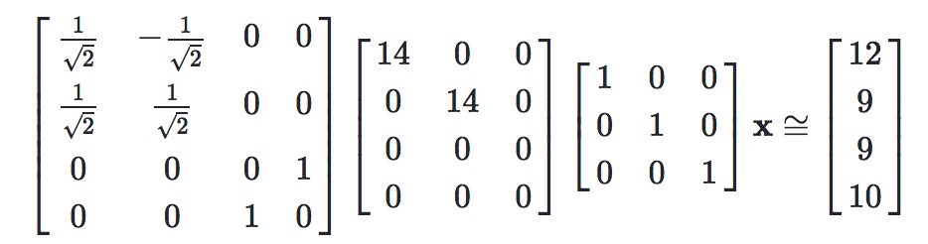
Example:
Consider solving the least squares problem $A x≅b$, where the singular value decomposition of the matrix $A=U Σ V^{T}x$ is:
Determine ${\left\|b−A x\right\|}_{2}$

Slide 32
Example
Suppose you have $A=U Σ V^{T}x$ calculated. What is the cost of solving
$\min_{x}{{\left\|b−A x\right\|}_{2}^{2}}$ ?
$O(n)$
$O({ n}^{2})$
$O(mn)$
$O\left(m\right)$
$O({ m}^{2})$
Notes:
Cost to obtain y is O(n)
To evaluate z = U^T*b (normally m^2), we only need to evaluate m*n (since only need the top n entries of z)
Recall cost of SVD is O(m n^2)

