Slide 1
Finite Difference Method

Slide 2
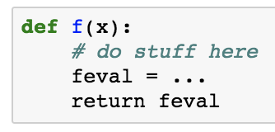
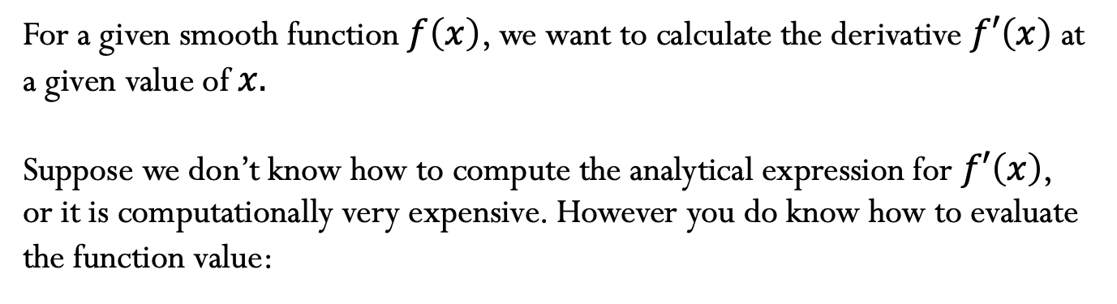

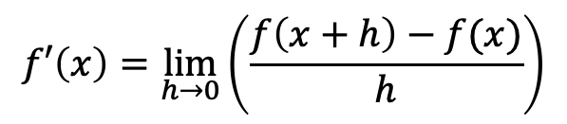
Motivation
For a given smooth function $f\left(x\right)$, we want to calculate the derivative $f′\left(x\right)$ at a given value of $x.$
Suppose we don’t know how to compute the analytical expression for $f′\left(x\right)$, or it is computationally very expensive. However you do know how to evaluate the function value:
We know that:
$$f′\left(x\right)=\lim_{h→0}\left(\frac{f\left(x+h\right)−f(x)}{h}\right)$$
Can we just use $f′\left(x\right)≈\frac{f\left(x+h\right)−f\left(x\right)}{h}$ as an approximation? How do we choose $h$? Can we get estimate the error of our approximation?

Slide 3
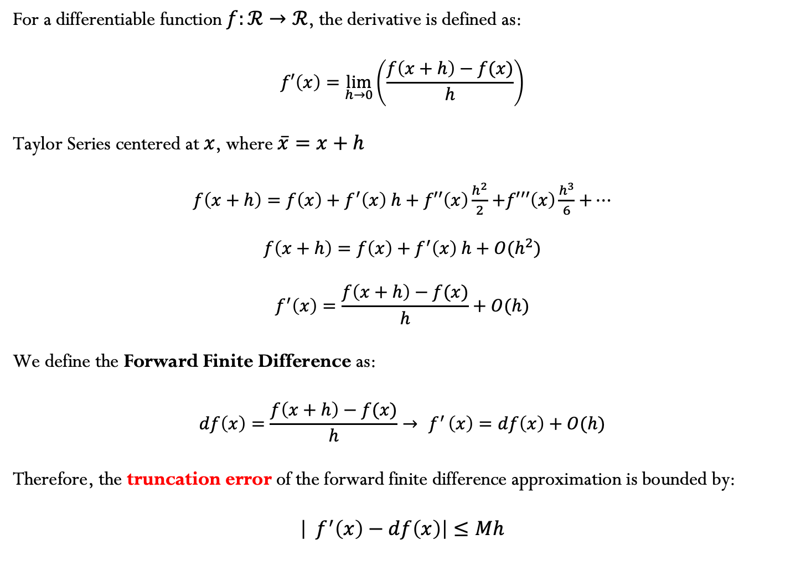
Finite difference method
For a differentiable function $f:ℛ→ℛ$, the derivative is defined as:
$$f′\left(x\right)=\lim_{h→0}\left(\frac{f\left(x+h\right)−f(x)}{h}\right)$$
Taylor Series centered at $x$, where $\overline{x}=x+h$
$f\left(x+h\right)=f\left(x\right)+f^{′}\left(x\right) h+f′′\left(x\right)\frac{h^{2}}{2}$ $+f′′′\left(x\right)\frac{h^{3}}{6}$ $+…$
$$f\left(x+h\right)=f\left(x\right)+f^{′}\left(x\right) h+O(h^{2})$$
$$f^{′}\left(x\right)=\frac{f\left(x+h\right)−f(x)}{h}+O(h)$$
We define the Forward Finite Difference as:
$$df\left(x\right)=\frac{f\left(x+h\right)−f(x)}{h}→{ f}^{′}\left(x\right)=df\left(x\right)+O(h)$$
Therefore, the truncation error of the forward finite difference approximation is bounded by:
$$\left|{ f}^{′}\left(x\right)−df\left(x\right)\right|≤Mh$$

Slide 4
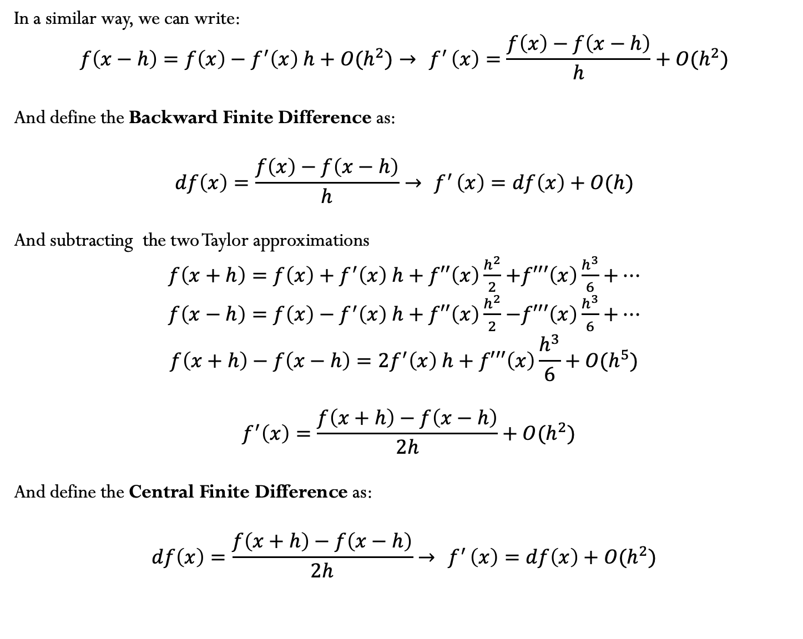
In a similar way, we can write:
$$f\left(x−h\right)=f\left(x\right)−f^{′}\left(x\right) h+O(h^{2})→{ f}^{′}\left(x\right)=\frac{f\left(x\right)−f\left(x−h\right)}{h}+O(h^{2})$$
And define the Backward Finite Difference as:
$$df\left(x\right)=\frac{f\left(x\right)−f\left(x−h\right)}{h}→{ f}^{′}\left(x\right)=df\left(x\right)+O(h)$$
And subtracting the two Taylor approximations
$f\left(x+h\right)=f\left(x\right)+f^{′}\left(x\right) h+f′′\left(x\right)\frac{h^{2}}{2}$ $+f′′′\left(x\right)\frac{h^{3}}{6}$ $+…$
$f\left(x−h\right)=f\left(x\right)−f^{′}\left(x\right) h+f′′\left(x\right)\frac{h^{2}}{2}$ $−f′′′\left(x\right)\frac{h^{3}}{6}$ $+…$
$$f\left(x+h\right)−f\left(x−h\right)=2f^{′}\left(x\right) h+f′′′\left(x\right)\frac{h^{3}}{6}+O(h^{5})$$
$${ f}^{′}\left(x\right)=\frac{f\left(x+h\right)−f\left(x−h\right)}{2h}+O(h^{2})$$
And define the Central Finite Difference as:
$$df\left(x\right)=\frac{f\left(x+h\right)−f\left(x−h\right)}{2h}→{ f}^{′}\left(x\right)=df\left(x\right)+O(h^{2})$$

Slide 5
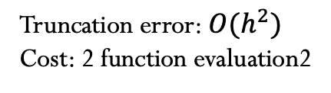
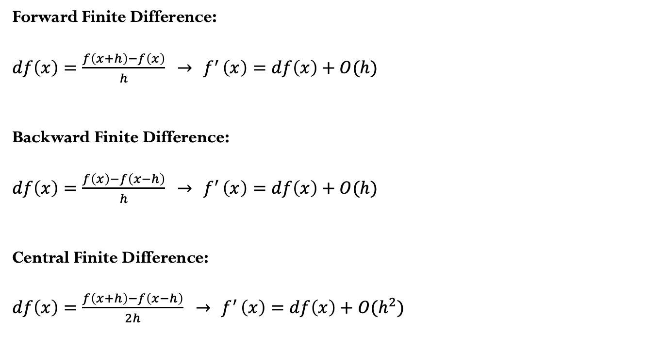
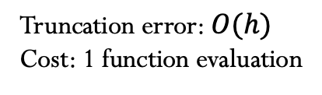
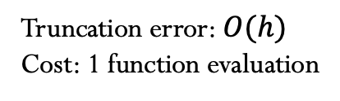

How accurate is the finite difference approximation? How many function evaluations (in additional to $f\left(x\right)$)?
Forward Finite Difference:
$df\left(x\right)=\frac{f\left(x+h\right)−f\left(x\right)}{h}$ $→{ f}^{′}\left(x\right)=df\left(x\right)+O(h)$
Backward Finite Difference:
$df\left(x\right)=\frac{f\left(x\right)−f\left(x−h\right)}{h}$ $→{ f}^{′}\left(x\right)=df\left(x\right)+O(h)$
Central Finite Difference:
$df\left(x\right)=\frac{f\left(x+h\right)−f\left(x−h\right)}{2h}$ $→{ f}^{′}\left(x\right)=df\left(x\right)+O(h^{2})$
Truncation error: $O(h)$
Cost: 1 function evaluation
Truncation error: $O(h)$
Cost: 1 function evaluation
Truncation error: $O(h^{2})$
Cost: 2 function evaluation2
Our typical trade-off issue! We can get better accuracy with Central Finite Difference with the (possible) increased computational cost.
How small should the value of $h$?

Slide 6
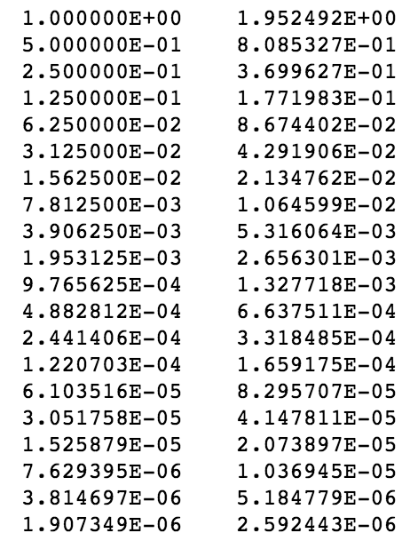



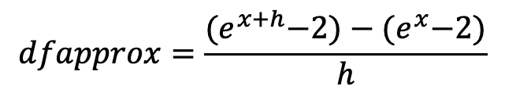



Example
$$h$$
$$error$$
$$f\left(x\right)=e^{x}−2$$
$$f′\left(x\right)=e^{x}$$
We want to obtain an approximation for $f′\left(1\right)$
$$dfapprox=\frac{{(e}^{x+h}−2)−{(e}^{x}−2)}{h}$$
Truncation error
$$error(h)=abs(f′\left(x\right)−dfapprox)$$

Slide 7
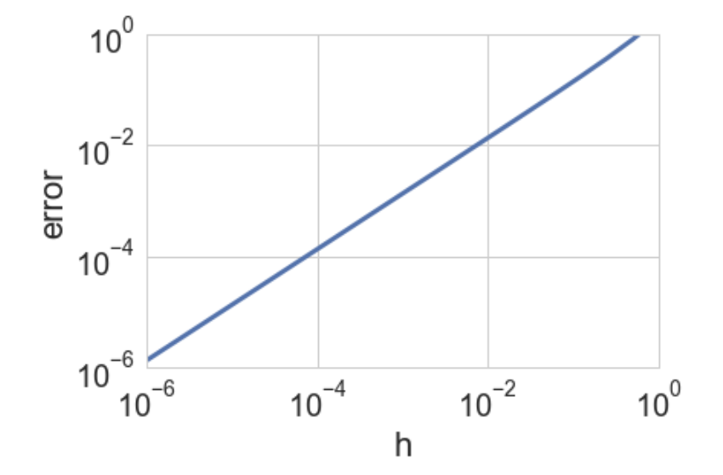
Example
Should we just keep decreasing the perturbation $h$, in order to approach the limit $h→0$ and obtain a better approximation for the derivative?
Notes:
The truncation is approximately h f’’(xi)/2, since

Slide 8
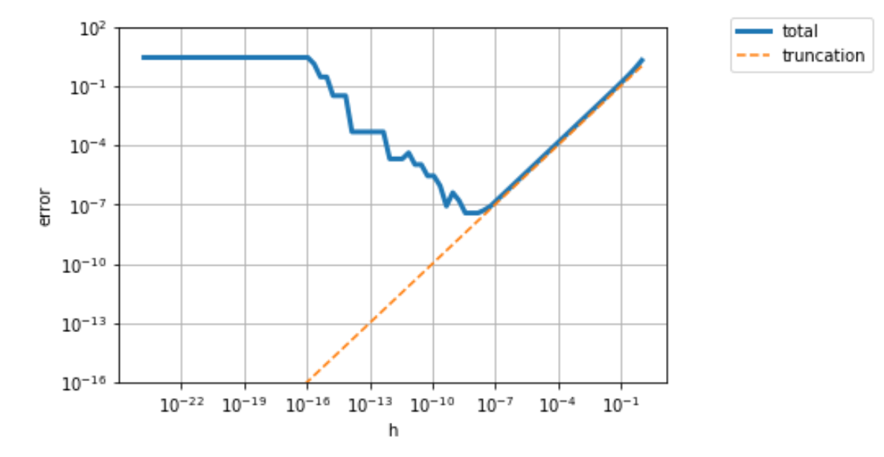
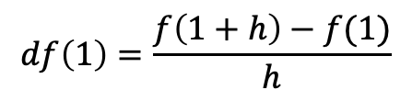
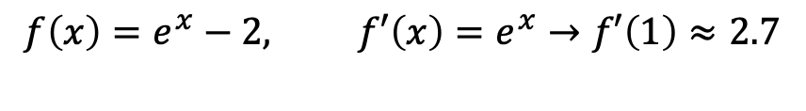
Uh-Oh!
What happened here?
$$f\left(x\right)=e^{x}−2, f′\left(x\right)=e^{x}→f′\left(1\right)≈2.7$$
Forward Finite Difference
$$df\left(1\right)=\frac{f\left(1+h\right)−f(1)}{h}$$
If h is very “small”, we will have the issue of cancelation!
Notes:
The truncation is approximately h f’’(xi)/2, since

Slide 9
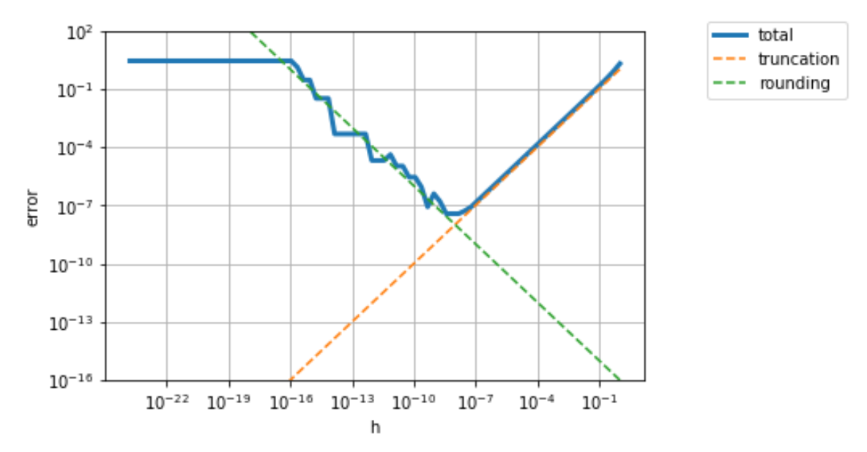
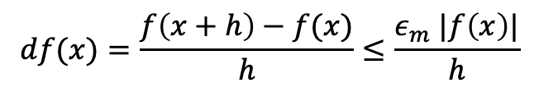
When computing the finite difference approximation, we have two competing source of errors: Truncation errors and Rounding errors
$$df(x)=\frac{f\left(x+h\right)−f(x)}{h}≤\frac{ε_{m} |f\left(x\right)|}{h}$$
Notes:
The truncation is approximately h f’’(xi)/2, since

Slide 10
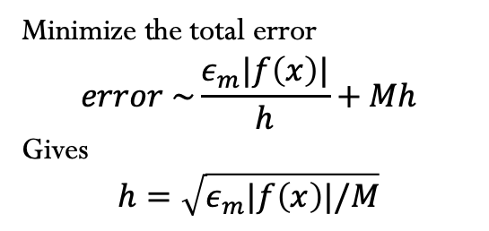
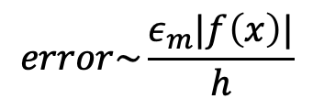

Loss of accuracy due to rounding
Minimize the total error
$$error \sim \frac{ε_{m}|f\left(x\right)|}{h}+Mh$$
Gives
$$h=\sqrt{ε_{m}|f\left(x\right)|/M}$$
Truncation error:
$$error\sim M h$$
Optimal “h”
$$error\sim \frac{ε_{m}|f\left(x\right)|}{h}$$
Rounding error:

