Slide 1
Python: brief introduction

Slide 2
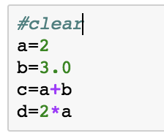
1.1. Types
c is float, d is float
c is float, d is int
c is int, d is int
c is int, d is float

Slide 3
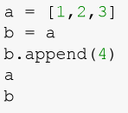
1.2. Names and values
a
1
2
3
b
The list is an object, and both names
and are bounded to the same list (values)
1
2
3
a
b
Notes:
Two names are referring to the same value, in this case, a list

Slide 4
Modifying an object
b
1
2
3
4
b.append(4) modifies the object list [1,2,3]
What happens to the name “a”?
Because “a” and “b” are bounded to the same location, they will have the same values once the list is modified
b
1
2
3
4
a

Slide 5
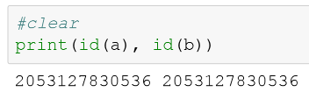

Get the “id” for an object
b
1
2
3
4
a
Since “a” and “b” are bounded to the same object, then they have the same “id”
Check if both names have the same “id”

Slide 6
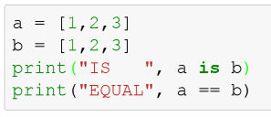
In summary …
a
1
2
3
b
1
2
3
b
1
2
3
4
a

Slide 7
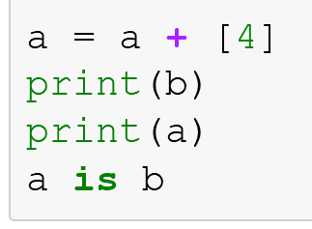
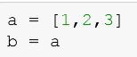
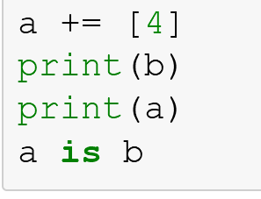
Mutable and immutable types
Mutable objects: can be changed after they are created (e.g. lists, dictionaries)
Immutable objects: cannot be changed after they are created (e.g. tuples, strings, floats)
Mutable object: List
a
1
2
3
b
Do you get the same results when running these two pieces of code?
A) YES B) NO
Notes:
Since everything in Python is an Object, every variable holds an object instance. When an object is initiated, it is assigned a unique object id. Its type is defined at runtime and once set can never change, however its state can be changed if it is mutable.
Simple put, a mutable object can be changed after it is created, and an immutable object can’t.
ython interns low integers and reuses them. They are immutable after all. You really only need 1 copy of the number 1

Slide 8
Mutable object: List
a
1
2
3
b
“a” gets reassigned to a new object, “b” is still bounded to the initial object.
a
1
2
3
4
b
1
2
3
The object list is modified, however, “a” and “b” remain bounded to the object.
a
1
2
3
4
b
Notes:
Since everything in Python is an Object, every variable holds an object instance. When an object is initiated, it is assigned a unique object id. Its type is defined at runtime and once set can never change, however its state can be changed if it is mutable.
Simple put, a mutable object can be changed after it is created, and an immutable object can’t.
ython interns low integers and reuses them. They are immutable after all. You really only need 1 copy of the number 1

Slide 9
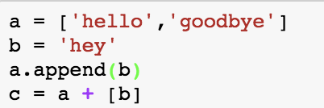
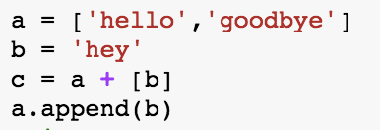
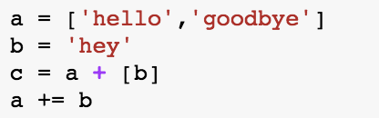

1.2. Names and values
Which of the following code snippets
A)
C)
B)
Results in
Notes:
c

Slide 10
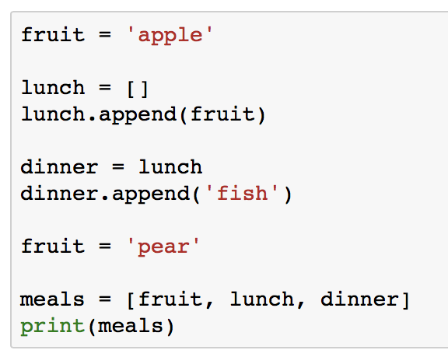
1.3. Advanced Names

Slide 11
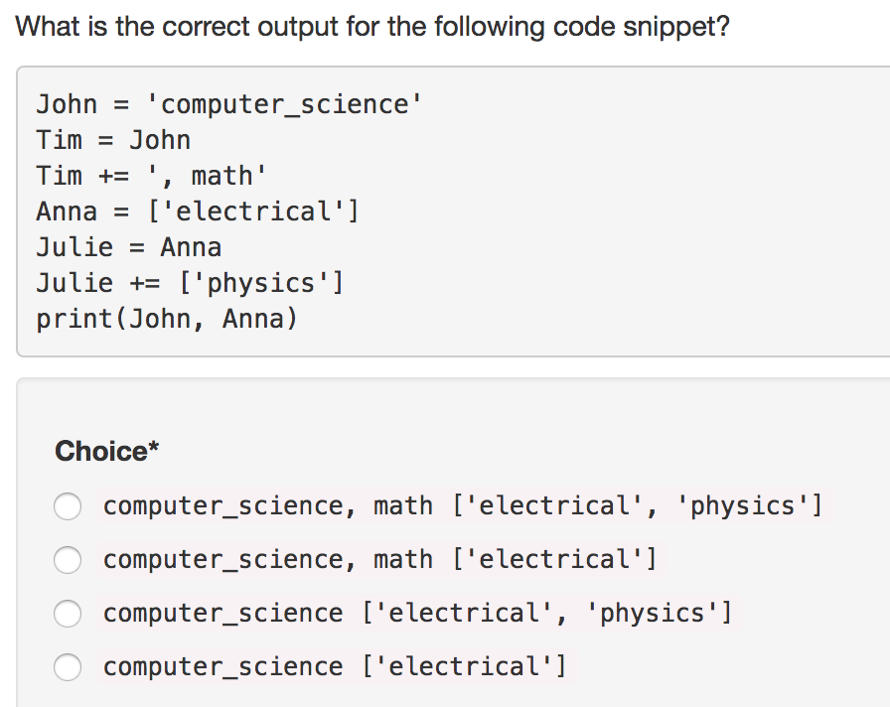
1.3. Naming advanced
A)
B)
C)
D)
Notes:
Answer is C

Slide 12
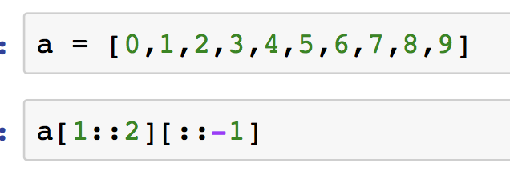
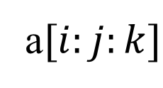
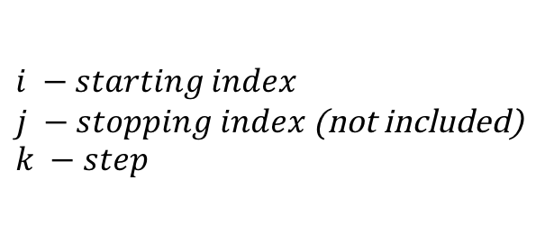
1.4 Indexing
$$i −starting index$$
$j −stopping index$ (not included)
$$k −step$$
a$[i:j:k]$
What is the output for the command line above?
[1,3,5,7,9]
[1,3]
[3,1]
[9,7]
[9,7,5,3,1]

Slide 13
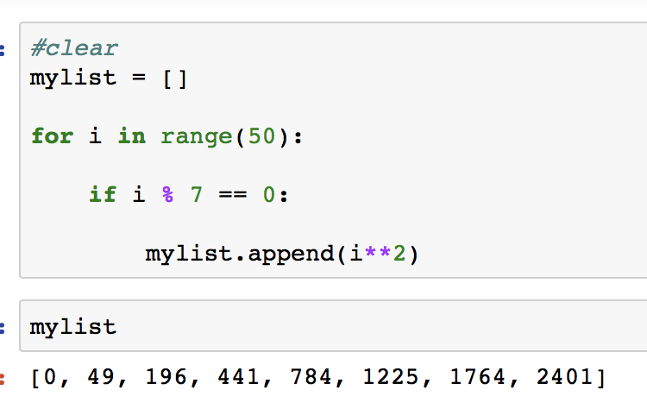
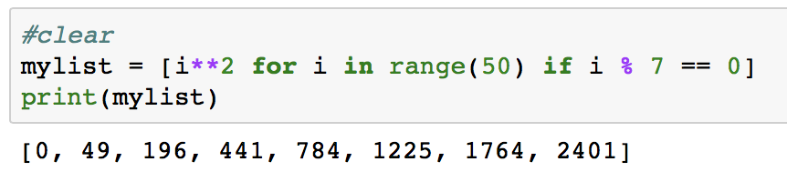
1.5 Control Flow

Slide 14
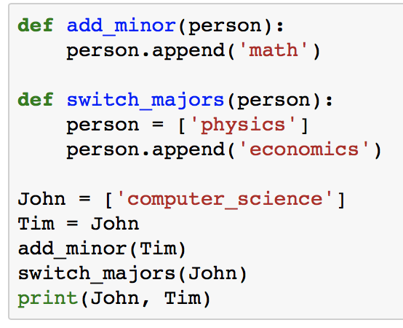
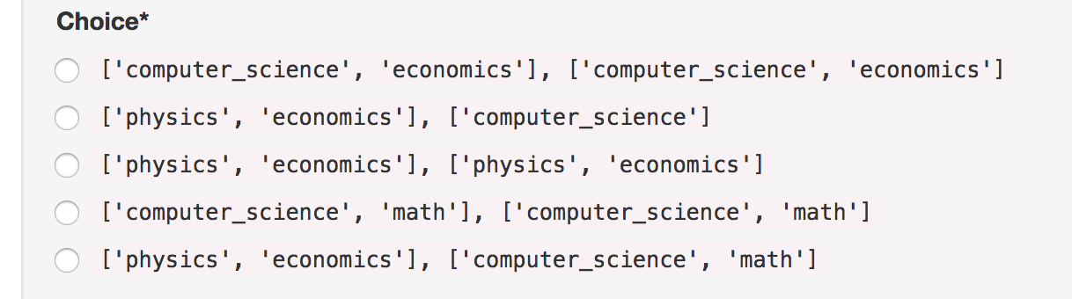
1.6 Functions
A)
B)
C)
D)
E)
Notes:
Answer is D

Slide 15
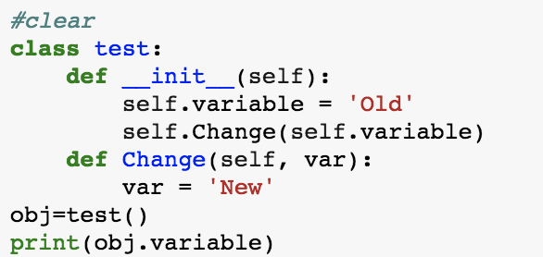
1.7 Objects
A) Error message, because the function Change can't be called in the __init__ function
B) ‘Old’
C) ‘New’
Notes:
Answer is D

Slide 16
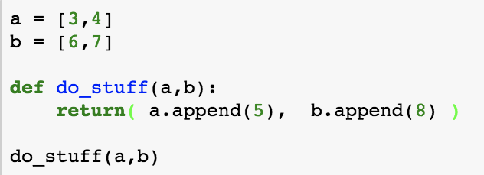
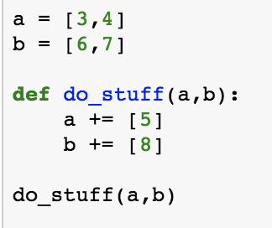
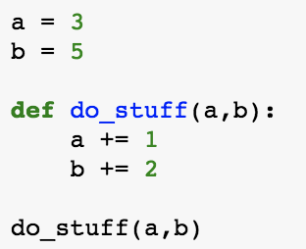
A)
C)
B)
Which code snippet does not modify the variables?
Notes:
B

Slide 17
2.2 Numpy Indexing
a = np.array([[1, 4, 9], [2, 8, 18]])
Notes:
Answer is D

Slide 18
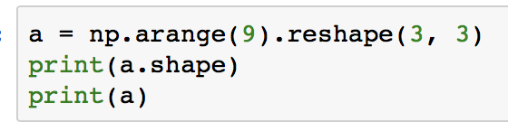
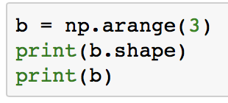
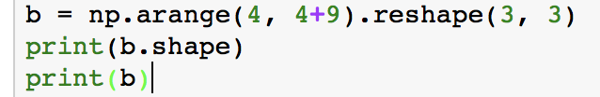
2.3 Broadcasting

Slide 19
2.3 Broadcasting
Given A and B numpy arrays such that:
A.shape is (5,4)
B.shape is (1,4)
What is the shape of A + B?
(1,4)
(5,1,4)
(5,4)
Not a valid operation

