Slide 1
Review of binary number representation

Slide 2

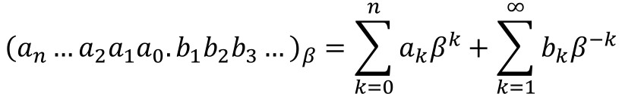
Number systems and bases
A given number in a $β$-system is represented as
Examples:
Decimal base:
$${\left(426.97\right)}_{10}=4×{10}^{2}+2×{10}^{1}+6×{10}^{0}+9×{10}^{−1}+7×{10}^{−2}$$
Binary base:
$${\left(1011.001\right)}_{2}=1×2^{3}+0×2^{2}+1×2^{1}+1×2^{0}+0×2^{−1}+0×2^{−2}+1×2^{−3}$$
$${\left(a_{n}…a_{2}a_{1}a_{0}.b_{1}b_{2}b_{3}…\right)}_{β}=\sum_{k=0}^{n}{a_{k}β^{k}}+\sum_{k=1}^{∞}{b_{k}β^{−k}}$$
Notes:
Modern computers use transistors to store data. These transistors can either be ON (1) or OFF (0). In order to store integers in a computer, we must first convert them to binary.

Slide 3
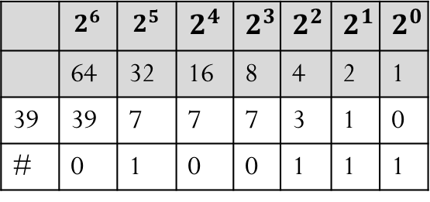
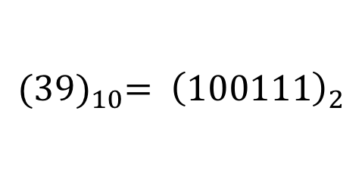
Integer numbers in a computer
From decimal to binary: ${(39)}_{10}$
Method 1:
#/2 | Quotient | Remainder
39/2 | 19 | 1
19/2 | 9 | 1
9/2 | 4 | 1
4/2 | 2 | 0
2/2 | 1 | 0
1/2 | 0 | 1
Method 2:
 | $$2^{6}$$ | $$2^{5}$$ | $$2^{4}$$ | $$2^{3}$$ | $$2^{2}$$ | $$2^{1}$$ | $$2^{0}$$
 | 64 | 32 | 16 | 8 | 4 | 2 | 1
39 | 39 | 7 | 7 | 7 | 3 | 1 | 0
# | 0 | 1 | 0 | 0 | 1 | 1 | 1
$${{(39)}_{10}= \left(100111\right)}_{2}$$
Notes:
Modern computers use transistors to store data. These transistors can either be ON (1) or OFF (0). In order to store integers in a computer, we must first convert them to binary.

Slide 4












Integer numbers in a computer
From binary to decimal: ${\left(10111\right)}_{2}$
$${\left(10111\right)}_{2}=$$
$$1$$
$$0$$
$$1$$
$$1$$
$$1$$
$$2^{4}$$
$$2^{3}$$
$$2^{2}$$
$$2^{1}$$
$$2^{0}$$
$$=1×16+0×8+1×4+1×2+1×1=23$$
$${\left(10111\right)}_{2}={\left(23\right)}_{10}$$
Notes:
Modern computers use transistors to store data. These transistors can either be ON (1) or OFF (0). In order to store integers in a computer, we must first convert them to binary.

Slide 5
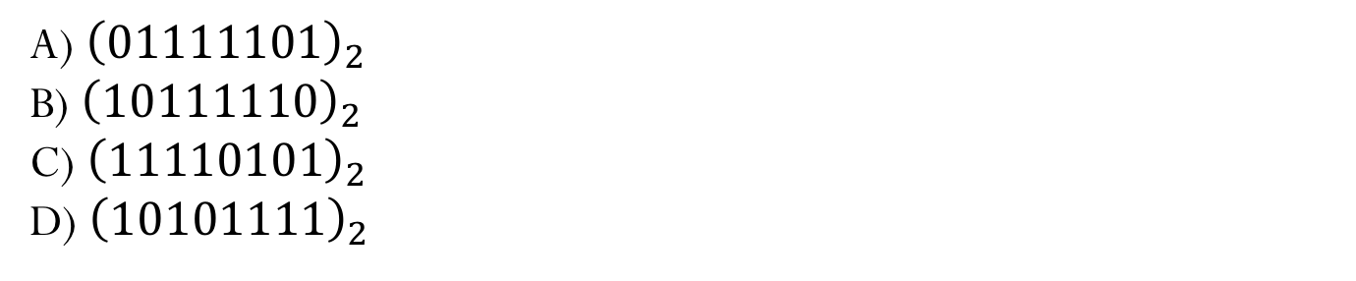
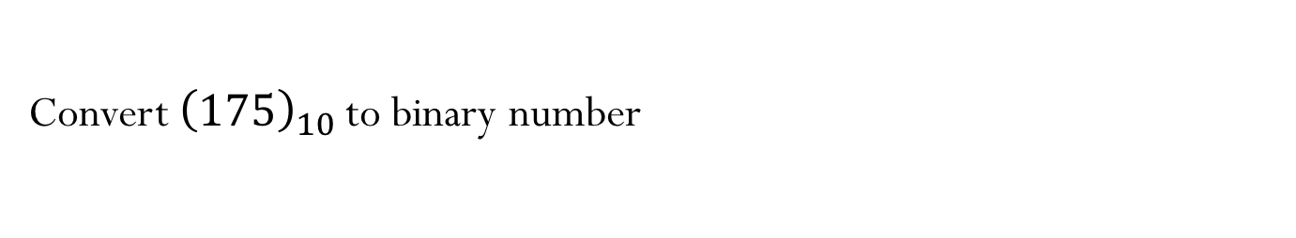
Practice questions
Convert ${\left(110101\right)}_{2}$ to decimal number
A) 43
B) 53
C) 42
D) 52
Convert ${\left(175\right)}_{10}$to binary number
A) ${\left(01111101\right)}_{2}$
B) ${\left(10111110\right)}_{2}$
C) ${\left(11110101\right)}_{2}$
D) ${\left(10101111\right)}_{2}$
Notes:
2 a) 125 b) 190 c) 245 d) 175

Slide 6
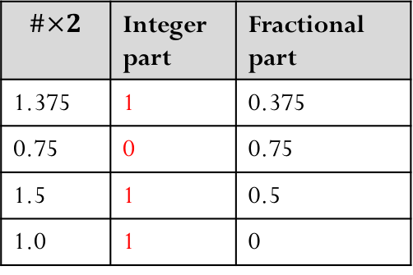
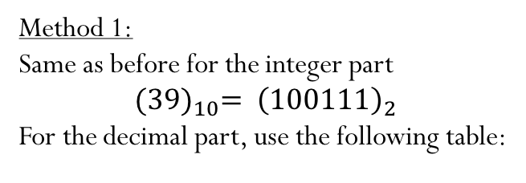
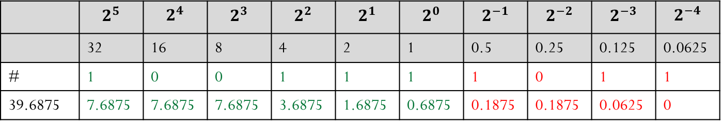
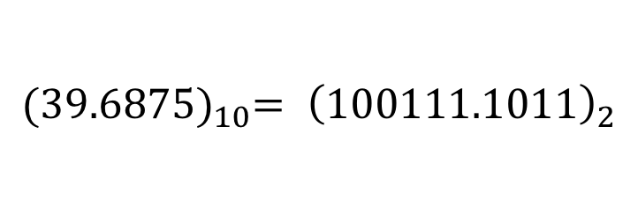
Real numbers in a computer
Real numbers add an extra level of complexity. Not only do they have a leading integer, they also have a fractional part.
From decimal to binary: ${(39.6875)}_{10}$
Method 1:
Same as before for the integer part
$${{(39)}_{10}= \left(100111\right)}_{2}$$
For the decimal part, use the following table:
$$\#×2$$ | Integer part | Fractional part
1.375 | 1 | 0.375
0.75 | 0 | 0.75
1.5 | 1 | 0.5
1.0 | 1 | 0
$${{(39.6875)}_{10}= \left(100111.1011\right)}_{2}$$
Method 2:
 | $$2^{5}$$ | $$2^{4}$$ | $$2^{3}$$ | $$2^{2}$$ | $$2^{1}$$ | $$2^{0}$$ | $$2^{−1}$$ | $$2^{−2}$$ | $$2^{−3}$$ | $$2^{−4}$$
 | 32 | 16 | 8 | 4 | 2 | 1 | 0.5 | 0.25 | 0.125 | 0.0625
# | 1 | 0 | 0 | 1 | 1 | 1 | 1 | 0 | 1 | 1
39.6875 | 7.6875 | 7.6875 | 7.6875 | 3.6875 | 1.6875 | 0.6875 | 0.1875 | 0.1875 | 0.0625 | 0

Slide 7




















Real numbers in a computer
From binary to decimal: ${\left(101101.101\right)}_{2}$
$${\left(101101.101\right)}_{2}=$$
$$1$$
$$0$$
$$1$$
$$1$$
$$0$$
$$1$$
$$1$$
$$0$$
$$1$$
$$2^{5}$$
$$2^{4}$$
$$2^{3}$$
$$2^{2}$$
$$2^{1}$$
$$2^{0}$$
$$2^{−1}$$
$$2^{−2}$$
$$2^{−3}$$
$$=1×32+0×16+1×8+1×4+0×2+1×1+1×2^{−1}+0×2^{−2}+1×2^{−3}$$
$${\left(101101.101\right)}_{2}={\left(45.625\right)}_{10}$$

Slide 8
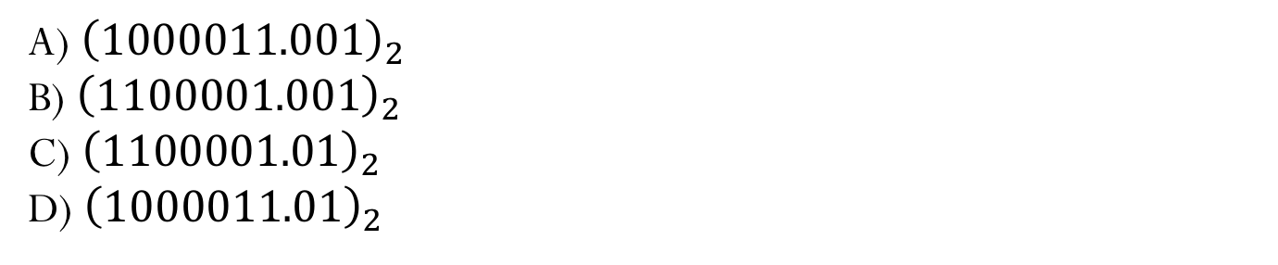
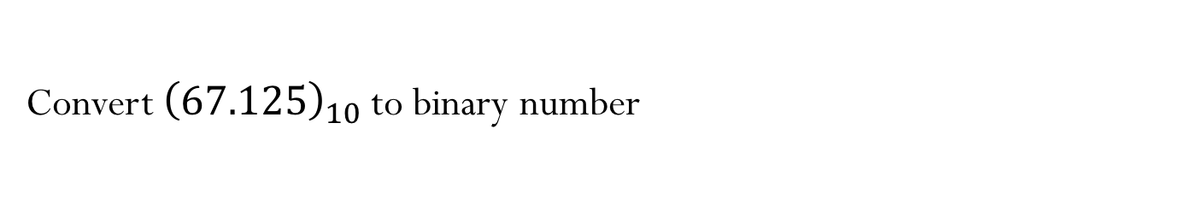
Practice questions
Convert ${\left(11101.11\right)}_{2}$ to decimal number
A) 19.75
B) 25.75
C) 23.75
D) 29.75
Convert ${\left(67.125\right)}_{10}$to binary number
A) ${\left(1000011.001\right)}_{2}$
B) ${\left(1100001.001\right)}_{2}$
C) ${\left(1100001.01\right)}_{2}$
D) ${\left(1000011.01\right)}_{2}$
Notes:
1)D
2)A

Slide 9
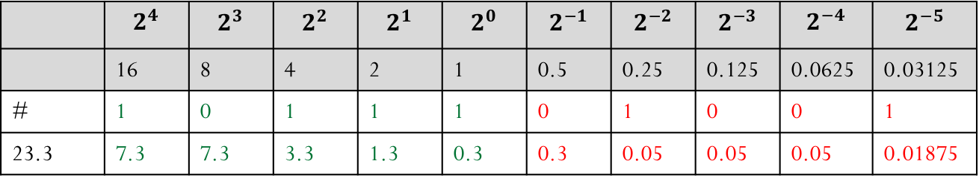
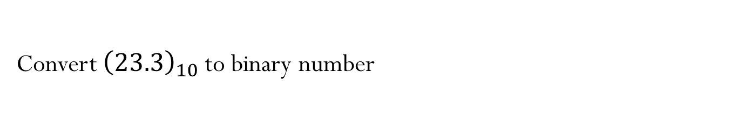
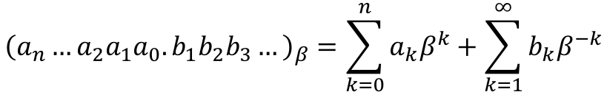
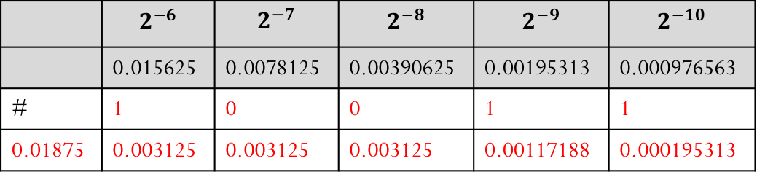
Convert ${\left(23.3\right)}_{10}$to binary number
 | $$2^{4}$$ | $$2^{3}$$ | $$2^{2}$$ | $$2^{1}$$ | $$2^{0}$$ | $$2^{−1}$$ | $$2^{−2}$$ | $$2^{−3}$$ | $$2^{−4}$$ | $$2^{−5}$$
 | 16 | 8 | 4 | 2 | 1 | 0.5 | 0.25 | 0.125 | 0.0625 | 0.03125
# | 1 | 0 | 1 | 1 | 1 | 0 | 1 | 0 | 0 | 1
23.3 | 7.3 | 7.3 | 3.3 | 1.3 | 0.3 | 0.3 | 0.05 | 0.05 | 0.05 | 0.01875
 | $$2^{−6}$$ | $$2^{−7}$$ | $$2^{−8}$$ | $$2^{−9}$$ | $$2^{−10}$$
 | 0.015625 | 0.0078125 | 0.00390625 | 0.00195313 | 0.000976563
# | 1 | 0 | 0 | 1 | 1
0.01875 | 0.003125 | 0.003125 | 0.003125 | 0.00117188 | 0.000195313
$${\left(\text{10111.010011001}\right)}_{2}={\left(\text{23}\text{.2998046875 }\right)}_{10}$$
Looks like 23.3 is represented by an infinite series in the binary base!
$${\left(a_{n}…a_{2}a_{1}a_{0}.b_{1}b_{2}b_{3}…\right)}_{β}=\sum_{k=0}^{n}{a_{k}β^{k}}+\sum_{k=1}^{∞}{b_{k}β^{−k}}$$

Slide 10
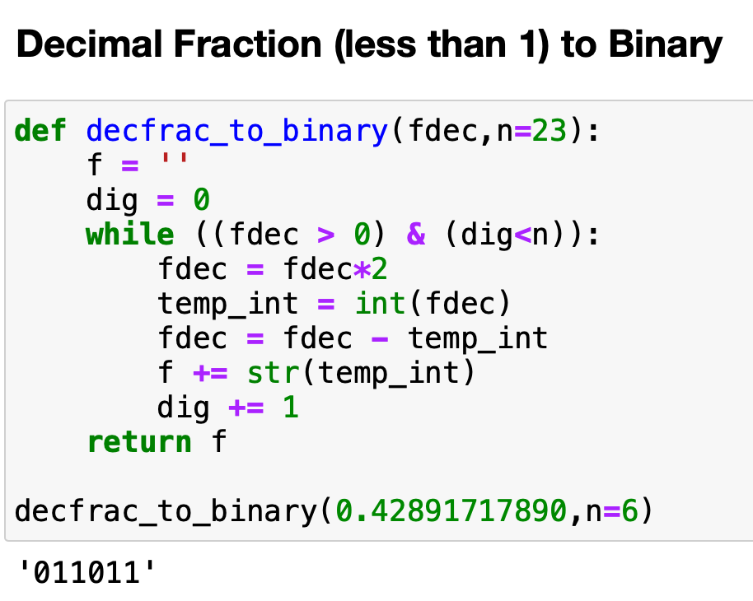
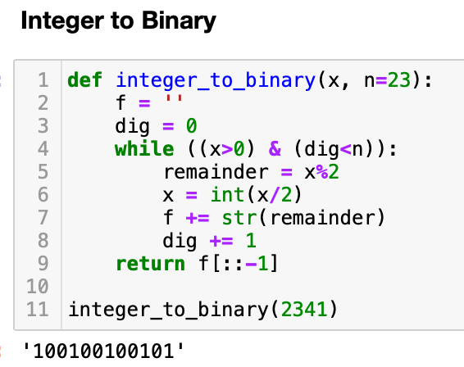
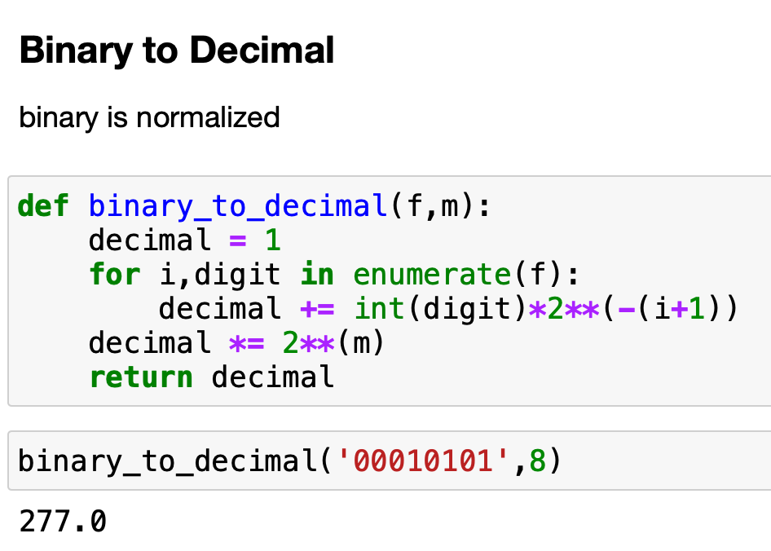
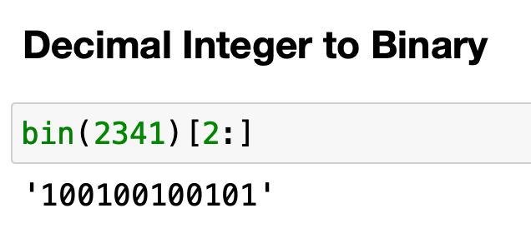
Tips for conversion using Python:
There are more ways to do this! You can use your own favorite method.
Much simpler method to convert integer to binary
Conversion of other systems (for example, ternary), can be obtained with a simple modification of these code snippets.

