Slide 1
Rounding errors

Slide 2
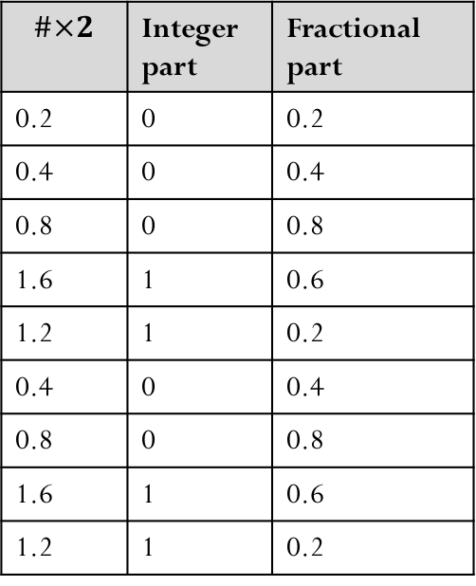



Example
Show demo: “Waiting for 1”.
Determine the double-precision machine representation for 0.1
$${0.1=\left(0.000110011 \overline{0011}… \right)}_{2}={\left(1.100110011…\right)}_{2}×2^{−4}$$
$$s=0$$
$$\#×2$$ | Integer part | Fractional part
0.2 | 0 | 0.2
0.4 | 0 | 0.4
0.8 | 0 | 0.8
1.6 | 1 | 0.6
1.2 | 1 | 0.2
0.4 | 0 | 0.4
0.8 | 0 | 0.8
1.6 | 1 | 0.6
1.2 | 1 | 0.2
$$f=\text{100110011}…\text{00110011010}$$
$$m=−4$$
$$c=m+1023=1019={\left(01111111011\right)}_{2}$$
$$0 01111111011 10011…0011…0011010$$
(52-bit)
Roundoff error in its basic form!

Slide 3

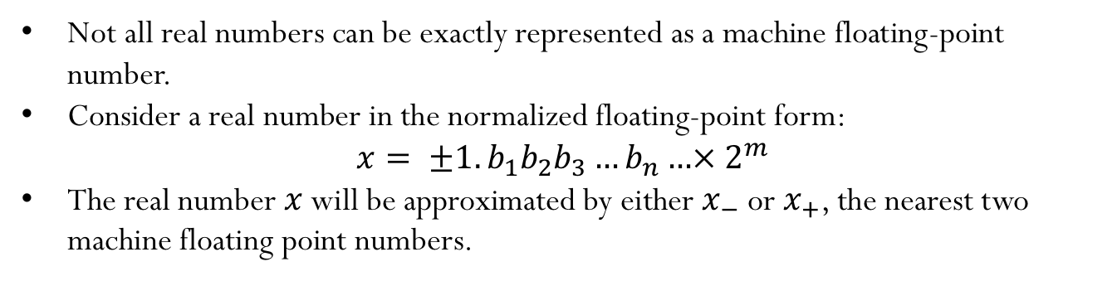








Machine floating point number
Not all real numbers can be exactly represented as a machine floating-point number.
Consider a real number in the normalized floating-point form:
$$x= ±1.b_{1}b_{2}b_{3}…b_{n}…×{ 2}^{m}$$
The real number $x$ will be approximated by either $x_{−}$ or $x_{+}$, the nearest two machine floating point numbers.
$$x_{−}$$
$$x$$
$$x_{+}$$
$$+∞$$
$$0$$
Without loss of generality, let’s see what happens when trying to represent a positive machine floating point number:
Exact number:
$$x= 1.b_{1}b_{2}b_{3}…b_{n}…×{ 2}^{m}$$
$x_{−} = 1.b_{1}b_{2}b_{3}…b_{n}×{ 2}^{m}$ (rounding by chopping)
$x_{+} = 1.b_{1}b_{2}b_{3}…b_{n}×{ 2}^{m}$+ $0.000…01×{ 2}^{m}$
$$ε_{m}$$

Slide 4











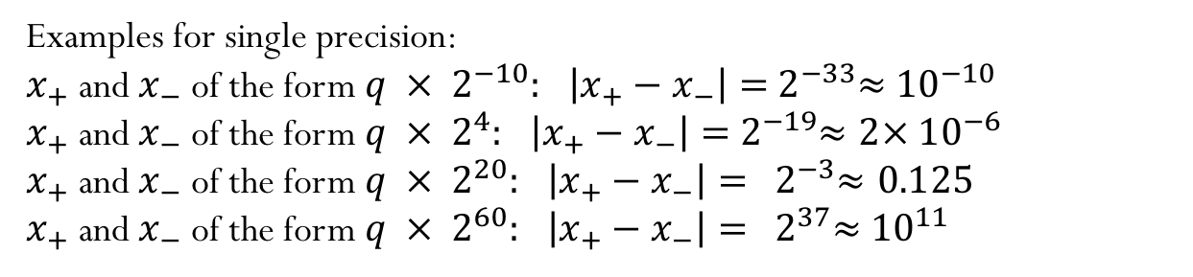
$$x_{−}$$
$$x$$
$$x_{+}$$
$$+∞$$
$$0$$
Exact number:
$$x= 1.b_{1}b_{2}b_{3}…b_{n}…×{ 2}^{m}$$
$$x_{−} = 1.b_{1}b_{2}b_{3}…b_{n}×{ 2}^{m}$$
$x_{+} = 1.b_{1}b_{2}b_{3}…b_{n}×{ 2}^{m}$+ $0.000…01×{ 2}^{m}$
$$ε_{m}$$
Gap between $x_{+}$ and $x_{−}$:
$$\left|x_{+}−x_{−}\right|=ε_{m} × { 2}^{m}$$
Examples for single precision:
$x_{+}$ and $x_{−}$ of the form $q × { 2}^{−10}:$ $\left|x_{+}−x_{−}\right|={ 2}^{−33}≈{ 10}^{−10}$
$x_{+}$ and $x_{−}$ of the form $q × { 2}^{4}:$ $\left|x_{+}−x_{−}\right|={ 2}^{−19}≈2×{ 10}^{−6}$
$x_{+}$ and $x_{−}$ of the form $q × { 2}^{20}:$ $\left|x_{+}−x_{−}\right|= { 2}^{−3}≈0.125$
$x_{+}$ and $x_{−}$ of the form $q × { 2}^{60}:$ $\left|x_{+}−x_{−}\right|= { 2}^{37}≈{ 10}^{11}$
The interval between successive floating point numbers is not uniform: the interval is smaller as the magnitude of the numbers themselves is smaller, and it is bigger as the numbers get bigger.

Slide 5
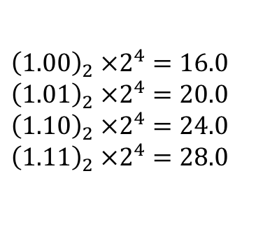
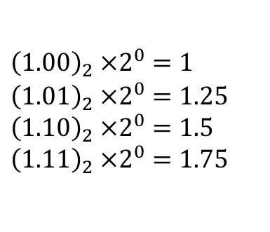
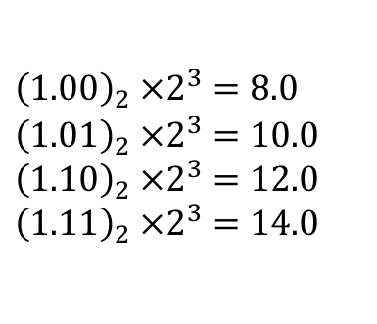
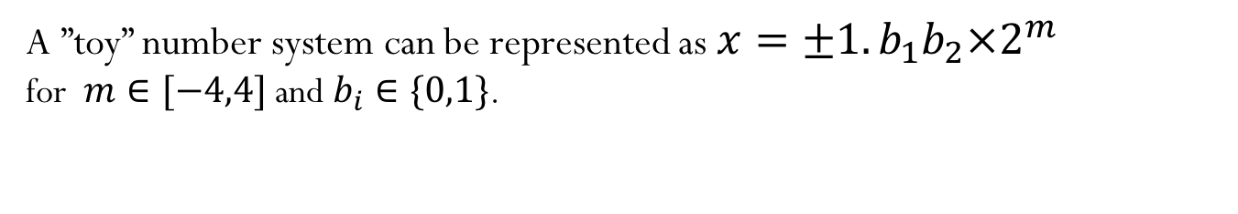
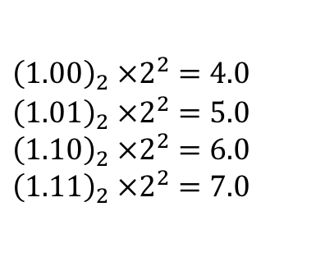
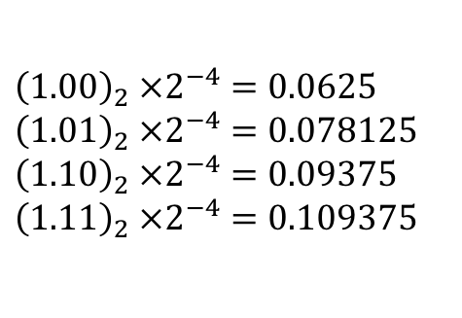
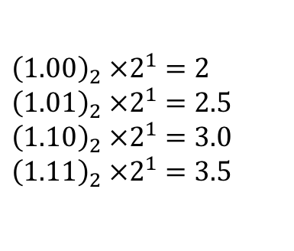
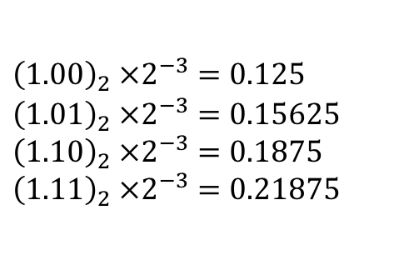
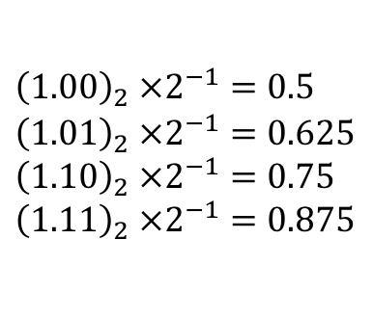
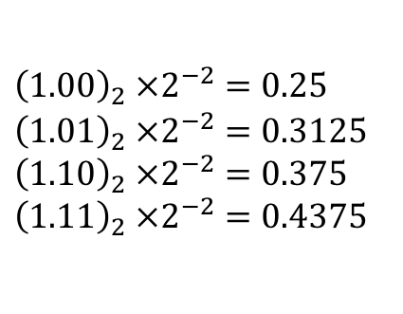
Gap between two successive machine floating point numbers
A ”toy” number system can be represented as $x=±1.b_{1}b_{2}×2^{m}$
for $m∈[−4,4]$ and $b_{i}∈\{0,1\}$.
$${\left(1.00\right)}_{2} ×2^{0}=1$$
$${\left(1.01\right)}_{2} ×2^{0}=1.25$$
$${\left(1.10\right)}_{2} ×2^{0}=1.5$$
$${\left(1.11\right)}_{2} ×2^{0}=1.75$$
$${\left(1.00\right)}_{2} ×2^{1}=2$$
$${\left(1.01\right)}_{2} ×2^{1}=2.5$$
$${\left(1.10\right)}_{2} ×2^{1}=3.0$$
$${\left(1.11\right)}_{2} ×2^{1}=3.5$$
$${\left(1.00\right)}_{2} ×2^{2}=4.0$$
$${\left(1.01\right)}_{2} ×2^{2}=5.0$$
$${\left(1.10\right)}_{2} ×2^{2}=6.0$$
$${\left(1.11\right)}_{2} ×2^{2}=7.0$$
$${\left(1.00\right)}_{2} ×2^{3}=8.0$$
$${\left(1.01\right)}_{2} ×2^{3}=10.0$$
$${\left(1.10\right)}_{2} ×2^{3}=12.0$$
$${\left(1.11\right)}_{2} ×2^{3}=14.0$$
$${\left(1.00\right)}_{2} ×2^{4}=16.0$$
$${\left(1.01\right)}_{2} ×2^{4}=20.0$$
$${\left(1.10\right)}_{2} ×2^{4}=24.0$$
$${\left(1.11\right)}_{2} ×2^{4}=28.0$$
$${\left(1.00\right)}_{2} ×2^{−1}=0.5$$
$${\left(1.01\right)}_{2} ×2^{−1}=0.625$$
$${\left(1.10\right)}_{2} ×2^{−1}=0.75$$
$${\left(1.11\right)}_{2} ×2^{−1}=0.875$$
$${\left(1.00\right)}_{2} ×2^{−2}=0.25$$
$${\left(1.01\right)}_{2} ×2^{−2}=0.3125$$
$${\left(1.10\right)}_{2} ×2^{−2}=0.375$$
$${\left(1.11\right)}_{2} ×2^{−2}=0.4375$$
$${\left(1.00\right)}_{2} ×2^{−3}=0.125$$
$${\left(1.01\right)}_{2} ×2^{−3}=0.15625$$
$${\left(1.10\right)}_{2} ×2^{−3}=0.1875$$
$${\left(1.11\right)}_{2} ×2^{−3}=0.21875$$
$${\left(1.00\right)}_{2} ×2^{−4}=0.0625$$
$${\left(1.01\right)}_{2} ×2^{−4}=0.078125$$
$${\left(1.10\right)}_{2} ×2^{−4}=0.09375$$
$${\left(1.11\right)}_{2} ×2^{−4}=0.109375$$

Slide 6

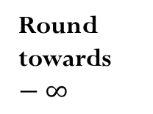
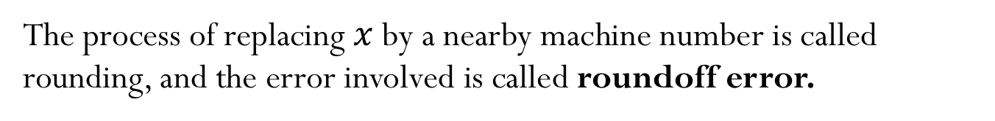
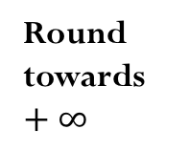




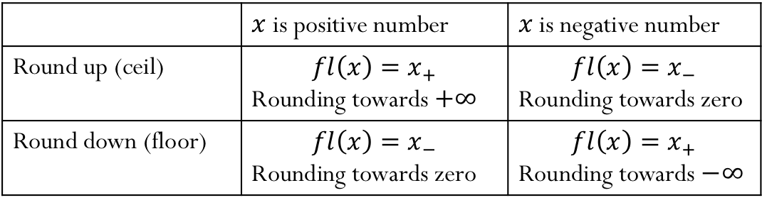
Rounding
The process of replacing $x$ by a nearby machine number is called rounding, and the error involved is called roundoff error.
Round towards $−∞$
Round towards zero
Round towards zero
Round towards $+∞$
$$−∞$$
$$x_{+}$$
$$x$$
$$x_{−}$$
$$0$$
$$x_{−}$$
$$x$$
$$x_{+}$$
$$+∞$$
Round by chopping: ${fl\left(x\right)=x}_{−}$
 | $x$ is positive number | $x$ is negative number
Round up (ceil) | $${fl\left(x\right)=x}_{+}$$ Rounding towards $+∞$ | ${fl\left(x\right)=x}_{−}$ Rounding towards zero
Round down (floor) | ${fl\left(x\right)=x}_{−}$ Rounding towards zero | $${fl\left(x\right)=x}_{+}$$ Rounding towards $−∞$
Round to nearest: either round up or round down, whichever is closer
Notes:
Round to nearest: in case of a tie, the rounded number is the one in which the last stored digit is an even number.
Rounding by chopping gives machine epsilon = 2^(1-p) – same as the gap between 1 and the next largest number
Rounding to nearest gives machine epsilon =0.5* 2^(1-p)

Slide 7
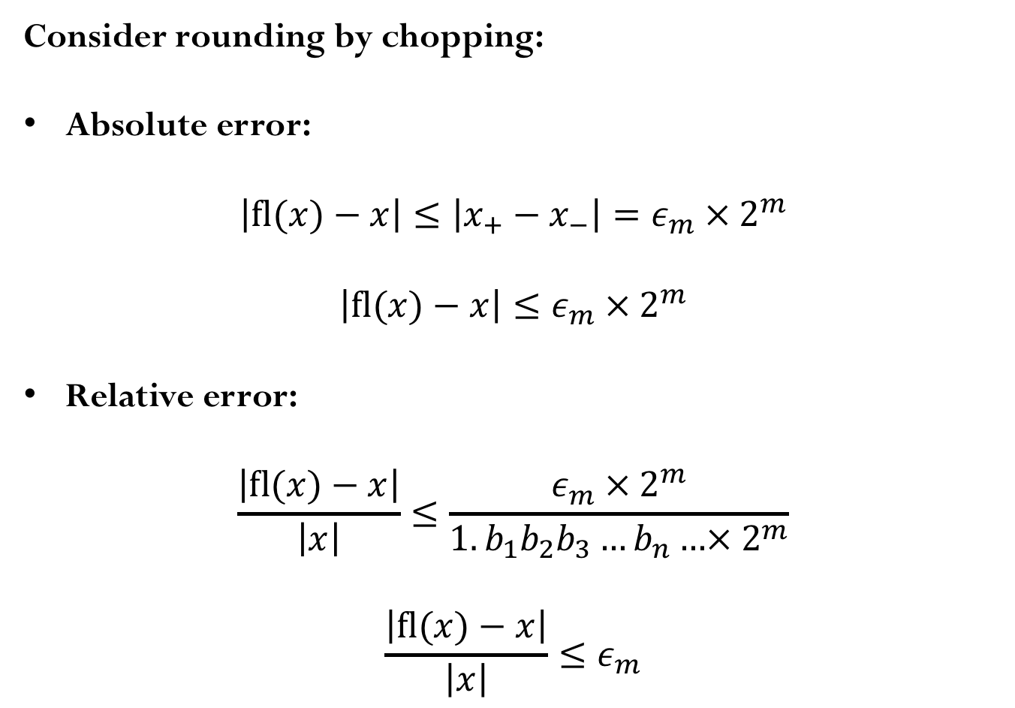
Rounding (roundoff) errors
Consider rounding by chopping:
Absolute error:
$$\left|fl(x)−x\right|≤\left|x_{+}−x_{−}\right|={ε_{m} × 2}^{m}$$
$$\left|fl(x)−x\right|≤{ε_{m} × 2}^{m}$$
Relative error:
$$\frac{\left|fl(x)−x\right|}{\left|x\right|}≤\frac{{ε_{m} × 2}^{m}}{1.b_{1}b_{2}b_{3}…b_{n}…×{ 2}^{m}}$$
$$\frac{\left|fl(x)−x\right|}{\left|x\right|}≤ε_{m}$$
Notes:
The machine epsilon determines the maximum possible relative error in representing a non-zero real number x in a floating-point system.

Slide 8
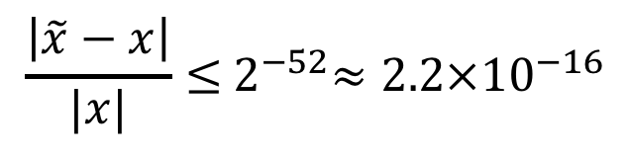
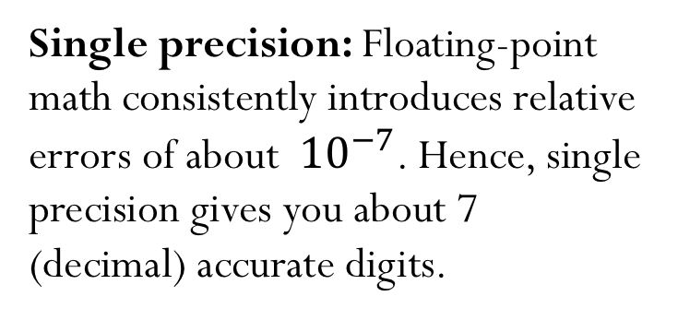
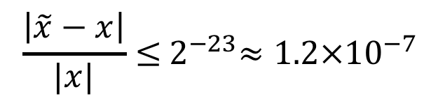


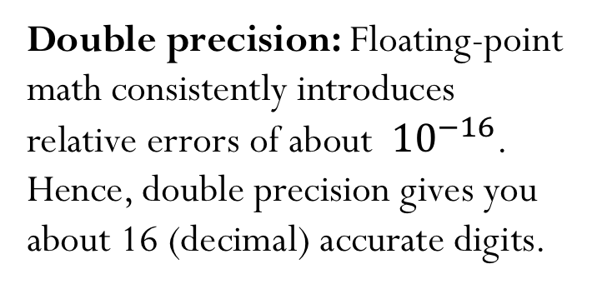
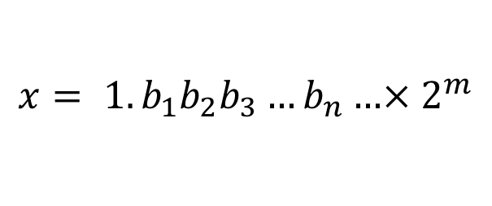
Rounding (roundoff) errors
$$x_{−}$$
$$x= 1.b_{1}b_{2}b_{3}…b_{n}…×{ 2}^{m}$$
$$x_{+}$$
$$\frac{\left|\tilde{x}−x\right|}{|x|}≤{ 2}^{−23}≈{1.2×10}^{−7}$$
$$\frac{\left|\tilde{x}−x\right|}{|x|}≤{ 2}^{−52}≈{2.2×10}^{−16}$$
Single precision: Floating-point math consistently introduces relative errors of about ${ 10}^{−7}$. Hence, single precision gives you about 7 (decimal) accurate digits.
Double precision: Floating-point math consistently introduces relative errors of about ${ 10}^{−16}$. Hence, double precision gives you about 16 (decimal) accurate digits.
Notes:
The machine epsilon determines the maximum possible relative error in representing a non-zero real number x in a floating-point system.

Slide 9

Iclicker question
Assume you are working with IEEE single-precision numbers. Find the smallest number $a$ that satisfies
$$2^{8}+a≠2^{8}$$
$2^{−1074}$
$2^{−1022}$
$2^{−52}$
$2^{−15}$
$2^{−8}$
Notes:
D)

Slide 10
Demo

Slide 11
Arithmetic with machine numbers

Slide 12
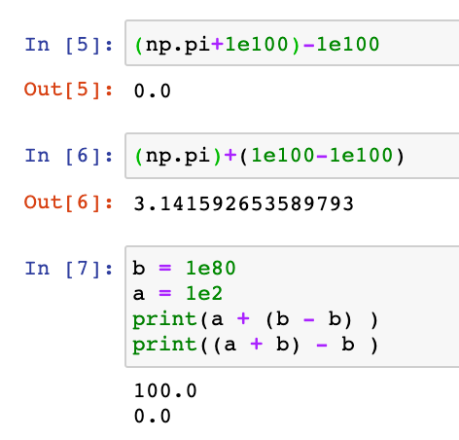
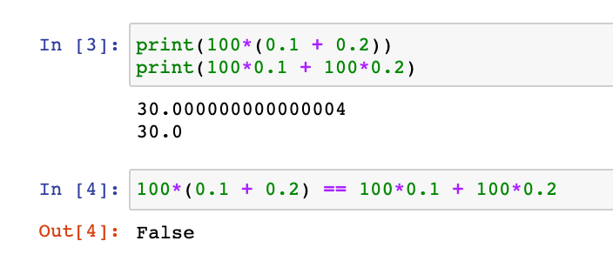




Mathematical properties of FP operations
Not necessarily associative:
For some $x , y,z$the result below is possible:
$$\left(x+y\right)+z ≠x+(y+z)$$
Not necessarily distributive:
For some $x , y,z$the result below is possible:
$$z \left(x+y\right) ≠z x+z y$$
Not necessarily cumulative:
Repeatedly adding a very small number to a large number may do nothing

Slide 13





Floating point arithmetic (basic idea)
$$x ={(−1)}^{s} 1.f ×{ 2}^{m} =$$
$$s$$
$$c$$
$$f$$
First compute the exact result
Then round the result to make it fit into the desired precision
$x+y=fl\left(x+y\right)$
$x × y=fl\left(x × y\right)$
Notes:
Add here about operations
Add in errors the notes about sigfig
Add in Taylor more detail about FD

Slide 14
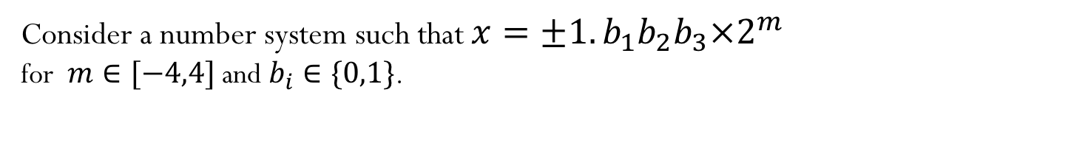
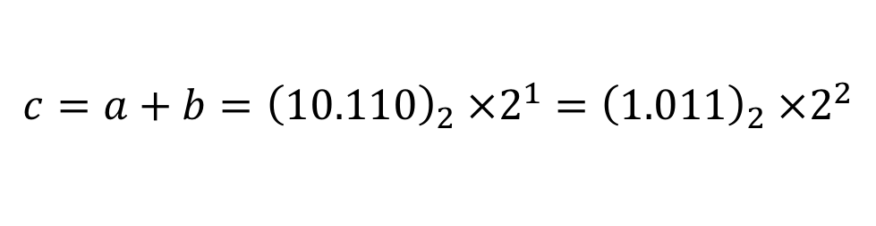
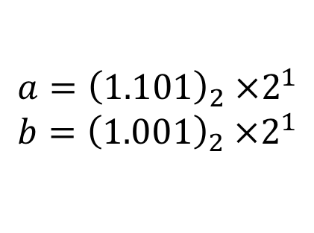
Floating point arithmetic
Consider a number system such that $x=±1.b_{1}b_{2}b_{3}×2^{m}$
for $m∈[−4,4]$ and $b_{i}∈\{0,1\}$.
Rough algorithm for addition and subtraction:
Bring both numbers onto a common exponent
Do “grade-school” operation
Round result
Example 1: No rounding needed
$${a=\left(1.101\right)}_{2} ×2^{1}$$
$${b=\left(1.001\right)}_{2} ×2^{1}$$
$${c=a+b=\left(10.110\right)}_{2} ×2^{1}={\left(1.011\right)}_{2} ×2^{2}$$

Slide 15
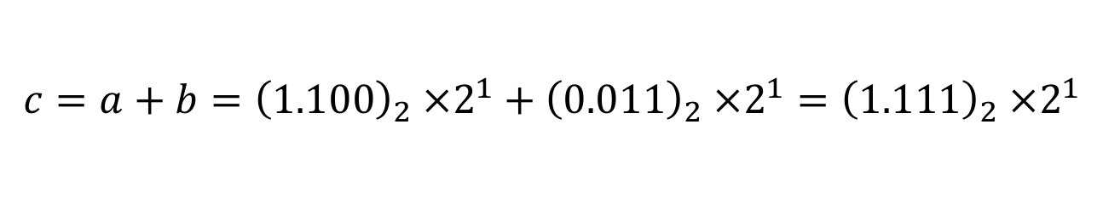
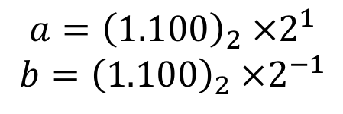
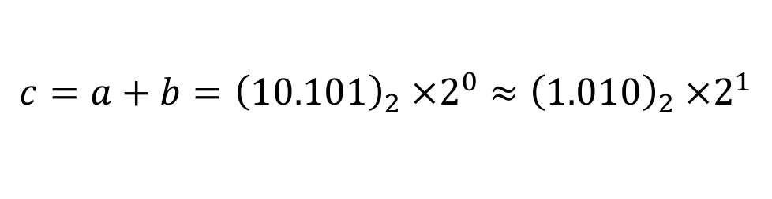
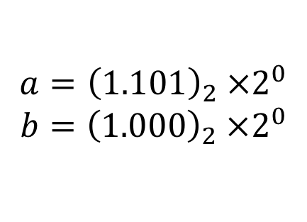
Floating point arithmetic
Consider a number system such that $x=±1.b_{1}b_{2}b_{3}×2^{m}$
for $m∈[−4,4]$ and $b_{i}∈\{0,1\}$.
Example 2: Require rounding
$${a=\left(1.101\right)}_{2} ×2^{0}$$
$${b=\left(1.000\right)}_{2} ×2^{0}$$
$${c=a+b=\left(10.101\right)}_{2} ×2^{0}≈{\left(1.010\right)}_{2} ×2^{1}$$
Example 3:
$${a=\left(1.100\right)}_{2} ×2^{1}$$
$${b=\left(1.100\right)}_{2} ×2^{−1}$$
$${c=a+b=\left(1.100\right)}_{2} ×2^{1}+{\left(0.011\right)}_{2} ×2^{1}={\left(1.111\right)}_{2} ×2^{1}$$

Slide 16
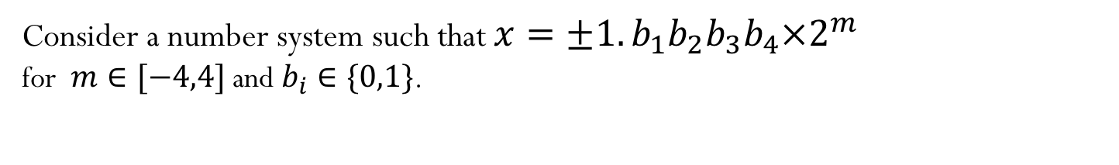
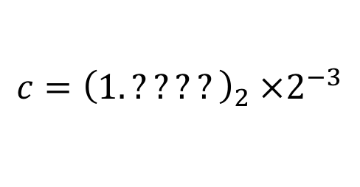
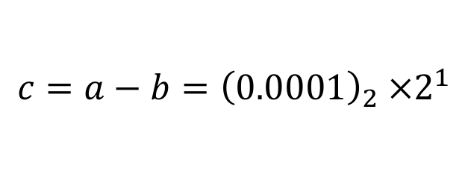
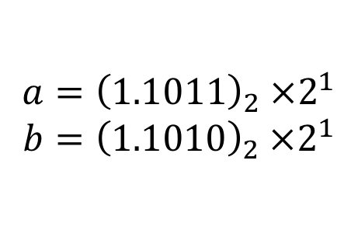
Floating point arithmetic
Consider a number system such that $x=±1.b_{1}b_{2}b_{3}b_{4}×2^{m}$
for $m∈[−4,4]$ and $b_{i}∈\{0,1\}$.
Example 4:
$${a=\left(1.1011\right)}_{2} ×2^{1}$$
$${b=\left(1.1010\right)}_{2} ×2^{1}$$
$${c=a−b=\left(0.0001\right)}_{2} ×2^{1}$$
Or after normalization:
$${c=\left(1.????\right)}_{2} ×2^{−3}$$
Unfortunately there is not data to indicate what the missing digits should be. The effect is that the number of significant digits in the result is reduced. Machine fills them with its best guess, which is often not good (usually what is called spurious zeros). This phenomenon is called Catastrophic Cancellation.
Notes:
just mention in class that there are a few implementation details we aren’t discussing but if you are interested, you can go look at the reference material posted (it’s on the other reference material under floating point)

Slide 17
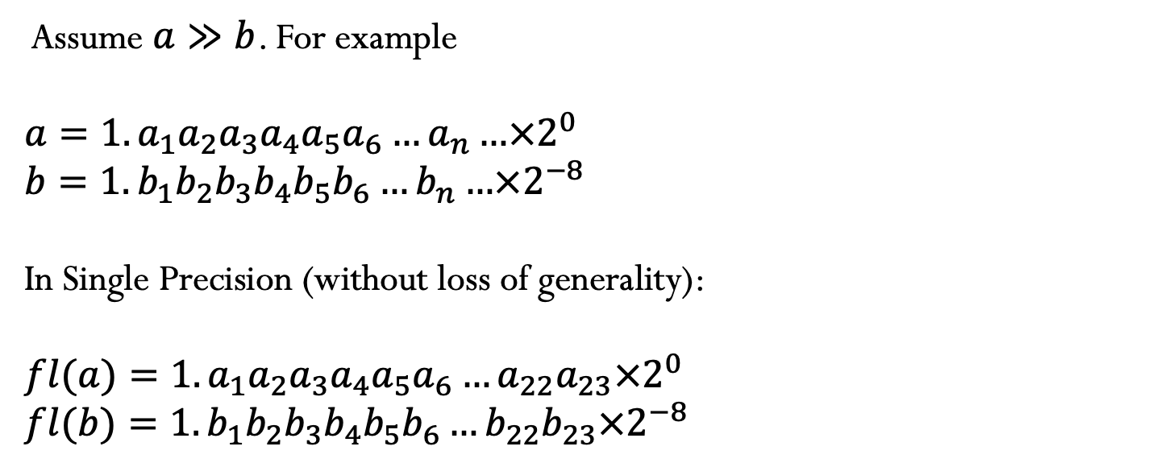
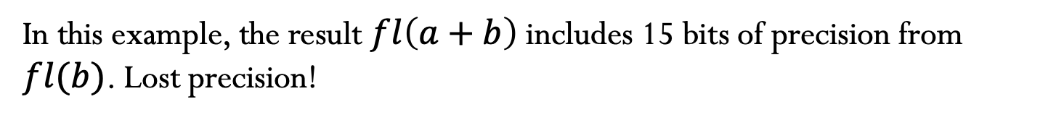

Loss of significance
Assume $a≫b$. For example
$$a=1.a_{1}a_{2}a_{3}a_{4}a_{5}a_{6}…a_{n}…×2^{0}$$
$$b=1.b_{1}b_{2}b_{3}b_{4}b_{5}b_{6}…b_{n}…×2^{−8}$$
In Single Precision (without loss of generality):
$$fl(a)=1.a_{1}a_{2}a_{3}a_{4}a_{5}a_{6}…a_{22}a_{23}×2^{0}$$
$$fl(b)=1.b_{1}b_{2}b_{3}b_{4}b_{5}b_{6}…b_{22}b_{23}×2^{−8}$$
$$1.a_{1}a_{2}a_{3}a_{4}a_{5}a_{6}a_{7}a_{8}a_{9}…a_{22}a_{23}×2^{0}$$
$$+$$
$$0.00000001b_{1}b_{2}b_{3}b_{4}b_{5}…b_{14}b_{15}×2^{0}$$
In this example, the result $fl\left(a+b\right)$ includes 15 bits of precision from $fl(b)$. Lost precision!
Notes:
just mention in class that there are a few implementation details we aren’t discussing but if you are interested, you can go look at the reference material posted (it’s on the other reference material under floating point)

Slide 18
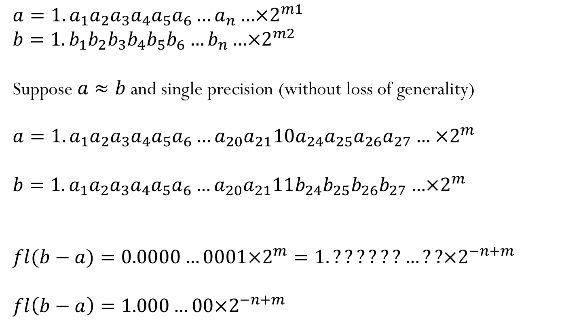
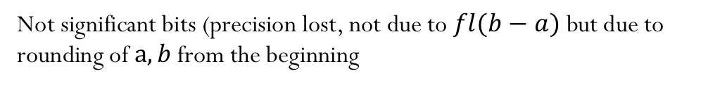
Cancellation
$$a=1.a_{1}a_{2}a_{3}a_{4}a_{5}a_{6}…a_{n}…×2^{m1}$$
$$b=1.b_{1}b_{2}b_{3}b_{4}b_{5}b_{6}…b_{n}…×2^{m2}$$
Suppose $a≈b$ and single precision (without loss of generality)
$$a=1.a_{1}a_{2}a_{3}a_{4}a_{5}a_{6}…a_{20}a_{21}10a_{24}a_{25}a_{26}a_{27}… ×2^{m}$$
$$b=1.a_{1}a_{2}a_{3}a_{4}a_{5}a_{6}…a_{20}a_{21}11b_{24}b_{25}b_{26}b_{27}…×2^{m}$$
$$fl(b−a)=0.0000…0001×2^{m}=1.??????…??×2^{−n+m}$$
$$fl\left(b−a\right)=1.000…00×2^{−n+m}$$
Lost due to rounding
Not significant bits (precision lost, not due to $fl(b−a)$ but due to rounding of $a,b$ from the beginning
Notes:
just mention in class that there are a few implementation details we aren’t discussing but if you are interested, you can go look at the reference material posted (it’s on the other reference material under floating point)

Slide 19
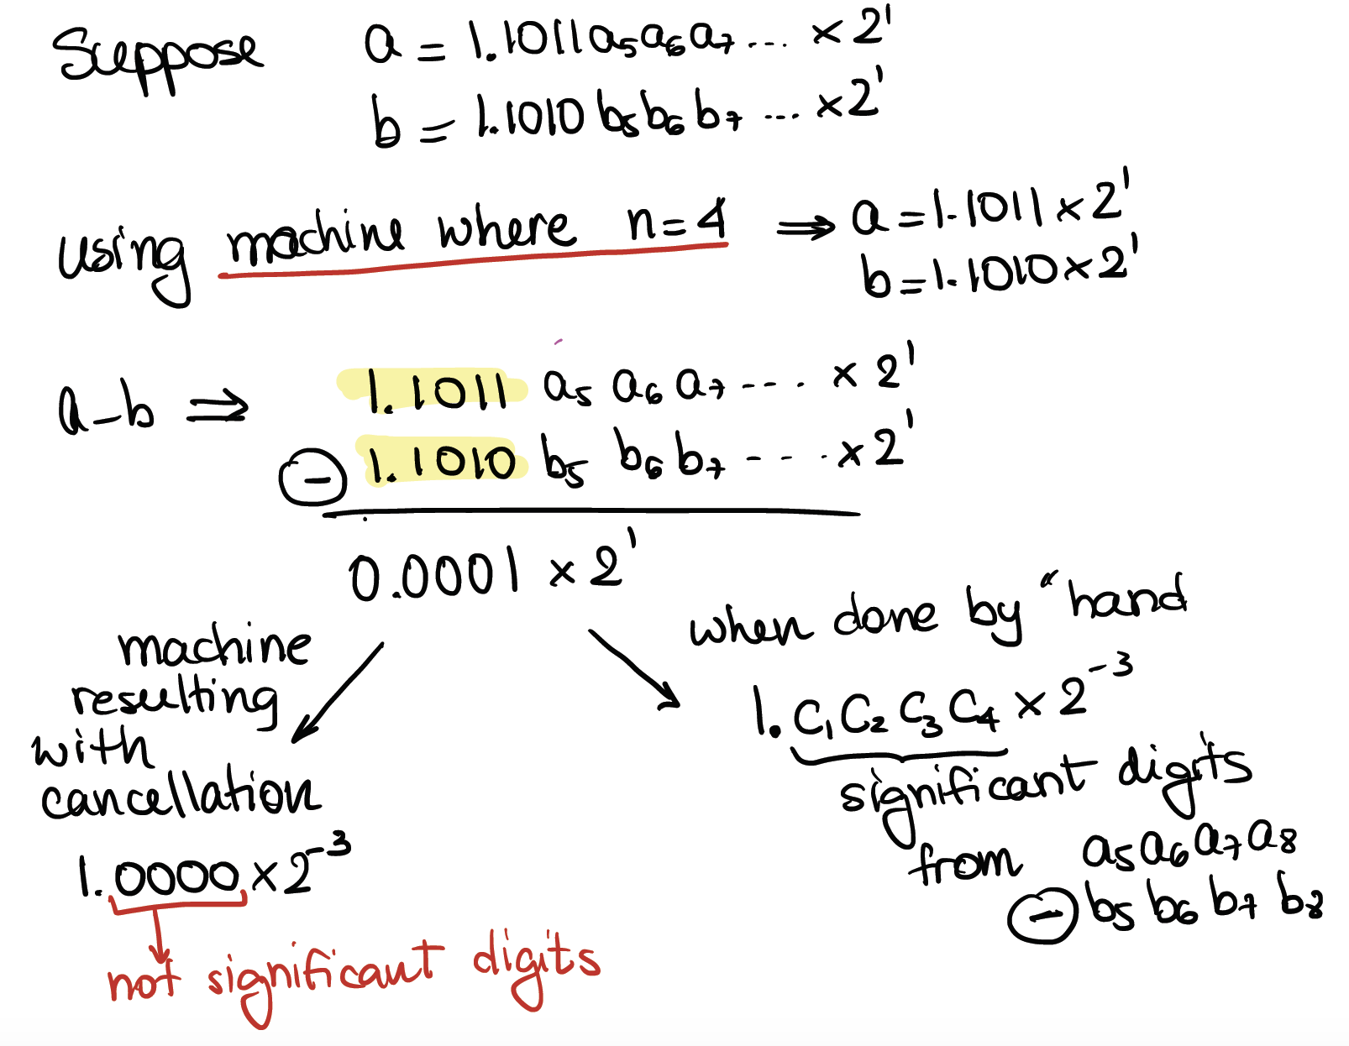
Example of cancellation:

Slide 20
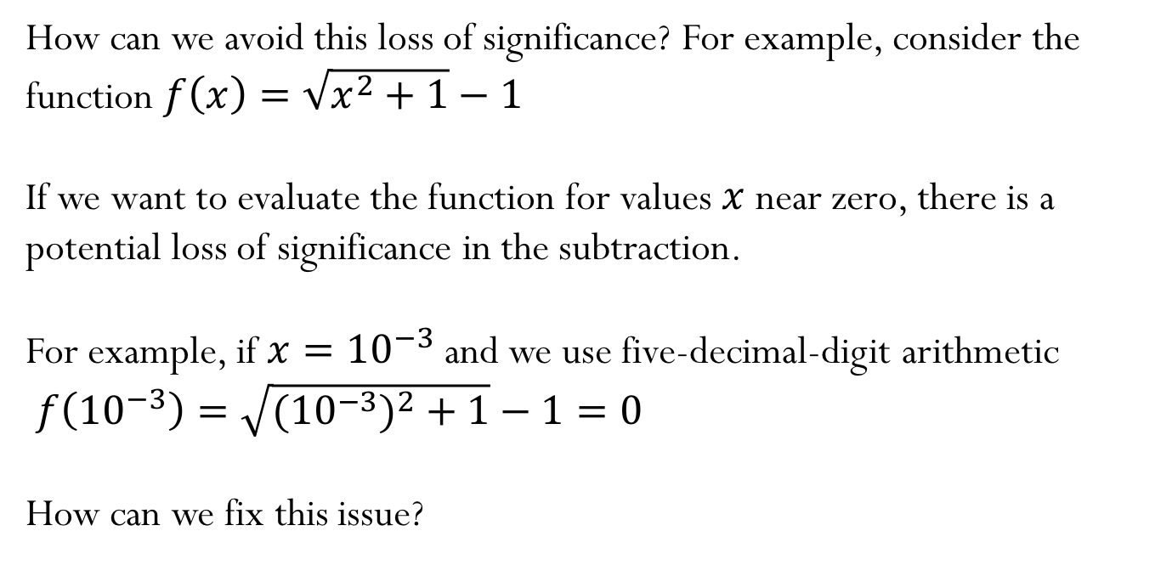
Loss of Significance
How can we avoid this loss of significance? For example, consider the function $f\left(x\right)=\sqrt{x^{2}+1}−1$
If we want to evaluate the function for values $x$ near zero, there is a potential loss of significance in the subtraction.
For example, if $x={10}^{−3}$ and we use five-decimal-digit arithmetic
$f\left({10}^{−3}\right)=\sqrt{{{(10}^{−3})}^{2}+1}−1=0$
How can we fix this issue?

Slide 21
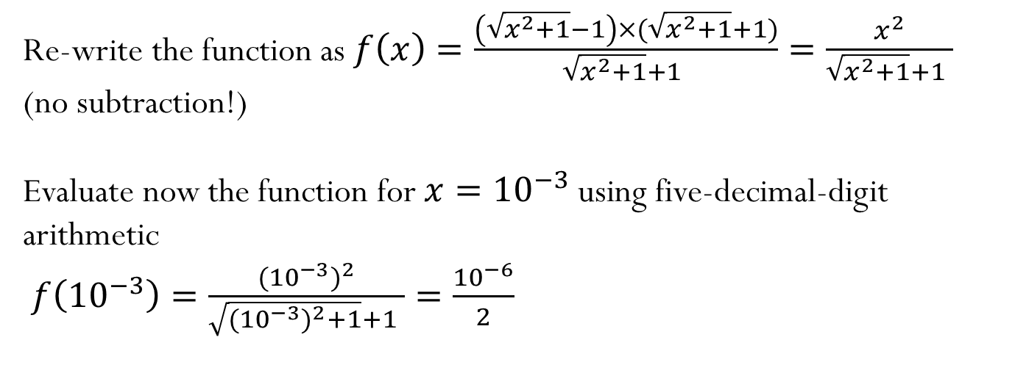
Loss of Significance
Re-write the function as $f\left(x\right)=\frac{\left(\sqrt{x^{2}+1}−1\right)×(\sqrt{x^{2}+1}+1)}{\sqrt{x^{2}+1}+1 }=\frac{x^{2}}{\sqrt{x^{2}+1}+1 }$
(no subtraction!)
Evaluate now the function for $x={10}^{−3}$ using five-decimal-digit arithmetic
$f\left({10}^{−3}\right)=\frac{{({10}^{−3})}^{2}}{\sqrt{{({10}^{−3})}^{2}+1}+1 }=\frac{{10}^{−6}}{2}$

Slide 22
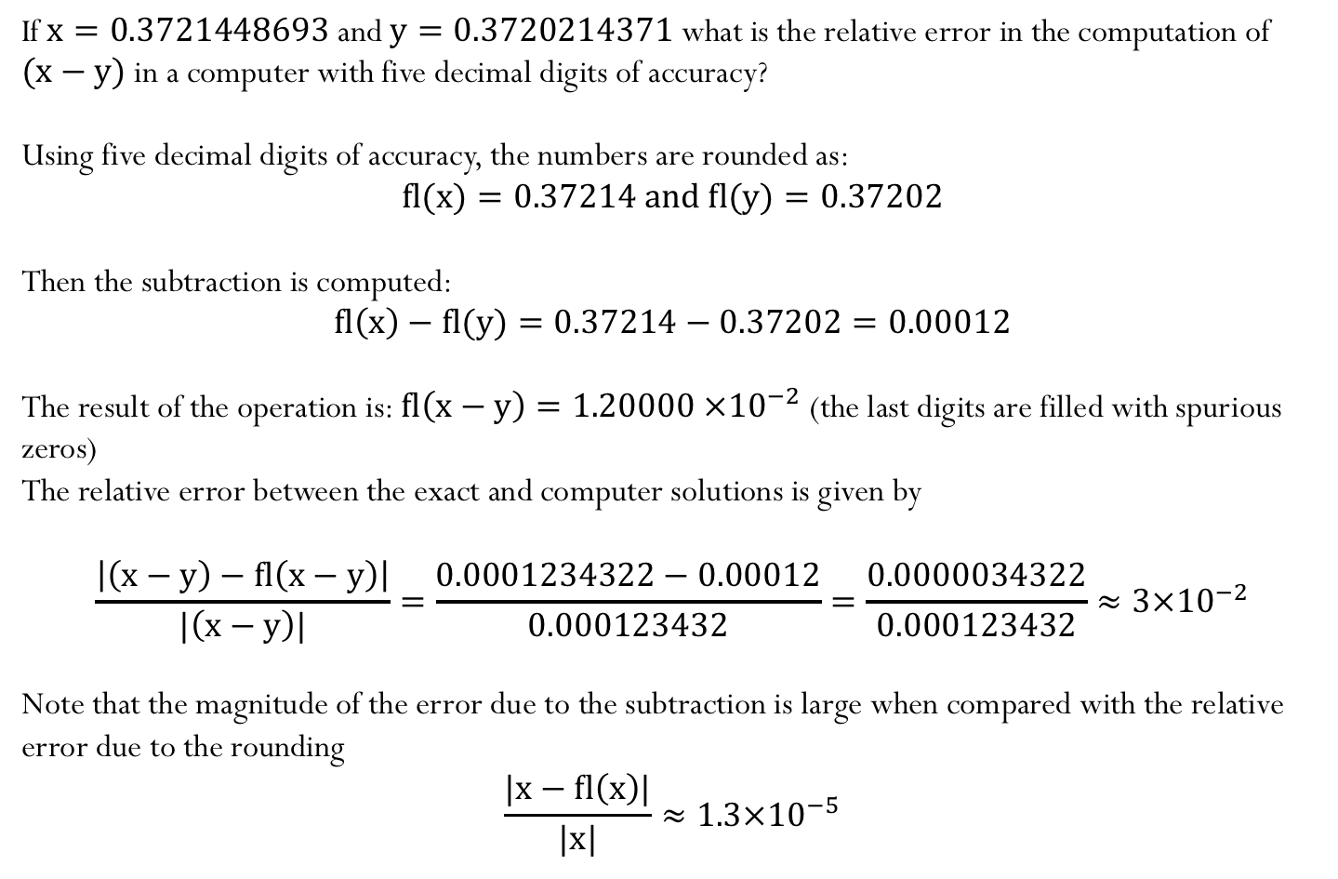
Example:
If$x=0.3721448693$ and $y=0.3720214371$what is the relative error in the computation of $(x−y)$ in a computer with five decimal digits of accuracy?
Using five decimal digits of accuracy, the numbers are rounded as:
$fl(x)=0.37214$and $fl(y)=0.37202$
Then the subtraction is computed:
$$fl\left(x\right)−fl(y)=0.37214−0.37202=0.00012$$
The result of the operation is: $fl\left(x−y\right)=1.20000$ $×{10}^{−2}$ (the last digits are filled with spurious zeros)
The relative error between the exact and computer solutions is given by
$$\frac{\left|\left(x−y\right)−fl\left(x−y\right)\right|}{|\left(x−y\right)|}=\frac{0.0001234322−0.00012}{0.000123432}=\frac{0.0000034322}{0.000123432}≈3×{10}^{−2}$$
Note that the magnitude of the error due to the subtraction is large when compared with the relative error due to the rounding
$$\frac{|x−fl\left(x\right)|}{|x|}≈1.3×{10}^{−5}$$
Notes:
The relative error is in fact ~1.3 * 10^(-5)

