Slide 1
Random numbers and Monte Carlo methods

Slide 2
Randomness
What types of problems can we solve with the help of random numbers?
We can compute (potentially) complicated averages:
Where does “the average” web surfer end up? (PageRank)
How much is my stock portfolio/option going to be worth?
What are my odds to win a certain competition?

Slide 3
Random number generators
Computers are deterministic - operations are reproducible
How do we get random numbers out of a determinist machine?
Demo “Playing around with random number generators”
Pseudo-random numbers
Numbers and sequences appear random, but they are in fact reproducible
Good for algorithm development and debugging
How truly random are the pseudo-random numbers?
Notes:
Some computers will have a chip that can generate random numbers, but that is not very usual.
Note that the same numbers are generated when not changing the seed. Good for algorithm development and debugging (debugging algorithms with different numbers is extremely difficult)
Sequence is the same when not changing the seed
For cryptography, we may be worried about the quality of the random numbers (how random they are), but for numerics we are often interested in medium quality random numbers.
Extra from questions:
Operating systems provide a way to obtain random numbers from hardware noise. Problems: in particular not that much randomness. In cryptography, they often use this to generate the seed, and then use other methods to generate random numbers

Slide 4

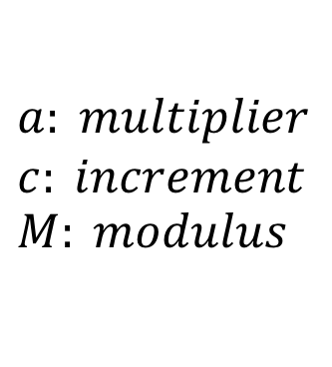
Example: Linear congruential generator
$$x_{o}=seed$$
$$x_{n+1}=\left({a x}_{n}+c \right) (mod M)$$
$$a: multiplier$$
$$c: increment$$
$$M: modulus$$
If we keep generating numbers using this algorithm, will we eventually get the same number again? Can we define a period?
Demo “Random numbers”
Notes:
The LCG is totally non-random. In red, you see parameters that should be chosen.
If we keep generating numbers using the LCG method, will we eventually get the same number again? Does this generator have a period or the numbers will never repeat?
Computers are finite, there are only a finite numbers that can be generated. It will repeat by pigeonhole principle.
For cryptography, we may be worried about the quality of the random numbers (how random they are), but for numerics we are often interested in medium quality random numbers.
Extra from questions:
Operating systems provide a way to obtain random numbers from hardware noise. Problems: in particular not that much randomness. In cryptography, they often use this to generate the seed, and then use other methods to generate random numbers

Slide 5
Good random number generator
Random pattern
Long period
Efficiency
Repeatability
Portability

Slide 6
Random variables
We can think of a random variable X as a function that maps the outcome of unpredictable (random) processes to numerical quantities.
Examples:
How much rain are we getting tomorrow?
Will my buttered bread land face-down?
We don’t have an exact number to represent these random processes, but we can get something that represents the average case.
To do that, we need to know how likely each individual value of X is.

Slide 7

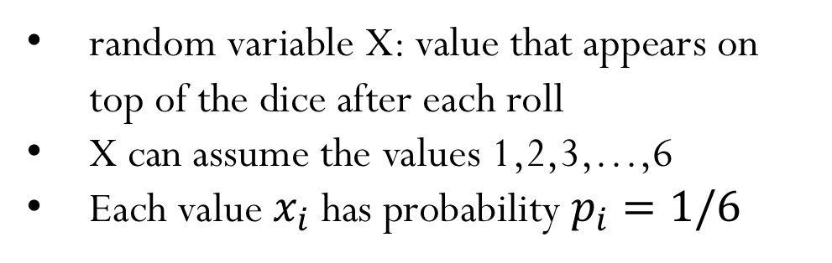
Discrete random variables
Each random value X takes values $x_{i}$ with probability $p_{i}$
for $i=1,…,m$ and $\sum_{i=1}^{m}{p_{i}}=1$
Example:
random variable X: value that appears on top of the dice after each roll
X can assume the values 1,2,3,…,6
Each value $x_{i}$ has probability $p_{i}=1/6$

Slide 8
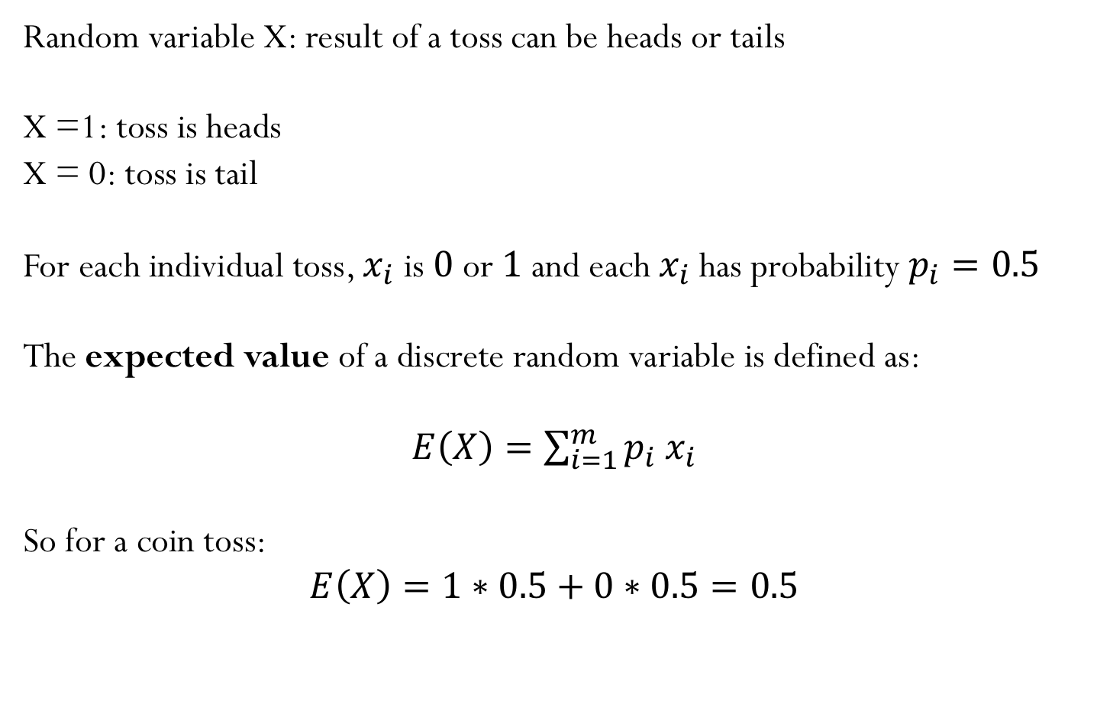
Coin toss example
Random variable X: result of a toss can be heads or tails
X =1: toss is heads
X = 0: toss is tail
For each individual toss, $x_{i}$ is $0$ or $1$ and each $x_{i}$has probability $p_{i}=0.5$
The expected value of a discrete random variable is defined as:
$E\left(X\right)=\sum_{i=1}^{m}{p_{i}}$ $x_{i}$
So for a coin toss:
$$E\left(X\right)=1∗0.5+0∗0.5=0.5$$

Slide 9
Coin toss example
Let’s toss a “fair” coin 1000 times, and record the number of times we get heads.
The recorded number would likely land close to the expected value 0.5.
If we run this 1000 coin toss experiment N times (let’s say N = 100), the results will look like a normal distribution, with the majority of the results close to 0.5.

Slide 10
Texas Holdem Game
Question: for each starting pair of cards, what is the probability of winning?
One Game: set of 7 cards
Starting hand
Opponent hand
Dealer hand
Compares the cards and decides who wins the game
One numerical experiment:
“Play” N games and record the result of each one of them

Slide 11
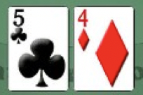
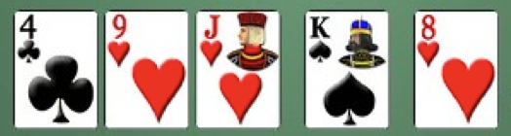
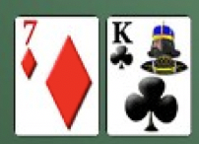
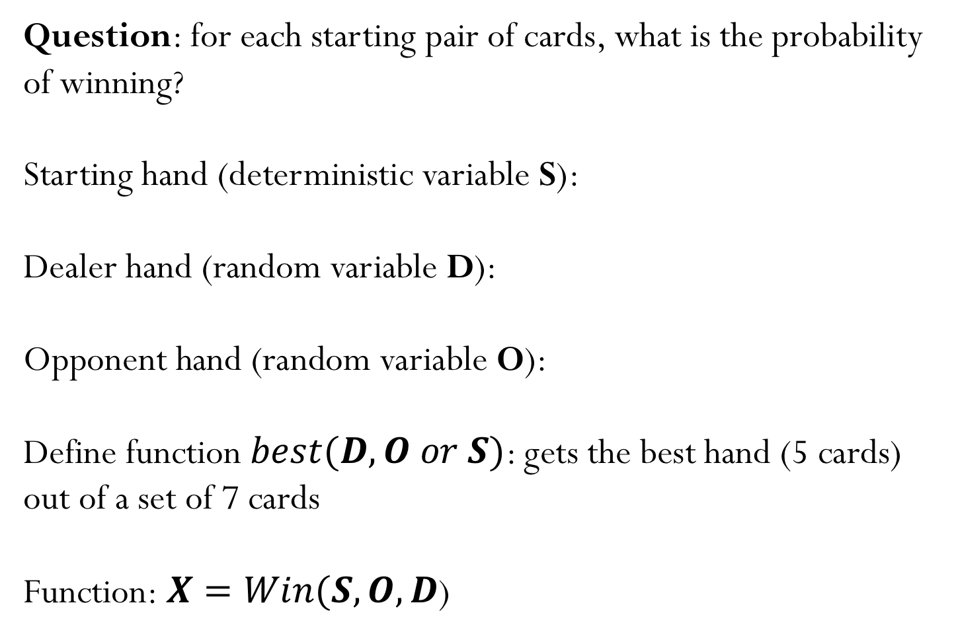
Texas Holdem Game
Question: for each starting pair of cards, what is the probability of winning?
Starting hand (deterministic variable S):
Dealer hand (random variable D):
Opponent hand (random variable O):
Define function $best(D,O or S)$: gets the best hand (5 cards) out of a set of 7 cards
Function:$X=Win(S,O,D$)

Slide 12
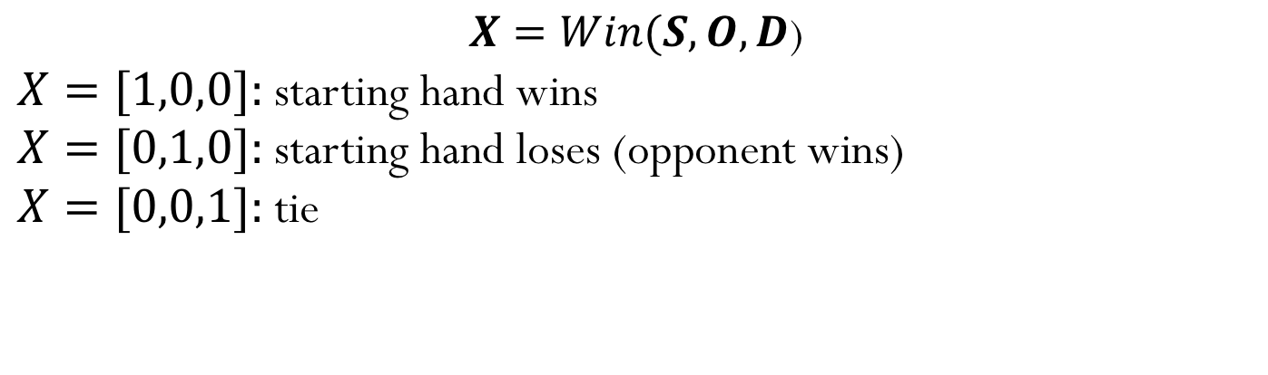
Texas Holdem Game
$$X=Win(S,O,D\text{)}$$
$X=[1,0,0]:$starting hand wins
$X=[0,1,0]:$starting hand loses (opponent wins)
$X=[0,0,1]:$tie
GAME
Let’s say we now run 1,000 “games” with the starting hand 5 clubs and 4 of diamonds. The experiment produces 350 wins, 590 losses and 60 ties.
If we run this same numerical experiment again, would we get the same results (odds)?
ODDS: W=0.35, L=0.59, T=0.06

Slide 13
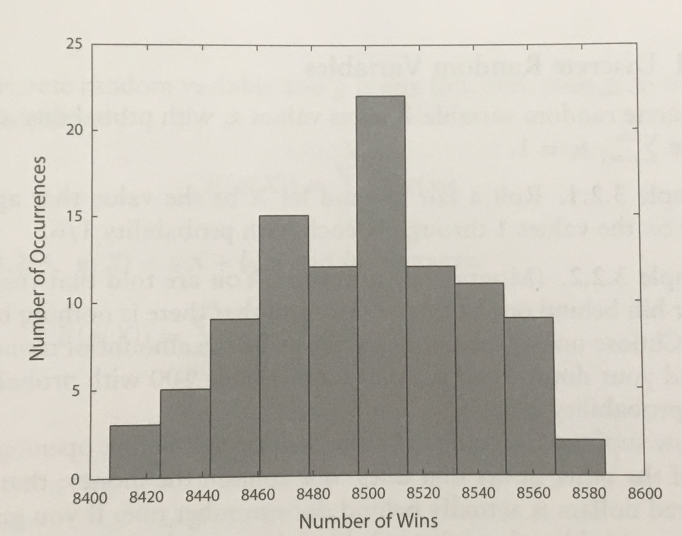
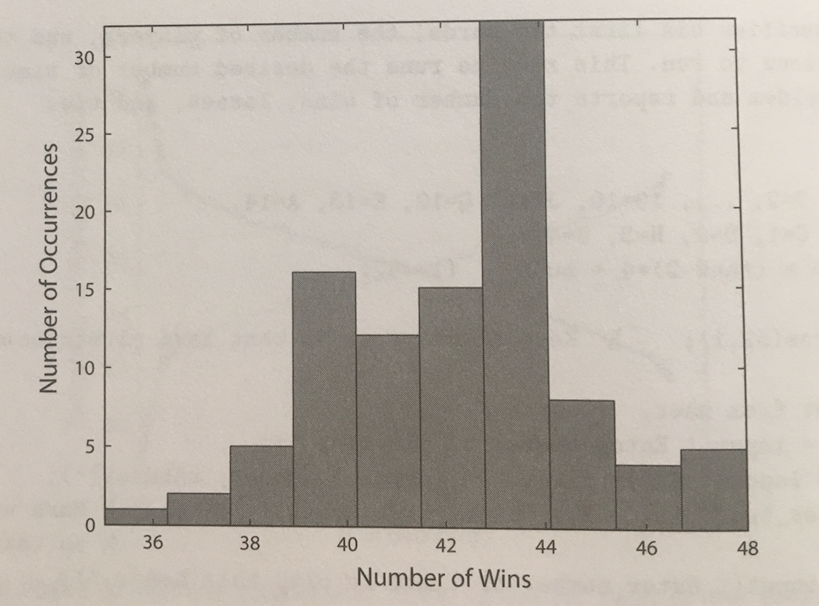



Texas Holdem Game
Starting hand: pair of aces
Plotting the number of wins for 100 numerical experiments
$$72\%$$
$$96\%$$
$$84\%$$
50 games
10,000 games

Slide 14
Monte Carlo methods
You just implemented an example of a Monte Carlo method!
Algorithm that compute APPROXIMATIONS of desired quantities based on randomized sampling
Notes:
Some computers will have a chip that can generate random numbers, but that is not very usual.
Note that the same numbers are generated when not changing the seed. Good for algorithm development and debugging (debugging algorithms with different numbers is extremely difficult)
Sequence is the same when not changing the seed
For cryptography, we may be worried about the quality of the random numbers (how random they are), but for numerics we are often interested in medium quality random numbers.
Extra from questions:
Operating systems provide a way to obtain random numbers from hardware noise. Problems: in particular not that much randomness. In cryptography, they often use this to generate the seed, and then use other methods to generate random numbers

Slide 15
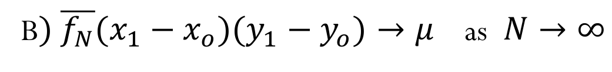
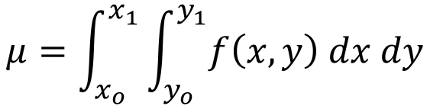
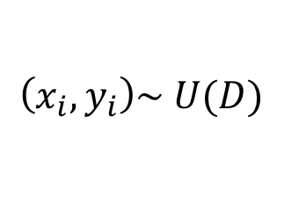
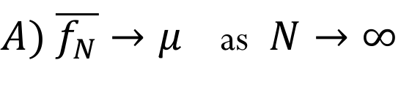
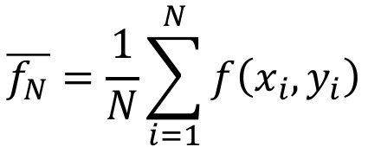
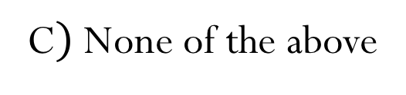
Monte Carlo Methods
To approximate integration problems
$$μ=\int_{x_{o}}^{x_{1}}{\int_{y_{o}}^{y_{1}}{f\left(x,y\right) dx dy}}$$
We sample points uniformly inside the domain $D=\left[x_{o},x_{1}\right]×\left[y_{o},y_{1}\right]$
$$\overline{f_{N}}=\frac{1}{N}\sum_{i=1}^{N}{f\left(x_{i},y_{i}\right)}$$
$$\left(x_{i},y_{i}\right)\sim U(D)$$
Mark the correct answer:
$A) \overline{f_{N}}→μ$ as $N→∞$
B$) \overline{f_{N}}(x_{1}−x_{o})(y_{1}−y_{o})→μ$ as $N→∞$
C$)$None of the above
Notes:
Guaranteed under very lose assumptions. Function does not need to be differentiable or continuous. It will work for all the functions that you probably have seen so far.
Show demo ratio of a circle to a box

Slide 16

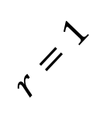



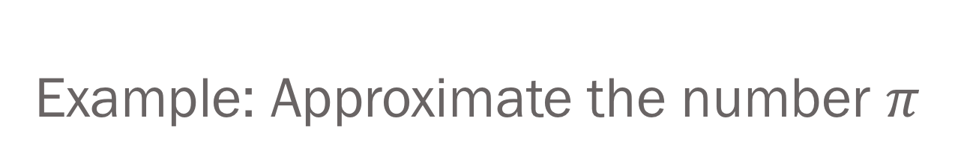


Example: Approximate the number $π$
$$A_{C}=π$$
$$A_{S}=4$$
$$r=1$$
$$N_{C}∝A_{C}$$
$$N_{S}=N∝A_{S}$$
$$\frac{N_{C}}{N_{S}}≈\frac{A_{C}}{A_{S}}$$
$$A_{C}≈4\frac{N_{C}}{N}$$
Notes:
The area of the circle is pi. So how can we approximate this area?

Slide 17
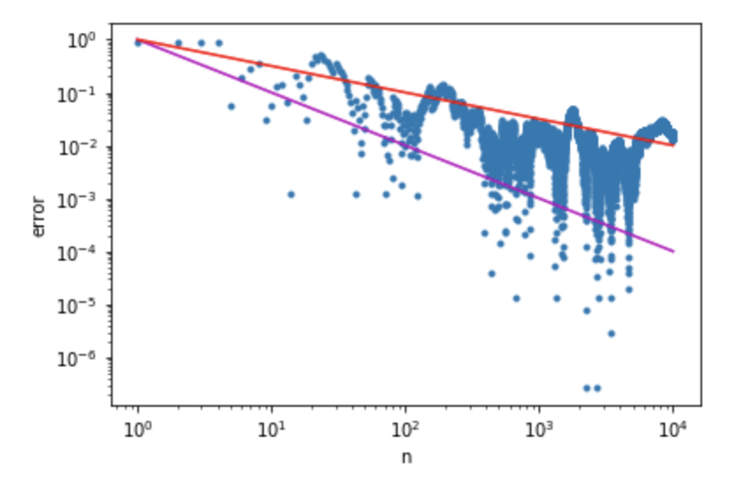
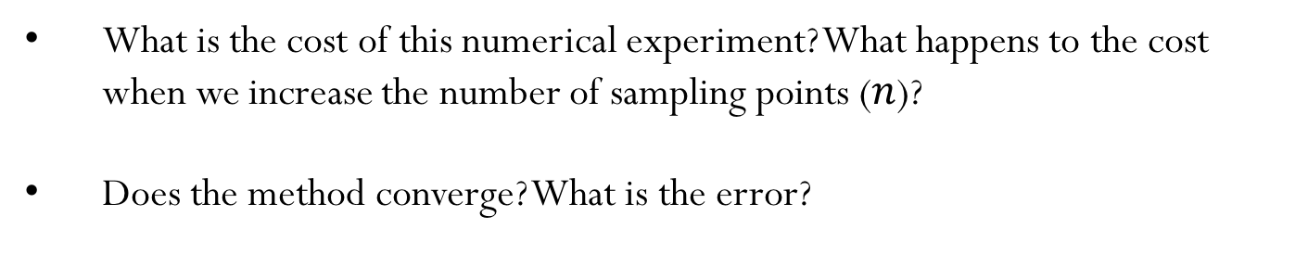


What can we learn about this simple numerical experiment?
What is the cost of this numerical experiment? What happens to the cost when we increase the number of sampling points ($n$)?
Does the method converge? What is the error?
$$error=O\left(\frac{1}{\sqrt{n}}\right)$$
$$error=O\left(\frac{1}{n}\right)$$
CONS: Slow convergence rate when using Monte Carlo Methods
PROS: Efficiency does not degrade with increase in the dimension of the problem (try to modify the demo to approximate the area of an sphere)
Notes:
Error uses the actual value of pi. In general, we don’t know what the exact value is, and therefore errors should be evaluated in a different manner.
Why the jumpy behavior? Hard question, out of the scope of this class. Can take a class in stochastic methods to understand this type of behavior.
Change the number of points, and ask about the rate of convergence. Can you get that using linear plots?
We need a log-log plot

