Slide 1
Solving Linear System of Equations

Slide 2

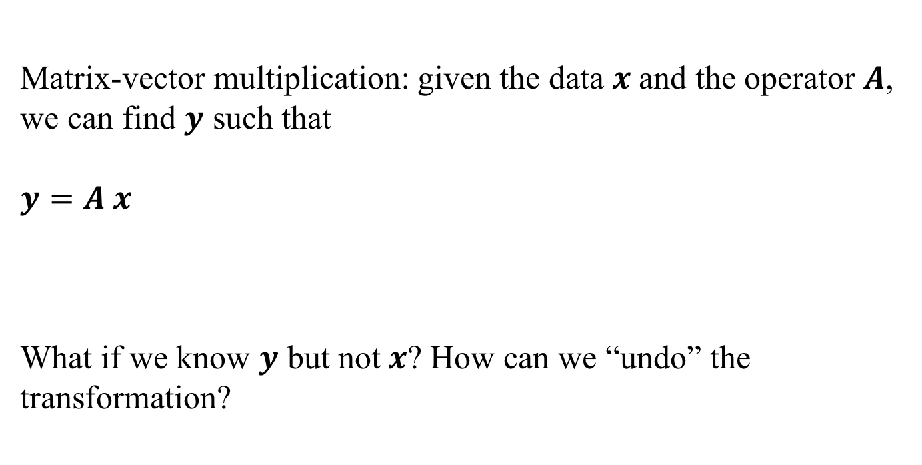


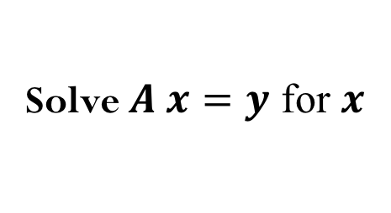




The “Undo” button for Linear Operations
Matrix-vector multiplication: given the data $x$and the operator $A$, we can find $y$ such that
$$y=A x$$
What if we know $y$ but not$x$? How can we “undo” the transformation?
$$A$$
$$x$$
$$y$$
transformation
$$A^{−1}$$
$$y$$
$$x$$
Solve $A x=y$ for $x$
$$?$$
Notes:
Inversion transform in neural networks

Slide 3
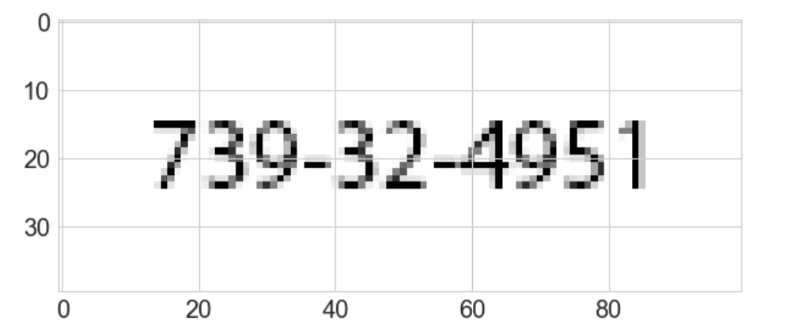
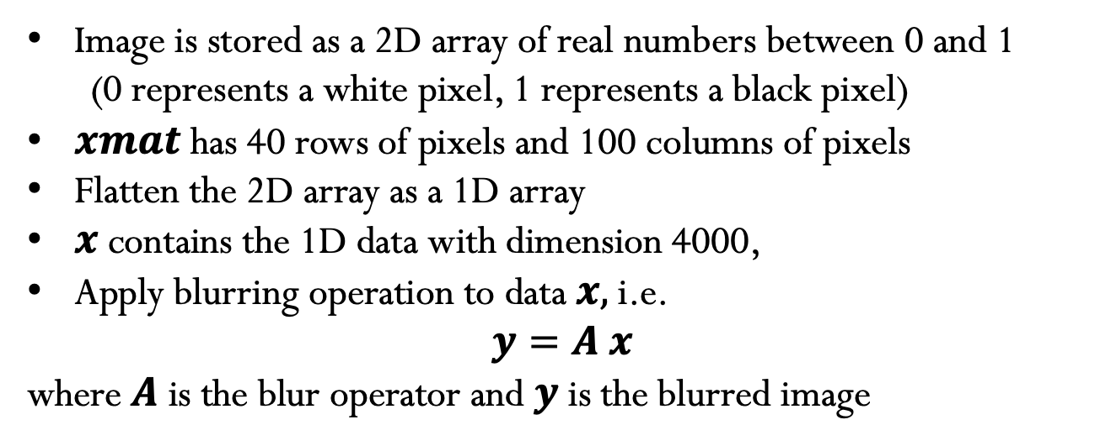
Image Blurring Example
Image is stored as a 2D array of real numbers between 0 and 1
(0 represents a white pixel, 1 represents a black pixel)
$xmat$has 40 rows of pixels and 100 columns of pixels
Flatten the 2D array as a 1D array
$x$ contains the 1D data with dimension 4000,
Apply blurring operation to data $x,$i.e.
$$y=A x$$
where $A$ is the blur operator and $y$ is the blurred image

Slide 4
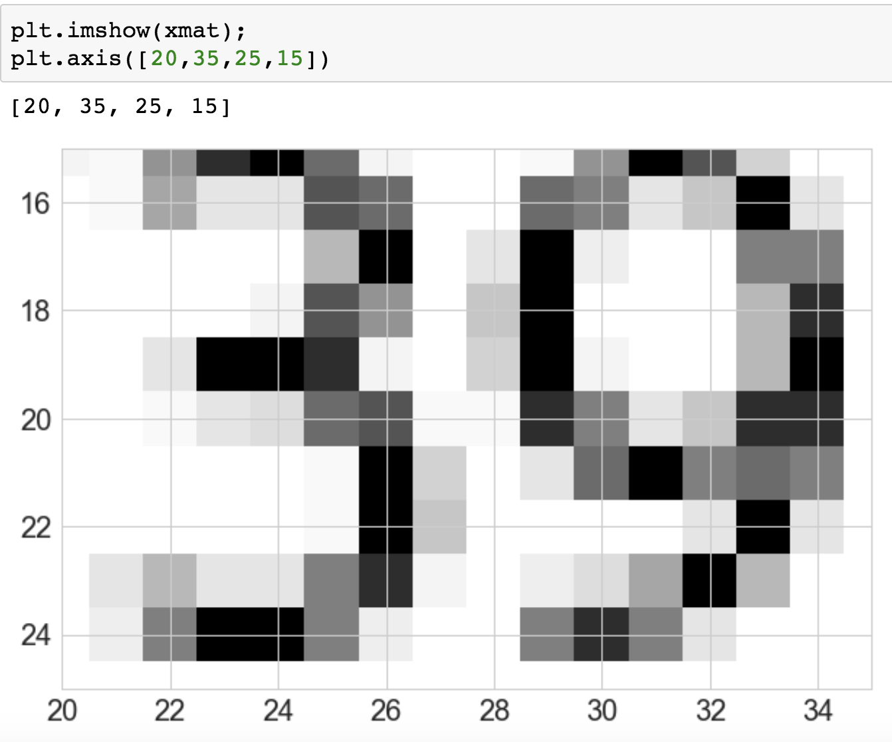
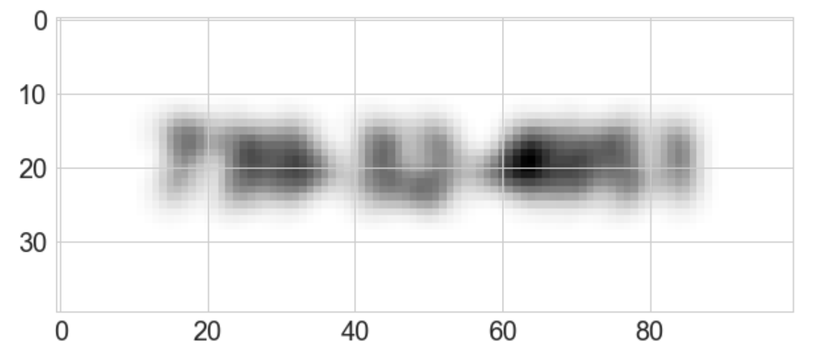

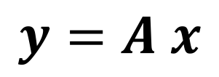


Blur operator
$$x$$
Blur operator
$$A$$
blurred image (4000,)
"original” image (4000,)
Blur operator (4000,4000)
$$y$$
$$y=A x$$

Slide 5
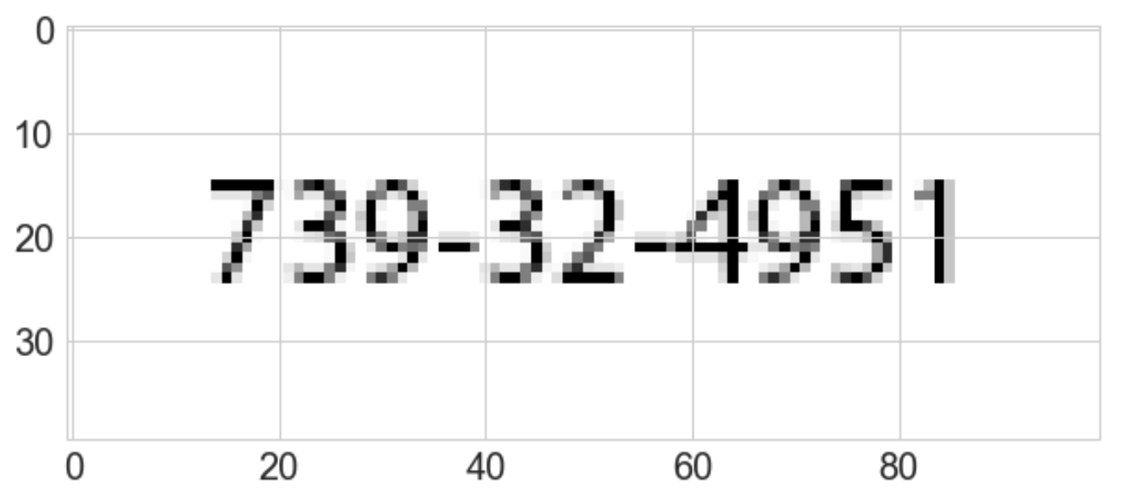
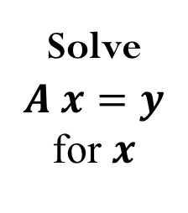


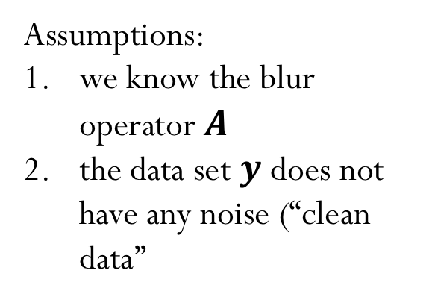
”Undo” Blur to recover original image
$$y$$
Assumptions:
we know the blur operator $A$
the data set $y$ does not have any noise (“clean data”
Solve $A x=y$ for $x$
$$x$$

Slide 6
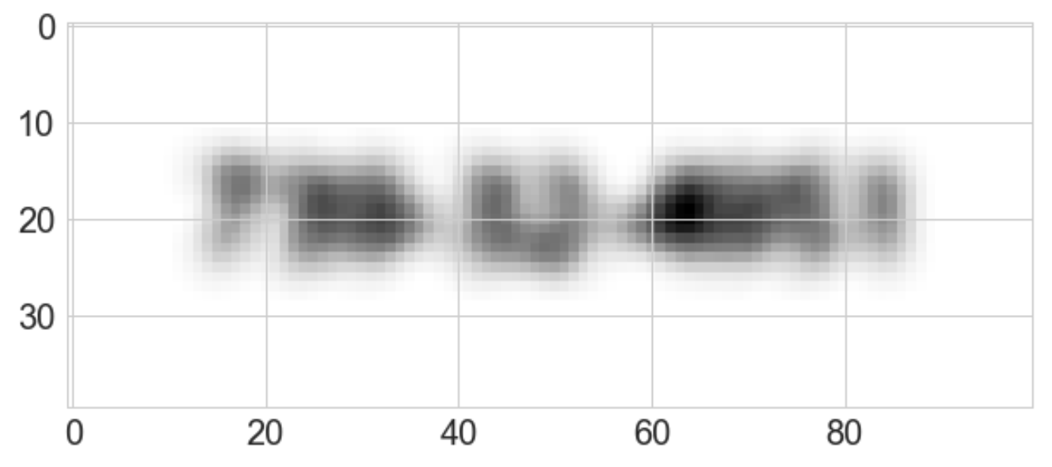

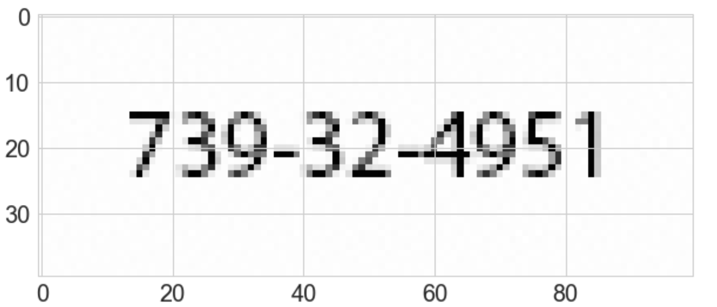
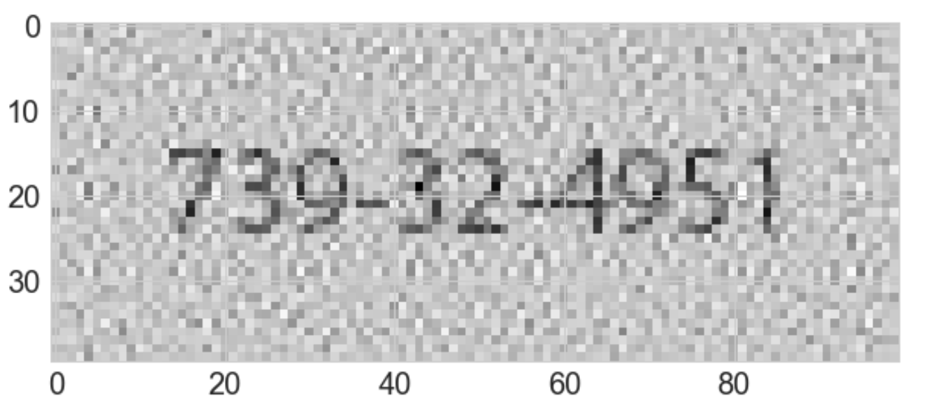
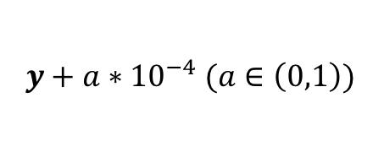
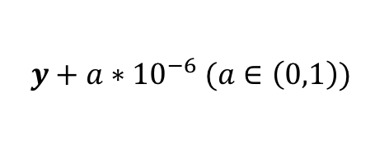
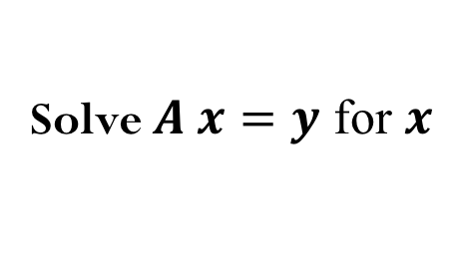
”Undo” Blur to recover original image
$$y+{a∗10}^{−6} (a∈\left(0,1\right))$$
$$y+{a∗10}^{−4} (a∈\left(0,1\right))$$
Solve $A x=y$ for $x$
How much noise can we add and still be able to recover meaningful information from the original image? At which point this inverse transformation fails?
We will talk about sensitivity of the “undo” operation later.

Slide 7
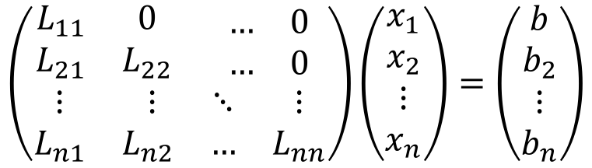
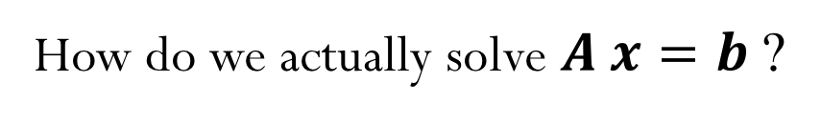
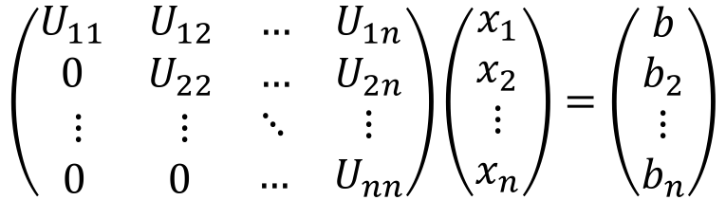
Linear System of Equations
How do we actually solve $A x=b$ ?
We can start with an “easier” system of equations…
Let’s consider triangular matrices (lower and upper):
$$\left(\begin{matrix}\begin{matrix}L_{11} & 0 \\ L_{21} & L_{22}\end{matrix} & \begin{matrix}… & 0 \\ … & 0\end{matrix} \\ \begin{matrix}⋮ & ⋮ \\ L_{n1} & L_{n2}\end{matrix} & \begin{matrix}⋱ & ⋮ \\ … & L_{nn}\end{matrix}\end{matrix}\right)\left(\begin{matrix}\begin{matrix}x_{1} \\ x_{2}\end{matrix} \\ \begin{matrix}⋮ \\ x_{n}\end{matrix}\end{matrix}\right)=\left(\begin{matrix}\begin{matrix}b \\ b_{2}\end{matrix} \\ \begin{matrix}⋮ \\ b_{n}\end{matrix}\end{matrix}\right)$$
$$\left(\begin{matrix}\begin{matrix}U_{11} & U_{12} \\ 0 & U_{22}\end{matrix} & \begin{matrix}… & U_{1n} \\ … & U_{2n}\end{matrix} \\ \begin{matrix}⋮ & ⋮ \\ 0 & 0\end{matrix} & \begin{matrix}⋱ & ⋮ \\ … & U_{nn}\end{matrix}\end{matrix}\right)\left(\begin{matrix}\begin{matrix}x_{1} \\ x_{2}\end{matrix} \\ \begin{matrix}⋮ \\ x_{n}\end{matrix}\end{matrix}\right)=\left(\begin{matrix}\begin{matrix}b \\ b_{2}\end{matrix} \\ \begin{matrix}⋮ \\ b_{n}\end{matrix}\end{matrix}\right)$$

Slide 8
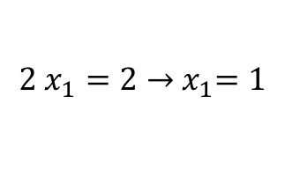
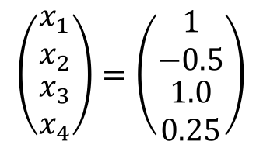
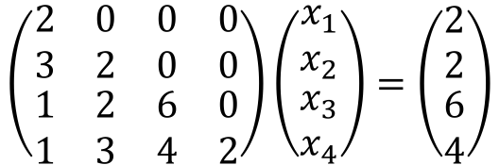
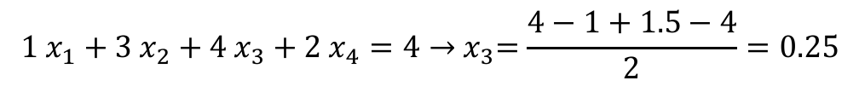
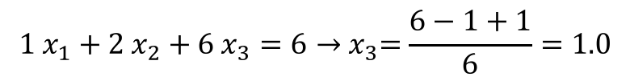
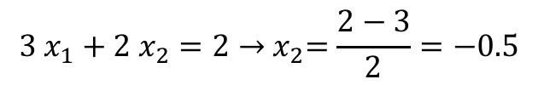
Example: Forward-substitution for lower triangular systems
$$\left(\begin{matrix}\begin{matrix}2 & 0 \\ 3 & 2\end{matrix} & \begin{matrix}0 & 0 \\ 0 & 0\end{matrix} \\ \begin{matrix}1 & 2 \\ 1 & 3\end{matrix} & \begin{matrix}6 & 0 \\ 4 & 2\end{matrix}\end{matrix}\right)\left(\begin{matrix}\begin{matrix}x_{1} \\ x_{2}\end{matrix} \\ \begin{matrix}x_{3} \\ x_{4}\end{matrix}\end{matrix}\right)=\left(\begin{matrix}\begin{matrix}2 \\ 2\end{matrix} \\ \begin{matrix}6 \\ 4\end{matrix}\end{matrix}\right)$$
$$2{ x}_{1}=2→{ x}_{1}=1$$
$$3{ x}_{1}+2{ x}_{2}=2→{ x}_{2}=\frac{2−3}{2}=−0.5$$
$$1{ x}_{1}+2{ x}_{2}+6{ x}_{3}=6→{ x}_{3}=\frac{6−1+1}{6}=1.0$$
$$1{ x}_{1}+3{ x}_{2}+4{ x}_{3}+2{ x}_{4}=4→{ x}_{3}=\frac{4−1+1.5−4}{2}=0.25$$
$$\left(\begin{matrix}\begin{matrix}x_{1} \\ x_{2}\end{matrix} \\ \begin{matrix}x_{3} \\ x_{4}\end{matrix}\end{matrix}\right)=\left(\begin{matrix}\begin{matrix}1 \\ −0.5\end{matrix} \\ \begin{matrix}1.0 \\ 0.25\end{matrix}\end{matrix}\right)$$

Slide 9
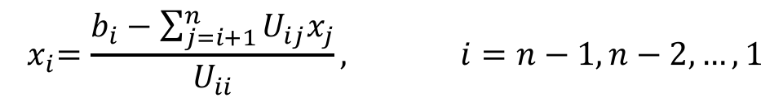
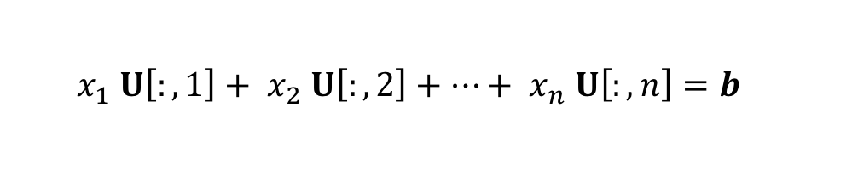
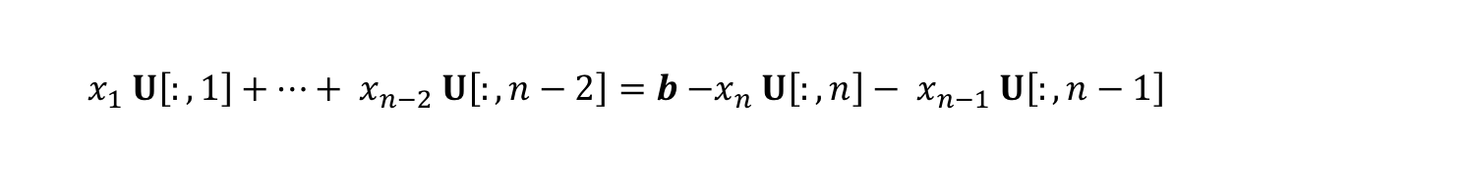
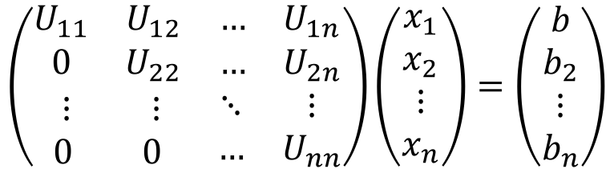
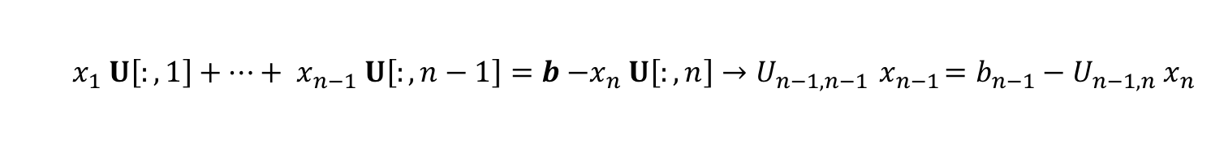
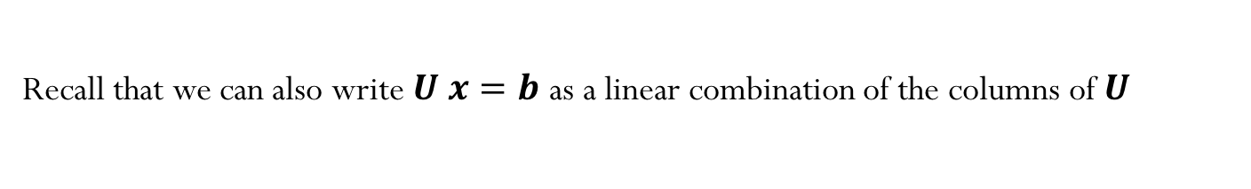
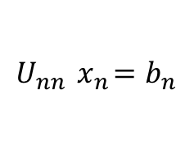

Triangular Matrices
$$\left(\begin{matrix}\begin{matrix}U_{11} & U_{12} \\ 0 & U_{22}\end{matrix} & \begin{matrix}… & U_{1n} \\ … & U_{2n}\end{matrix} \\ \begin{matrix}⋮ & ⋮ \\ 0 & 0\end{matrix} & \begin{matrix}⋱ & ⋮ \\ … & U_{nn}\end{matrix}\end{matrix}\right)\left(\begin{matrix}\begin{matrix}x_{1} \\ x_{2}\end{matrix} \\ \begin{matrix}⋮ \\ x_{n}\end{matrix}\end{matrix}\right)=\left(\begin{matrix}\begin{matrix}b \\ b_{2}\end{matrix} \\ \begin{matrix}⋮ \\ b_{n}\end{matrix}\end{matrix}\right)$$
Recall that we can also write $U x=b$ as a linear combination of the columns of $U$
$$x_{1} U\left[:,1\right]+{ x}_{2} U\left[:,2\right]+…+{ x}_{n} U\left[:,n\right]=b$$
Hence we can write the solution as
$$U_{nn}{ x}_{n}=b_{n}$$
$$x_{1} U\left[:,1\right]+…+{ x}_{n−1} U\left[:,n−1\right]=b{ −x}_{n} U\left[:,n\right]→U_{n−1,n−1}{ x}_{n−1}=b_{n−1}−U_{n−1,n}{ x}_{n}$$
$$x_{1} U\left[:,1\right]+…+{ x}_{n−2} U\left[:,n−2\right]=b{ −x}_{n} U\left[:,n\right]−{ x}_{n−1} U\left[:,n−1\right]$$
Or in general (backward-substitution for upper triangular systems):
$${ x}_{i}=\frac{b_{i}−\sum_{j=i+1}^{n}{U_{ij}x_{j}}}{U_{ii}}, i=n−1,n−2,…,1$$
$$x_{n}=b_{n}/U_{nn}$$

Slide 10

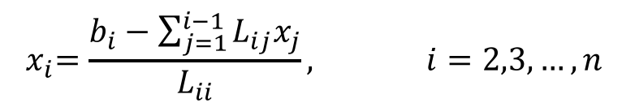
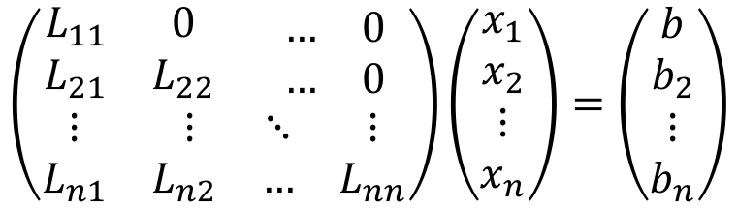
Triangular Matrices
Forward-substitution for lower-triangular systems:
$$\left(\begin{matrix}\begin{matrix}L_{11} & 0 \\ L_{21} & L_{22}\end{matrix} & \begin{matrix}… & 0 \\ … & 0\end{matrix} \\ \begin{matrix}⋮ & ⋮ \\ L_{n1} & L_{n2}\end{matrix} & \begin{matrix}⋱ & ⋮ \\ … & L_{nn}\end{matrix}\end{matrix}\right)\left(\begin{matrix}\begin{matrix}x_{1} \\ x_{2}\end{matrix} \\ \begin{matrix}⋮ \\ x_{n}\end{matrix}\end{matrix}\right)=\left(\begin{matrix}\begin{matrix}b \\ b_{2}\end{matrix} \\ \begin{matrix}⋮ \\ b_{n}\end{matrix}\end{matrix}\right)$$
$${ x}_{i}=\frac{b_{i}−\sum_{j=1}^{i−1}{L_{ij}x_{j}}}{L_{ii}}, i=2,3,…,n$$
$$x_{1}=b_{1}/L_{11}$$

Slide 11
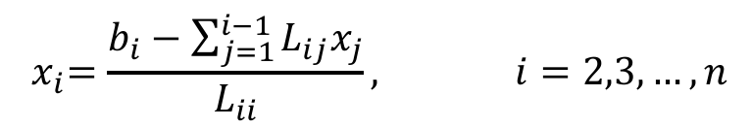


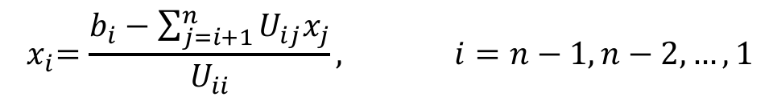
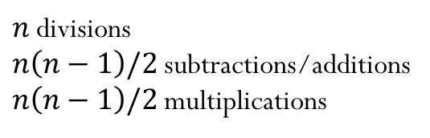

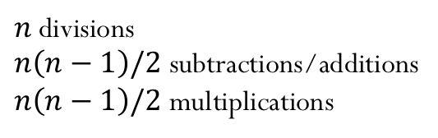
Cost of solving triangular systems
$${ x}_{i}=\frac{b_{i}−\sum_{j=i+1}^{n}{U_{ij}x_{j}}}{U_{ii}}, i=n−1,n−2,…,1$$
$$x_{n}=b_{n}/U_{nn}$$
$n$ divisions
$n\left(n−1\right)/2$ subtractions/additions
$n\left(n−1\right)/2$ multiplications
Computational complexity is $O(n^{2})$
$${ x}_{i}=\frac{b_{i}−\sum_{j=1}^{i−1}{L_{ij}x_{j}}}{L_{ii}}, i=2,3,…,n$$
$$x_{1}=b_{1}/L_{11}$$
$n$ divisions
$n\left(n−1\right)/2$ subtractions/additions
$n\left(n−1\right)/2$ multiplications
Computational complexity is $O(n^{2})$

Slide 12

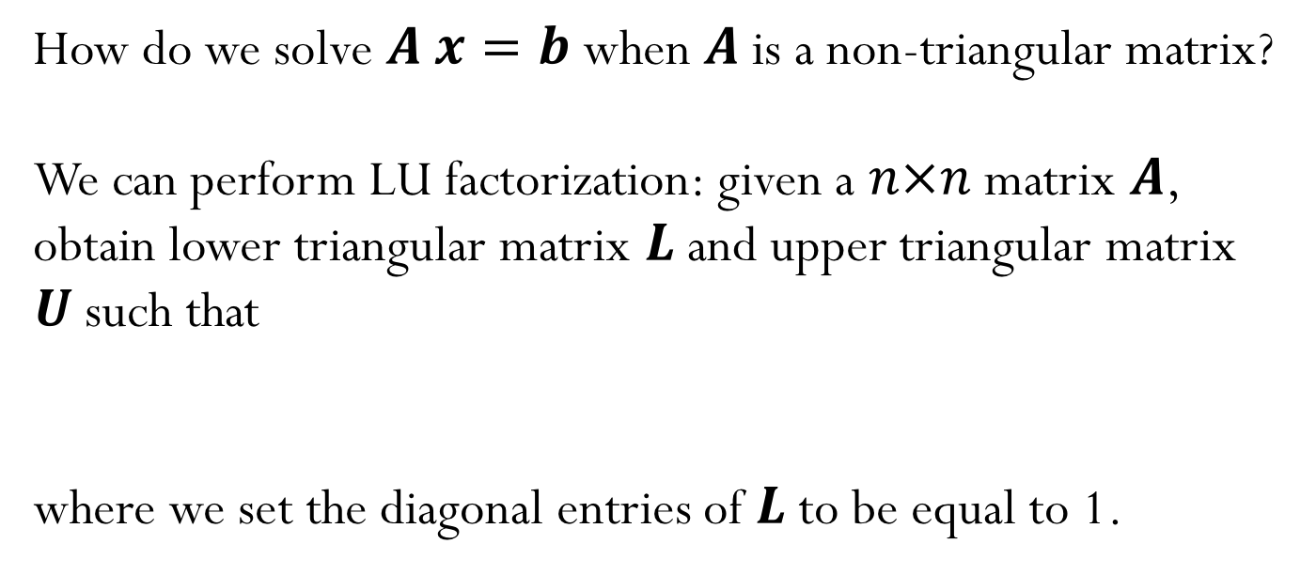
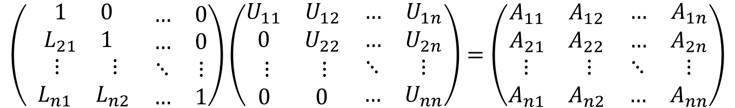
Linear System of Equations
How do we solve $A x=b$ when $A$ is a non-triangular matrix?
We can perform LU factorization: given a $n×n$ matrix $A$, obtain lower triangular matrix $L$ and upper triangular matrix $U$such that
where we set the diagonal entries of $L$ to be equal to 1.
$$A=LU$$
$$\left(\begin{matrix}\begin{matrix}1 & 0 \\ L_{21} & 1\end{matrix} & \begin{matrix}… & 0 \\ … & 0\end{matrix} \\ \begin{matrix} ⋮ & ⋮ \\ L_{n1} & L_{n2}\end{matrix} & \begin{matrix}⋱ & ⋮ \\ … & 1\end{matrix}\end{matrix}\right)\left(\begin{matrix}\begin{matrix}U_{11} & U_{12} \\ 0 & U_{22}\end{matrix} & \begin{matrix}… & U_{1n} \\ … & U_{2n}\end{matrix} \\ \begin{matrix}⋮ & ⋮ \\ 0 & 0\end{matrix} & \begin{matrix}⋱ & ⋮ \\ … & U_{nn}\end{matrix}\end{matrix}\right)=\left(\begin{matrix}\begin{matrix}A_{11} & A_{12} \\ A_{21} & A_{22}\end{matrix} & \begin{matrix}… & A_{1n} \\ … & A_{2n}\end{matrix} \\ \begin{matrix}⋮ & ⋮ \\ A_{n1} & A_{n2}\end{matrix} & \begin{matrix}⋱ & ⋮ \\ … & A_{nn}\end{matrix}\end{matrix}\right)$$

Slide 13

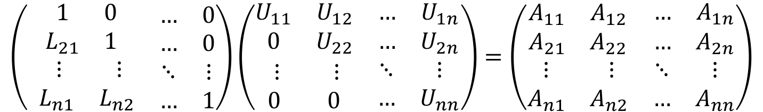



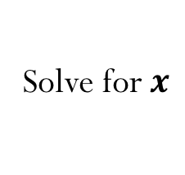


LU Factorization
$$\left(\begin{matrix}\begin{matrix}1 & 0 \\ L_{21} & 1\end{matrix} & \begin{matrix}… & 0 \\ … & 0\end{matrix} \\ \begin{matrix} ⋮ & ⋮ \\ L_{n1} & L_{n2}\end{matrix} & \begin{matrix}⋱ & ⋮ \\ … & 1\end{matrix}\end{matrix}\right)\left(\begin{matrix}\begin{matrix}U_{11} & U_{12} \\ 0 & U_{22}\end{matrix} & \begin{matrix}… & U_{1n} \\ … & U_{2n}\end{matrix} \\ \begin{matrix}⋮ & ⋮ \\ 0 & 0\end{matrix} & \begin{matrix}⋱ & ⋮ \\ … & U_{nn}\end{matrix}\end{matrix}\right)=\left(\begin{matrix}\begin{matrix}A_{11} & A_{12} \\ A_{21} & A_{22}\end{matrix} & \begin{matrix}… & A_{1n} \\ … & A_{2n}\end{matrix} \\ \begin{matrix}⋮ & ⋮ \\ A_{n1} & A_{n2}\end{matrix} & \begin{matrix}⋱ & ⋮ \\ … & A_{nn}\end{matrix}\end{matrix}\right)$$
Assuming the LU factorization is know, we can solve the general system
By solving two triangular systems:
But what is the cost of the LU factorization? Is it beneficial?
$LU x=b$
Solve for $y$
$L y=b$
Forward-substitution with complexity $O(n^{2})$
Solve for$x$
$U x=y$
Backward-substitution with complexity $O(n^{2})$
Notes:
Make sure to explain this well during lecture. It seems that students struggle to understand how the solve works.

Slide 14

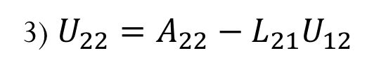
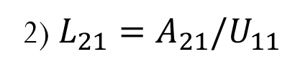
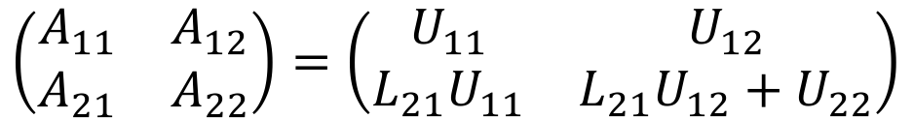

2x2 LU Factorization (simple example)
$$\left(\begin{matrix}A_{11} & A_{12} \\ A_{21} & A_{22}\end{matrix}\right)=\left(\begin{matrix}1 & 0 \\ L_{21} & 1\end{matrix}\right)\left(\begin{matrix}U_{11} & U_{12} \\ 0 & U_{22}\end{matrix}\right)$$
$$\left(\begin{matrix}A_{11} & A_{12} \\ A_{21} & A_{22}\end{matrix}\right)=\left(\begin{matrix}U_{11} & U_{12} \\ L_{21}U_{11} & L_{21}U_{12}+U_{22}\end{matrix}\right)$$
$${U_{11}=A}_{21}/U_{11}$$
2) ${L_{21}=A}_{21}/U_{11}$
3) ${U_{22}=A}_{22}−L_{21}U_{12}$
Seems quite simple! Can we generalize this for a $n×n$ matrix $A$?

Slide 15
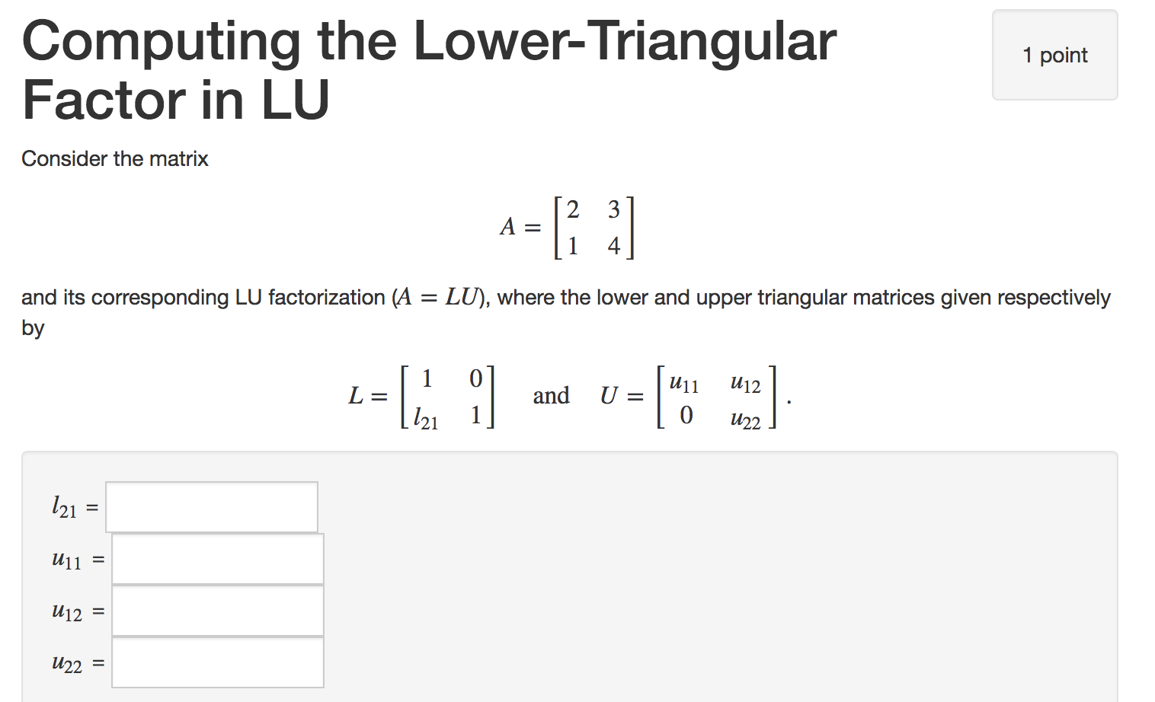

Slide 16

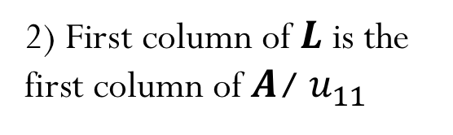
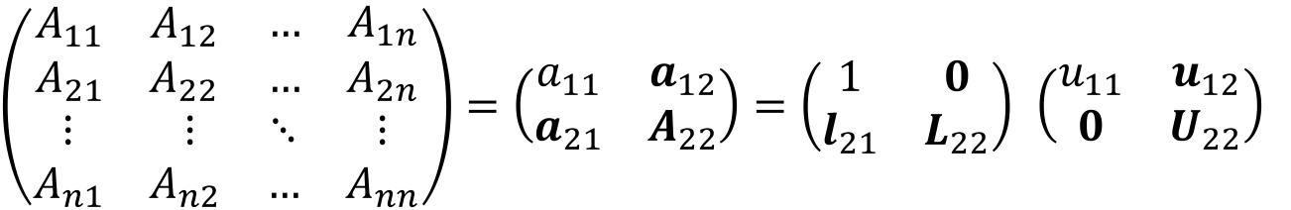









$a_{11}:$ scalar
$a_{12}$: row vector $(1×(n−1))$
$a_{21}$: column vector $\left((n−1)×1\right)$
$A_{22}$: matrix $\left((n−1)×(n−1)\right)$
LU Factorization
$$a_{11}$$
$$a_{12}$$
$\left(\begin{matrix}\begin{matrix}A_{11} & A_{12} \\ A_{21} & A_{22}\end{matrix} & \begin{matrix}… & A_{1n} \\ … & A_{2n}\end{matrix} \\ \begin{matrix}⋮ & ⋮ \\ A_{n1} & A_{n2}\end{matrix} & \begin{matrix}⋱ & ⋮ \\ … & A_{nn}\end{matrix}\end{matrix}\right)=\left(\begin{matrix}a_{11} & a_{12} \\ a_{21} & A_{22}\end{matrix}\right)=\left(\begin{matrix}1 & 0 \\ l_{21} & L_{22}\end{matrix}\right)$ $\left(\begin{matrix}u_{11} & u_{12} \\ 0 & U_{22}\end{matrix}\right)$
$$a_{21}$$
$$A_{22}$$
1) First row of $U$ is the first row of $A$
$$\left(\begin{matrix}a_{11} & a_{12} \\ a_{21} & A_{22}\end{matrix}\right)=\left(\begin{matrix}u_{11} & u_{12} \\ {u_{11} l}_{21} & {l_{21}u_{12}+L}_{22}U_{22}\end{matrix}\right)$$
$l_{21}=\frac{1}{u_{11}}a_{21}$
$A_{22}={l_{21}u_{12}+L}_{22}U_{22}$
Known!
2) First column of $L$ is the first column of $A$/ $u_{11}$
3) ${L_{22}U_{22}=A}_{22}−l_{21}u_{12}$
Need another factorization!

Slide 17



$a_{11}:$ scalar
$a_{12}$: row vector $(1×(n−1))$
$a_{21}$: column vector $\left((n−1)×1\right)$
$A_{22}$: matrix $\left((n−1)×(n−1)\right)$
LU Factorization
$$a_{11}$$
$$a_{12}$$
$\left(\begin{matrix}\begin{matrix}A_{11} & A_{12} \\ A_{21} & A_{22}\end{matrix} & \begin{matrix}… & A_{1n} \\ … & A_{2n}\end{matrix} \\ \begin{matrix}⋮ & ⋮ \\ A_{n1} & A_{n2}\end{matrix} & \begin{matrix}⋱ & ⋮ \\ … & A_{nn}\end{matrix}\end{matrix}\right)=\left(\begin{matrix}a_{11} & a_{12} \\ a_{21} & A_{22}\end{matrix}\right)=\left(\begin{matrix}1 & 0 \\ l_{21} & L_{22}\end{matrix}\right)$ $\left(\begin{matrix}u_{11} & u_{12} \\ 0 & U_{22}\end{matrix}\right)$
$$a_{21}$$
$$A_{22}$$
1) First row of $U$ is the first row of $A$
$$\left(\begin{matrix}a_{11} & a_{12} \\ a_{21} & A_{22}\end{matrix}\right)=\left(\begin{matrix}u_{11} & u_{12} \\ {u_{11} l}_{21} & {l_{21}u_{12}+L}_{22}U_{22}\end{matrix}\right)$$
2) $l_{21}=\frac{1}{u_{11}}a_{21}$
Known!
3) ${{M=L}_{22}U_{22}=A}_{22}−l_{21}u_{12}$
First column of $L$ is the first column of $A$/ $u_{11}$
Need another factorization!

Slide 18



Example
1) First row of $U$ is the first row of $A$
2) First column of $L$ is the first column of $A$/ $u_{11}$
$$M=\left(\begin{matrix}\begin{matrix}2 & 8 \\ 1 & 2\end{matrix} & \begin{matrix}4 & 1 \\ 3 & 3\end{matrix} \\ \begin{matrix}1 & 2 \\ 1 & 3\end{matrix} & \begin{matrix}6 & 2 \\ 4 & 2\end{matrix}\end{matrix}\right)$$
3) ${L_{22}U_{22}=A}_{22}−l_{21}u_{12}$

Slide 19











Example
$$M=\left(\begin{matrix}\begin{matrix}2 & 8 \\ 1 & 2\end{matrix} & \begin{matrix}4 & 1 \\ 3 & 3\end{matrix} \\ \begin{matrix}1 & 2 \\ 1 & 3\end{matrix} & \begin{matrix}6 & 2 \\ 4 & 2\end{matrix}\end{matrix}\right)$$
$$L=\left(\begin{matrix}\begin{matrix}1 & 0 \\ 0.5 & 0\end{matrix} & \begin{matrix}0 & 0 \\ 0 & 0\end{matrix} \\ \begin{matrix}0.5 & 0 \\ 0.5 & 0\end{matrix} & \begin{matrix}0 & 0 \\ 0 & 0\end{matrix}\end{matrix}\right)$$
$$U=\left(\begin{matrix}\begin{matrix}2 & 8 \\ 0 & 0\end{matrix} & \begin{matrix}4 & 1 \\ 0 & 0\end{matrix} \\ \begin{matrix}0 & 0 \\ 0 & 0\end{matrix} & \begin{matrix}0 & 0 \\ 0 & 0\end{matrix}\end{matrix}\right)$$
$$M=\left(\begin{matrix}\begin{matrix}2 & 8 \\ 1 & −2\end{matrix} & \begin{matrix}4 & 1 \\ 1 & 2.5\end{matrix} \\ \begin{matrix}1 & −2 \\ 1 & −1\end{matrix} & \begin{matrix}4 & 1.5 \\ 2 & 1.5\end{matrix}\end{matrix}\right)$$
$$L=\left(\begin{matrix}\begin{matrix}1 & 0 \\ 0.5 & 1\end{matrix} & \begin{matrix}0 & 0 \\ 0 & 0\end{matrix} \\ \begin{matrix}0.5 & 1 \\ 0.5 & 0.5\end{matrix} & \begin{matrix}0 & 0 \\ 0 & 0\end{matrix}\end{matrix}\right)$$
$$U=\left(\begin{matrix}\begin{matrix}2 & 8 \\ 0 & −2\end{matrix} & \begin{matrix}4 & 1 \\ 1 & 2.5\end{matrix} \\ \begin{matrix}0 & 0 \\ 0 & 0\end{matrix} & \begin{matrix}0 & 0 \\ 0 & 0\end{matrix}\end{matrix}\right)$$
$$M=\left(\begin{matrix}\begin{matrix}2 & 8 \\ 1 & −2\end{matrix} & \begin{matrix}4 & 1 \\ 1 & 2.5\end{matrix} \\ \begin{matrix}1 & −2 \\ 1 & −1\end{matrix} & \begin{matrix}3 & −1 \\ 1.5 & 0.25\end{matrix}\end{matrix}\right)$$
$$L=\left(\begin{matrix}\begin{matrix}1 & 0 \\ 0.5 & 1\end{matrix} & \begin{matrix}0 & 0 \\ 0 & 0\end{matrix} \\ \begin{matrix}0.5 & 1 \\ 0.5 & 0.5\end{matrix} & \begin{matrix}1 & 0 \\ 0.5 & 0\end{matrix}\end{matrix}\right)$$
$$U=\left(\begin{matrix}\begin{matrix}2 & 8 \\ 0 & −2\end{matrix} & \begin{matrix}4 & 1 \\ 1 & 2.5\end{matrix} \\ \begin{matrix}0 & 0 \\ 0 & 0\end{matrix} & \begin{matrix}3 & −1 \\ 0 & 0\end{matrix}\end{matrix}\right)$$
$$M=\left(\begin{matrix}\begin{matrix}2 & 8 \\ 1 & −2\end{matrix} & \begin{matrix}4 & 1 \\ 1 & 2.5\end{matrix} \\ \begin{matrix}1 & −2 \\ 1 & −1\end{matrix} & \begin{matrix}3 & −1 \\ 1.5 & 0.75\end{matrix}\end{matrix}\right)$$
$$L=\left(\begin{matrix}\begin{matrix}1 & 0 \\ 0.5 & 1\end{matrix} & \begin{matrix}0 & 0 \\ 0 & 0\end{matrix} \\ \begin{matrix}0.5 & 1 \\ 0.5 & 0.5\end{matrix} & \begin{matrix}1 & 0 \\ 0.5 & 1\end{matrix}\end{matrix}\right)$$
$$U=\left(\begin{matrix}\begin{matrix}2 & 8 \\ 0 & −2\end{matrix} & \begin{matrix}4 & 1 \\ 1 & 2.5\end{matrix} \\ \begin{matrix}0 & 0 \\ 0 & 0\end{matrix} & \begin{matrix}3 & −1 \\ 0 & 0.75\end{matrix}\end{matrix}\right)$$

Slide 20

Algorithm: LU Factorization of matrix A

Slide 21


Side note:
Cost of LU factorization
$$\sum_{i=1}^{m}{i}=\frac{1}{2}m\left(m+1\right)$$
$$\sum_{i=1}^{m}{i^{2}}=\frac{1}{6}m\left(m+1\right)\left(2m+1\right)$$

Slide 22


Side note:
Cost of LU factorization
$$\sum_{i=1}^{m}{i}=\frac{1}{2}m\left(m+1\right)$$
$$\sum_{i=1}^{m}{i^{2}}=\frac{1}{6}m\left(m+1\right)\left(2m+1\right)$$
Number of divisions: $\left(n−1\right)+\left(n−2\right)+…+1=n\left(n−1\right)/2$
Number of multiplications ${\left(n−1\right)}^{2}+{\left(n−2\right)}^{2}+{…+\left(1\right)}^{2}=\frac{n^{3}}{3}−\frac{n^{2}}{2}+\frac{n}{6}$
Number of subtractions: ${\left(n−1\right)}^{2}+{\left(n−2\right)}^{2}+{…+\left(1\right)}^{2}=\frac{n^{3}}{3}−\frac{n^{2}}{2}+\frac{n}{6}$
Computational complexity is $O(n^{3})$
Demo “Complexity of Mat-Mat multiplication and LU”

Slide 23

Solving linear systems
In general, we can solve a linear system of equations following the steps:
Factorize the matrix $A$:$A=LU$ (complexity $O(n^{3}))$
Solve $L y=b$ (complexity $O(n^{2}))$
Solve $U x=y$ (complexity $O(n^{2}))$
But why should we decouple the factorization from the actual solve?
(Remember from Linear Algebra, Gaussian Elimination does not decouple these two steps…)

Slide 24




Example: Optimization of automotive control arm
Find the distribution of material inside the design space $(d)$ that maximizes the stiffness, i.e.,
$\min{U^{T}F}$ where $K\left(d\right) U=F$ $(U$: displacement vector, $F$: load vector, $K$: stiffness matrix)
Solve the linear system of equations
$$K U=F$$
for the load vector$F$. What if we have many different loading conditions (pothole, hitting a curb, breaking, etc)?

Slide 25

Iclicker question
Let’s assume that when solving the system of equations $K U=F$, we observe the following:
When the stiffness matrix has dimensions (100,100), computing the LU factorization takes about 1 second and each solve (forward + backward substitution) takes about 0.01 seconds.
Estimate the total time it will take to find the displacement response corresponding to 10 different load vectors $F$when the stiffness matrix has dimensions (1000,1000)?
$$A) \sim 10 seconds$$
$$B) \sim {10}^{2} seconds$$
$$C) \sim {10}^{3} seconds$$
$$D) \sim {10}^{4} seconds$$
$$E) \sim {10}^{5} seconds$$

Slide 26
What can go wrong with the previous algorithm?
If division by zero occurs, LU factorization fails.
What can we do to get something like an LU factorization?
Notes:
Start of Thursday class?

Slide 27





What can go wrong with the previous algorithm?
Demo “Little c”
$$M=\left(\begin{matrix}\begin{matrix}2 & 8 \\ 1 & 4\end{matrix} & \begin{matrix}4 & 1 \\ 3 & 3\end{matrix} \\ \begin{matrix}1 & 2 \\ 1 & 3\end{matrix} & \begin{matrix}6 & 2 \\ 4 & 2\end{matrix}\end{matrix}\right)$$
$$L=\left(\begin{matrix}\begin{matrix}1 & 0 \\ 0.5 & 0\end{matrix} & \begin{matrix}0 & 0 \\ 0 & 0\end{matrix} \\ \begin{matrix}0.5 & 0 \\ 0.5 & 0\end{matrix} & \begin{matrix}0 & 0 \\ 0 & 0\end{matrix}\end{matrix}\right)$$
$$U=\left(\begin{matrix}\begin{matrix}2 & 8 \\ 0 & 0\end{matrix} & \begin{matrix}4 & 1 \\ 0 & 0\end{matrix} \\ \begin{matrix}0 & 0 \\ 0 & 0\end{matrix} & \begin{matrix}0 & 0 \\ 0 & 0\end{matrix}\end{matrix}\right)$$
$$l_{21}u_{12}=\left(\begin{matrix}4 & 2 & 0.5 \\ 4 & 2 & 0.5 \\ 4 & 2 & 0.5\end{matrix}\right)$$
$$M−l_{21}u_{12}=\left(\begin{matrix}\begin{matrix}2 & 8 \\ 1 & 0\end{matrix} & \begin{matrix}4 & 1 \\ 1 & 2.5\end{matrix} \\ \begin{matrix}1 & −2 \\ 1 & −1\end{matrix} & \begin{matrix}4 & 1.5 \\ 2 & 1.5\end{matrix}\end{matrix}\right)$$
The next update for the lower triangular matrix will result in a division by zero! LU factorization fails.
What can we do to get something like an LU factorization?
Notes:
Start of Thursday class?

Slide 28

Pivoting
Approach:
Swap rows if there is a zero entry in the diagonal
Even better idea: Find the largest entry (by absolute value) and swap it to the top row.
The entry we divide by is called the pivot.
Swapping rows to get a bigger pivot is called (partial) pivoting.
$$\left(\begin{matrix}a_{11} & a_{12} \\ a_{21} & A_{22}\end{matrix}\right)=\left(\begin{matrix}u_{11} & u_{12} \\ {u_{11} l}_{21} & {l_{21}u_{12}+L}_{22}U_{22}\end{matrix}\right)$$
Find the largest entry (in magnitude)
Notes:
Start of Thursday class?

Slide 29
LU Factorization with Partial Pivoting
LU factorization with partial pivoting can be completed for any matrix A
Suppose you are at stage k and there is no non-zero entry on or below the diagonal in column k. At this point, there is nothing else you can do, so the algorithm leaves a zero in the diagonal entry of U. Note that the matrix U is singular, and so is the matrix A. Subsequent backward substitutions using U will fail, but the LU factorization itself is still completed.
Notes:
Start of Thursday class?

Slide 30







LU Factorization with Partial Pivoting
$A=PLU$
where $P$ is a permutation matrix
Then solve two triangular systems:
$$A x=b →PLU x=b→LU x=P^{T}b$$
$L y=P^{T}b$
(Solve for $y$)
$U x=y$
(Solve for$x$)
Notes:
Start of Thursday class?

Slide 31








Example
$$A=M=\left(\begin{matrix}\begin{matrix}2 & 8 \\ 1 & 2\end{matrix} & \begin{matrix}4 & 1 \\ 3 & 3\end{matrix} \\ \begin{matrix}1 & 2 \\ 1 & 3\end{matrix} & \begin{matrix}3 & 2 \\ 4 & 2\end{matrix}\end{matrix}\right)$$
$$L=\left(\begin{matrix}\begin{matrix}1 & 0 \\ 0.5 & 0\end{matrix} & \begin{matrix}0 & 0 \\ 0 & 0\end{matrix} \\ \begin{matrix}0.5 & 0 \\ 0.5 & 0\end{matrix} & \begin{matrix}0 & 0 \\ 0 & 0\end{matrix}\end{matrix}\right)$$
$$U=\left(\begin{matrix}\begin{matrix}2 & 8 \\ 0 & 0\end{matrix} & \begin{matrix}4 & 1 \\ 0 & 0\end{matrix} \\ \begin{matrix}0 & 0 \\ 0 & 0\end{matrix} & \begin{matrix}0 & 0 \\ 0 & 0\end{matrix}\end{matrix}\right)$$
$$M=\left(\begin{matrix}\begin{matrix}2 & 8 \\ 1 & −2\end{matrix} & \begin{matrix}4 & 1 \\ 1 & 2.5\end{matrix} \\ \begin{matrix}1 & −2 \\ 1 & −1\end{matrix} & \begin{matrix}1 & 1.5 \\ 2 & 1.5\end{matrix}\end{matrix}\right)$$
$$L=\left(\begin{matrix}\begin{matrix}1 & 0 \\ 0.5 & 1\end{matrix} & \begin{matrix}0 & 0 \\ 0 & 0\end{matrix} \\ \begin{matrix}0.5 & 1 \\ 0.5 & 0.5\end{matrix} & \begin{matrix}0 & 0 \\ 0 & 0\end{matrix}\end{matrix}\right)$$
$$U=\left(\begin{matrix}\begin{matrix}2 & 8 \\ 0 & −2\end{matrix} & \begin{matrix}4 & 1 \\ 1 & 2.5\end{matrix} \\ \begin{matrix}0 & 0 \\ 0 & 0\end{matrix} & \begin{matrix}0 & 0 \\ 0 & 0\end{matrix}\end{matrix}\right)$$
$$M=\left(\begin{matrix}\begin{matrix}2 & 8 \\ 1 & −2\end{matrix} & \begin{matrix}4 & 1 \\ 1 & 2.5\end{matrix} \\ \begin{matrix}1 & −2 \\ 1 & −1\end{matrix} & \begin{matrix}0 & −1 \\ 1.5 & 0.25\end{matrix}\end{matrix}\right)$$
$$L=\left(\begin{matrix}\begin{matrix}1 & 0 \\ 0.5 & 1\end{matrix} & \begin{matrix}0 & 0 \\ 0 & 0\end{matrix} \\ \begin{matrix}0.5 & 0.5 \\ 0.5 & 1.0\end{matrix} & \begin{matrix}0 & 0 \\ 0 & 0\end{matrix}\end{matrix}\right)$$
$$U=\left(\begin{matrix}\begin{matrix}2 & 8 \\ 0 & −2\end{matrix} & \begin{matrix}4 & 1 \\ 1 & 2.5\end{matrix} \\ \begin{matrix}0 & 0 \\ 0 & 0\end{matrix} & \begin{matrix}0 & 0 \\ 0 & 0\end{matrix}\end{matrix}\right)$$
$$M=\left(\begin{matrix}\begin{matrix}2 & 8 \\ 1 & −2\end{matrix} & \begin{matrix}4 & 1 \\ 1 & 2.5\end{matrix} \\ \begin{matrix}1 & −1 \\ 1 & −2\end{matrix} & \begin{matrix}1.5 & 0.25 \\ 0 & −1\end{matrix}\end{matrix}\right)$$
$$L=\left(\begin{matrix}\begin{matrix}1 & 0 \\ 0.5 & 1\end{matrix} & \begin{matrix}0 & 0 \\ 0 & 0\end{matrix} \\ \begin{matrix}0.5 & 0.5 \\ 0.5 & 1.0\end{matrix} & \begin{matrix}1.0 & 0 \\ 0 & 1.0\end{matrix}\end{matrix}\right)$$
$$U=\left(\begin{matrix}\begin{matrix}2 & 8 \\ 0 & −2\end{matrix} & \begin{matrix}4 & 1 \\ 1 & 2.5\end{matrix} \\ \begin{matrix}0 & 0 \\ 0 & 0\end{matrix} & \begin{matrix}1.5 & 0.25 \\ 0 & −1\end{matrix}\end{matrix}\right)$$

Slide 32






Demo “Pivoting example”
$$A=\left(\begin{matrix}\begin{matrix}2 & 1 \\ 4 & 3\end{matrix} & \begin{matrix}1 & 0 \\ 3 & 1\end{matrix} \\ \begin{matrix}8 & 7 \\ 6 & 7\end{matrix} & \begin{matrix}9 & 5 \\ 9 & 8\end{matrix}\end{matrix}\right)$$
$\overline{A}=PA=\left(\begin{matrix}\begin{matrix}0 & 0 \\ 0 & 1\end{matrix} & \begin{matrix}1 & 0 \\ 0 & 0\end{matrix} \\ \begin{matrix}1 & 0 \\ 0 & 0\end{matrix} & \begin{matrix}0 & 0 \\ 0 & 1\end{matrix}\end{matrix}\right)$ $\left(\begin{matrix}\begin{matrix}2 & 1 \\ 4 & 3\end{matrix} & \begin{matrix}1 & 0 \\ 3 & 1\end{matrix} \\ \begin{matrix}8 & 7 \\ 6 & 7\end{matrix} & \begin{matrix}9 & 5 \\ 9 & 8\end{matrix}\end{matrix}\right)=\left(\begin{matrix}\begin{matrix}8 & 7 \\ 4 & 3\end{matrix} & \begin{matrix}9 & 5 \\ 3 & 1\end{matrix} \\ \begin{matrix}2 & 1 \\ 6 & 7\end{matrix} & \begin{matrix}1 & 0 \\ 9 & 8\end{matrix}\end{matrix}\right)$
$$L=\left(\begin{matrix}\begin{matrix}1 & 0 \\ 0.5 & 0\end{matrix} & \begin{matrix}0 & 0 \\ 0 & 0\end{matrix} \\ \begin{matrix}0.25 & 0 \\ 0.75 & 0\end{matrix} & \begin{matrix}0 & 0 \\ 0 & 0\end{matrix}\end{matrix}\right)$$
$$U=\left(\begin{matrix}\begin{matrix}8 & 7 \\ 0 & 0\end{matrix} & \begin{matrix}9 & 5 \\ 0 & 0\end{matrix} \\ \begin{matrix}0 & 0 \\ 0 & 0\end{matrix} & \begin{matrix}0 & 0 \\ 0 & 0\end{matrix}\end{matrix}\right)$$
$$l_{21}u_{12}=\left(\begin{matrix}3.5 & 4.5 & 2.5 \\ 1.75 & 2.25 & 1.25 \\ 5.25 & 6.75 & 3.75\end{matrix}\right)$$
$$\overline{A}−l_{21}u_{12}=\left(\begin{matrix}\begin{matrix}8 & 7 \\ 4 & −0.5\end{matrix} & \begin{matrix}9 & 5 \\ −1.5 & −1.5\end{matrix} \\ \begin{matrix}2 & −0.75 \\ 6 & 1.75\end{matrix} & \begin{matrix}−1.25 & −1.25 \\ 2.25 & 4.25\end{matrix}\end{matrix}\right)$$

Slide 33





Demo “Pivoting example”
$$\overline{A}=\overline{A}−l_{21}u_{12}=\left(\begin{matrix}\begin{matrix}8 & 7 \\ 4 & −0.5\end{matrix} & \begin{matrix}9 & 5 \\ −1.5 & −1.5\end{matrix} \\ \begin{matrix}2 & −0.75 \\ 6 & 1.75\end{matrix} & \begin{matrix}−1.25 & −1.25 \\ 2.25 & 4.25\end{matrix}\end{matrix}\right)$$
$\overline{A}=P\overline{A}=\left(\begin{matrix}\begin{matrix}0 & 0 \\ 0 & 0\end{matrix} & \begin{matrix}1 & 0 \\ 0 & 1\end{matrix} \\ \begin{matrix}1 & 0 \\ 0 & 1\end{matrix} & \begin{matrix}0 & 0 \\ 0 & 0\end{matrix}\end{matrix}\right)\left(\begin{matrix}\begin{matrix}8 & 7 \\ 6 & 1.75\end{matrix} & \begin{matrix}9 & 5 \\ 2.25 & 4.25\end{matrix} \\ \begin{matrix}2 & −0.75 \\ 4 & −0.5\end{matrix} & \begin{matrix}−1.25 & −1.25 \\ −1.5 & −1.5\end{matrix}\end{matrix}\right)=$ $\left(\begin{matrix}\begin{matrix}8 & 7 \\ 6 & 1.75\end{matrix} & \begin{matrix}9 & 5 \\ 2.25 & 4.25\end{matrix} \\ \begin{matrix}2 & −0.75 \\ 4 & −0.5\end{matrix} & \begin{matrix}−1.25 & −1.25 \\ −1.5 & −1.5\end{matrix}\end{matrix}\right)$
$$L=\left(\begin{matrix}\begin{matrix}1 & 0 \\ 0.75 & 1\end{matrix} & \begin{matrix}0 & 0 \\ 0 & 0\end{matrix} \\ \begin{matrix}0.25 & −0.428 \\ 0.5 & −0.285\end{matrix} & \begin{matrix}0 & 0 \\ 0 & 0\end{matrix}\end{matrix}\right)$$
$$U=\left(\begin{matrix}\begin{matrix}8 & 7 \\ 0 & 1.75\end{matrix} & \begin{matrix}9 & 5 \\ 2.25 & 4.25\end{matrix} \\ \begin{matrix}0 & 0 \\ 0 & 0\end{matrix} & \begin{matrix}0 & 0 \\ 0 & 0\end{matrix}\end{matrix}\right)$$
$$l_{21}u_{12}=\left(\begin{matrix}−0.963 & −1.819 \\ −0.6412 & −1.2112\end{matrix}\right)$$
$$\overline{A}=\overline{A}−l_{21}u_{12}=\left(\begin{matrix}\begin{matrix}8 & 7 \\ 6 & 1.75\end{matrix} & \begin{matrix}9 & 5 \\ 2.25 & 4.25\end{matrix} \\ \begin{matrix}2 & −0.75 \\ 4 & −0.5\end{matrix} & \begin{matrix}−0.287 & 0.569 \\ −0.8587 & −0.2887\end{matrix}\end{matrix}\right)$$

Slide 34






Demo “Pivoting example”
$$\overline{A}=\overline{A}−l_{21}u_{12}=\left(\begin{matrix}\begin{matrix}8 & 7 \\ 6 & 1.75\end{matrix} & \begin{matrix}9 & 5 \\ 2.25 & 4.25\end{matrix} \\ \begin{matrix}2 & −0.75 \\ 4 & −0.5\end{matrix} & \begin{matrix}−0.287 & 0.569 \\ −0.8587 & −0.2887\end{matrix}\end{matrix}\right)$$
$$\overline{A}=P\overline{A}=\left(\begin{matrix}\begin{matrix}0 & 0 \\ 0 & 0\end{matrix} & \begin{matrix}1 & 0 \\ 0 & 1\end{matrix} \\ \begin{matrix}0 & 1 \\ 1 & 0\end{matrix} & \begin{matrix}0 & 0 \\ 0 & 0\end{matrix}\end{matrix}\right)\left(\begin{matrix}\begin{matrix}8 & 7 \\ 6 & 1.75\end{matrix} & \begin{matrix}9 & 5 \\ 2.25 & 4.25\end{matrix} \\ \begin{matrix}2 & −0.75 \\ 4 & −0.5\end{matrix} & \begin{matrix}−0.287 & 0.569 \\ −0.8587 & −0.2887\end{matrix}\end{matrix}\right)=\left(\begin{matrix}\begin{matrix}8 & 7 \\ 6 & 1.75\end{matrix} & \begin{matrix}9 & 5 \\ 2.25 & 4.25\end{matrix} \\ \begin{matrix}4 & −0.5 \\ 2 & −0.75\end{matrix} & \begin{matrix}−0.8587 & −0.2887 \\ −0.287 & 0.569\end{matrix}\end{matrix}\right)$$
$$L=\left(\begin{matrix}\begin{matrix}1 & 0 \\ 0.75 & 1\end{matrix} & \begin{matrix}0 & 0 \\ 0 & 0\end{matrix} \\ \begin{matrix}0.5 & −0.285 \\ 0.25 & −0.428\end{matrix} & \begin{matrix}1 & 0 \\ 0.334 & 0\end{matrix}\end{matrix}\right)$$
$$U=\left(\begin{matrix}\begin{matrix}8 & 7 \\ 0 & 1.75\end{matrix} & \begin{matrix}9 & 5 \\ 2.25 & 4.25\end{matrix} \\ \begin{matrix}0 & 0 \\ 0 & 0\end{matrix} & \begin{matrix}−0.86 & −0.29 \\ 0 & 0\end{matrix}\end{matrix}\right)$$
$$L=\left(\begin{matrix}\begin{matrix}1 & 0 \\ 0.75 & 1\end{matrix} & \begin{matrix}0 & 0 \\ 0 & 0\end{matrix} \\ \begin{matrix}0.5 & −0.285 \\ 0.25 & −0.428\end{matrix} & \begin{matrix}1 & 0 \\ 0.334 & 1\end{matrix}\end{matrix}\right)$$
$$U=\left(\begin{matrix}\begin{matrix}8 & 7 \\ 0 & 1.75\end{matrix} & \begin{matrix}9 & 5 \\ 2.25 & 4.25\end{matrix} \\ \begin{matrix}0 & 0 \\ 0 & 0\end{matrix} & \begin{matrix}−0.86 & −0.29 \\ 0 & 0.67\end{matrix}\end{matrix}\right)$$
$$P=\left(\begin{matrix}\begin{matrix}0 & 0 \\ 0 & 0\end{matrix} & \begin{matrix}1 & 0 \\ 0 & 1\end{matrix} \\ \begin{matrix}0 & 1 \\ 1 & 0\end{matrix} & \begin{matrix}0 & 0 \\ 0 & 0\end{matrix}\end{matrix}\right)$$

