Slide 1
Truncation errors: using Taylor series to approximate functions

Slide 2

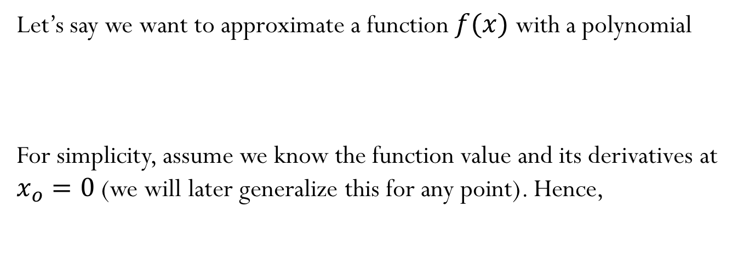
Approximating functions using polynomials:
Let’s say we want to approximate a function $f(x)$ with a polynomial
For simplicity, assume we know the function value and its derivatives at $x_{o}=0$ (we will later generalize this for any point). Hence,
$$f\left(x\right)=a_{o}+a_{1} x+ a_{2} x^{2}+a_{3} x^{3}+a_{4} x^{4}+⋯$$
$$f^{′}\left(x\right)=a_{1}+ {2 a}_{2} x+3 a_{3} x^{2}+4 a_{4} x^{3}+⋯$$
$$f^{′′}(x)={2 a}_{2}+ {\left(3×2\right)a}_{3 }x+{(4×3)a}_{4 }x^{2}+…$$
$$f^{′′′}(x)={\left(3×2\right)a}_{3 }+{(4×3×2)a}_{4 }x+…$$
$$f^{′v}(x)={(4×3×2)a}_{4 }+…$$

Slide 3
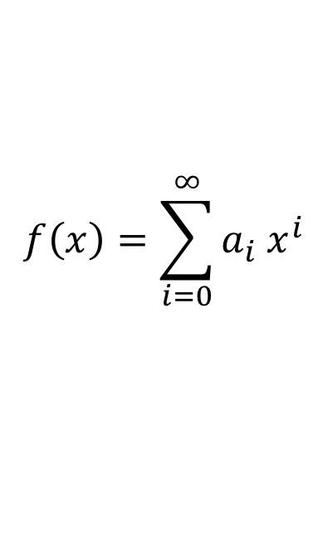
Taylor Series
Taylor Series approximation about point $x_{o}=0$
$$f\left(x\right)=a_{o}+a_{1} x+ a_{2} x^{2}+a_{3} x^{3}+a_{4} x^{4}+⋯$$
$$f\left(x\right)=\sum_{i=0}^{∞}{a_{i} x^{i}}$$

Slide 4
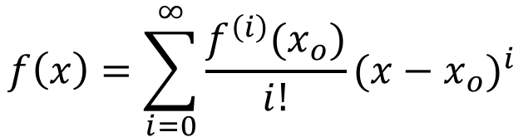
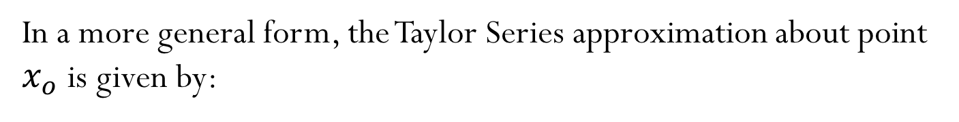
Taylor Series
In a more general form, the Taylor Series approximation about point $x_{o}$ is given by:
$$f\left(x\right)=f\left(x_{o}\right)+f^{′}\left(x_{o}\right)(x−x_{o})+\frac{f^{′′}\left(x_{o}\right)}{2!}{(x−x_{o})}^{2}+\frac{f^{′′′}\left(x_{o}\right)}{3!}{(x−x_{o})}^{3}+⋯$$
$$f\left(x\right)=\sum_{i=0}^{∞}{\frac{f^{\left(i\right)}(x_{o})}{i!}{(x−x_{o})}^{i}}$$

Slide 5
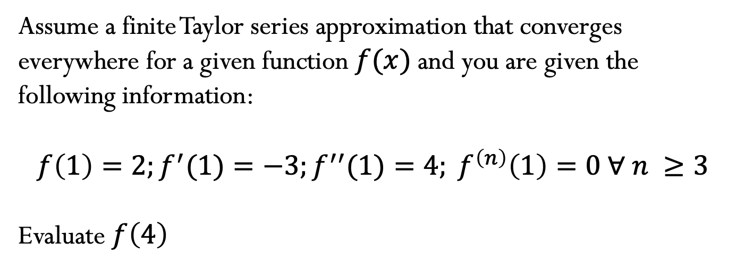
Use Taylor to approximate functions at given point
Assume a finite Taylor series approximation that converges everywhere for a given function $f(x)$ and you are given the following information:
$$f\left(1\right)=2;f^{′}(1)=−3;f^{′′}(1)=4; f^{\left(n\right)}\left(1\right)=0 ∀ n ≥3$$
Evaluate $f\left(4\right)$

Slide 6
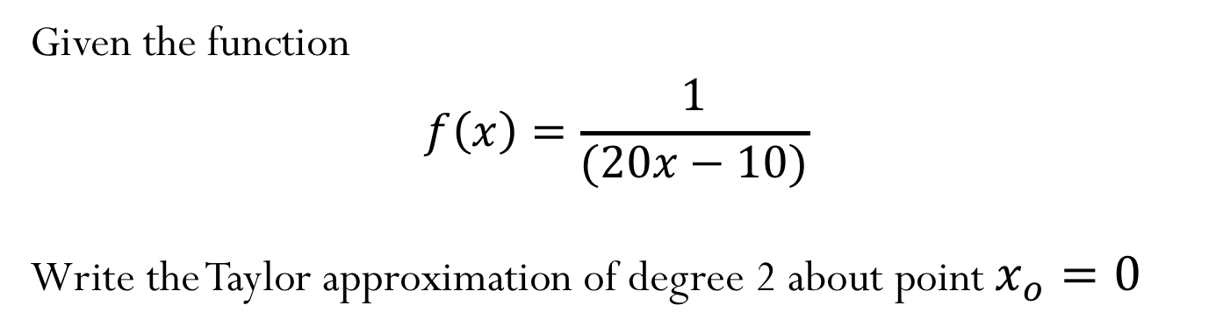
Example:
Given the function
$$f\left(x\right)=\frac{1}{(20x−10)}$$
Write the Taylor approximation of degree 2 about point $x_{o}=0$

Slide 7
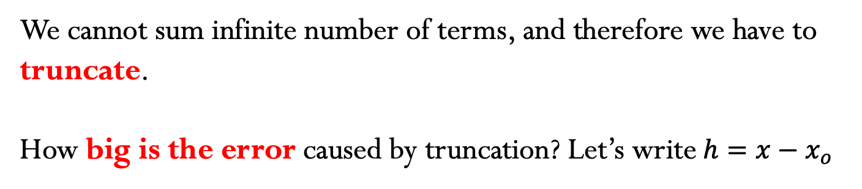
Taylor Series – what is the error?
We cannot sum infinite number of terms, and therefore we have to truncate.
How big is the error caused by truncation? Let’s write$h=x−x_{o}$

Slide 9

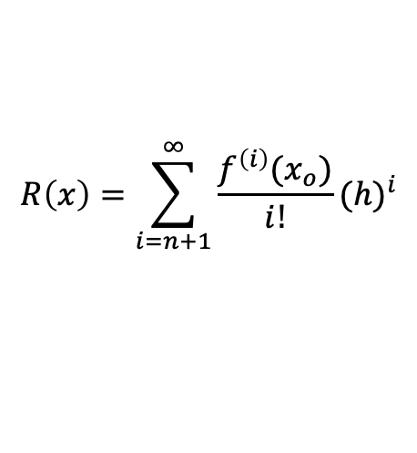
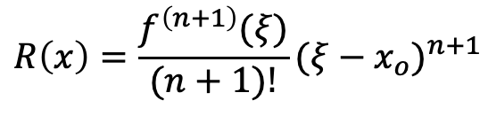
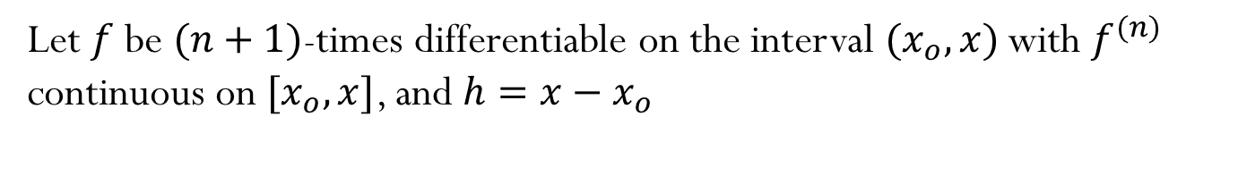
Taylor series with remainder
Let $f$ be $(n+1)$-times differentiable on the interval ${(x}_{o},x)$ with $f^{(n)}$ continuous on ${[x}_{o},x]$, and $h=x−x_{o}$
$$R\left(x\right)=\sum_{i=n+1}^{∞}{\frac{f^{\left(i\right)}(x_{o})}{i!}{(h)}^{i}}$$
$$f\left(x\right)=t_{n}\left(x\right)+R(x)$$
Then there exists a ${ξ∈(x}_{o},x)$ so that
$$R\left(x\right)=\frac{f^{\left(n+1\right)}(ξ)}{(n+1)!}{(ξ−x_{o})}^{n+1}$$

Slide 10
Graphical representation:

Slide 11
How can we use the known asymptotic behavior of the error?

Slide 12
Making error predictions

Slide 13
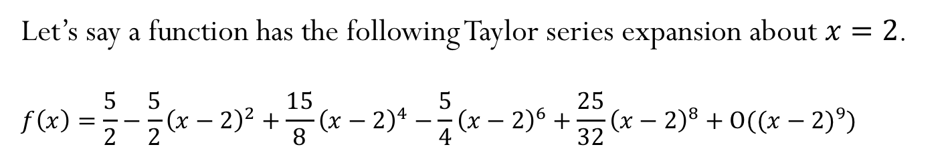


Using Taylor approximations to obtain derivatives
Let’s say a function has the following Taylor series expansion about $x=2$.
$$f\left(x\right)=\frac{5}{2}−\frac{5}{2}{\left(x−2\right)}^{2}+\frac{15}{8}{\left(x−2\right)}^{4}−\frac{5}{4}{\left(x−2\right)}^{6}+\frac{25}{32}{\left(x−2\right)}^{8}+O(({x−2)}^{9})$$
$$t\left(x\right)$$
$$f\left(x\right)$$

