Slide 1
Solving Linear System of Equations

Slide 2

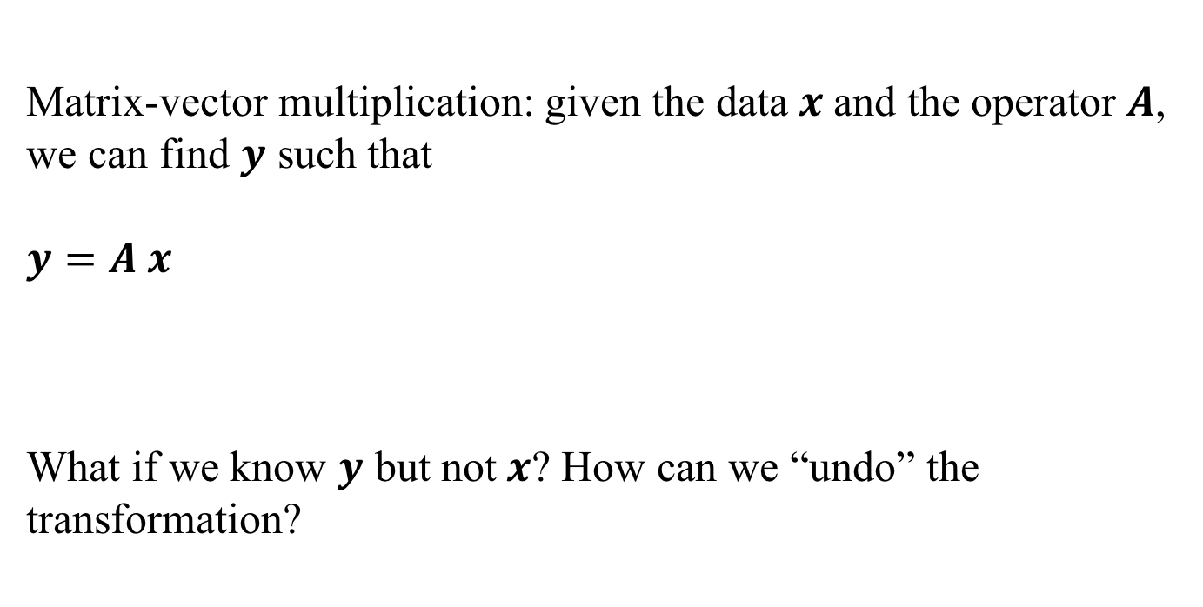


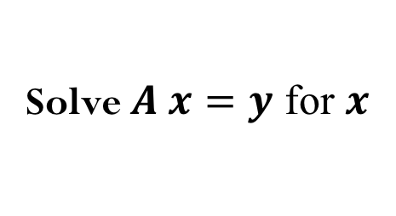




The “Undo” button for Linear Operations
Matrix-vector multiplication: given the data $x$and the operator $A$, we can find $y$ such that
$$y=A x$$
What if we know $y$ but not$x$? How can we “undo” the transformation?
$$A$$
$$x$$
$$y$$
transformation
$$A^{−1}$$
$$y$$
$$x$$
Solve $A x=y$ for $x$
$$?$$
Notes:
Inversion transform in neural networks

Slide 3
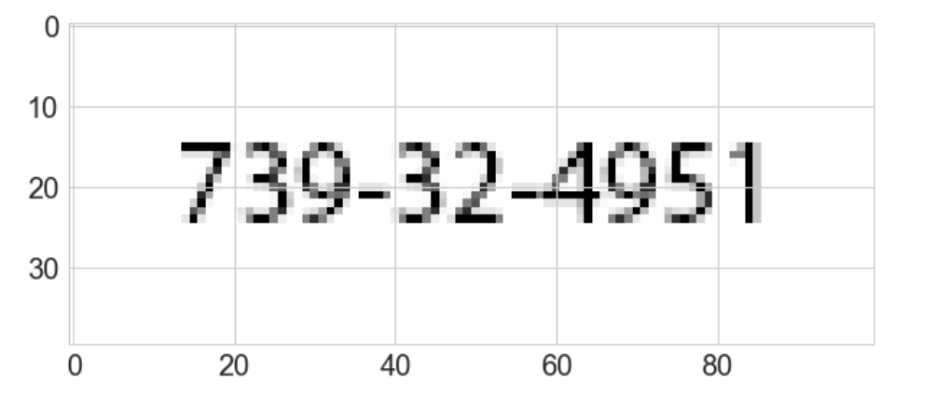
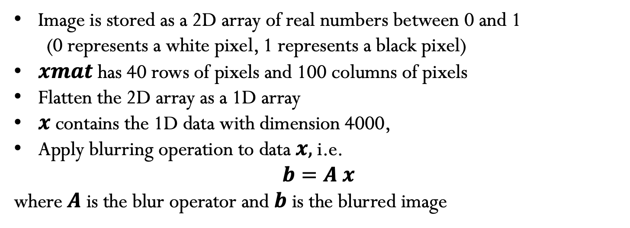
Image Blurring Example
Image is stored as a 2D array of real numbers between 0 and 1
(0 represents a white pixel, 1 represents a black pixel)
$xmat$has 40 rows of pixels and 100 columns of pixels
Flatten the 2D array as a 1D array
$x$ contains the 1D data with dimension 4000,
Apply blurring operation to data $x,$i.e.
$$b=A x$$
where $A$ is the blur operator and $b$ is the blurred image

Slide 4
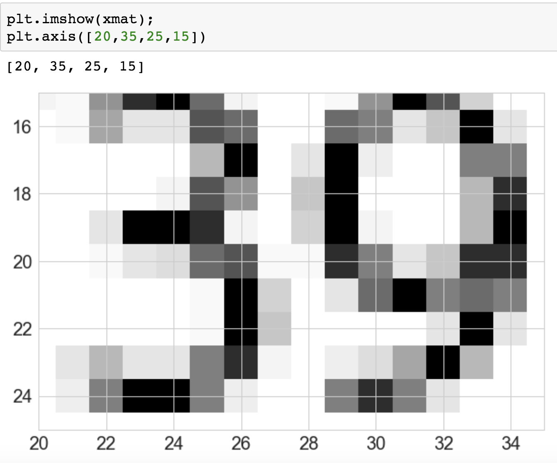
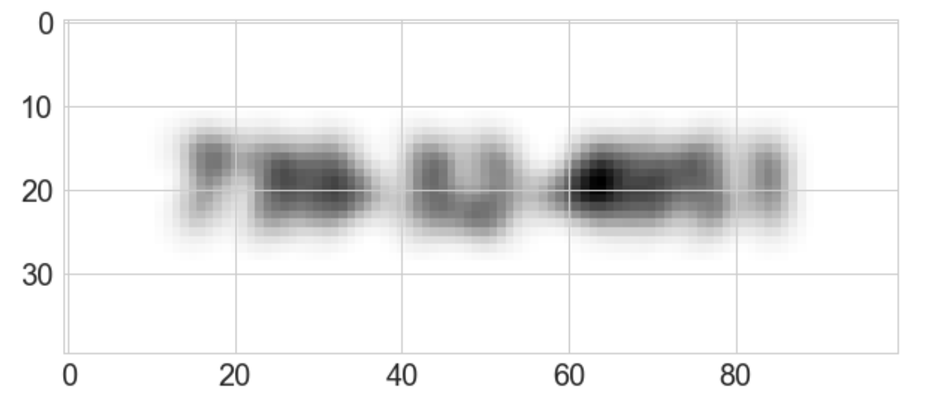


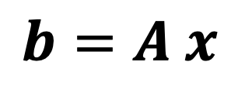

Blur operator
$$x$$
Blur operator
$$A$$
blurred image (4000,)
"original” image (4000,)
Blur operator (4000,4000)
$$b$$
$$b=A x$$

Slide 5
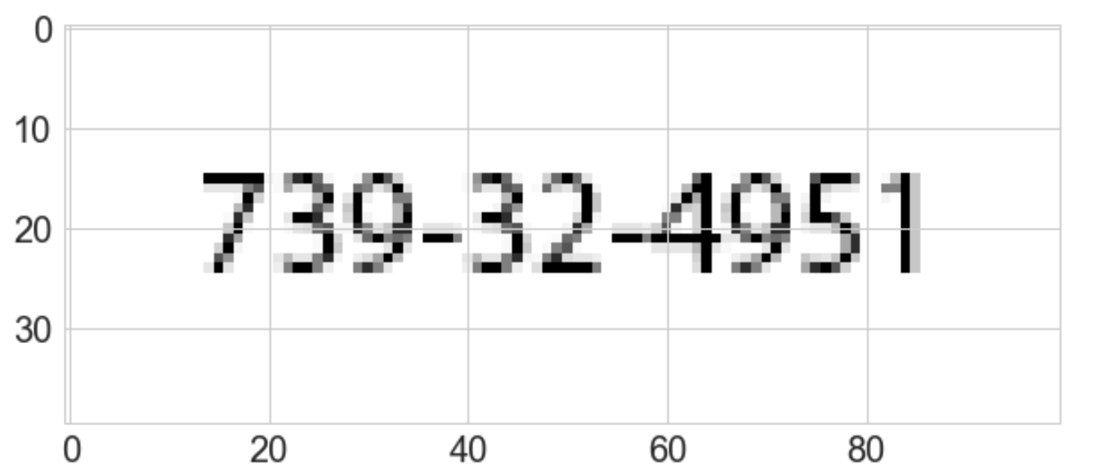
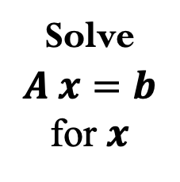


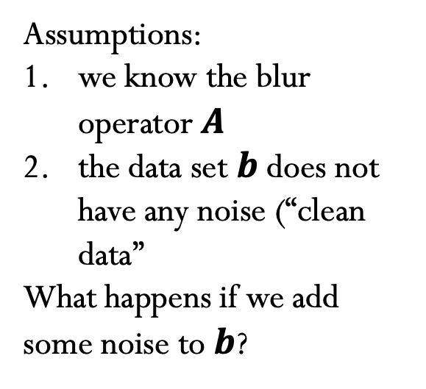
”Undo” Blur to recover original image
$$b$$
Assumptions:
we know the blur operator $A$
the data set $b$ does not have any noise (“clean data”
What happens if we add some noise to $b$?
Solve $A x=b$ for $x$
$$x$$

Slide 6
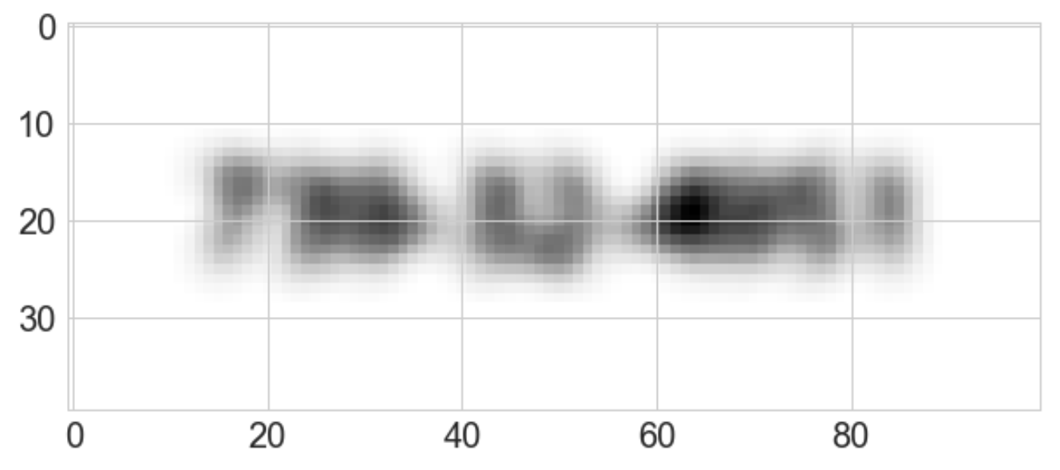

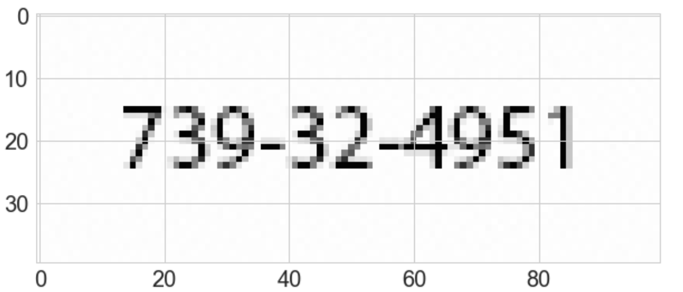
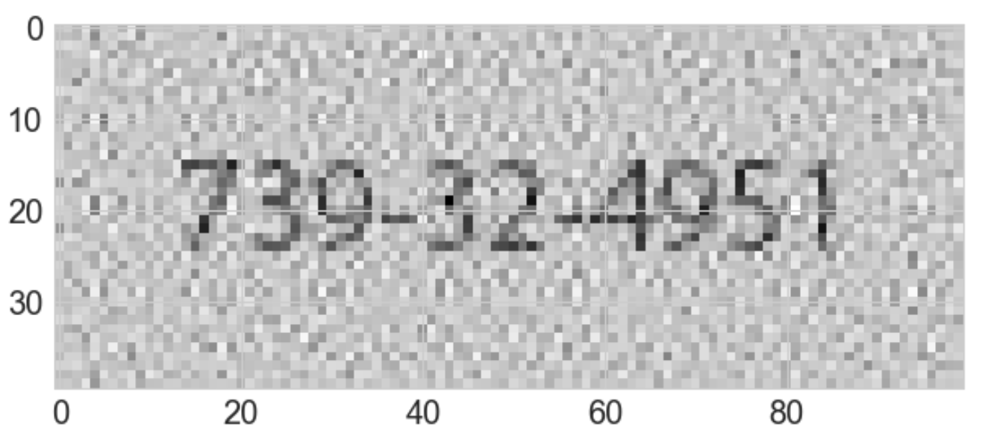
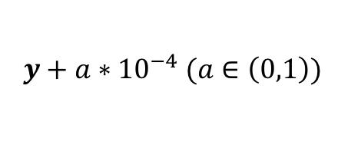
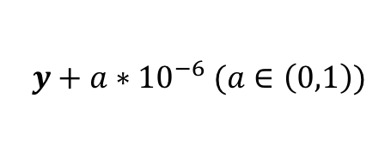
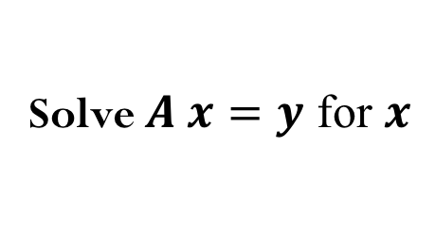
”Undo” Blur to recover original image
$$y+{a∗10}^{−6} (a∈\left(0,1\right))$$
$$y+{a∗10}^{−4} (a∈\left(0,1\right))$$
Solve $A x=y$ for $x$
How much noise can we add and still be able to recover meaningful information from the original image? At which point this inverse transformation fails?
We will talk about sensitivity of the “undo” operation later.

Slide 7
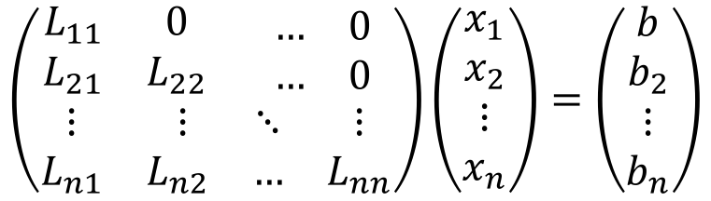
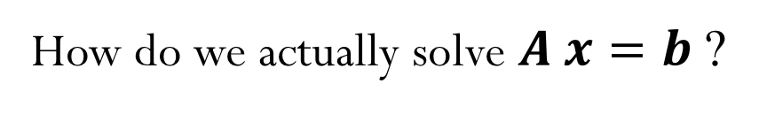
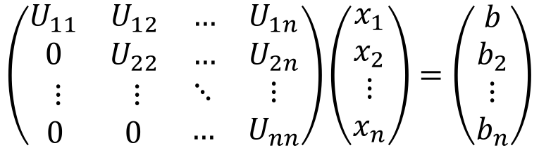
Linear System of Equations
How do we actually solve $A x=b$ ?
We can start with an “easier” system of equations…
Let’s consider triangular matrices (lower and upper):
$$\left(\begin{matrix}\begin{matrix}L_{11} & 0 \\ L_{21} & L_{22}\end{matrix} & \begin{matrix}… & 0 \\ … & 0\end{matrix} \\ \begin{matrix}⋮ & ⋮ \\ L_{n1} & L_{n2}\end{matrix} & \begin{matrix}⋱ & ⋮ \\ … & L_{nn}\end{matrix}\end{matrix}\right)\left(\begin{matrix}\begin{matrix}x_{1} \\ x_{2}\end{matrix} \\ \begin{matrix}⋮ \\ x_{n}\end{matrix}\end{matrix}\right)=\left(\begin{matrix}\begin{matrix}b \\ b_{2}\end{matrix} \\ \begin{matrix}⋮ \\ b_{n}\end{matrix}\end{matrix}\right)$$
$$\left(\begin{matrix}\begin{matrix}U_{11} & U_{12} \\ 0 & U_{22}\end{matrix} & \begin{matrix}… & U_{1n} \\ … & U_{2n}\end{matrix} \\ \begin{matrix}⋮ & ⋮ \\ 0 & 0\end{matrix} & \begin{matrix}⋱ & ⋮ \\ … & U_{nn}\end{matrix}\end{matrix}\right)\left(\begin{matrix}\begin{matrix}x_{1} \\ x_{2}\end{matrix} \\ \begin{matrix}⋮ \\ x_{n}\end{matrix}\end{matrix}\right)=\left(\begin{matrix}\begin{matrix}b \\ b_{2}\end{matrix} \\ \begin{matrix}⋮ \\ b_{n}\end{matrix}\end{matrix}\right)$$

Slide 8

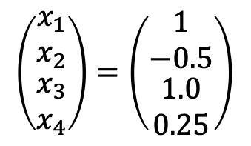
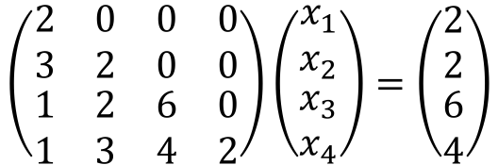
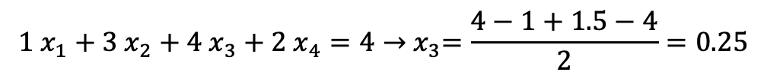
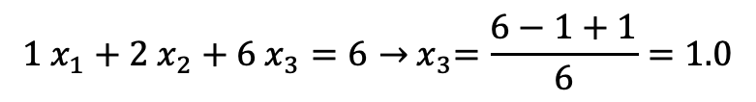
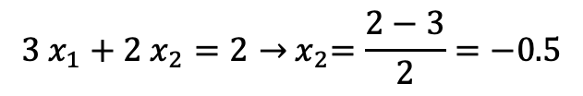
Example: Forward-substitution for lower triangular systems
$$\left(\begin{matrix}\begin{matrix}2 & 0 \\ 3 & 2\end{matrix} & \begin{matrix}0 & 0 \\ 0 & 0\end{matrix} \\ \begin{matrix}1 & 2 \\ 1 & 3\end{matrix} & \begin{matrix}6 & 0 \\ 4 & 2\end{matrix}\end{matrix}\right)\left(\begin{matrix}\begin{matrix}x_{1} \\ x_{2}\end{matrix} \\ \begin{matrix}x_{3} \\ x_{4}\end{matrix}\end{matrix}\right)=\left(\begin{matrix}\begin{matrix}2 \\ 2\end{matrix} \\ \begin{matrix}6 \\ 4\end{matrix}\end{matrix}\right)$$
$$2{ x}_{1}=2→{ x}_{1}=1$$
$$3{ x}_{1}+2{ x}_{2}=2→{ x}_{2}=\frac{2−3}{2}=−0.5$$
$$1{ x}_{1}+2{ x}_{2}+6{ x}_{3}=6→{ x}_{3}=\frac{6−1+1}{6}=1.0$$
$$1{ x}_{1}+3{ x}_{2}+4{ x}_{3}+2{ x}_{4}=4→{ x}_{3}=\frac{4−1+1.5−4}{2}=0.25$$
$$\left(\begin{matrix}\begin{matrix}x_{1} \\ x_{2}\end{matrix} \\ \begin{matrix}x_{3} \\ x_{4}\end{matrix}\end{matrix}\right)=\left(\begin{matrix}\begin{matrix}1 \\ −0.5\end{matrix} \\ \begin{matrix}1.0 \\ 0.25\end{matrix}\end{matrix}\right)$$

Slide 9
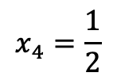
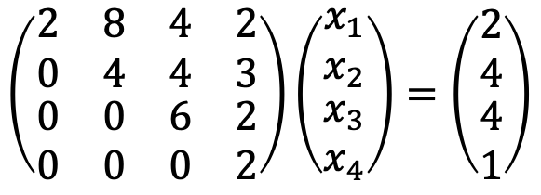
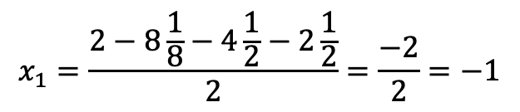
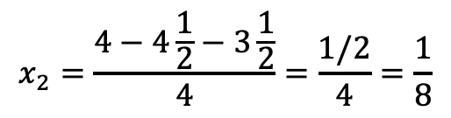
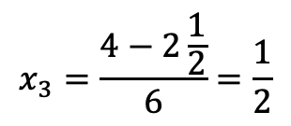
Example: Backward-substitution for upper triangular systems
$$\left(\begin{matrix}\begin{matrix}2 & 8 \\ 0 & 4\end{matrix} & \begin{matrix}4 & 2 \\ 4 & 3\end{matrix} \\ \begin{matrix}0 & 0 \\ 0 & 0\end{matrix} & \begin{matrix}6 & 2 \\ 0 & 2\end{matrix}\end{matrix}\right)\left(\begin{matrix}\begin{matrix}x_{1} \\ x_{2}\end{matrix} \\ \begin{matrix}x_{3} \\ x_{4}\end{matrix}\end{matrix}\right)=\left(\begin{matrix}\begin{matrix}2 \\ 4\end{matrix} \\ \begin{matrix}4 \\ 1\end{matrix}\end{matrix}\right)$$
$$x_{4}=\frac{1}{2}$$
$$x_{3}=\frac{4−2\frac{1}{2}}{6}=\frac{1}{2}$$
$$x_{2}=\frac{4−4\frac{1}{2}−3\frac{1}{2}}{4}=\frac{1/2}{4}=\frac{1}{8}$$
$$x_{1}=\frac{2−8\frac{1}{8}−4\frac{1}{2}−2\frac{1}{2}}{2}=\frac{−2}{2}=−1$$

Slide 10

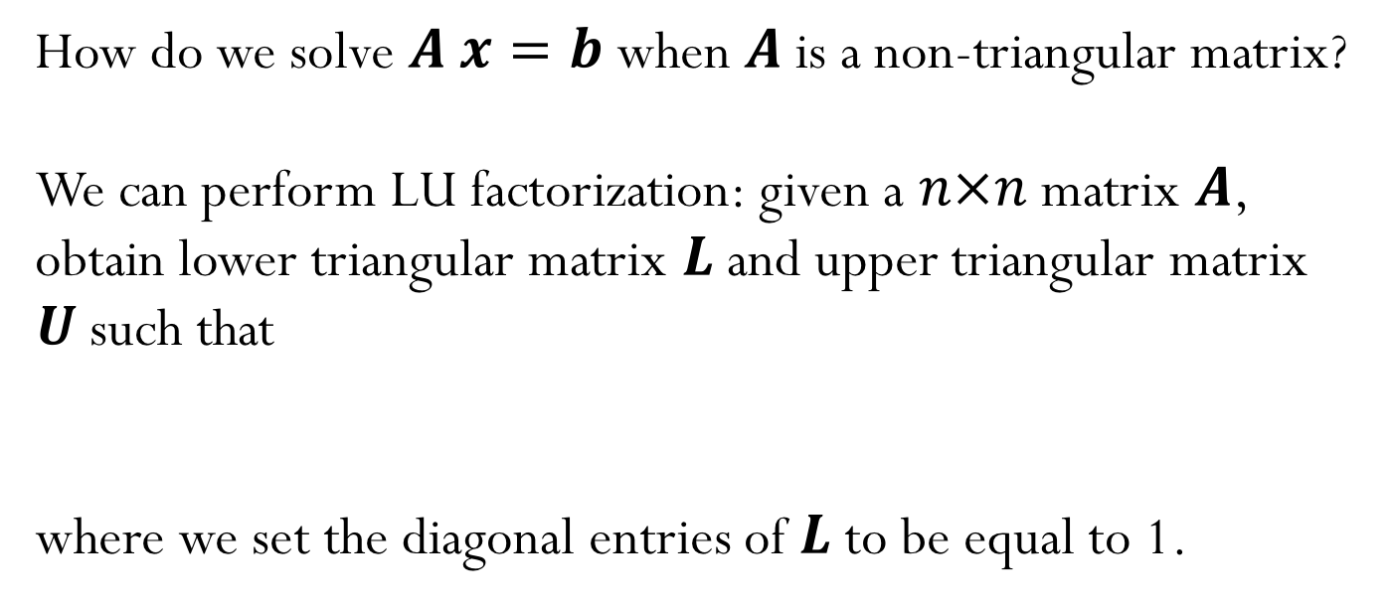
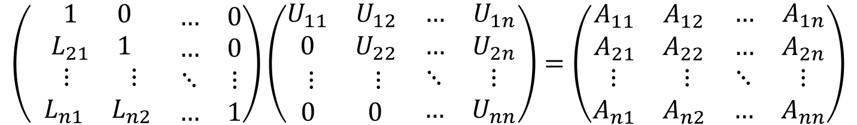
LU Factorization
How do we solve $A x=b$ when $A$ is a non-triangular matrix?
We can perform LU factorization: given a $n×n$ matrix $A$, obtain lower triangular matrix $L$ and upper triangular matrix $U$such that
where we set the diagonal entries of $L$ to be equal to 1.
$$A=LU$$
$$\left(\begin{matrix}\begin{matrix}1 & 0 \\ L_{21} & 1\end{matrix} & \begin{matrix}… & 0 \\ … & 0\end{matrix} \\ \begin{matrix} ⋮ & ⋮ \\ L_{n1} & L_{n2}\end{matrix} & \begin{matrix}⋱ & ⋮ \\ … & 1\end{matrix}\end{matrix}\right)\left(\begin{matrix}\begin{matrix}U_{11} & U_{12} \\ 0 & U_{22}\end{matrix} & \begin{matrix}… & U_{1n} \\ … & U_{2n}\end{matrix} \\ \begin{matrix}⋮ & ⋮ \\ 0 & 0\end{matrix} & \begin{matrix}⋱ & ⋮ \\ … & U_{nn}\end{matrix}\end{matrix}\right)=\left(\begin{matrix}\begin{matrix}A_{11} & A_{12} \\ A_{21} & A_{22}\end{matrix} & \begin{matrix}… & A_{1n} \\ … & A_{2n}\end{matrix} \\ \begin{matrix}⋮ & ⋮ \\ A_{n1} & A_{n2}\end{matrix} & \begin{matrix}⋱ & ⋮ \\ … & A_{nn}\end{matrix}\end{matrix}\right)$$

Slide 11
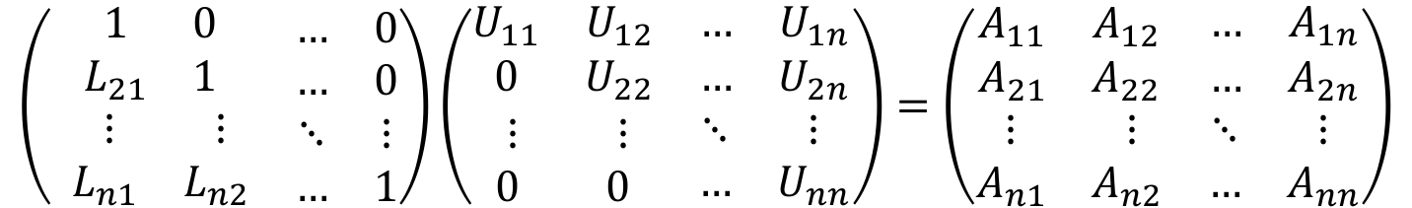
LU Factorization
$$\left(\begin{matrix}\begin{matrix}1 & 0 \\ L_{21} & 1\end{matrix} & \begin{matrix}… & 0 \\ … & 0\end{matrix} \\ \begin{matrix} ⋮ & ⋮ \\ L_{n1} & L_{n2}\end{matrix} & \begin{matrix}⋱ & ⋮ \\ … & 1\end{matrix}\end{matrix}\right)\left(\begin{matrix}\begin{matrix}U_{11} & U_{12} \\ 0 & U_{22}\end{matrix} & \begin{matrix}… & U_{1n} \\ … & U_{2n}\end{matrix} \\ \begin{matrix}⋮ & ⋮ \\ 0 & 0\end{matrix} & \begin{matrix}⋱ & ⋮ \\ … & U_{nn}\end{matrix}\end{matrix}\right)=\left(\begin{matrix}\begin{matrix}A_{11} & A_{12} \\ A_{21} & A_{22}\end{matrix} & \begin{matrix}… & A_{1n} \\ … & A_{2n}\end{matrix} \\ \begin{matrix}⋮ & ⋮ \\ A_{n1} & A_{n2}\end{matrix} & \begin{matrix}⋱ & ⋮ \\ … & A_{nn}\end{matrix}\end{matrix}\right)$$
Assuming the LU factorization is know, we can solve the general system
Notes:
Make sure to explain this well during lecture. It seems that students struggle to understand how the solve works.

Slide 12

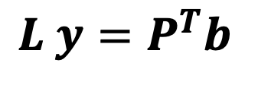
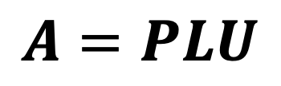
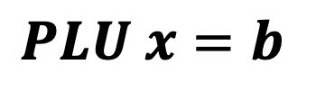
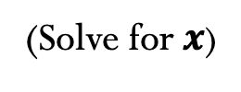
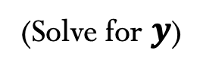
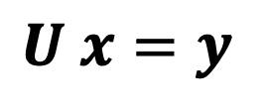
LU Factorization (with pivoting)
Factorize:
$$A=PLU$$
$PLU x=b$
$$y$$
Forward-substitution
$L y=P^{T}b$
(Solve for $y$)
Backward-substitution
$U x=y$
(Solve for$x$)

Slide 13
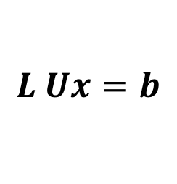

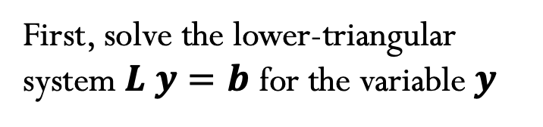
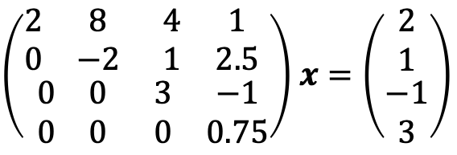
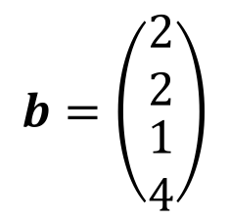
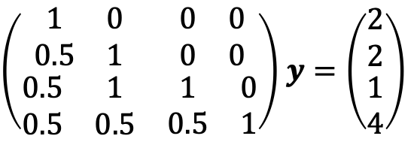
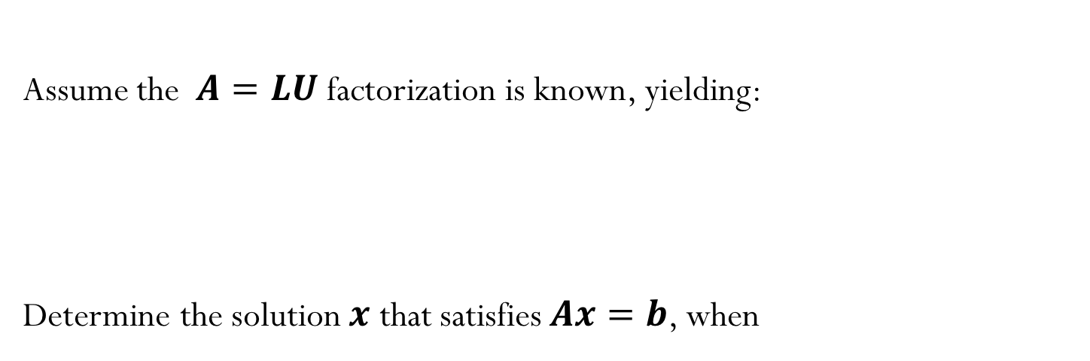
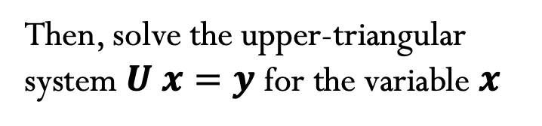


Example
Assume the $A=LU$factorization is known, yielding:
Determine the solution $x$ that satisfies $Ax=b$, when
$$L=\left(\begin{matrix}\begin{matrix}1 & 0 \\ 0.5 & 1\end{matrix} & \begin{matrix}0 & 0 \\ 0 & 0\end{matrix} \\ \begin{matrix}0.5 & 1 \\ 0.5 & 0.5\end{matrix} & \begin{matrix}1 & 0 \\ 0.5 & 1\end{matrix}\end{matrix}\right)$$
$$U=\left(\begin{matrix}\begin{matrix}2 & 8 \\ 0 & −2\end{matrix} & \begin{matrix}4 & 1 \\ 1 & 2.5\end{matrix} \\ \begin{matrix}0 & 0 \\ 0 & 0\end{matrix} & \begin{matrix}3 & −1 \\ 0 & 0.75\end{matrix}\end{matrix}\right)$$
$$b=\left(\begin{matrix}\begin{matrix}2 \\ 2\end{matrix} \\ \begin{matrix}1 \\ 4\end{matrix}\end{matrix}\right)$$
$$L Ux=b$$
$$y$$
First, solve the lower-triangular system $L y=b$ for the variable $y$
Then, solve the upper-triangular system $U x=y$ for the variable$x$
$\left(\begin{matrix}\begin{matrix}1 & 0 \\ 0.5 & 1\end{matrix} & \begin{matrix}0 & 0 \\ 0 & 0\end{matrix} \\ \begin{matrix}0.5 & 1 \\ 0.5 & 0.5\end{matrix} & \begin{matrix}1 & 0 \\ 0.5 & 1\end{matrix}\end{matrix}\right)$ $y=\left(\begin{matrix}\begin{matrix}2 \\ 2\end{matrix} \\ \begin{matrix}1 \\ 4\end{matrix}\end{matrix}\right)$
$\left(\begin{matrix}\begin{matrix}2 & 8 \\ 0 & −2\end{matrix} & \begin{matrix}4 & 1 \\ 1 & 2.5\end{matrix} \\ \begin{matrix}0 & 0 \\ 0 & 0\end{matrix} & \begin{matrix}3 & −1 \\ 0 & 0.75\end{matrix}\end{matrix}\right)$ $x=\left(\begin{matrix}\begin{matrix}2 \\ 1\end{matrix} \\ \begin{matrix}−1 \\ 3\end{matrix}\end{matrix}\right)$
Notes:
B)
C)

Slide 14
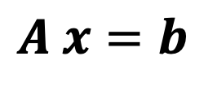
Methods to solve linear system of equations
$A x=b$
LU
Cholesky
Sparse

Slide 15
LU Factorization - Algorithm

Slide 16
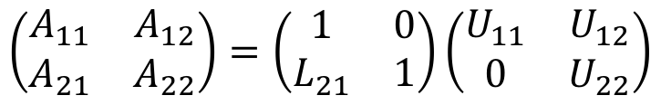
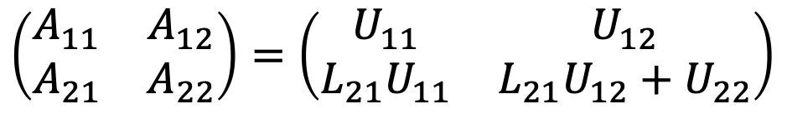
2x2 LU Factorization (simple example)
$$\left(\begin{matrix}A_{11} & A_{12} \\ A_{21} & A_{22}\end{matrix}\right)=\left(\begin{matrix}1 & 0 \\ L_{21} & 1\end{matrix}\right)\left(\begin{matrix}U_{11} & U_{12} \\ 0 & U_{22}\end{matrix}\right)$$
$$\left(\begin{matrix}A_{11} & A_{12} \\ A_{21} & A_{22}\end{matrix}\right)=\left(\begin{matrix}U_{11} & U_{12} \\ L_{21}U_{11} & L_{21}U_{12}+U_{22}\end{matrix}\right)$$

Slide 17







$a_{11}:$ scalar
$a_{12}$: row vector $(1×(n−1))$
$a_{21}$: column vector $\left((n−1)×1\right)$
$A_{22}$: matrix $\left((n−1)×(n−1)\right)$
LU Factorization
$$a_{11}$$
$$a_{12}$$
$\left(\begin{matrix}\begin{matrix}A_{11} & A_{12} \\ A_{21} & A_{22}\end{matrix} & \begin{matrix}… & A_{1n} \\ … & A_{2n}\end{matrix} \\ \begin{matrix}⋮ & ⋮ \\ A_{n1} & A_{n2}\end{matrix} & \begin{matrix}⋱ & ⋮ \\ … & A_{nn}\end{matrix}\end{matrix}\right)=\left(\begin{matrix}a_{11} & a_{12} \\ a_{21} & A_{22}\end{matrix}\right)=\left(\begin{matrix}1 & 0 \\ l_{21} & L_{22}\end{matrix}\right)$ $\left(\begin{matrix}u_{11} & u_{12} \\ 0 & U_{22}\end{matrix}\right)$
$$a_{21}$$
$$A_{22}$$
$$\left(\begin{matrix}a_{11} & a_{12} \\ a_{21} & A_{22}\end{matrix}\right)=\left(\begin{matrix}u_{11} & u_{12} \\ {u_{11} l}_{21} & {l_{21}u_{12}+L}_{22}U_{22}\end{matrix}\right)$$

Slide 18




$a_{11}:$ scalar
$a_{12}$: row vector $(1×(n−1))$
$a_{21}$: column vector $\left((n−1)×1\right)$
$A_{22}$: matrix $\left((n−1)×(n−1)\right)$
LU Factorization
$$a_{11}$$
$$a_{12}$$
$\left(\begin{matrix}\begin{matrix}A_{11} & A_{12} \\ A_{21} & A_{22}\end{matrix} & \begin{matrix}… & A_{1n} \\ … & A_{2n}\end{matrix} \\ \begin{matrix}⋮ & ⋮ \\ A_{n1} & A_{n2}\end{matrix} & \begin{matrix}⋱ & ⋮ \\ … & A_{nn}\end{matrix}\end{matrix}\right)=\left(\begin{matrix}a_{11} & a_{12} \\ a_{21} & A_{22}\end{matrix}\right)=\left(\begin{matrix}1 & 0 \\ l_{21} & L_{22}\end{matrix}\right)$ $\left(\begin{matrix}u_{11} & u_{12} \\ 0 & U_{22}\end{matrix}\right)$
$$a_{21}$$
$$A_{22}$$
1) First row of $U$ is the first row of $A$
$$\left(\begin{matrix}a_{11} & a_{12} \\ a_{21} & A_{22}\end{matrix}\right)=\left(\begin{matrix}u_{11} & u_{12} \\ {u_{11} l}_{21} & {l_{21}u_{12}+L}_{22}U_{22}\end{matrix}\right)$$
2) $l_{21}=\frac{1}{u_{11}}a_{21}$
Known!
3) ${{M=L}_{22}U_{22}=A}_{22}−l_{21}u_{12}$
First column of $L$ is the first column of $A$/ $u_{11}$
Need another factorization!

Slide 19







Example
1) First row of $U$ is the first row of $A$
$$M=\left(\begin{matrix}\begin{matrix}2 & 8 \\ 1 & 2\end{matrix} & \begin{matrix}4 & 1 \\ 3 & 3\end{matrix} \\ \begin{matrix}1 & 2 \\ 1 & 3\end{matrix} & \begin{matrix}6 & 2 \\ 4 & 2\end{matrix}\end{matrix}\right)$$
2) First column of $L$ is the first column of $A$/ $u_{11}$
3) ${L_{22}U_{22}=A}_{22}−l_{21}u_{12}$
$$L=\left(\begin{matrix}\begin{matrix}1 & 0 \\ 0.5 & 0\end{matrix} & \begin{matrix}0 & 0 \\ 0 & 0\end{matrix} \\ \begin{matrix}0.5 & 0 \\ 0.5 & 0\end{matrix} & \begin{matrix}0 & 0 \\ 0 & 0\end{matrix}\end{matrix}\right)$$
$$U=\left(\begin{matrix}\begin{matrix}2 & 8 \\ 0 & 0\end{matrix} & \begin{matrix}4 & 1 \\ 0 & 0\end{matrix} \\ \begin{matrix}0 & 0 \\ 0 & 0\end{matrix} & \begin{matrix}0 & 0 \\ 0 & 0\end{matrix}\end{matrix}\right)$$
$${L_{22}U_{22}=A}_{22}−l_{21}u_{12}=\left(\begin{matrix}\begin{matrix}2\end{matrix} & \begin{matrix}3 & 3\end{matrix} \\ \begin{matrix}2 \\ 3\end{matrix} & \begin{matrix}6 & 2 \\ 4 & 2\end{matrix}\end{matrix}\right)−\left(\begin{matrix}\begin{matrix}4\end{matrix} & \begin{matrix}2 & 0.5\end{matrix} \\ \begin{matrix}4 \\ 4\end{matrix} & \begin{matrix}2 & 0.5 \\ 2 & 0.5\end{matrix}\end{matrix}\right)$$
$$M=\left(\begin{matrix}\begin{matrix}2 & 8 \\ 1 & −2\end{matrix} & \begin{matrix}4 & 1 \\ 1 & 2.5\end{matrix} \\ \begin{matrix}1 & −2 \\ 1 & −1\end{matrix} & \begin{matrix}4 & 1.5 \\ 2 & 1.5\end{matrix}\end{matrix}\right)$$

Slide 20





$$M=\left(\begin{matrix}\begin{matrix}2 & 8 \\ 1 & −2\end{matrix} & \begin{matrix}4 & 1 \\ 1 & 2.5\end{matrix} \\ \begin{matrix}1 & −2 \\ 1 & −1\end{matrix} & \begin{matrix}4 & 1.5 \\ 2 & 1.5\end{matrix}\end{matrix}\right)$$
$$L=\left(\begin{matrix}\begin{matrix}1 & 0 \\ 0.5 & 1\end{matrix} & \begin{matrix}0 & 0 \\ 0 & 0\end{matrix} \\ \begin{matrix}0.5 & 1 \\ 0.5 & 0.5\end{matrix} & \begin{matrix}0 & 0 \\ 0 & 0\end{matrix}\end{matrix}\right)$$
$$U=\left(\begin{matrix}\begin{matrix}2 & 8 \\ 0 & −2\end{matrix} & \begin{matrix}4 & 1 \\ 1 & 2.5\end{matrix} \\ \begin{matrix}0 & 0 \\ 0 & 0\end{matrix} & \begin{matrix}0 & 0 \\ 0 & 0\end{matrix}\end{matrix}\right)$$
$${L_{22}U_{22}=A}_{22}−l_{21}u_{12}=\left(\begin{matrix}4 & 1.5 \\ 2 & 1.5\end{matrix}\right)−\left(\begin{matrix}1 & 2.5 \\ 0.5 & 1.25\end{matrix}\right)$$
$$M=\left(\begin{matrix}\begin{matrix}2 & 8 \\ 1 & −2\end{matrix} & \begin{matrix}4 & 1 \\ 1 & 2.5\end{matrix} \\ \begin{matrix}1 & −2 \\ 1 & −1\end{matrix} & \begin{matrix}3 & −1 \\ 1.5 & 0.25\end{matrix}\end{matrix}\right)$$

Slide 21





$$M=\left(\begin{matrix}\begin{matrix}2 & 8 \\ 1 & −2\end{matrix} & \begin{matrix}4 & 1 \\ 1 & 2.5\end{matrix} \\ \begin{matrix}1 & −2 \\ 1 & −1\end{matrix} & \begin{matrix}3 & −1 \\ 1.5 & 0.25\end{matrix}\end{matrix}\right)$$
$$L=\left(\begin{matrix}\begin{matrix}1 & 0 \\ 0.5 & 1\end{matrix} & \begin{matrix}0 & 0 \\ 0 & 0\end{matrix} \\ \begin{matrix}0.5 & 1 \\ 0.5 & 0.5\end{matrix} & \begin{matrix}1 & 0 \\ 0.5 & 0\end{matrix}\end{matrix}\right)$$
$$U=\left(\begin{matrix}\begin{matrix}2 & 8 \\ 0 & −2\end{matrix} & \begin{matrix}4 & 1 \\ 1 & 2.5\end{matrix} \\ \begin{matrix}0 & 0 \\ 0 & 0\end{matrix} & \begin{matrix}3 & −1 \\ 0 & 0\end{matrix}\end{matrix}\right)$$
$${L_{22}U_{22}=A}_{22}−l_{21}u_{12}=0.25−\left(−0.5\right)=0.75$$
$$L=\left(\begin{matrix}\begin{matrix}1 & 0 \\ 0.5 & 1\end{matrix} & \begin{matrix}0 & 0 \\ 0 & 0\end{matrix} \\ \begin{matrix}0.5 & 1 \\ 0.5 & 0.5\end{matrix} & \begin{matrix}1 & 0 \\ 0.5 & 1\end{matrix}\end{matrix}\right)$$
$$U=\left(\begin{matrix}\begin{matrix}2 & 8 \\ 0 & −2\end{matrix} & \begin{matrix}4 & 1 \\ 1 & 2.5\end{matrix} \\ \begin{matrix}0 & 0 \\ 0 & 0\end{matrix} & \begin{matrix}3 & −1 \\ 0 & 0.75\end{matrix}\end{matrix}\right)$$

Slide 22
$a_{11}:$ scalar
$a_{12}$: row vector $(1×(n−1))$
$a_{21}$: column vector $\left((n−1)×1\right)$
$A_{22}$: matrix $\left((n−1)×(n−1)\right)$
LU Factorization
$$a_{11}$$
$$a_{12}$$
$\left(\begin{matrix}\begin{matrix}A_{11} & A_{12} \\ A_{21} & A_{22}\end{matrix} & \begin{matrix}… & A_{1n} \\ … & A_{2n}\end{matrix} \\ \begin{matrix}⋮ & ⋮ \\ A_{n1} & A_{n2}\end{matrix} & \begin{matrix}⋱ & ⋮ \\ … & A_{nn}\end{matrix}\end{matrix}\right)=\left(\begin{matrix}a_{11} & a_{12} \\ a_{21} & A_{22}\end{matrix}\right)=\left(\begin{matrix}1 & 0 \\ l_{21} & L_{22}\end{matrix}\right)$ $\left(\begin{matrix}u_{11} & u_{12} \\ 0 & U_{22}\end{matrix}\right)$
$$a_{21}$$
$$A_{22}$$
1) First row of $U$ is the first row of $A$
$$\left(\begin{matrix}a_{11} & a_{12} \\ a_{21} & A_{22}\end{matrix}\right)=\left(\begin{matrix}u_{11} & u_{12} \\ {u_{11} l}_{21} & {l_{21}u_{12}+L}_{22}U_{22}\end{matrix}\right)$$
2) $l_{21}=\frac{1}{u_{11}}a_{21}$
Known!
3) ${{M=L}_{22}U_{22}=A}_{22}−l_{21}u_{12}$
First column of $L$ is the first column of $A$/ $u_{11}$
Need another factorization!

Slide 23
Cost of solving linear system of equations

Slide 24


Cost of solving triangular systems
$${ x}_{i}=\frac{b_{i}−\sum_{j=i+1}^{n}{U_{ij}x_{j}}}{U_{ii}}, i=n−1,n−2,…,1$$
$$x_{n}=b_{n}/U_{nn}$$

Slide 25








Cost of solving triangular systems
$${ x}_{i}=\frac{b_{i}−\sum_{j=i+1}^{n}{U_{ij}x_{j}}}{U_{ii}}, i=n−1,n−2,…,1$$
$$x_{n}=b_{n}/U_{nn}$$
$n$ divisions
$n\left(n−1\right)/2$ subtractions/additions
$n\left(n−1\right)/2$ multiplications
Computational complexity is $O(n^{2})$
$${ x}_{i}=\frac{b_{i}−\sum_{j=1}^{i−1}{L_{ij}x_{j}}}{L_{ii}}, i=2,3,…,n$$
$$x_{1}=b_{1}/L_{11}$$
$n$ divisions
$n\left(n−1\right)/2$ subtractions/additions
$n\left(n−1\right)/2$ multiplications
Computational complexity is $O(n^{2})$

Slide 26



Side note:
Cost of LU factorization
$$\sum_{i=1}^{m}{i}=\frac{1}{2}m\left(m+1\right)$$
$$\sum_{i=1}^{m}{i^{2}}=\frac{1}{6}m\left(m+1\right)\left(2m+1\right)$$

Slide 27

Solving linear systems
In general, we can solve a linear system of equations following the steps:
Factorize the matrix $A$:$A=LU$ (complexity $O(n^{3}))$
Solve $L y=b$ (complexity $O(n^{2}))$
Solve $U x=y$ (complexity $O(n^{2}))$
But why should we decouple the factorization from the actual solve?
(Remember from Linear Algebra, Gaussian Elimination does not decouple these two steps…)

Slide 28

Example
Let’s assume that when solving the system of equations $K U=F$, we observe the following:
When the matrix $K$has dimensions (100,100), computing the LU factorization takes about 1 second and each solve (forward + backward substitution) takes about 0.01 seconds.
Estimate the total time it will take to find the response $U$corresponding to 10 different vectors $F$when the matrix $K$ has dimensions (1000,1000)?
$$A) \sim 10 seconds$$
$$B) \sim {10}^{2} seconds$$
$$C) \sim {10}^{3} seconds$$
$$D) \sim {10}^{4} seconds$$
$$E) \sim {10}^{5} seconds$$

Slide 29
LU Factorization with pivoting

Slide 30





What can go wrong with the previous algorithm for LU factorization?
$$M=\left(\begin{matrix}\begin{matrix}2 & 8 \\ 1 & 4\end{matrix} & \begin{matrix}4 & 1 \\ 3 & 3\end{matrix} \\ \begin{matrix}1 & 2 \\ 1 & 3\end{matrix} & \begin{matrix}6 & 2 \\ 4 & 2\end{matrix}\end{matrix}\right)$$
$$L=\left(\begin{matrix}\begin{matrix}1 & 0 \\ 0.5 & 0\end{matrix} & \begin{matrix}0 & 0 \\ 0 & 0\end{matrix} \\ \begin{matrix}0.5 & 0 \\ 0.5 & 0\end{matrix} & \begin{matrix}0 & 0 \\ 0 & 0\end{matrix}\end{matrix}\right)$$
$$U=\left(\begin{matrix}\begin{matrix}2 & 8 \\ 0 & 0\end{matrix} & \begin{matrix}4 & 1 \\ 0 & 0\end{matrix} \\ \begin{matrix}0 & 0 \\ 0 & 0\end{matrix} & \begin{matrix}0 & 0 \\ 0 & 0\end{matrix}\end{matrix}\right)$$
$$l_{21}u_{12}=\left(\begin{matrix}4 & 2 & 0.5 \\ 4 & 2 & 0.5 \\ 4 & 2 & 0.5\end{matrix}\right)$$
$$M−l_{21}u_{12}=\left(\begin{matrix}\begin{matrix}2 & 8 \\ 1 & 0\end{matrix} & \begin{matrix}4 & 1 \\ 1 & 2.5\end{matrix} \\ \begin{matrix}1 & −2 \\ 1 & −1\end{matrix} & \begin{matrix}4 & 1.5 \\ 2 & 1.5\end{matrix}\end{matrix}\right)$$
The next update for the lower triangular matrix will result in a division by zero! LU factorization fails.
What can we do to get something like an LU factorization?
Notes:
Start of Thursday class?

Slide 31

Pivoting
Approach:
Swap rows if there is a zero entry in the diagonal
Even better idea: Find the largest entry (by absolute value) and swap it to the top row.
The entry we divide by is called the pivot.
Swapping rows to get a bigger pivot is called (partial) pivoting.
$$\left(\begin{matrix}a_{11} & a_{12} \\ a_{21} & A_{22}\end{matrix}\right)=\left(\begin{matrix}u_{11} & u_{12} \\ {u_{11} l}_{21} & {l_{21}u_{12}+L}_{22}U_{22}\end{matrix}\right)$$
Find the largest entry (in magnitude)
Notes:
Start of Thursday class?

