Slide 1
Eigenvalues and Eigenvectors

Slide 2
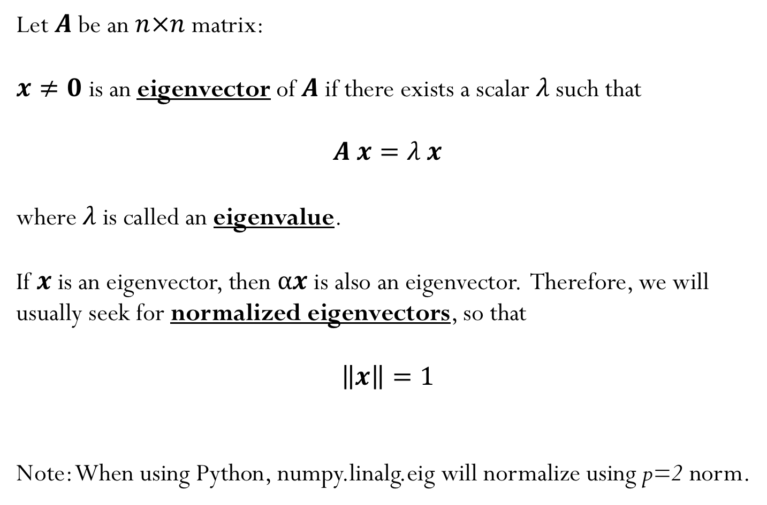
Eigenvalue problem
Let $A$ be an $n×n$ matrix:
$x≠0$ is an eigenvector of $A$if there exists a scalar $λ$such that
$A x=λ x$
where $λ$is called an eigenvalue.
If $x$ is an eigenvector, then $αx$ is also an eigenvector. Therefore, we will usually seek for normalized eigenvectors, so that
$$\left\|x\right\|=1$$
Note: When using Python, numpy.linalg.eig will normalize using p=2 norm.

Slide 3
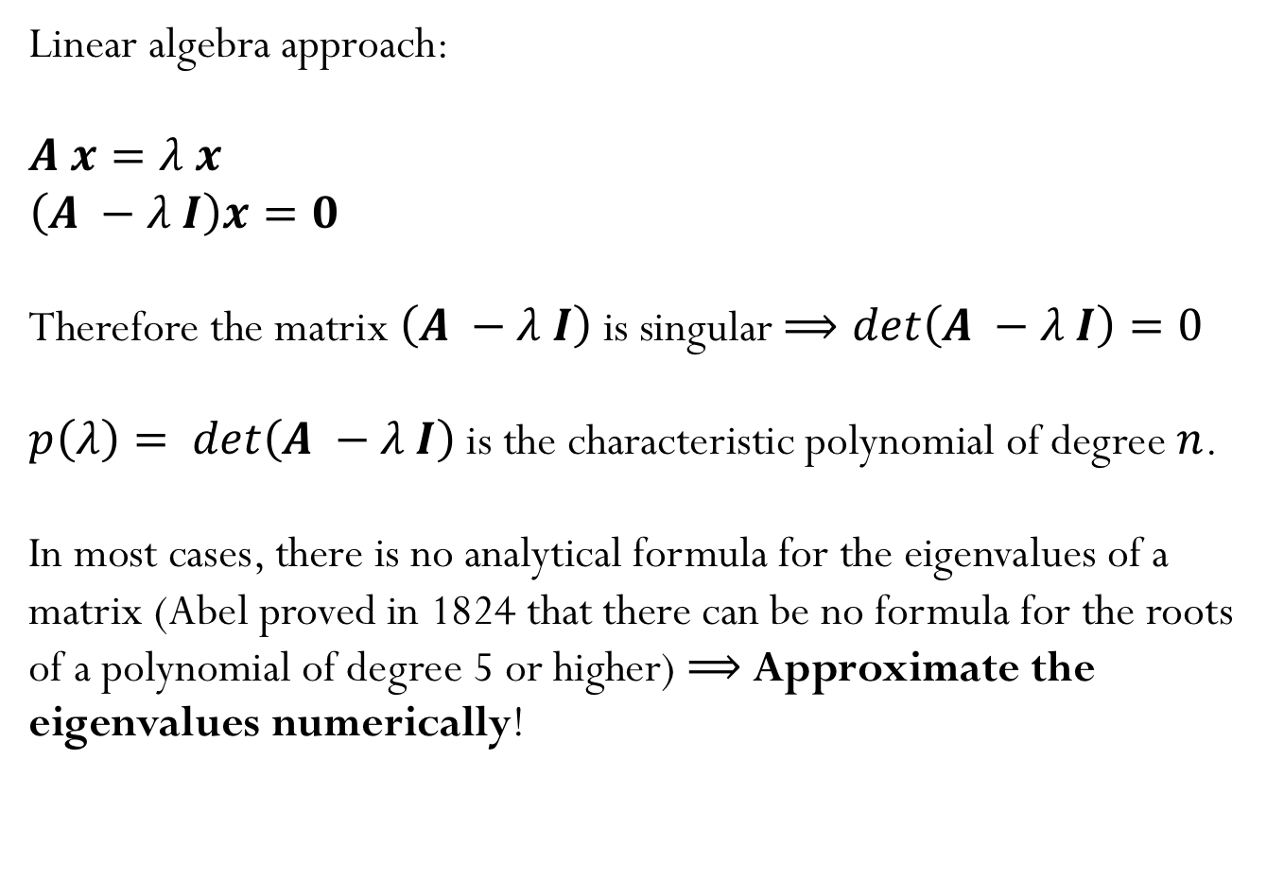
How do we find eigenvalues?
Linear algebra approach:
$A x=λ x$
$\left(A −λ I\right)x=0$
Therefore the matrix $\left(A −λ I\right)$ is singular $⟹det\left(A −λ I\right)=0$
$p\left(λ\right)= det\left(A −λ I\right)$ is the characteristic polynomial of degree $n$.
In most cases, there is no analytical formula for the eigenvalues of a matrix (Abel proved in 1824 that there can be no formula for the roots of a polynomial of degree 5 or higher) $⟹$ Approximate the eigenvalues numerically!
Notes:
Algorithmically, that means we will need to approximate. So
far (e.g. for LU and QR), if it had not been for FP error, we would
have obtained exact answers. For eigenvalue problems, that is
no longer true–we can only hope for an approximate answer.

Slide 4
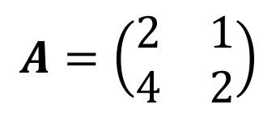
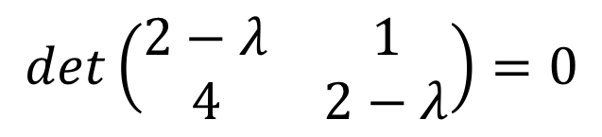
Example
$$A=\left(\begin{matrix}2 & 1 \\ 4 & 2\end{matrix}\right)$$
$$det\left(\begin{matrix}2−λ & 1 \\ 4 & 2−λ\end{matrix}\right)=0$$

Slide 5
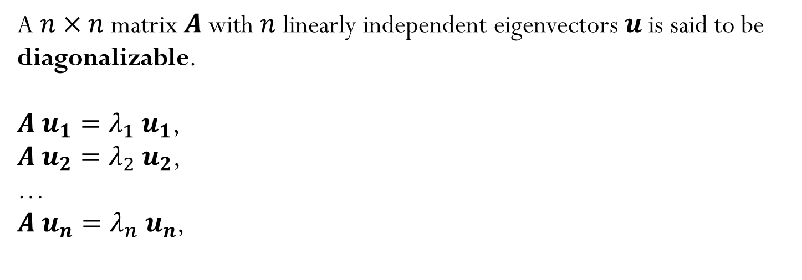
Diagonalizable Matrices
A $n×n$ matrix $A$ with $n$ linearly independent eigenvectors $u$is said to be diagonalizable.
$A{ u}_{1}={λ_{1} u}_{1}$,
$A{ u}_{2}={λ_{2} u}_{2}$,
…
$A{ u}_{n}={λ_{n} u}_{n}$,

Slide 6
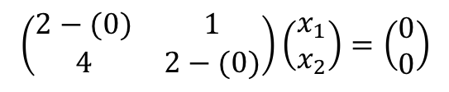
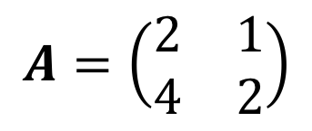

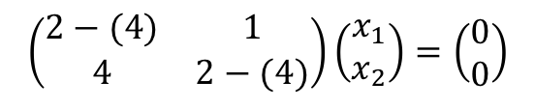
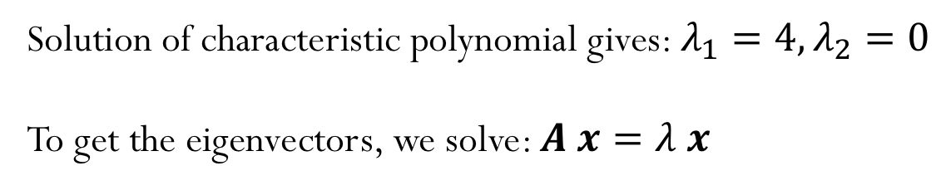
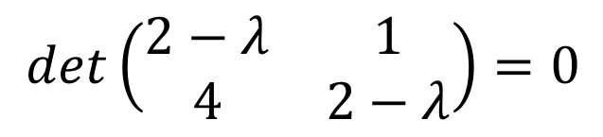

$$A=\left(\begin{matrix}2 & 1 \\ 4 & 2\end{matrix}\right)$$
$$det\left(\begin{matrix}2−λ & 1 \\ 4 & 2−λ\end{matrix}\right)=0$$
Example
Solution of characteristic polynomial gives: $λ_{1}=4,λ_{2}=0$
To get the eigenvectors, we solve: $A x=λ x$
$$\left(\begin{matrix}2−(4) & 1 \\ 4 & 2−(4)\end{matrix}\right)\left(\begin{matrix}x_{1} \\ x_{2}\end{matrix}\right)=\left(\begin{matrix}0 \\ 0\end{matrix}\right)$$
$$x=\left(\begin{matrix}1 \\ 2\end{matrix}\right)$$
$$\left(\begin{matrix}2−(0) & 1 \\ 4 & 2−(0)\end{matrix}\right)\left(\begin{matrix}x_{1} \\ x_{2}\end{matrix}\right)=\left(\begin{matrix}0 \\ 0\end{matrix}\right)$$
$$x=\left(\begin{matrix}−1 \\ 2\end{matrix}\right)$$

Slide 7
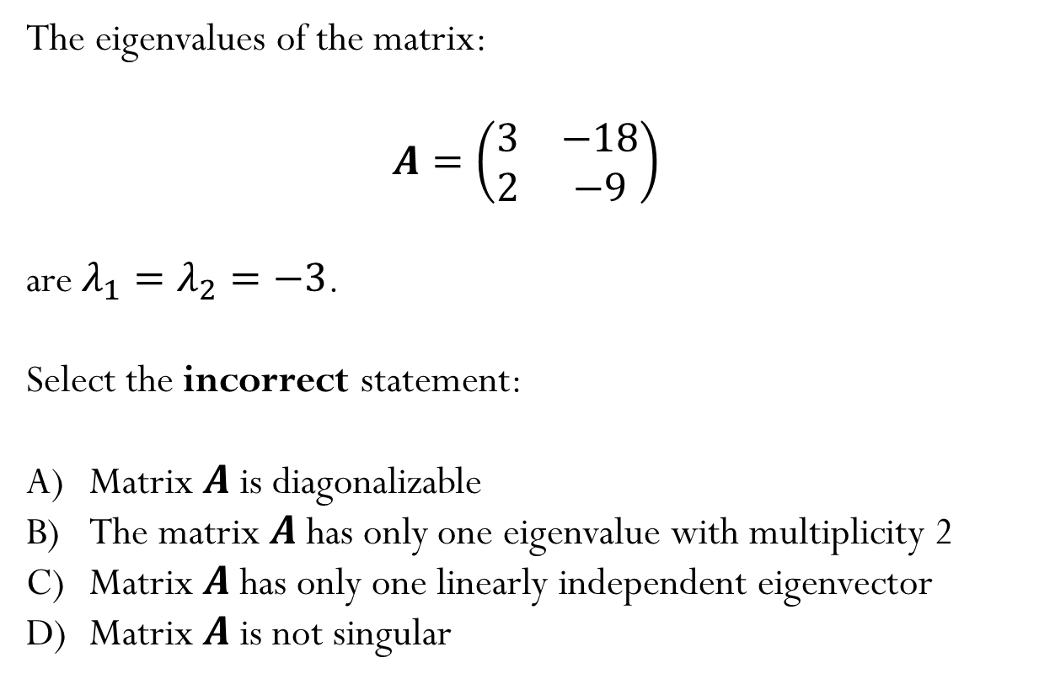
Example
The eigenvalues of the matrix:
$$A=\left(\begin{matrix}3 & −18 \\ 2 & −9\end{matrix}\right)$$
are $λ_{1}=λ_{2}=−3$.
Select the incorrect statement:
Matrix $A$ is diagonalizable
The matrix $A$ has only one eigenvalue with multiplicity 2
Matrix $A$ has only one linearly independent eigenvector
Matrix $A$ is not singular

Slide 8
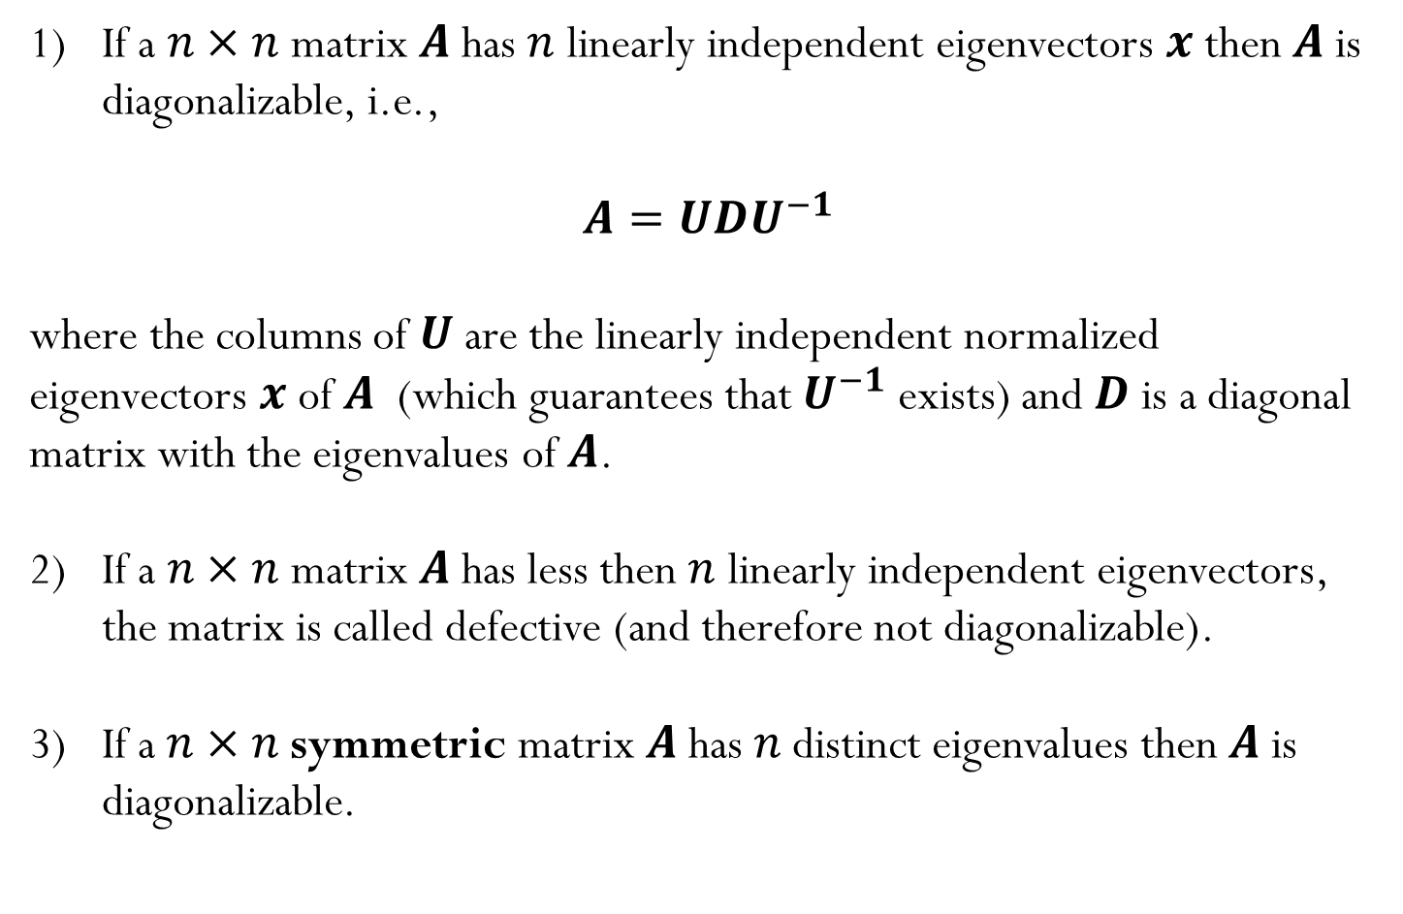
Let’s look back at diagonalization…
If a $n×n$ matrix $A$ has $n$ linearly independent eigenvectors $x$ then $A$ is diagonalizable, i.e.,
$A=UDU^{−1}$
where the columns of $U$ are the linearly independent normalized eigenvectors $x$ of $A$ (which guarantees that $U^{−1}$ exists) and $D$ is a diagonal matrix with the eigenvalues of $A$.
If a $n×n$ matrix $A$ has less then $n$ linearly independent eigenvectors, the matrix is called defective (and therefore not diagonalizable).
If a$n×n$symmetric matrix $A$has $n$distinct eigenvalues then $A$ is diagonalizable.
Notes:
ADD the slide about defective eigenvalues from Spring 2019

Slide 9
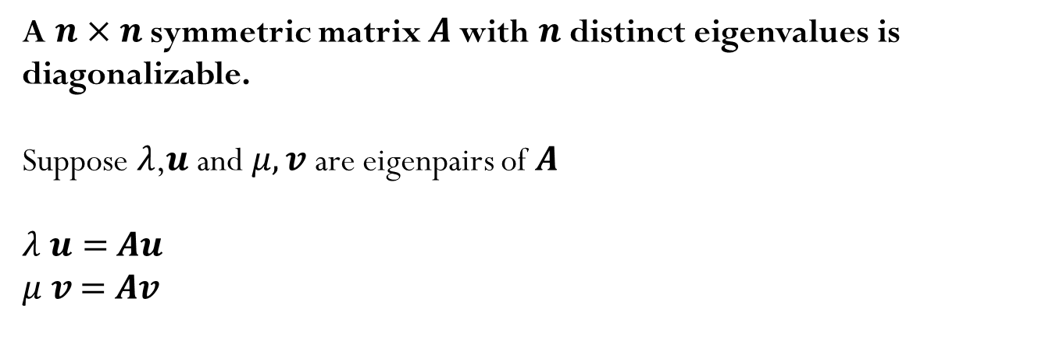
A$n×n$symmetric matrix $A$with $n$distinct eigenvalues is diagonalizable.
Suppose $λ$,$u$ and $μ, v$ are eigenpairs of $A$
$λ u=$ $Au$
$μ v$ $=$ $Av$
Notes:
Complete this slide later

Slide 10
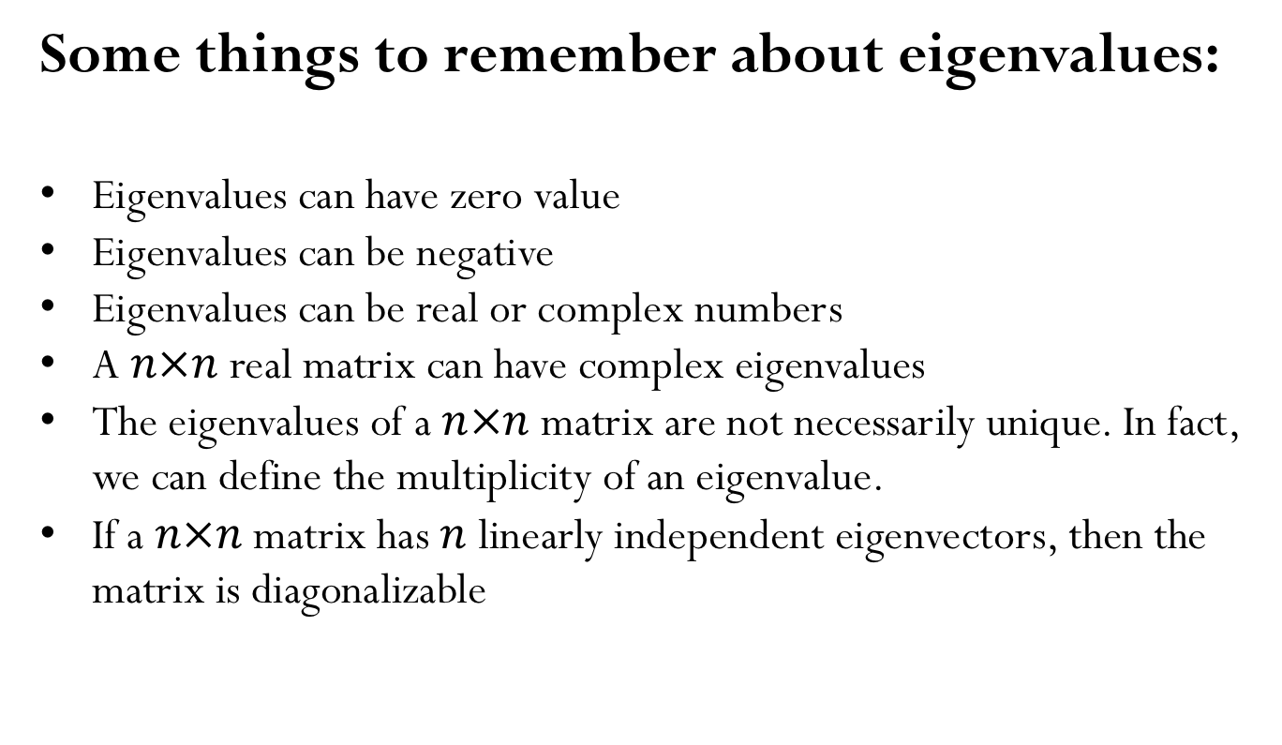
Some things to remember about eigenvalues:
Eigenvalues can have zero value
Eigenvalues can be negative
Eigenvalues can be real or complex numbers
A $n×n$ real matrix can have complex eigenvalues
The eigenvalues of a $n×n$ matrix are not necessarily unique. In fact, we can define the multiplicity of an eigenvalue.
If a $n×n$ matrix has $n$ linearly independent eigenvectors, then the matrix is diagonalizable

Slide 11
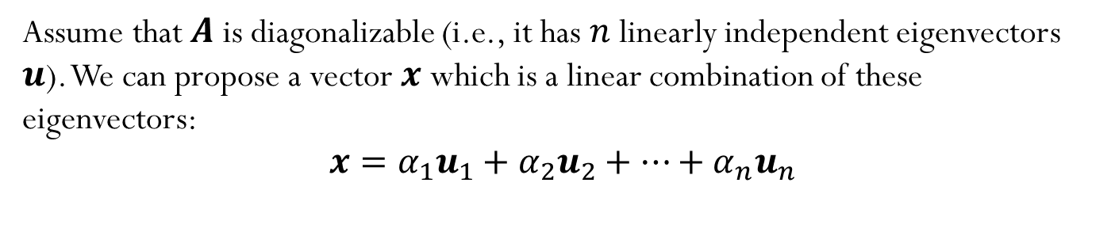
How can we get eigenvalues numerically?
Assume that $A$ is diagonalizable (i.e., it has $n$ linearly independent eigenvectors $u$). We can propose a vector $x$ which is a linear combination of these eigenvectors:
$$x=α_{1}u_{1}+α_{2}u_{2}+…+α_{n}u_{n}$$

Slide 12

Power Iteration
Our goal is to find an eigenvector $u_{i}$of $A.$ We will use an iterative process, where we start with an initial vector, where here we assume that it can be written as a linear combination of the eigenvectors of $A$.
$$x_{0}=α_{1}u_{1}+α_{2}u_{2}+…+α_{n}u_{n}$$

Slide 13
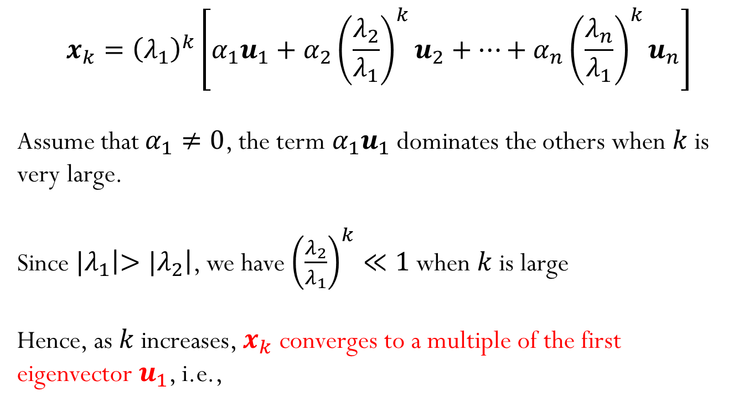
Power Iteration
$$x_{k}={\left(λ_{1}\right)}^{k}\left[α_{1}u_{1}+α_{2}{{\left(\frac{λ_{2}}{λ_{1}}\right)}^{k}u}_{2}+…+α_{n}{{\left(\frac{λ_{n}}{λ_{1}}\right)}^{k}u}_{n}\right]$$
Assume that $α_{1}≠0$, the term $α_{1}u_{1}$ dominates the others when $k$ is very large.
Since ${|λ}_{1}\left|>{|λ}_{2}\right|$, we have ${\left(\frac{λ_{2}}{λ_{1}}\right)}^{k}≪1$ when $k$ is large
Hence, as $k$ increases, $x_{k}$ converges to a multiple of the first eigenvector $u_{1}$, i.e.,

