Slide 1
Eigenvalues and Eigenvectors

Slide 2
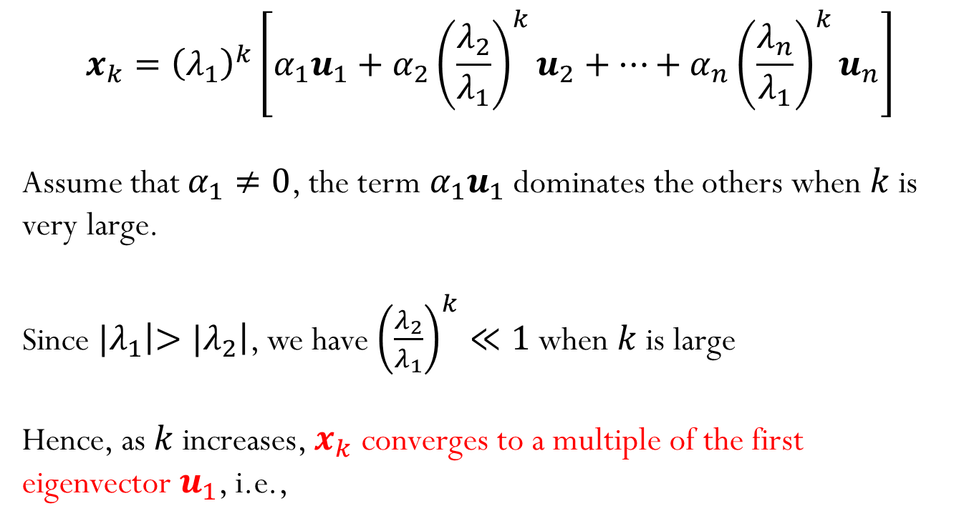
Power Iteration
$$x_{k}={\left(λ_{1}\right)}^{k}\left[α_{1}u_{1}+α_{2}{{\left(\frac{λ_{2}}{λ_{1}}\right)}^{k}u}_{2}+…+α_{n}{{\left(\frac{λ_{n}}{λ_{1}}\right)}^{k}u}_{n}\right]$$
Assume that $α_{1}≠0$, the term $α_{1}u_{1}$ dominates the others when $k$ is very large.
Since ${|λ}_{1}\left|>{|λ}_{2}\right|$, we have ${\left(\frac{λ_{2}}{λ_{1}}\right)}^{k}≪1$ when $k$ is large
Hence, as $k$ increases, $x_{k}$ converges to a multiple of the first eigenvector $u_{1}$, i.e.,

Slide 3
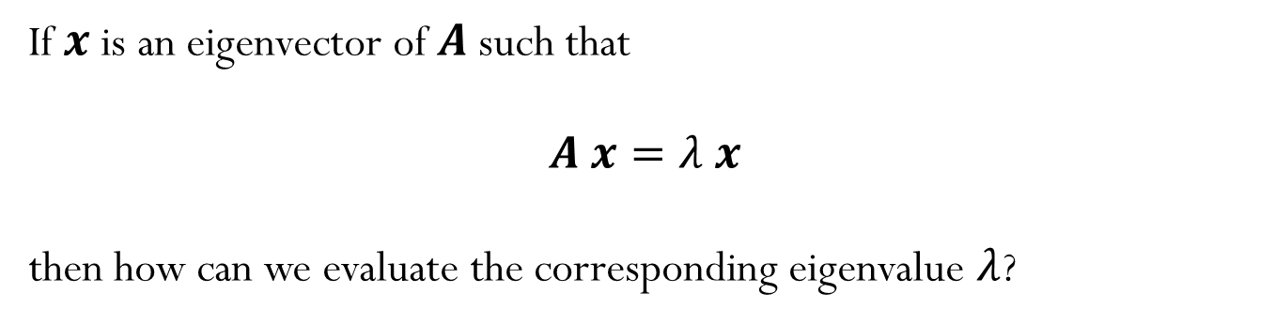
How can we now get the eigenvalues?
If $x$ is an eigenvector of $A$such that
$A x=λ x$
then how can we evaluate the corresponding eigenvalue $λ$?

Slide 4
Power Iteration

Slide 5


Normalized Power Iteration
$$x_{k}={\left(λ_{1}\right)}^{k}\left[α_{1}u_{1}+α_{2}{{\left(\frac{λ_{2}}{λ_{1}}\right)}^{k}u}_{2}+…+α_{n}{{\left(\frac{λ_{n}}{λ_{1}}\right)}^{k}u}_{n}\right]$$
$$x_{0}=arbitrary nonzero vector$$
$$x_{0}=\frac{x_{0}}{\left\|x_{0}\right\|}$$
for $k=1,2,…$
$y_{k}=A{ x}_{k−1}$
$x_{k}=\frac{y_{k}}{\left\|y_{k}\right\|}$
Notes:
Talk about convergence with different norms

Slide 6
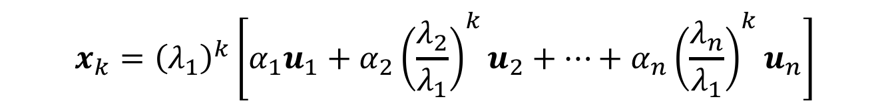
Normalized Power Iteration
$$x_{k}={\left(λ_{1}\right)}^{k}\left[α_{1}u_{1}+α_{2}{{\left(\frac{λ_{2}}{λ_{1}}\right)}^{k}u}_{2}+…+α_{n}{{\left(\frac{λ_{n}}{λ_{1}}\right)}^{k}u}_{n}\right]$$
What if the starting vector $x_{0}$ have no component in the dominant eigenvector $u_{1}$ ($α_{1}=0$)?
Notes:
Talk about convergence with different norms

Slide 7

Normalized Power Iteration
$$x_{k}={\left(λ_{1}\right)}^{k}\left[α_{1}u_{1}+α_{2}{{\left(\frac{λ_{2}}{λ_{1}}\right)}^{k}u}_{2}+…+α_{n}{{\left(\frac{λ_{n}}{λ_{1}}\right)}^{k}u}_{n}\right]$$
What if the first two largest eigenvalues (in magnitude) are the same, ${|λ}_{1}\left|={|λ}_{2}\right|$?
$1) λ_{1}$ and $λ_{2}$ both positives
Notes:
Talk about convergence with different norms

Slide 8

Normalized Power Iteration
$$x_{k}={\left(λ_{1}\right)}^{k}\left[α_{1}u_{1}+α_{2}{{\left(\frac{λ_{2}}{λ_{1}}\right)}^{k}u}_{2}+…+α_{n}{{\left(\frac{λ_{n}}{λ_{1}}\right)}^{k}u}_{n}\right]$$
What if the first two largest eigenvalues (in magnitude) are the same, ${|λ}_{1}\left|={|λ}_{2}\right|$?
$2) λ_{1}$ and $λ_{2}$ both negative
Notes:
Talk about convergence with different norms

Slide 9

Normalized Power Iteration
$$x_{k}={\left(λ_{1}\right)}^{k}\left[α_{1}u_{1}+α_{2}{{\left(\frac{λ_{2}}{λ_{1}}\right)}^{k}u}_{2}+…+α_{n}{{\left(\frac{λ_{n}}{λ_{1}}\right)}^{k}u}_{n}\right]$$
What if the first two largest eigenvalues (in magnitude) are the same, ${|λ}_{1}\left|={|λ}_{2}\right|$?
$3) λ_{1}$ and $λ_{2}$ opposite signs
Notes:
Talk about convergence with different norms

Slide 10
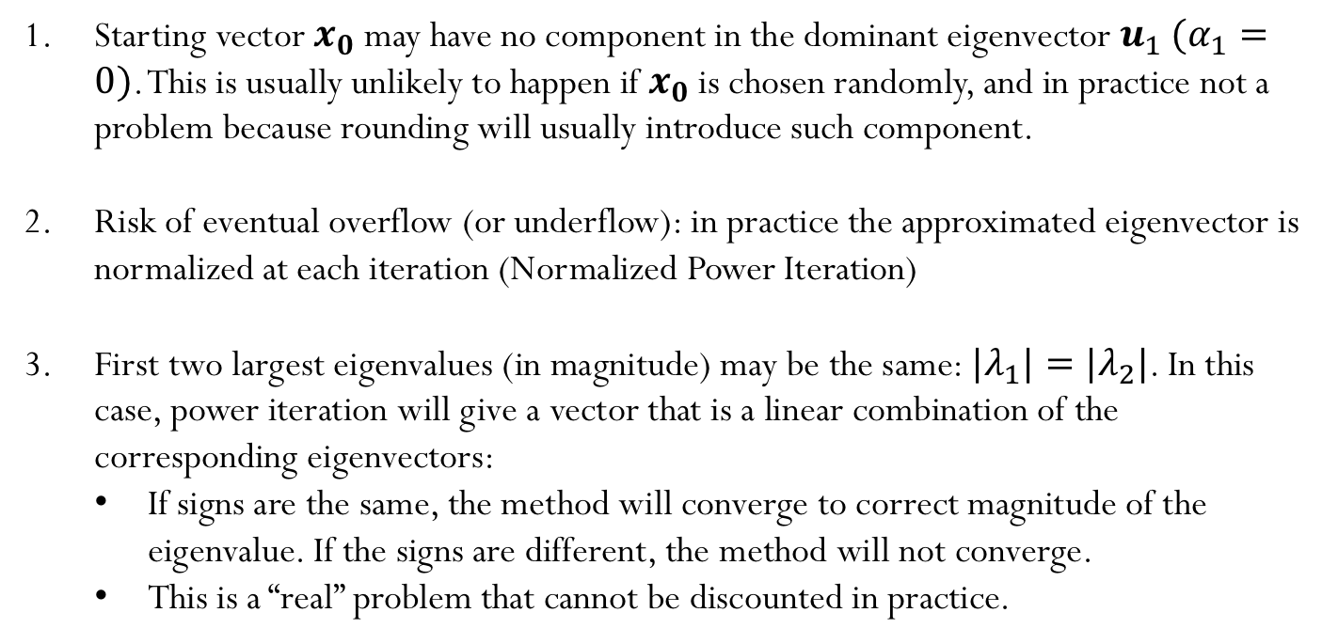
Potential pitfalls
Starting vector $x_{0}$ may have no component in the dominant eigenvector${ u}_{1}$ $(α_{1}=0)$. This is usually unlikely to happen if $x_{0}$ is chosen randomly, and in practice not a problem because rounding will usually introduce such component.
Risk of eventual overflow (or underflow): in practice the approximated eigenvector is normalized at each iteration (Normalized Power Iteration)
First two largest eigenvalues (in magnitude) may be the same: ${|λ}_{1}|={|λ}_{2}|$. In this case, power iteration will give a vector that is a linear combination of the corresponding eigenvectors:
If signs are the same, the method will converge to correct magnitude of the eigenvalue. If the signs are different, the method will not converge.
This is a “real” problem that cannot be discounted in practice.

Slide 11
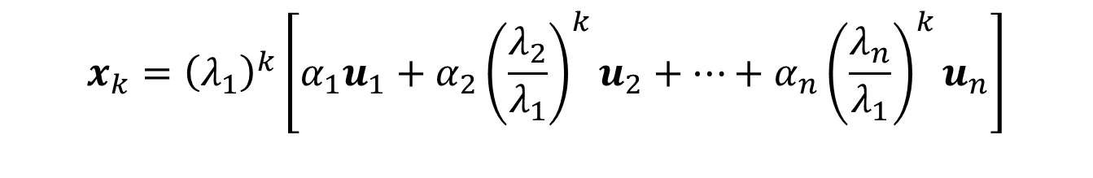
Error
$$x_{k}={\left(λ_{1}\right)}^{k}\left[α_{1}u_{1}+α_{2}{{\left(\frac{λ_{2}}{λ_{1}}\right)}^{k}u}_{2}+…+α_{n}{{\left(\frac{λ_{n}}{λ_{1}}\right)}^{k}u}_{n}\right]$$

Slide 12
Convergence and error

Slide 13
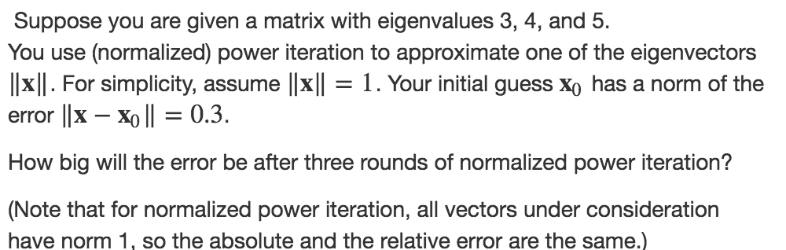
Example

Slide 14

Suppose $x$ is an eigenvector of $A$such that
$A x=λ x$
What is an eigenvalue of $A^{−1}$?

Slide 15
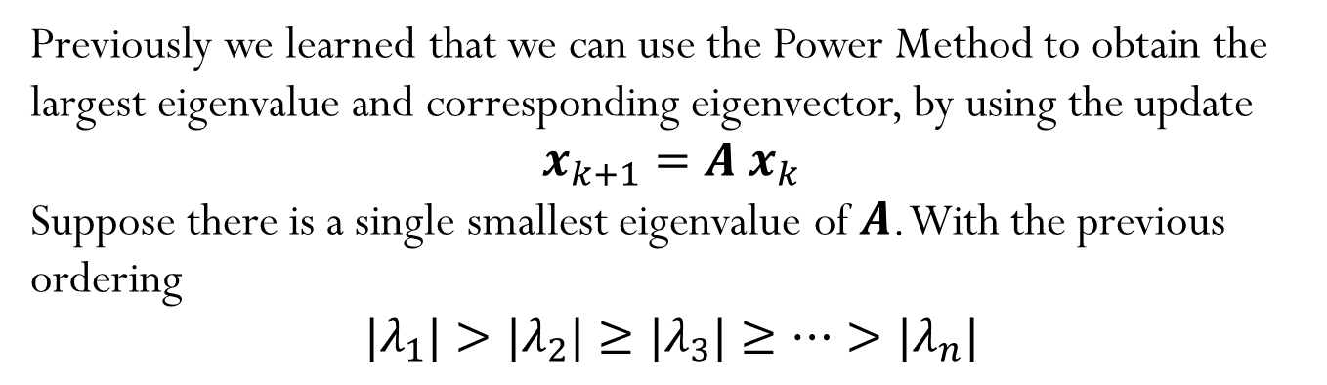
Inverse Power Method
Previously we learned that we can use the Power Method to obtain the largest eigenvalue and corresponding eigenvector, by using the update
$$x_{k+1}=A{ x}_{k}$$
Suppose there is a single smallest eigenvalue of $A$. With the previous ordering
$${|λ}_{1}|>{|λ}_{2}|≥{|λ}_{3}|≥…>{|λ}_{n}|$$

Slide 16
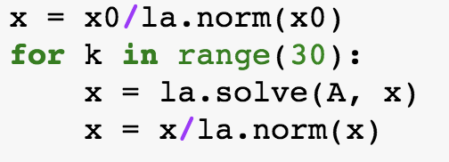
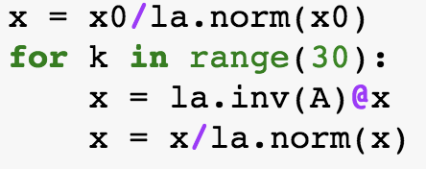
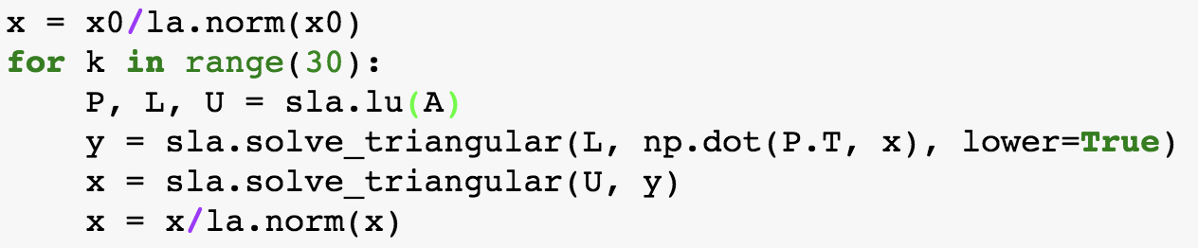


Think about this question…
Which code snippet is the best option to compute the smallest eigenvalue of the matrix $A$?
A)
B)
C)
D)
E) I have no idea!

Slide 17
Inverse Power Method

Slide 18
Cost of computing eigenvalues using inverse power iteration

Slide 19
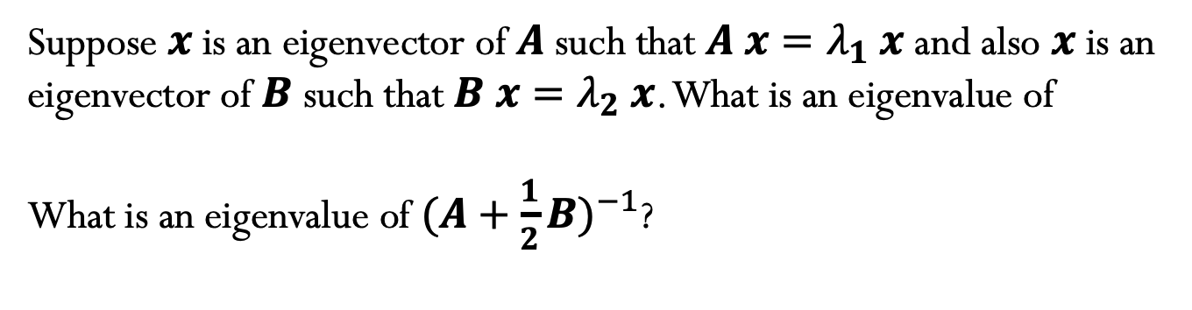
Suppose $x$ is an eigenvector of $A$such that $A x=λ_{1} x$ and also $x$ is an eigenvector of $B$such that $B x=λ_{2} x$. What is an eigenvalue of
What is an eigenvalue of ${(A+\frac{1}{2}B)}^{−1}$?

Slide 20
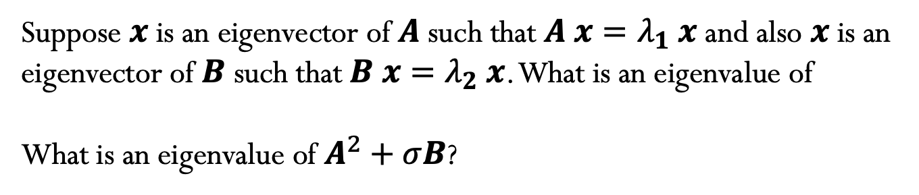
Suppose $x$ is an eigenvector of $A$such that $A x=λ_{1} x$ and also $x$ is an eigenvector of $B$such that $B x=λ_{2} x$. What is an eigenvalue of
What is an eigenvalue of $A^{2}+σB$?

Slide 21

Eigenvalues of a Shifted Inverse Matrix
Suppose the eigenpairs $\left(x,λ\right)$satisfy $Ax=λ x$.

Slide 22
Eigenvalues of a Shifted Inverse Matrix

Slide 23
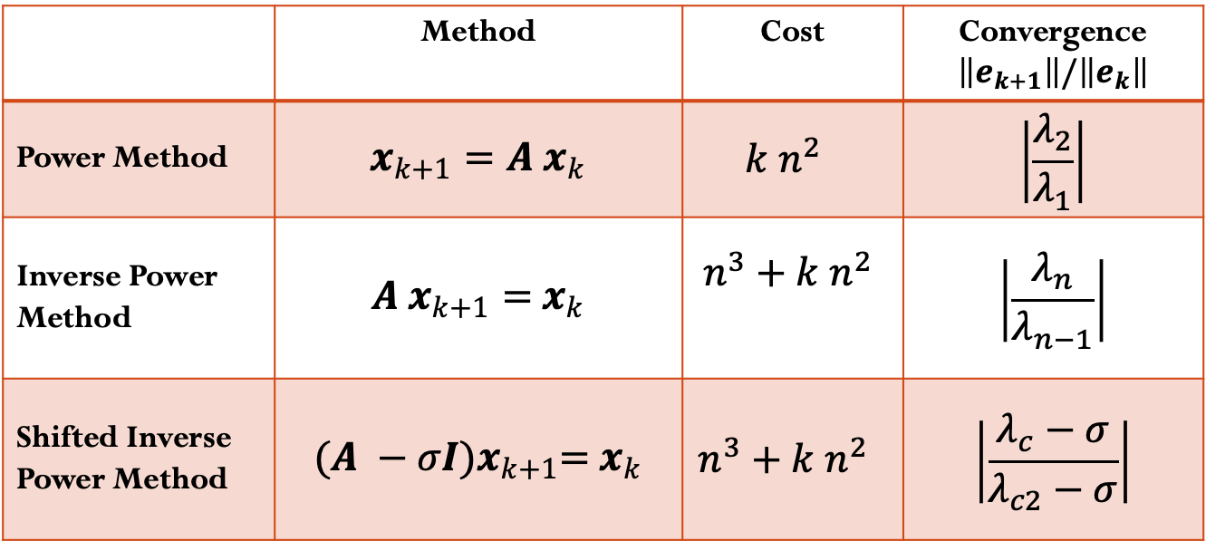
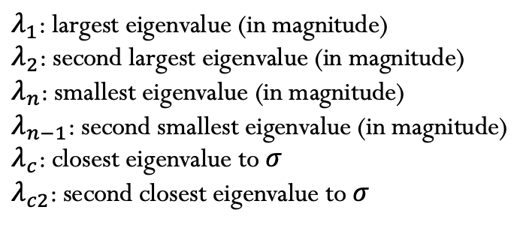
Convergence summary
 | Method | Cost | Convergence $\left\|e_{k+1}\right\|/\left\|e_{k}\right\|$
Power Method | $$x_{k+1}=A{ x}_{k}$$ | $$k n^{2}$$ | $$\left|\frac{λ_{2}}{λ_{1}}\right|$$
Inverse Power Method | $${A x}_{k+1}={ x}_{k}$$ | $$n^{3}+k n^{2}$$ | $$\left|\frac{λ_{n}}{λ_{n−1}}\right|$$
Shifted Inverse Power Method | $${(A −σI)x}_{k+1}={ x}_{k}$$ | $$n^{3}+k n^{2}$$ | $$\left|\frac{λ_{c}−σ}{λ_{c2}−σ}\right|$$
$λ_{1}$: largest eigenvalue (in magnitude)
$λ_{2}$: second largest eigenvalue (in magnitude)
$λ_{n}$: smallest eigenvalue (in magnitude)
$λ_{n−1}$: second smallest eigenvalue (in magnitude)
$λ_{c}$: closest eigenvalue to $σ$
$λ_{c2}$: second closest eigenvalue to $σ$

