Slide 1
Nonlinear Equations

Slide 2

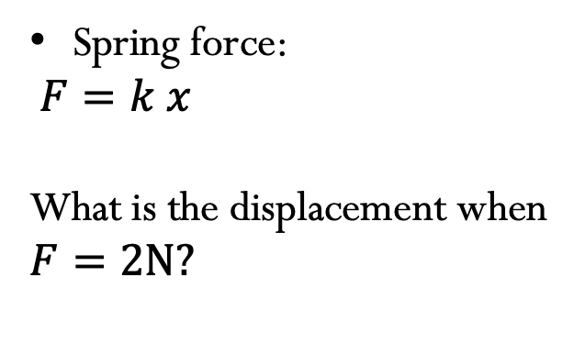
How can we solve these equations?
Spring force:
$$F=k x$$
What is the displacement when $F=2N?$
$$k=40 N/m$$
Notes:
Cd: drag coefficient, rho: density of the fluid, A: cross section area, speed of the object
Spring x = 0.05m
Drag v = 6.3 m/s

Slide 3

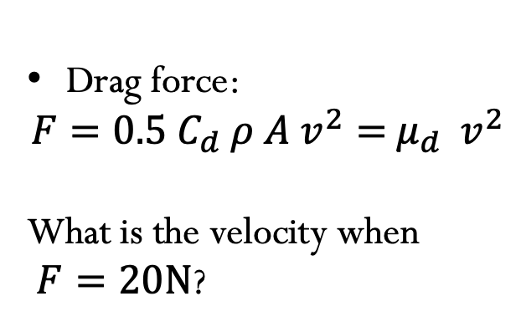
How can we solve these equations?
Drag force:
$$F={0.5 C}_{d} ρ {A v}^{2}={ μ}_{d} { v}^{2}$$
What is the velocity when
$F=20N$?
$${ μ}_{d} =0.5 Ns/m$$
Notes:
Cd: drag coefficient, rho: density of the fluid, A: cross section area, speed of the object
Spring x = 0.05m
Drag v = 6.3 m/s

Slide 4
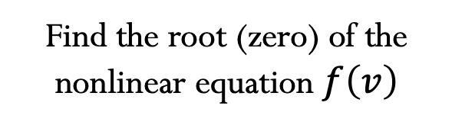

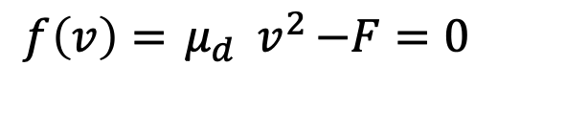
$${ μ}_{d} =0.5 Ns/m$$
$$f\left(v\right)={ μ}_{d} { v}^{2}−F=0$$
Find the root (zero) of the nonlinear equation $f\left(v\right)$
Nonlinear Equations in 1D
Goal: Solve $f\left(x\right)=0$ for $f:ℛ→ℛ$
Often called Root Finding

Slide 5
Bisection method

Slide 6
Bisection method

Slide 7
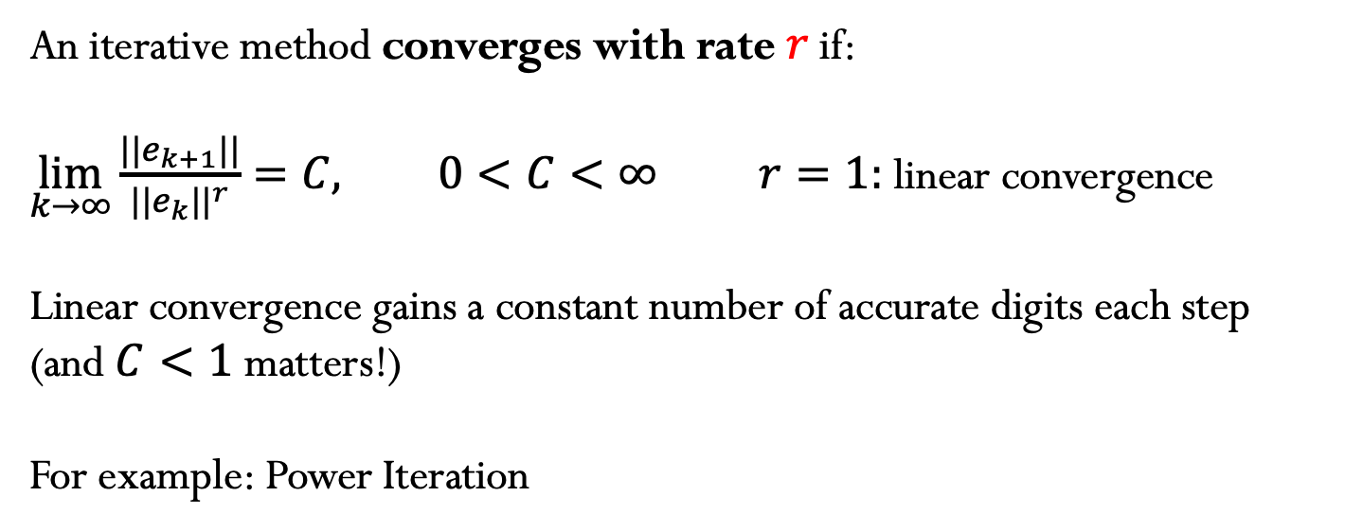
Convergence
An iterative method converges with rate $r$if:
$\lim_{k→∞}{\frac{||e_{k+1}||}{{||e_{k}||}^{r}}=C, 0<C<∞} r=1:$ linear convergence
Linear convergence gains a constant number of accurate digits each step (and $C<1$ matters!)
For example: Power Iteration

Slide 8
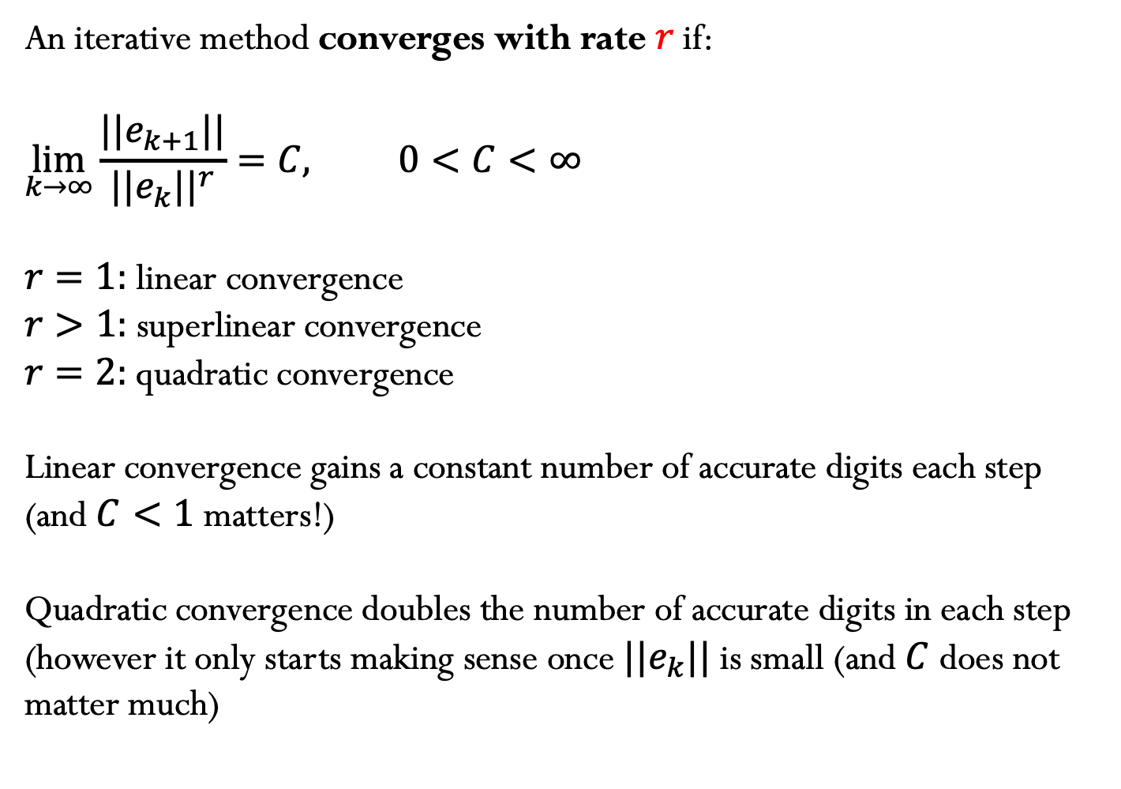
Convergence
An iterative method converges with rate $r$if:
$$\lim_{k→∞}{\frac{||e_{k+1}||}{{||e_{k}||}^{r}}=C, 0<C<∞}$$
$r=1:$ linear convergence
$r>1:$ superlinear convergence
$r=2:$ quadratic convergence
Linear convergence gains a constant number of accurate digits each step (and $C<1$ matters!)
Quadratic convergence doubles the number of accurate digits in each step (however it only starts making sense once $||e_{k}||$is small (and $C$ does not matter much)

Slide 9
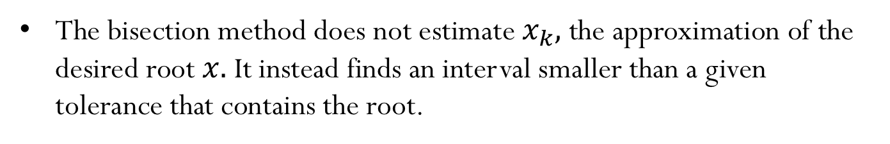
Convergence
The bisection method does not estimate${ x}_{k},$ the approximation of the desired root $x.$ It instead finds an interval smaller than a given tolerance that contains the root.

Slide 10
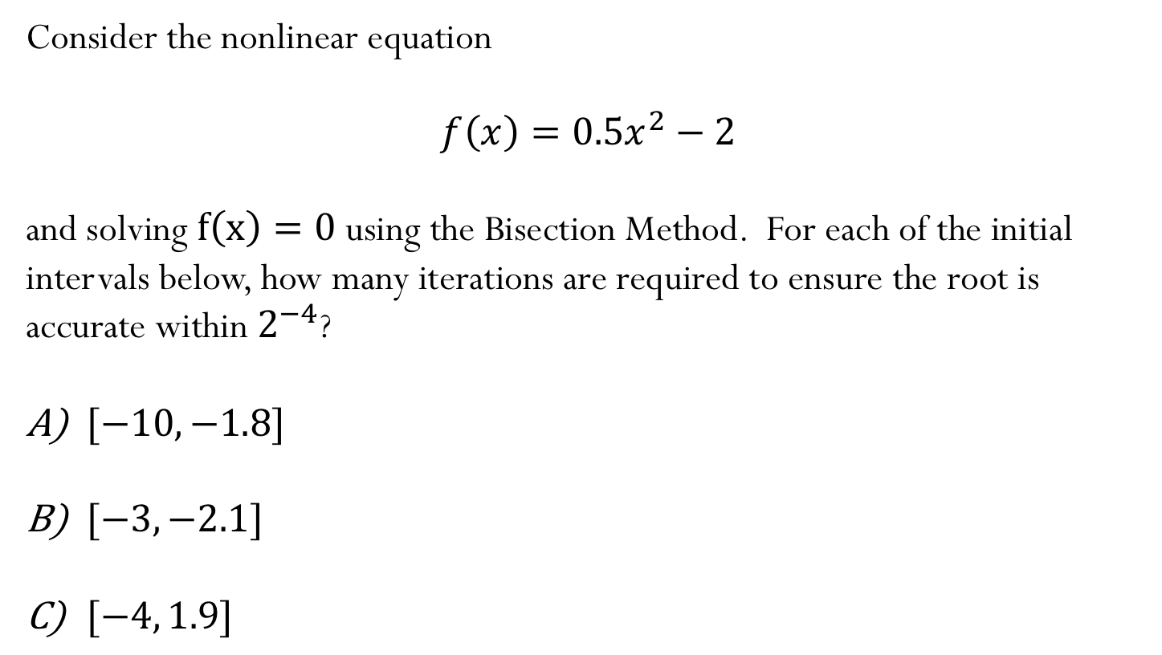
Example:
Consider the nonlinear equation
$$f\left(x\right)=0.5x^{2}−2$$
and solving $f\left(x\right)=0$ using the Bisection Method. For each of the initial intervals below, how many iterations are required to ensure the root is accurate within $2^{−4}$?
$[−10,−1.8]$
$[−3,−2.1]$
$[−4, 1.9]$
Notes:
Signs differ, length = 8.2, takes 8 iterations (requires more iterations even tough -1.8 is very close to root -2)
Signs don’t differ (not valid interval), so not best even tough shortest interval
Signs differ, length = 3.5, takes 6 iterations
Signs differ length = 5.9, takes 7 iterations

Slide 11
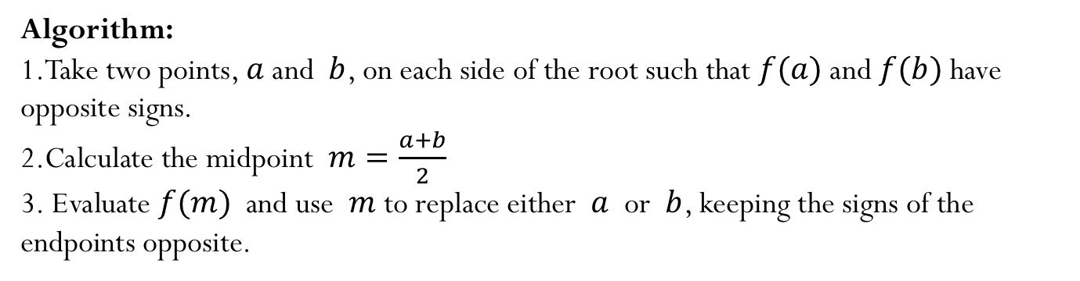
Bisection method
Algorithm:
Take two points, $a$ and $b$, on each side of the root such that $f(a)$and $f(b)$have opposite signs.
Calculate the midpoint $m=\frac{a+b}{2}$
Evaluate $f(m)$ and use $m$ to replace either $a$ or $b$, keeping the signs of the endpoints opposite.

Slide 12
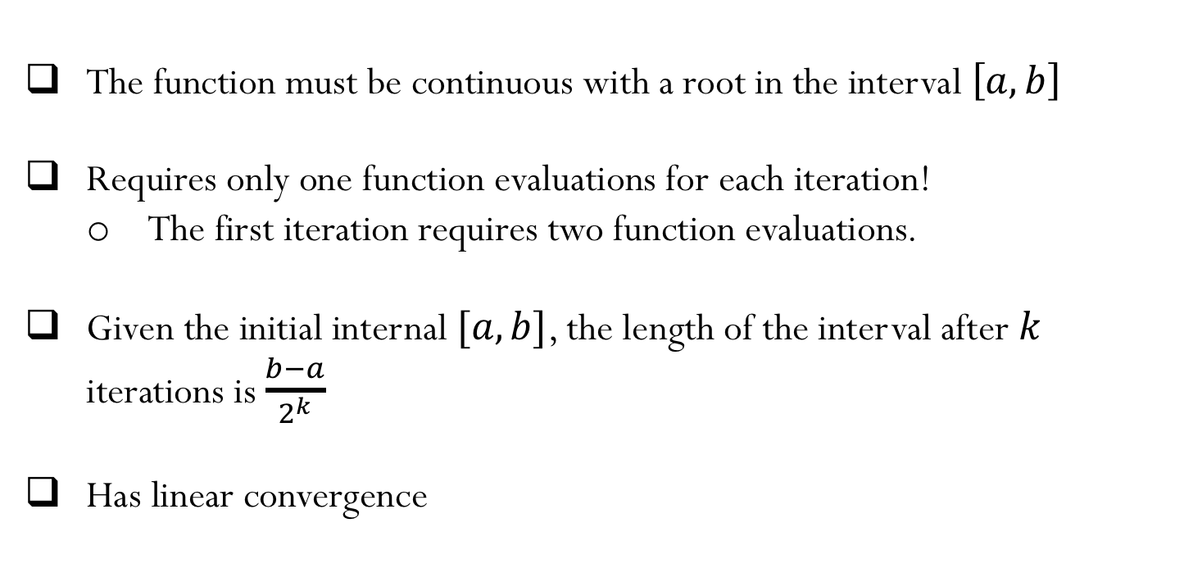
Bisection Method - summary
The function must be continuous with a root in the interval $\left[a,b\right]$
Requires only one function evaluations for each iteration!
The first iteration requires two function evaluations.
Given the initial internal $[a,b]$, the length of the interval after $k$ iterations is $\frac{b−a}{2^{k}}$
Has linear convergence

Slide 13
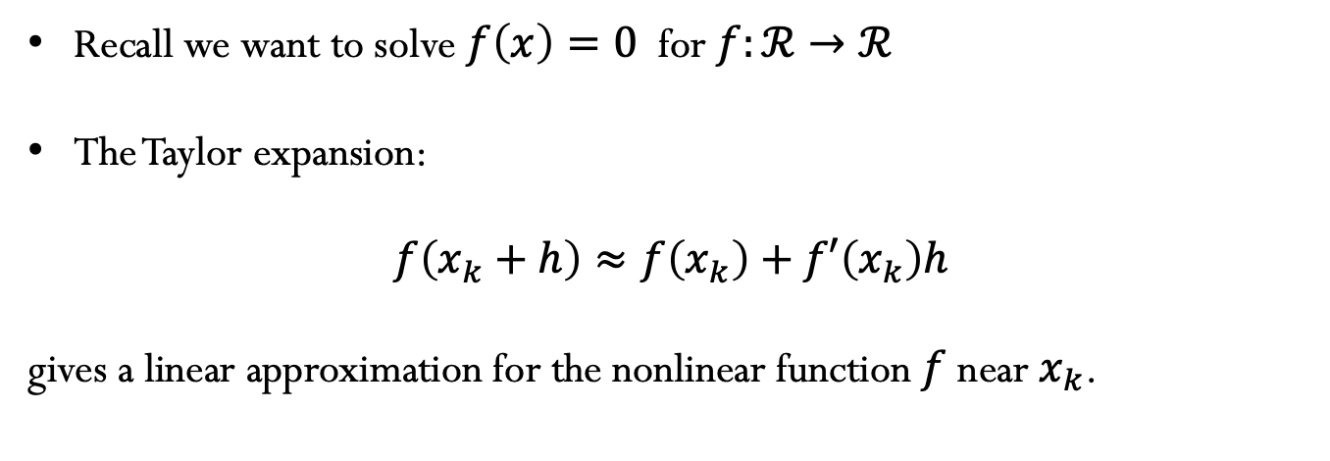
Newton’s method
Recall we want to solve $f\left(x\right)=0$ for $f:ℛ→ℛ$
The Taylor expansion:
$$f\left(x_{k}+h\right)≈f\left(x_{k}\right)+f′\left(x_{k}\right)h$$
gives a linear approximation for the nonlinear function $f$ near $x_{k}$.

Slide 14

Newton’s method
$$x_{k}$$

Slide 15
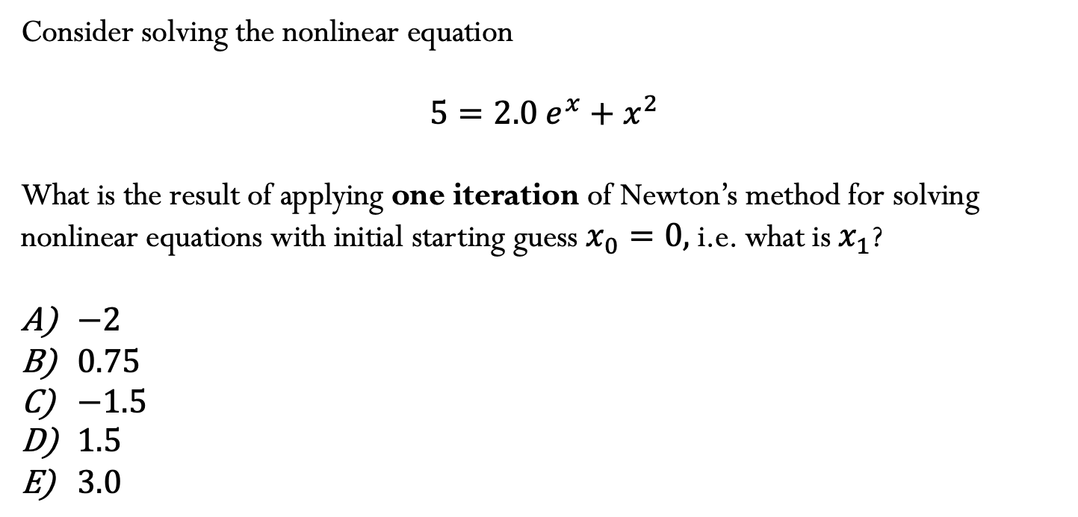
Example
Consider solving the nonlinear equation
$$5=2.0 e^{x}+x^{2}$$
What is the result of applying one iteration of Newton’s method for solving nonlinear equations with initial starting guess $x_{0}=0,$i.e. what is $x_{1}$?
$−2$
$0.75$
$−1.5$
$1.5$
$3.0$

Slide 16
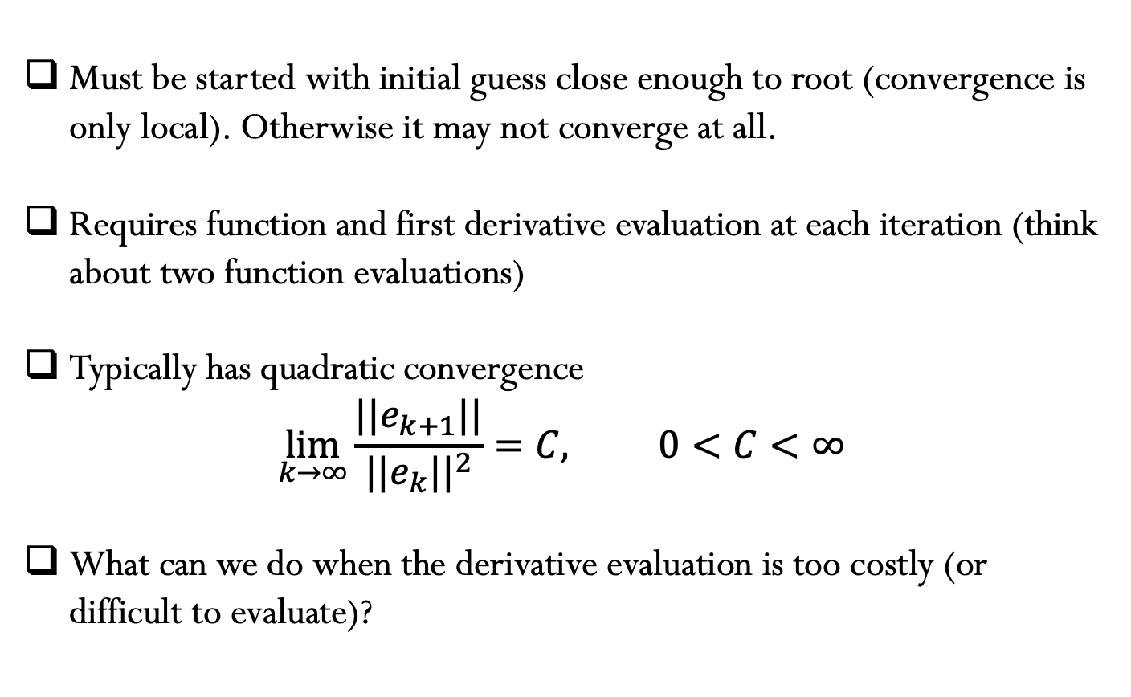
Newton’s Method - summary
Must be started with initial guess close enough to root (convergence is only local). Otherwise it may not converge at all.
Requires function and first derivative evaluation at each iteration (think about two function evaluations)
Typically has quadratic convergence
$$\lim_{k→∞}{\frac{||e_{k+1}||}{{||e_{k}||}^{2}}=C, 0<C<∞}$$
What can we do when the derivative evaluation is too costly (or difficult to evaluate)?

Slide 17

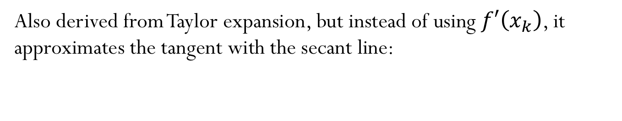
Secant method
Also derived from Taylor expansion, but instead of using $f′\left(x_{k}\right)$, it approximates the tangent with the secant line:
$$x_{k+1}=x_{k}−f\left(x_{k}\right)/f′\left(x_{k}\right)$$

Slide 18
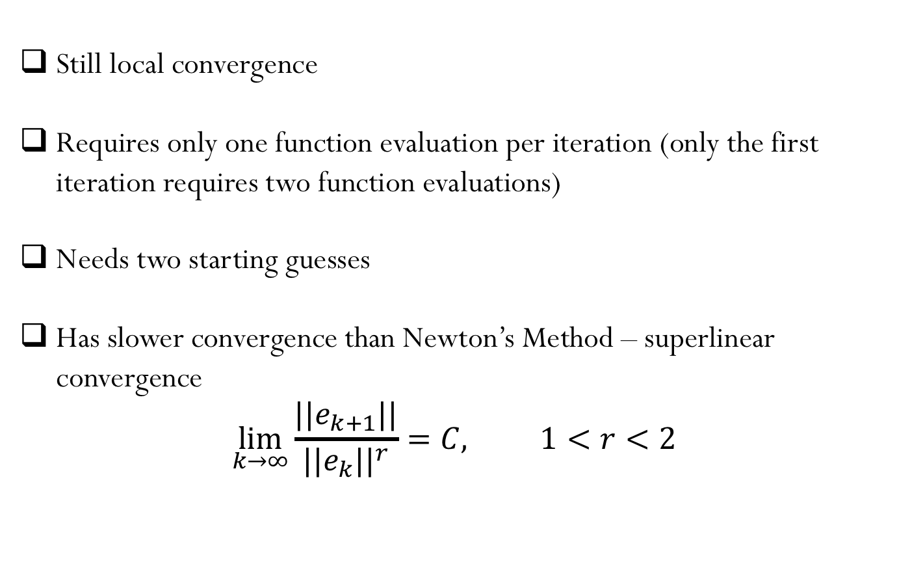
Secant Method - summary
Still local convergence
Requires only one function evaluation per iteration (only the first iteration requires two function evaluations)
Needs two starting guesses
Has slower convergence than Newton’s Method – superlinear convergence
$$\lim_{k→∞}{\frac{||e_{k+1}||}{{||e_{k}||}^{r}}=C, 1<r<2}$$

Slide 19
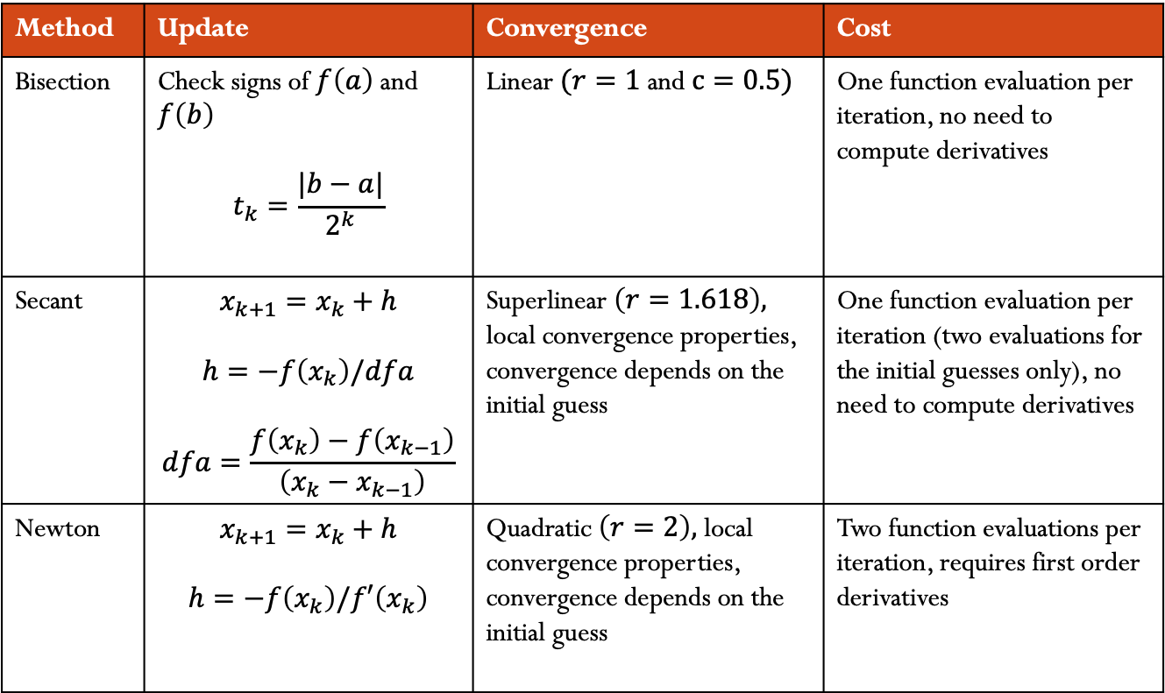
1D methods for root finding:
Method | Update | Convergence | Cost
Bisection | Check signs of $f\left(a\right)$and $f\left(b\right)$ $$t_{k}=\frac{|b−a|}{2^{k}}$$ | Linear $(r=1$and $c=0.5)$ | One function evaluation per iteration, no need to compute derivatives
Secant | $$x_{k+1}=x_{k}+h$$ $$h=−f\left(x_{k}\right)/dfa$$ $$dfa=\frac{f\left(x_{k}\right)−f\left(x_{k−1}\right)}{\left(x_{k}−x_{k−1}\right)}$$ | Superlinear $\left(r=1.618\right),$ local convergence properties, convergence depends on the initial guess | One function evaluation per iteration (two evaluations for the initial guesses only), no need to compute derivatives
Newton | $$x_{k+1}=x_{k}+h$$ $$h=−f\left(x_{k}\right)/f′\left(x_{k}\right)$$ | Quadratic $\left(r=2\right),$ local convergence properties, convergence depends on the initial guess | Two function evaluations per iteration, requires first order derivatives

