Slide 1
Nonlinear Equations

Slide 2
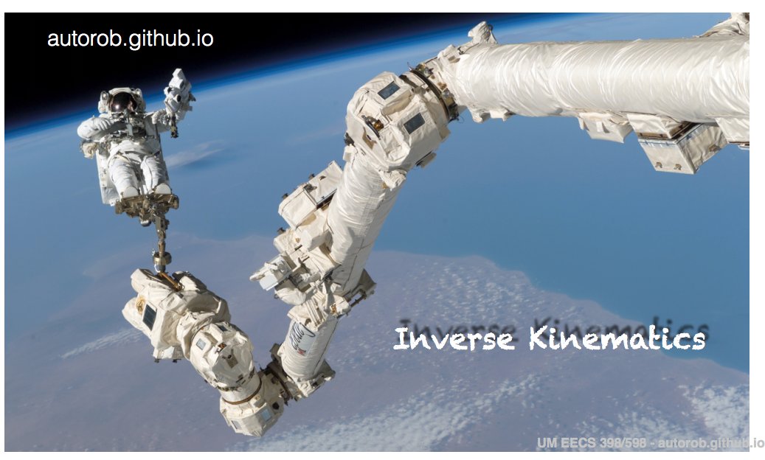
Nonlinear system of equations

Slide 3
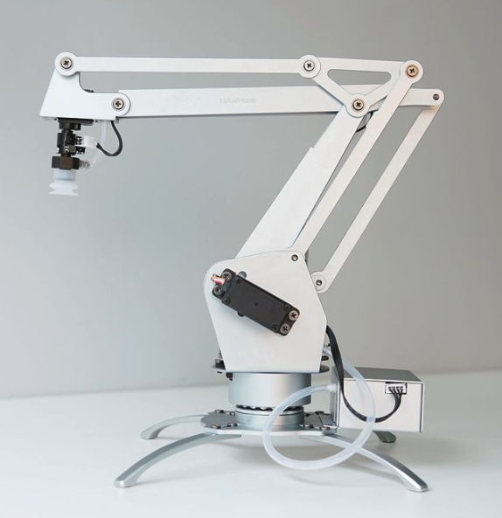
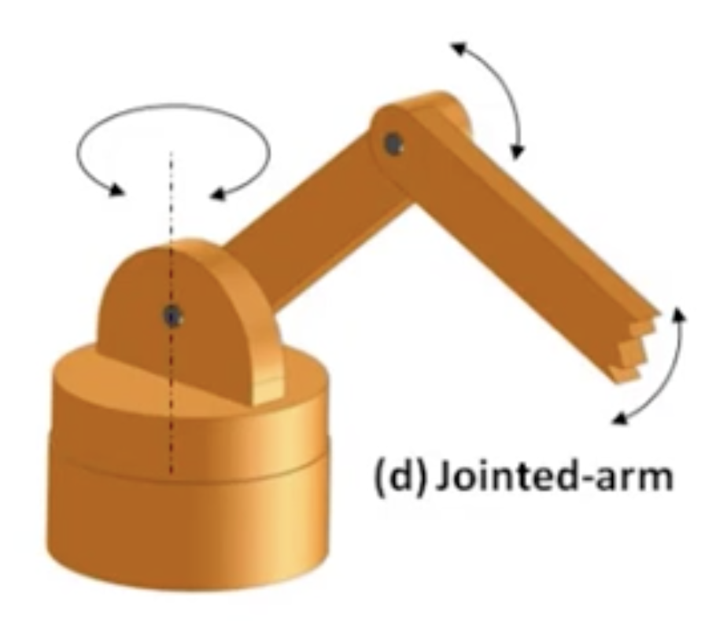
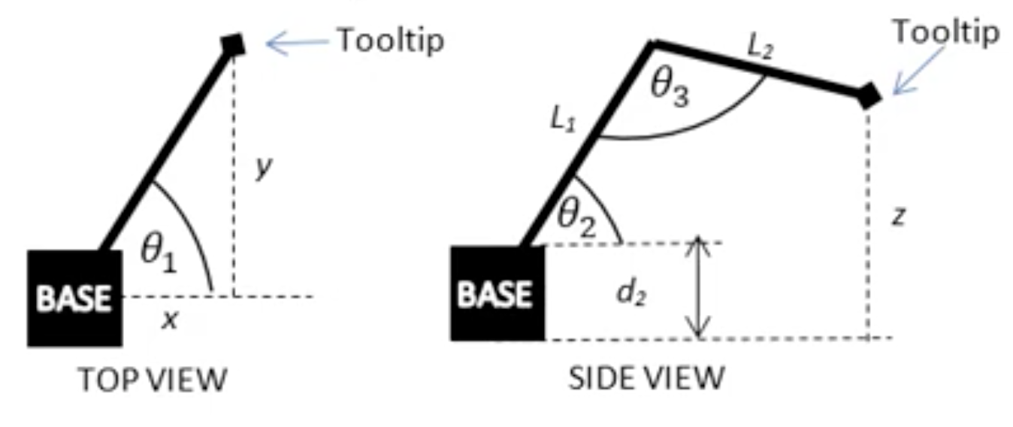
Robotic arms
https://www.youtube.com/watch?v=NRgNDlVtmz0 (Robotic arm 1)
https://www.youtube.com/watch?v=9DqRkLQ5Sv8 (Robotic arm 2)
https://www.youtube.com/watch?v=DZ_ocmY8xEI (Blender)

Slide 4
Inverse Kinematics

Slide 5

Nonlinear system of equations
Goal: Solve $f\left(x\right)=0$ for $f:ℛ^{n}→ℛ^{n}$

Slide 6
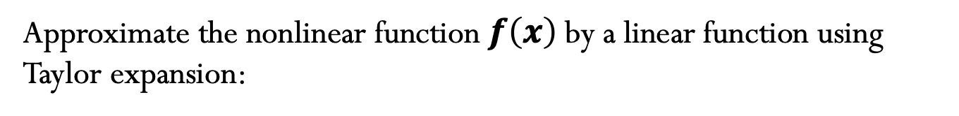
Newton’s method
Approximate the nonlinear function $f\left(x\right)$by a linear function using Taylor expansion:

Slide 7
Newton’s method
Algorithm:
Convergence:
Typically has quadratic convergence
Drawback: Still only locally convergent
Cost:
Main cost associated with computing the Jacobian matrix and solving the Newton step.

Slide 8
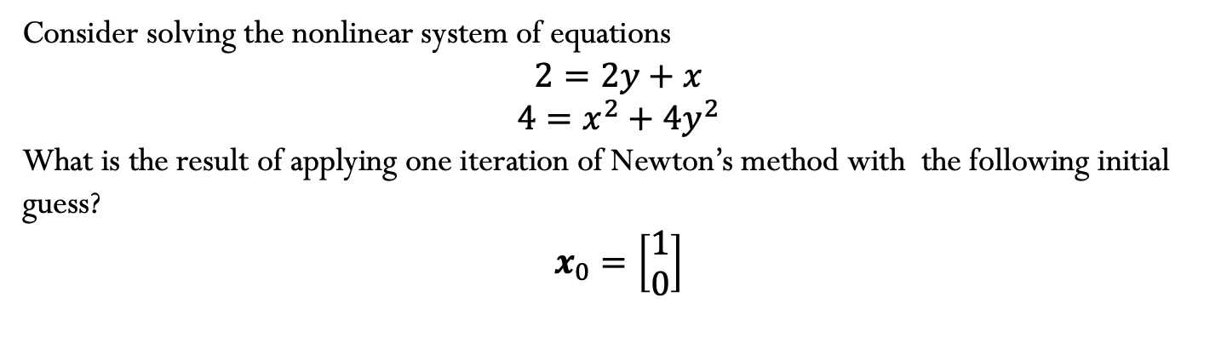
Example
Consider solving the nonlinear system of equations
$$2=2y+x$$
$$4=x^{2}+{4y}^{2}$$
What is the result of applying one iteration of Newton’s method with the following initial guess?
$$x_{0}=\left[\begin{matrix}1 \\ 0\end{matrix}\right]$$

Slide 9
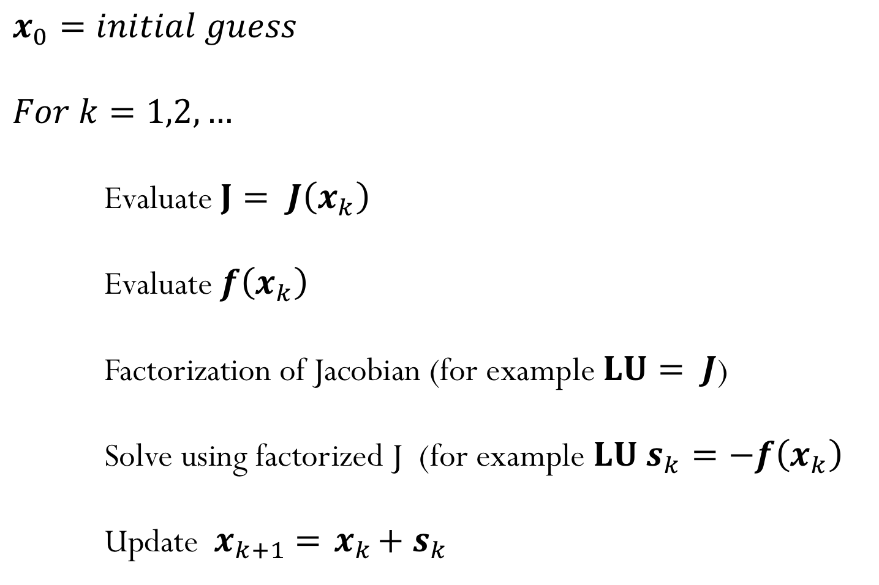
Newton’s method
$$x_{0}=initial guess$$
$$For k=1,2,…$$
Evaluate $J= J\left(x_{k}\right)$
Evaluate $f\left(x_{k}\right)$
Factorization of Jacobian (for example $LU= J$)
Solve using factorized J (for example $LU{ s}_{k}=−f\left(x_{k}\right)$
Update ${{ x}_{k+1} ={ x}_{k}+ s}_{k}$
Notes:
Comment about Secant methods where Jacobian is approximated to avoid need to calculate derivatives

Slide 10
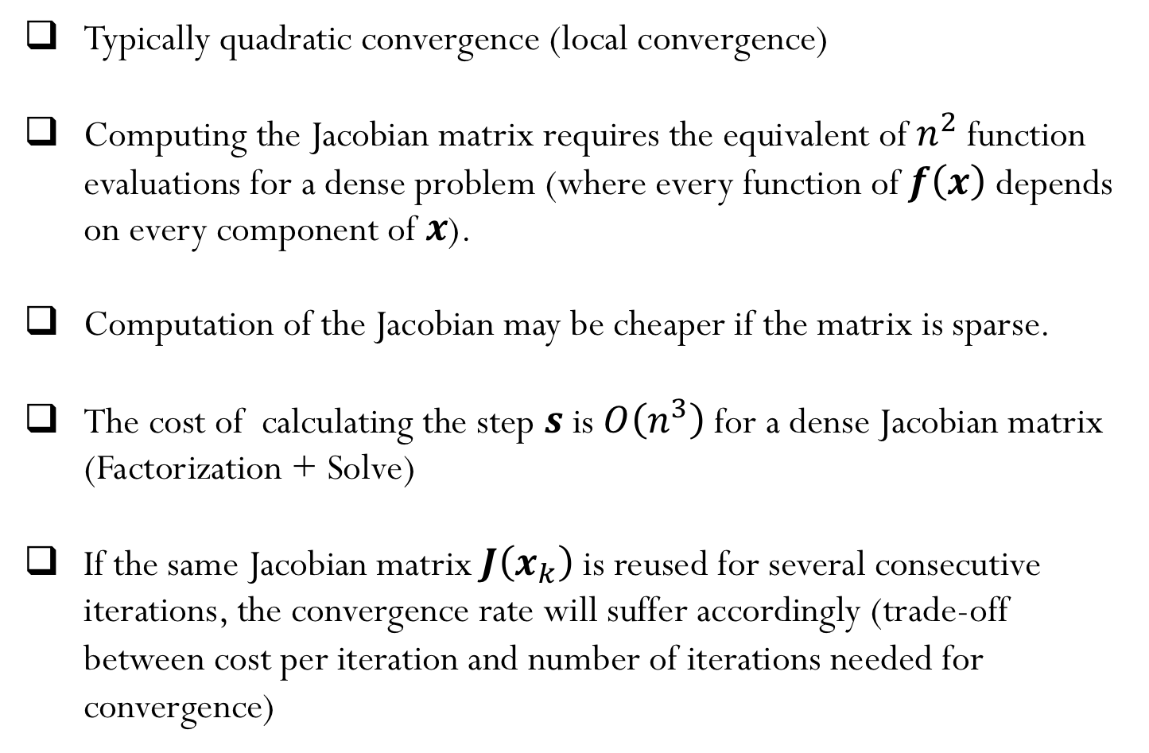
Newton’s method - summary
Typically quadratic convergence (local convergence)
Computing the Jacobian matrix requires the equivalent of $n^{2}$ function evaluations for a dense problem (where every function of $f\left(x\right)$ depends on every component of $x$).
Computation of the Jacobian may be cheaper if the matrix is sparse.
The cost of calculating the step $s$ is $O\left(n^{3}\right)$ for a dense Jacobian matrix (Factorization + Solve)
If the same Jacobian matrix $J\left(x_{k}\right)$ is reused for several consecutive iterations, the convergence rate will suffer accordingly (trade-off between cost per iteration and number of iterations needed for convergence)
Notes:
Comment about Secant methods where Jacobian is approximated to avoid need to calculate derivatives

Slide 11
Inverse Kinematics

