Slide 1
Optimization (Introduction)

Slide 2
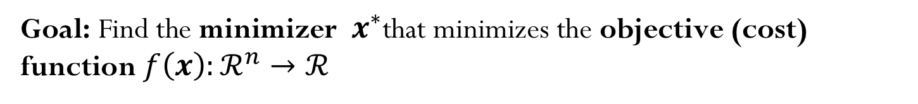
Optimization
Goal: Find the minimizer $x^{∗}$that minimizes the objective (cost) function $f\left(x\right):ℛ^{n}→ℛ$
Unconstrained Optimization

Slide 3
Optimization
Goal: Find the minimizer $x^{∗}$that minimizes the objective (cost) function $f\left(x\right):ℛ^{n}→ℛ$
Constrained Optimization

Slide 4

Unconstrained Optimization
What if we are looking for a maximizer $x^{∗}?$
$$f\left(x^{∗}\right)=\max_{x}{f\left(x\right)}$$

Slide 5
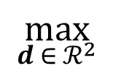
Calculus problem: maximize the rectangle area subject to perimeter constraint
$$\max_{d ∈{ ℛ}^{2}}{ }$$

Slide 6
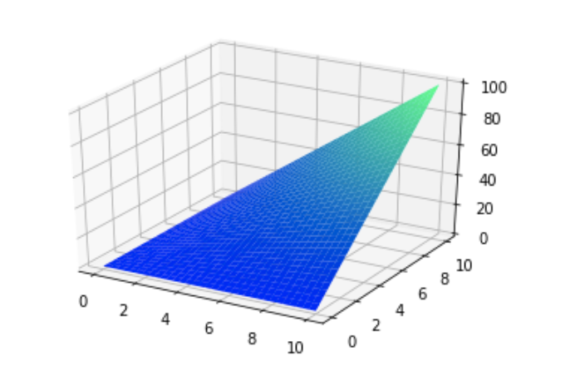
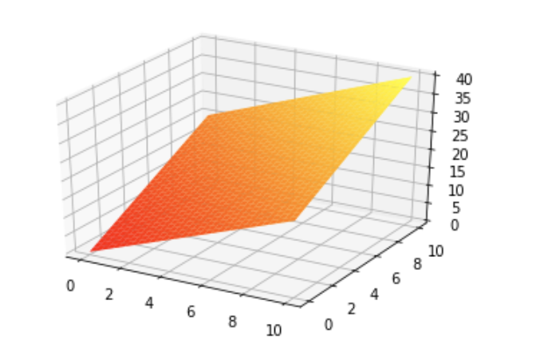






$$Area=d_{1}d_{2}$$
$$d_{2}$$
$$d_{1}$$
$$Perimeter=2(d_{1}+d_{2})$$
$$d_{2}$$
$$d_{1}$$

Slide 8
Unconstrained Optimization 1D

Slide 9
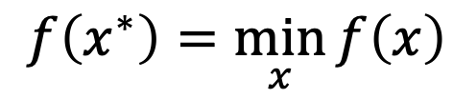
What is the optimal solution? (1D)
$$f\left(x^{∗}\right)=\min_{x}{f\left(x\right)}$$
(First-order) Necessary condition
(Second-order) Sufficient condition

Slide 10
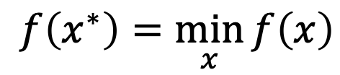
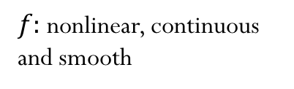
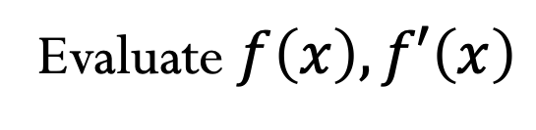
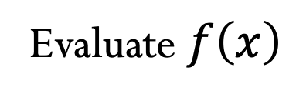
Types of optimization problems
$$f\left(x^{∗}\right)=\min_{x}{f\left(x\right)}$$
$f:$ nonlinear, continuous and smooth
Gradient-free methods
Evaluate $f\left(x\right)$
Gradient (first-derivative) methods
Evaluate$f\left(x\right),f′\left(x\right)$
Second-derivative methods
Evaluate $f\left(x\right)$, $f′\left(x\right)$, $f′′\left(x\right)$

Slide 11
Does the solution exists? Local or global solution?

Slide 12
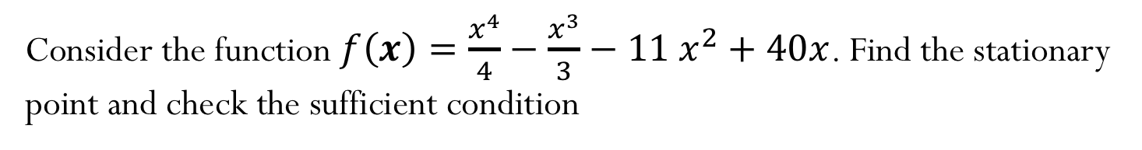
Example (1D)
Consider the function $f\left(x\right)=\frac{x^{4}}{4}−\frac{x^{3}}{3}−{11 x}^{2}+40x$. Find the stationary point and check the sufficient condition

Slide 13
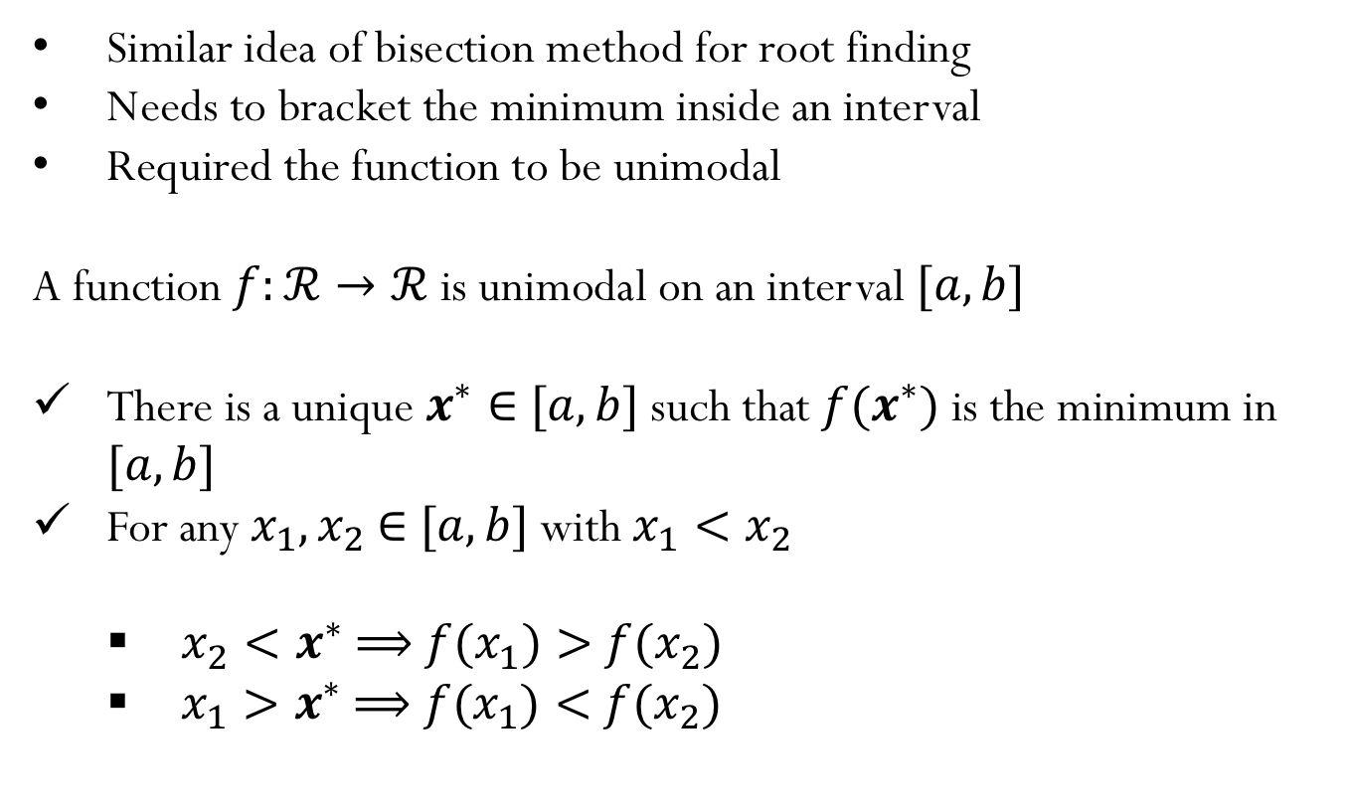
Optimization in 1D: Golden Section Search
Similar idea of bisection method for root finding
Needs to bracket the minimum inside an interval
Required the function to be unimodal
A function $f:ℛ→ℛ$ is unimodal on an interval $[a,b]$
There is a unique $x^{∗}∈$ $[a,b]$ such that $f(x^{∗})$ is the minimum in $[a,b]$
For any $x_{1},x_{2}$ $∈$ $[a,b]$ with $x_{1}<x_{2}$
$x_{2}<x^{∗}$ $⟹$ $f(x_{1})>$ $f(x_{2})$
$x_{1}>x^{∗}$ $⟹$ $f(x_{1})<$ $f(x_{2})$

Slide 14






















$$f_{1}$$
$$f_{1}$$
$$f_{3}$$
$$f_{3}$$
$$f_{4}$$
$$f_{2}$$
$$f_{2}$$
$$f_{4}$$
$$x_{1}$$
$$x_{2}$$
$$x_{4}$$
$$x_{3}$$
$$x_{1}$$
$$x_{2}$$
$$x_{4}$$
$$x_{3}$$
$$c$$
$$c$$
$$a$$
$$a$$
$$b$$
$$b$$

Slide 17
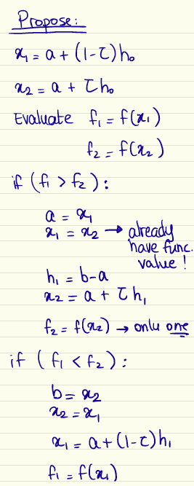
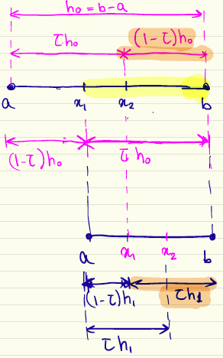
Golden Section Search

Slide 18

Golden Section Search
What happens with the length of the interval after one iteration?
$$h_{1}={τ h}_{o}$$
Or in general: $h_{k+1}={τ h}_{k}$
Hence the interval gets reduced by $τ$
(for bisection method to solve nonlinear equations, $τ$=0.5)
For recursion:
$${τ h}_{1}={(1−τ) h}_{o}$$
$${τ τ h}_{o} ={(1−τ) h}_{o}$$
$$τ^{2}=(1−τ)$$
$$τ=0.618$$

Slide 19
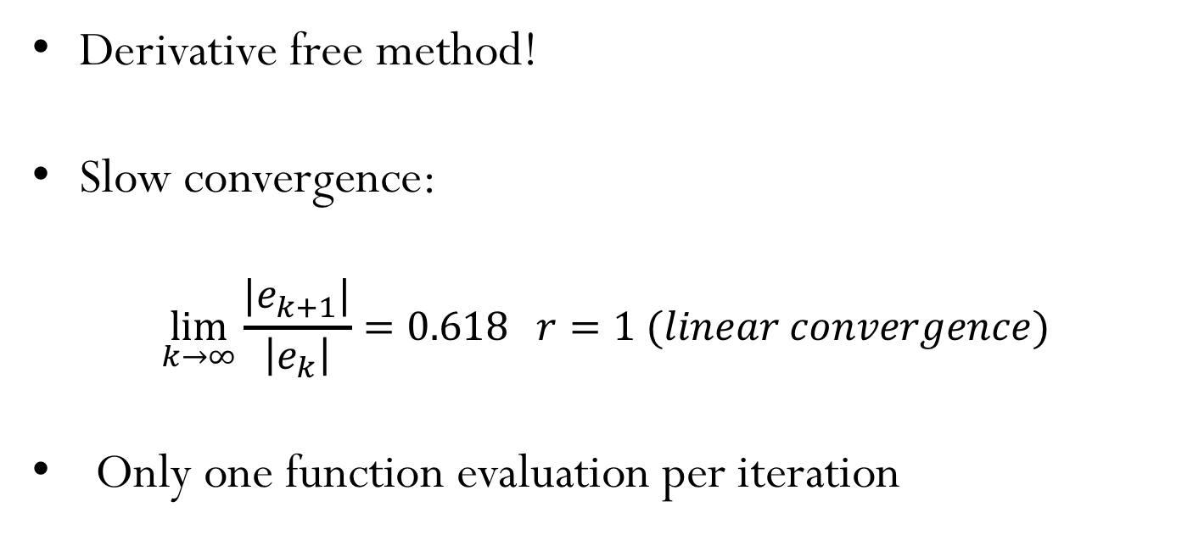
Golden Section Search
Derivative free method!
Slow convergence:
$$\lim_{k→∞}{\frac{|e_{k+1}|}{\left|e_{k}\right|}=0.618 r=1 (linear convergence)}$$
Only one function evaluation per iteration

Slide 20
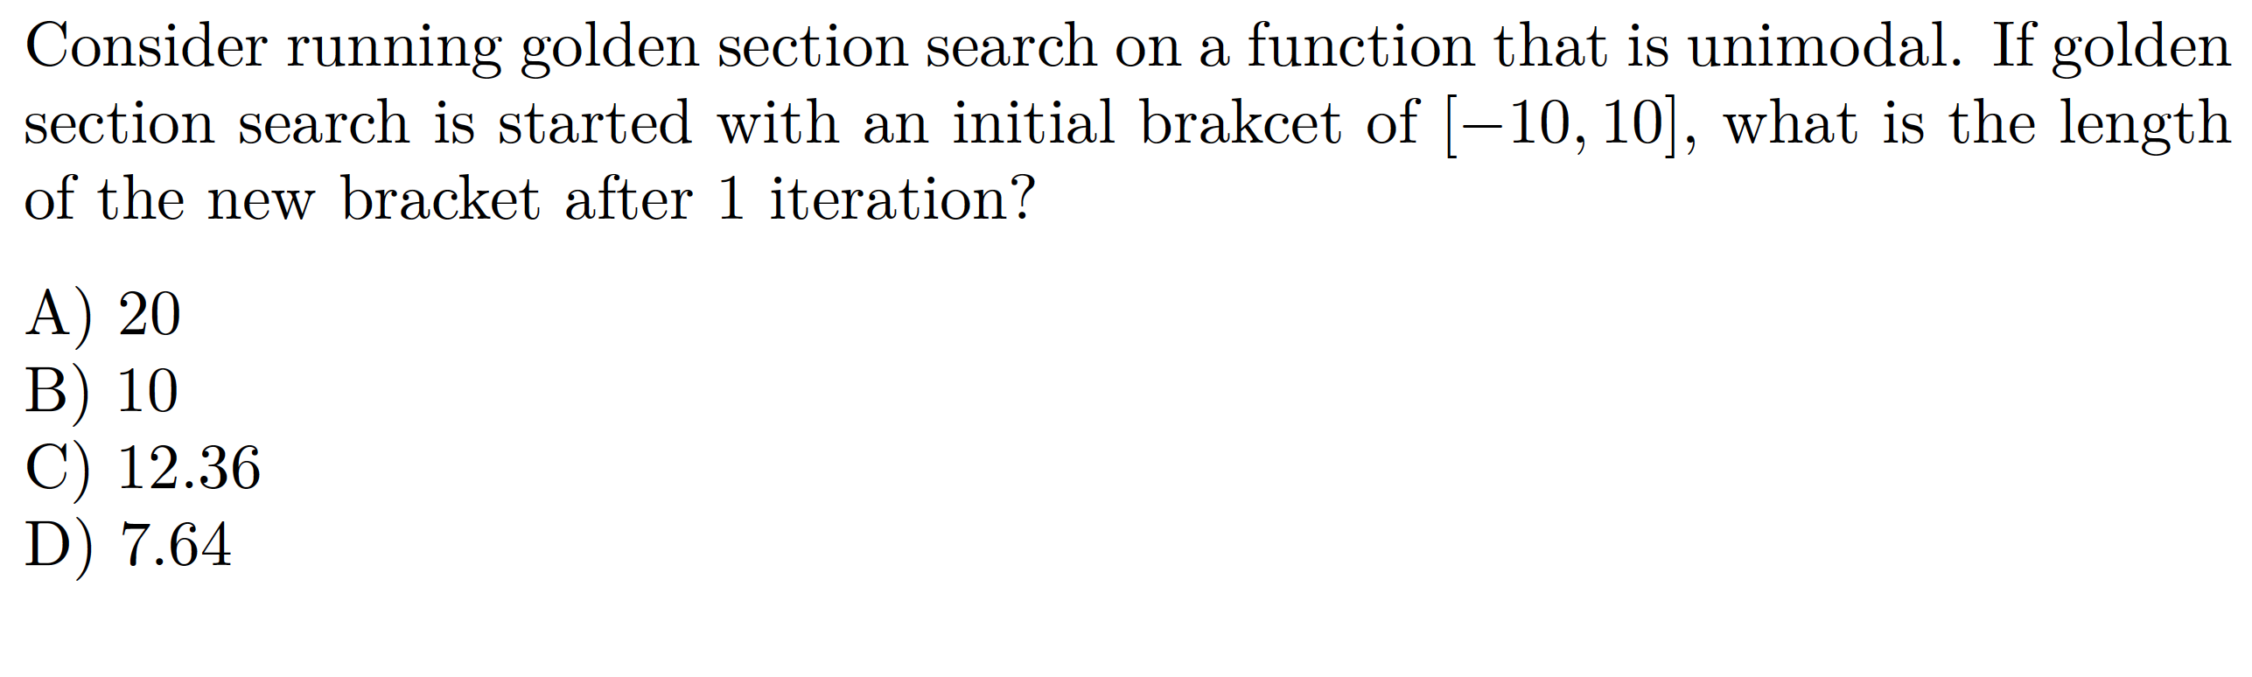
Example
Notes:
C

Slide 21
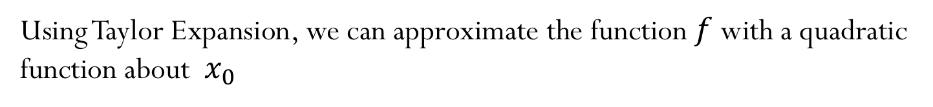
Newton’s Method
Using Taylor Expansion, we can approximate the function $f$ with a quadratic function about $x_{0}$
$f\left(x\right)≈f\left(x_{0}\right)+f^{′}\left(x_{0}\right) (x−x_{0})+\frac{1}{2}$ $f^{′}′\left(x_{0}\right) {({x−x}_{0})}^{2}$
And we want to find the minimum of the quadratic function using the first-order necessary condition

Slide 22
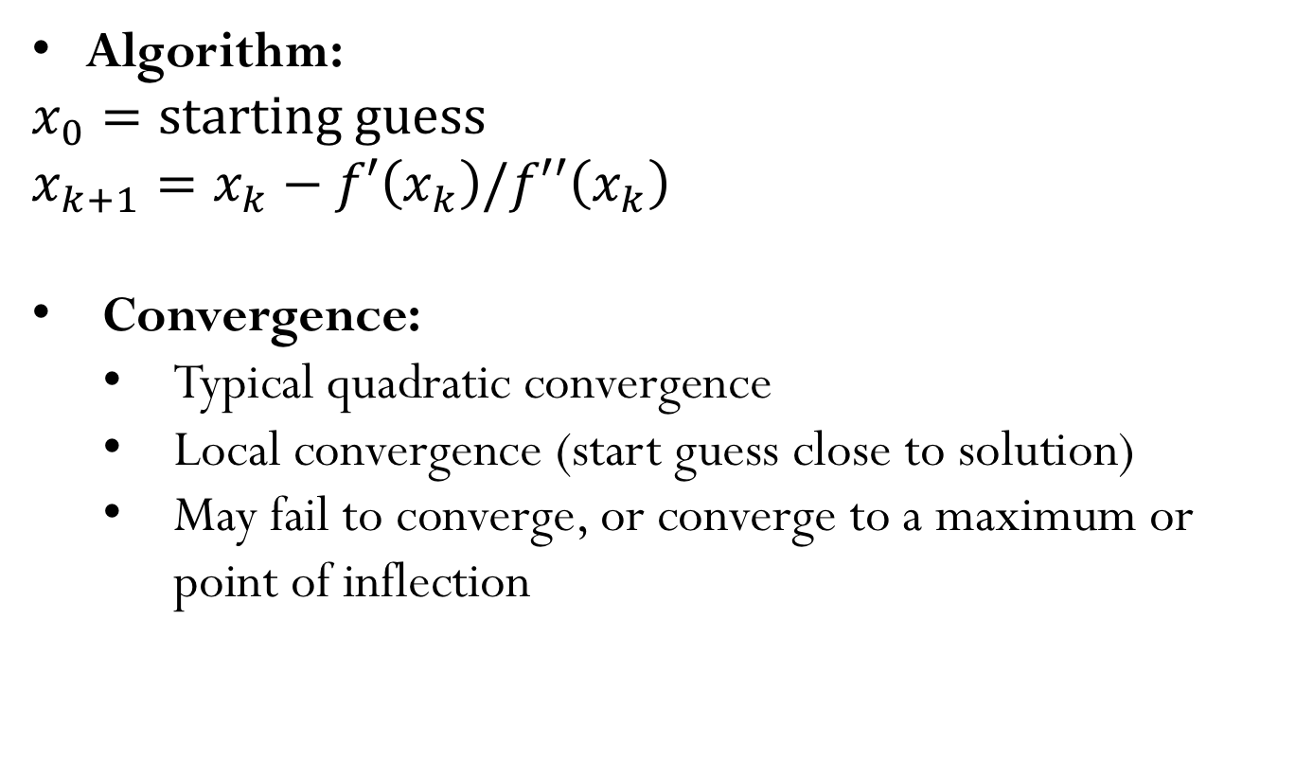
Newton’s Method
Algorithm:
$$x_{0}=starting guess$$
$$x_{k+1}=x_{k}−f′\left(x_{k}\right)/f′′\left(x_{k}\right)$$
Convergence:
Typical quadratic convergence
Local convergence (start guess close to solution)
May fail to converge, or converge to a maximum or point of inflection

Slide 23
Newton’s Method (Graphical Representation)

Slide 24
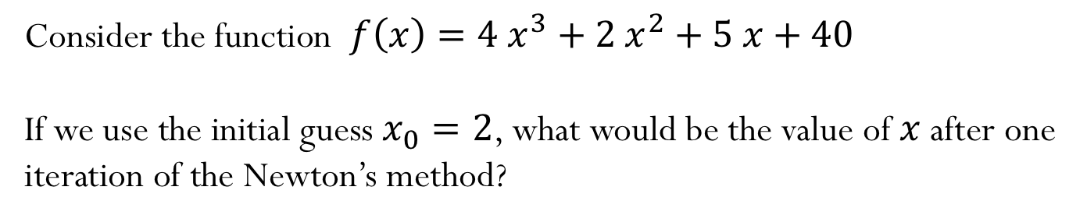
Example
Consider the function $f\left(x\right)=4 x^{3}+2{ x}^{2}+5 x+40$
If we use the initial guess $x_{0}=2$, what would be the value of $x$ after one iteration of the Newton’s method?
Notes:
$x_{1}=0.827$

