Slide 1
Unconstrained Optimization ND

Slide 2
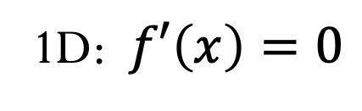

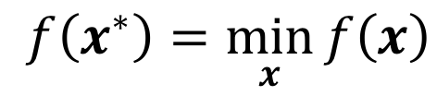
What is the optimal solution? (ND)
$$f\left(x^{∗}\right)=\min_{x}{f\left(x\right)}$$
(First-order) Necessary condition
1D: $f′\left(x\right)=0$
(Second-order) Sufficient condition
1D: $f^{′′}\left(x\right)>0$

Slide 3
Taking derivatives…

Slide 4
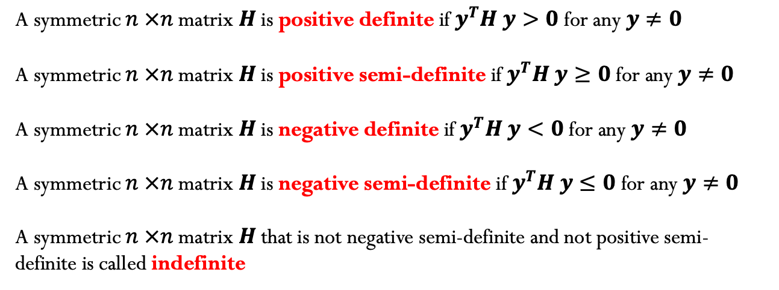
From linear algebra:
A symmetric $n ×n$matrix $H$ is positive definite if $y^{T}H y>0$ for any $y≠0$
A symmetric $n ×n$matrix $H$ is positive semi-definite if $y^{T}H y≥0$ for any $y≠0$
A symmetric $n ×n$matrix $H$ is negative definite if $y^{T}H y<0$ for any $y≠0$
A symmetric $n ×n$matrix $H$ is negative semi-definite if $y^{T}H y≤0$ for any $y≠0$
A symmetric $n ×n$matrix $H$ that is not negative semi-definite and not positive semi-definite is called indefinite

Slide 5
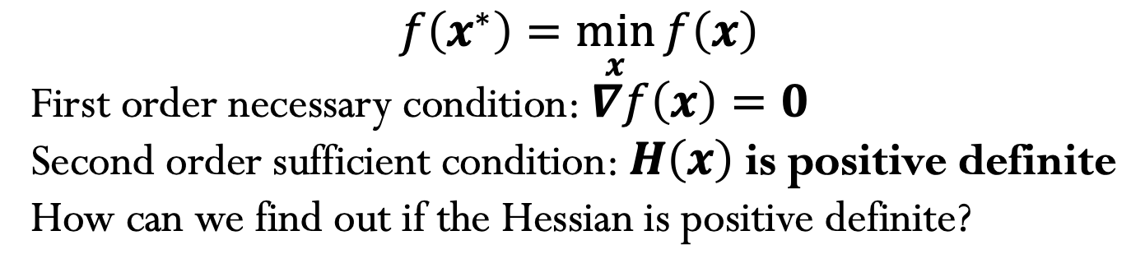
$$f\left(x^{∗}\right)=\min_{x}{f\left(x\right)}$$
First order necessary condition: $∇f\left(x\right)=0$
Second order sufficient condition: $H\left(x\right)$ is positive definite
How can we find out if the Hessian is positive definite?

Slide 6
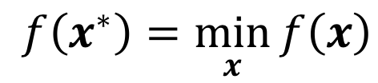
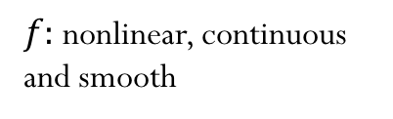
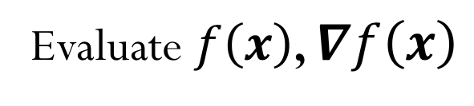
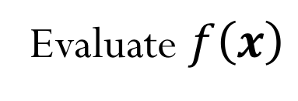
Types of optimization problems
$$f\left(x^{∗}\right)=\min_{x}{f\left(x\right)}$$
$f:$ nonlinear, continuous and smooth
Gradient-free methods
Evaluate $f\left(x\right)$
Gradient (first-derivative) methods
Evaluate $f\left(x\right)$, $∇f\left(x\right)$
Second-derivative methods
Evaluate $f\left(x\right)$, $∇f\left(x\right),∇^{2}f\left(x\right)$

Slide 7
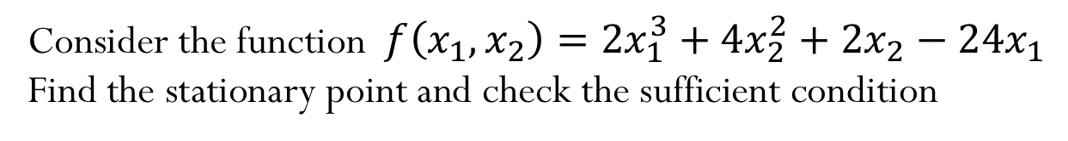
Example (ND)
Consider the function$f\left(x_{1},x_{2}\right)=2x_{1}^{3}+4x_{2}^{2}+2x_{2}−24x_{1}$
Find the stationary point and check the sufficient condition

Slide 8
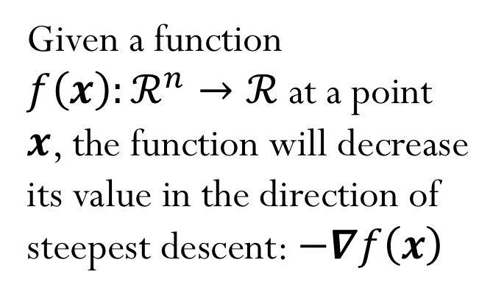

Optimization in ND: Steepest Descent Method
$$f\left(x_{1},x_{2}\right)={(x_{1}−1)}^{2}+{(x_{2}−1)}^{2}$$
Given a function $f\left(x\right):ℛ^{n}→ℛ$ at a point $x$, the function will decrease its value in the direction of steepest descent: $−∇f\left(x\right)$
What is the steepest descent direction?
Notes:
Add arrows to the plot with different options for the direction

Slide 9
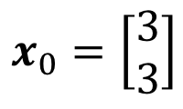
Steepest Descent Method
Start with initial guess:
$$x_{0}=\left[\begin{matrix}3 \\ 3\end{matrix}\right]$$
$$f\left(x_{1},x_{2}\right)={(x_{1}−1)}^{2}+{(x_{2}−1)}^{2}$$
Check the update:

Slide 10
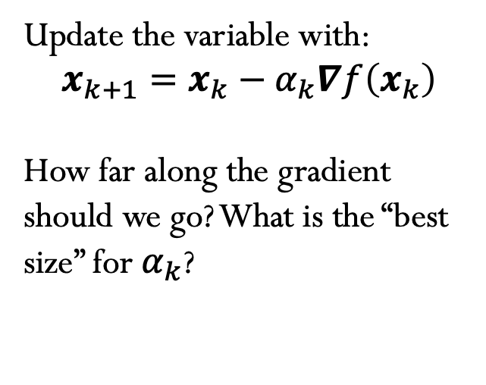
Steepest Descent Method
Update the variable with:
$$x_{k+1}=x_{k}−α_{k}∇f\left(x_{k}\right)$$
How far along the gradient should we go? What is the “best size” for $α_{k}$?
$$f\left(x_{1},x_{2}\right)={(x_{1}−1)}^{2}+{(x_{2}−1)}^{2}$$
Notes:
B

Slide 12
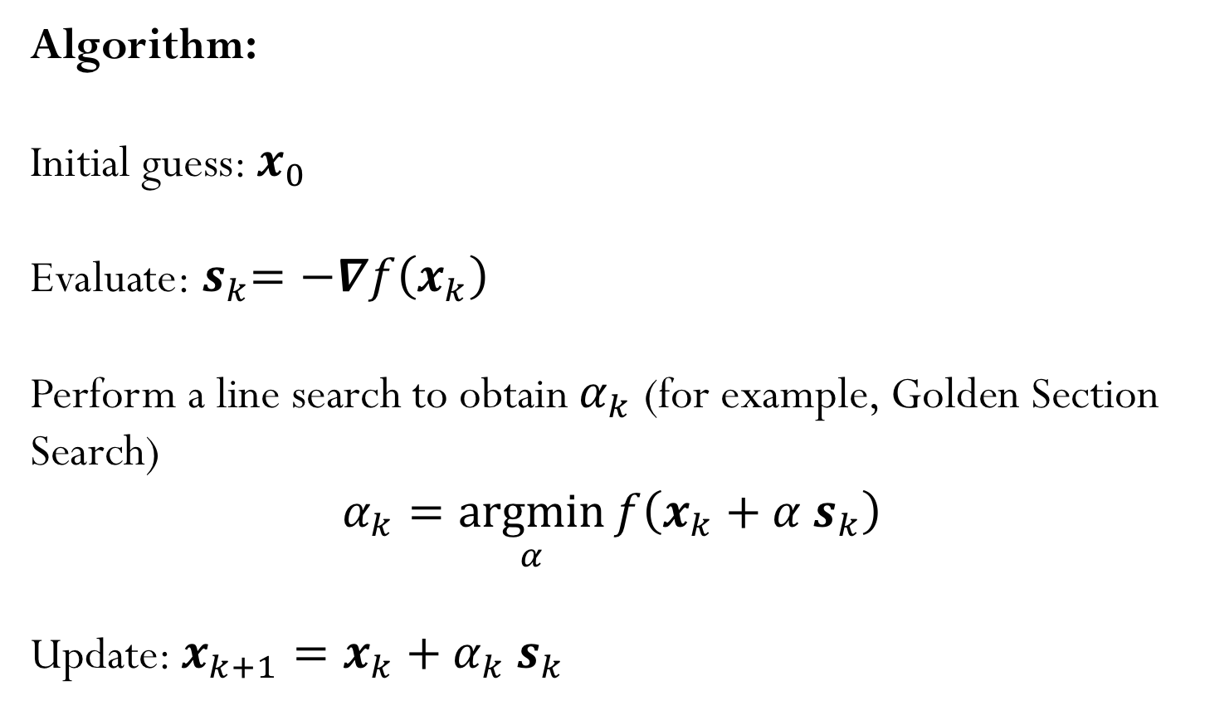
Steepest Descent Method
Algorithm:
Initial guess: $x_{0}$
Evaluate:${ s}_{k}=−∇f\left(x_{k}\right)$
Perform a line search to obtain $α_{k}$ (for example, Golden Section Search)
$$α_{k}=\underset{α}{argmin}{f\left(x_{k}+α{ s}_{k}\right)}$$
Update: $x_{k+1}=x_{k}+α_{k}{ s}_{k}$

Slide 13
Line Search

Slide 14
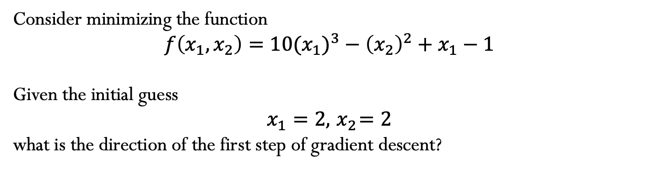
Example
Consider minimizing the function
$$f\left(x_{1},x_{2}\right)={10(x_{1})}^{3}−{\left(x_{2}\right)}^{2}+x_{1}−1$$
Given the initial guess
$$x_{1}=2,{ x}_{2}=2$$
what is the direction of the first step of gradient descent?
Notes:
D

Slide 15
Newton’s Method
Using Taylor Expansion, we build the approximation:
Notes:
Hessian is related to the curvature, how fast my function is “curving” and therefore it gives the idea of how much the step should be

Slide 16

Newton’s Method
Algorithm:
Initial guess: $x_{0}$
Solve:${{ H}_{f}\left(x_{k}\right) s}_{k}=−∇f\left(x_{k}\right)$
Update: $x_{k+1}=x_{k}+{ s}_{k}$
Note that the Hessian is related to the curvature and therefore contains the information about how large the step should be.

Slide 17

Try this out!
$$f\left(x,y \right)=0.5x^{2}+{2.5y}^{2}$$
When using the Newton’s Method to find the minimizer of this function, estimate the number of iterations it would take for convergence?
A) 1 B) 2-5 C) 5-10 D) More than 10 E) Depends on the initial guess
Notes:
Newton’s method will find the minimizer in one step since the function is quadratic (and in this case the quadratic approximation of the method is actually the exact function)

Slide 18
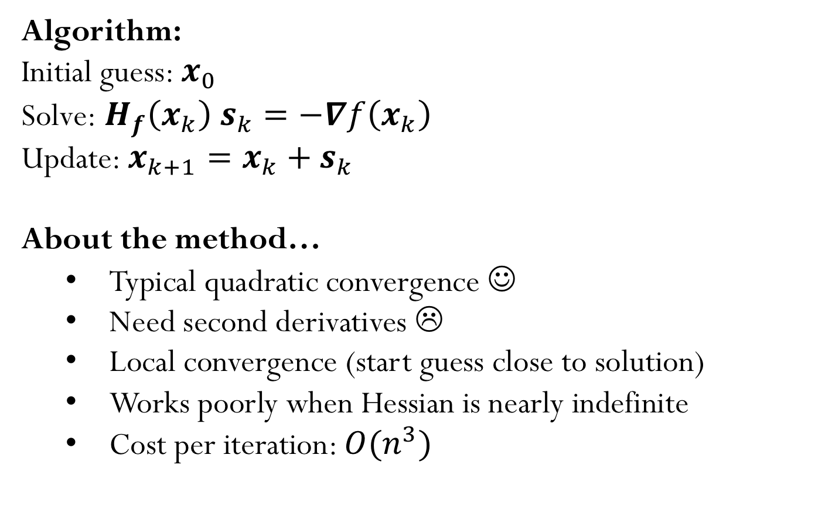
Newton’s Method Summary
Algorithm:
Initial guess: $x_{0}$
Solve:${{ H}_{f}\left(x_{k}\right) s}_{k}=−∇f\left(x_{k}\right)$
Update: $x_{k+1}=x_{k}+{ s}_{k}$
About the method…
Typical quadratic convergence ☺
Need second derivatives ☹
Local convergence (start guess close to solution)
Works poorly when Hessian is nearly indefinite
Cost per iteration: $O(n^{3})$

