Slide 1
Least Squares and Data Fitting
Notes:
Make updates! Look at this reference book!
https://web.stanford.edu/~boyd/vmls/vmls.pdf

Slide 2
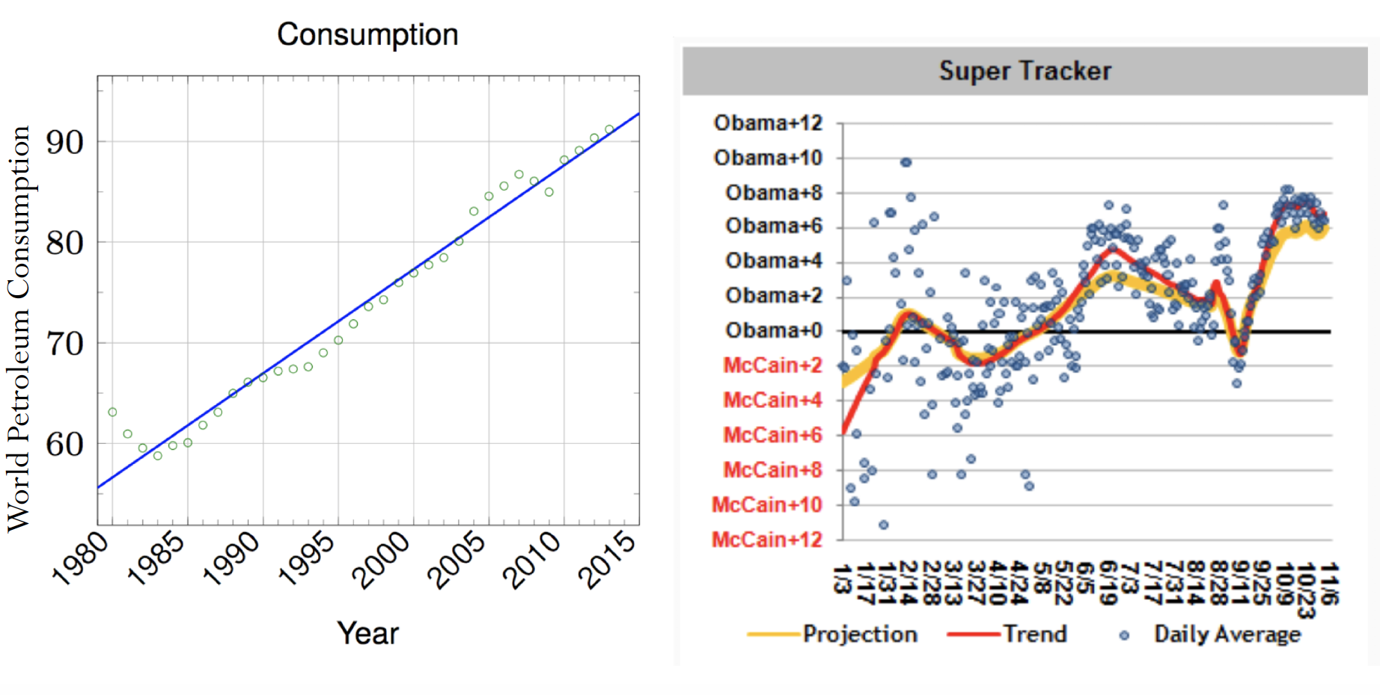
Data fitting
How do we best fit a set of data points?

Slide 3
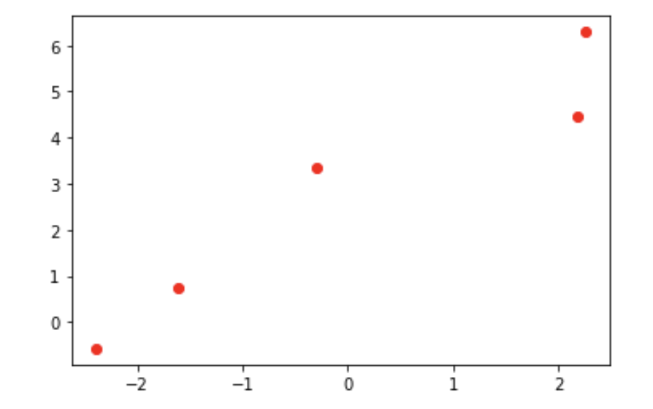
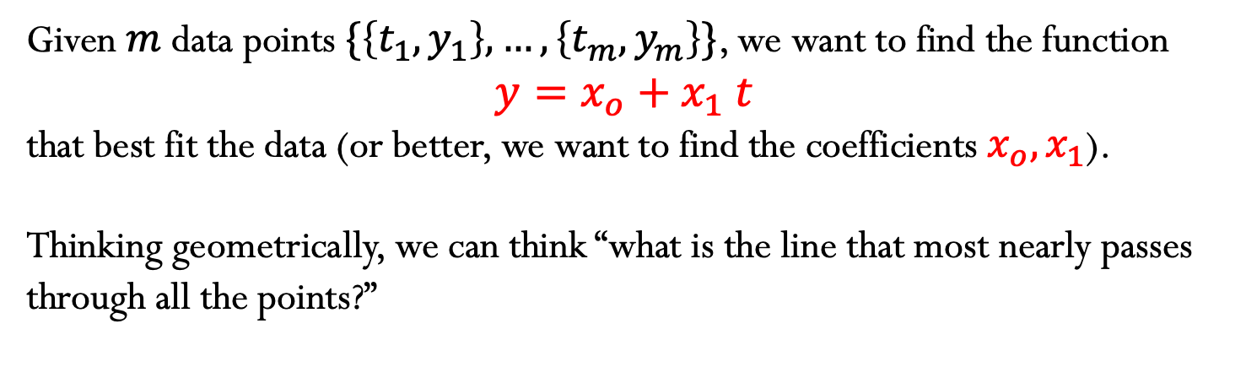
Linear Least Squares
1) Fitting with a line
Given$m$data points $\{\left\{t_{1},y_{1}\right\},…,\left\{t_{m},y_{m}\right\}\}$, we want to find the function
$$y=x_{o}+x_{1} t$$
that best fit the data (or better, we want to find the coefficients $x_{o},x_{1}$).
Thinking geometrically, we can think “what is the line that most nearly passes through all the points?”

Slide 4
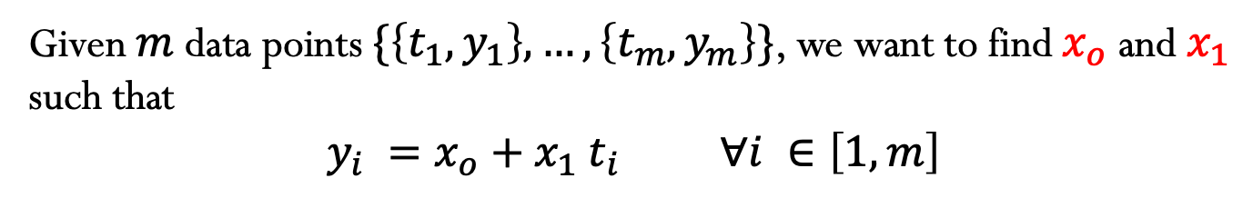
Given$m$data points $\{\left\{t_{1},y_{1}\right\},…,\left\{t_{m},y_{m}\right\}\}$, we want to find${ x}_{o}$ and $x_{1}$ such that
$$y_{i} =x_{o}+x_{1} t_{i} ∀i ∈\left[1,m\right]$$

Slide 5
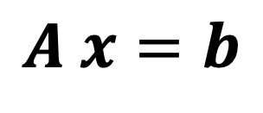
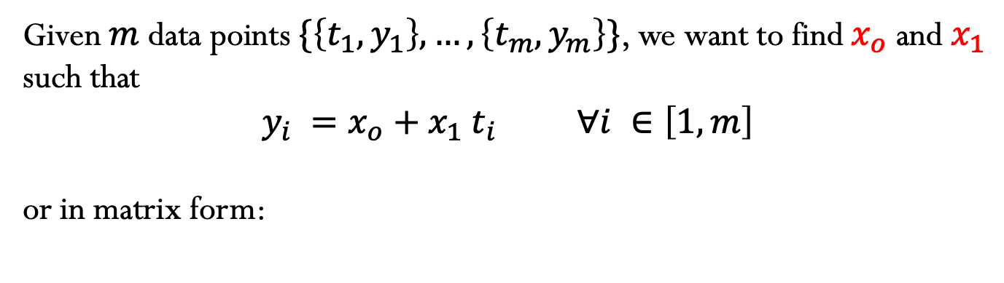
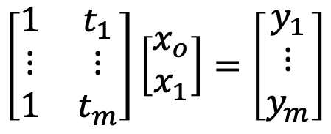



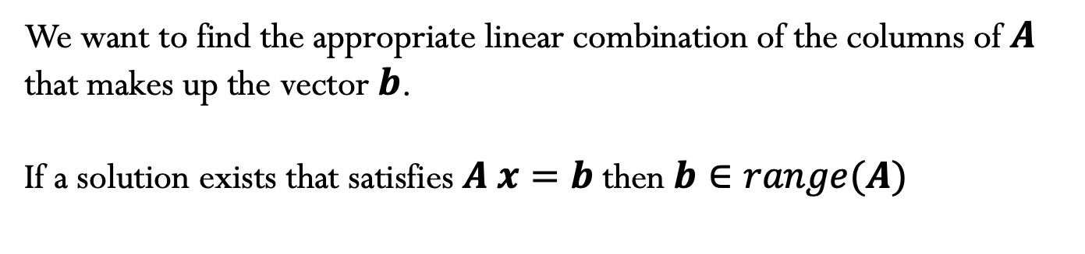
Given$m$data points $\{\left\{t_{1},y_{1}\right\},…,\left\{t_{m},y_{m}\right\}\}$, we want to find${ x}_{o}$ and $x_{1}$ such that
$$y_{i} =x_{o}+x_{1} t_{i} ∀i ∈\left[1,m\right]$$
or in matrix form:
Note that this system of linear equations has more equations than unknowns – OVERDETERMINED SYSTEMS
$$\left[\begin{matrix}1 & t_{1} \\ ⋮ & ⋮ \\ 1 & t_{m}\end{matrix}\right]\left[\begin{matrix}x_{o} \\ x_{1}\end{matrix}\right]=\left[\begin{matrix}y_{1} \\ ⋮ \\ y_{m}\end{matrix}\right]$$
$$A x=b$$
$$m×n$$
$$n×1$$
$$m×1$$
We want to find the appropriate linear combination of the columns of $A$ that makes up the vector $b$.
If a solution exists that satisfies $A x=b$ then $b∈range(A)$

Slide 6
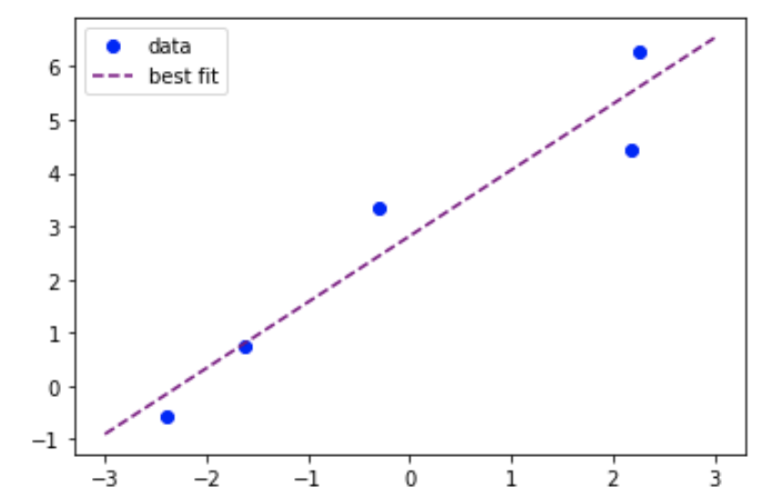

Linear Least Squares
In most cases, $b∉range(A)$ and $A x=b$ does not have an exact solution!
Therefore, an overdetermined system is better expressed as
$$A x≅b$$

Slide 7

Linear Least Squares
Least Squares: find the solution $x$ that minimizes the residual
$$r=b−A x$$
Let’s define the function $φ$ as the square of the 2-norm of the residual
$$φ\left(x\right)={\left\|b−A x\right\|}_{2}^{2}$$
Notes:
Why the 2-norm? Does not need to be. OTher p-norms could be used. However, just taking the summation of the absolute values will create problems when defining the optimization problem, since the derivative may not exist.

Slide 8
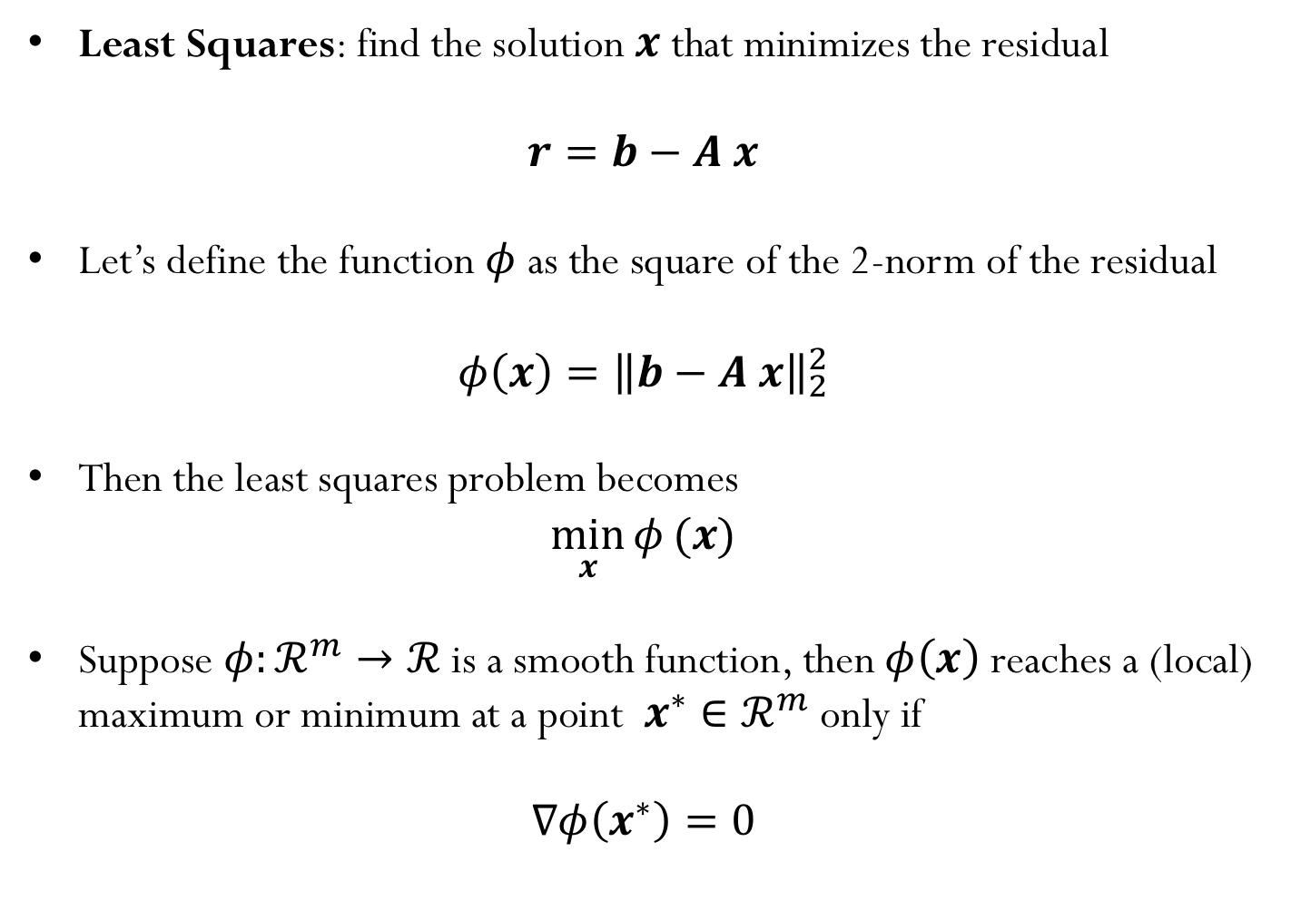
Linear Least Squares
Least Squares: find the solution $x$ that minimizes the residual
$$r=b−A x$$
Let’s define the function $φ$ as the square of the 2-norm of the residual
$$φ\left(x\right)={\left\|b−A x\right\|}_{2}^{2}$$
Then the least squares problem becomes
$$\min_{x}{φ}(x)$$
Suppose $φ:ℛ^{m}→ℛ$ is a smooth function, then$φ\left(x\right)$ reaches a (local) maximum or minimum at a point $x^{∗}∈ℛ^{m}$ only if
$$∇φ\left(x^{∗}\right)=0$$
Notes:
Why the 2-norm? Does not need to be. OTher p-norms could be used. However, just taking the summation of the absolute values will create problems when defining the optimization problem, since the derivative may not exist.

Slide 9
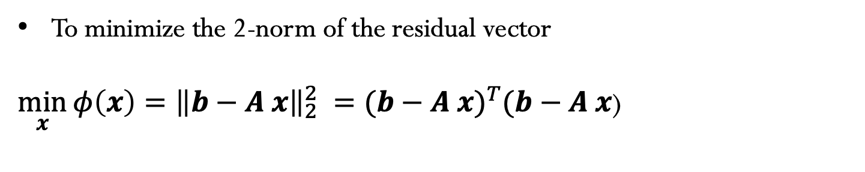
How to find the minimizer?
To minimize the 2-norm of the residual vector
$\min_{x}{{φ\left(x\right)=\left\|b−A x\right\|}_{2}^{2}} ={(b−A x)}^{T}(b−A x$)
Notes:
Why the 2-norm? Does not need to be. Othate er p-norms could be used. However, just taking the summation of the absolute values will create problems when defining the optimization problem, since the derivative may not exist.

Slide 10
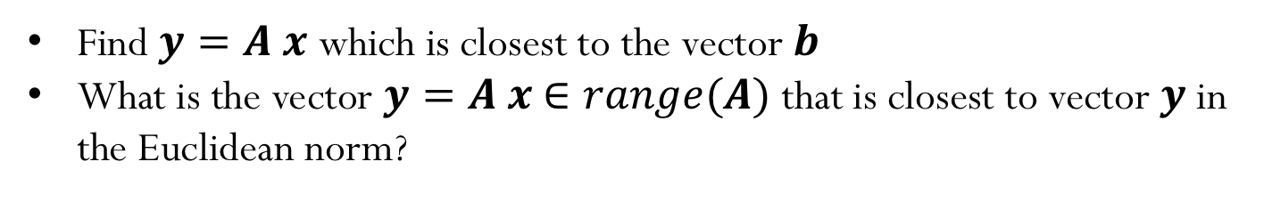
Linear Least Squares (another approach)
Find $y=A x$ which is closest to the vector $b$
What is the vector $y=A x$ $∈range(A)$ that is closest to vector $y$in the Euclidean norm?

Slide 11
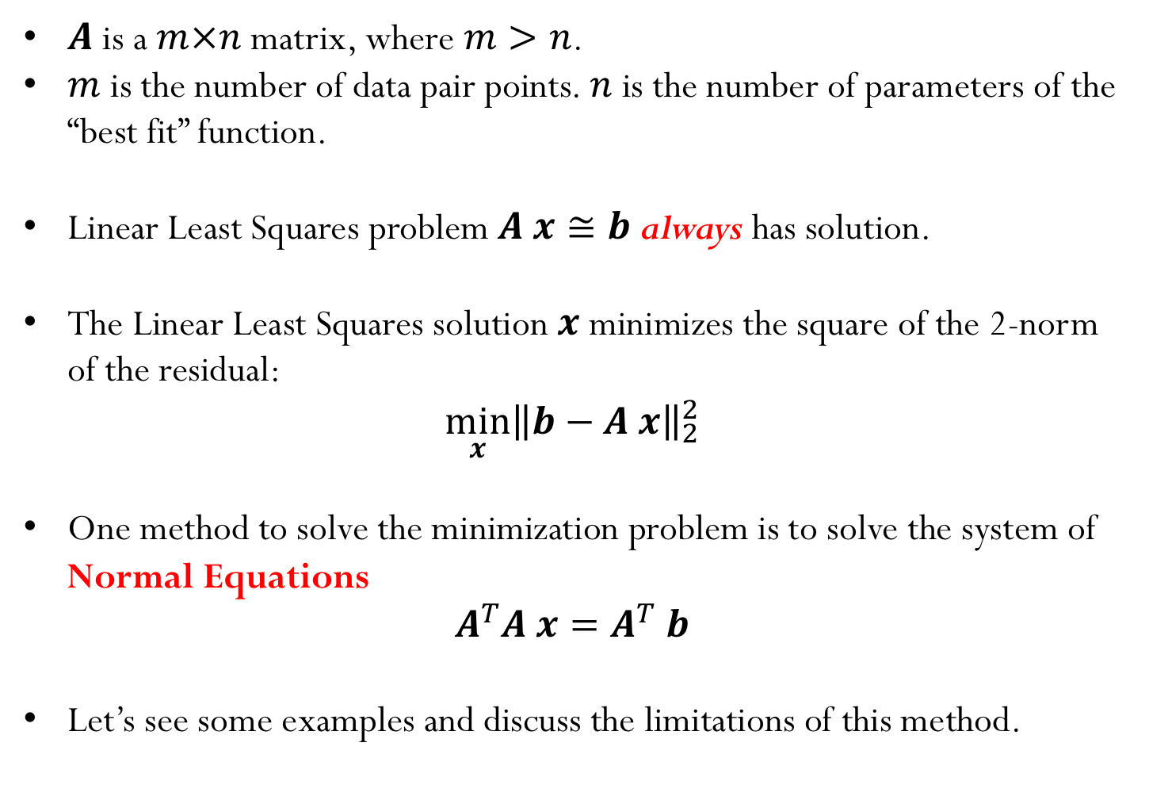
Summary:
$A$ is a $m×n$ matrix, where $m>n$.
$m$ is the number of data pair points. $n$ is the number of parameters of the “best fit” function.
Linear Least Squares problem $A x≅b$ always has solution.
The Linear Least Squares solution $x$ minimizes the square of the 2-norm of the residual:
$$\min_{x}{{\left\|b−A x\right\|}_{2}^{2}}$$
One method to solve the minimization problem is to solve the system of Normal Equations
$$A^{T}A x=A^{T} b$$
Let’s see some examples and discuss the limitations of this method.

Slide 12
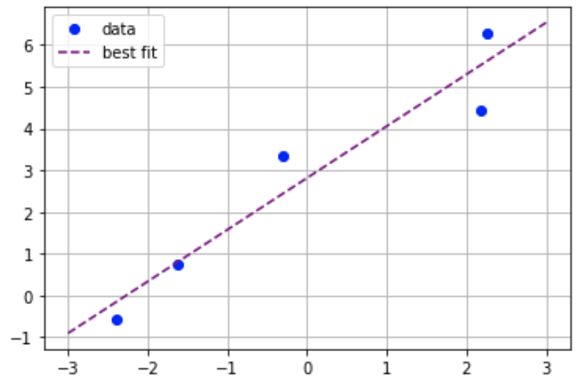
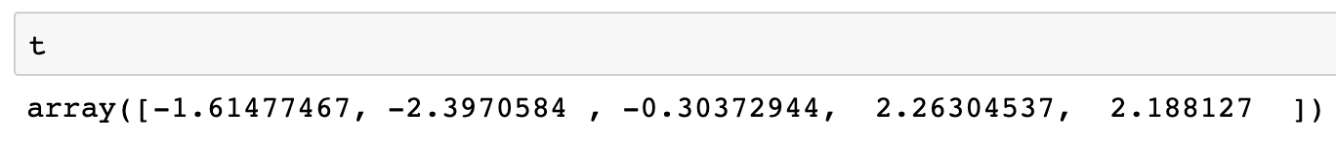
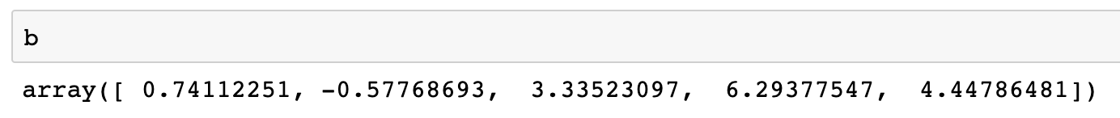
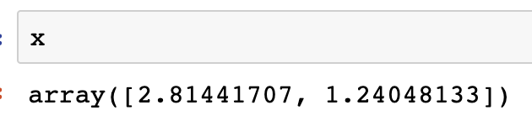
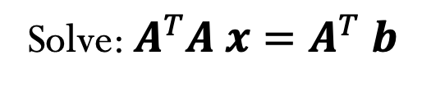
Example:
Solve: $A^{T}A x=A^{T} b$

Slide 13
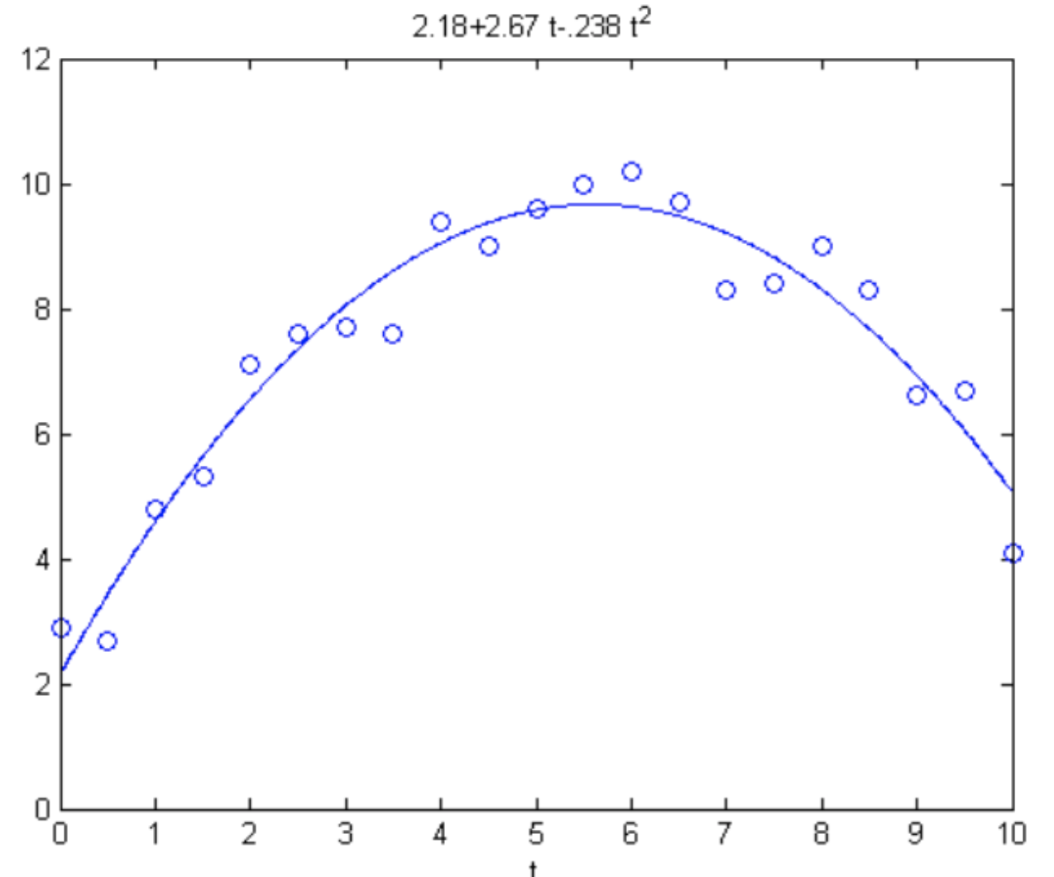
Data fitting - not always a line fit!
Does not need to be a line! For example, here we are fitting the data using a quadratic curve.
Linear Least Squares: The problem is linear in its coefficients!
Notes:
D

Slide 14
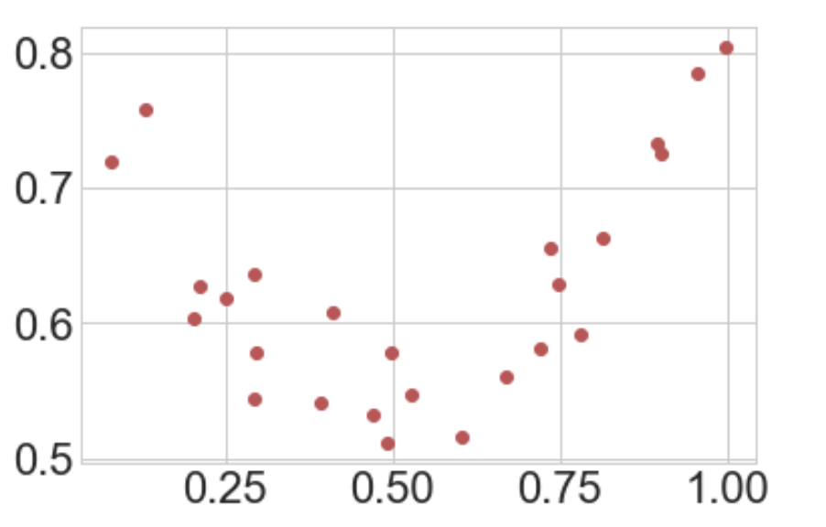
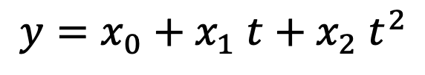
Another example
We want to find the coefficients of the quadratic function that best fits the data points:
$$y=x_{0}+x_{1} t+x_{2} t^{2}$$
We would not want our “fit” curve to pass through the data points exactly as we are looking to model the general trend and not capture the noise.

Slide 15
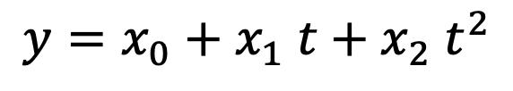
Data fitting
$$y=x_{0}+x_{1} t+x_{2} t^{2}$$

Slide 16
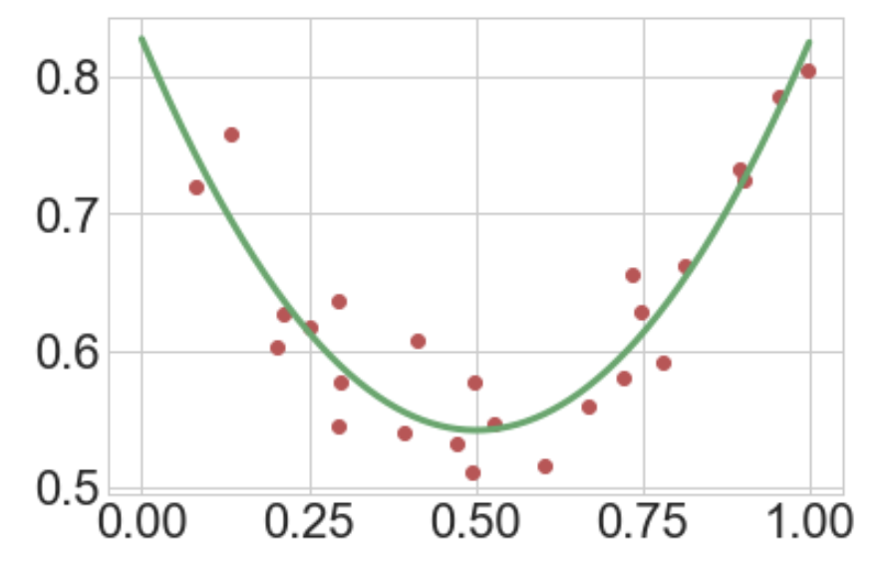
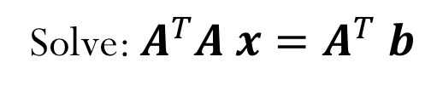
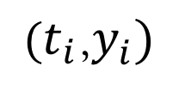
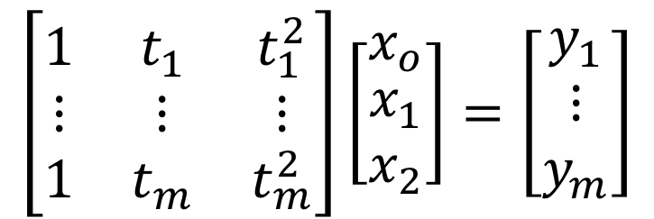
Data fitting
$$\left[\begin{matrix}1 & t_{1} & t_{1}^{2} \\ ⋮ & ⋮ & ⋮ \\ 1 & t_{m} & t_{m}^{2}\end{matrix}\right]\left[\begin{matrix}x_{o} \\ \begin{aligned}x_{1} \\ x_{2}\end{aligned}\end{matrix}\right]=\left[\begin{matrix}y_{1} \\ ⋮ \\ y_{m}\end{matrix}\right]$$
Solve: $A^{T}A x=A^{T} b$
$(t_{i}$,$y_{i})$

Slide 17
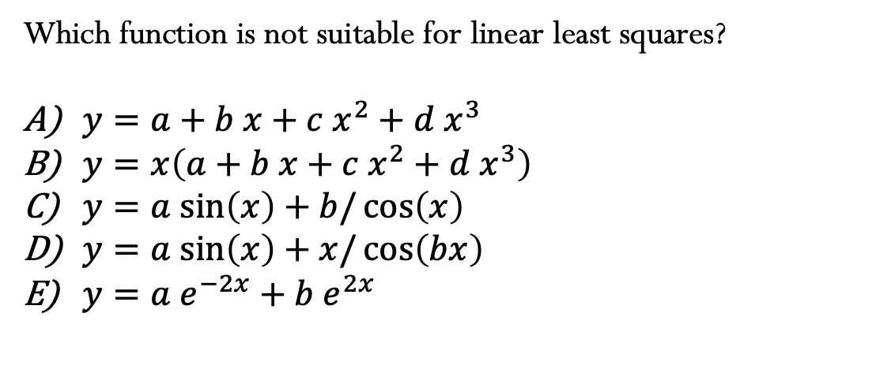
Which function is not suitable for linear least squares?
$y=a+b x+c{ x}^{2}+d{ x}^{3}$
$y=x\left(a+b x+c{ x}^{2}+d{ x}^{3}\right)$
$y=a sin\left(x\right)+b/\cos\left(x\right)$
$y=a sin\left(x\right)+x/\cos\left(bx\right)$
$y={a e}^{−2x}+{b e}^{2x}$
Notes:
D

Slide 18
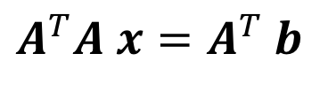
Computational Cost
$$A^{T}A x=A^{T} b$$
Notes:
Solve linear systems, for example using LU factorization. Since it is symmetric, we can also use methods that take advantage of the symmetry, such as cholesky factorization
(Cholesky cost = n^3/3; LU cost = 2*n^3/3 (cholesky reduces cost by half)
One way of thinking about matrix multiplication is computing the dot product of each column of A with each row of AT in order to get a single column in the resulting matrix A^T*A. So the length of the columns of A are m and same for the rows of AT. So to compute one of these dot product requires m multiplications and additions. And we need to do this for each row in AT, of which there are n rows. So computing a single column resulting from this matrix-matrix multiplication costs O(mn) work. There are n columns in A and so the total cost of computing ATA is O(m*n^2).
Cost to compute A^T*A = O(m*n^2) + Cost to factorize and solve (n)
Total = O(m*n^2+n^3). Since m>n, then O(mn^2)

Slide 19
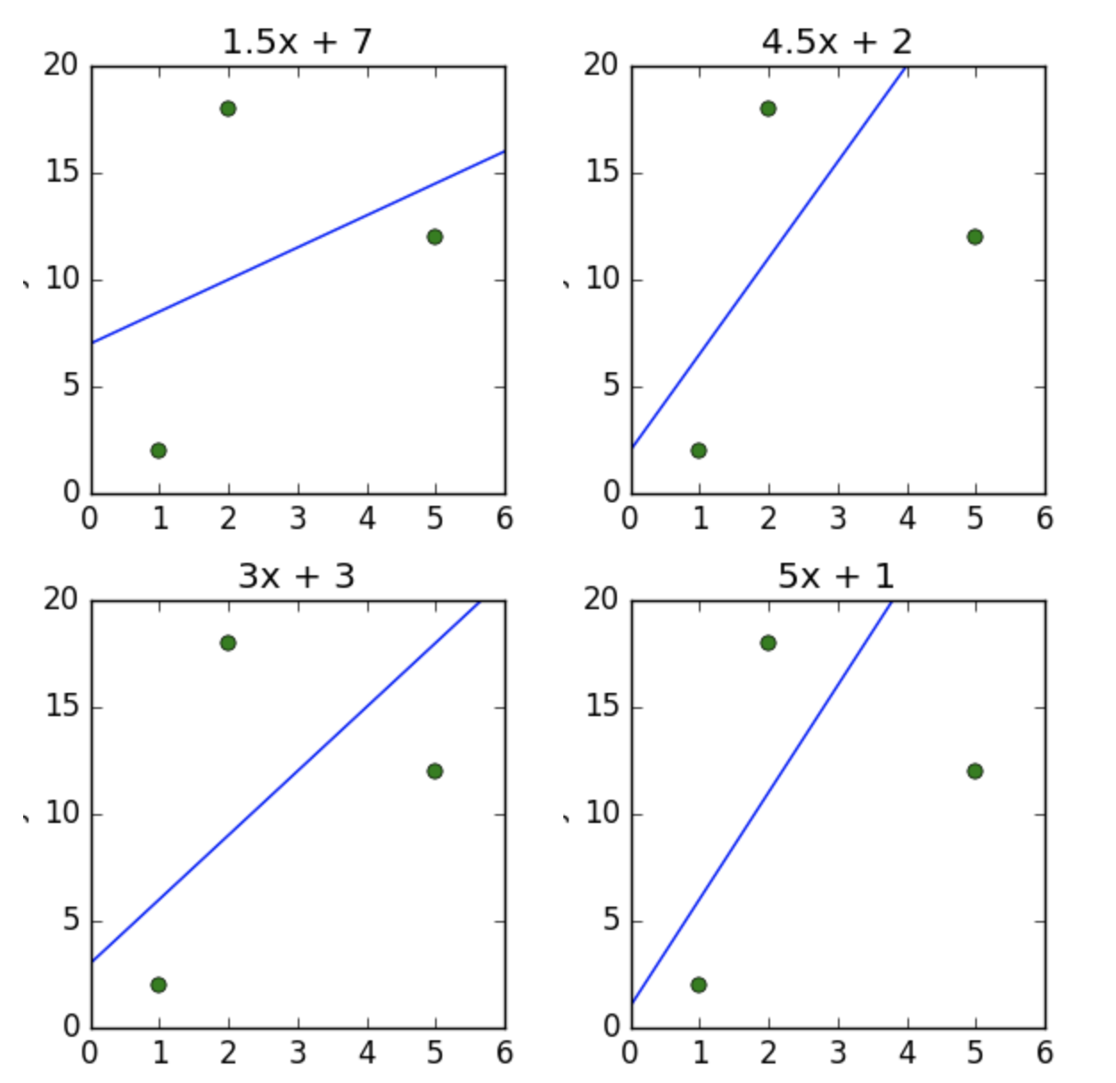
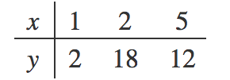
Short questions
Given the data in the table below, which of the plots shows the line of best fit in terms of least squares?
A)
B)
C)
D)
Notes:
A

Slide 20
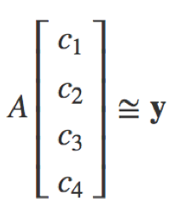
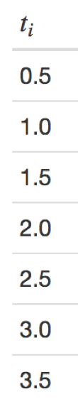
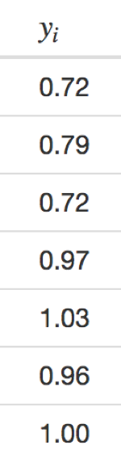


Short questions
Given the data in the table below, and the least squares model
$$y=c_{1}+c_{2}\sin\left(tπ\right)+c_{3}\sin\left(tπ/2\right)+c_{4}\sin\left(tπ/4\right)$$
written in matrix form as
determine the entry $A_{23}$ of the matrix $A$.
Note that indices start with 1.
A) $−1.0$
B) $1.0$
C) $− 0.7$
D) $0.7$
E) $0.0$
Notes:
Correct answer is 1 (B)

