Slide 1
Solving Linear Least Squares with SVD
Notes:
Make updates! Look at this reference book!
https://web.stanford.edu/~boyd/vmls/vmls.pdf

Slide 2
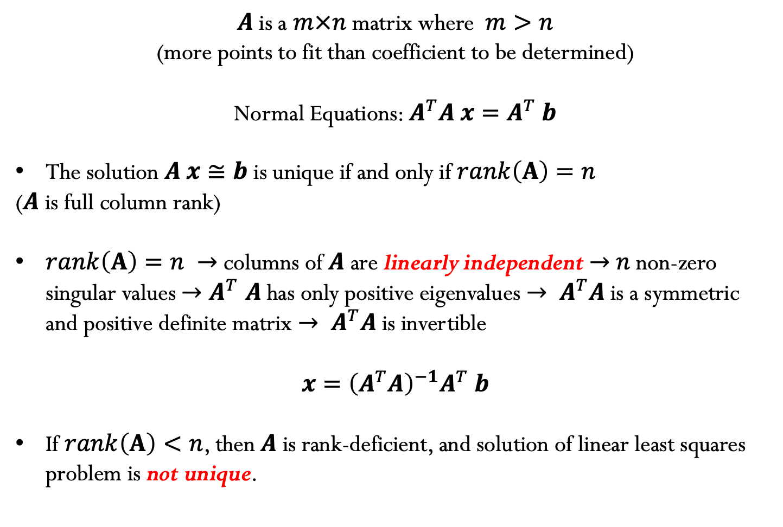
What we have learned so far…
$A$ is a $m×n$ matrix where $m>n$
(more points to fit than coefficient to be determined)
Normal Equations: $A^{T}A x=A^{T} b$
The solution $A x≅b$ is unique if and only if $rank\left(A\right)=n$
($A$ is full column rank)
$rank\left(A\right)=n →$ columns of $A$ are linearly independent $→$ $n$ non-zero singular values ${→A}^{T}A$has only positive eigenvalues $→ A^{T}A \text{is} \text{a} \text{symmetric} \text{and} \text{positive} \text{definite} \text{matrix}$ $→ A^{T}A$is invertible
$$x={\left(A^{T}A\right)}^{−1}A^{T} b$$
If $rank\left(A\right)<n$, then $A$ is rank-deficient, and solution of linear least squares problem is not unique.

Slide 3
SVD to solve linear least squares problems
$A \text{is} \text{a} m×n \text{rectangular} \text{matrix} \text{where} m>n,$and hence the SVD decomposition is given by:
$A=\left(\begin{matrix}⋮ & … & ⋮ \\ u_{1} & … & u_{m} \\ ⋮ & … & ⋮\end{matrix}\right)$ $\left(\begin{aligned}\begin{matrix}σ_{1} & & \\ & ⋱ & \\ & & σ_{n}\end{matrix} \\ \begin{matrix} & & 0 \\ & & ⋮ \\ & & 0\end{matrix}\end{aligned}\right)\left(\begin{matrix}… & v_{1}^{T} & … \\ ⋮ & ⋮ & ⋮ \\ … & v_{n}^{T} & …\end{matrix}\right)$
We want to find the least square solution of $A x≅b$, where$A=U Σ V^{T}$
or better expressed in reduced form: $A=U_{R} { Σ}_{R }V^{T}$

Slide 4
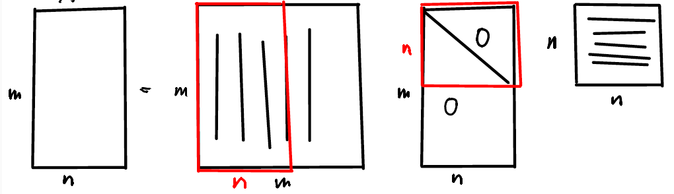
Recall Reduced SVD
$$m>n$$
$$A=U_{R} { Σ}_{R }V^{T}$$
$$m×n$$
$$m×n$$
$$n×n$$
$$n×n$$

Slide 5
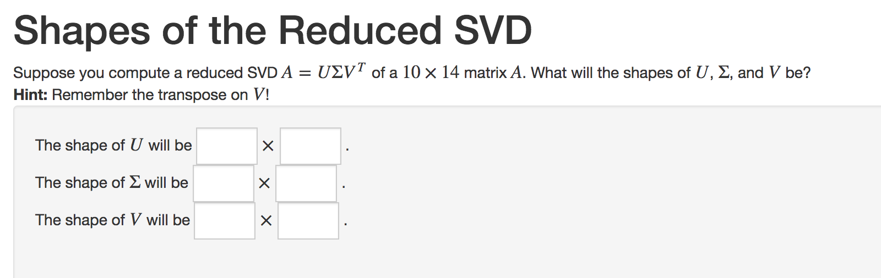

Slide 6
SVD to solve linear least squares problems
$$A=U_{R} { Σ}_{R }V^{T}$$
$A=\left(\begin{matrix}⋮ & … & ⋮ \\ u_{1} & … & u_{n} \\ ⋮ & … & ⋮\end{matrix}\right)$ $\left(\begin{aligned}\begin{matrix}σ_{1} & & \\ & ⋱ & \\ & & σ_{n}\end{matrix}\end{aligned}\right)\left(\begin{matrix}… & v_{1}^{T} & … \\ ⋮ & ⋮ & ⋮ \\ … & v_{n}^{T} & …\end{matrix}\right)$

Slide 11
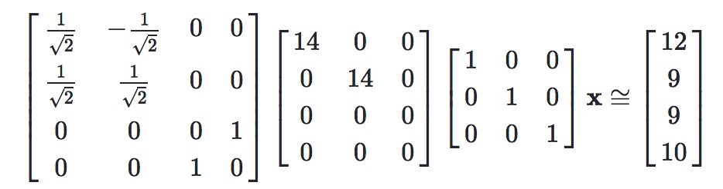
Example:
Consider solving the least squares problem $A x≅b$, where the singular value decomposition of the matrix $A=U Σ V^{T}x$ is:
Determine ${\left\|b−A x\right\|}_{2}$

Slide 13
Example
Suppose you have $A=U Σ V^{T}x$ calculated. What is the cost of solving
$\min_{x}{{\left\|b−A x\right\|}_{2}^{2}}$ ?
$O(n)$
$O({ n}^{2})$
$O(mn)$
$O\left(m\right)$
$O({ m}^{2})$
Notes:
Cost to obtain y is O(n)
To evaluate z = U^T*b (normally m^2), we only need to evaluate m*n (since only need the top n entries of z)
Recall cost of SVD is O(m n^2)

