Slide 1
Singular Value Decomposition (applications)

Slide 2
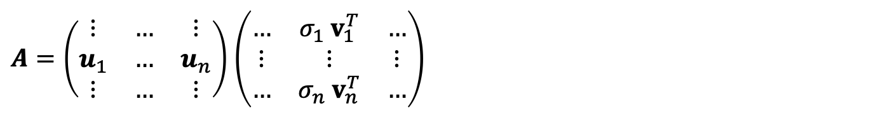
1) Determining the rank of a matrix
Suppose$A \text{is} \text{a} m×n \text{rectangular} \text{matrix} \text{where} m>n$:
$$A=\left(\begin{matrix}⋮ & … & ⋮ & … & ⋮ \\ u_{1} & … & u_{n} & … & u_{m} \\ ⋮ & … & ⋮ & … & ⋮\end{matrix}\right) \left(\begin{aligned}\begin{matrix}σ_{1} & & \\ & ⋱ & \\ & & σ_{n}\end{matrix} \\ \begin{matrix} & & 0 \\ & & ⋮ \\ & & 0\end{matrix}\end{aligned}\right)\left(\begin{matrix}… & v_{1}^{T} & … \\ ⋮ & ⋮ & ⋮ \\ … & v_{n}^{T} & …\end{matrix}\right)$$
$A=\left(\begin{matrix}⋮ & … & ⋮ \\ u_{1} & … & u_{n} \\ ⋮ & … & ⋮\end{matrix}\right)$ $\left(\begin{matrix}… & σ_{1}{ v}_{1}^{T} & … \\ ⋮ & ⋮ & ⋮ \\ … & σ_{n} v_{n}^{T} & …\end{matrix}\right)$

Slide 3
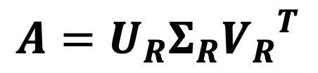
Rank of a matrix
For general rectangular matrix$A$ with dimensions $m×n$, the reduced SVD is:
$$A=U_{R}Σ_{R}{V_{R}}^{T}$$

Slide 4
Rank of a matrix
The rank of A equals the number of non-zero singular values which is the same as the number of non-zero diagonal elements in Σ.
Rounding errors may lead to small but non-zero singular values in a rank deficient matrix, hence the rank of a matrix determined by the number of non-zero singular values is sometimes called “effective rank”.
The right-singular vectors (columns of $V$) corresponding to vanishing singular values span the null space of A.
The left-singular vectors (columns of $U$) corresponding to the non-zero singular values of A span the range of A.

Slide 5
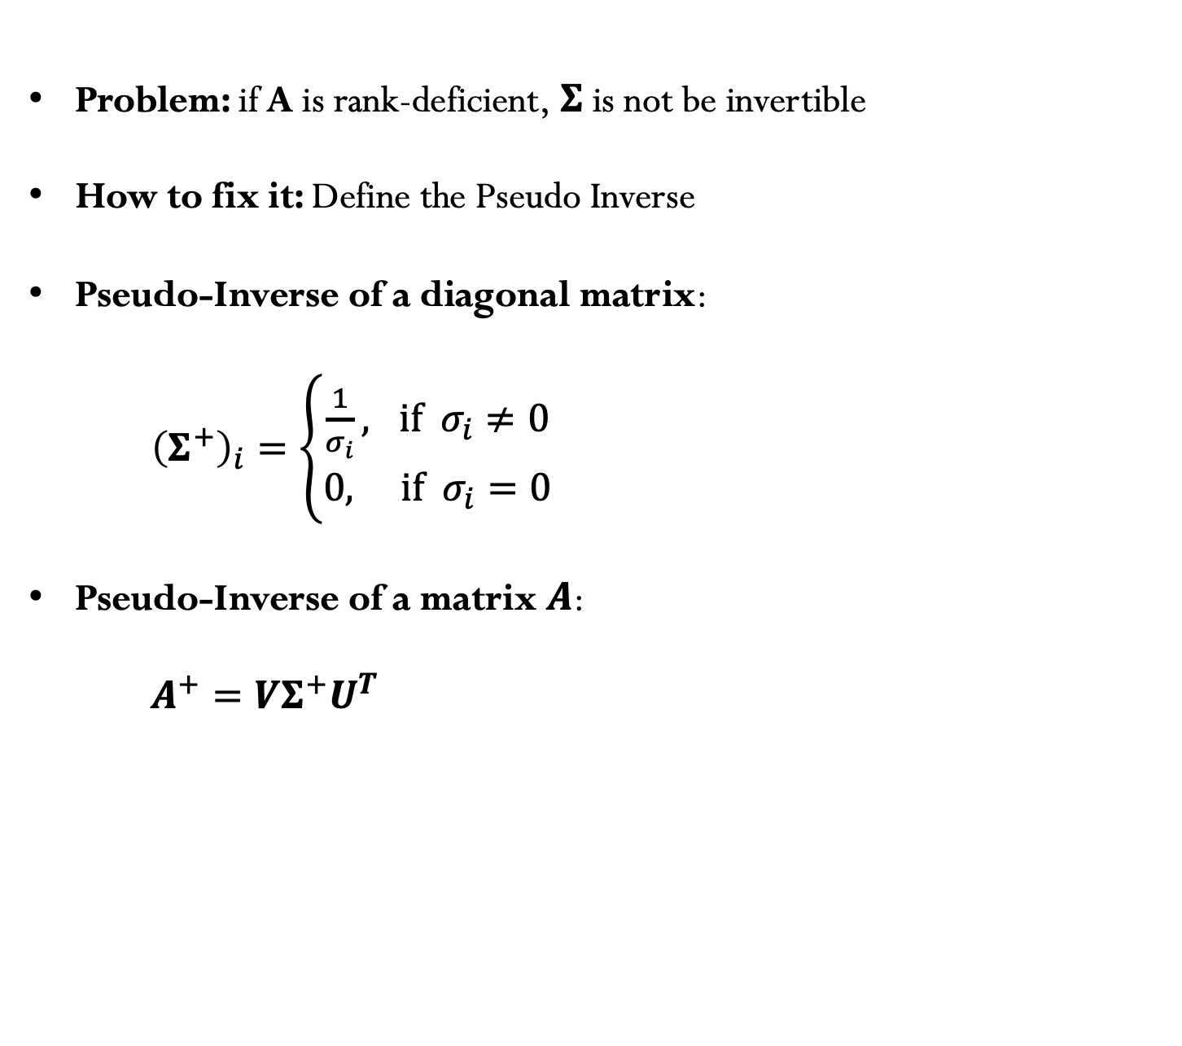
2) Pseudo-inverse
Problem: if A is rank-deficient, $Σ$ is not be invertible
How to fix it: Define the Pseudo Inverse
Pseudo-Inverse of a diagonal matrix:
${\left(Σ^{+}\right)}_{i}=\left\{\begin{matrix}\frac{1}{σ_{i}}, if { σ}_{i}≠0 \\ 0, if { σ}_{i}=0\end{matrix}\right.$
Pseudo-Inverse of a matrix $A$:
$A^{+}=VΣ^{+}U^{T}$

Slide 6

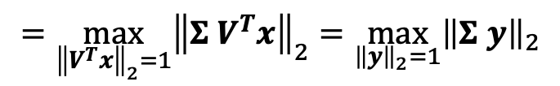
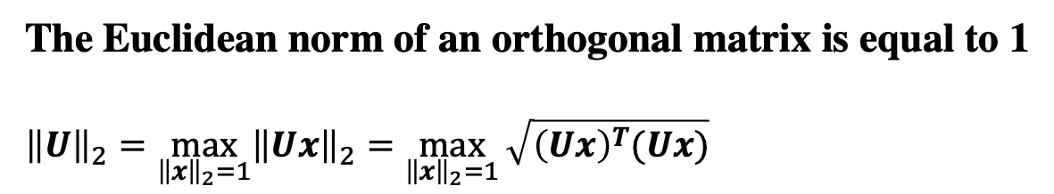
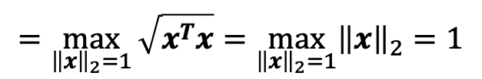
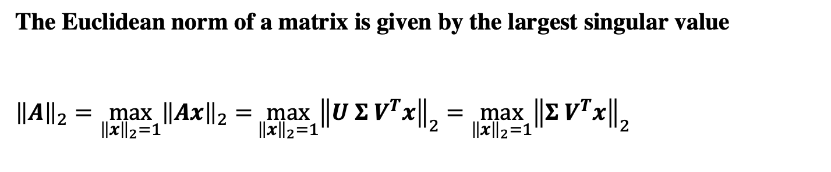
3) Matrix norms
The Euclidean norm of an orthogonal matrix is equal to 1
$${\left\|U\right\|}_{2}=\max_{{\left\|x\right\|}_{2}=1}{{\left\|Ux\right\|}_{2}=\max_{{\left\|x\right\|}_{2}=1}{\sqrt{{\left(Ux\right)}^{T}(Ux)}}}$$
$$=\max_{{\left\|x\right\|}_{2}=1}{\sqrt{x^{T}x}}=\max_{{\left\|x\right\|}_{2}=1}{{\left\|x\right\|}_{2}=1}$$
The Euclidean norm of a matrix is given by the largest singular value
${\left\|A\right\|}_{2}=\max_{{\left\|x\right\|}_{2}=1}{{\left\|Ax\right\|}_{2}=}\max_{{\left\|x\right\|}_{2}=1}{{\left\|U Σ V^{T}x\right\|}_{2}}$ $=\max_{{\left\|x\right\|}_{2}=1}{{\left\|Σ V^{T}x\right\|}_{2}}$
$$=\max_{{\left\|V^{T}x\right\|}_{2}=1}{{\left\|Σ V^{T}x\right\|}_{2}=\max_{{\left\|y\right\|}_{2}=1}{{\left\|Σ y\right\|}_{2}}}$$
Where we used the fact that ${\left\|U\right\|}_{2}=1$, ${\left\|V\right\|}_{2}=1.$Since $Σ$is diagonal we get:
${\left\|A\right\|}_{2}=\max\left(σ_{i}\right)=$ $σ_{max}$
$σ_{max}$ is the largest singular value

Slide 7
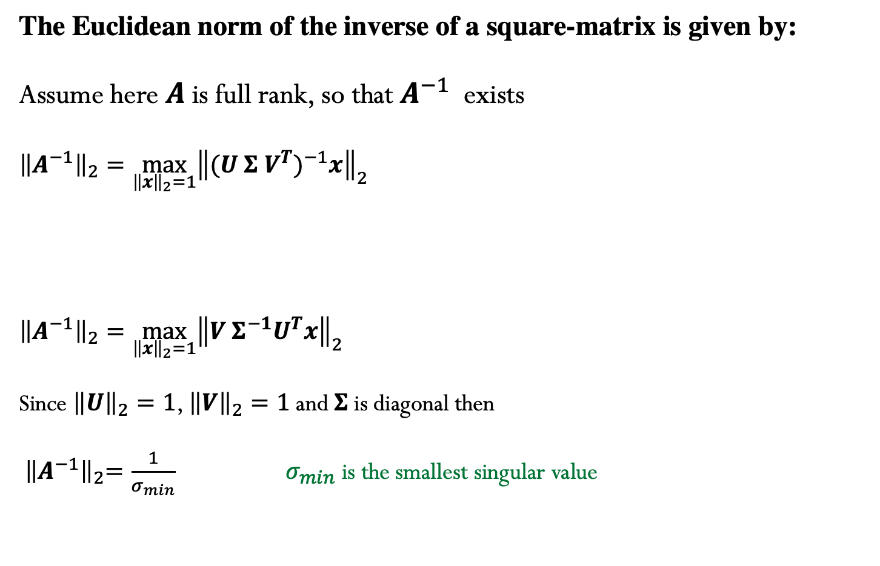
4) Norm for the inverse of a matrix
The Euclidean norm of the inverse of a square-matrix is given by:
Assume here $A$is full rank, so that $A^{−1}$ exists
$${\left\|A^{−1}\right\|}_{2}=\max_{{\left\|x\right\|}_{2}=1}{{\left\|{(U Σ V^{T})}^{−1}x\right\|}_{2}}$$
$${\left\|A^{−1}\right\|}_{2}=\max_{{\left\|x\right\|}_{2}=1}{{\left\|V{ Σ}^{−1}U^{T}x\right\|}_{2}}$$
Since ${\left\|U\right\|}_{2}=1$, ${\left\|V\right\|}_{2}=1$ and $Σ$is diagonal then
${ \left\|A^{−1}\right\|}_{2}=\frac{1}{σ_{min}} { σ}_{min}$ is the smallest singular value

Slide 8
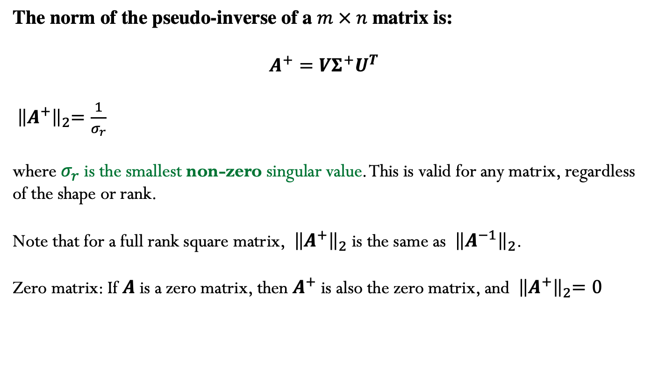
5) Norm of the pseudo-inverse matrix
The norm of the pseudo-inverse of a $m × n$ matrix is:
$$A^{+}=VΣ^{+}U^{T}$$
${ \left\|A^{+}\right\|}_{2}=\frac{1}{σ_{r}}$
where $σ_{r}$ is the smallest non-zero singular value. This is valid for any matrix, regardless of the shape or rank.
Note that for a full rank square matrix, ${ \left\|A^{+}\right\|}_{2}$ is the same as ${ \left\|A^{−1}\right\|}_{2}$.
Zero matrix: If $A$ is a zero matrix, then $A^{+}$ is also the zero matrix, and ${ \left\|A^{+}\right\|}_{2}=0$

Slide 9
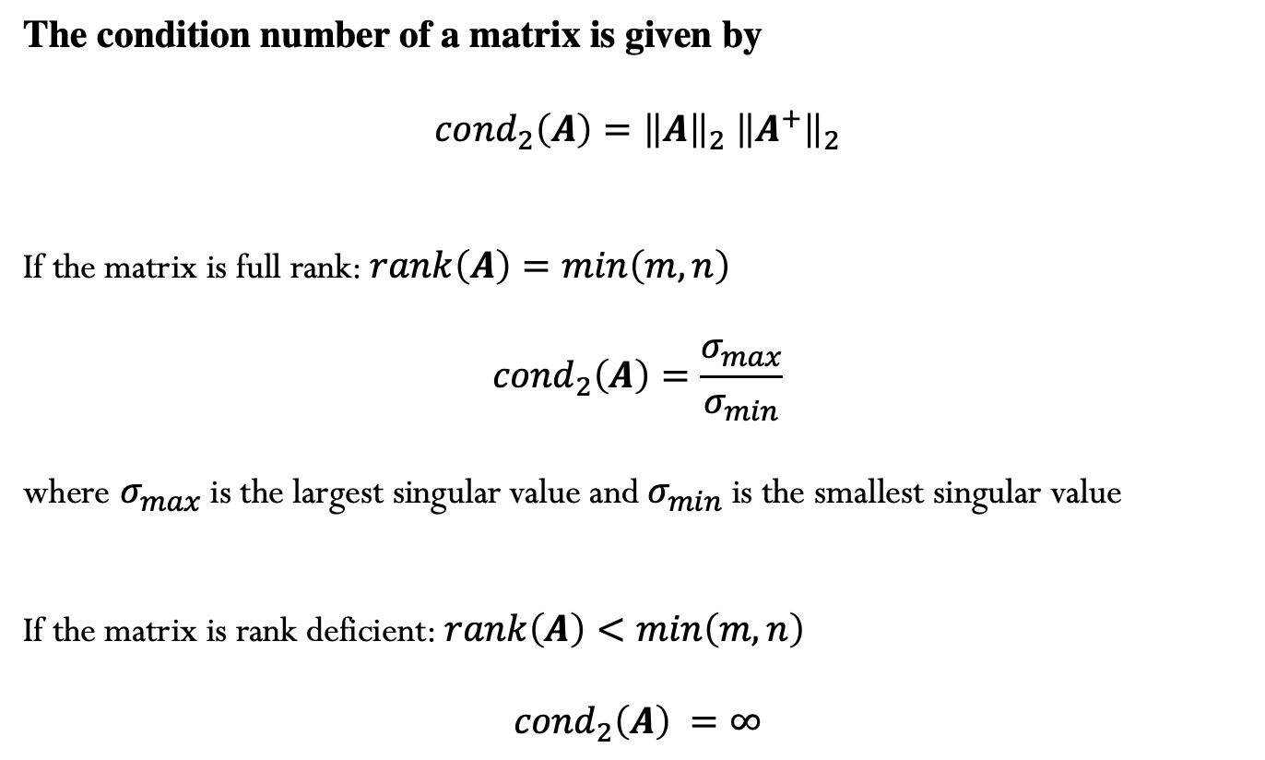
6) Condition number of a matrix
The condition number of a matrix is given by
$${cond}_{2}\left(A\right)={\left\|A\right\|}_{2}{ \left\|A^{+}\right\|}_{2}$$
If the matrix is full rank: $rank\left(A\right)=min\left(m,n\right)$
$${cond}_{2}\left(A\right)=\frac{σ_{max}}{σ_{min}}$$
where $σ_{max}$is the largest singular value and $σ_{min}$is the smallest singular value
If the matrix is rank deficient: $rank\left(A\right)<min\left(m,n\right)$
$${cond}_{2}\left(A\right) =∞$$

Slide 10
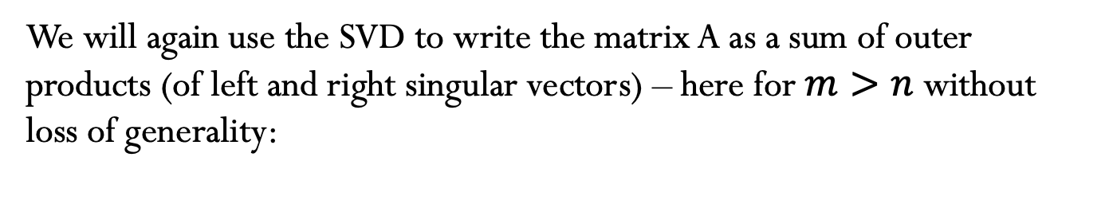

7) Low-Rank Approximation
We will again use the SVD to write the matrix A as a sum of outer products (of left and right singular vectors) – here for $m>n$ without loss of generality:
$A=\left(\begin{matrix}⋮ & … & ⋮ \\ u_{1} & … & u_{m} \\ ⋮ & … & ⋮\end{matrix}\right)$ $\left(\begin{aligned}\begin{matrix}σ_{1} & & \\ & ⋱ & \\ & & σ_{n}\end{matrix} \\ \begin{matrix} & & 0 \\ & & ⋮ \\ & & 0\end{matrix}\end{aligned}\right)\left(\begin{matrix}… & v_{1}^{T} & … \\ ⋮ & ⋮ & ⋮ \\ … & v_{n}^{T} & …\end{matrix}\right)$
$=\left(\begin{matrix}⋮ & … & ⋮ \\ u_{1} & … & u_{n} \\ ⋮ & … & ⋮\end{matrix}\right)$ $\left(\begin{matrix}… & σ_{1}{ v}_{1}^{T} & … \\ ⋮ & ⋮ & ⋮ \\ … & σ_{n} v_{n}^{T} & …\end{matrix}\right)$
$$=σ_{1}u_{1}v_{1}^{T}+σ_{2}u_{2}v_{2}^{T}+…+σ_{n}u_{n}v_{n}^{T}$$

Slide 11
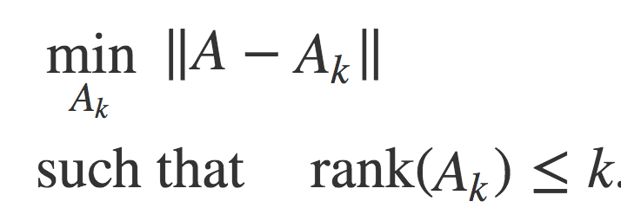

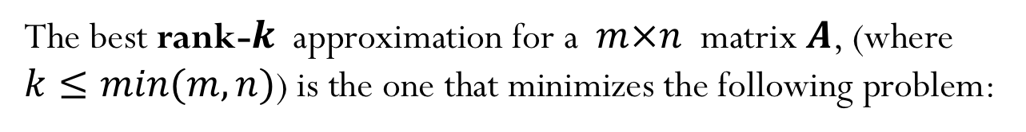
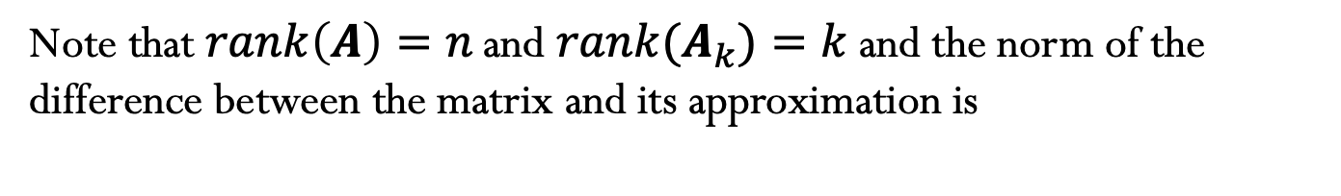
7) Low-Rank Approximation (cont.)
The best rank-$k$ approximation for a $m×n$ matrix $A$, (where $k≤min(m,n)$) is the one that minimizes the following problem:
When using the induced 2-norm, the best rank-$k$ approximation is given by:
$${A_{k}=σ}_{1}u_{1}v_{1}^{T}+σ_{2}u_{2}v_{2}^{T}+…+σ_{k}u_{k}v_{k}^{T}$$
$σ_{1}≥σ_{2}≥σ_{3}…$ $≥0$
Note that $rank\left(A\right)=n \text{and} rank{(A}_{k})=k$ and the norm of the difference between the matrix and its approximation is

Slide 12
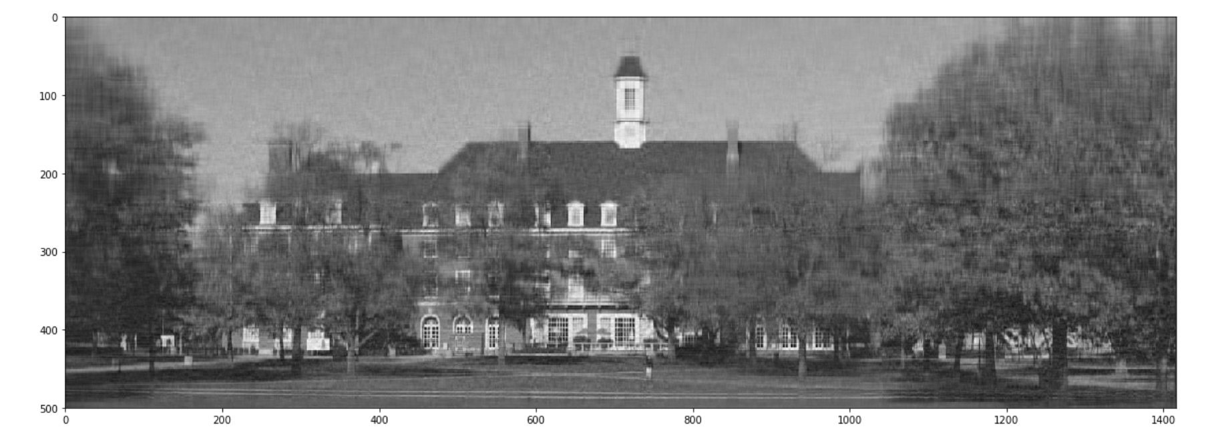


Example: Image compression
$$1417$$
$$500$$
Image using rank-50 approximation

Slide 13
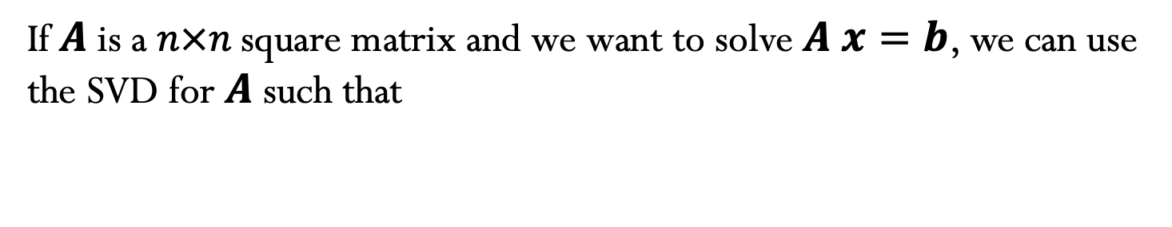
8) Using SVD to solve square system of linear equations
If $A$is a $n×n$ square matrix and we want to solve $A x=b$, we can use
the SVD for $A$ such that
Notes:
Can use SVD to solve square system of linear equations, but no advantage over LU decomposition

