Slide 1


Slide 2

https://www.prairielearn.org/pl/course_instance/129442/instructor/question/1792364/preview

Slide 3

https://www.prairielearn.org/pl/course_instance/129442/instructor/question/9046900/preview

Slide 4
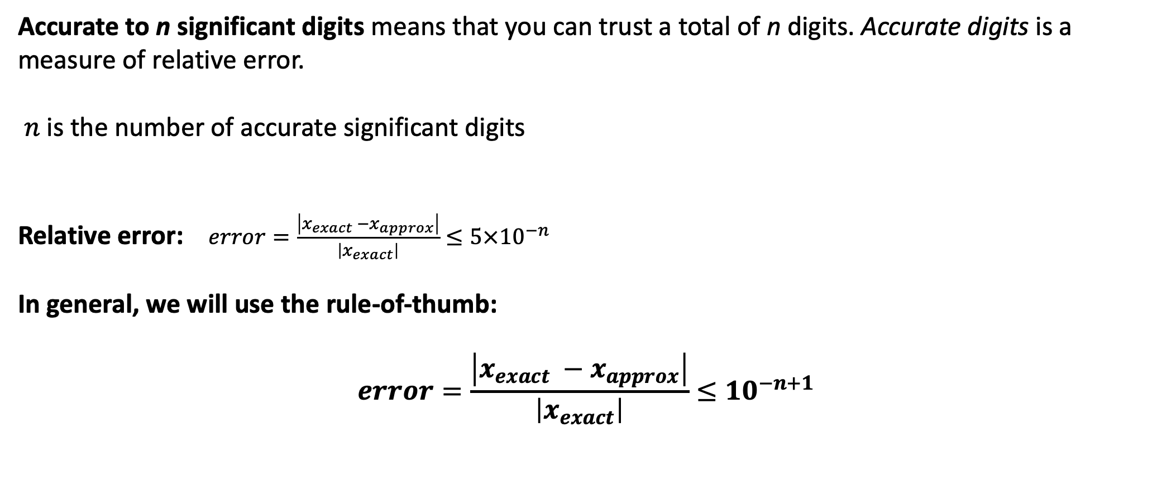

$\hat{x}$ has $n$ significant figures of $x$if $\left|x−\hat{x}\right|$has zeros in the first $n$ decimal places counting from the leftmost nonzero (leading) digit of $x$, followed by a digit from 0 to 4.
Accurate to n significant digits means that you can trust a total of n digits. Accurate digits is a measure of relative error.
$n$ is the number of accurate significant digits
Relative error: $error=\frac{\left|x_{exact} −x_{approx}\right|}{\left|x_{exact}\right|}≤5×{10}^{−n}$
In general, we will use the rule-of-thumb:
$$error=\frac{\left|x_{exact} −x_{approx}\right|}{\left|x_{exact}\right|}≤{10}^{−n+1}$$

Slide 5
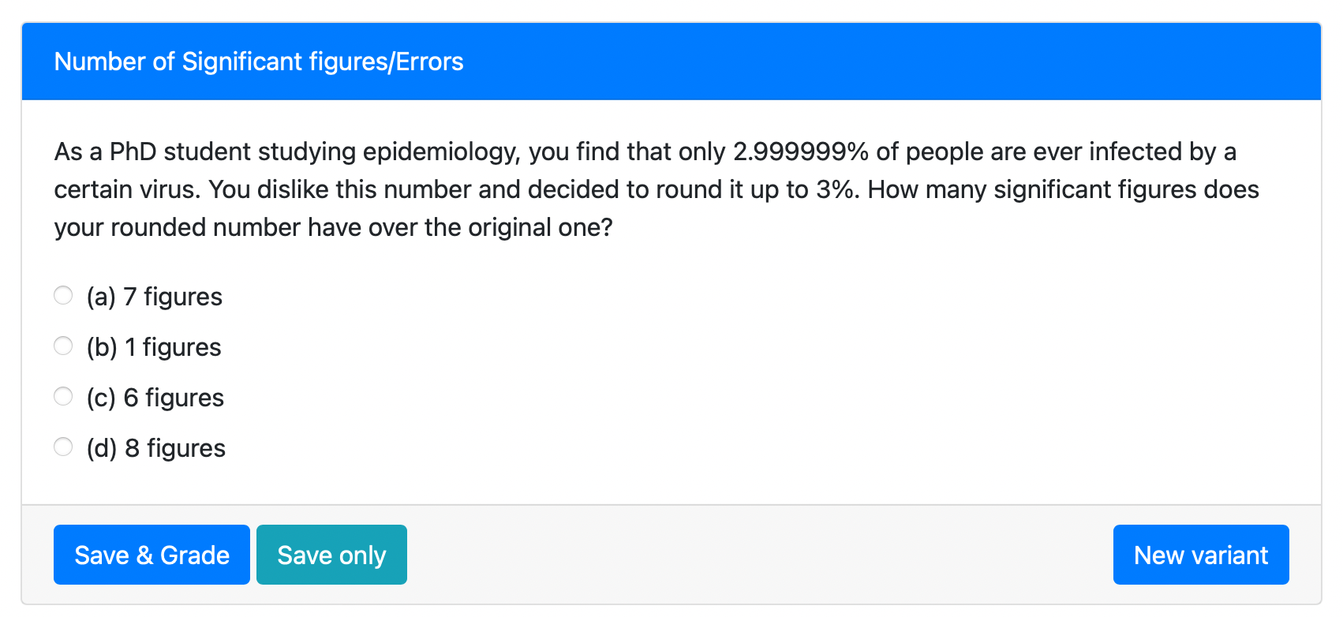
https://www.prairielearn.org/pl/course_instance/129442/instructor/question/9046898/preview

Slide 6
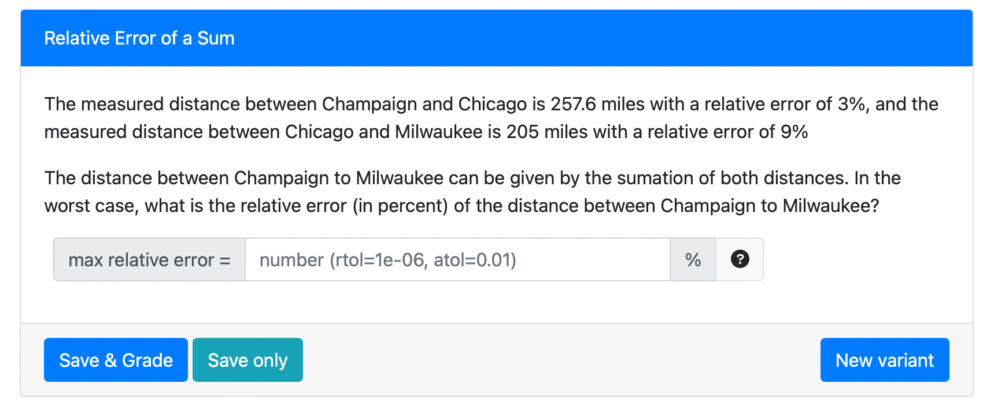
https://www.prairielearn.org/pl/course_instance/129442/instructor/question/1902810/preview

