Slide 1
Singular Value Decomposition (matrix factorization)

Slide 2
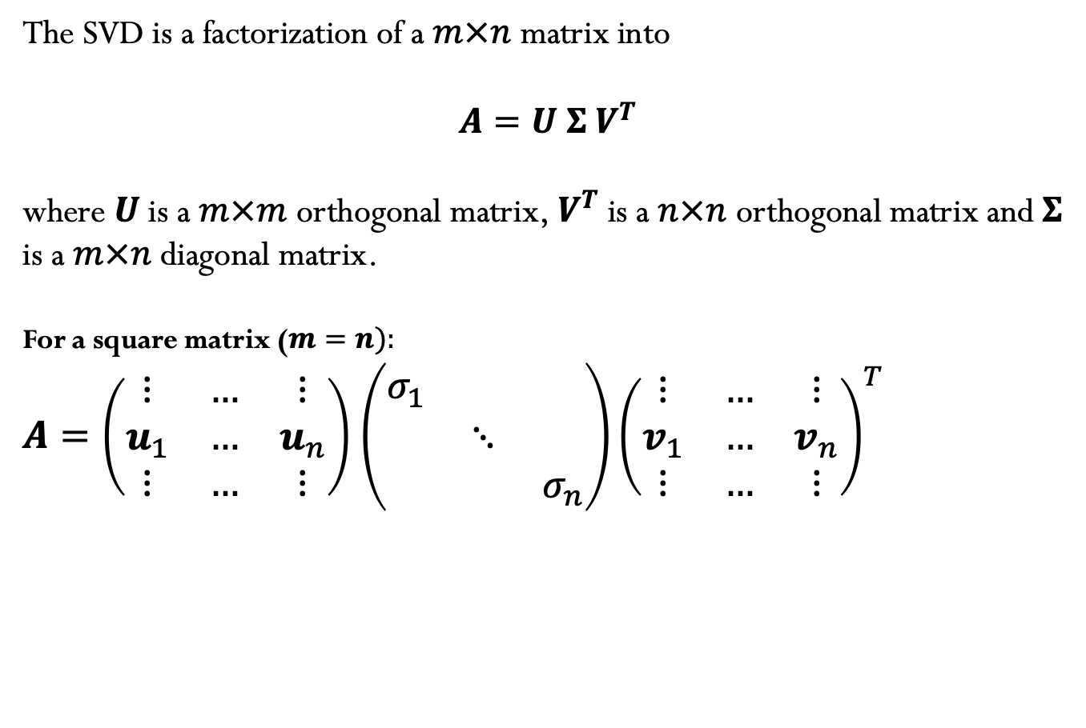
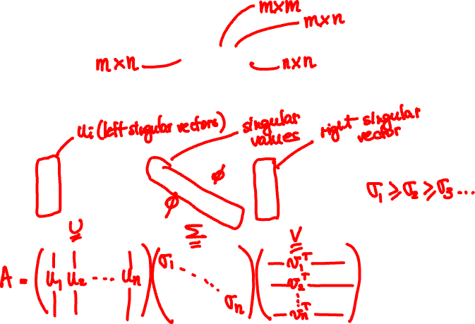

Singular Value Decomposition
The SVD is a factorization of a $m×n$ matrix into
$A=U Σ V^{T}$
where $U$ is a $m×m$ orthogonal matrix,${ V}^{T}$ is a $n×n$ orthogonal matrix and $Σ$ is a $m×n$ diagonal matrix.
For a square matrix ($m=n):$
$A=\left(\begin{matrix}⋮ & … & ⋮ \\ u_{1} & … & u_{n} \\ ⋮ & … & ⋮\end{matrix}\right)$ $\left(\begin{matrix}σ_{1} & & \\ & ⋱ & \\ & & σ_{n}\end{matrix}\right){\left(\begin{matrix}⋮ & … & ⋮ \\ v_{1} & … & v_{n} \\ ⋮ & … & ⋮\end{matrix}\right)}^{T}$
$$σ_{1}≥σ_{2}≥σ_{3}…$$

Slide 3
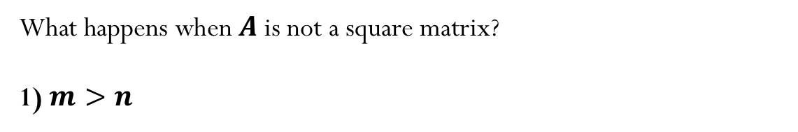
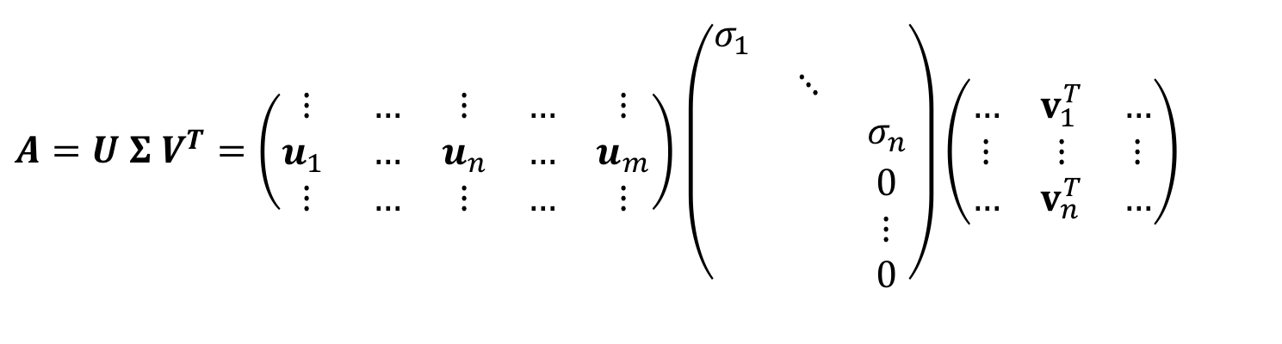


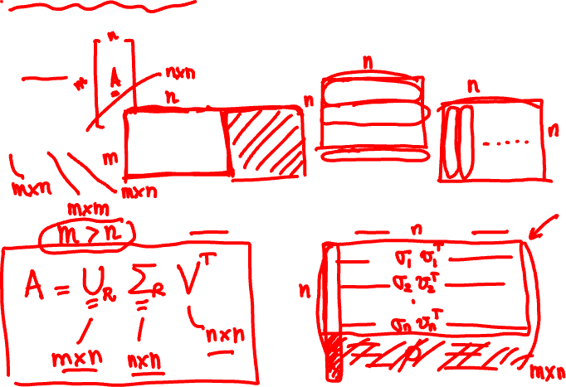

Reduced SVD
What happens when $A$ is not a square matrix?
1) $m>n$
$A=U Σ V^{T}=\left(\begin{matrix}⋮ & … & ⋮ & … & ⋮ \\ u_{1} & … & u_{n} & … & u_{m} \\ ⋮ & … & ⋮ & … & ⋮\end{matrix}\right)$ $\left(\begin{aligned}\begin{matrix}σ_{1} & & \\ & ⋱ & \\ & & σ_{n}\end{matrix} \\ \begin{matrix} & & 0 \\ & & ⋮ \\ & & 0\end{matrix}\end{aligned}\right)\left(\begin{matrix}… & v_{1}^{T} & … \\ ⋮ & ⋮ & ⋮ \\ … & v_{n}^{T} & …\end{matrix}\right)$
$$m×m$$
$$m×n$$
$$n×n$$

Slide 4

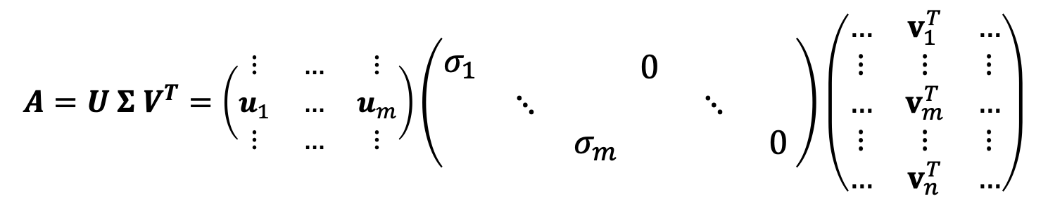




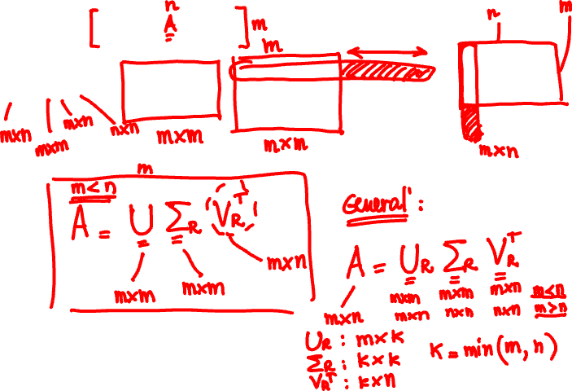
Reduced SVD
2) $n>m$
$$A=U Σ V^{T}=\left(\begin{matrix}⋮ & … & ⋮ \\ u_{1} & … & u_{m} \\ ⋮ & … & ⋮\end{matrix}\right)\left(\begin{aligned}\begin{matrix}σ_{1} & & \\ & ⋱ & \\ & & σ_{m}\end{matrix}\end{aligned} \begin{matrix}0 & & \\ & ⋱ & \\ & & 0\end{matrix}\right)\left(\begin{matrix}… & v_{1}^{T} & … \\ ⋮ & ⋮ & ⋮ \\ … & v_{m}^{T} & … \\ ⋮ & ⋮ & ⋮ \\ … & v_{n}^{T} & …\end{matrix}\right)$$
$$n×m$$
$$m×n$$
$$n×n$$

Slide 5
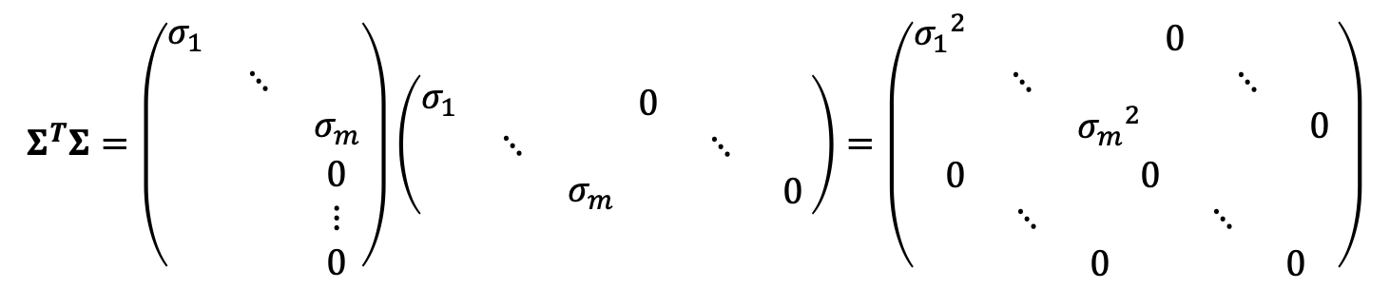
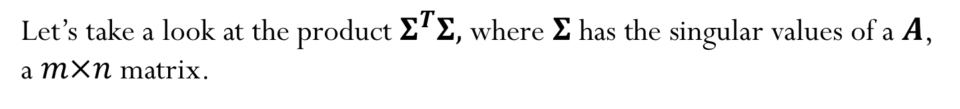




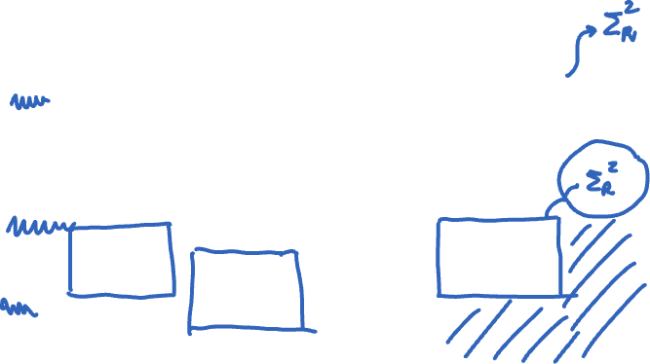


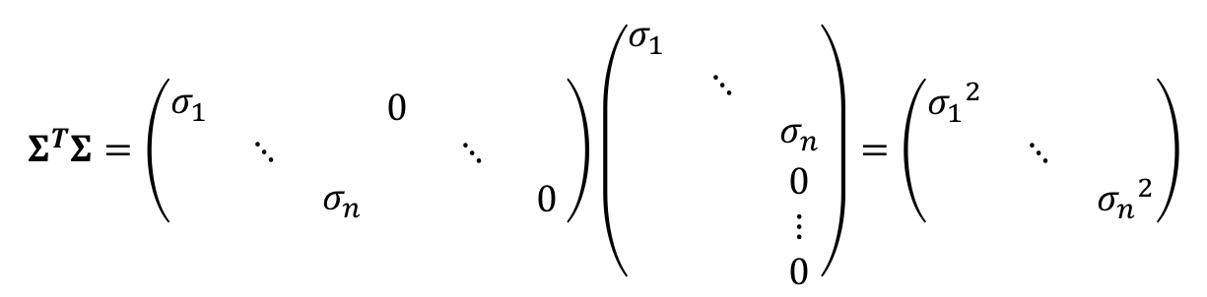

Let’s take a look at the product $Σ^{T}Σ,$where $Σ$ has the singular values of a $A$, a $m×n$ matrix.
$$m>n$$
$$Σ^{T}Σ=\left(\begin{aligned}\begin{matrix}σ_{1} & & \\ & ⋱ & \\ & & σ_{n}\end{matrix}\end{aligned} \begin{matrix}0 & & \\ & ⋱ & \\ & & 0\end{matrix}\right)\left(\begin{aligned}\begin{matrix}σ_{1} & & \\ & ⋱ & \\ & & σ_{n}\end{matrix} \\ \begin{matrix} & & 0 \\ & & ⋮ \\ & & 0\end{matrix}\end{aligned}\right)=\left(\begin{matrix}{σ_{1}}^{2} & & \\ & ⋱ & \\ & & {σ_{n}}^{2}\end{matrix}\right)$$
$$n×m$$
$$n×n$$
$$m×n$$
$$n>m$$
$$Σ^{T}Σ=\left(\begin{aligned}\begin{matrix}σ_{1} & & \\ & ⋱ & \\ & & σ_{m}\end{matrix} \\ \begin{matrix} & & 0 \\ & & ⋮ \\ & & 0\end{matrix}\end{aligned}\right)\left(\begin{aligned}\begin{matrix}σ_{1} & & \\ & ⋱ & \\ & & σ_{m}\end{matrix}\end{aligned} \begin{matrix}0 & & \\ & ⋱ & \\ & & 0\end{matrix}\right)=\left(\begin{aligned}\begin{matrix}{σ_{1}}^{2} & & \\ & ⋱ & \\ & & {σ_{m}}^{2}\end{matrix} \begin{matrix}0 & & \\ & ⋱ & \\ & & 0\end{matrix} \\ \begin{matrix}0 & & \\ & ⋱ & \\ & & 0\end{matrix} \begin{matrix}0 & & \\ & ⋱ & \\ & & 0\end{matrix}\end{aligned}\right)$$
$$m×n$$
$$n×m$$
$$n×n$$

Slide 6
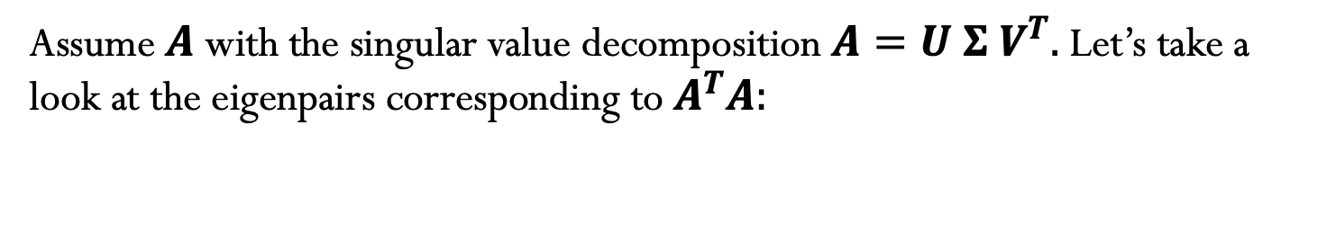
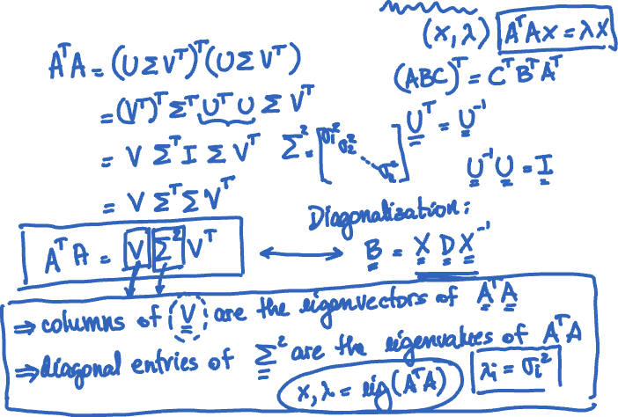
Assume $A$ with the singular value decomposition $A=U Σ V^{T}.$Let’s take a look at the eigenpairs corresponding to $A^{T}A:$

Slide 7
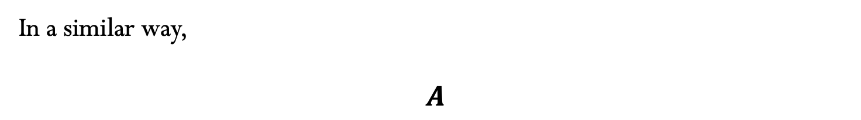
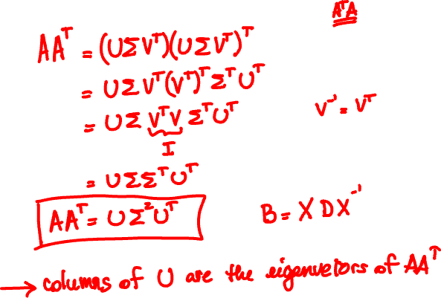
In a similar way,
$$A$$

Slide 8
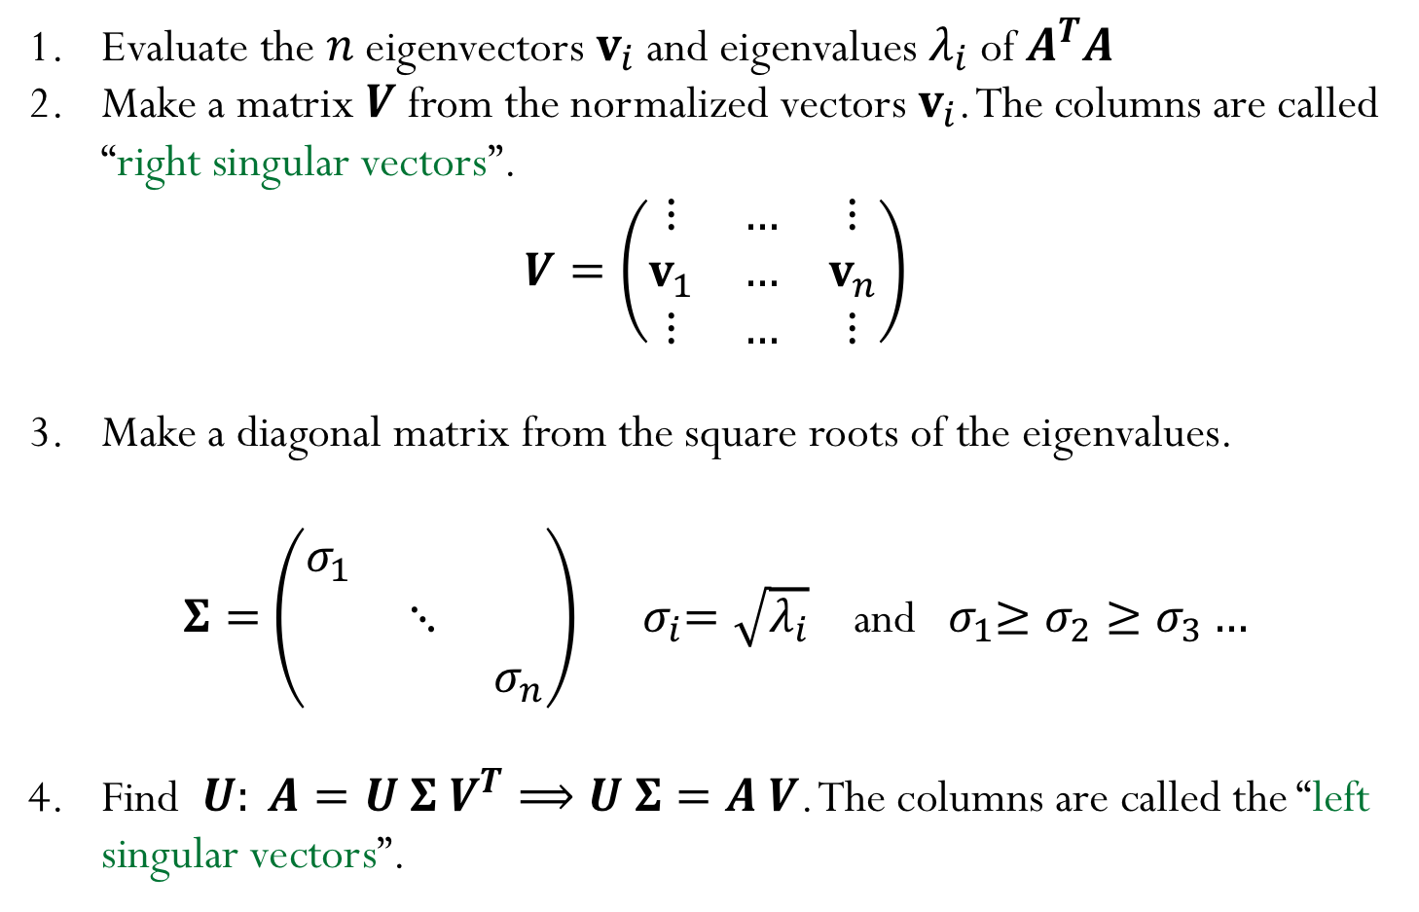


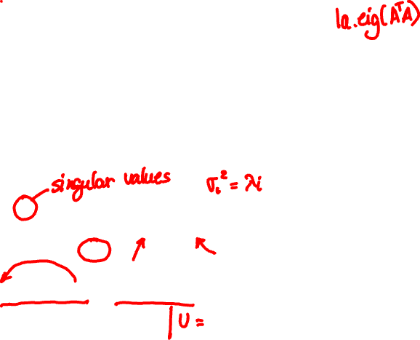
How can we compute an SVD of a matrix A ?
Evaluate the $n$ eigenvectors $v_{i}$and eigenvalues $λ_{i}$of $A^{T}A$
Make a matrix $V$ from the normalized vectors $v_{i}$. The columns are called “right singular vectors”.
$$V=\left(\begin{matrix}⋮ & … & ⋮ \\ v_{1} & … & v_{n} \\ ⋮ & … & ⋮\end{matrix}\right)$$
Make a diagonal matrix from the square roots of the eigenvalues.
$Σ=$ $\left(\begin{matrix}σ_{1} & & \\ & ⋱ & \\ & & σ_{n}\end{matrix}\right)$ ${ σ}_{i}=\sqrt{λ_{i}}$ and ${ σ}_{1}≥σ_{2}≥σ_{3}…$
Find $U: A=U Σ V^{T}⟹U Σ=A V$. The columns are called the “left singular vectors”.

Slide 9
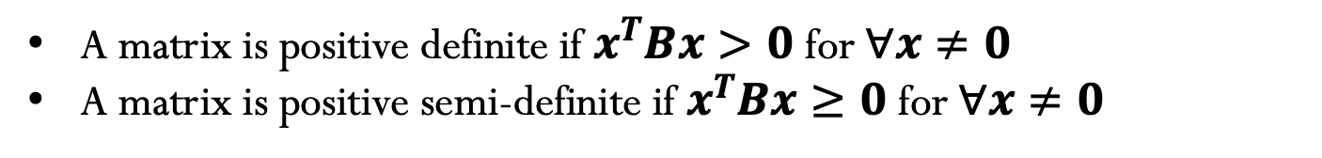
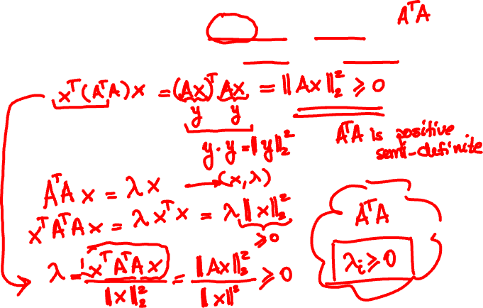
Singular values are always non-negative
A matrix is positive definite if $x^{T}Bx>0$ for $∀x≠0$
A matrix is positive semi-definite if $x^{T}Bx≥0$ for $∀x≠0$
Notes:
It will be positive definite if full rank

Slide 10
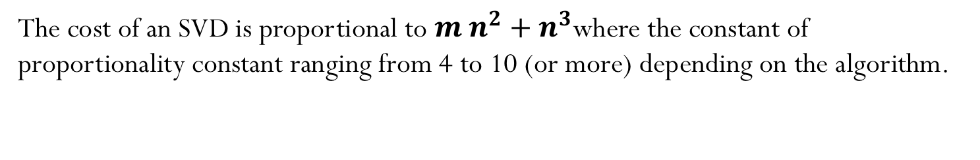
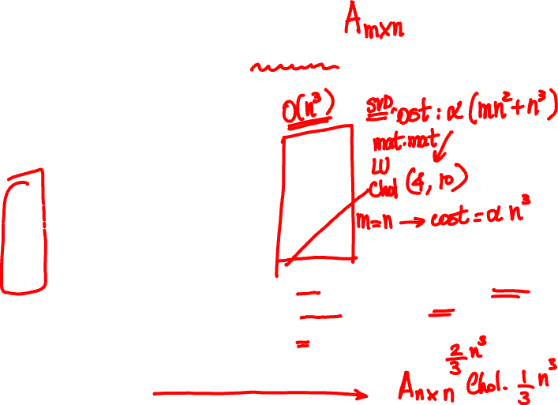
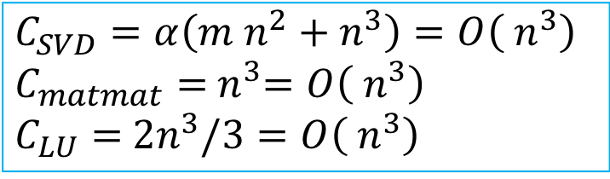
Cost of SVD
The cost of an SVD is proportional to $m{ n}^{2}+{ n}^{3}$where the constant of proportionality constant ranging from 4 to 10 (or more) depending on the algorithm.
$$C_{SVD}=α\left(m{ n}^{2}+{ n}^{3}\right)=O\left({ n}^{3}\right)$$
$$C_{matmat}={ n}^{3}=O\left({ n}^{3}\right)$$
$$C_{LU}={ 2n}^{3}/3=O\left({ n}^{3}\right)$$
Notes:
M n^2 + n^3

Slide 11
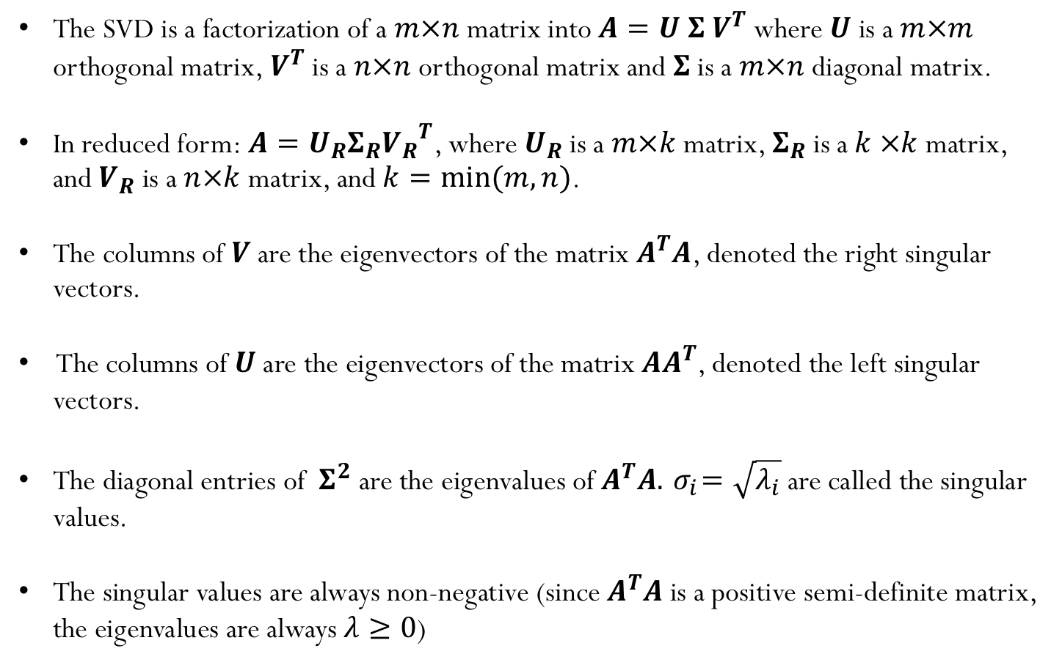
SVD summary:
The SVD is a factorization of a $m×n$ matrix into $A=U Σ V^{T}$ where $U$ is a $m×m$ orthogonal matrix,${ V}^{T}$ is a $n×n$ orthogonal matrix and $Σ$ is a $m×n$ diagonal matrix.
In reduced form:$A=U_{R}Σ_{R}{V_{R}}^{T}$, where $U_{R}$ is a $m×k$matrix, $Σ_{R}$is a $k ×k$ matrix, and $V_{R}$ is a $n×k$ matrix, and $k=min⁡(m,n)$.
The columns of $V$ are the eigenvectors of the matrix $A^{T}A$, denoted the right singular vectors.
The columns of $U$ are the eigenvectors of the matrix $AA^{T}$, denoted the left singular vectors.
The diagonal entries of ${ Σ}^{2}$ are the eigenvalues of $A^{T}A.{ σ}_{i}=\sqrt{λ_{i}}$are called the singular values.
The singular values are always non-negative (since $A^{T}A$ is a positive semi-definite matrix, the eigenvalues are always $λ≥0$)

