Slide 1
Peer Instruction: From Questions to Concepts & Bits and Bytes of Being a GSI Pat Virtue
CS 375, June 25, 2018

Slide 2

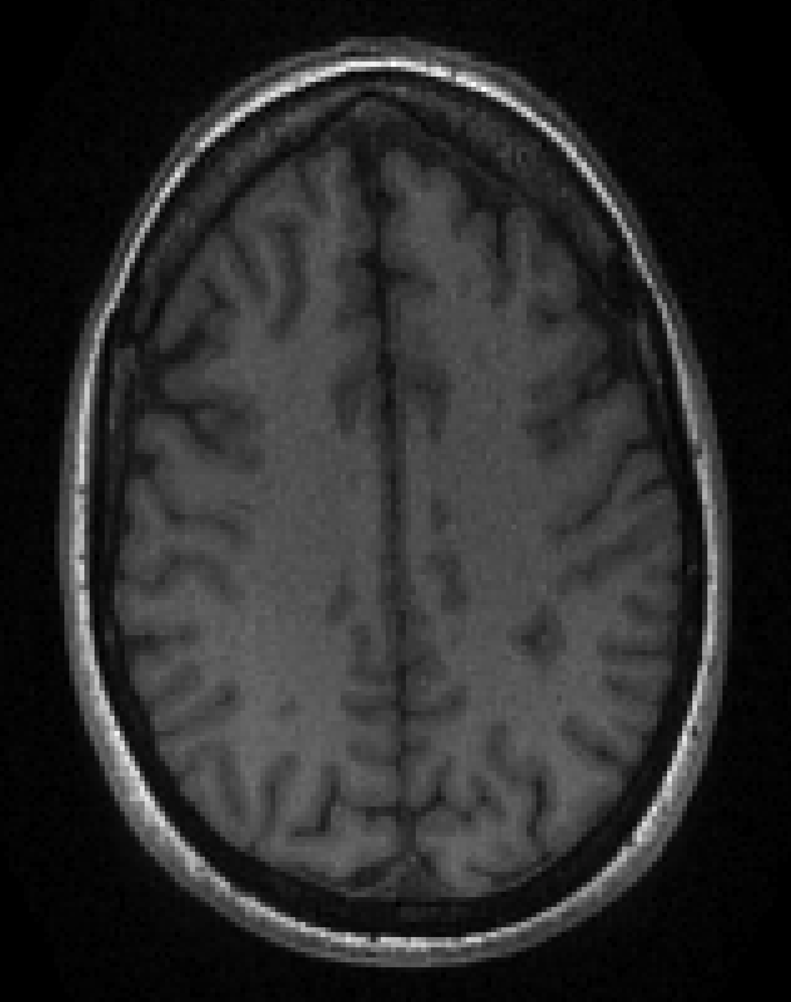
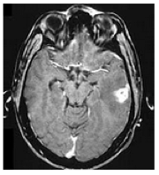
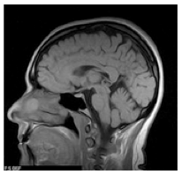

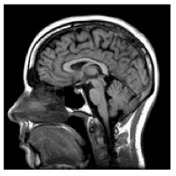
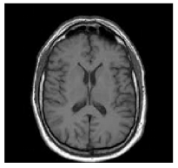
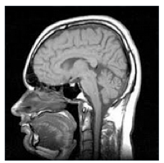
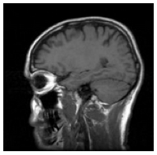
What I do…

Slide 3


What I do…

Slide 4
Outline
Peer Instruction
Bits and bytes of being a GSI

Slide 5
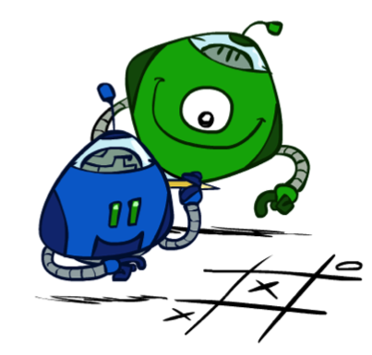
Peer Instruction
Image: ai.berkeley.edu

Slide 6
Peer Instruction
Overview of Peer Instruction
Adapting Peer Instruction for GSIs
Digging for ConcepTests

Slide 7
Motivation
https://www.youtube.com/watch?v=e1DnltskkWk
Question:
List 3 reasons why a Berkeley CS class is better than a library card.

Slide 8
The dawn of Peer Instruction
Eric Mazur
Physics Professor, Harvard University
https://www.youtube.com/watch?v=FUY049rIjdM

Slide 9
Keys to Peer Instruction
Pre-class reading
Focus on depth in class
ConcepTests

Slide 10
ConcepTests
Question
Thinking
Individual answer
Peer discussion
Revised/Group answer
Explanation

Slide 11
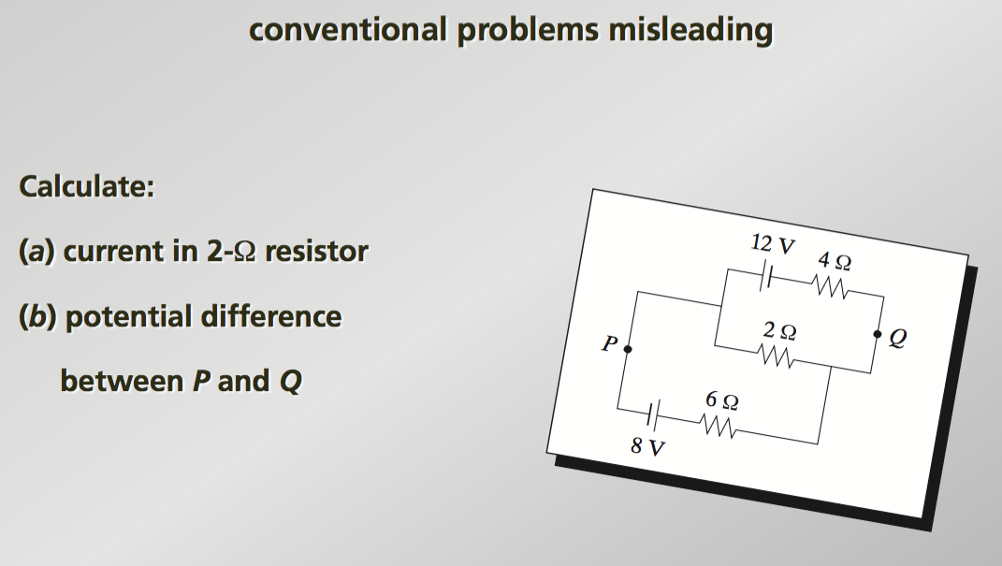
From questions to concepts
Slides: Eric Mazur

Slide 12
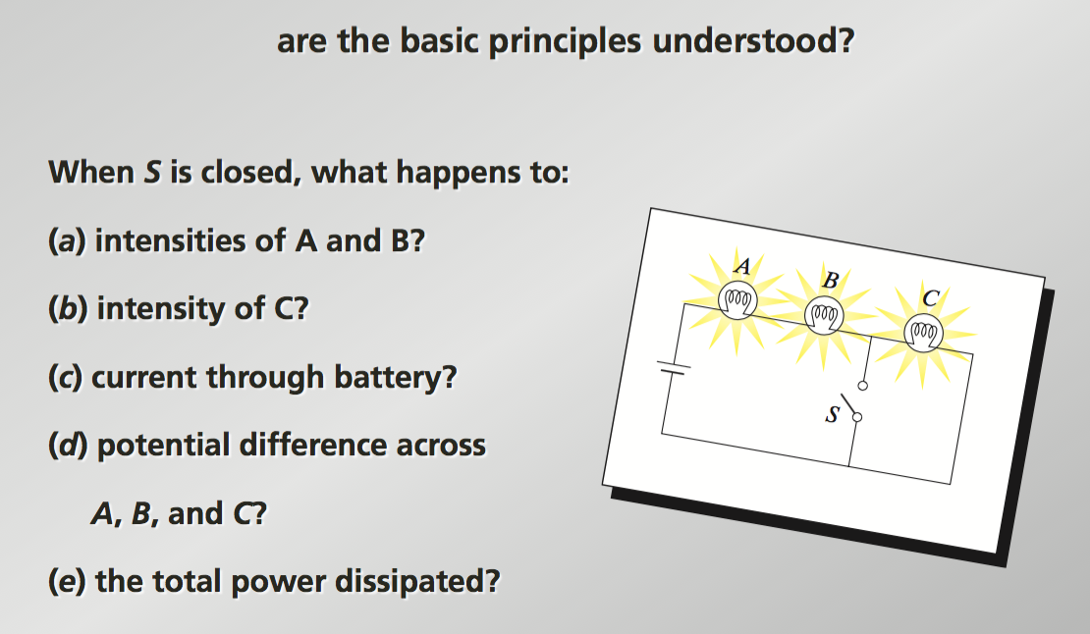
From questions to concepts
Slides: Eric Mazur

Slide 13
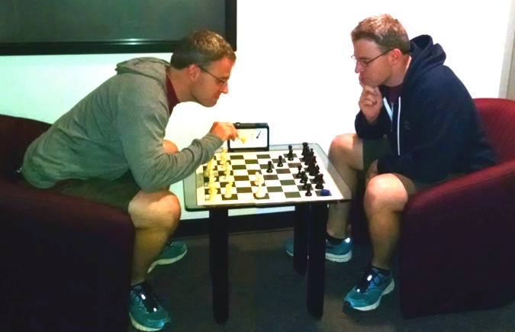
Concept test example

Slide 14

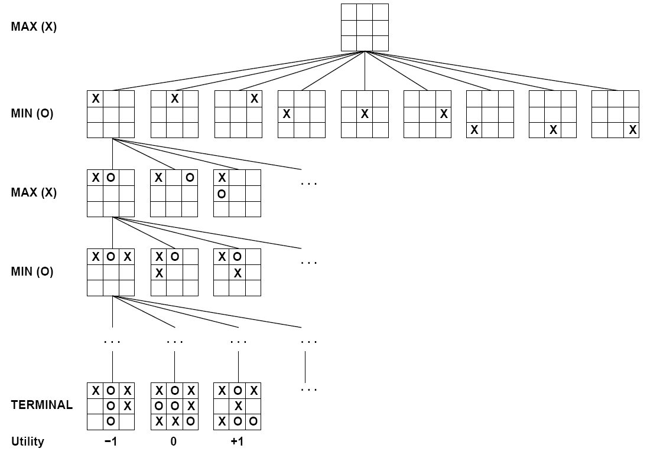

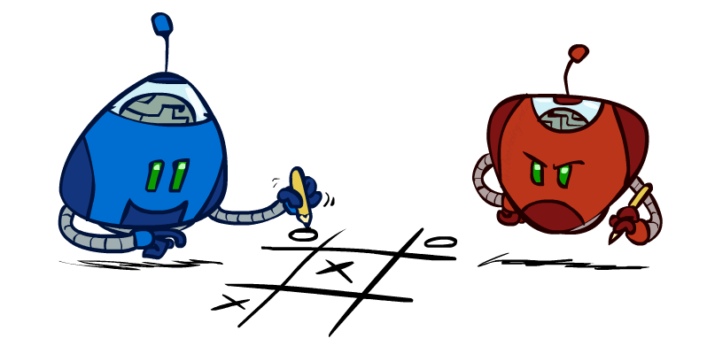
Quick lecture on game trees

Slide 15


Minimax values
MAX nodes:
Under agent’s control
MIN nodes:
Under opponent’s control
-8
-8
-10
-8
-5
-10
+8
Terminal states

Slide 16
Minimax implementation
function max_value(tree)
if tree.is_leaf
return tree.value
else
return max( min_value(tree.left),
min_value(tree.right) )

Slide 17
Minimax implementation
function max_value(tree)
if tree.is_leaf
return tree.value
else
return max( min_value(tree.left),
min_value(tree.right) )

Slide 18
Minimax implementation
function max_value(tree)
if tree.is_leaf
return tree.value
else
return max( min_value(tree.left),
min_value(tree.right) )

Slide 19
Minimax implementation
function max_value(tree)
if tree.is_leaf
return tree.value
else
return max( min_value(tree.left),
min_value(tree.right) )

Slide 20
Demo

Slide 21
Concept test
Question:
How well would a minimax Pacman perform against a
ghost that moves randomly?
Better than against a minimax ghost
Worse than against a minimax ghost
Same as against a minimax ghost

Slide 22
Demo

Slide 23
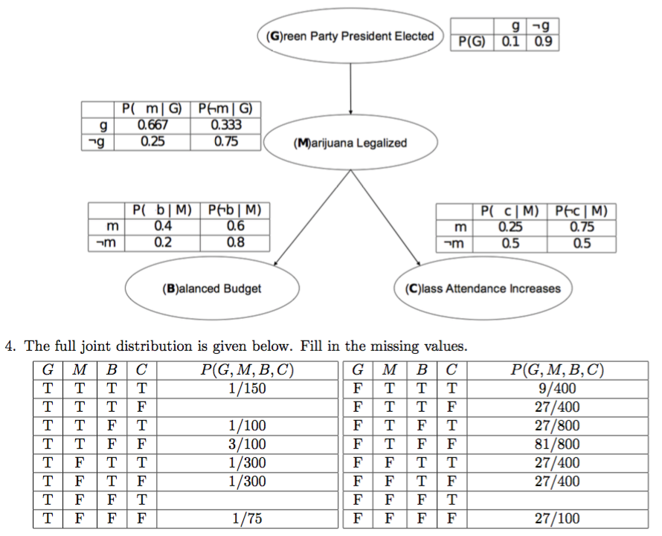
Concept test

Slide 24

Concept test
Question:
Which of the following probability tables sum to one?
$P(Q | E)$
$P(Q | e)$
$P(q | E)$
$P(q | e)$

Slide 25
Adapting Peer Instruction for GSIs
GSIs are the heroes!
Not strictly Peer Instruction, but can leverage:
Focus on concepts
Simple questions to gauge understanding
Value of discussing with peers
Need to balance trade-offs
Problem sets: working through conventional problems is important too

Slide 26
Adapting Peer Instruction for GSIs
Question:
Given a course topic, which ordering might be most effective for students:
Reading, lecture, discussion, homework, exam
Reading, lecture, homework, discussion, exam
Lecture, discussion, homework, reading, exam
Reading, homework, exam
No right answer

Slide 27
iClicker alternatives
https://plickers.com - Students vote with printed code card
https://b.socrative.com - Students vote with any device

Slide 28
Important aspects
Explain what you are doing
Ensure pre-class work has been completed
Don't grade correctness of ConcepTests
To students:
The answer not as important as how you analyze it
"How did you analyze this? How did you go about figuring it out?"
First time you do it (at least), have a more subjective question without necessarily a correct answer
Provides immediate feedback for both students and instructors

Slide 29
Concerns? Problems?
No discussion
Students get it all right or all wrong
Not learning enough
Need good questions
http://www.peerinstruction4cs.org/

Slide 30
Peer Instruction 4 CS
Group exercise:
Find one ConcepTest question within peerinstruction4cs.org
Present why it is a good question for your students
http://www.peerinstruction4cs.org/

Slide 31
Other active learning techniques
POGIL: https://pogil.org/
TBL: http://www.teambasedlearning.org/

Slide 32
Outline
Peer Instruction
Bits and bytes of being a GSI

Slide 33
Bits and bytes of being a GSI
Tips and Q&A
Tough stuff
Office hours
Discussion/lab section
Time management
Other

Slide 34
Tough stuff
Student in distress
https://uhs.berkeley.edu/counseling
Cheating
Inclusive
Power relationship
Privacy
DSP
http://dsp.berkeley.edu/

Slide 35
Office hours
http://www.dailymotion.com/video/x35jt3c
Have students write their name and issue/topic on the board as they walk in
A fair queue for topics
Cross them off as you complete, and note those that you need to return too.)
Helps remember names
Take a picture of that queue at the end of OH to help me learn names
Print out the roster photos if possible (your instructor has these)
Make a note by students that you interacted with in office hours (including date is helpful too); helps to be able to say: "I remember you from office hours a few weeks ago"
Encourage students to talk to each other about similar issues/topics
Students often encountered the same exact issue, and one of them may have already figured it out

Slide 36
Discussion/lab section
Prepare
You can't do it all
Plan your time
Plan to not finish
Prioritize
Anticipate misunderstandings
Tell students that you might not get to everything
Style
Level

Slide 37
Time management
https://www.youtube.com/watch?v=GjJCdCXFslY
Keep a simple log of your GSI activities and how long you spent on them
Helps you to see when you are putting too much (or too little?) time into a course
Helps you find places where you might be able to optimize your time
A really helpful tool for when instructors are giving you more work than you can handle
"I'd like to help with that task, but I'm these other GSI tasks are taking up this much time. What is the best way to prioritize my time?"
Plan for tasks later in the semester
Exam writing
Compiling grades
Unwritten/unfinished assigments later in the semester

Slide 38
Teamwork
Breadth vs. Depth
Expert roles are super efficient
e.g. I only work on coding projects, no discussions, no office hours
Minimize learning curves, maximize focus and dedication
But miss out on a variety of opportunities
Ask for help from you fellow TAs
If you are in charge of HW4, talk to the people who are in charge of HW1-3 as early as possible. They will likely have very sage advice, like:
Be sure to use this template
Don't forget to press the "release" button on edX

Slide 39
Other tips and concerns
Always bring markers
“What questions do you have?” + wait for reply
Tips for students
How to deal with professors/TAs that say "Any questions…Ok, moving on" too fast
Can always ask "could you please explain that again" if you have a feeling you didn't quite get it
http://csteachingtips.org/

Slide 40
Resources
https://uhs.berkeley.edu/counseling
http://gsi.berkeley.edu/
http://gsi.berkeley.edu/basics-for-gsis/faq-gsis/
http://gsi.berkeley.edu/basics-for-gsis/must-see-policies-resources/
http://csteachingtips.org/
http://www.peerinstruction4cs.org/

Slide 41
That’s all folks
Thanks!
Feel free to send me questions:
Pat Virtue
virtue@eecs.berkeley.edu

