Slide 1
Jungle presentation 2 – Domain model
The ‘C’ Team
Jake Marrapode
Ian Franklin
Braiden Wells
Saloni Choudhary

Slide 2
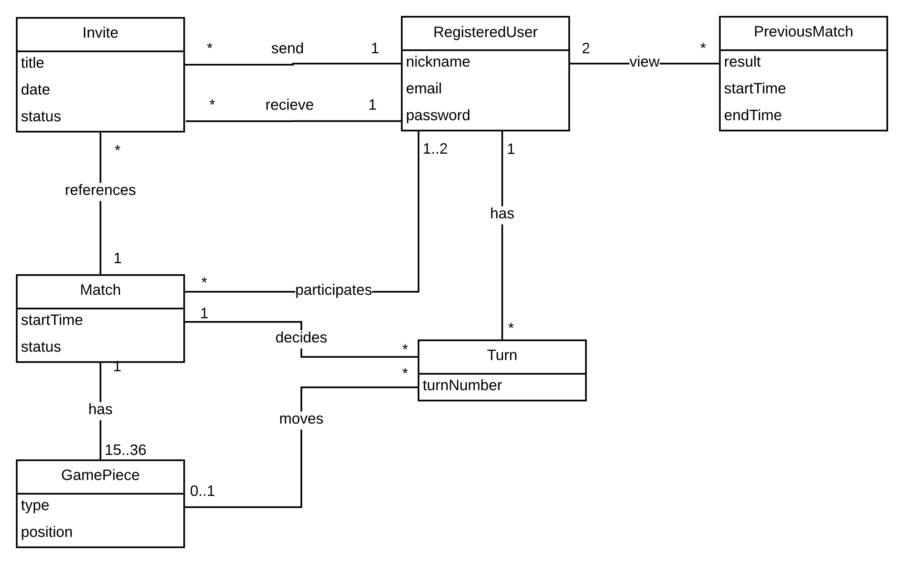
Domain model

Slide 3
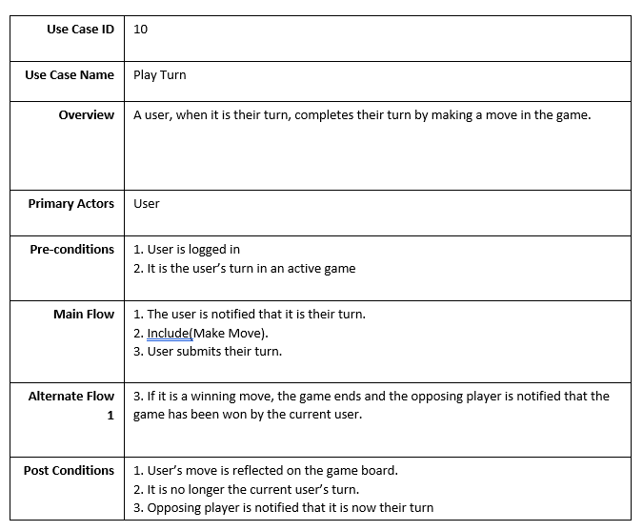
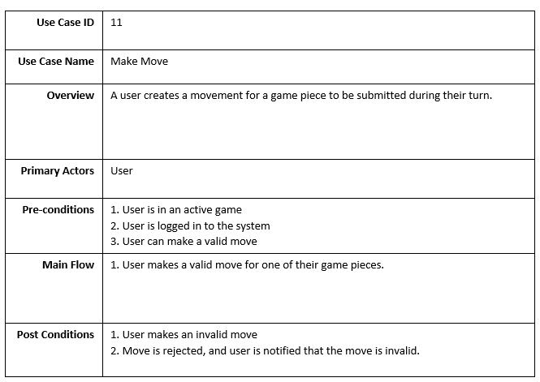
Old Use cases

Slide 4
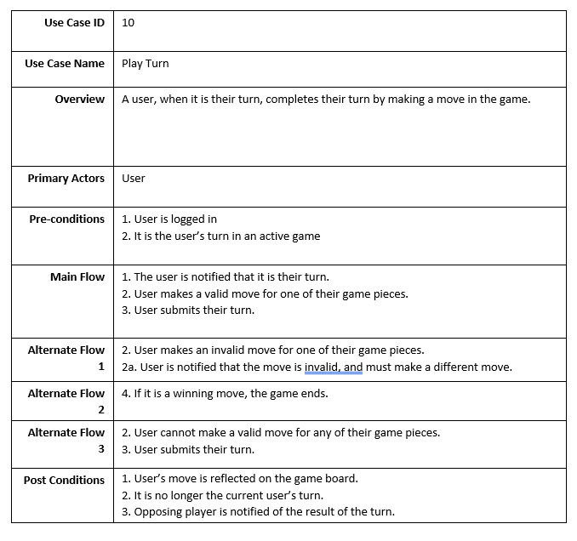
New Use case

