Slide 1
PROJECT JUNGLE Presentation-1 CS414-OBJECT ORIENTED DESIGN
TEAM NAME : THE ‘C’ TEAM
TEAM MEMBERS: 1. JAKE MARRAPODE
2 .IAN FRANKLIN
3.BRAIDEN WALLS
4. SALONI CHOUDHARY

Slide 2
description
The task is to create a multi-player game named Jungle , in which we can have multiple users register using e-mail ids. We have to fulfil requirements of our client by providing functionalities to our game like send match invites , match players if invites are accepted , have saved games to be resumed back , record the match history for every user and also store them to be viewed by different users .

Slide 3
The approach
We identified the actors(users) and stakeholders(client) of the system
Listed the goals of our clients.
Created a domain model for better understanding of the functionality.
Identified the use cases for each goal .
Created the use cases.

Slide 4
Goals to be achieved
Online Game platform
Registration of users using e-mail id.
Users should be able to send invites themselves ,accept invites and reject them by other users.
Create match for players and they should be able to join multiple games

Slide 5
Contd..
Users should be able to leave the match at their will.
User should be able to view the current state of the board as well.
Storage and look up of match history
Users can view match history of other users as well.

Slide 6
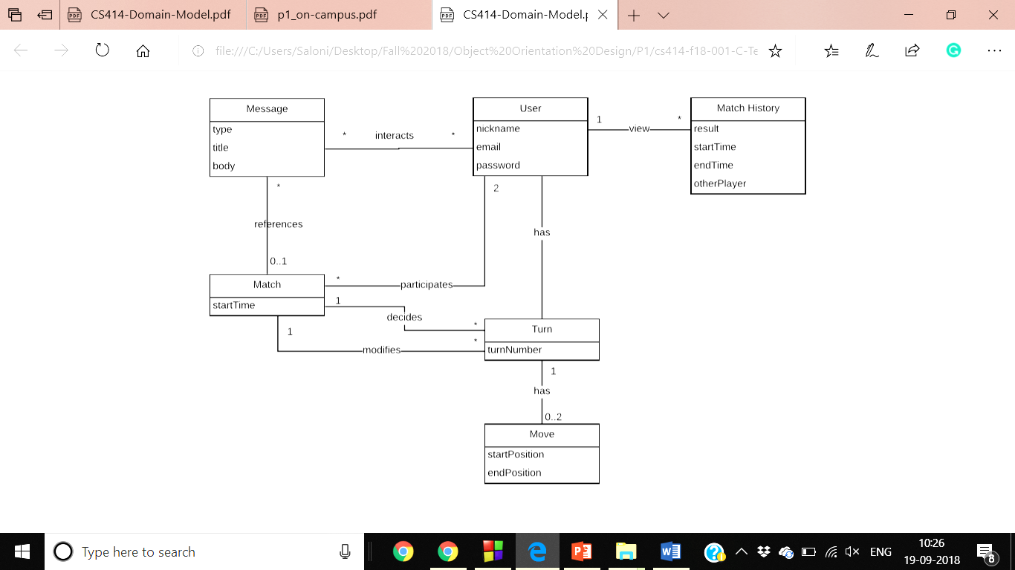
The Domain model

Slide 7
Use cases identified
User can register/unregister account and manage/store user information.
User can send/receive notifications and can accept/deny invites from other user.
User can play the game and start multiple matches at once.
User can end match via quitting the game or winning/losing.
User can look up previous match history of another user.
User can view the current state of the matchboard.

Slide 8
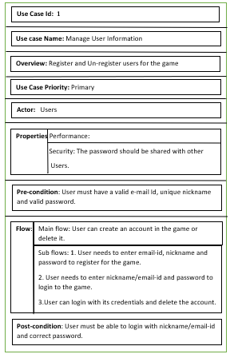
Use Case-1

Slide 9
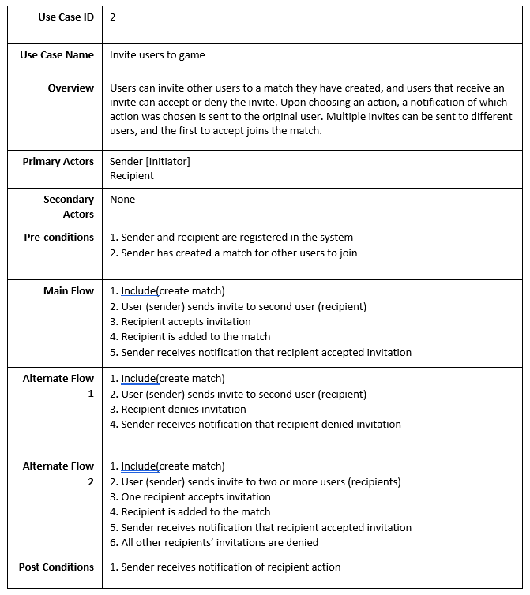
Use case -2

Slide 10
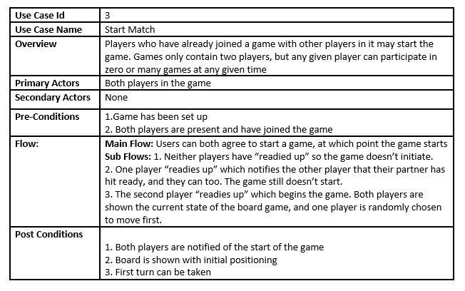
Use case-3

Slide 11
Thank you

