Slide 1
Project 2.0 the other alex
Devin Kadillak, Alex Shellum, Lucas Wilson, Alex Malott, Aaron Thompson

Slide 2
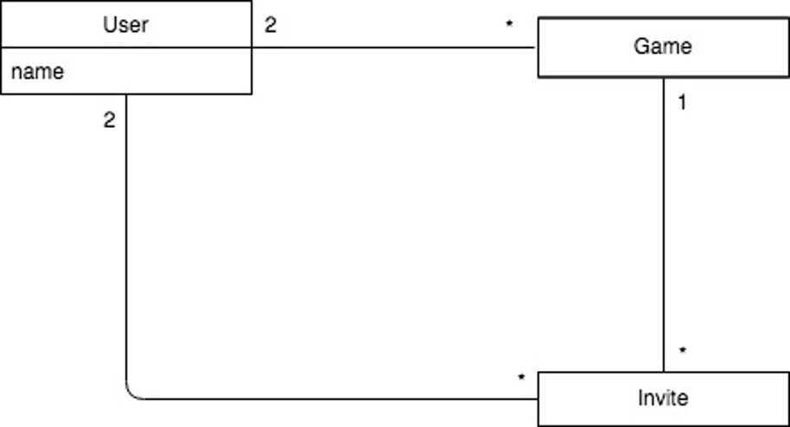
DOMAIN MODEL
Three core features: Game, User, Invite
In the future, we will add more

Slide 3
GLOSSARY
USER: A person interacting with the system.
GAME: An instance of the game Banqi created by a user.
INVITE: A pending invitation from one user to another to join a game.
NAME: A unique identifier which refers to a user.
'What are the important words and phrases that need to be defined?'

Slide 4
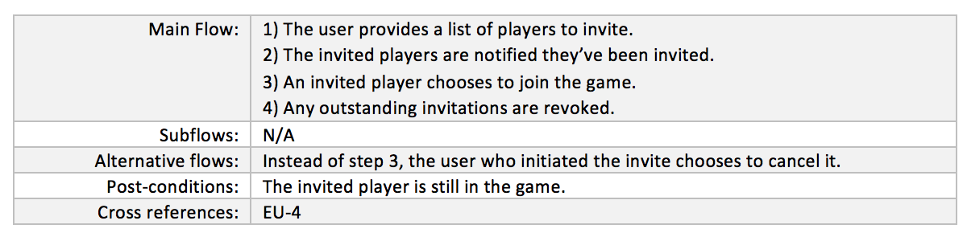
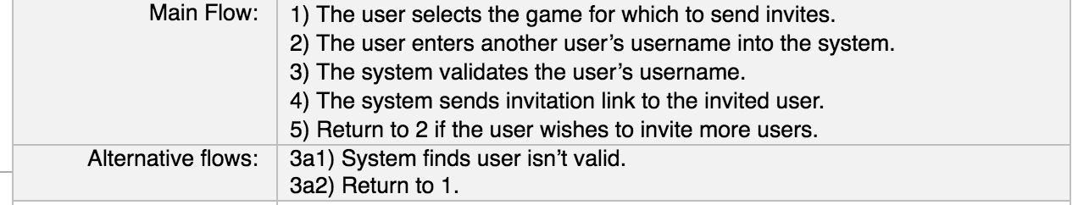
Use case update: Changing from Passive to Active voice
P1
P2
Example taken from EU-3,
The use case on Inviting players
No passive voice. More concretely defined behavior. Removes ambiguity.

Slide 5
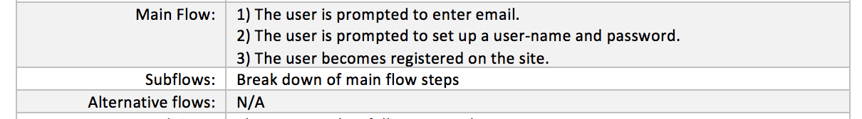
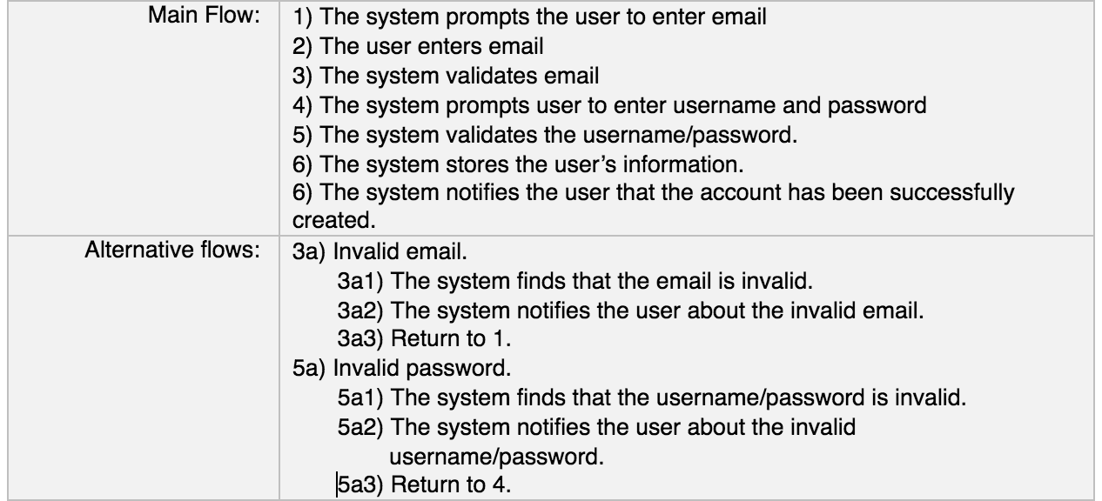
USE CASE UPDATE: Specifying alternate flows, Adding system responses
P1
Alternate flows specified
P2
Added system responses
Example taken from EU-1,
The use case on registering

Slide 6
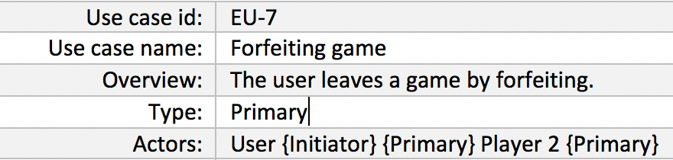
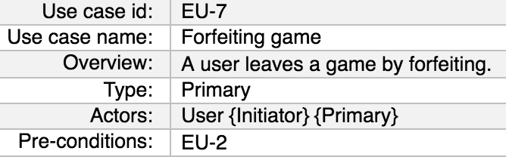
USE CASE UPDATE: Removing ambiguity in the actors field
P1
Only User as actor
P2
User and Player 2 as actor
Example taken from EU-7,
The use case on forfeiting

Slide 7
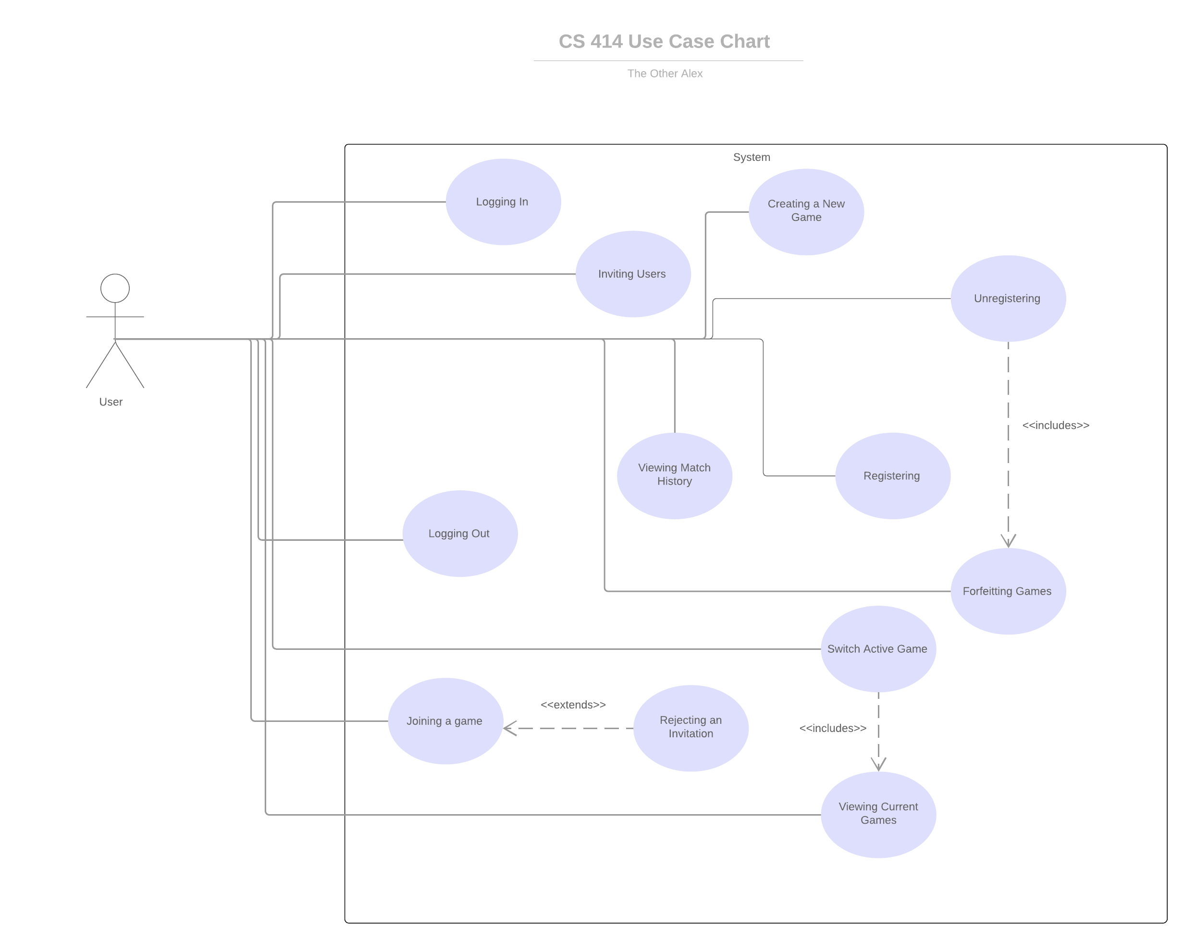
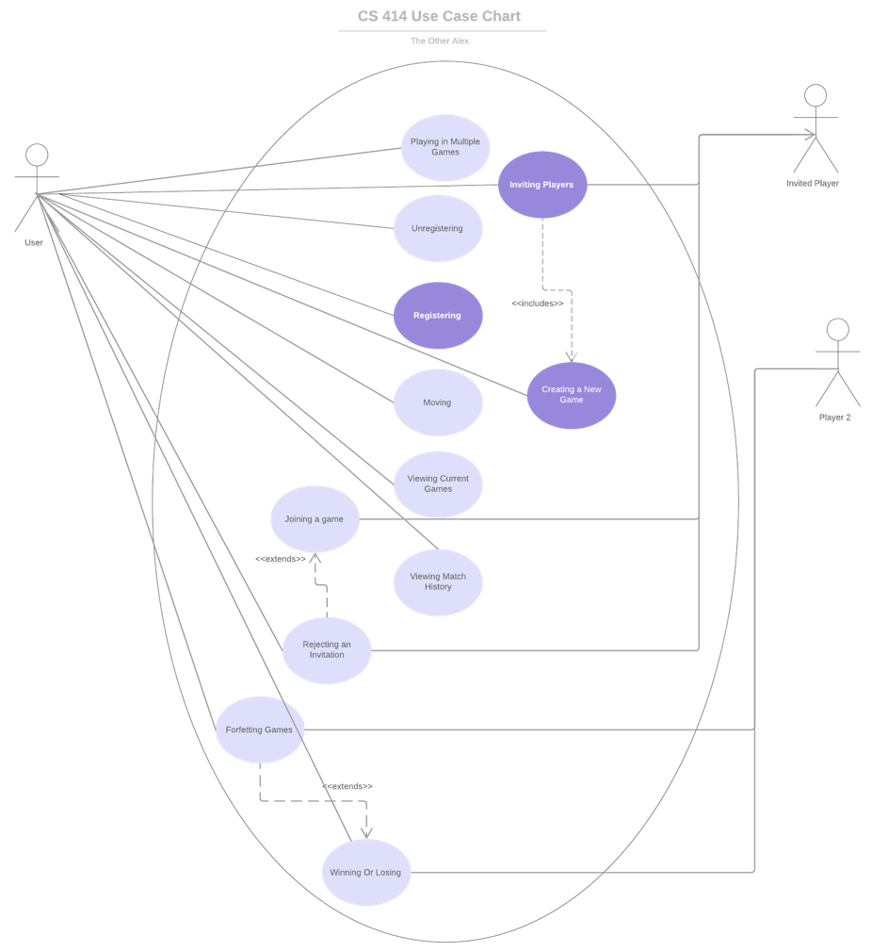
Difference in Use Case Diagram

