Slide 1
The Other Alex
Alex Shellum, Alex Malott, Aaron Thompson
Devin Kadillak, Lucas Wilson

Slide 2
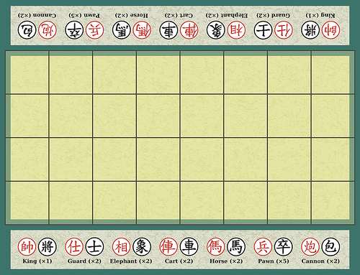
Banqi Board

Slide 3
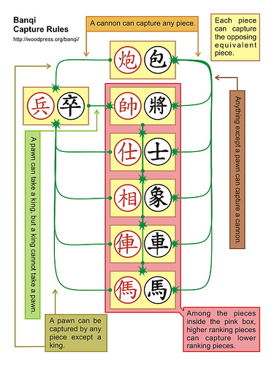
Banqi Capture Rules

Slide 4
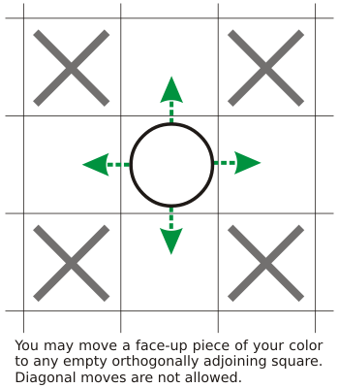
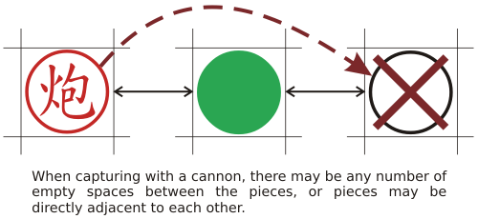
Banqi Movement

Slide 5
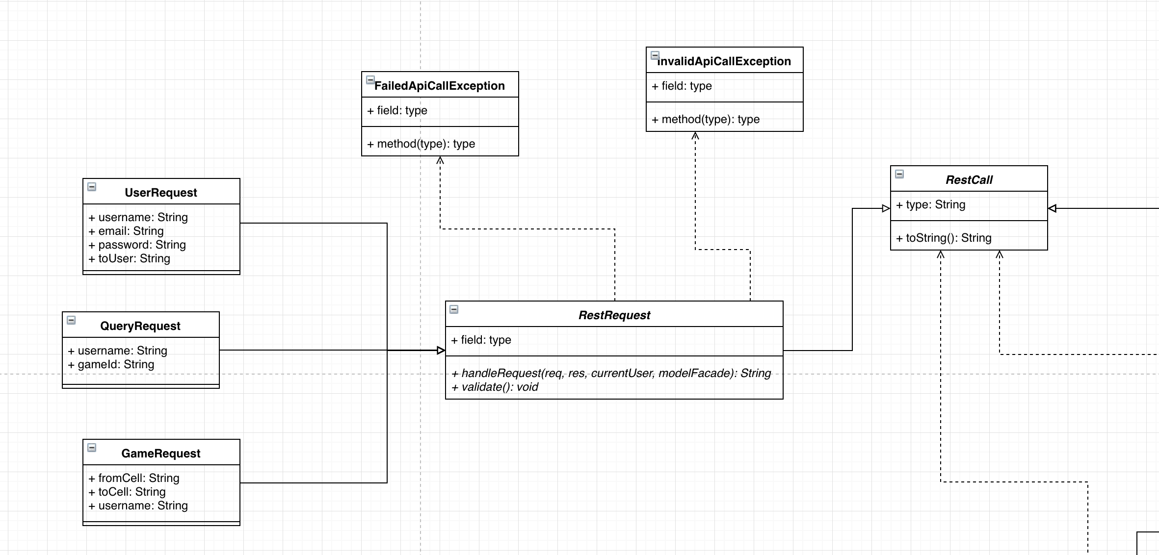
Class Diagram

Slide 6
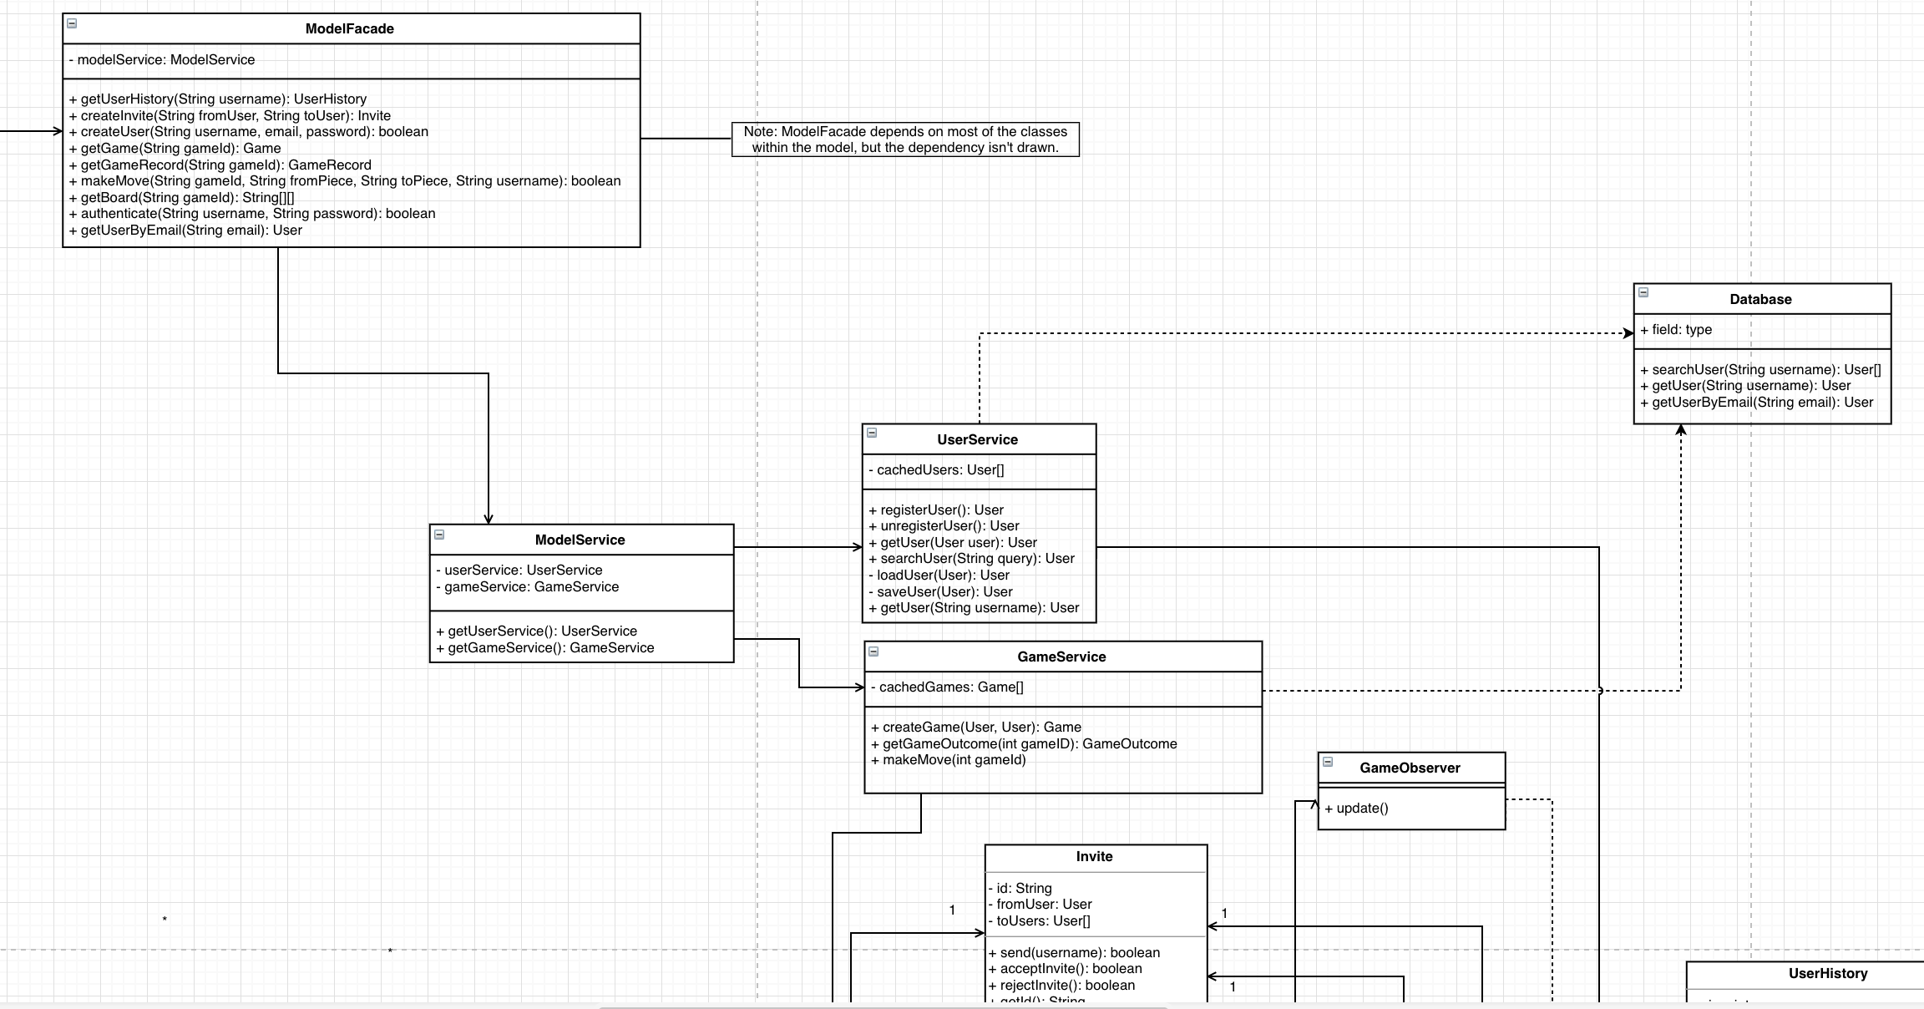
Class Diagram

Slide 7
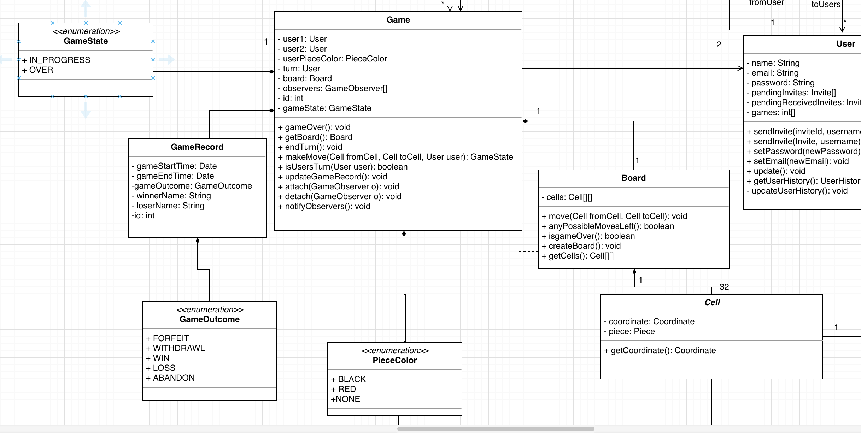
Class Diagram

Slide 8
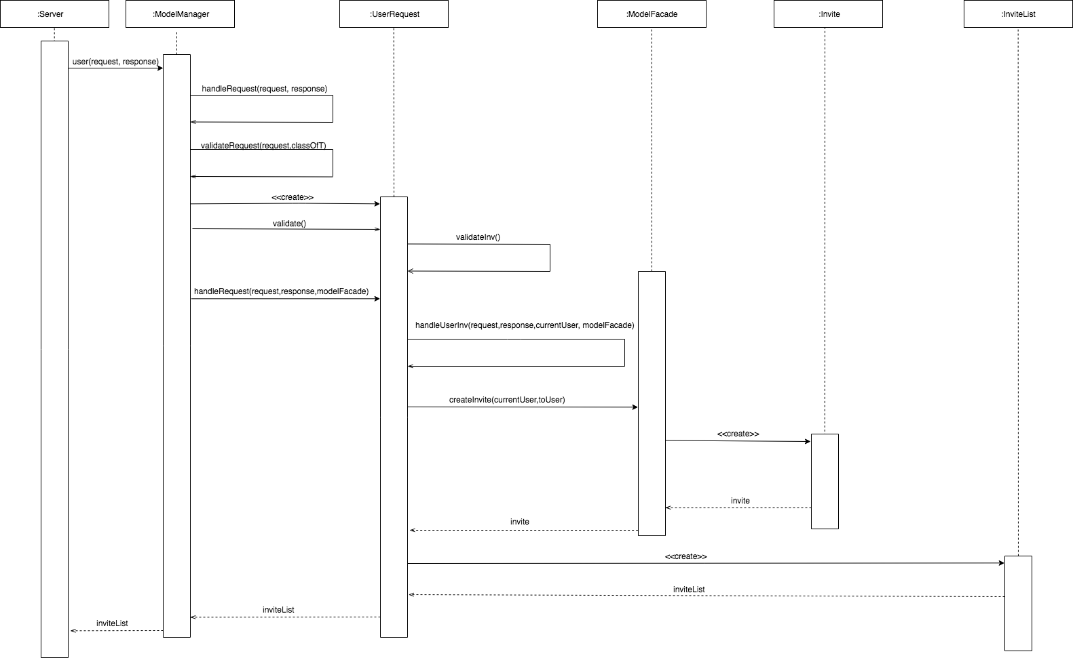
Sequence Diagram

Slide 9
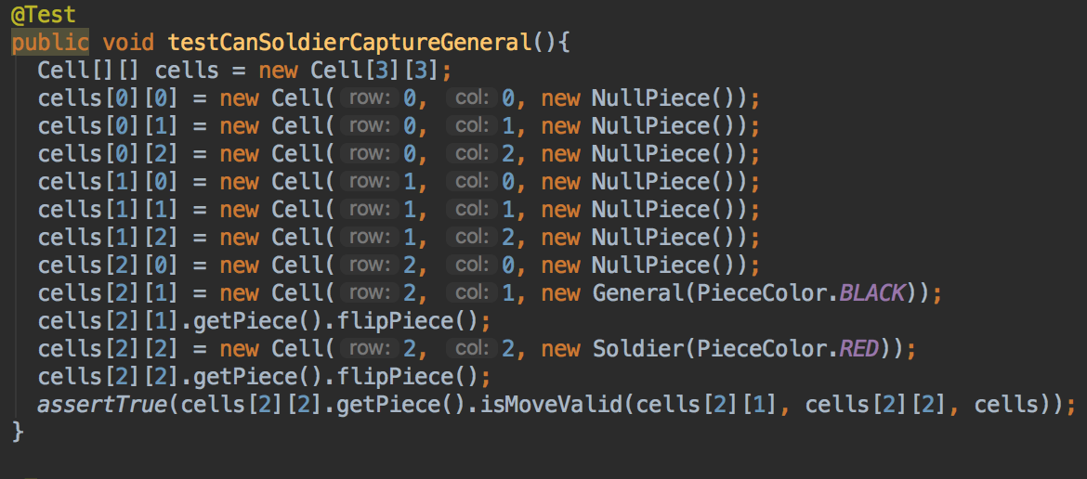
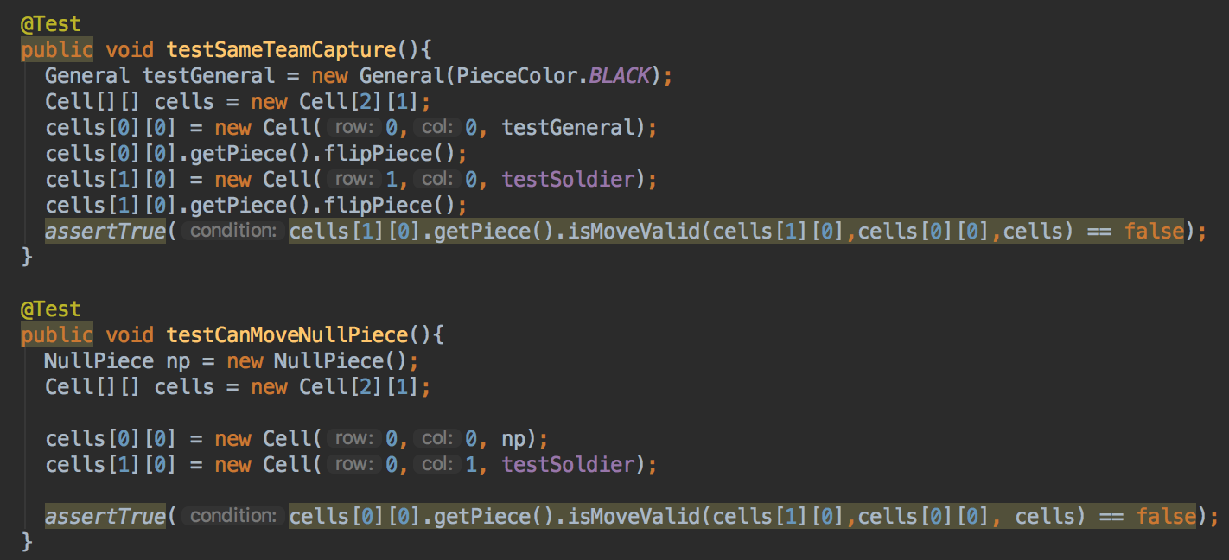
Testing Document
Testing corner cases
Testing basic functionality

Slide 10
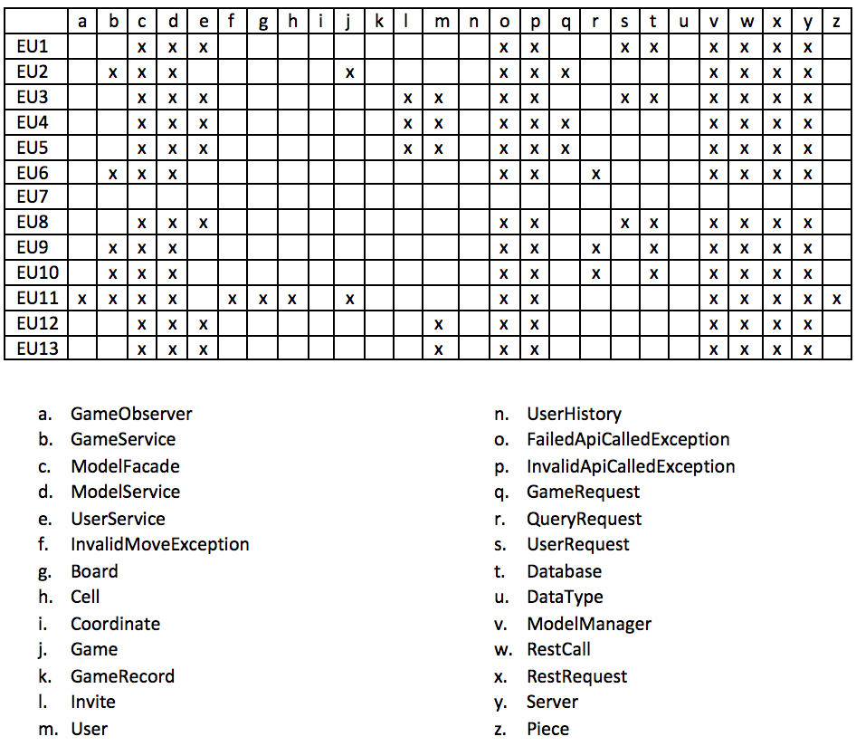
Traceability Link Matrix
EU1: Registering
EU2: Creating a game
EU3: Inviting Users
EU4: Joining a game
EU5: Rejecting Invitation
EU6: Switch active game
EU7: Forfeiting a game
EU8: Unregistering
EU9: Viewing match history
EU10: Viewing Active Games
EU11: Moving
EU12: Logging In
EU13: Logging out

Slide 11
Technologies and Tools
Git (version control)
Travis CI (build testing)
Gradle (build tool)
CodeClimate (code quality)
Zenhub (task management)
React/Html/Bootstrap (front end UI)
Spark (backend server)
JUnit (Java testing)

Slide 12
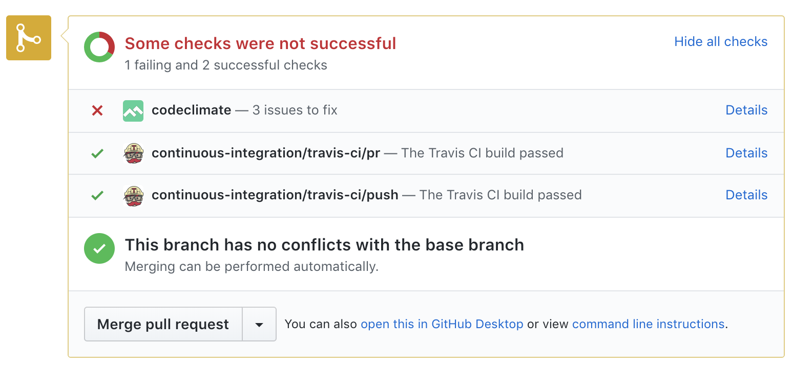
Technologies and Tools

Slide 13
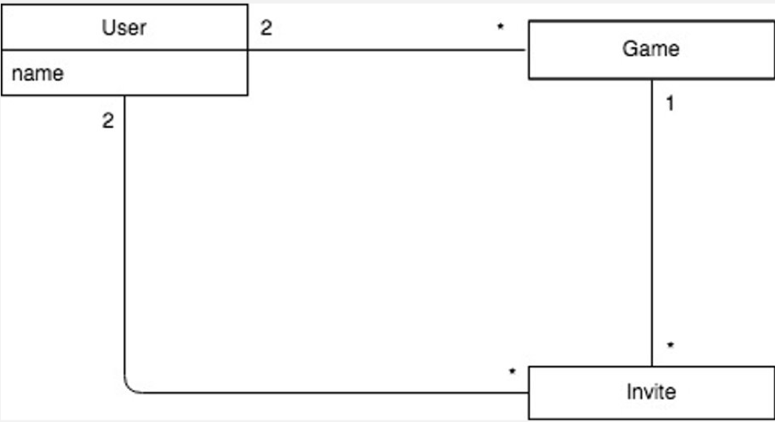
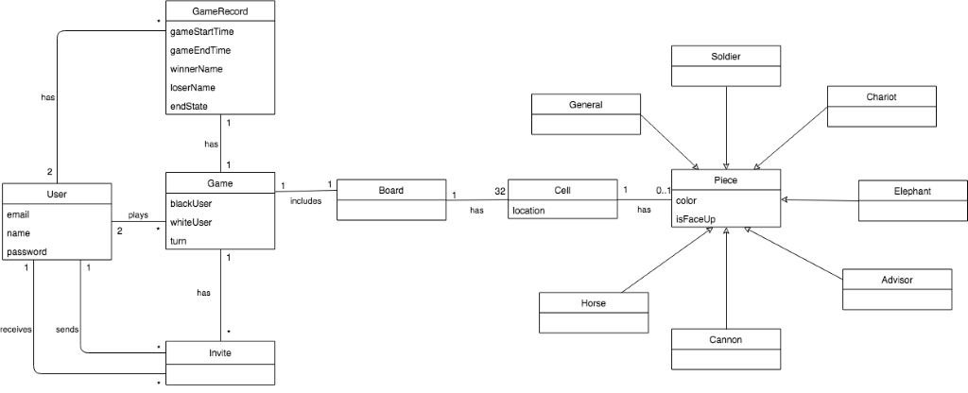
Domain Model Update
Old and busted
Revised

